Slide 1
Team 522 – Rockwell Automation Manufacturing Device for Students
Luis Garcia, Caleb Mears, Chloe Keiran, Maria Rojas, Caden Schwartz

Slide 2





Team Introductions
Luis Garcia
Systems/
Dynamics
Engineer
Caleb Mears
Manufacturing
Engineer
Maria Rojas
Test Engineer
Chloe Keiran
Design
Engineer
Caden Schwartz
Electrical Systems Engineer

Slide 3





Sponsor and Advisor
Industry Sponsor
Tajaey Young
Rockwell Automation
Industry Sponsor
Amanda Eason
Rockwell Automation
Academic Advisor
Shayne McConomy, Ph.D.
Professor/Advisor

Slide 4
Objective
The objective of this project is to create a system that can demonstrate the automated manufacturing process and create an educational item.

Slide 5


Key Goals & Targets
Key Goals
Showcase automated manufacturing process
Provide educational experience
Create
tangible product

Slide 6




Key Goals & Targets
Key Goals
Showcase automated manufacturing process
Provide educational experience
Create
tangible product
Targets

Slide 7
Key Goals & Targets
Key Goals
Showcase automated manufacturing process
Provide educational experience
Create
tangible product
Targets
Latency:
5 ms

Slide 8
Key Goals & Targets
Key Goals
Showcase automated manufacturing process
Provide educational experience
Create
tangible product
Targets
Latency:
5 ms
Load Cap:
30 lb

Slide 9
Key Goals & Targets
Key Goals
Showcase automated manufacturing process
Provide educational experience
Create
tangible product
Targets
Latency:
5 ms
Load Cap:
30 lb
Cycle Time: <5 min

Slide 10
Key Goals & Targets
Key Goals
Showcase automated manufacturing process
Provide educational experience
Create
tangible product
Targets
Latency:
5 ms
Load Cap:
30 lb
Cycle Time: <5 min
Survey Percentage:
>70%
Notes:
Main reason for Rockwell to do this project, spark interest in the manufacturing industry and the advantages of having an automated process to make any products. How it turns raw material into a finished product
We're showing this to kids K-12 and we want them to get interested in the subject and learn about this process.
That the viewers can take home with them.
Response time for our sensor, we wanted a smooth process while the product is being built with quick responses from the sensors at each station.
Structure will be being moved from place to place to be showcased and we want it to be easily transported and moved around by 1-2 people.
Time it takes to run through a full assembly and make one full product. we don t want a slow process that makes it boring for the viewers since they might have a shorter attention span. So we want the process to be engaging and keep the viewers interested in what is happening in the system as well as being able to identify what is happening at each stage of the manufacturing line.
This is kind of a survey where we ask the viewers how interesting it was and if they feel they learned something to measure the success of the demonstration and they grade it from 1-10, and we want that score to be greater than 70%.

Slide 11
Concept Selection
Concept Generation
Binary Pairwise Comparison
House of Quality
Pugh Chart
Analytical Hierarchy Process
Final Selection

Slide 12
Final Selection
Metal Pin
Highest alternative value
Most plausible within given timeline
Satisfies customer requirements
Concept Selection

Slide 13
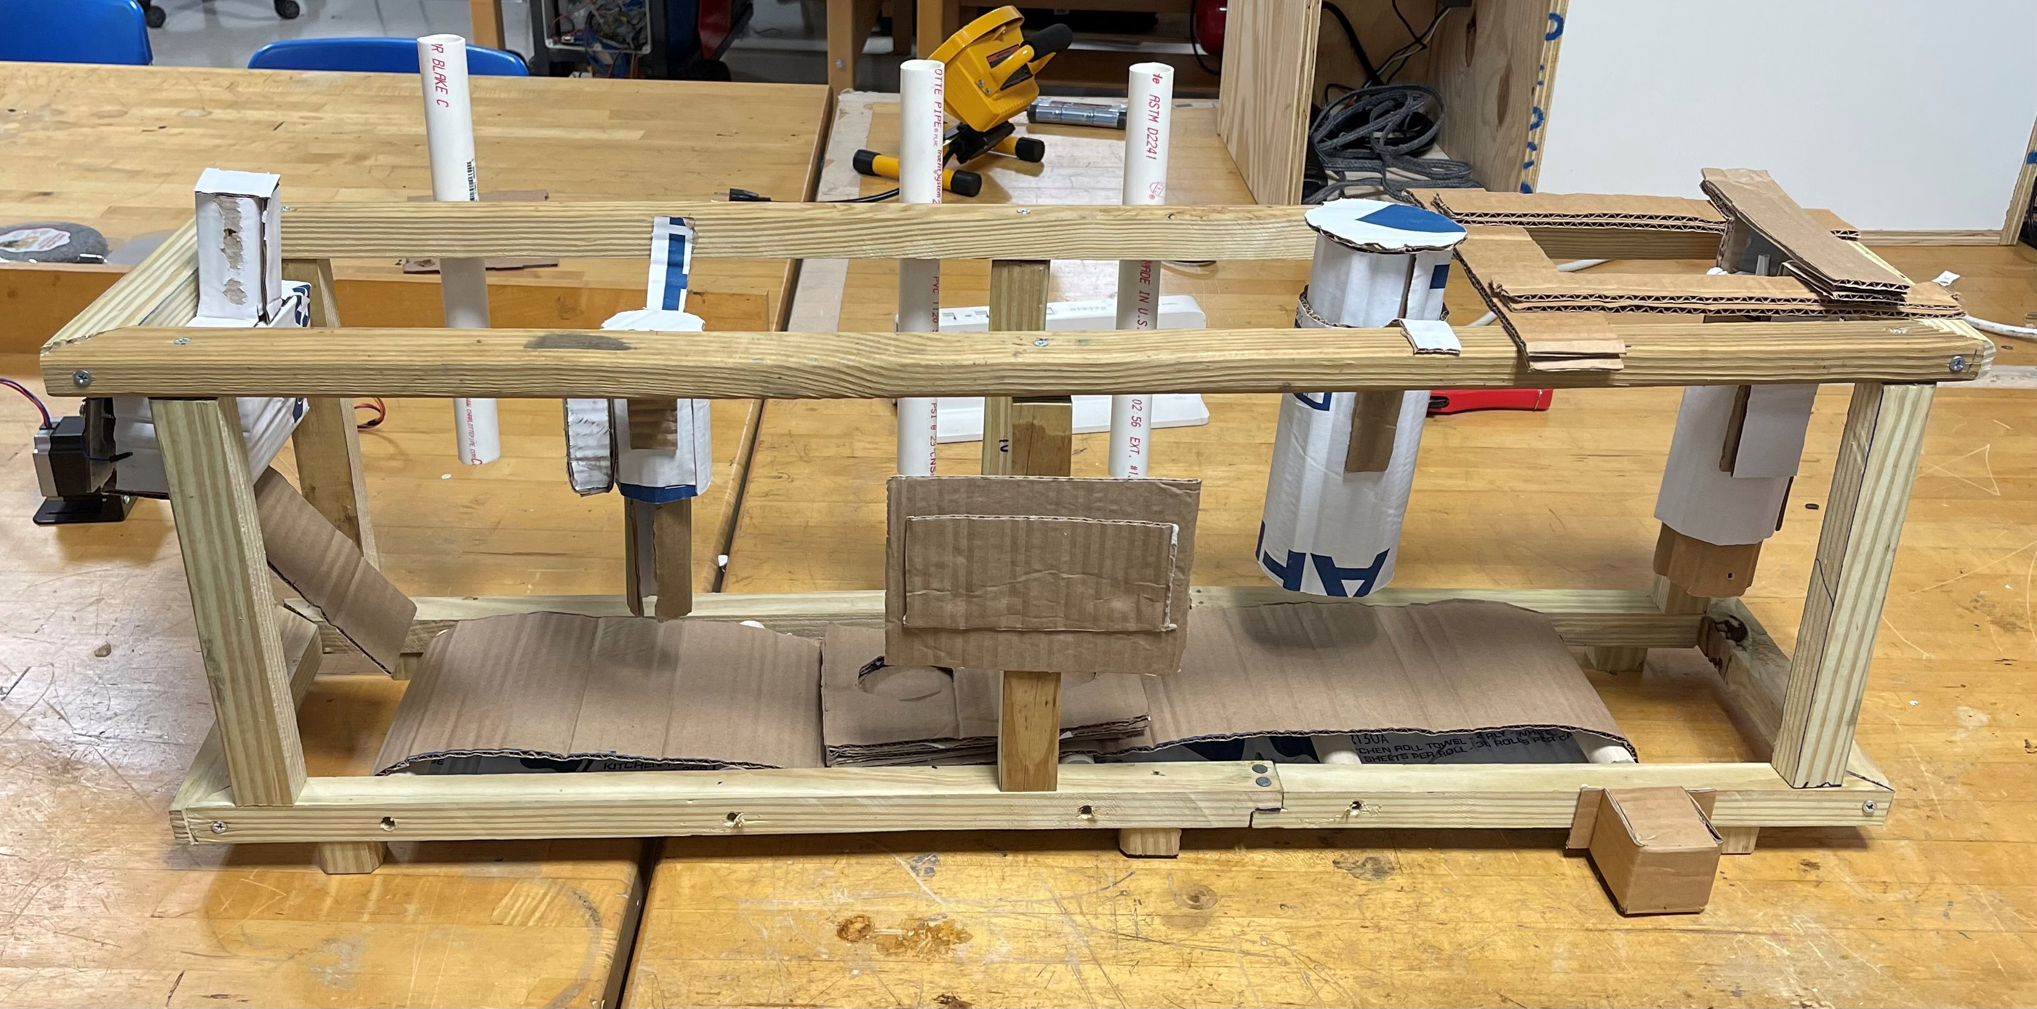
Initial System Design
Insert design
Pin top
Orient design
Mylar plastic
Pin bottom
Press pin
Eject pin

Slide 14

Design Updates
OLD DESIGN
NEW DESIGN
Quality check with color sensor
Emulate3D
PLC
Arduino/breadboard control
Integrated assembly line
ON/OFF stepper motors
Fully automated system
Manual system

Slide 15
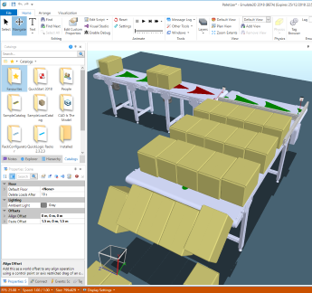
Emulate3D
Developed by Rockwell
Simulates industrial automation systems
Instrumental for testing

Slide 16
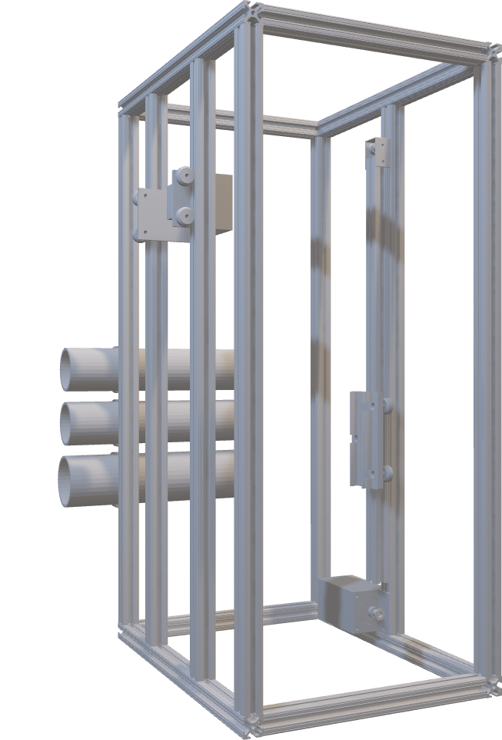
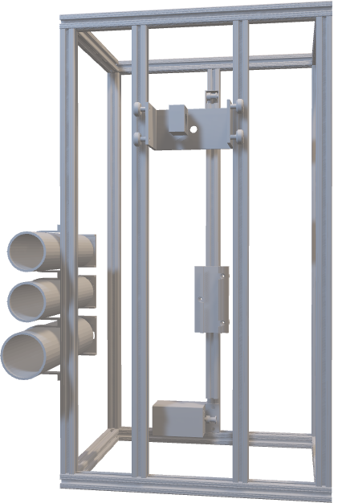
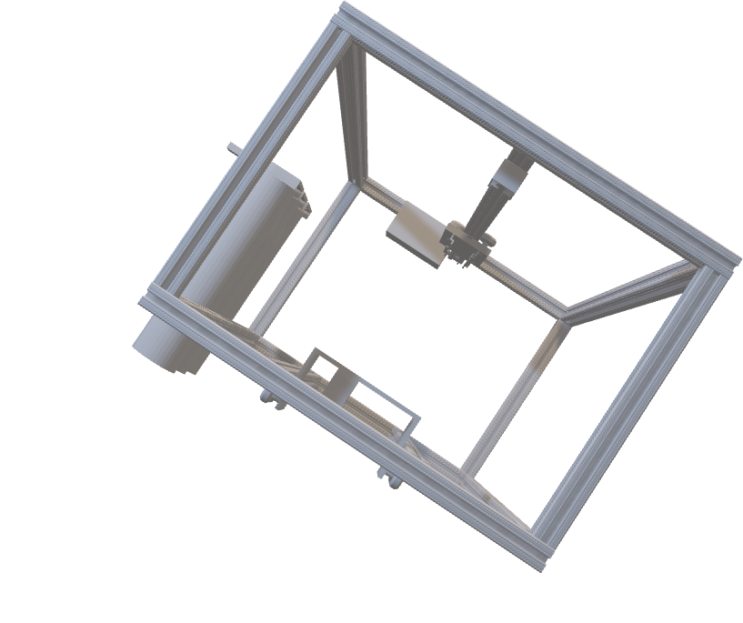
CAD Model

Slide 17
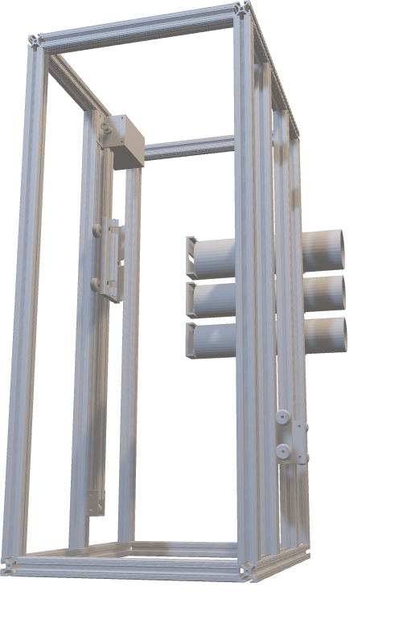
Machine Shop Parts
1.0 ft (x4)
1.5 ft (x4)
2.5 ft (x1)
3.0 ft (x7)

Slide 18
Budget Update
Initial Budget: $2,000
Order # | Cost
1 | $393.29
2 | $206.92
3 | $603.60
4 | $112.92
Total Spent | Amount Remaining
$1316.73 | $683.27

Slide 19
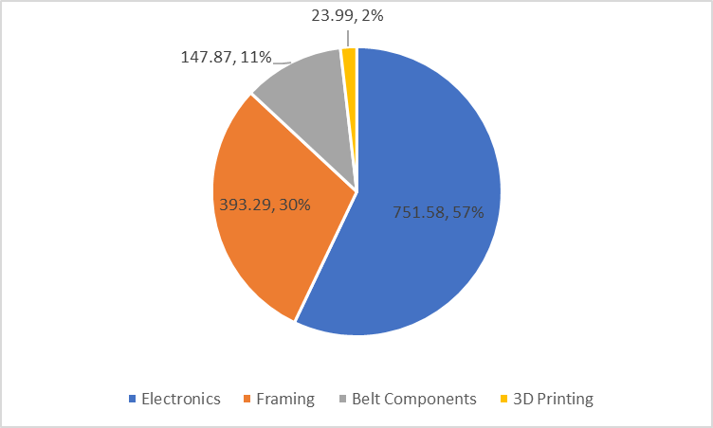
Budget Update

Slide 20
Electrical Components
Power Supply 1
Arduino
Power Supply 2
1
1
2
Motor Controllers
SM1
SM 2
SM 3
1
1
Push Button w/ LED
LS1 (Door)
3
1
2
3
1
Ramp Actuation
1
2
4
5
1
1
Bin1
Bin2
Bin3
Manual Pin Press
Out Bin
LS3 (Eject)
LS2 (Track1)
1
1
1
TRACK 1

Slide 21
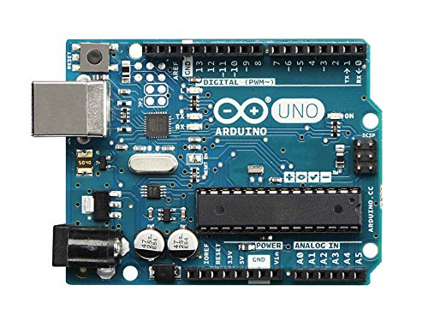
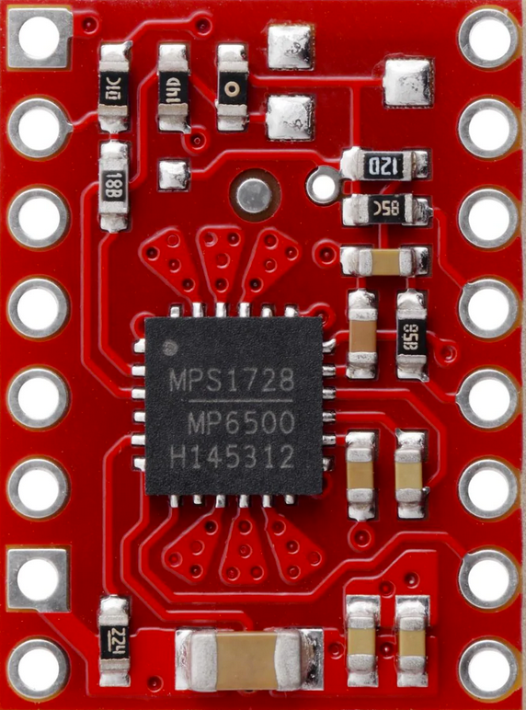
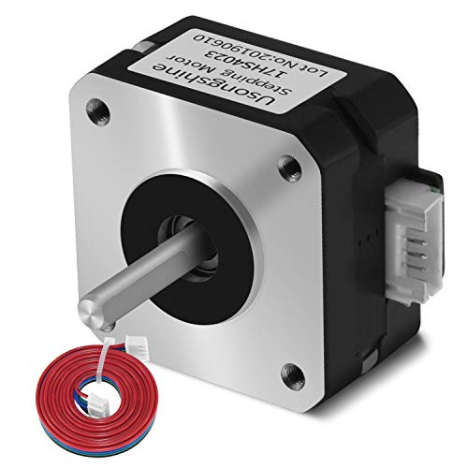
Motion Control
Microcontroller
Arduino UNO 3
Motor Driver
MP6500
Stepper Motor
17HS4023

Slide 22
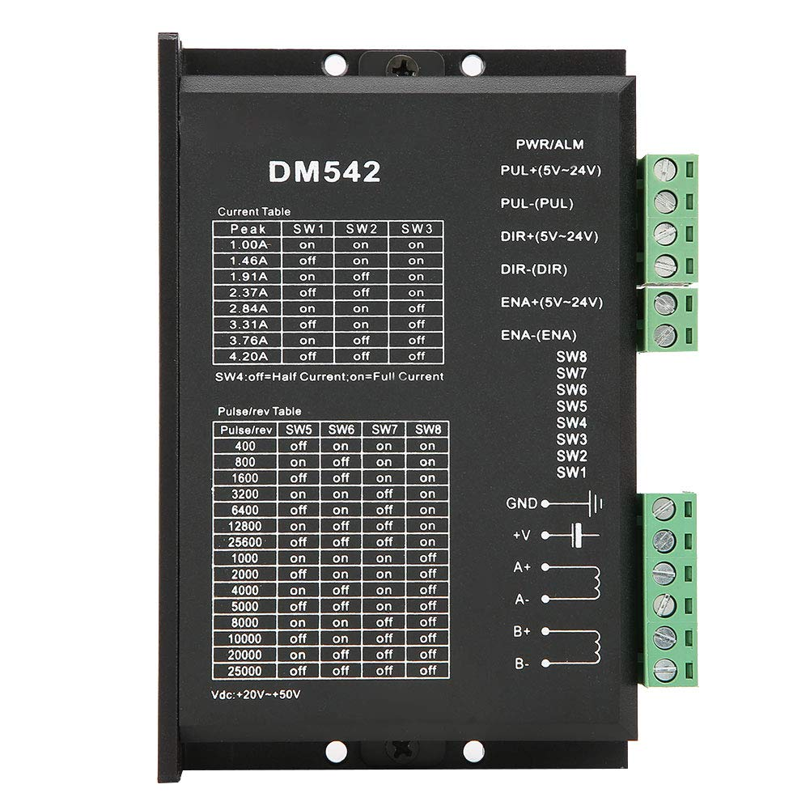
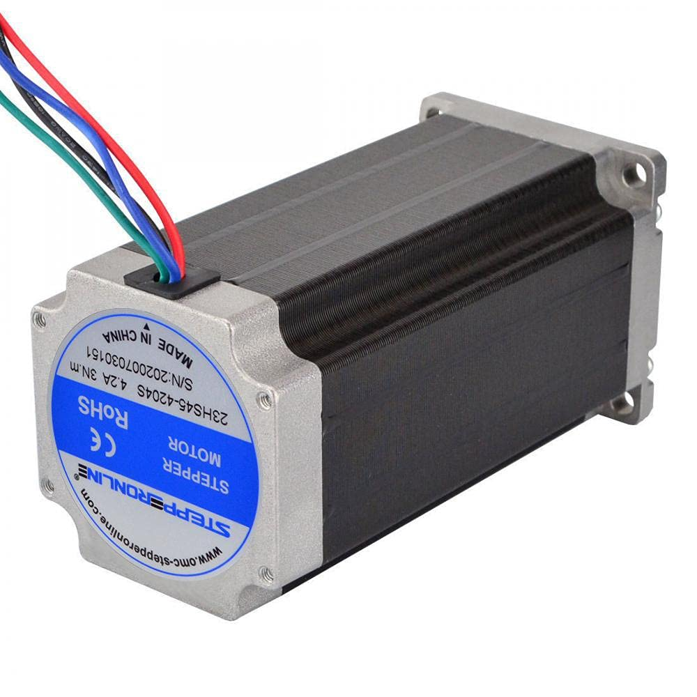
Motion Control
Motor Driver
DM542
Stepper Motor
23HS45-4204S

Slide 23
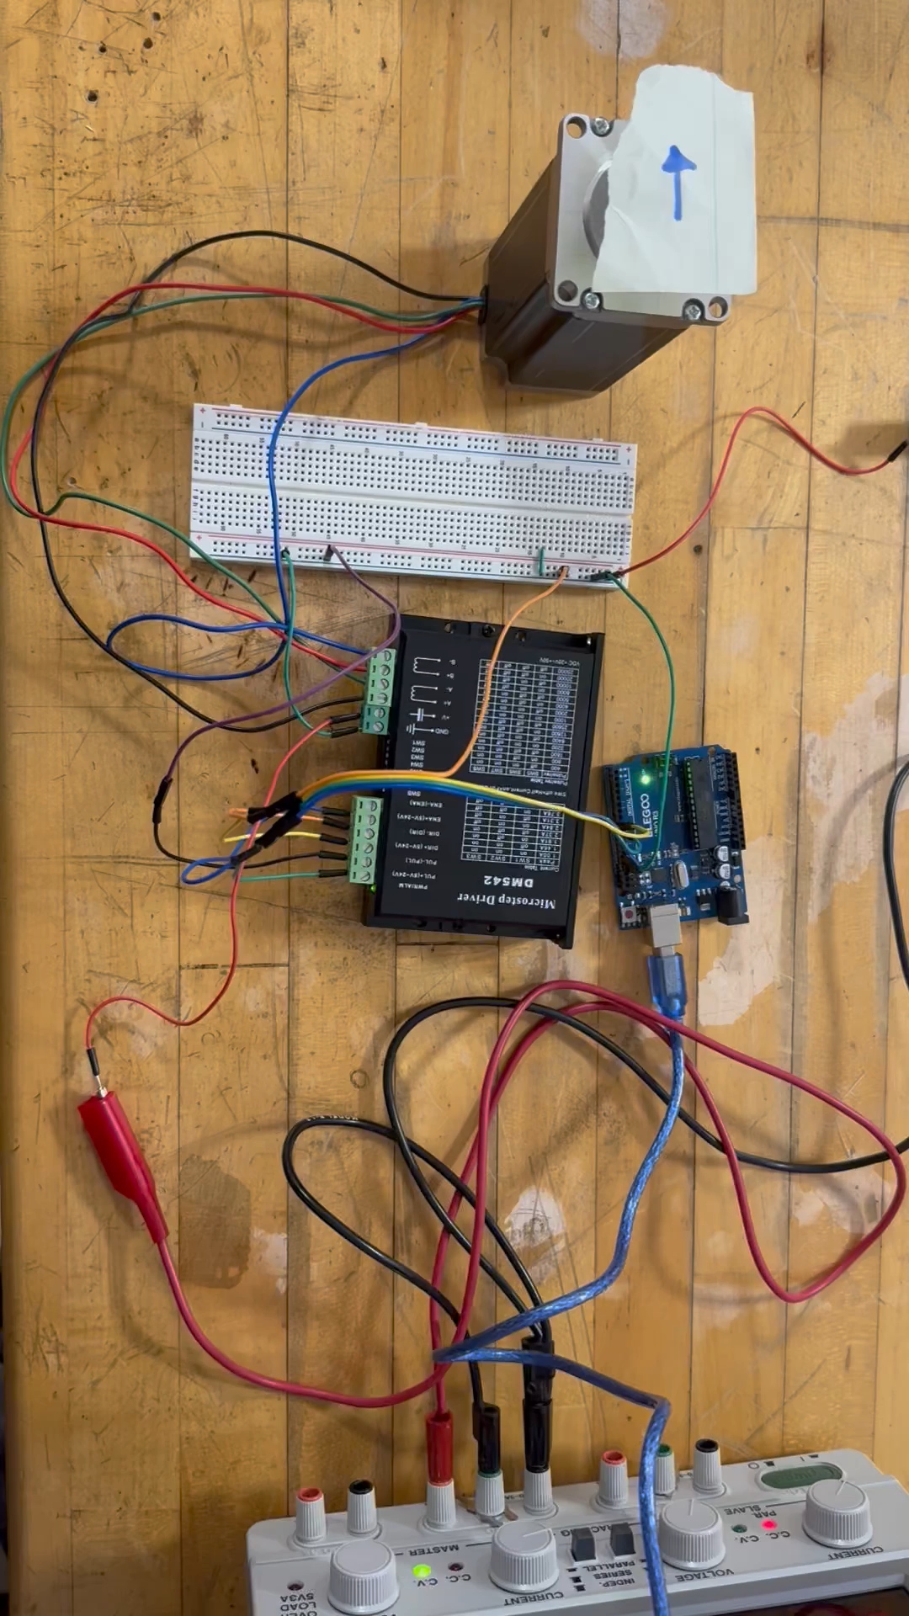
Stepper Motors
Motor control using micro-stepping
COMPONENTS
Stepper Motor: 23HS45-4204S
Motor Driver: DM542 micro-step drive
Microcontroller: Arduino UNO 3
Power Supply:
0 – 30V DC range

Slide 24
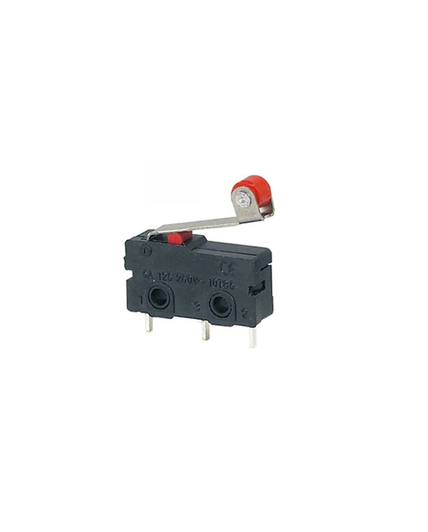
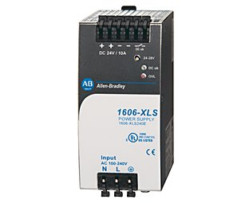
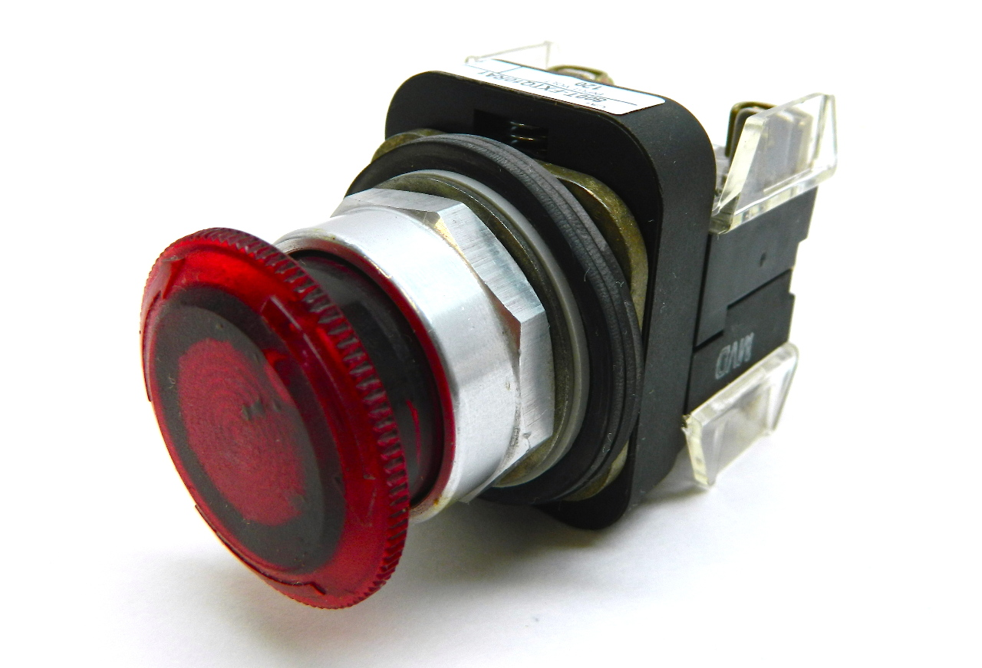
Electrical Updates
SOFTWARE
HARDWARE
Fine tune precision motor control code for assembly.
Limit switches and push buttons used as inputs to direct motor position.
Rockwell power supply and illuminated pushbuttons unavailable.
System designed for ease of changing parts from generic to Rockwell.

Slide 25
Electrical Updates
Electronics enclosure
Ensure easy access to components for maintenance and future upgrades.
Designed for external connectivity and interfacing to motors within assembly.
Accommodate motor drivers' heat dissipation.
Electrical assembly
Wiring and soldering of enclosed electronic components.
Wire motors within assembly.
Calibrate motion control for accuracy within assembly.
Detailed documentation of electrical system and operation procedure for future users.

Slide 26
Future Work
Assemble Virtual Model in Emulate3D
Assemble Physical Prototype
Fine Tune Physical Prototype
Engineering Design Day

Slide 27
Questions?
When you invest in Team 522 solutions, you invest in the future of educational manufacturing.

Slide 28
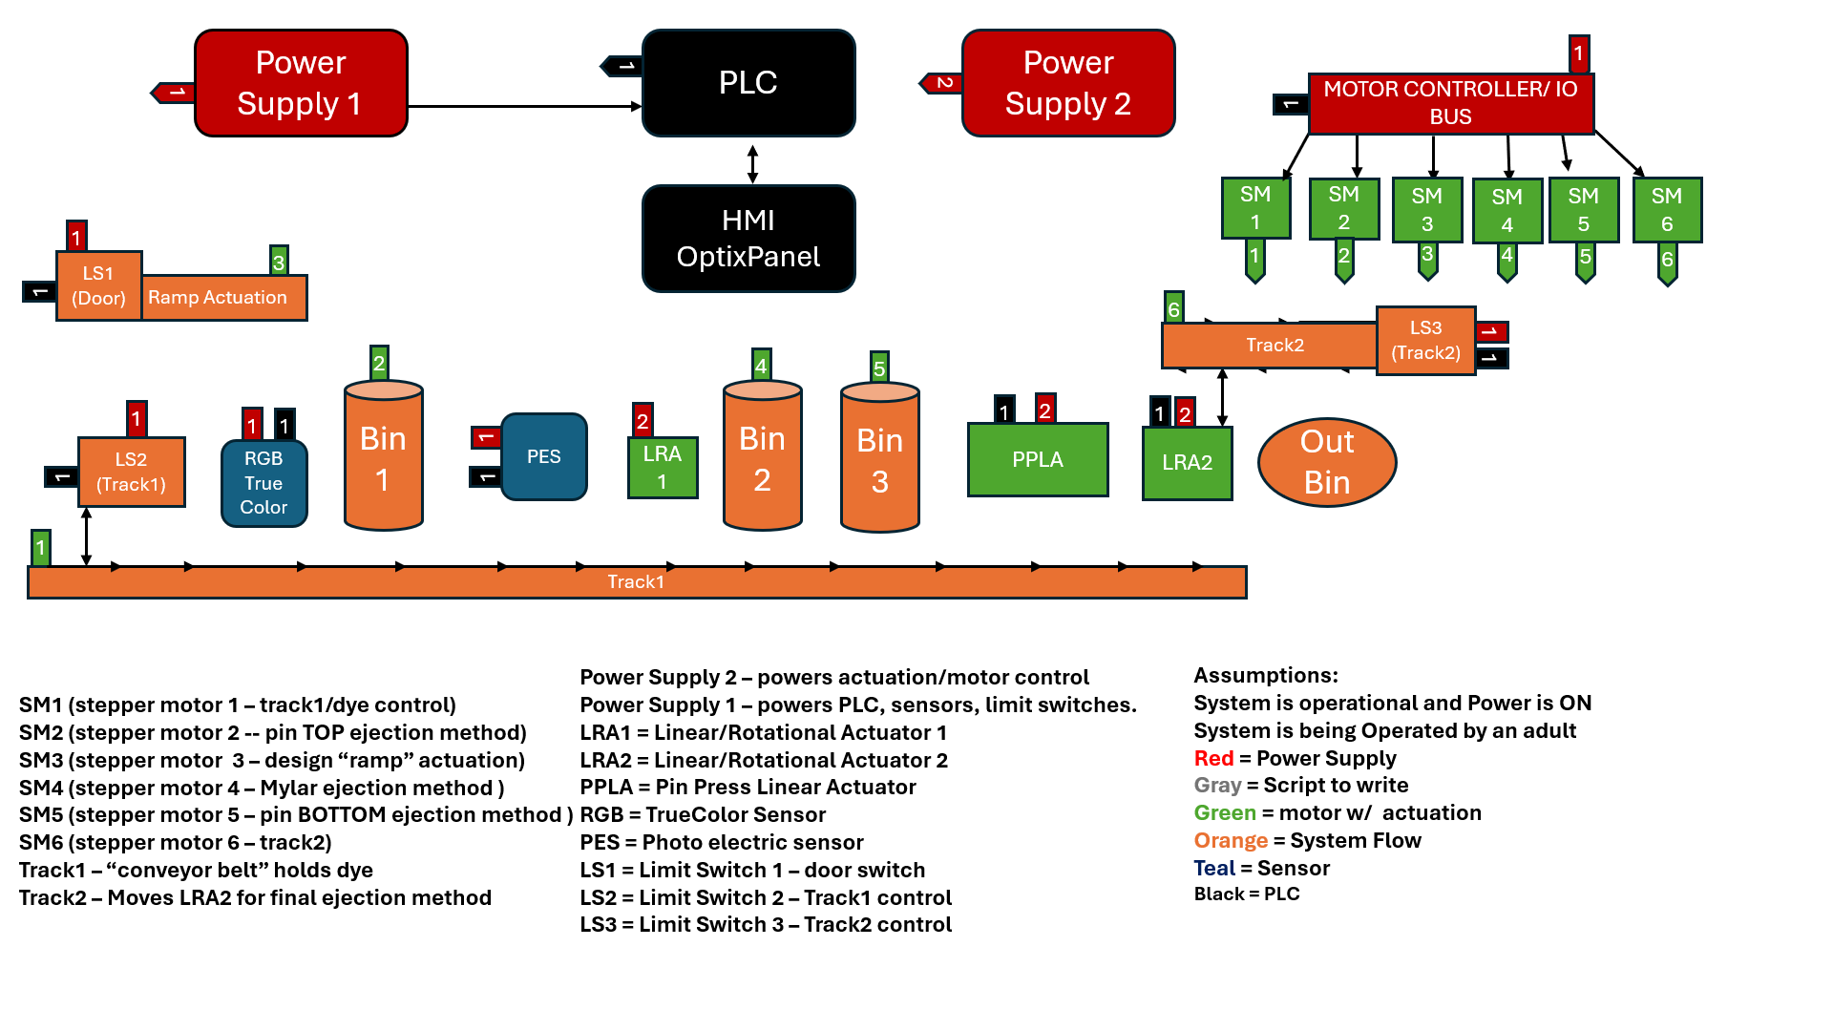
System Design

Slide 29
This is 10-point
This is 15–point Times
This is 20–point
This is 25–point
This is 30–point
This is 35–point
This is 40–point
This is 50–point
This is 60–point
This is 72–point
Notes:
Use at least 20-point font in Room A105, B134, and B136
Use at least 25-point font in Room B135

Slide 30
Project Updates
Simulate Emulate model
Complete frame build****
Optimized code

Slide 31
Power Supply 1
1
MCU
Power Supply 2
1
2
MOTOR CONTOLLERS
Push Button w/ LED
SM1
SM2
SM3
1
1
1
2
3
LS1 (Door)
3
1
Ramp Actuation
1
2
4
5
Bin1
Bin2
Bin3
Out Bin
1
1
LS2 (Track1)
Manual Pin Press
LS3 (Eject)
1
1
1
Track1
SIMPLIFIED DESIGN
Power Supply 2 – powers actuation/motor control
Power Supply 1 – powers PLC, LED, limit switches.
LS1 = Limit Switch 1 – door switch
LS2 = Limit Switch 2 – Track1 control
LS3 = Limit Switch 3 – Track2 control
PUSHBUTTON = ROCKWELL LED PB
SM1 (stepper motor 1 – track1/dye control)
SM2 (stepper motor 2 -- pin TOP ejection method)
SM3 (stepper motor 3 – design “ramp” actuation)
SM4 (stepper motor 4 – Mylar ejection method )
SM5 (stepper motor 5 – pin BOTTOM ejection method )
Track1 – “conveyor belt” holds dye

Slide 32
College of Engineering Color Palette
1 2 3 4
Pantone: PMS 195 C
RGB: 120, 47, 64
Hex: #782F40
CMYK:19, 90, 50, 55
1 2 3 4
Pantone: Black C
RGB: 0, 0, 0
Hex: #000000
CMYK:0, 0, 0, 100
Garnet
Black
1 2 3 4
RGB: 238, 118, 36
Hex: #EE7624
CMYK:2, 66, 99, 0
1 2 3 4
Pantone: PMS 000C
RGB: 255, 255, 255
Hex: #FFFFFF
CMYK: 0, 0, 0, 0
Fang
Orange
White
Notes:
Avoid 75% Black in B135

Slide 33
Accent Color Palette
1 2 3 4
RGB: 0, 59, 111
Hex: #003B6F
CMYK:
1 2 3 4
RGB: 0, 59, 111
Hex: #003B6F
CMYK:
1 2 3 4
RGB: 251, 236, 93
Hex: #FBEC5D
CMYK:
1 2 3 4
RGB: 219, 215, 210
Hex: #DBD7D2
CMYK:
1 2 3 4
RGB: 251, 236, 93
Hex: #FBEC5D
CMYK:
1 2 3 4
RGB: 219, 215, 210
Hex: #DBD7D2
CMYK:
Tardis Blue
Tardis Blue
Corn
Timberwolf
Corn
Timberwolf
1 2 3 4
RGB: 206, 0, 88
Hex: #CE0058
CMYK: 0, 100, 43, 12
1 2 3 4
RGB: 206, 0, 88
Hex: #CE0058
CMYK: 0, 100, 43, 12
1 2 3 4
RGB: 104, 40, 96
Hex: #682860
CMYK:
1 2 3 4
RGB: 220, 220, 220
Hex: #DCDCDC
CMYK:
Rubine Red
Rubine Red
Imperial
Gainsboro
1 2 3 4
RGB: 72, 146, 155
Hex: #48929b
CMYK:
1 2 3 4
RGB: 64, 224, 208
Hex: #40E0D0
CMYK:
1 2 3 4
RGB: 255, 139, 0
Hex: #FF8B00
CMYK:
Asagi-iro
Turquoise
American Orange
Notes:
Remove American orange add hyperlink grey
Make corn the last for b135
All work in 134 imperial move later
Tardis doesn’t work in b136

Slide 34
F7AB19
D67F15
EE7624
D64615
F73119
Analogous
https://color.adobe.com/create/color-wheel
6E3610
F0A16C
EE7624
6E4931
BASB1C
Monochromatic
A14508
4BED3B
EE7624
250CED
2010A1
Triad
A1470C
FF8C40
EE7624
0098A1
24E2ED
Complementary
28A164
2FED8D
EE7624
0848A1
1871ED
Split Complementary
EDAC2F
3BED93
EE7624
0C6AED
ED2F18
Double Split Complementary
ED660C
C7ED3B
EE7624
0CE1ED
A418ED
Square
BA7E09
87724A
EE7624
60EFCF
09BA61
Compound
AD551A
6E3610
EE7624
FA7625
D46820
Shades
Notes:
These are the variants that work well with Fang Orange. The bolded items show well on the projectors.

Slide 35
85412D
8F3831
782f40
8F3176
792D85
Analogous
https://color.adobe.com/create/color-wheel
C44D69
8E626D
782F40
C48796
451B25
Monochromatic
C43959
78743B
782F40
236178
43A2C4
Triad
C43959
C46078
782F40
25C43D
2F783A
Complementary
93C460
577835
782F40
39C49D
297861
Split Complementary
784435
5A783B
782F40
237860
6E2978
Double Split Complementary
782337
78683b
782F40
237830
293978
Square
AB4D32
DEBAAF
782F40
5D8555
70AB32
Compound
38161E
C44D69
782F40
853447
5E2532
Shades

Slide 36
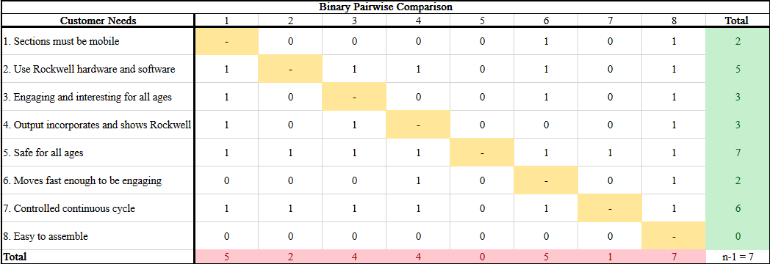
Binary Pairwise Comparison

Slide 37
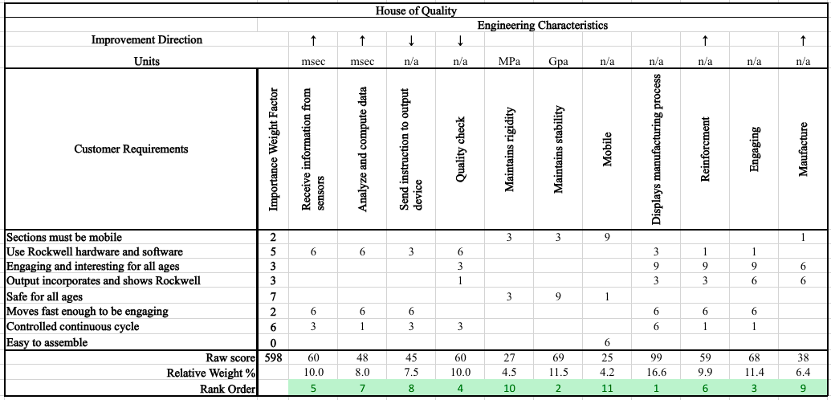
HOQ

Slide 38
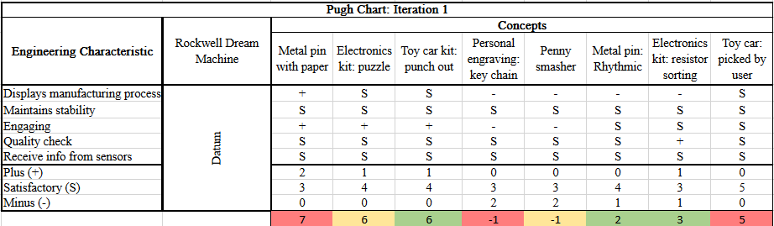
Pugh Chart iteration #1

Slide 39
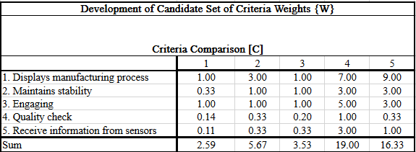
AHP

Slide 40
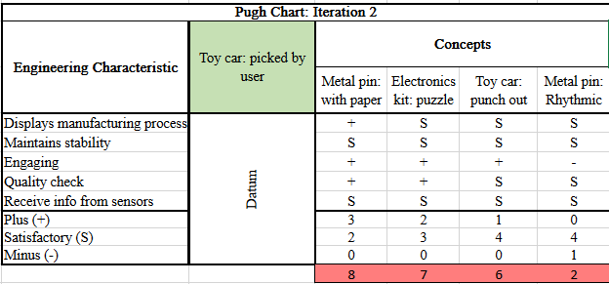
Pugh Chart Iteration #2

Slide 41
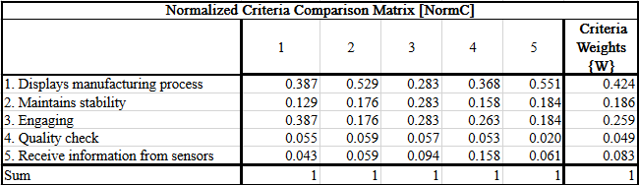
Normalized AHP

Slide 42
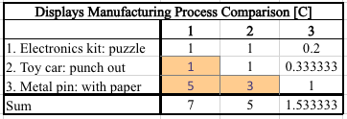
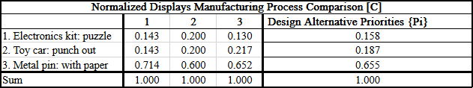
AHP DESIGN ALTERNATIVE - "Displays Manufacturing Process"

Slide 43


AHP DESIGN ALTERNATIVE - "Displays Manufacturing Process"

Slide 44
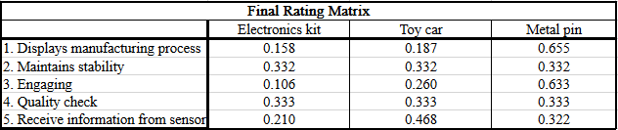
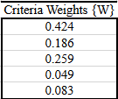
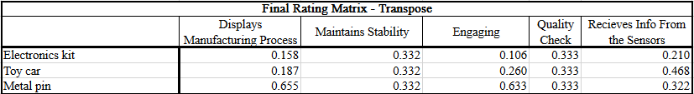

Final Rating Matrix

Slide 45
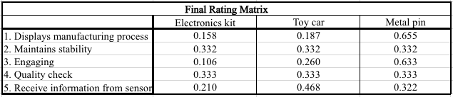

Final Selection

Slide 46
A105
A105
B135 Stage Left
B135 Stage Right
B136
B134, A105
B135

