Slide 1
Team 522 – Rockwell Automation Manufacturing Device for Students
Luis Garcia, Caleb Mears, Maria Rojas, Chloe Keiran, Caden Schwartz, Mark Hanna

Slide 2
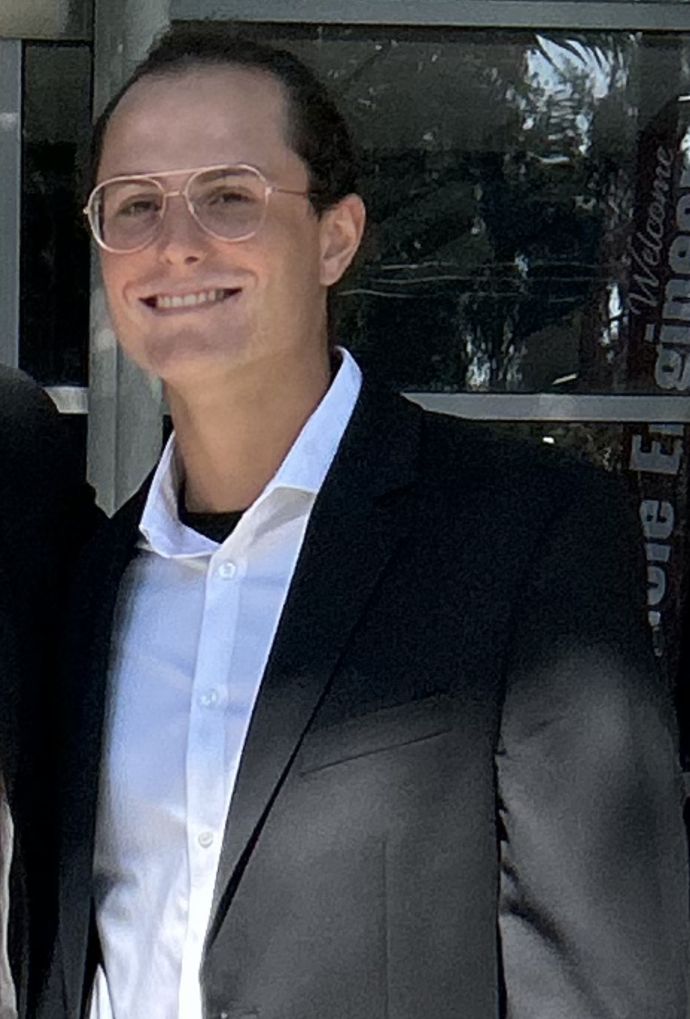
Team Introductions
Luis Garcia
Systems/
Dynamics
Engineer
Caleb Mears
Manufacturing
Engineer
Maria Rojas
Test Engineer
Chloe Keiran
Design
Engineer
Caden Schwartz
Electrical Systems Engineer
Mark Hanna
Computer/
Software
Engineer

Slide 3
Sponsor and Advisor
Industry Sponsor
Tajaey Young
Rockwell Automation
Industry Sponsor
Amanda Eason
Rockwell Automation
Academic Advisor
Shayne McConomy, Ph.D.
Professor/Advisor

Slide 4
Objective
Create a system that can demonstrate the automated manufacturing process and create an educational item.

Slide 5
Project Background
Global leaders of automation in the manufacturing industry and digital transformation services.
When you invest in Rockwell Automation technology and solutions, you invest in the future of manufacturing.

Slide 6
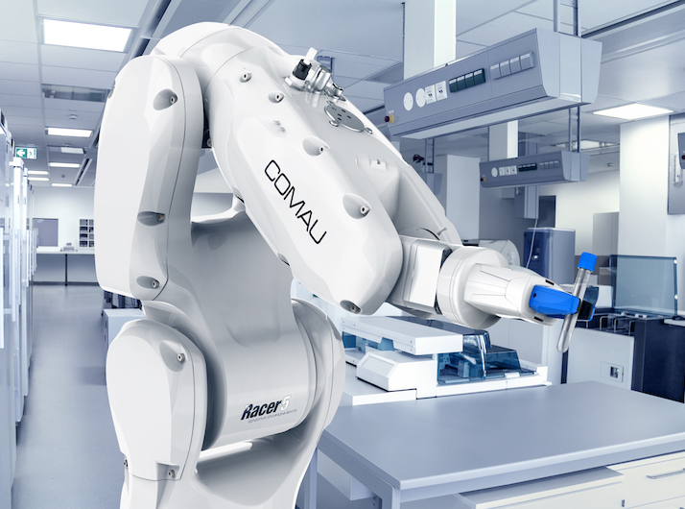
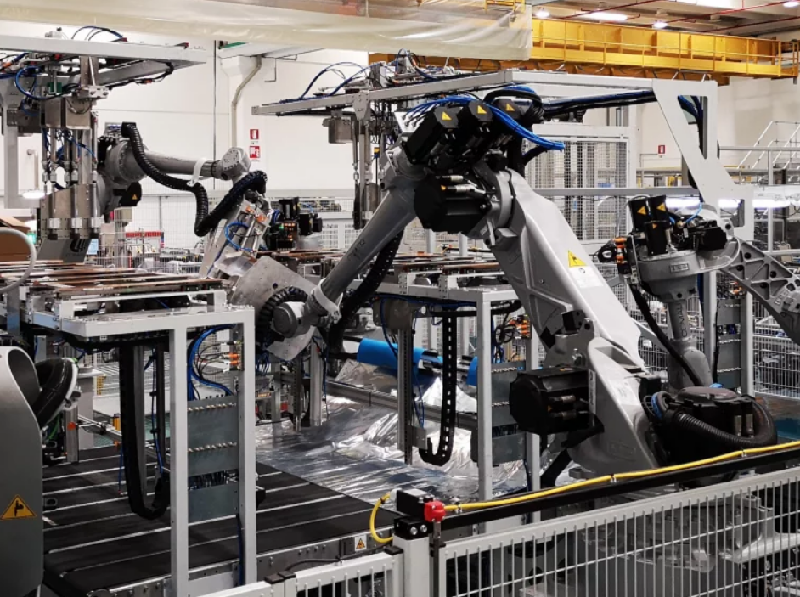
Project Background
Rockwell Automation is interested in engaging wider demographics on automated manufacturing.
Project aims to develop an aid system to demonstrate automated manufacturing and create an educational item through process.

Slide 7
Key Goals
Notes:
Simulate an automated manufacturing process
Provide an educational experience
Create a tangible educational product

Slide 8
Key Goals
Simulate an automated manufacturing process

Slide 9
Key Goals
Simulate an automated manufacturing process
Provide an educational experience

Slide 10
Key Goals
Simulate an automated manufacturing process
Provide an educational experience
Create a tangible educational product

Slide 11
Customer Needs
System Questions
Responses
Responses
What are some crucial assumptions for the final product?
If modular, what should the expected assembly experience be?
What are the size and weight restraints?
System must be safe to operate
System must be simple to assemble
System must be transportable
Engaging to an audience aged K-12
Manufacture a product quickly and in iteration

Slide 12
Customer Needs
Manufacturing Questions
Responses
Responses
Is the system continuously producing the item?
Is there an ideal time range for the manufacturing time?
Are there any requirements for the manufactured item?
Manufacturing cycle will be continuous and iterative
The system will manufacture the product quickly
The manufactured item will display Rockwell branding
Engaging to an audience aged K-12

Slide 13
Customer Needs
Responses
Miscellaneous
Is there a preference for the type of resources used in the project?
What demographics should we seek to appeal to with the item?
The system should showcase Rockwell software and hardware.
Engaging to audiences age K-12

Slide 14
Markets & Stakeholders
The primary market is Rockwell Automation

Slide 15
Markets & Stakeholders
The secondary market is schools K-12

Slide 16
Assumptions
An adult will be supervising the process for the entire demonstration time.
Students might touch the system so it should be designed accordingly to maintain safety as a priority.
The system must be mobile since it will be used to showcase in various locations.

Slide 17
Functional Decomposition
Major Functions
ROCKWELL AUTOMATED LEARNING TOOL
CONTROL
SUPPORT
EDUCATE
MANUFACTURE

Slide 18
Functional Decomposition
Major Functions
ROCKWELL AUTOMATED LEARNING TOOL
CONTROL
SUPPORT
EDUCATE
MANUFACTURE
CONTROL

Slide 19
Functional Decomposition
Functions - Control
Analyze and compute data
Receive information from sensors
CONTROL
Checks Quality
Send instructions to output device

Slide 20
Functional Decomposition
Major Functions
ROCKWELL AUTOMATED LEARNING TOOL
SUPPORT
EDUCATE
MANUFACTURE
CONTROL
SUPPORT

Slide 21
Functional Decomposition
Functions - Support
Maintains stability
Maintains rigidity
SUPPORT
Showcase Rockwell Hardware
Mobile

Slide 22
Functional Decomposition
Major Functions
ROCKWELL AUTOMATED LEARNING TOOL
EDUCATE
MANUFACTURE
CONTROL
SUPPORT
EDUCATE

Slide 23
Functional Decomposition
Functions - Educate
Displays Manufacturing Process
INPUT
OUTPUT
EDUCATE
Reinforcement
Engaging

Slide 24
Functional Decomposition
Major Functions
ROCKWELL AUTOMATED LEARNING TOOL
MANUFACTURE
CONTROL
SUPPORT
EDUCATE
MANUFACTURE

Slide 25
Functional Decomposition
Functions - Manufacture
Receive Raw Materials
MANUFACTURE
Manipulate raw materials
Eject final object

Slide 26
Functional Decomposition
 | SYSTEM
FUNCTION | CONTROL | SUPPORT | EDUCATE | MANUFACTURE
Receives Information from Sensors | X
Analyzes and Computes Data | X
Sends Instructions to Output Devices | X
Checks Quality | X |  | X
Maintains Stability |  | X
Maintains Rigidity |  | X
Major Functions
ROCKWELL AUTOMATED LEARNING TOOL
CONTROL
SUPPORT
EDUCATE

Slide 27
 | SYSTEM
FUNCTION | CONTROL | SUPPORT | EDUCATE | MANUFACTURE
Mobile |  | X
Showcase Rockwell Hardware |  | X
Display Manufacturing Process |  | X | X
Reinforcement |  |  | X
Engaging |  |  | X
Receive Raw Materials |  | X | X | X
Manipulate Raw Materials | X |  | X | X
Eject Final Object | X |  | X | X
Major Functions

Slide 28
 | SYSTEM
FUNCTION | CONTROL | SUPPORT | EDUCATE | MANUFACTURE
Mobile |  | X
Showcase Rockwell Hardware |  | X
Display Manufacturing Process |  | X | X
Reinforcement |  |  | X
Engaging |  |  | X
Receive Raw Materials |  | X | X | X
Manipulate Raw Materials | X |  | X | X
Eject Final Object | X |  | X | X
Major Functions

Slide 29
Thank you When you invest in Team 522 solutions, you invest in the future of educational manufacturing.

Slide 32
This is 10-point
This is 15–point Times
This is 20–point
This is 25–point
This is 30–point
This is 35–point
This is 40–point
This is 50–point
This is 60–point
This is 72–point
Notes:
Use at least 20-point font in Room A105, B134, and B136
Use at least 25-point font in Room B135

Slide 33
College of Engineering Color Palette
1 2 3 4
Pantone: PMS 195 C
RGB: 120, 47, 64
Hex: #782F40
CMYK:19, 90, 50, 55
1 2 3 4
Pantone: Black C
RGB: 0, 0, 0
Hex: #000000
CMYK:0, 0, 0, 100
Garnet
Black
1 2 3 4
RGB: 238, 118, 36
Hex: #EE7624
CMYK:2, 66, 99, 0
1 2 3 4
Pantone: PMS 000C
RGB: 255, 255, 255
Hex: #FFFFFF
CMYK: 0, 0, 0, 0
Fang
Orange
White
Notes:
Avoid 75% Black in B135

Slide 34
Accent Color Palette
1 2 3 4
RGB: 0, 59, 111
Hex: #003B6F
CMYK:
1 2 3 4
RGB: 0, 59, 111
Hex: #003B6F
CMYK:
1 2 3 4
RGB: 251, 236, 93
Hex: #FBEC5D
CMYK:
1 2 3 4
RGB: 219, 215, 210
Hex: #DBD7D2
CMYK:
1 2 3 4
RGB: 251, 236, 93
Hex: #FBEC5D
CMYK:
1 2 3 4
RGB: 219, 215, 210
Hex: #DBD7D2
CMYK:
Tardis Blue
Tardis Blue
Corn
Timberwolf
Corn
Timberwolf
1 2 3 4
RGB: 206, 0, 88
Hex: #CE0058
CMYK: 0, 100, 43, 12
1 2 3 4
RGB: 206, 0, 88
Hex: #CE0058
CMYK: 0, 100, 43, 12
1 2 3 4
RGB: 104, 40, 96
Hex: #682860
CMYK:
1 2 3 4
RGB: 220, 220, 220
Hex: #DCDCDC
CMYK:
Rubine Red
Rubine Red
Imperial
Gainsboro
1 2 3 4
RGB: 72, 146, 155
Hex: #48929b
CMYK:
1 2 3 4
RGB: 64, 224, 208
Hex: #40E0D0
CMYK:
1 2 3 4
RGB: 255, 139, 0
Hex: #FF8B00
CMYK:
Asagi-iro
Turquoise
American Orange
Notes:
Remove American orange add hyperlink grey
Make corn the last for b135
All work in 134 imperial move later
Tardis doesn’t work in b136

Slide 35
F7AB19
D67F15
EE7624
D64615
F73119
Analogous
https://color.adobe.com/create/color-wheel
6E3610
F0A16C
EE7624
6E4931
BASB1C
Monochromatic
A14508
4BED3B
EE7624
250CED
2010A1
Triad
A1470C
FF8C40
EE7624
0098A1
24E2ED
Complementary
28A164
2FED8D
EE7624
0848A1
1871ED
Split Complementary
EDAC2F
3BED93
EE7624
0C6AED
ED2F18
Double Split Complementary
ED660C
C7ED3B
EE7624
0CE1ED
A418ED
Square
BA7E09
87724A
EE7624
60EFCF
09BA61
Compound
AD551A
6E3610
EE7624
FA7625
D46820
Shades
Notes:
These are the variants that work well with Fang Orange. The bolded items show well on the projectors.

Slide 36
85412D
8F3831
782f40
8F3176
792D85
Analogous
https://color.adobe.com/create/color-wheel
C44D69
8E626D
782F40
C48796
451B25
Monochromatic
C43959
78743B
782F40
236178
43A2C4
Triad
C43959
C46078
782F40
25C43D
2F783A
Complementary
93C460
577835
782F40
39C49D
297861
Split Complementary
784435
5A783B
782F40
237860
6E2978
Double Split Complementary
782337
78683b
782F40
237830
293978
Square
AB4D32
DEBAAF
782F40
5D8555
70AB32
Compound
38161E
C44D69
782F40
853447
5E2532
Shades

Slide 37
A105
A105
B135 Stage Left
B135 Stage Right
B136
B134, A105
B135

