Slide 1
Team 520: NASA-MSFC Actively Sealed Cryogenic Coupler (ASCC)
Design Review 5
Jason Goldstein, Lauren Roche, Sean Rodney,
Valerie Rodriguez, Nicolas Sgammato

Slide 2



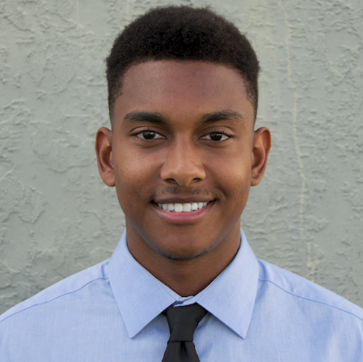



Team 520 Members
Jason Goldstein
Jason Goldstein
Materials Engineer
Lauren Roche
Cryogenics Engineer
Sean Rodney
Test Engineer
Valerie Rodriguez
Thermal-Fluids Engineer
Nicolas Sgammato
Design Engineer
Department of Mechanical Engineering
2

Slide 3



Sponsors
Jason Goldstein
James C. Buzzell
Propulsion Systems Engineer,
NASA MSFC
Marvin W. Barnes
Advanced Propulsion Research and Development,
NASA MSFC
Department of Mechanical Engineering
3

Slide 4

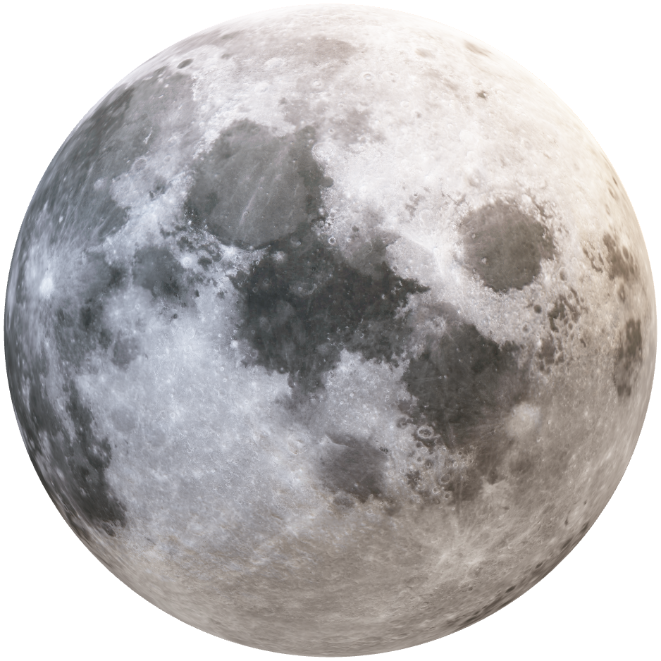
Objective
Jason Goldstein
The objective of this project is to design,
build, and test an actively sealed coupler
that prevents the leakage of cryogenic fuel
during the transfer from depot to vessel for future
deep space NASA missions.
Department of Mechanical Engineering
4

Slide 5
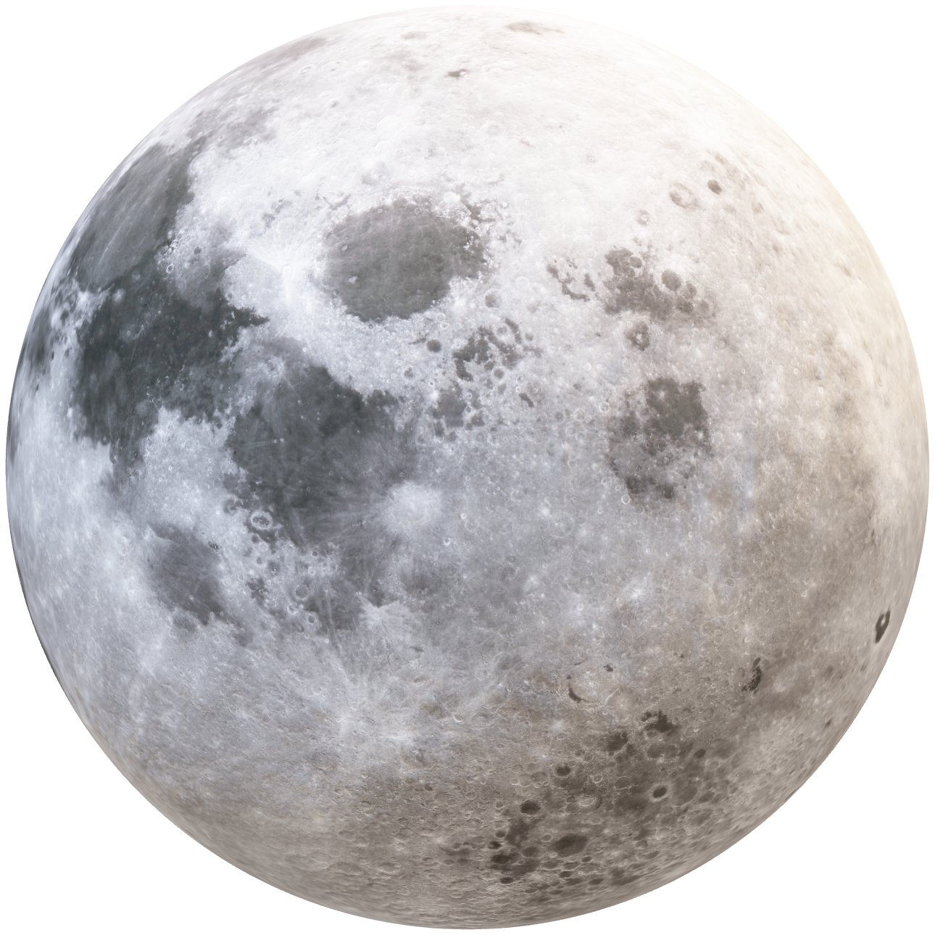
Background
Jason Goldstein
Cryogenic Fuel Transfer
Mechanical Connection
Force Held
Department of Mechanical Engineering
5

Slide 6
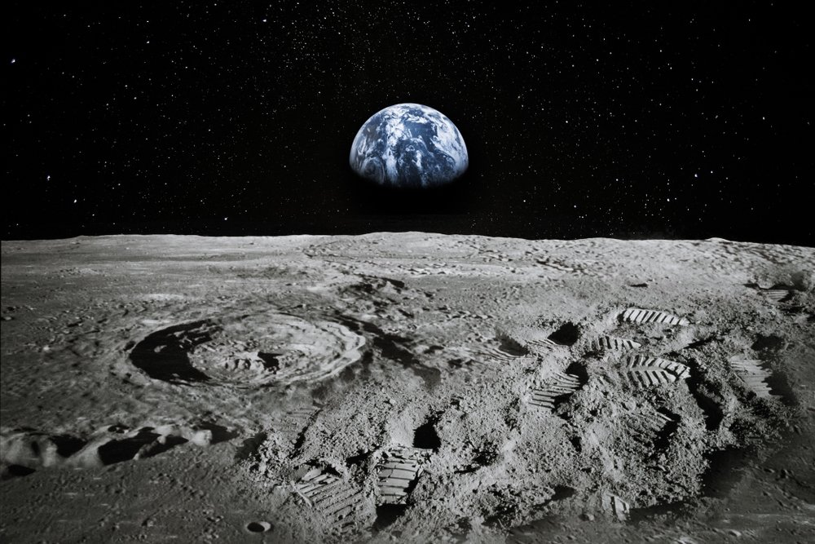
Key Goals
Jason Goldstein
Effective Sealing
Prevent and Monitor
Leaks
90-Day Lunar Mission
Department of Mechanical Engineering
6

Slide 7
Jason Goldstein
Coupler Operation
Department of Mechanical Engineering
7

Slide 8
Jason Goldstein
Coupler Operation
Department of Mechanical Engineering
8

Slide 9
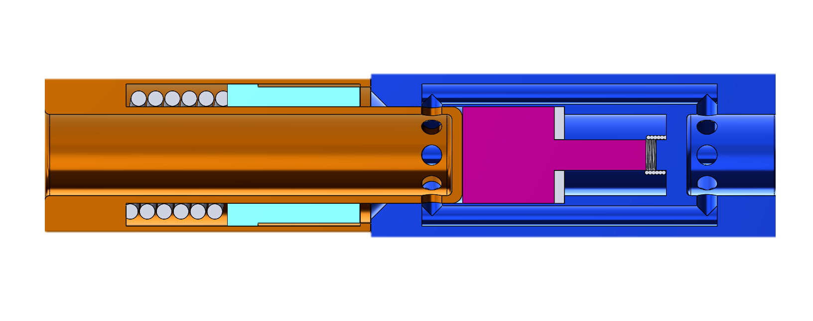
Initial Concept
Nicolas Sgammato
Department of Mechanical Engineering
9

Slide 10
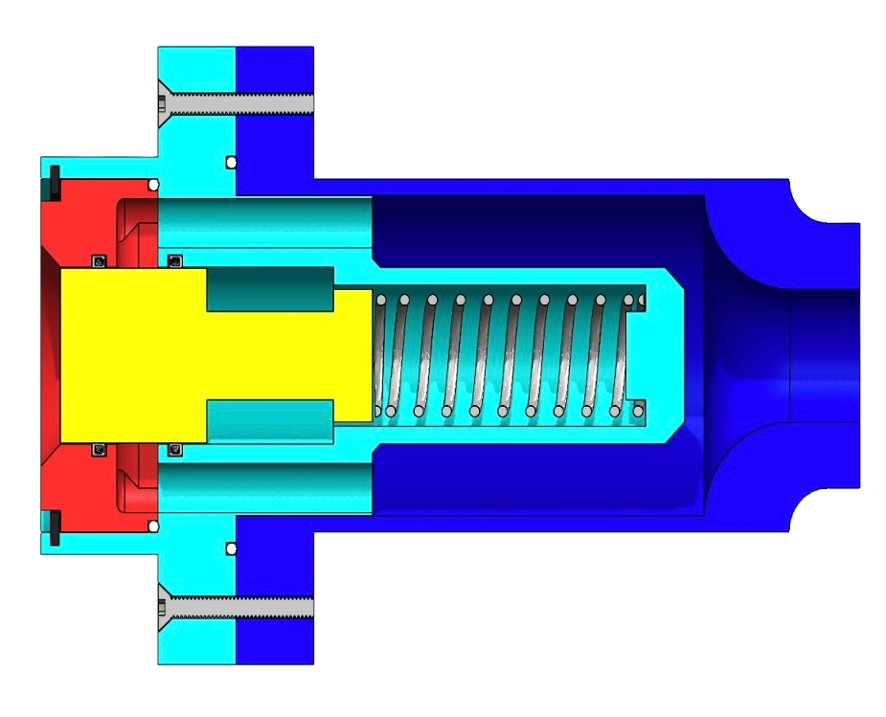
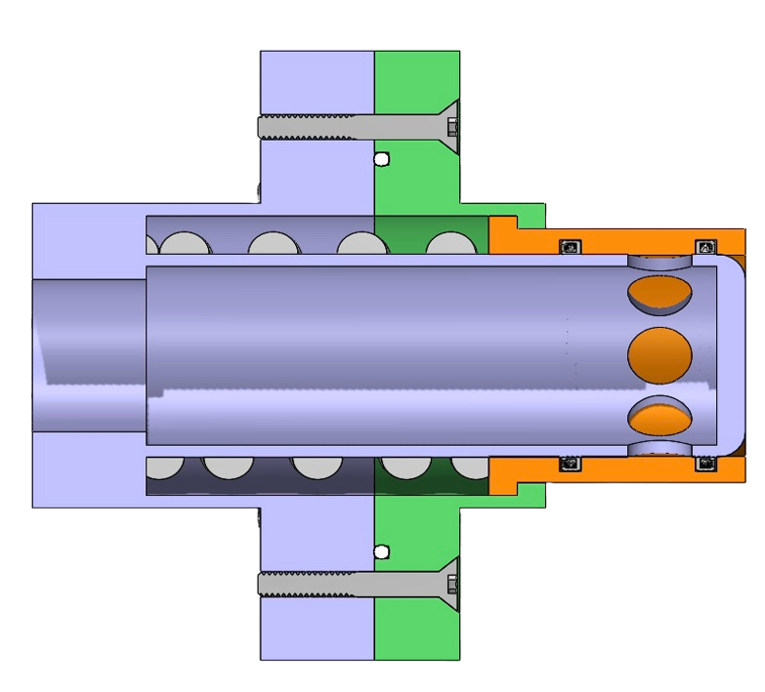
ASCC MK2
Nicolas Sgammato
Department of Mechanical Engineering
10

Slide 11
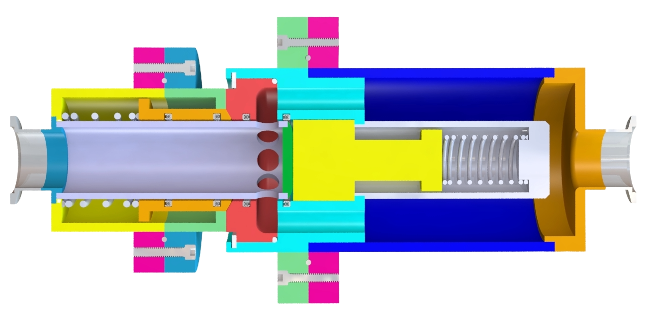
ASCC MK3
Nicolas Sgammato
Department of Mechanical Engineering
11

Slide 12
Design Revisions
Nicolas Sgammato
Single flow channel on receiver side
Arbitrary dimensions based on previous design
Multiple flow channels on receiver required alignment
Dimensions adjusted to match standard pipe sizes
Flange diameters and thicknesses decreased
Probe end fixed to outer surface
Oversized flange dimensions
Probe split from outer surface and cap feature added
Department of Mechanical Engineering
12

Slide 13
Design Revisions Continued
Nicolas Sgammato
Flange seals located primarily within one flange half
Flange seal location moved to between flange surfaces
Large and complex components created manufacturing difficulties
Components split up into multiple pieces
Gap formed between probe actuator and receiver cap upon mating
Chamfer added to outer edge of probe actuator
Cryogenic testing inhibited by open ends
Adapters added to connect KF fittings for testing
Department of Mechanical Engineering
13

Slide 14
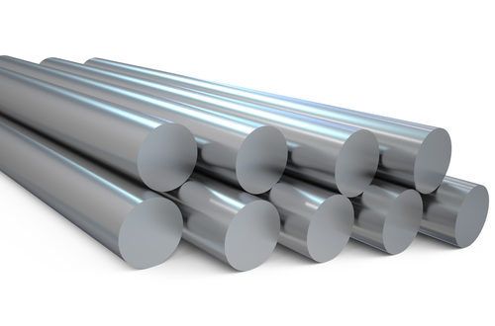
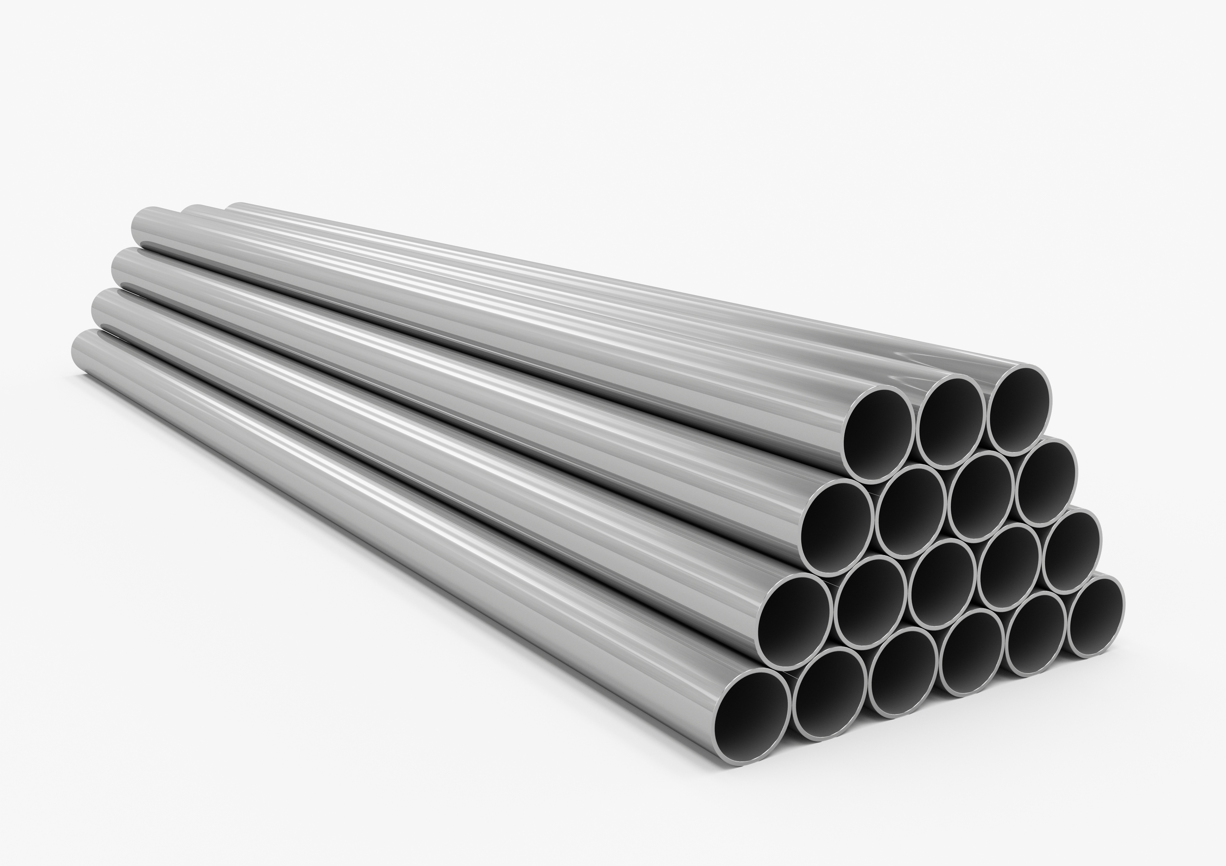
Manufacturing Revisions
Nicolas Sgammato
Round bar stock was discarded in favor of pipes
Less machining and more welding
Significantly reduces manufacturing time and material cost
Department of Mechanical Engineering
14

Slide 15
Anticipated Challenges + Solutions
Nicolas Sgammato
Order materials as soon as possible to allow time for re-order in case of a manufacturer issue
Material Issues
Design for less required machining and budget for extra materials in the event of irreparable fabrication errors
Machining Errors
Flow Channel Interference With Seals
If scraping of the seals by the flow channel holes is observed, a feature may need to be added to prevent significant seal damage
Department of Mechanical Engineering
15

Slide 16
Budget Breakdown
Nicolas Sgammato
Remaining Budget
Raw Materials
Department of Mechanical Engineering
16

Slide 17
Budget Breakdown
Nicolas Sgammato
Raw Materials - $1248.72
Seals - $380.00
Springs - $41.14
Miscellaneous - $66.36
Remaining Budget - $263.78
Total Budget - $2000.00
Department of Mechanical Engineering
17

Slide 18

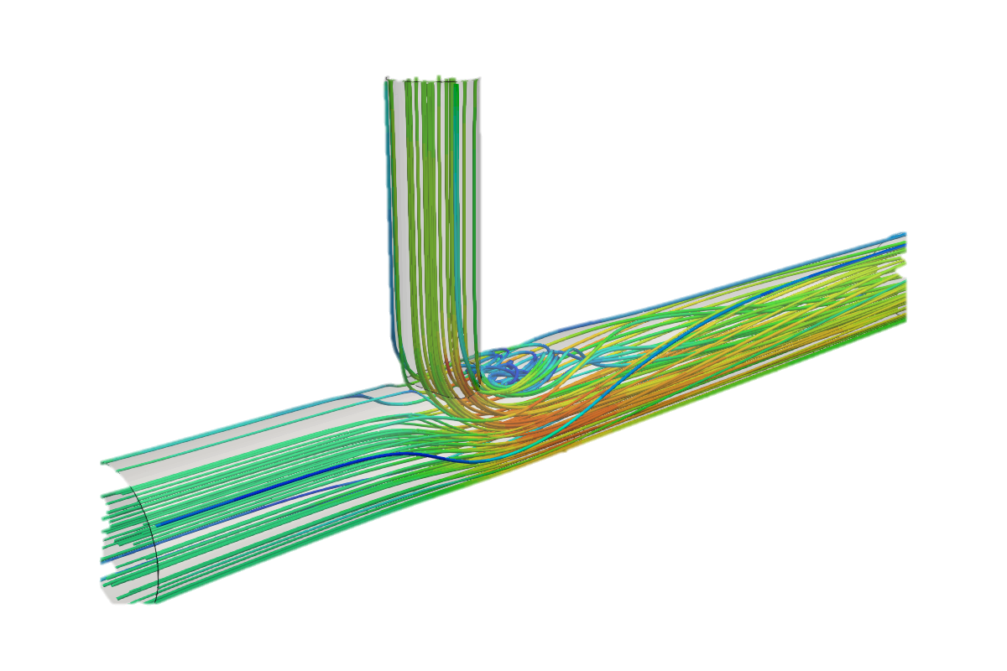


Lauren Roche
Testing
Gross Leakage
Cryogenic Flow
Fluid Dynamics
Durability
Status:
3D Printing Begun
Status:
Training Complete
Status:
Setup Initiated
Status:
Approved
Department of Mechanical Engineering
18

Slide 19
Lauren Roche
Gross Leakage Testing
Flow room temperature water through 3D-printed model
Locate any gross leak paths
Use environmental correction factor to get flow coefficient data
Status:
3D Printing Begun
Department of Mechanical Engineering
19

Slide 20
Lauren Roche
Cryogenic Flow Testing
Flow liquid nitrogen through stainless steel coupler
Ensure leakage rates remain within target
Verify normal operation under cryogenic conditions
Status:
Training Complete
Department of Mechanical Engineering
20

Slide 21
Lauren Roche
Fluid Flow Simulation
Use computational fluid dynamics to analyze flow through coupler
Ensure pressure drop does not inhibit fueling
Analyze heat transfer through coupler during fueling
Status:
Setup Initiated
Department of Mechanical Engineering
21

Slide 22
Lauren Roche
Durability Testing
Use pressure sensitive paint to analyze stresses in coupler
Ensure design safety requirements are met
Test for any gross leakage paths that may have formed
Status:
Approved
Department of Mechanical Engineering
22

Slide 23




Current Priorities
Lauren Roche
Conduct water leakage test with 3D-printed model of design
Analyze and interpret data from testing to improve the design
Order necessary materials/parts to begin manufacturing and assembly of coupler
Complete cryogenic testing at the National High Magnet Field Laboratory (NHMFL)
Department of Mechanical Engineering
23
Notes:
Previous version is in back up slides. Add or make any changes.

Slide 24



Future Work
Lauren Roche
Perform fluid flow simulations using SolidWorks
Conduct durability tests on the final coupler design
Implement spray on foam insulation (SOFI) to outer surface
Department of Mechanical Engineering
24
Notes:
Previous version is in back up slides. Add or make any changes.

Slide 25
Thank You.
520: NASA Actively Sealed Cryogenic Coupler
Jason Goldstein, Lauren Roche, Sean Rodney,
Valerie Rodriguez, Nicolas Sgammato

Slide 26




Name
Future Work
Conduct all
testing methods
Finish calculations, order parts, build prototype and refine design
*This slide probably needs to be updated
Analyze and Interpret
data from testing
Manufacture final design at machine shop
Department of Mechanical Engineering
26

Slide 27
Backup Slides

Slide 28

Flow Rate Testing
Valerie Rodriguez
In the case testing at the FCAAP lab is denied, fluid dynamics will be simulated in COMSOL.
Testing using PIV would be ideal but main concerns can still be analyzed using this software.
Department of Mechanical Engineering
28

Slide 29
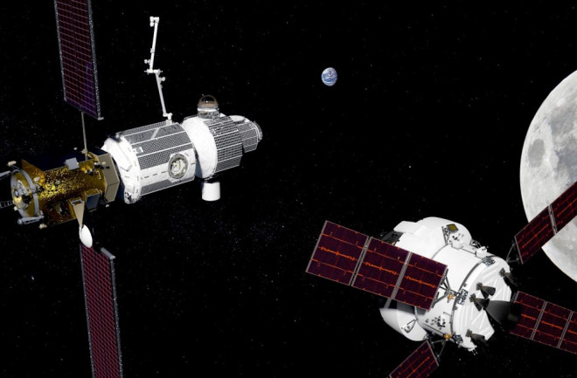
Lunar Refueling Depot
Reduced Cost
Increased Safety
Extended Mission Capabilities

Slide 30
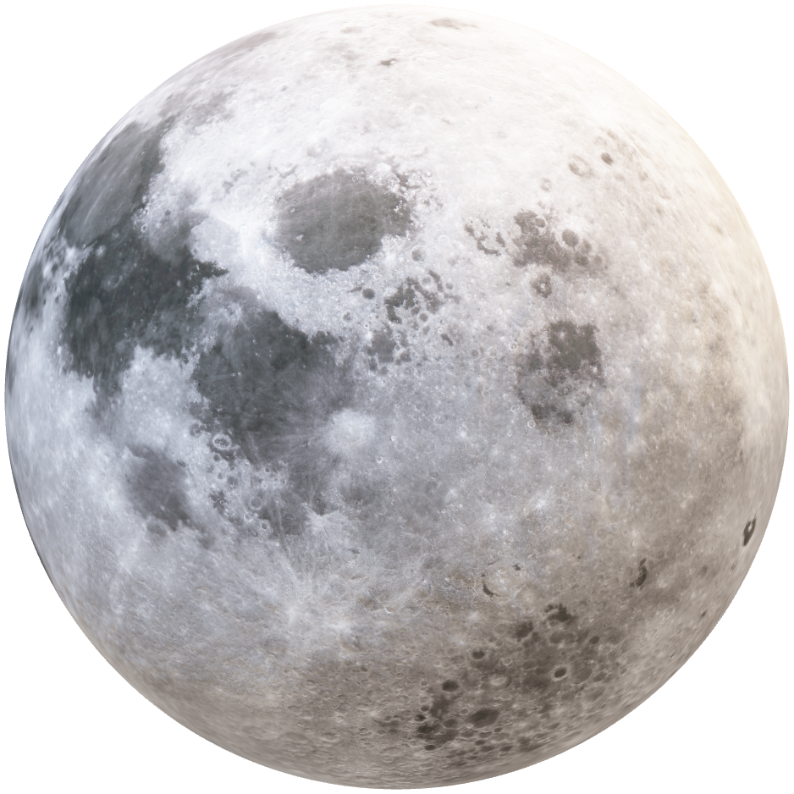
Problems with Current Designs
Sealing and Leakage
Thermal Radiation
Contamination

Slide 31
Actively Sealed Coupler
Seals when the two halves make contact

Slide 32
Background
Lauren Roche
Cryogenic Fuel Transfer
Deep Space Mission
Lunar Base Fuel Depot
Department of Mechanical Engineering
32

Slide 33

Customer Needs
Valerie Rodriguez
Extend the life of the cryogenic fuel storage in space
Minimize the leakage rate of fuels during the transfer process
Seal activation upon contact of coupler halves
Limit boil-off of fuel due to heat transfer
Protect system from foreign particulate matter

Slide 34
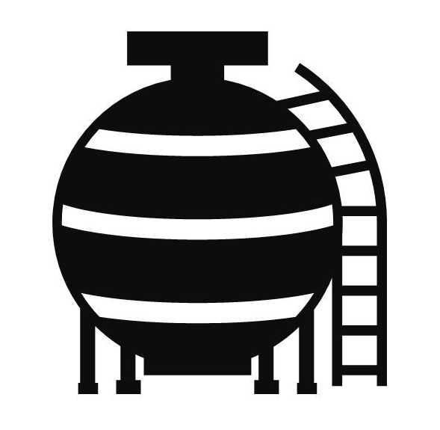



Customer Needs
Valerie Rodriguez
Extend life of the cryogenic fuel
Minimize the leakage rate
Seal activation upon contact of coupler halves
Limit Boil Off
System Protection

Slide 35
Customer Needs
Valerie Rodriguez
Extend life of the cryogenic fuel
Minimize the leakage rate
Seal activation upon contact of coupler halves
Limit boil off
System protection

Slide 36
Functional Decomposition
Valerie Rodriguez
Coupling System
Durability
Connection
Fueling
Disconnection

Slide 37
Functional Decomposition
Valerie Rodriguez
Coupling System
Durability
Connection
Fueling
Disconnection
Major Function
Endure Solar Radiation
Mitigate Particulates
Minimize Heat Transfer
Tolerate Vehicle Misalignment
Uphold Structural Durability
Protect Electrical Components
Minor Function

Slide 38
Functional Decomposition
Valerie Rodriguez
Coupling System
Durability
Connection
Fueling
Disconnection
Major Function
Check Pressure Difference
Level Pressure
Lock two Halves Together
Seal the Connection
Minor Function

Slide 39
Functional Decomposition
Valerie Rodriguez
Coupling System
Durability
Connection
Fueling
Disconnection
Major Function
Open Pipe Valve
Minimize Fuel Leakage
Close Pipe Valve
Minor Function

Slide 40
Functional Decomposition
Valerie Rodriguez
Coupling System
Durability
Connection
Fueling
Disconnection
Major Function
Disconnect Both Halves
Purge Excess Fuel
Minor Function

Slide 41
Name
Status Update
Research on materials, locks, insulation, existing designs
Wrapping up concept generation and concept selection
Contact sponsor to get feedback on our top designs
Department of Mechanical Engineering
41

Slide 42


Nicolas Sgammato
Fuel Leakage
Measured Using Venturi Flowmeter at the National High Magnetic Field Laboratory (NHMFL)
Target From Critical Targets Table Provided by Sponsor
For Internal Leakage:
≤ 500 SCIM LN2 at 15 and 50 PSID While De-mated
For External Leakage:
≤ 50 SCIM LN2 at 5 and 50 PSIG Internal Pressure
Department of Mechanical Engineering
42

Slide 43


Nicolas Sgammato
Heat Transfer
Measured Using a Thermocouple in Coupler Interior
Target Derived From Boiling Point of Liquid Nitrogen
Coupler Interior Temperature
≤ 80 K
Department of Mechanical Engineering
43

Slide 44
Jason Goldstein
Coupler Connection
Measured using a Force Transducer Attached to One Half of Coupler
Target Derived From Previous NASA Coupler
Connection/
Disconnection Force:
≤ 250 LBF
Department of Mechanical Engineering
44

Slide 45


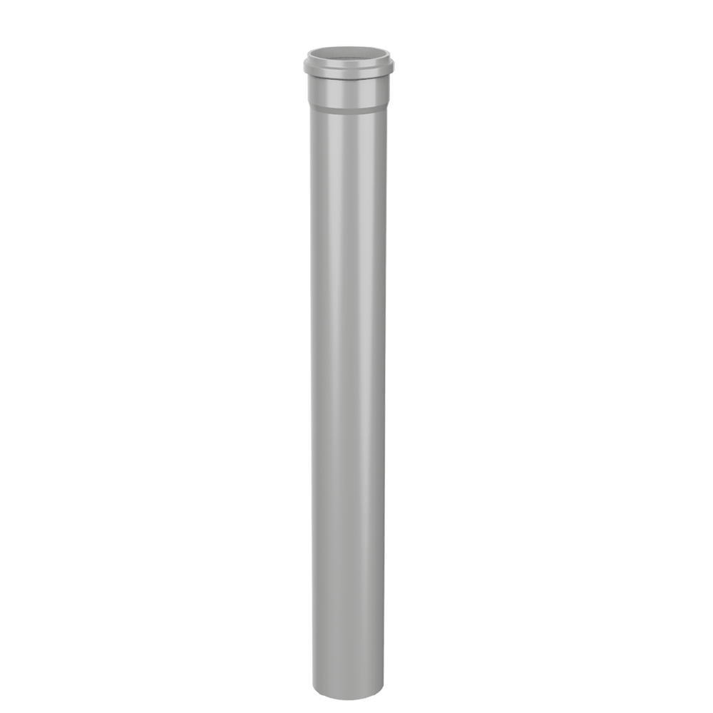
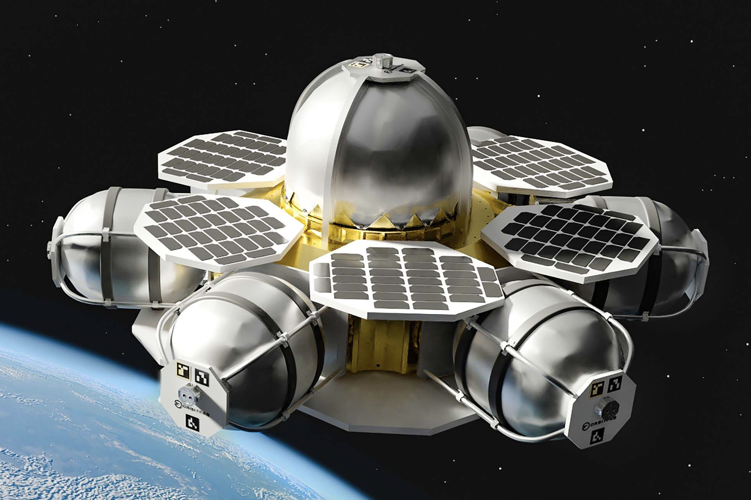
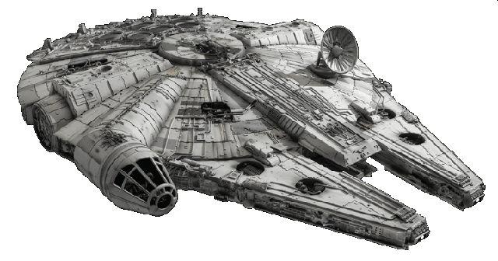
Jason Goldstein
Concept Generation Tactics
Biomimicry
Crap Shoot
Morphological Chart
1
A
A
B
C
1
1
1
2
B
2
2
2
3
C
3
3
3
4
D
5
E
Department of Mechanical Engineering
45

Slide 46
Lauren Roche
Terminology
Seals​
Insulation
MLI
SOFI
Double vacuum wall
Encapsulated O-ring
Teflon Seal
Locks
Valves
Force held
Collet Lock
Double poppet valve
Department of Mechanical Engineering
46

Slide 47
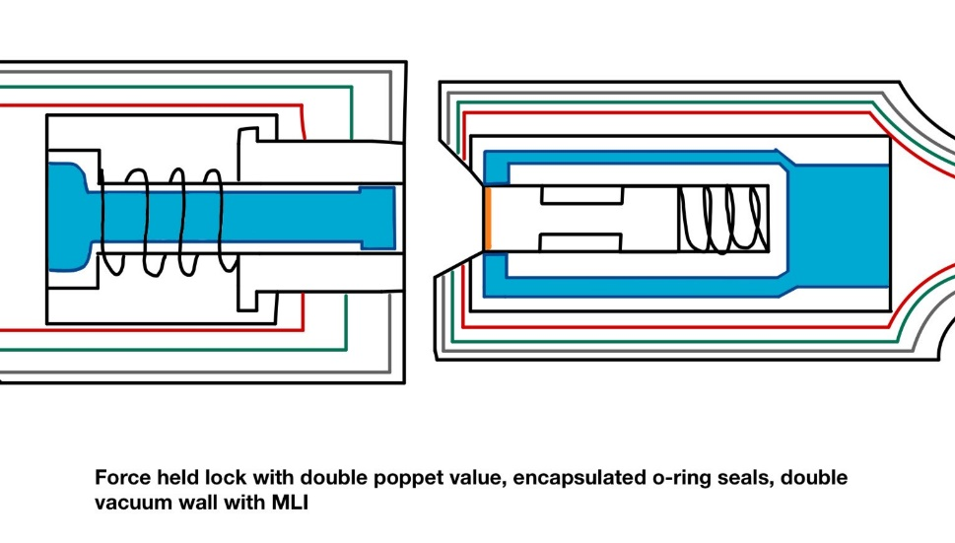
Lauren Roche
High Fidelity Concepts
Concept #33
Force held double poppet actuator, sealed with encapsulated O-rings, insulated by a double vacuum wall structure and Multi-Layered Insulation
Department of Mechanical Engineering
47

Slide 48
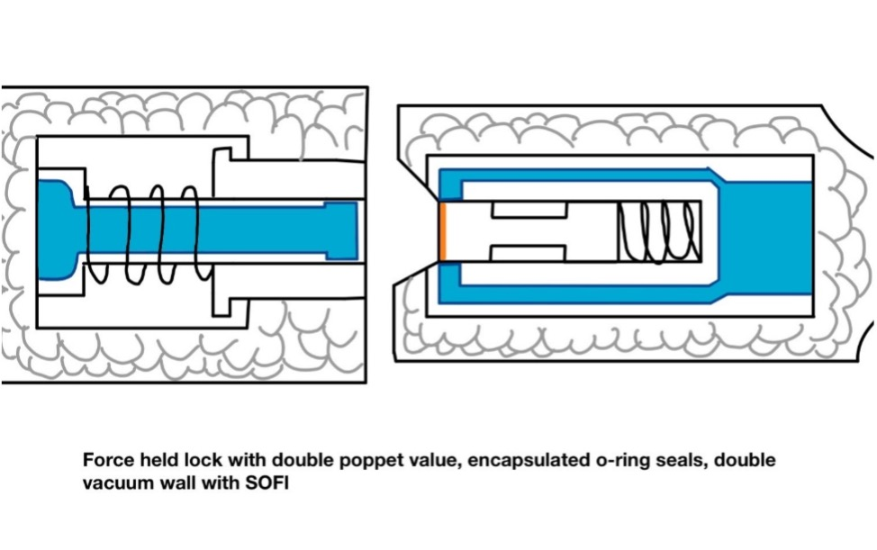
Lauren Roche
High Fidelity Concepts
Concept #98
Force held double poppet actuator, sealed with encapsulated O-rings, insulated by a double vacuum wall structure and Spray-On Foam Insulation (SOFI)
Department of Mechanical Engineering
48

Slide 49
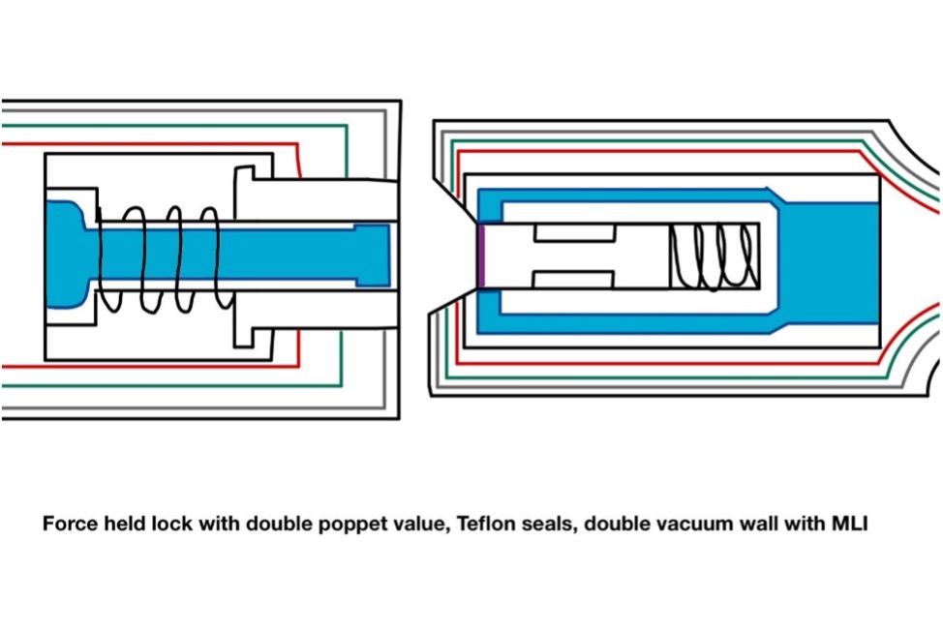
Nicolas Sgammato
High Fidelity Concepts
Concept #100
Force held double poppet actuator, sealed with Teflon, insulated by a double vacuum wall structure and Multi-Layered Insulation (MLI)
Department of Mechanical Engineering
49

Slide 50
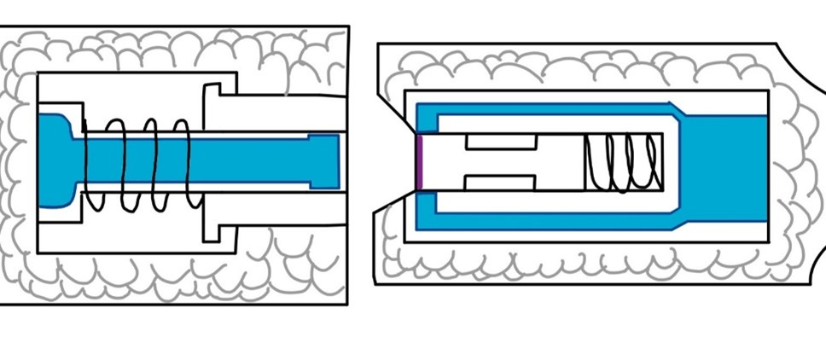
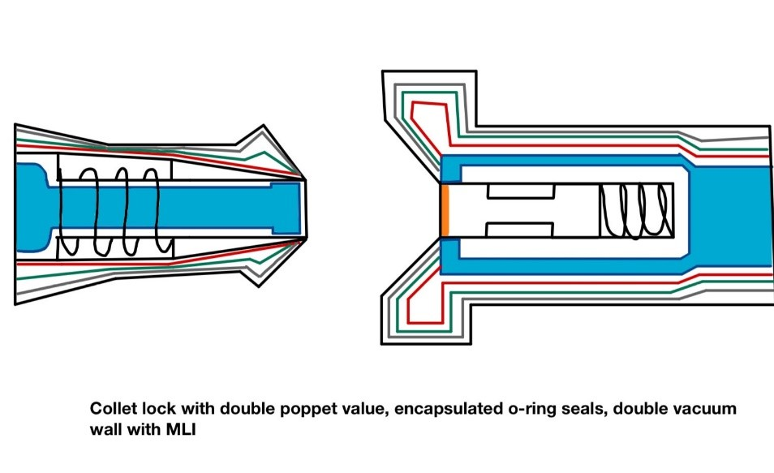
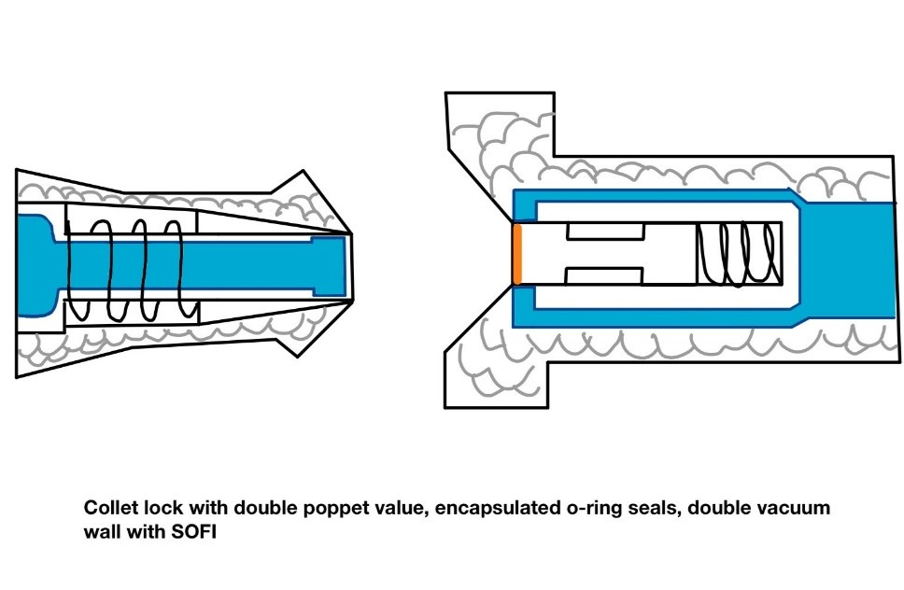
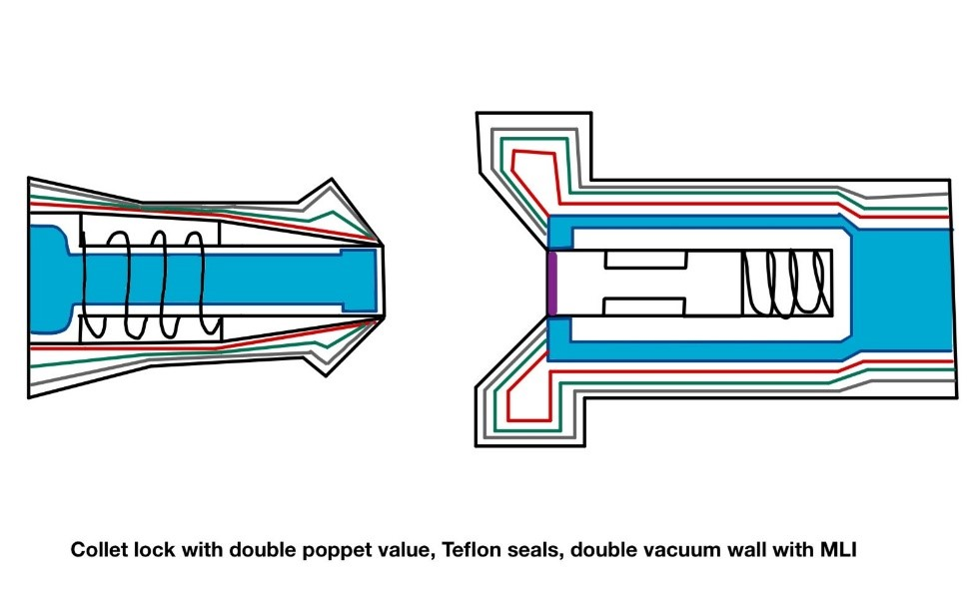
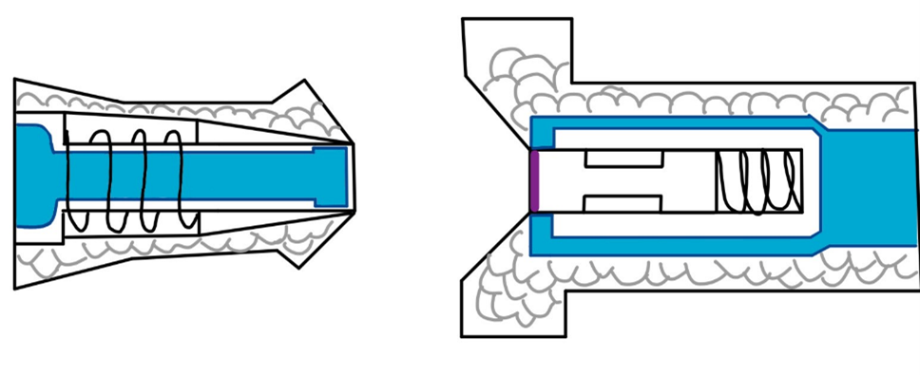
Nicolas Sgammato
Medium Fidelity Concepts
#99
#82
#81
#80
#79
Department of Mechanical Engineering
50

Slide 51

Nicolas Sgammato
Medium Fidelity Concepts
Force held lock
Double vacuum & SOFI
#99
Double Poppet
Teflon Seals
Department of Mechanical Engineering
51

Slide 52
Jason Goldstein
Medium Fidelity Concepts
Double vacuum & MLI
#82
Double Poppet
Collet lock
Encapsulated Seals
Department of Mechanical Engineering
52

Slide 53
Jason Goldstein
Medium Fidelity Concepts
Double vacuum & SOFI
#81
Double Poppet
Collet Lock
Encapsulated Seals
Department of Mechanical Engineering
53

Slide 54
Jason Goldstein
Pugh Charts- Second Iteration
Selection Criteria
Leakage
Lifetime
Seal
Resilience
Size
Cost
-
S
-
-
S
+
Concept #100
Force held double poppet actuator, sealed with Teflon, insulated by a double vacuum wall structure and Multi-Layered Insulation (MLI)
Datum: Concept #33
Department of Mechanical Engineering
54

Slide 55
Terminology
Seals​
Encapsulated O-ring seal​
Teflon Seal
Insulation
MLI
SOFI
Double vacuum wall
Locks
Force held
Collet Lock
Valves
Double poppet valve
Department of Mechanical Engineering
55

Slide 56
Name
Top Concepts
Force held lock with double poppet valve, encapsulated seals, double vacuum and MLI (multi-layered insulation)
Force held lock with double poppet valve, encapsulated seals, double vacuum and SOFI (spray-on foam insulation)
Collet lock with double poppet valve, encapsulated seals, double vacuum and MLI
Collet lock with double poppet valve, encapsulated seal, double vacuum and SOFI
Department of Mechanical Engineering
56

Slide 57
Nicolas Sgammato
Pugh Charts- Second Iteration
Selection Criteria
Leakage
Lifetime
Seal
Resilience
Size
Cost
S
-
S
-
+
+
Concept #98
Force held double poppet actuator, sealed with encapsulated O-rings, insulated by a double vacuum wall structure and Spray-On Foam Insulation (SOFI)
Datum: Concept #33
Department of Mechanical Engineering
57

Slide 58
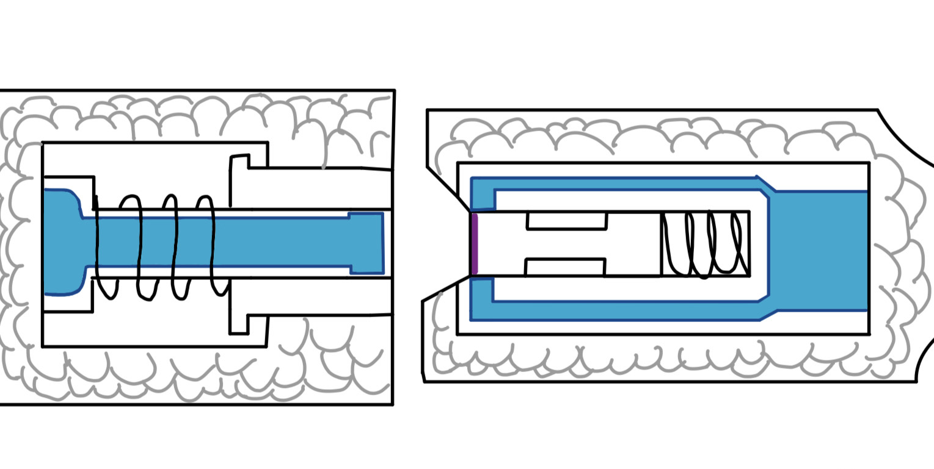
Jason Goldstein
Pugh Charts- Second Iteration
Selection Criteria
Leakage
Lifetime
Seal
Resilience
Size
Cost
-
-
-
-
+
+
Concept #99
Force held double poppet actuator, sealed with Teflon, double vacuum wall structure and Spray-On Foam Insulation (SOFI)
Datum: Concept #33
Department of Mechanical Engineering
58

Slide 59
Jason Goldstein
Analytical Hierarchy Process
Concept #33
Alternative Value:
1.032
Concept #98
Alternative Value:
0.466
Concept #100
Alternative Value:
0.632
Department of Mechanical Engineering
59

Slide 60
Nicolas Sgammato
Targets and Metrics
Fuel Leakage Heat Transfer Coupler Connection Structure Integrity
Fuel Leakage Rate from Flowmeter
Interior Temperature from Thermocouple
Connection Force from Transducer
Material Yielding from Tensile Test
Department of Mechanical Engineering
60

Slide 61
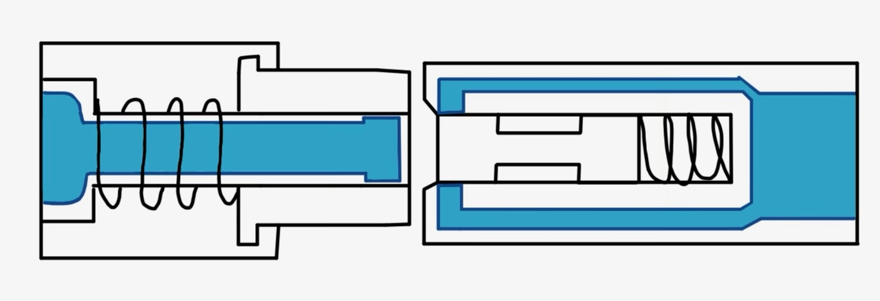
#33:
Encapsulated
O-ring seals and MLI
High Fidelity Concepts
#48:
Force held double – poppet actuator with double vacuum wall insulation structure paired with:
#50
Department of Mechanical Engineering
61

Slide 62
Jason Goldstein
Medium Fidelity Concepts
Double-poppet valve and double vacuum wall
#49 | Force-held lock Teflon seals SOFI
#32 | Collet lock encapsulated O-ring seals MLI
#31 | Collet lock encapsulated O-ring seals SOFI
#30 | Collet lock Teflon seals MLI
Department of Mechanical Engineering
62

Slide 63
Jason Goldstein
Medium Fidelity Concepts
Double vacuum & MLI
#80
Double Poppet
Collet Lock
Teflon Seals
Department of Mechanical Engineering
63

Slide 64
Lauren Roche
Medium Fidelity Concepts
Double vacuum & SOFI
#79
Double Poppet
Collet Lock
Teflon Seals
Department of Mechanical Engineering
64

Slide 65
Lauren Roche
Concept Selection
Binary Pairwise Comparison
House of Quality
Pugh Charts
Analytical Hierarchy Process
Final Selection
Department of Mechanical Engineering
65

Slide 66
Lauren Roche
Binary Pairwise Comparison
Compares Customer Needs to Each Other to Determine Relative Importance
Customer Needs | Score
Fluid Loss Prevention | 6
Active Seal | 6
Maintains Pressure | 6
Effective Coupling | 6
Heat Transfer Protection | 5
Particulate Mitigation | 4
Life-Span | 3
Cost | 3
Sizing Parameters | 3
Material Resilience | 2
Reusability | 1
Department of Mechanical Engineering
66

Slide 67
Jason Goldstein
Structural Integrity
Measured using Tensile Testing on Selected Material
Safe Range was Chosen Due to Material Not Yet Being Selected
Plastic Deformation of Chosen Material:
≤ 5%
Department of Mechanical Engineering
67

Slide 68
Nicolas Sgammato
House of Quality
Customer Requirements
Life-span
Fluid Loss
Active Seal
Material Resilience
Reusability
Maintains Pressure
Effective Coupling
Heat Transfer
Particulate Mitigation
Channel Sizing Parameters
Cost
Ranked Engineering Characteristics
1. Fuel Leakage
2. Seal
3. Heat Transfer
4. Durability
5. Weight
6. Cost
Department of Mechanical Engineering
68

Slide 69
Nicolas Sgammato
Pugh Charts- First Iteration
Selection Criteria
Leakage
Lifetime
Seal
Resilience
Size
Cost
#82
#81
#80
#33
#98
#100
#99
-2
-2
-2
1
1
1
1
Datum: NASA Low Separation Force Quick Disconnect
Department of Mechanical Engineering
69

Slide 70
Nicolas Sgammato
Medium Fidelity Concepts
#49
Force held double poppet actuator, sealed with Teflon, double vacuum wall structure and Spray-On Foam Insulation (SOFI)
Department of Mechanical Engineering
70

Slide 71
Nicolas Sgammato
Medium Fidelity Concepts
#32
Double poppet actuator with collet lock, sealed with encapsulated O-rings, double vacuum wall structure and Multi-Layer Insulation (MLI)
Department of Mechanical Engineering
71

Slide 72
Jason Goldstein
Medium Fidelity Concepts
#31
Collet locked double poppet actuator, sealed with encapsulated O-rings, double vacuum wall structure and Spray-On Foam Insulation
Department of Mechanical Engineering
72

Slide 73
Jason Goldstein
Medium Fidelity Concepts
#30
Double poppet-actuator with collet lock, Teflon seals, double vacuum wall structure and Multi-Layer Insulation
Department of Mechanical Engineering
73

Slide 74
Jason Goldstein
Medium Fidelity Concepts
#29
Double poppet-actuator with collet lock, Teflon seals, double vacuum wall structure and Spray on Foam Insulation
Department of Mechanical Engineering
74

Slide 75
High Fidelity Concepts
Concept #33
Concept #48
Concept #50
Department of Mechanical Engineering
75

Slide 76
Lauren Roche
High Fidelity Concepts
Force-held lock with double-poppet valve
and double vacuum wall
#33 | Encapsulated O-ring seals MLI
#48 | Encapsulated O-ring seals SOFI
#50 | Teflon seals MLI
Department of Mechanical Engineering
76

Slide 77
Nicolas Sgammato
Final Concept Selection
Force-held lock with double-poppet valve
and double vacuum wall
#33 | encapsulated O-ring seals MLI
Department of Mechanical Engineering
77

Slide 78
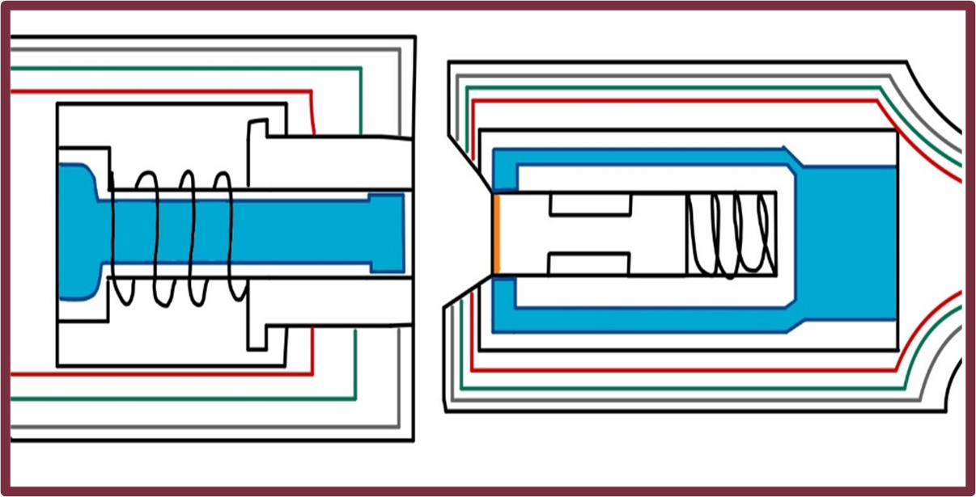
Fall Design
Double poppet actuator and force held lock, seal with encapsulated seals, insulated by double vacuum wall and Multi-Layer Insulation (MLI) blanket

Slide 79
Lauren Roche
Final Concept Selection
Concept #33: Double poppet actuator and force held lock, seal with encapsulated seals, insulated by double vacuum wall and Multi-Layer Insulation (MLI) blanket
Department of Mechanical Engineering
79

Slide 80
Lauren Roche
Concept #33
Department of Mechanical Engineering
80

Slide 81
Lauren Roche
Concept #33
Department of Mechanical Engineering
81

Slide 82
Lauren Roche
Concept #33
Department of Mechanical Engineering
82

Slide 83
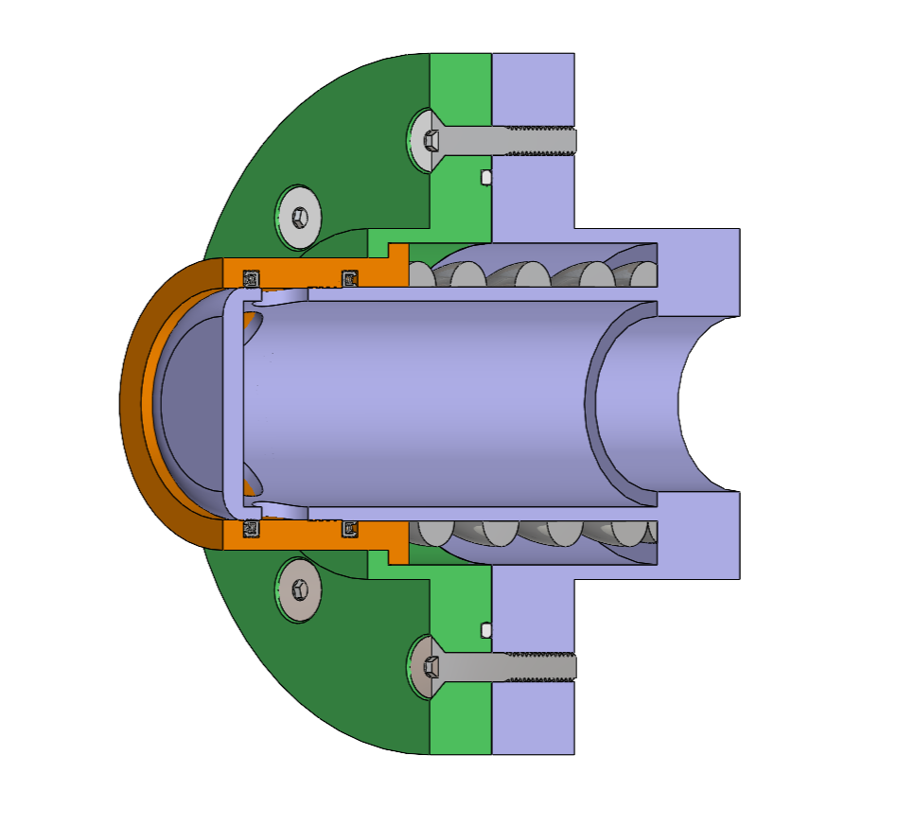
Probe Half
Sean Rodney
Static PTFE O-Rings
Actuator
Spring-Energized PTFE Seals
Stainless Steel Spring
Department of Mechanical Engineering
83

Slide 84
Sponsor Updates:
Sean Rodney
Insulation negligible for testing
SOFI: Smooth Exterior for future implementation
Flow rate should be low enough during fueling for pressure drop to be negligible.
Lubricant: Dry-film lube
Assume pressure in tanks is equalized.
Department of Mechanical Engineering
84

Slide 85
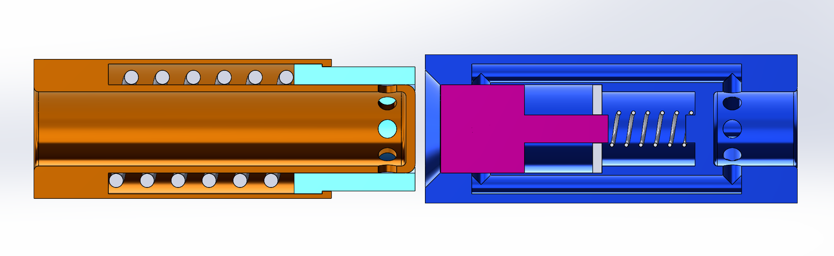
Fall Design
Valerie Rodriguez
Double-poppet actuator​
Force-held
lock
F
Encapsulated seals
Department of Mechanical Engineering
85

Slide 86
Initial Design Flaws
Valerie Rodriguez
Department of Mechanical Engineering
86

Slide 87
Valerie Rodriguez
Flow Channel Misalignment and Size
Insertion Relief Port
Difficult Seal Location and Manufacturing
Department of Mechanical Engineering
87

Slide 88
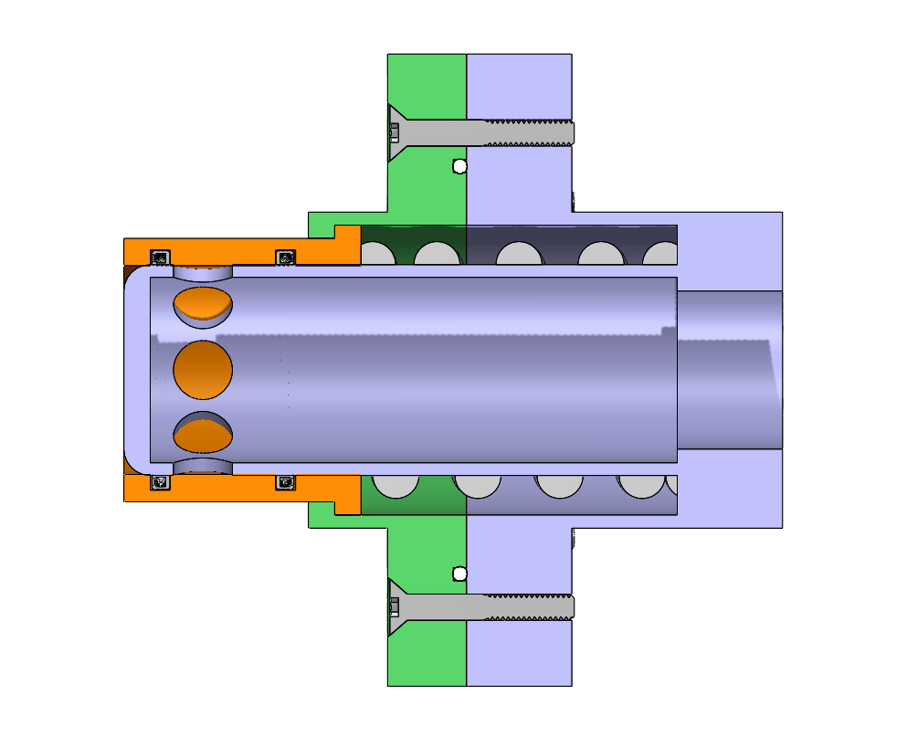
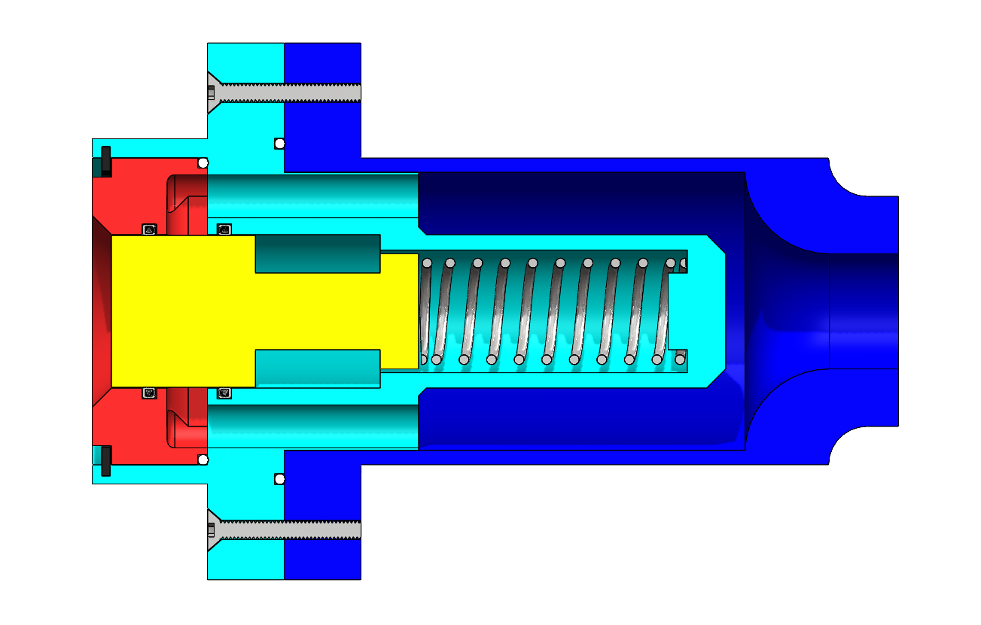
Updated Design
Sean Rodney
Department of Mechanical Engineering
88

Slide 89
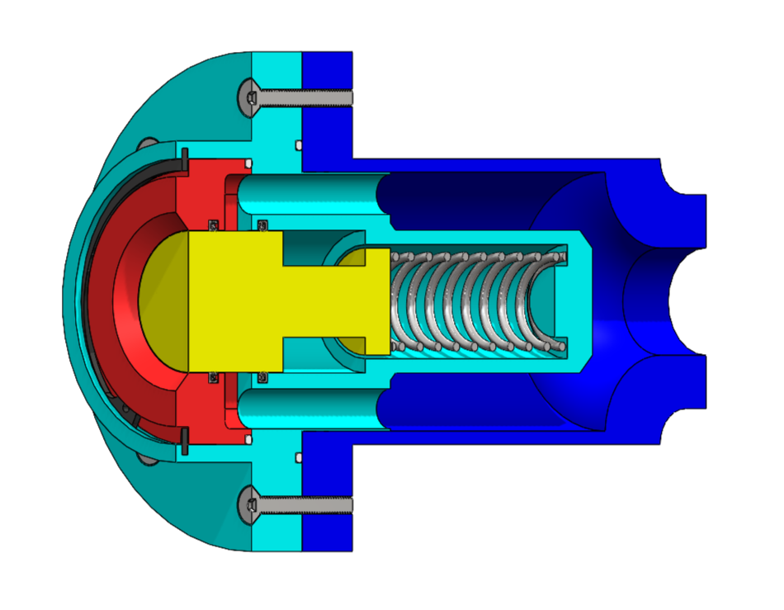
Receiving Half
Sean Rodney
Static PTFE O-Rings
Stainless Steel Spring
Actuator
Spring-Energized PTFE Seals
Department of Mechanical Engineering
89

Slide 90
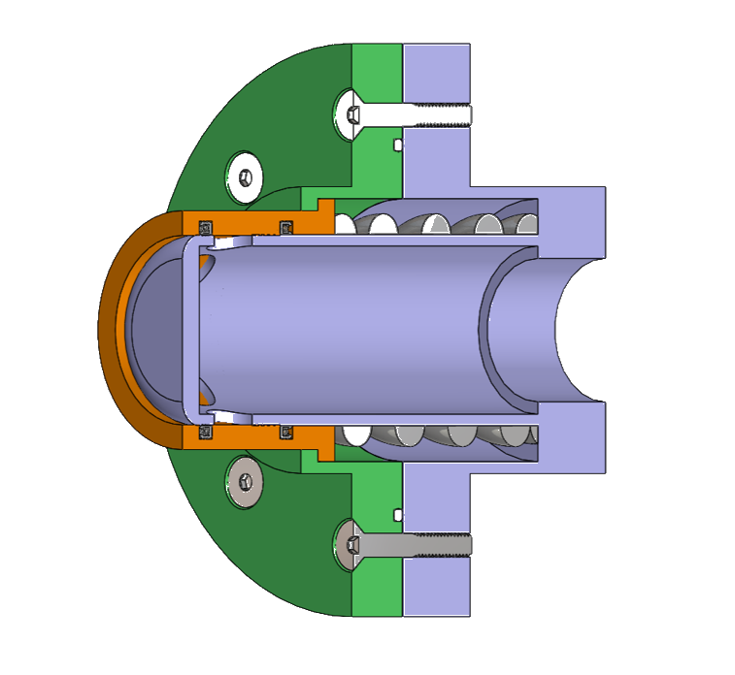
Sean Rodney
Static PTFE O-Rings
Actuator
Spring-Energized PTFE Seals
Stainless Steel Spring
Department of Mechanical Engineering
90

Slide 91
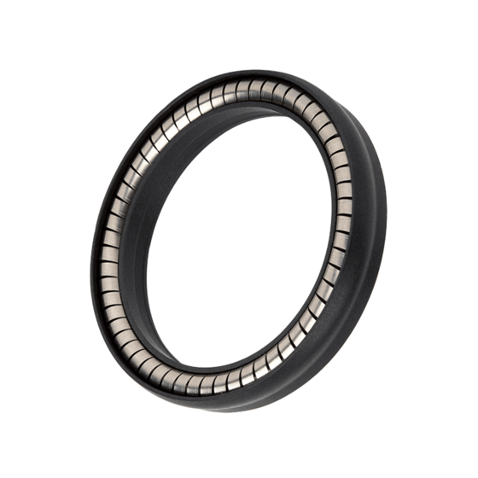
Updated Sealing
Sean Rodney
Spring-energized seal
Implements a circular spring to exert outward pressure
Encapsulated by PTFE (Teflon) due to excellent performance in cryogenic applications
Seals translating cylindrical bodies
Static and low speed applications
103A Omniseal​®
Note: Image for illustrative purposes only: The depicted seal is for stylization and a similar seal from McMaster-Carr will be implemented.
Department of Mechanical Engineering
91

Slide 92
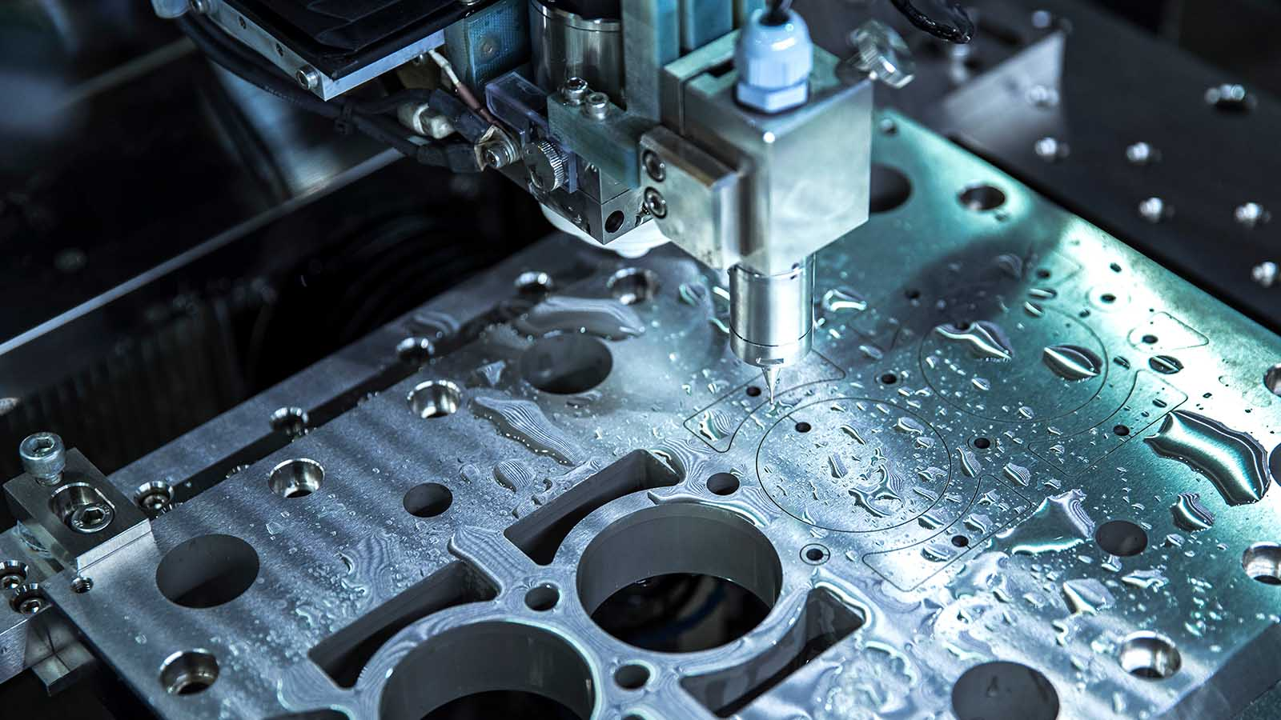
Manufacturing
Sean Rodney
Main components of probe and receiver will be CNC machined by the FAMU-FSU COE machine shop
Springs and seals will be ready to install from the manufacturer
Assembly of the coupler will be completed by the design team
Department of Mechanical Engineering
92

Slide 93
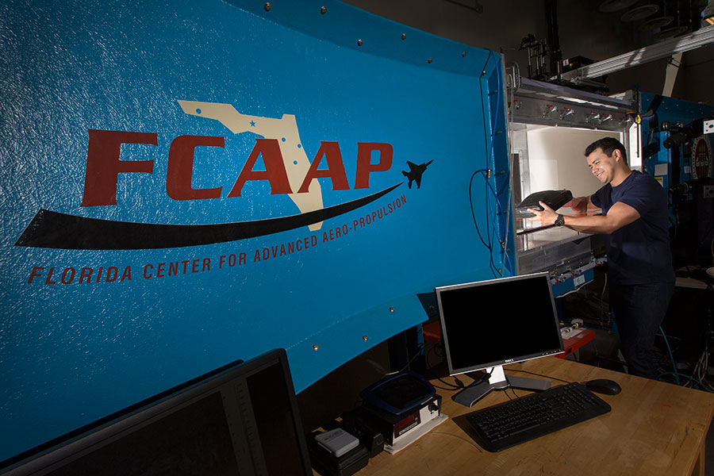
Sean Rodney
Testing
Cryogenic
Flow Rate
Leakage
Durability
Status:
In Progress
Status:
Approved
Status:
Pending Approval
Status:
Approved
Department of Mechanical Engineering
93

Slide 94



Leakage Testing
Sean Rodney
Identify design conflicts/areas of improvement
Calculate leakage rates and use Nasa environment correction factors to obtain target rates
Apply calculated rates and developed solutions to improve design before cryogenic testing
Department of Mechanical Engineering
94

Slide 95

Cryogenic Testing
Sean Rodney
Initiation of NHMFL
on-boarding and training
KF fitting for compatibility with NHMFL equipment
Material-safety check with Dr. Wei Guo
Department of Mechanical Engineering
95

Slide 96
Flow Rate Testing
Valerie Rodriguez
PIV testing will be conducted at the Florida Center For Advanced Aero-Propulsions
(FCAAP)
Particle Imaging Velocimetry will be used to analyze the flow inside the coupler
The design is to be sliced and placed in the low-speed wind tunnel to test flow rates
Department of Mechanical Engineering
96

Slide 97
Durability Testing
Valerie Rodriguez
Durability must be tested to identify any possible vulnerabilities in the design
The parts will be brushed with paint and tested at different forces
Leakage test will be preformed again to check for cracks and if design is reusable
The paint will chip away exposing areas experiencing the most force
Department of Mechanical Engineering
97

Slide 98
Testing
Validation
Valerie Rodriguez
External leakage: Less than 50 SCIM liquid nitrogen at 5 and 50 psig internal pressure
Leakage
Cryogenic
Internal leakage: Less than 500 SCIM liquid nitrogen at 15 and 50 psid while demated
Stainless steel springs can endure at least 10 N of force to keep tightly sealed connection
The valve can endure minimum 80 K temperatures
Flow Rate
Less than 5% plastic deformation
Durability
Department of Mechanical Engineering
98

Slide 99
Testing
Validation
Valerie Rodriguez
External leakage: Less than 50 SCIM liquid nitrogen at 5 and 50 psig internal pressure
Leakage
Cryogenic
Internal leakage: Less than 500 SCIM liquid nitrogen at 15 and 50 psid while demated
Stainless steel springs can endure at least 10 N of force to keep tightly sealed connection
The valve can endure minimum 80 K temperatures
Flow Rate
Less than 5% plastic deformation
Durability
Department of Mechanical Engineering
99

Slide 100
This is 10-point
This is 15–point Times
This is 20–point
This is 25–point
This is 30–point
This is 35–point
This is 40–point
This is 50–point
This is 60–point
This is 72–point
Notes:
Use at least 20-point font in Room A105, B134, and B136
Use at least 25-point font in Room B135

Slide 101
College of Engineering Color Palette
1 2 3 4
Pantone: PMS 195 C
RGB: 120, 47, 64
Hex: #782F40
CMYK:19, 90, 50, 55
1 2 3 4
Pantone: Black C
RGB: 0, 0, 0
Hex: #000000
CMYK:0, 0, 0, 100
Garnet
Black
1 2 3 4
RGB: 238, 118, 36
Hex: #EE7624
CMYK:2, 66, 99, 0
1 2 3 4
Pantone: PMS 000C
RGB: 255, 255, 255
Hex: #FFFFFF
CMYK: 0, 0, 0, 0
Fang
Orange
White
Notes:
Avoid 75% Black in B135

Slide 102
Accent Color Palette
1 2 3 4
RGB: 0, 59, 111
Hex: #003B6F
CMYK:
1 2 3 4
RGB: 0, 59, 111
Hex: #003B6F
CMYK:
1 2 3 4
RGB: 251, 236, 93
Hex: #FBEC5D
CMYK:
1 2 3 4
RGB: 219, 215, 210
Hex: #DBD7D2
CMYK:
1 2 3 4
RGB: 251, 236, 93
Hex: #FBEC5D
CMYK:
1 2 3 4
RGB: 219, 215, 210
Hex: #DBD7D2
CMYK:
Tardis Blue
Tardis Blue
Corn
Timberwolf
Corn
Timberwolf
1 2 3 4
RGB: 206, 0, 88
Hex: #CE0058
CMYK: 0, 100, 43, 12
1 2 3 4
RGB: 206, 0, 88
Hex: #CE0058
CMYK: 0, 100, 43, 12
1 2 3 4
RGB: 104, 40, 96
Hex: #682860
CMYK:
1 2 3 4
RGB: 220, 220, 220
Hex: #DCDCDC
CMYK:
Rubine Red
Rubine Red
Imperial
Gainsboro
1 2 3 4
RGB: 72, 146, 155
Hex: #48929b
CMYK:
1 2 3 4
RGB: 64, 224, 208
Hex: #40E0D0
CMYK:
1 2 3 4
RGB: 255, 139, 0
Hex: #FF8B00
CMYK:
Asagi-iro
Turquoise
American Orange
Notes:
Remove American orange add hyperlink grey
Make corn the last for b135
All work in 134 imperial move later
Tardis doesn’t work in b136

Slide 103
F7AB19
D67F15
EE7624
D64615
F73119
Analogous
https://color.adobe.com/create/color-wheel
6E3610
F0A16C
EE7624
6E4931
BASB1C
Monochromatic
A14508
4BED3B
EE7624
250CED
2010A1
Triad
A1470C
FF8C40
EE7624
0098A1
24E2ED
Complementary
28A164
2FED8D
EE7624
0848A1
1871ED
Split Complementary
EDAC2F
3BED93
EE7624
0C6AED
ED2F18
Double Split Complementary
ED660C
C7ED3B
EE7624
0CE1ED
A418ED
Square
BA7E09
87724A
EE7624
60EFCF
09BA61
Compound
AD551A
6E3610
EE7624
FA7625
D46820
Shades
Notes:
These are the variants that work well with Fang Orange. The bolded items show well on the projectors.

Slide 104
85412D
8F3831
782f40
8F3176
792D85
Analogous
https://color.adobe.com/create/color-wheel
C44D69
8E626D
782F40
C48796
451B25
Monochromatic
C43959
78743B
782F40
236178
43A2C4
Triad
C43959
C46078
782F40
25C43D
2F783A
Complementary
93C460
577835
782F40
39C49D
297861
Split Complementary
784435
5A783B
782F40
237860
6E2978
Double Split Complementary
782337
78683b
782F40
237830
293978
Square
AB4D32
DEBAAF
782F40
5D8555
70AB32
Compound
38161E
C44D69
782F40
853447
5E2532
Shades

Slide 105
A105
A105
B135 Stage Left
B135 Stage Right
B136
B134, A105
B135

Slide 111
Team 520: NASA-MSFC Actively Sealed Cryogenic Coupler
Virtual Design Review 4
Jason Goldstein, Lauren Roche, Sean Rodney,
Valerie Rodriguez, Nicolas Sgammato

