Slide 1
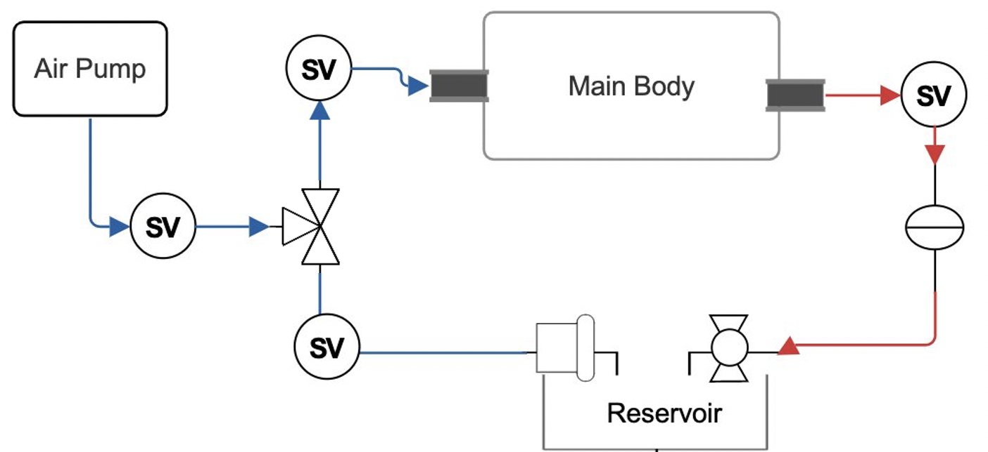
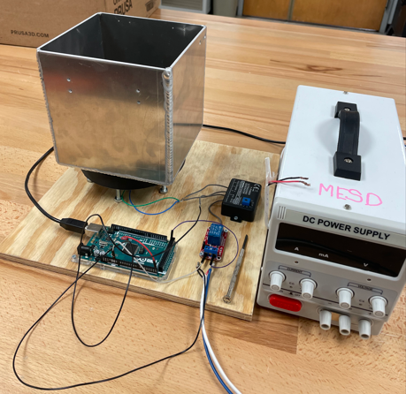
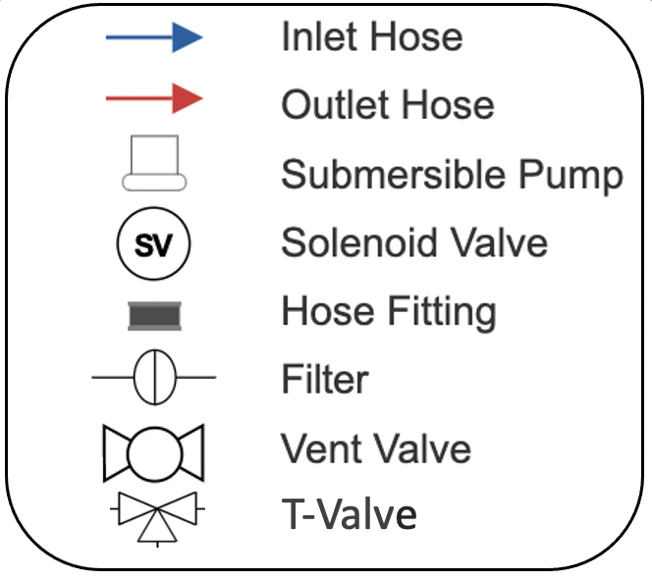
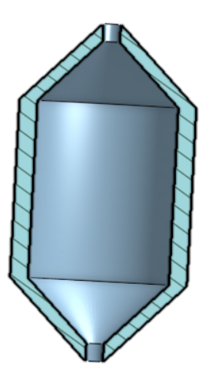
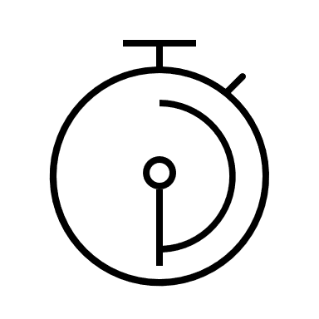
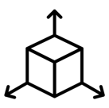
Powder Removal in Microgravity Environments
Team 518: Cole Daly, Kyle Evans, Alexander Fryer, Chelsea Kiselewski, Tripp Lappalainen, Lauren McNealy
Sponsor: Justin McElderry Academic Advisor: Shayne McConomy Ph.D
Objective
Current State of Design
Plumbing Diagram
r
`
The objective of this project is to develop a cleaning method for removing powder residue from additive manufactured parts in microgravity environments.
Sonic Wave Cleaner
Background
Powdered metals gets trapped in small crevices in parts and needs to be cleaned.
Testing Specimen
Powder residue in microgravity
leads to hazardous air and
combustion.
How it Works
Additive manufacturing creates unique parts that can be used in the aerospace industry.​
​
Powder residue in microgravity can be hazardous.​
Particle size 40 µm
Part designed for testing, printed out of nylon.
SLM is 40 microns, nylon is 40 microns or smaller.
1
The dirty part is placed into a mesh basket inside main body.
Key Targets
2
Cleaning fluid is pumped into main body and ultrasonic sensors pulse the fluid at 40kHz.
Total Mass: 18-25 lbs
3
Future Work
Run Time: 15-20 min per cycle
The fluid is spun to ensure that the debris remains off the part.
Finish the assembly
Test the machine
Volume of debris collection testing
Resolve issues found from testing
Debris Collected: 85-90%
4
Air is pumped in the main body as the fluid is drained to combat the effects of microgravity.
$${ in}^{3}$$
Total Volume: 8in x 8in x 8in
Notes:
40 micrometers
Selective laser melting (SLM) enables the production of intricate aerospace components. Cleaning these parts is essential for user safety, but it is challenging due to their complexity.
Targets
Create a functional prototype show casing ultrasonic cleaning without leakage
Clean 90% of the powder off the part
Use less than a gallon o
f cleaner per part
The Sonic Wave Cleaner uses high-frequency vibrations to dislodge and remove particles from the part. First, sonic waves are pulsed underneath the fluid. The fluid is spun, creating vortices, then drained to keep the part clean. Inspiration for this concept stems from ultrasonic cleaning applications in automotive and jewelry industries.

