Slide 1


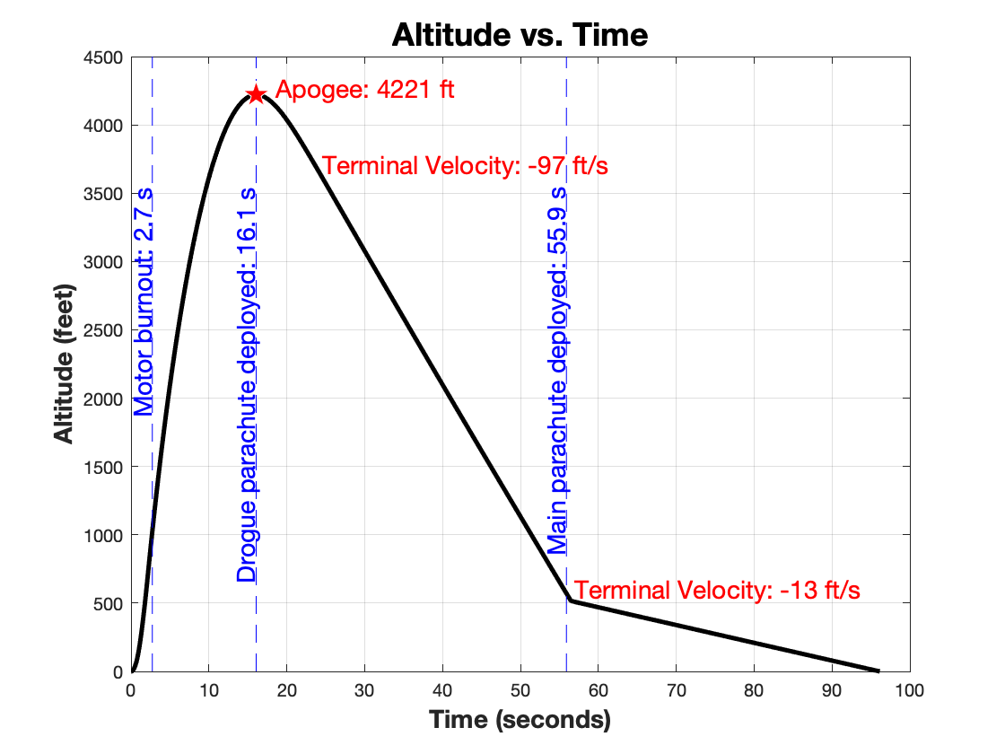
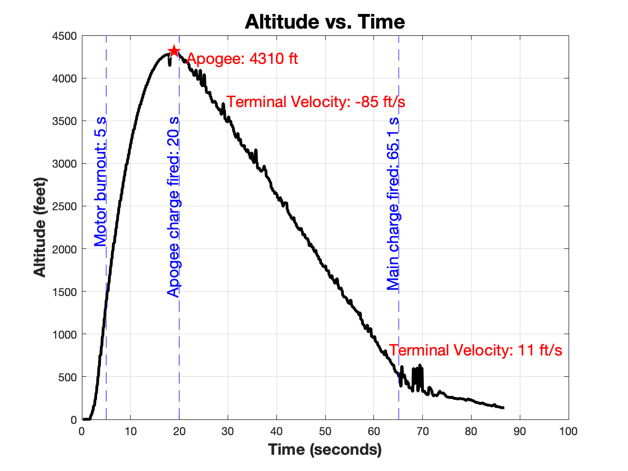
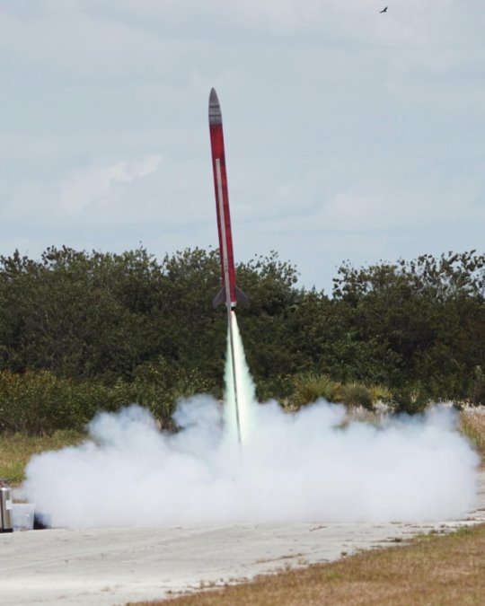
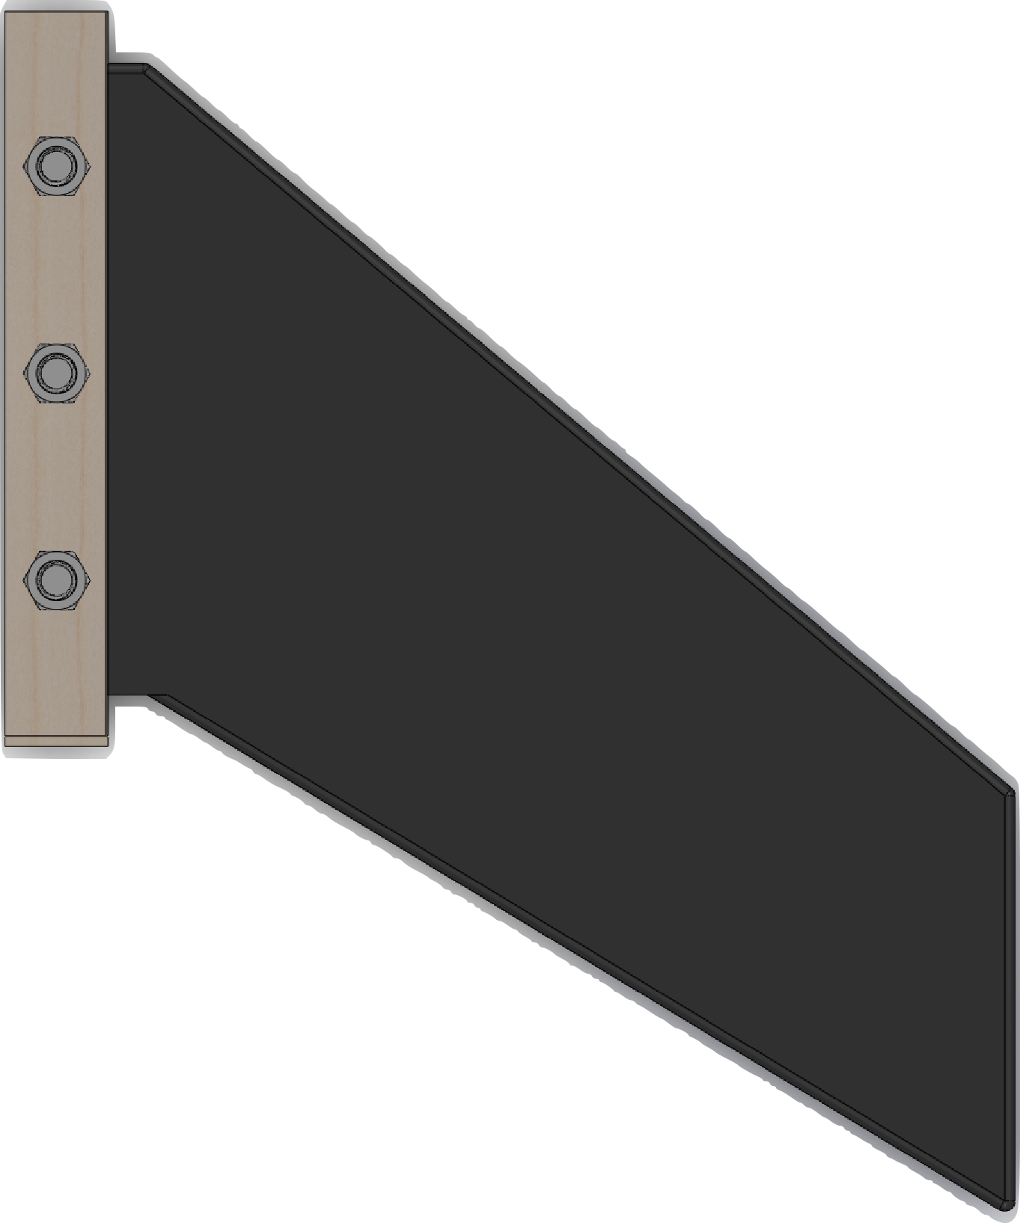
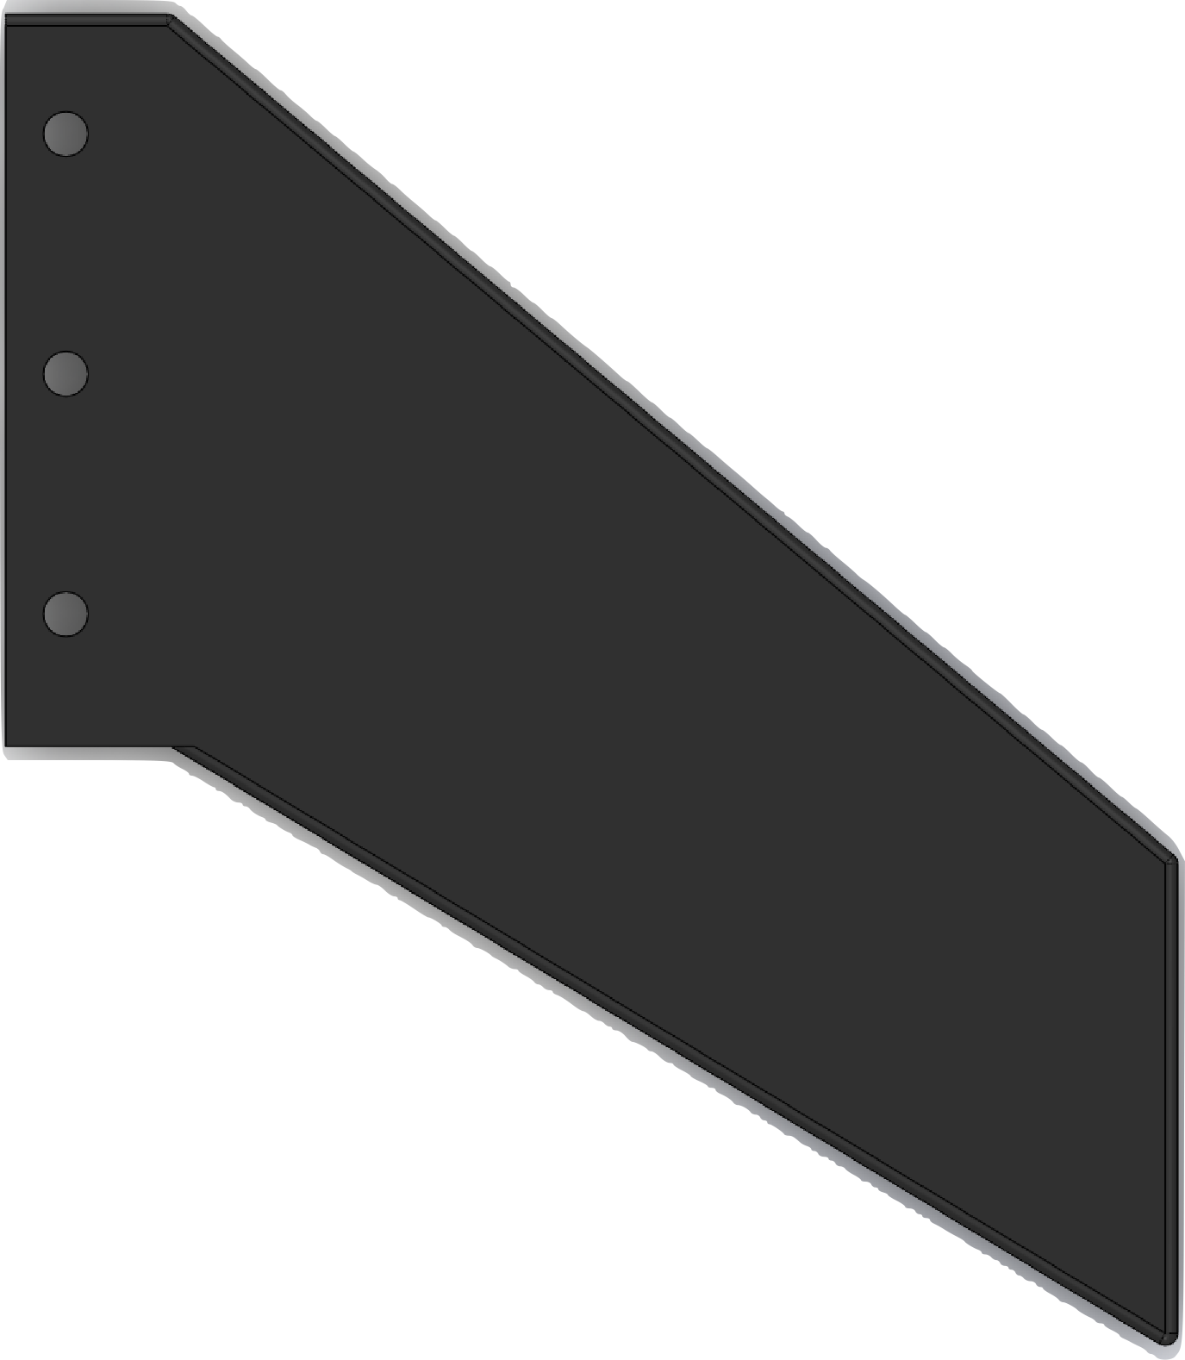
Team 502: NASA Student Launch Competition
Atzimba Avellaneda | Nicholas Hux | Jacob Miller | Jacob Schmitt | Connor Zhou
Objective
The objective of this project is to design, fabricate, and fly a high-powered rocket for competition in the 2024 NASA Student Launch. The vehicle will deliver a payload to a specified altitude and then be recovered safely.
Goals
Two-Stage Separation
The vehicle will deploy its recovery system in two stages. The drogue chute will be deployed at apogee to slow the vehicle for main chute deployment at 600ft.
Projected Flight Profile
Vehicle Design
Nose Cone Design
The shape is a long elliptical nose cone. This was selected because it is the best shape that minimizes drag. Bores were made so each piece fit accordingly.
Actual Flight Profile
Fin Design
The design is a 40˚ swept fin. They were configured using Open Rocket to optimize the stability margin and decrease drag.
Design Attributes
Long elliptical nose cone.
Conical tail cone.
Aerotech L2200-G solid propellant motor.
Stability margin: 4.16 cal.
Total mass: 55.9 lbs.
Thrust-to-weight ratio: 12.9.
Max velocity: Mach 0.53.
Apogee: 4,310 ft.
Simulation
The team has utilized a variety of different simulation software to ensure the vehicle has the greatest chance of success. OpenRocket was used for flight profile and stability simulations, while SolidWorks was used for FEA and CFD analysis.
Manufacturing
The nosecone and fins were manufactured using a SLS 3D printing method and are made from Nylon 12 powder. The airframe is pre-fabricated and made from a G12 fiberglass body tube. The centering rings and bulkheads are made from birch plywood, which was laser cut to meet design specifications. The machine shop fabricated the tail cone from aluminum 6061.
Demonstrate a successful sub-scale & full-scale flight.
Assemble and launch the vehicle at the official competition in Huntsville, Alabama.
Engage students to interact with STEM activities.
Complete all reports and ensure they are turned in before their due date or on their due date.
Conical Tail Cone
Long Elliptical Nose Cone
Avionics Bay
Main Chute/Payload Bay
Drogue Chute Bay

