Slide 1
PDR
2024 NASA Student Launch
FAMU-FSU College of Engineering

Slide 2
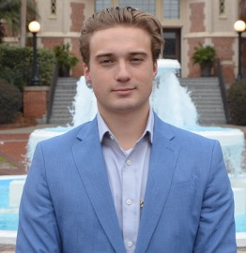
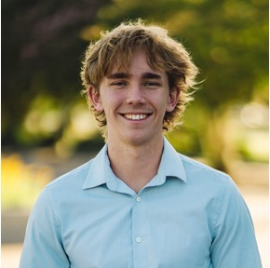
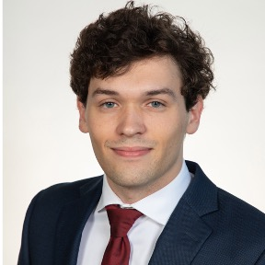
THE TEAM
Nicholas Hux
Jake Miller
Jacob Schmitt
Connor Zhou
Atzimba Avellaneda
Airframe Design
Lead
Avionics & Payload Lead
Team Lead
Recovery & Payload Lead
Fabrication
Lead

Slide 3
01
Vehicle Dimensions & Materials

Slide 4
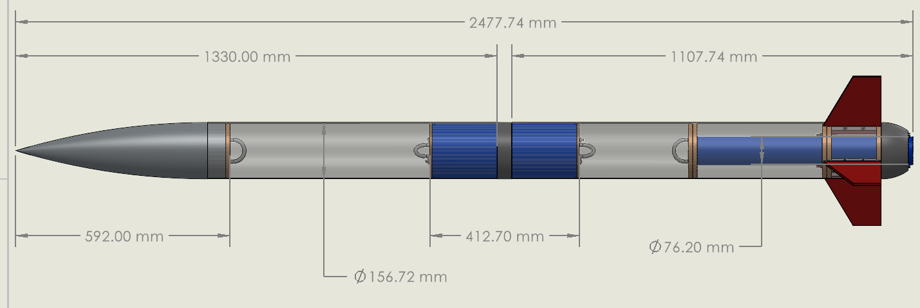
Vehicle Dimensions
Total Length – 97.55 in.
Mass – 33.45 lbs.

Slide 5
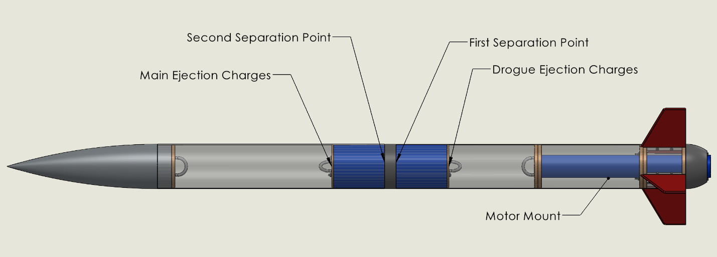
Vehicle Dimensions

Slide 6
Nosecone
Ogive shape
Low drag and enhance aerodynamics.
Effective at reducing intensity of shockwaves.
Reduces likelihood of turbulence and increases stability.
Simple shape to manufacture
Acrylonitrile Styrene Acrylate
UV, heat, impact, chemical resistance.
Ease of 3D printing.
Lower density.

Slide 7
Front End with Payload
Payload Housing
Main Chute Housing
G12 Fiberglass
High strength to weight ratio.
High heat, moisture, and impact resistance.
Smoothened surface.

Slide 8
Avionics Bay
Contents
Altimeters
CO2 Ejection charges
Black powder charges
Plywood bulkheads
High strength to weight ratio.
High heat, moisture, and impact resistance.
Smoothened surface.

Slide 9
Back End
Contents
Drogue
Solid Propellant Motor
Motor Casing
G12 Fiberglass
High strength to weight ratio.
High heat, moisture, and impact resistance.
Smoothened surface.
Plywood centering rings
High strength and durability.
Lightweight
Easy to work with.

Slide 10
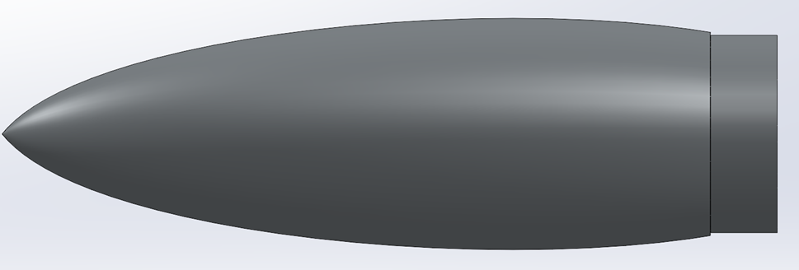
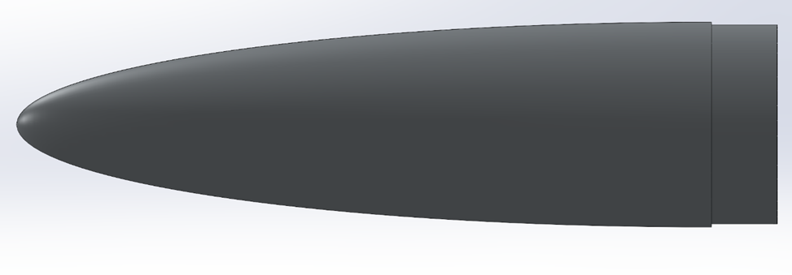
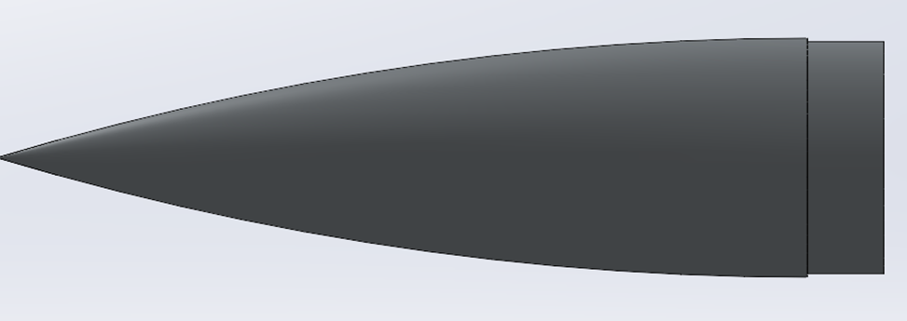
Nose Cone
Haack Series
Optimized to reduce drag, difficult to manufacture, mass efficient
Elliptical
Low drag, also difficult to manufacture
Ogive
Relatively easy to manufacture, not as mass efficient

Slide 11
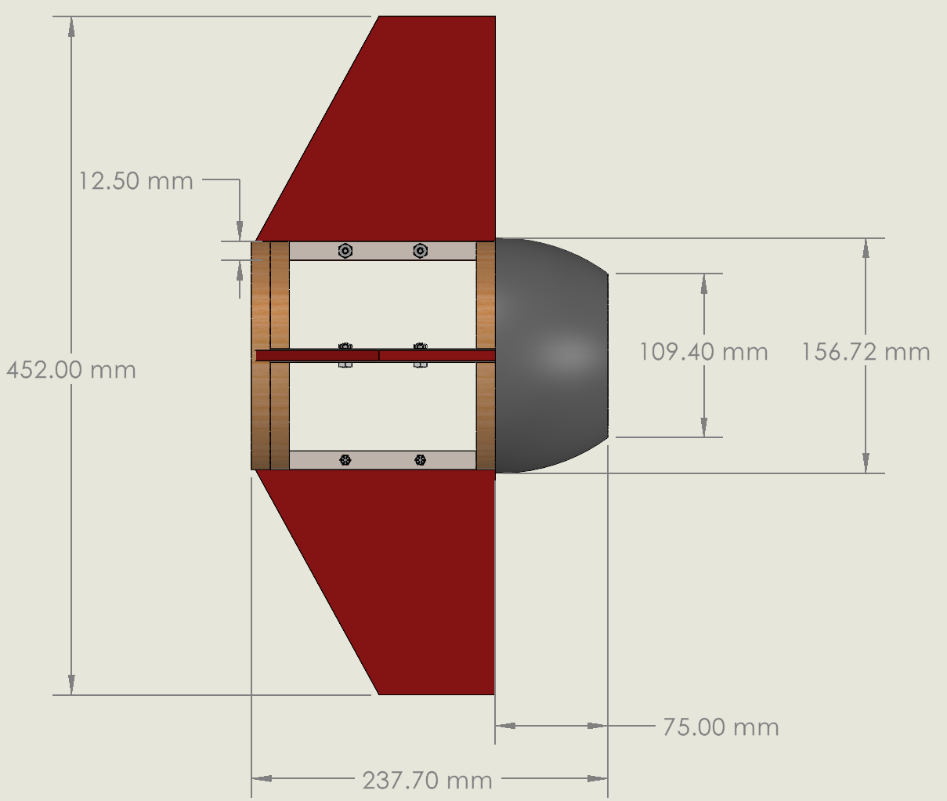
Thrust Structure/ Tail Cone
Aluminum plates provide support and easily mount the fins
Easy to assemble
Tail Cone combined into thrust structure
Parabolic Tail Cone
Assists in reducing vortices
Better flight stability
Mass efficient

Slide 12
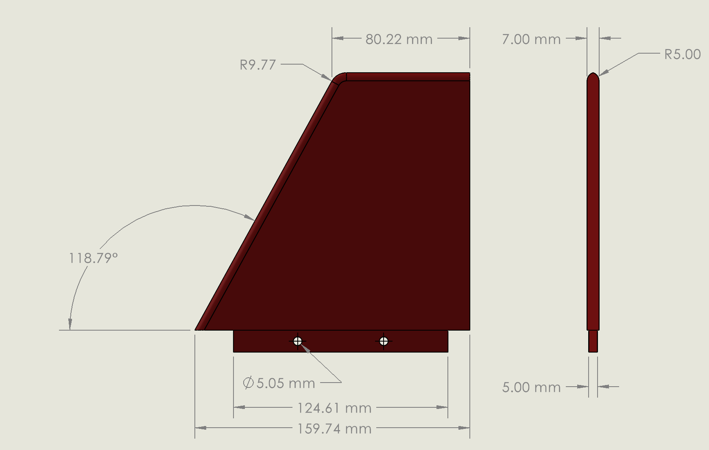
Fin Configuration
Clipped Delta fins utilized
Easy to manufacture
Cost efficient
Properly stabilize vehicle
Reduces drag loads
Optimized in Open Rocket
Fin Flutter
Max vehicle velocity 630 ft/s
Fin Flutter starts at around 900 ft/s
Equation used:
$k_{f}=a\sqrt{\frac{\frac{G}{1.337{AR}^{3}P(λ+1)}}{2(AR+2){(\frac{t}{c})}^{3}}}$

Slide 13
02
Stability, Pressure, & Gravity

Slide 14
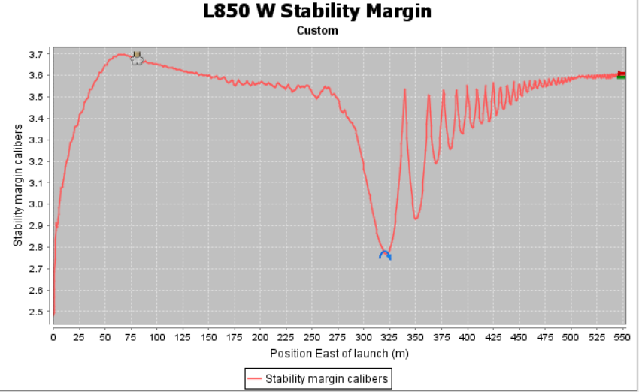
Stability, Pressure, & Gravity
Stability: 2.73 cal ​
CG: 138 cm from the nose tip​
CP: 181 cm from the nose tip​
Distance between CG and CP: 43 cm

Slide 15
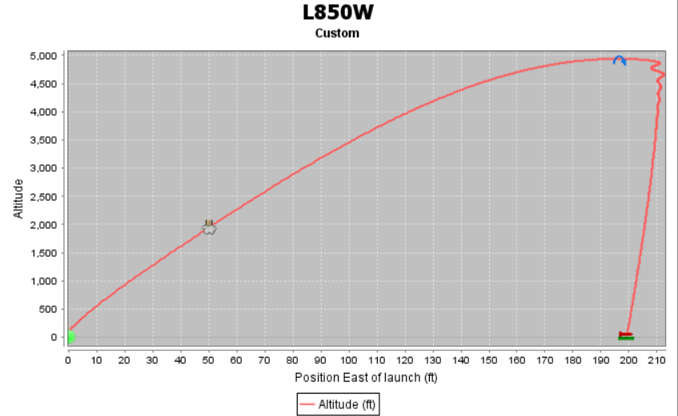
Apogee
Target Apogee is 4940 ft
Simulation with MATLAB code and OpenRocket

Slide 16
03
Separation

Slide 17
Separation
First separation stage will take place at apogee, deployment of drogue chute
Second separation stage will take place around 600ft, deployment of main chute.
Shear pins will hold rocket body parts together and shear apart upon CO2 ejection charge firing
Vehicle descends as 3 separate pieces conjoined by 2 parachutes

Slide 19
04
Motor Selection

Slide 20
AeroTech L850W
 | Value | Units
Apogee | 4940.945 | feet
Max. Velocity | 422.78 | miles per hour
Time to Apogee | 17.5 | seconds
Flight Time | 37.9 | seconds
Descent Time | 20.4 | seconds

Slide 21
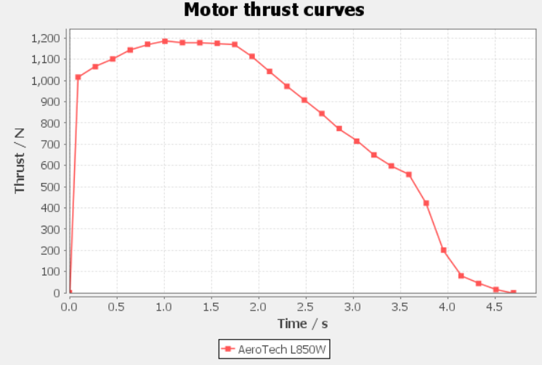

Slide 22
05
Thrust, Weight Rail Exit Velocity, Mission Performance

Slide 23
Thrust, weight, rail exit velocity, and more
Average thrust: 1000 N
Weight : 15kg * 9.81 m/s^2 = 147.15 N
T/F ratio = 6.8:1
Rail exit velocity: 36.4 ft/s
Max Velocity: 617 ft/s
Max Mach Number: 0.56
Max Kinetic Energy: 71.1 lbf-ft

Slide 24
06
Alternative Designs

Slide 25
Nosecone, Fins, & Tail Cone Alternatives
Acrylonitrile Styrene Acrylate (ASA)
Polyethylene Terephthalate Glycol (PETG)
Highly resistant
High strength and durability
Little difficulty printing
Less dense
Flexible, virtually unbreakable
Relatively high heat and chemical resistance
Little difficulty printing
More dense

Slide 26
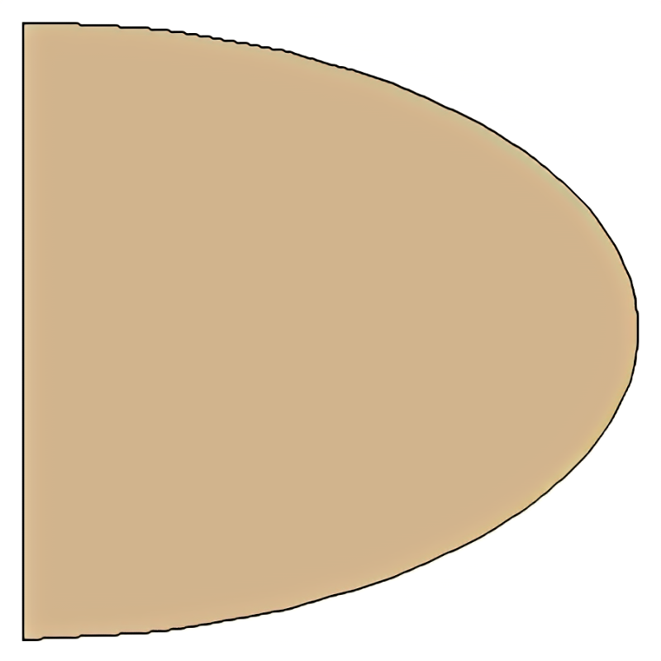
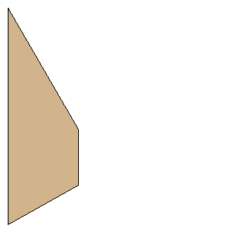
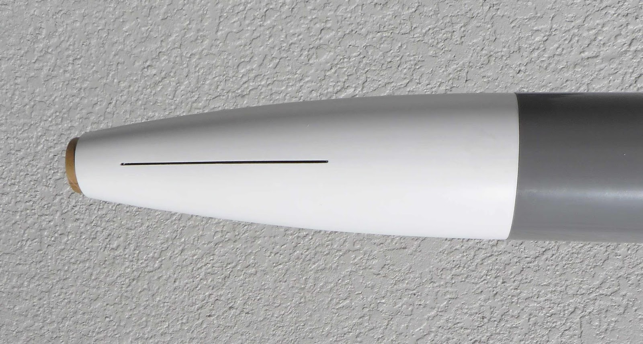
Fins, & Tail Cone Shape Alternatives
Fins
Tail Cone
Conical – very basic, not optimal
Elliptical – Difficult to manufacture
Elliptical – high velocity
Trapezoidal – easy to manufacture, decent stability

Slide 27
Airframe Alternatives
G12 Fiberglass
Blue Tube 2.0
Highly resistant
High strength and durability
Little difficulty printing
Less dense
Flexible, virtually unbreakable
Relatively high heat and chemical resistance
Little difficulty printing
More dense

Slide 28
Alternate Motors Considered
Motor | Manufacturer | Total Impulse (Ns) | Average Thrust (N) | Max Thrust (N) | Burn Time (s) | Weight (g)
L850W | Aerotech | 3,646.2 | 1,00.9 | 1,866.2 | 4.4 | 3,742
L1080BB | Animal Motor Works | 3,686 | 1,112 | 1258 | 3.31 | 3,592
L800-P | Cesaroni | 3731 | 805 | 1024 | 4.63 | 3,510

Slide 29
Altimeter Alternatives
 | TeleMega | TeleMetrum | Aim 3 | RRC3
Manufacturer | Altus Metrum | Altus Metrum | Entacore | Missile Works
Dimensions (L*W*H) (mm) | 88x32x16 | 27x70x16 | 65x25x15 | 100x23x4
Pyro Channels | 6 | 2 | 2 | 2
Field Output | Beeps, AltOS | Beeps, AltOS | Beeps | Beeps, LCD
Weight (g) | 24.95 | 20.13 | 12.81 | 17.01
Sampling Rate (Hz) | 100 | 100 | 10 | 20
Battery (V) | 3.7 | 3.7 | 3.7 | 3.7
Price | $508.85 | $381.63 | $121.15 | $101.33

Slide 30
Tracking Alternative
 | TeleGPS | GPS Tracker | EggTimer | AirTag
Manufacturer | Altus Metrum | Featherweight | TX Transmitter | Apple
Dimensions (L*W*H) (mm) | 38 x 25 x 6 | 31 x 20 x 3 | 23 x 76 x 6 | 32 x 32 x 8
Weight (g) | 12.3 | 15.0 | 12.0 | 11.0
Range (km) | 100 | 85 | 9 | N/A
Transmitter Frequency (MHz) | 433 | 915 | 900 | 13.56
Battery | 3.7 | 3.4 – 4.5 | 7.4 | 3
Price | $254.43 | $365 | $110 | $30

Slide 31
Drogue Alternatives
Drogue | Drag Coefficient | Projected Area (ft^2) | Descent Speed (ft/s) | Descent Time: Apogee to Main Deployment (s) | Wind Drift: Apogee to Main Deployment at 20-mph (ft)
Fruity Chute 15" Classic Elliptical | 1.5 | 1.178 | 117.434 | 37.391 | 1096.810
Fruity Chute 18" Classic Elliptical | 1.5 | 1.696 | 97.861 | 44.870 | 1316.185
Fruity Chute 24" Classic Elliptical | 1.5 | 3.016 | 73.397 | 59.826 | 1754.885
Fruity Chute 30" Classic Elliptical | 1.5 | 4.712 | 58.717 | 74.783 | 2193.619

Slide 32
Parachute Alternatives
Parachute | Drag Coefficient | Projected Area (ft^2) | Descent Speed (ft/s) | Descent Time from Main Deployment to Ground (s) | Wind Drift from Main Deployment to Ground at 20 MPH (ft) | Kinetic Energy of Heaviest Recovered Section (ft-lb)
Fruity Chute 60" Iris Ultra Standard | 2.2 | 19.027 | 24.129 | 22.794 | 668.632 | 139.363
Fruity Chute 72" Iris Ultra Standard | 2.2 | 27.399 | 20.107 | 27.353 | 802.359 | 96.779
Fruity Chute 84" Iris Ultra Standard | 2.2 | 37.292 | 17.235 | 31.912 | 936.085 | 71.103
Fruity Chute 96" Iris Ultra Standard | 2.2 | 48.708 | 15.081 | 36.471 | 1069.811 | 54.439

Slide 33
Payload Alternatives
Descent
Singlecopter
Quadcopter
Mechanical Lander
Gas Thruster

Slide 34
Payload Alternatives
Landing
Legs
Inflatables
Impalement

Slide 35
07
Subsystems

Slide 36
Subsystems
Avionics & Recovery
Payload
Flight computers, telemetry, stage separation
Payload design, fabrication, testing
Airframe
Airframe, nose cone, tail cone, fins, motor
Fabrication
Material selection, fabrication, tooling

Slide 37
08
Preliminary Payload Design

Slide 38
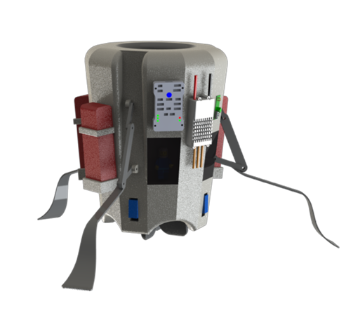
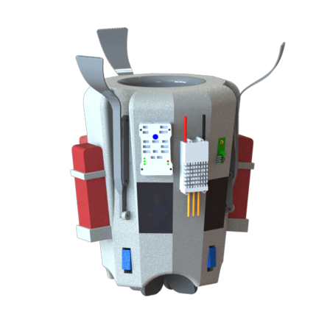
Autonomous Transit and Landing for Airdropped Singlecopter (ATLAS)
Systems
Descent
Control
Retention
Landing

Slide 39
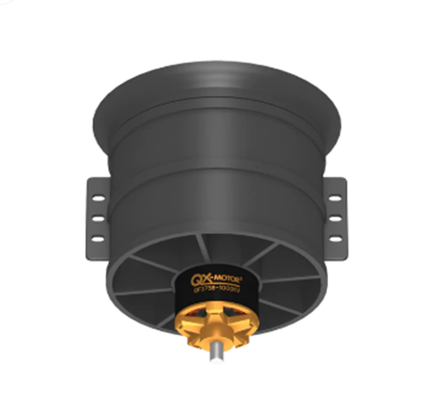
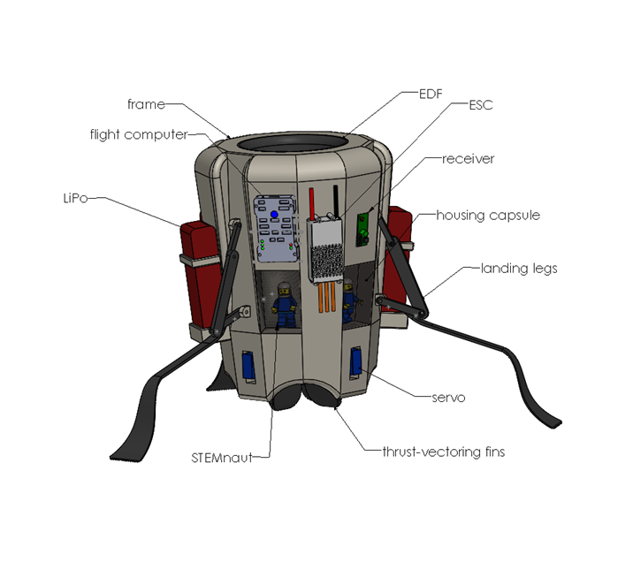
Descent
Uses an electric-powered ducted fan (EDF) to produce thrust
Up to 7lbs of thrust
Singlecopter design produces significant torque on the vehicle

Slide 40
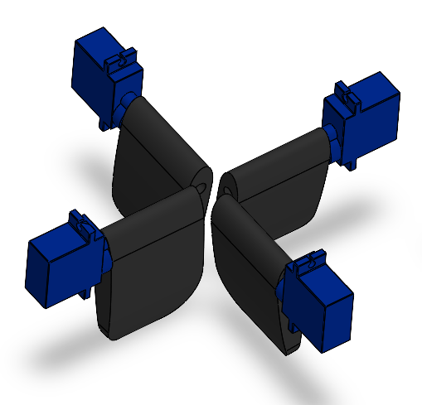
Control
Thrust vectoring fins to solve torque problem
Correct for environmental disturbances such as wind
Actuated by servos, which are controlled by flight computer
Compatibility with ArduPilot software

Slide 41
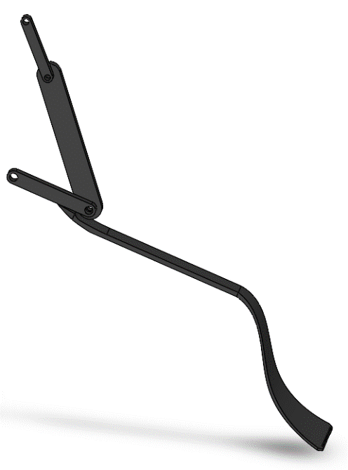
Landing
Four bar mechanism actuated by servos
Legs designed to maximize landing surface area
Absorbs energy from landing

Slide 42
Retention
STEMnauts retained in individual capsules spread throughout the vehicle
Distributes mass around the EDF
Payload retained in payload bay

Slide 43
Payload Mass Estimates
Component | Individual weight (g) | Quantity | Net Weight (g)
EDF/motor | 372 | 1 | 372
2S LiPo Batteries | 280 | 4 | 1120
ESC | 122 | 1 | 122
Receiver | 3 | 1 | 3
GPS | 12 | 1 | 12
Frame | 220 | 1 | 220
Servo | 9 | 7 | 63
Fin | 10 | 4 | 40
Leg Assembly | 80 | 3 | 240
Line Cutter | 22 | 1 | 22
Wire | 50 | 1 | 50
Tether | 5 | 1 | 5
STEMnaut | 3 | 4 | 12
TOTAL |  |  | 2,281.00

Slide 44
Requirements Compliance Plan
09

Slide 45
Requirements
Payload is 5 lbs
Stemnauts survive
Vehicle must follow the guidelines:
Apogee > 4000 ft and < 6000ft
Max velocity < M1

Slide 46
