Slide 1
Reversible Stemless Shoulder Implant
Team 102
03/05/24

Slide 2
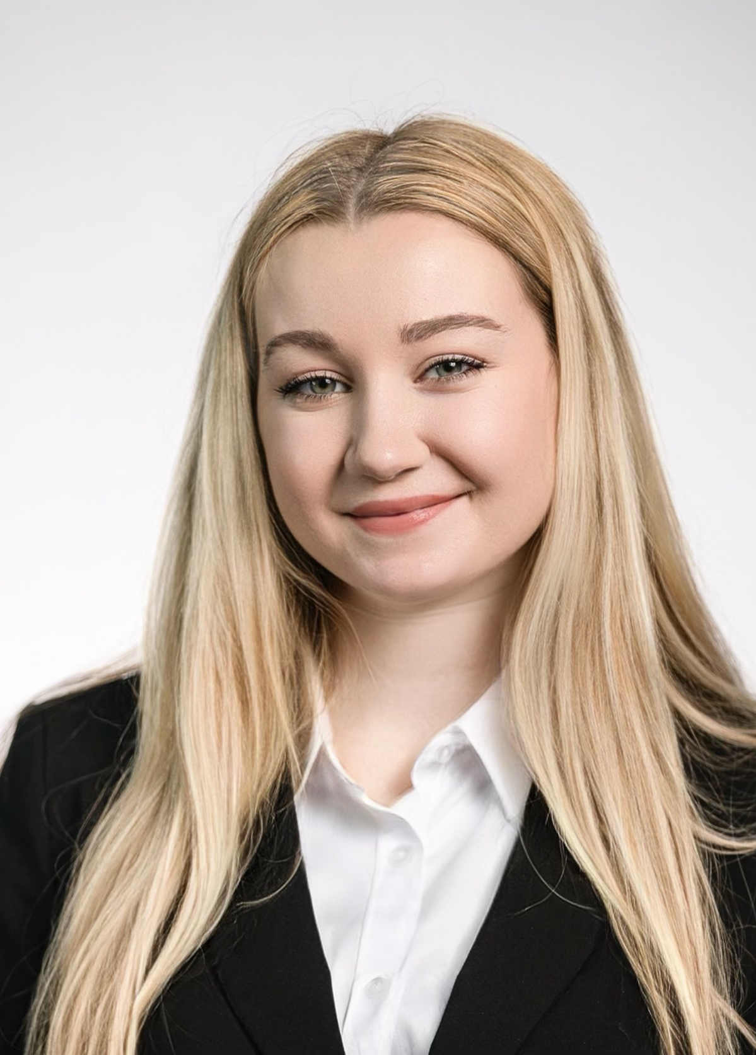
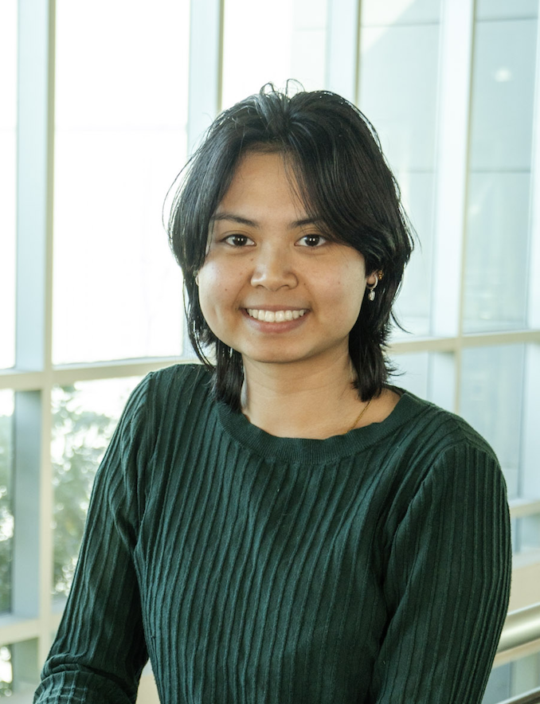
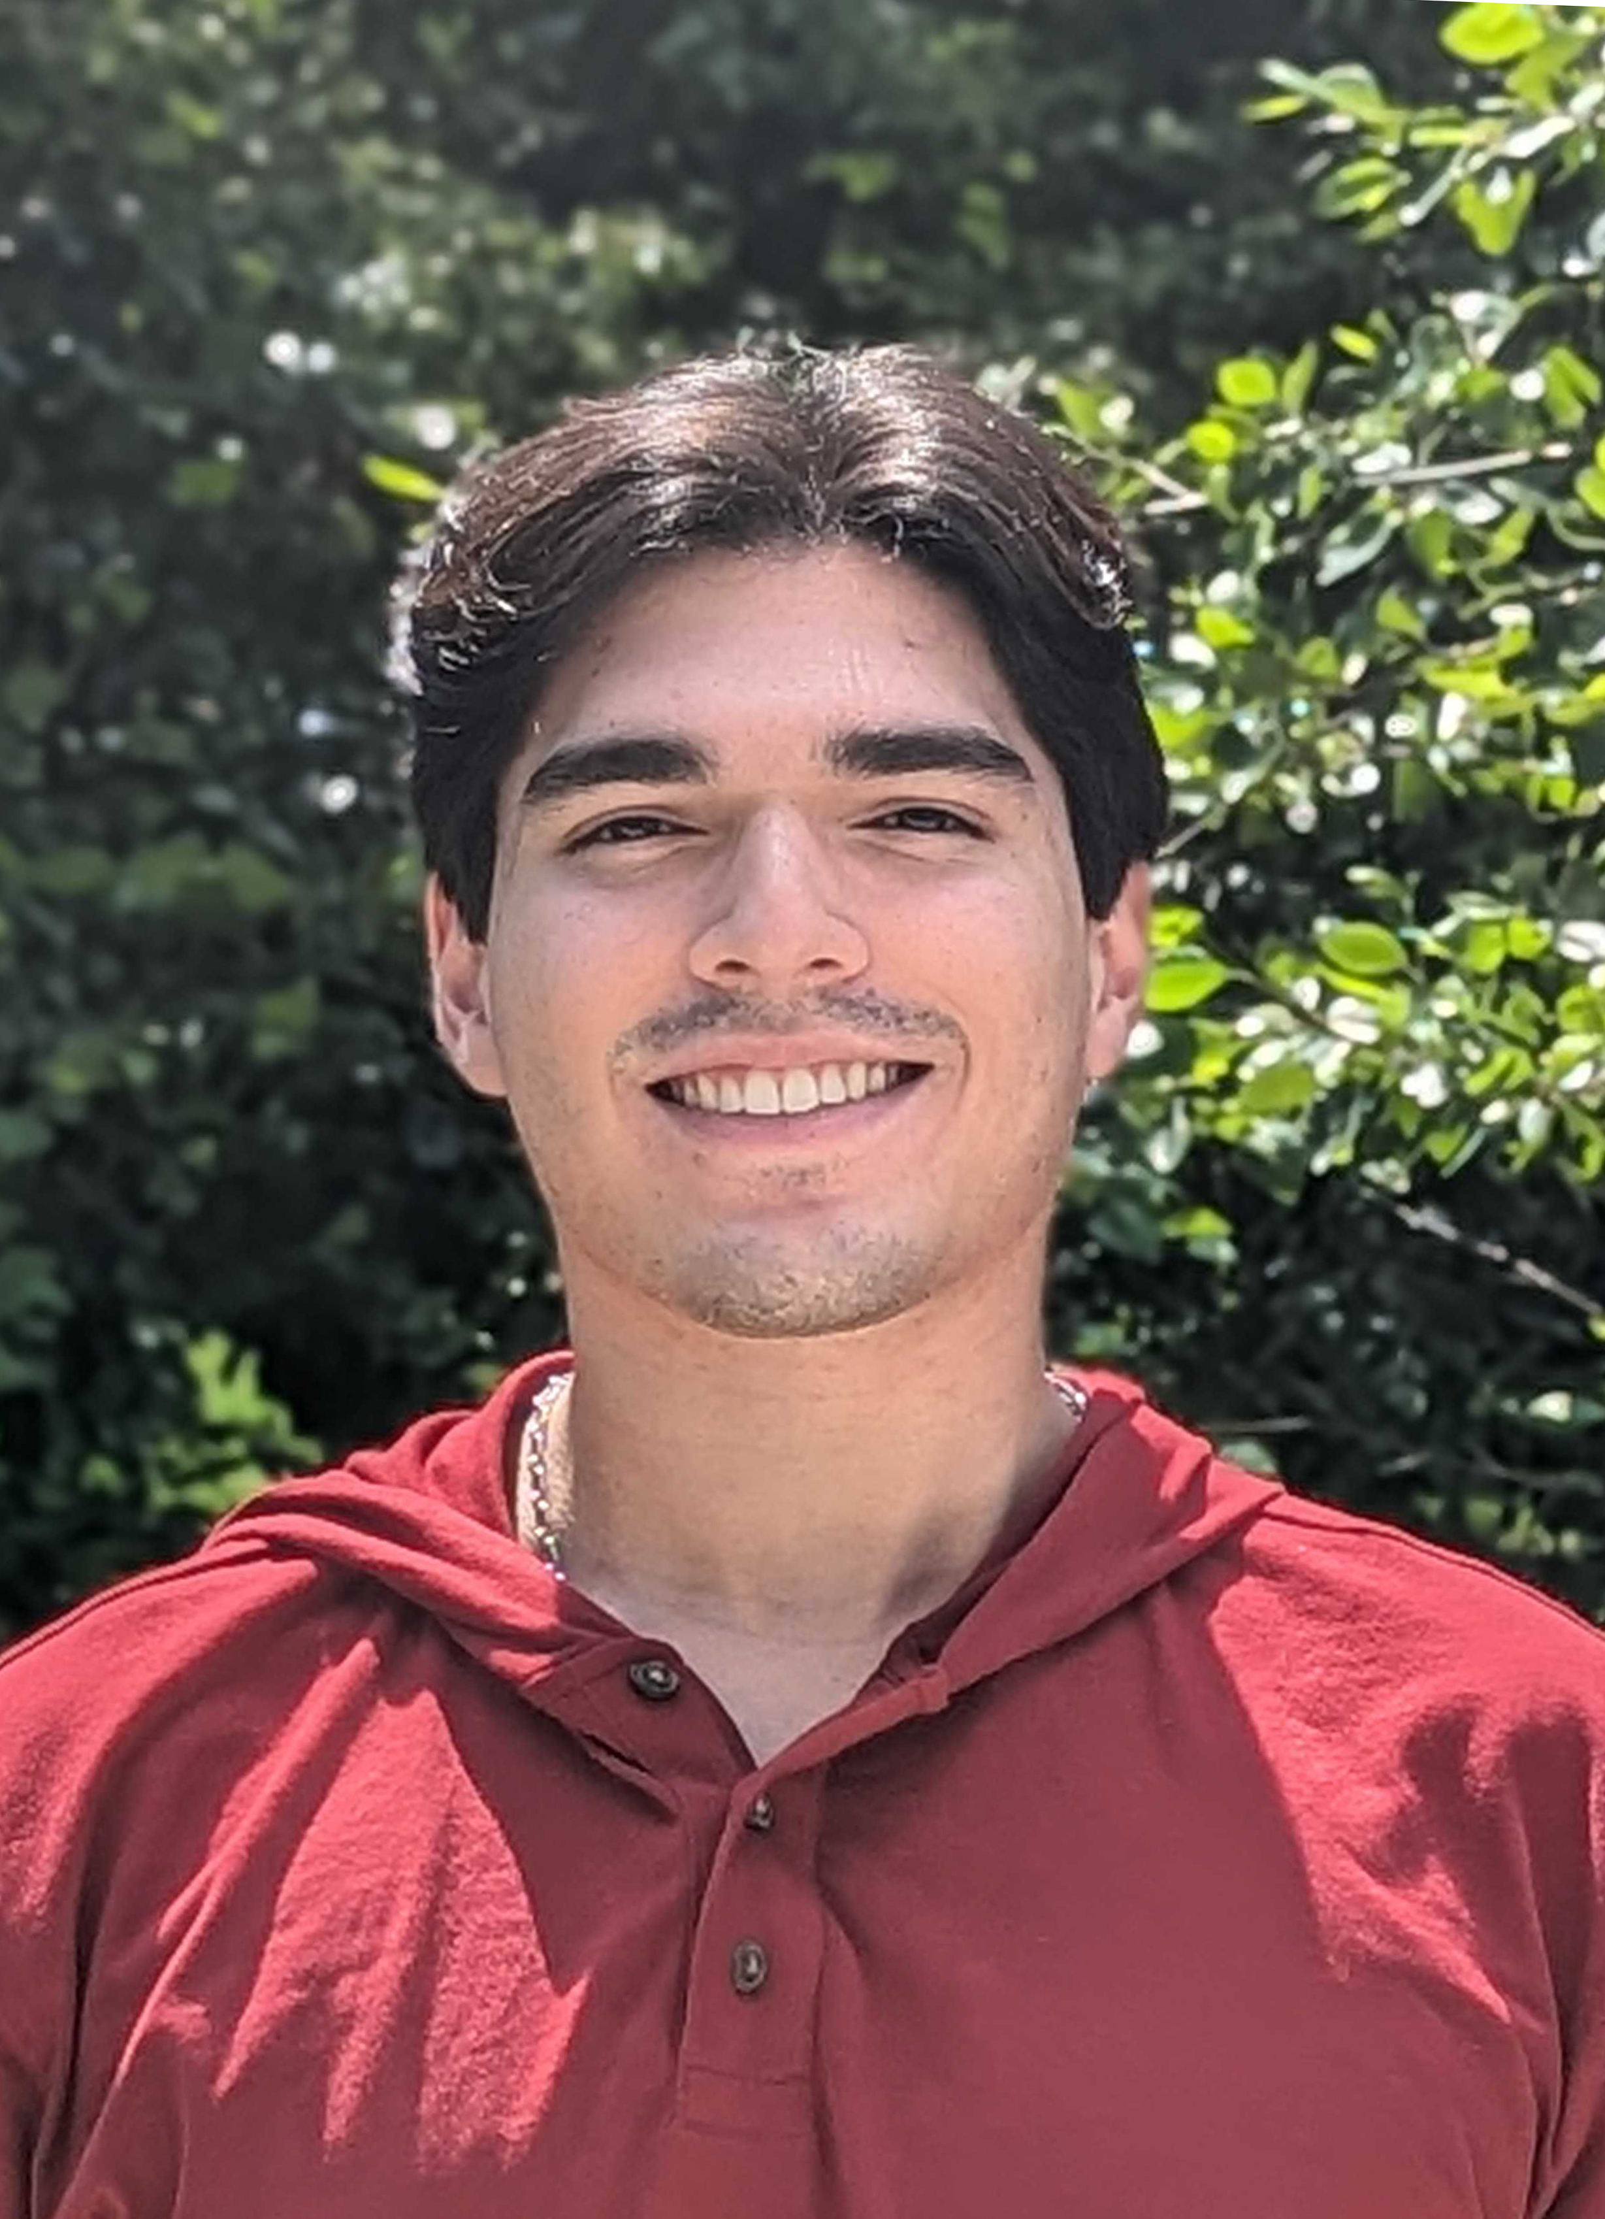
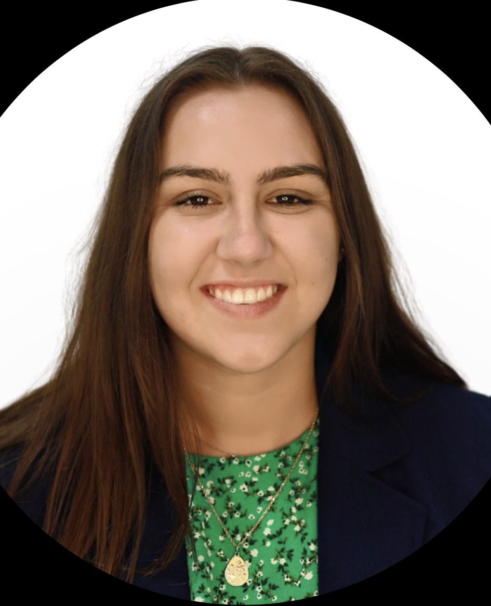


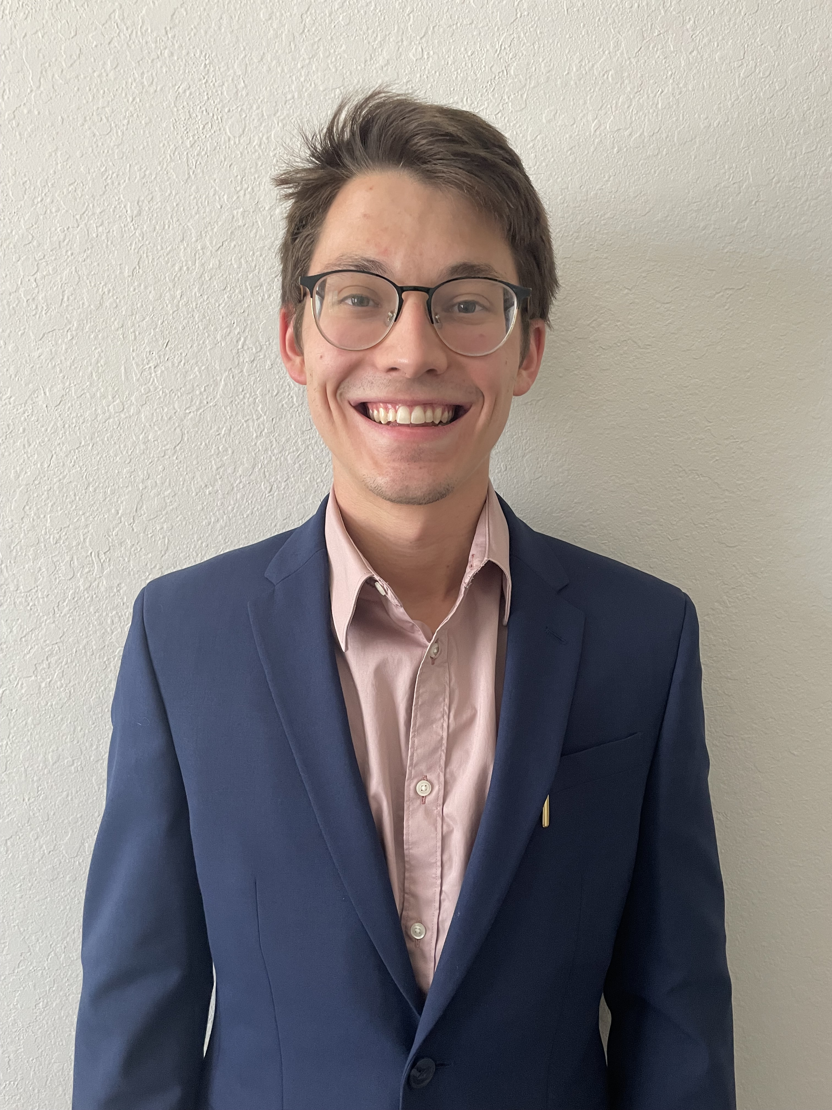
Team Introductions
Kiersten Cady
Kiersten Cady
Mechanical Engineer
Angelina Lanh
Biomedical Engineer
Santiago Lazarte
Biomedical Engineer
John Sorensen
Biomedical Engineer
Taylor Vanderlinden
Biomedical Engineer
William Wartman
Mechanical Engineer
Exactech Team
Notes:
Hello everyone, this is team 1x2 working with Exactech

Slide 3
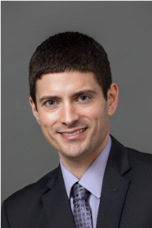
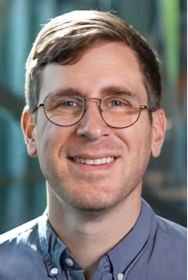
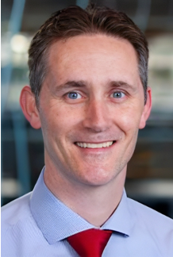
Sponsor and Advisors
Kiersten Cady
Engineering Mentor
Tom Vanasse
Liaison Engineer at Exactech
Academic Advisor
Stephan Arce, Ph.D.
Teaching Faculty III
Academic Advisor
Shayne McConomy, Ph.D.
Teaching Faculty II

Slide 4
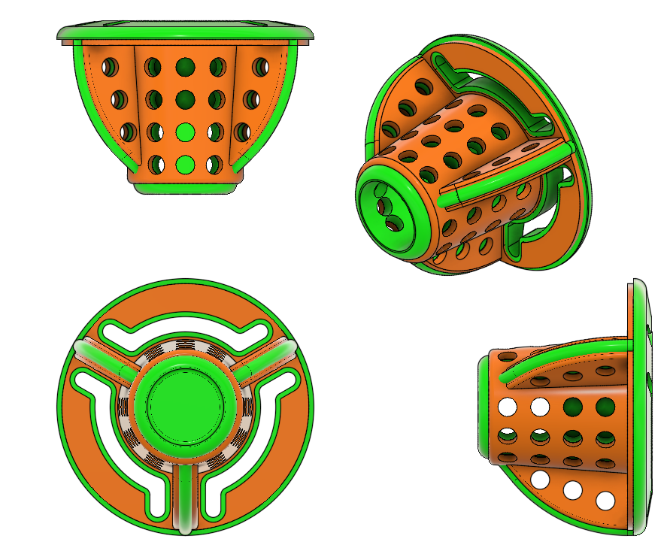
Objective
Kiersten Cady
The objective of this project is to improve upon Exactech's
current reversible stemless shoulder implant the Equinox

Slide 5
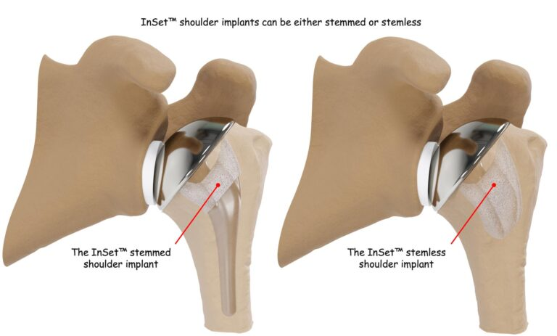
Stemmed vs Stemless
Kiersten Cady
Stemmed shoulder implant
Stemless shoulder implant

Slide 6
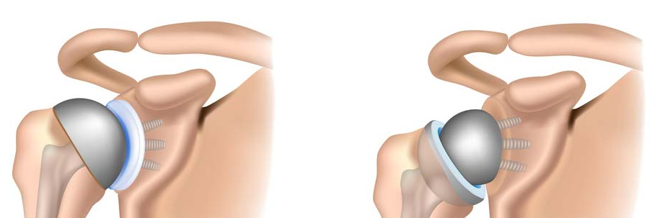
Anatomical vs Reverse
Kiersten Cady
Lazarte
Scapula
Humerus
Notes:
The reverse part of the reverse stemless arthroplasty is shown here on the left, versus the anatomical arthroplasty on the right. The anatomical model mimics how the actual shoulder joint is shaped, with the “ball” of the “Ball and Socket” joint on the humeral head as you can see with the dome-like implant head, and the socket on the scapula side at the glenoid.
In the reverse, the ball and socket positions are switched with the ball on the glenoid and the socket on the humeral head.
The reverse arthroplasty elongates the shoulder, allowing for a slightly larger range of motion. It also has a fixed fulcrum due to the offset and only requires the deltoid to be intact (the elongated shoulder stretches the deltoid, adding extra force that may have been needed from the rotator cuff).
In comparison, the anatomical model requires both he deltoid and the rotator cuff to be intact. Similar to a normal shoulder, the rotator cuff is responsible for keeping the joint tightly together, and the deltoid is the muscle in charge of movement.

Slide 7
Background
Kiersten Cady
Shoulder joint complications are becoming more prevalent, especially with the aging population, diseases, and accidents
The glenohumeral (shoulder) joint is the most mobile joint in the body but also the least stable
Current Models:
  Require extensive bone loss
  Impede upon range of motion
  Have prevalent post-operative complications

Slide 8
Previous Work
Kiersten Cady
Customer Needs
Functional Decomposition
  Stability
  Ergonomics
  Adaptability
Targets and Metrics
Concept Generation and Selection

Slide 9
Update
Kiersten Cady
Testing Apparatus
Initial implant test
Evaluation of testing methodology
Further ideas about how to verify failure criterion (discontinuity)
Code revision to allow for comma delineated output of data

Slide 10
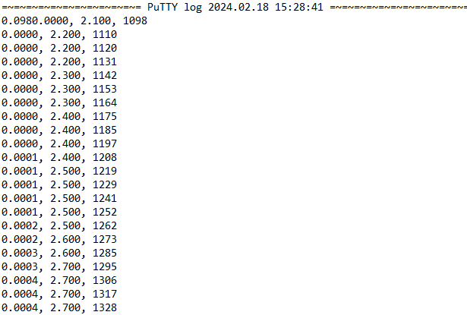
PuTTY Serial Output
William Wartman
Displacement (in)
Time (milliseconds)
Force (lbf)

Slide 11
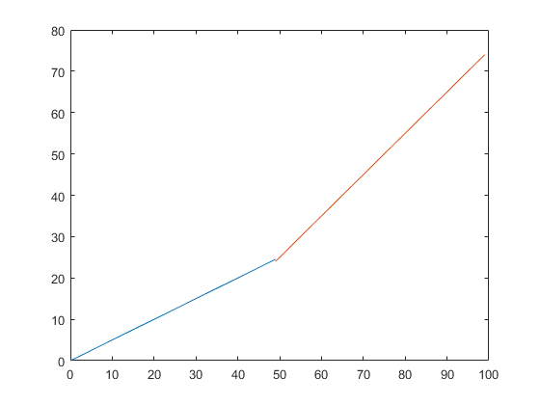
Discontinuity
William Wartman
Force
Displacement

Slide 12
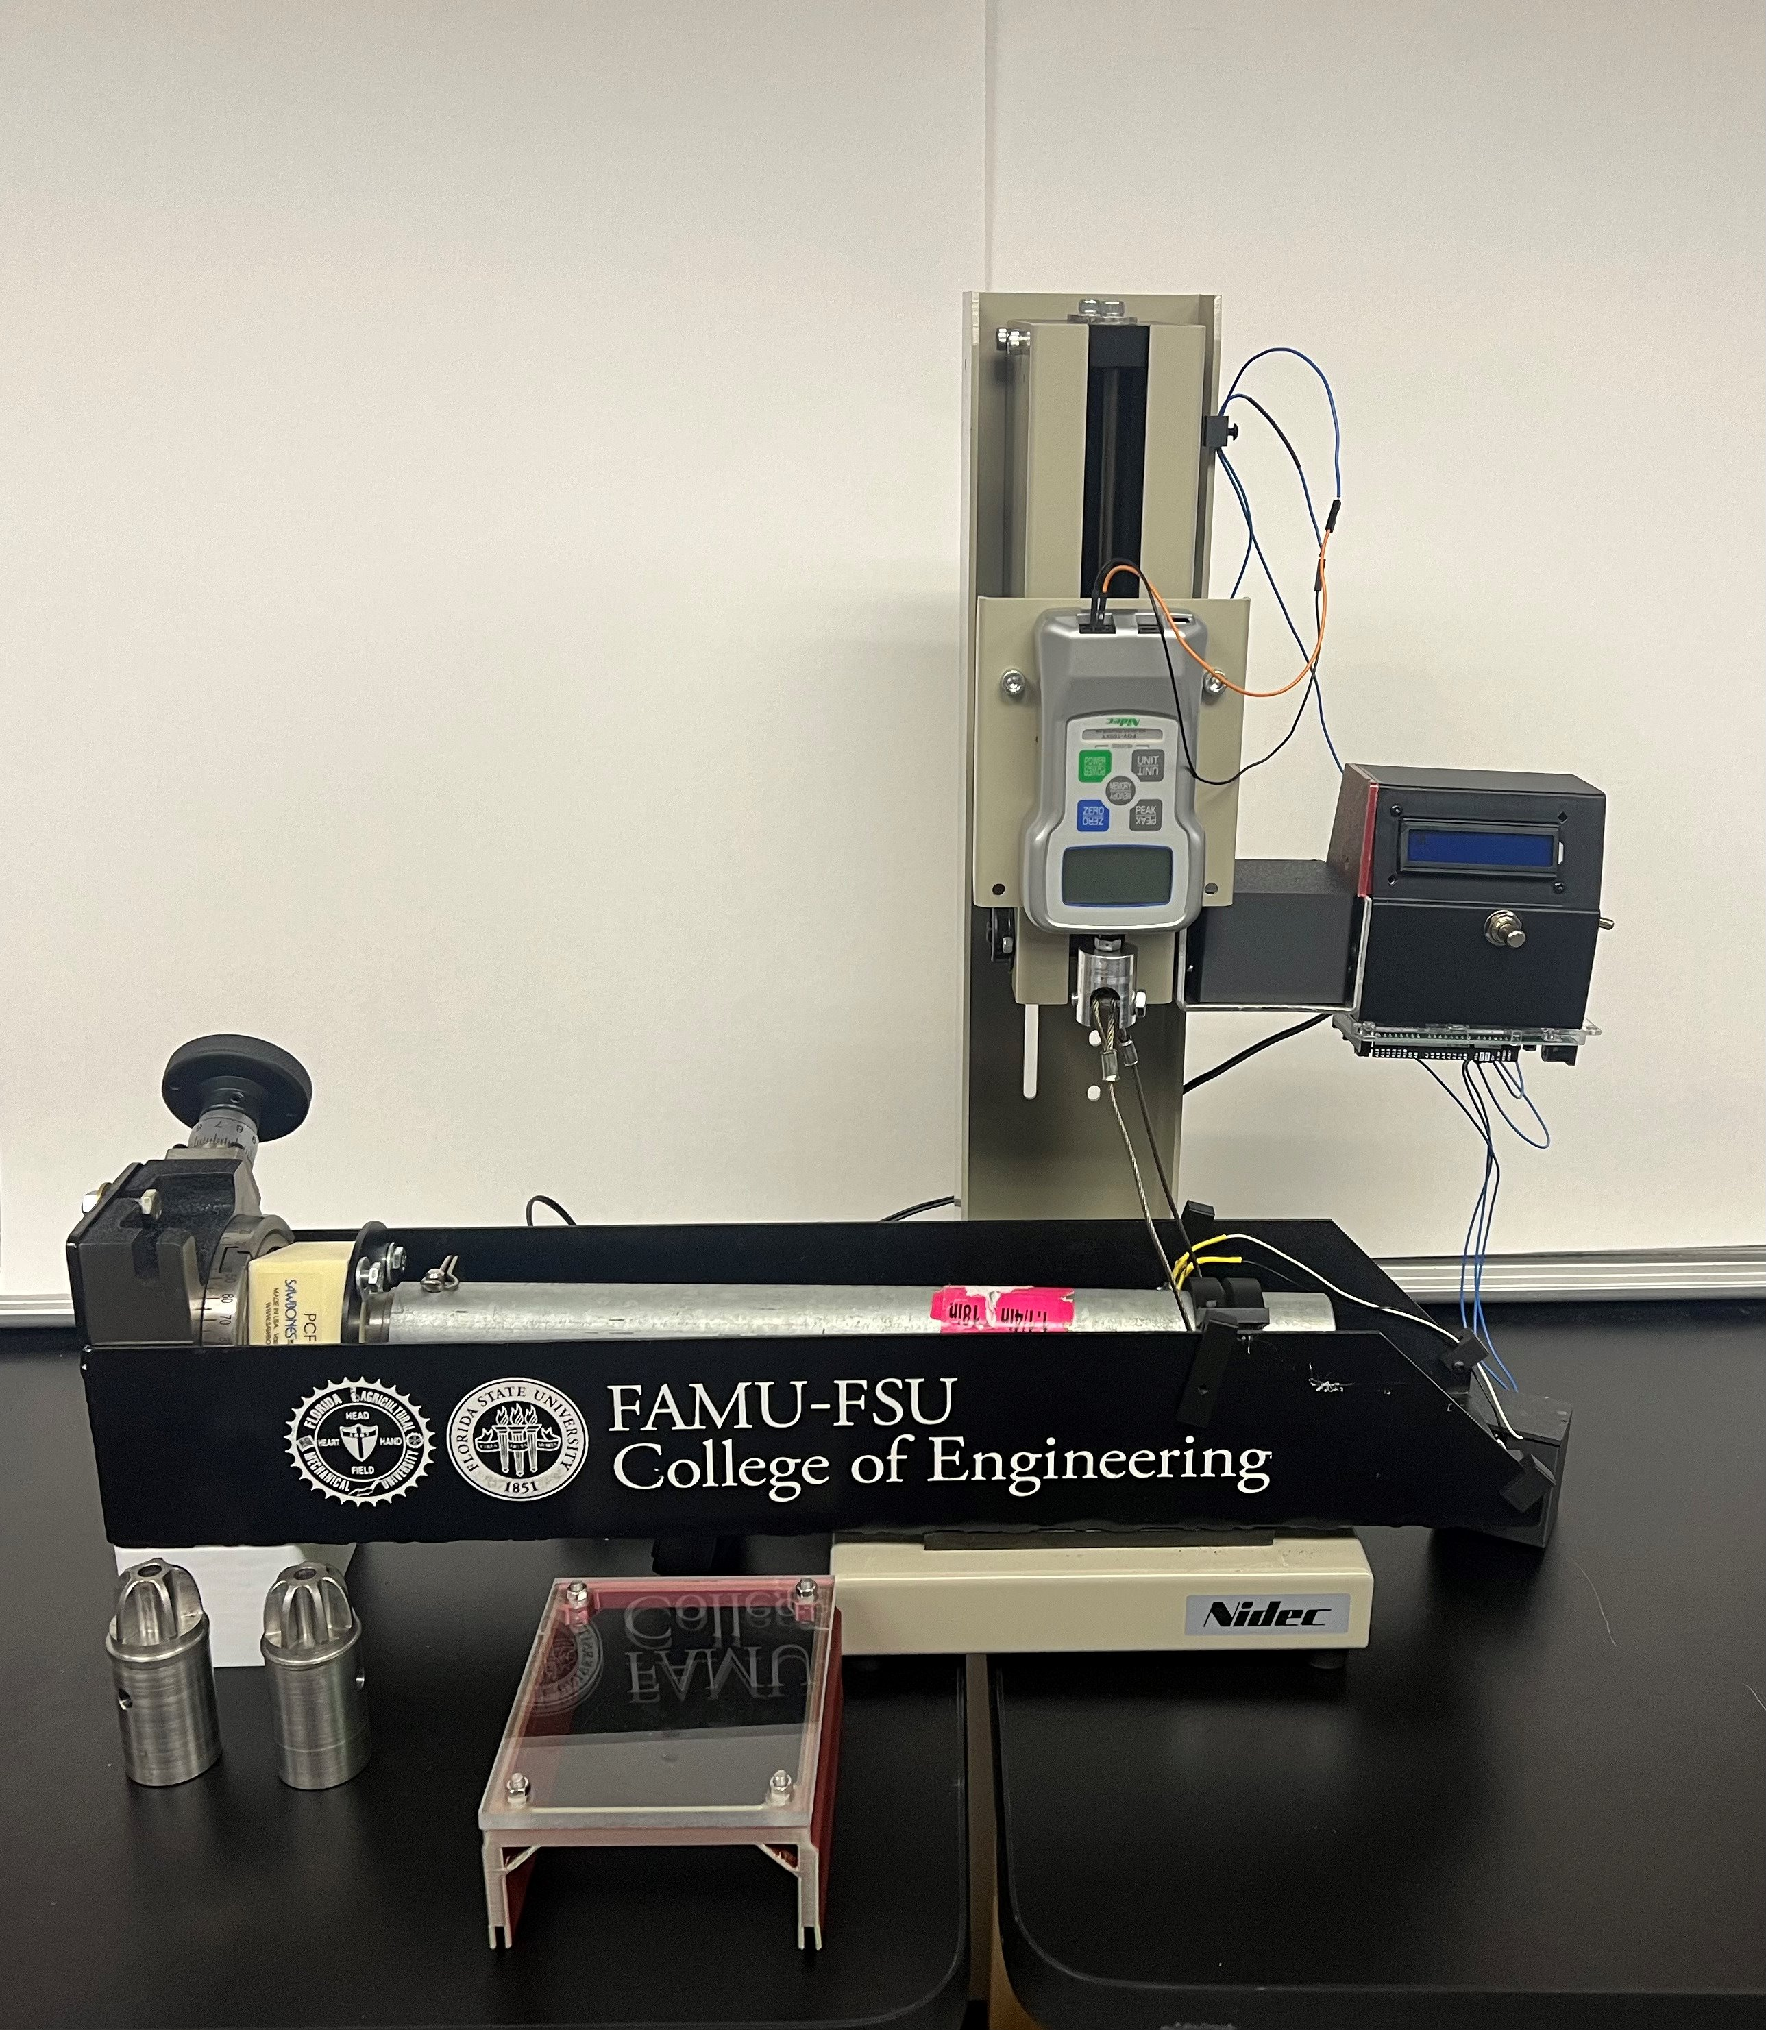
William Wartman

Slide 13
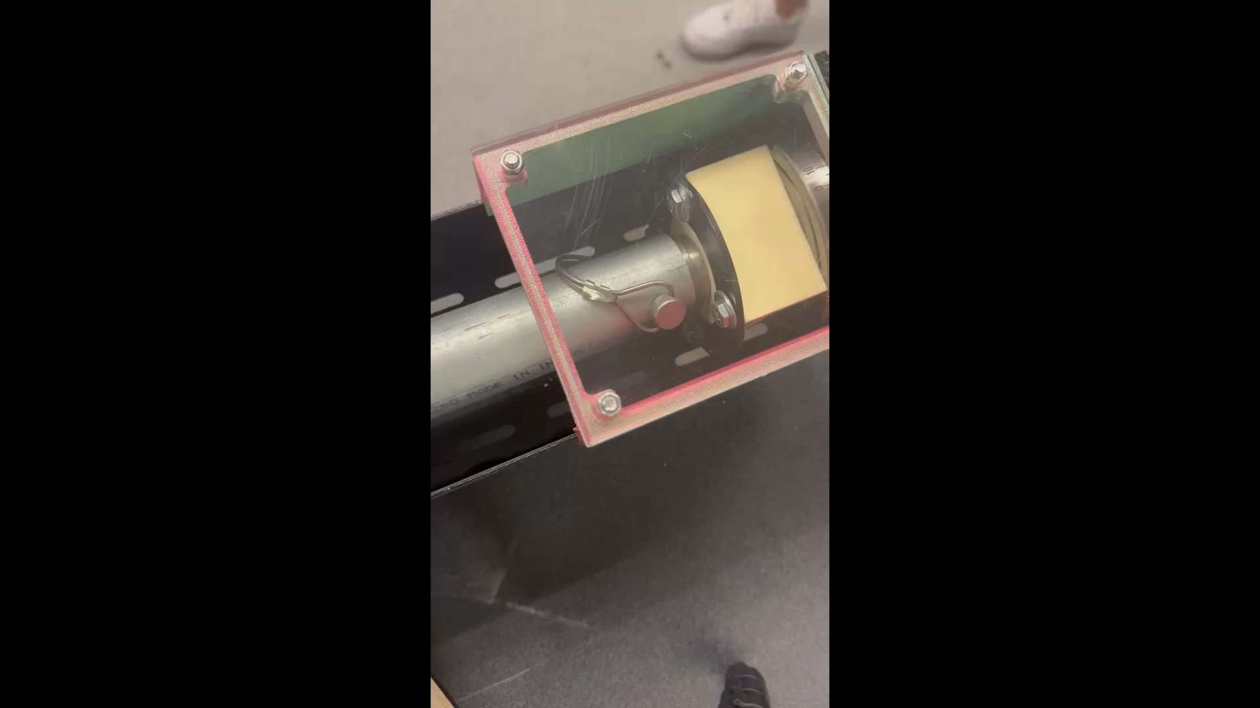
William Wartman

Slide 14
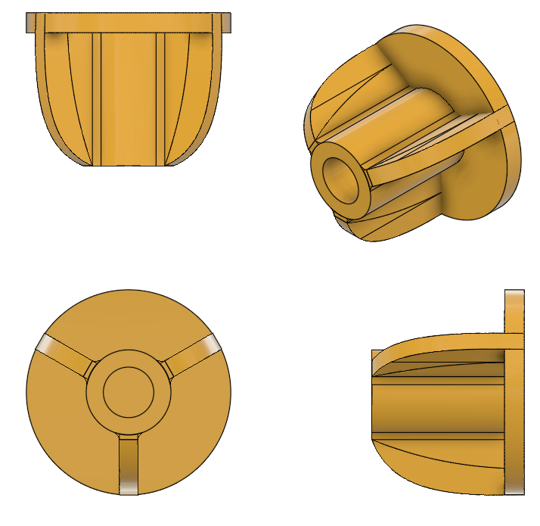
3 Fin Design
William Wartman

Slide 15
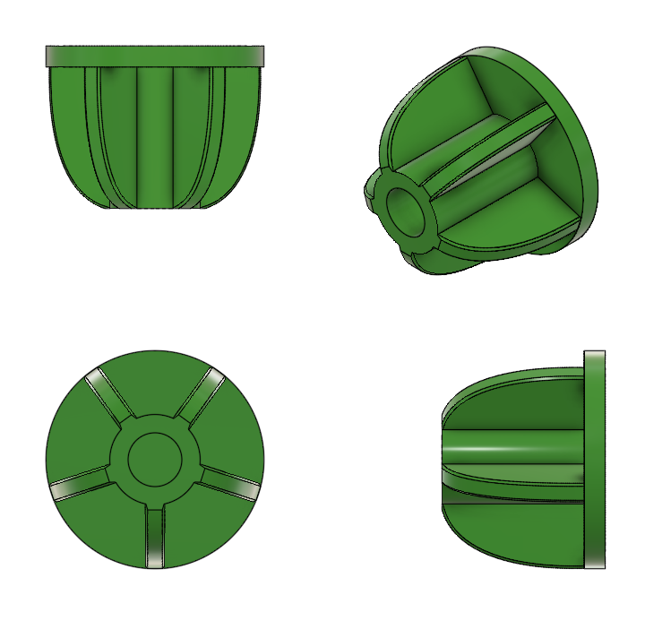
5 Fin Design
William Wartman

Slide 16
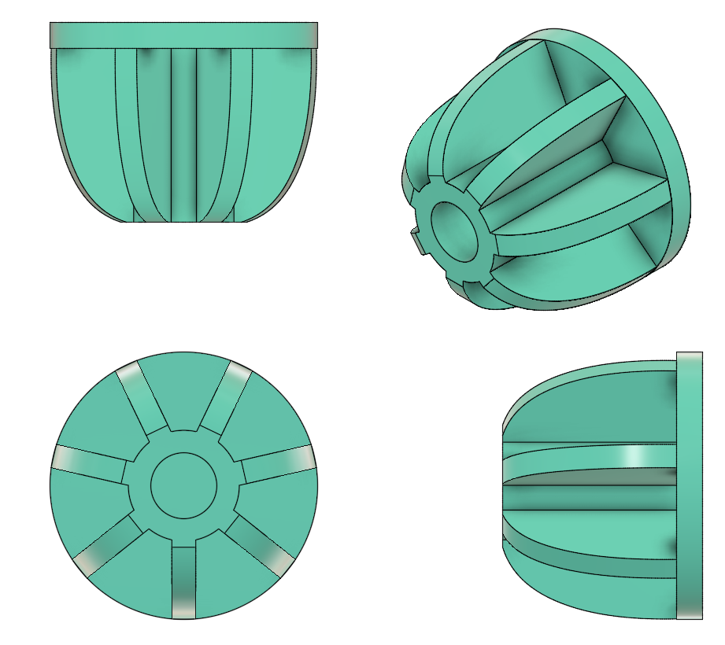
7 Fin Design
William Wartman

Slide 17
Future Work
William Wartman
Test for Absolute Failure
Analyse Results
Test for Fatigue Cycle
  Begin at 80% of Absolute Failure
  Change Depending on Number of Fatigue Cycle
Analyse Results
Determine if Implant Achieves Objective Statement
Review Possible Errors and Improvement

Slide 18
References
William Wartman
Equinoxe reverse system. www.exac.com. (2022, July 6).
https://www.exac.com/extremities/equinoxe-reverse-system/
Total shoulder replacement surgery. Shoulder Innovations. (2022, October 31). https://shoulderinnovations.com/total-shoulder-replacement-surgery/
McClintock, Dr. K. (2023, August 2). Pros and cons of reverse shoulder replacement surgery. Kyle McClintock, DO | Orthopedic Surgeon Roseville, CA. https://drmcclintock.com/pros-and-cons-of-reverse-shoulder-replacement-surgery/
Shoulder bones. Joint Preservation Center. (2013, April
5). http://josephbermanmd.com/anatomy-of-the-shoulder/shoulder-bones/

Slide 19
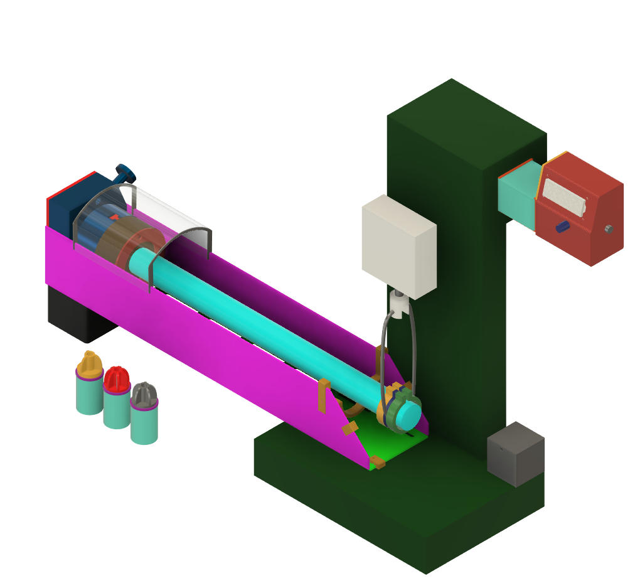
Test Stand Assembly
William Wartman

Slide 20
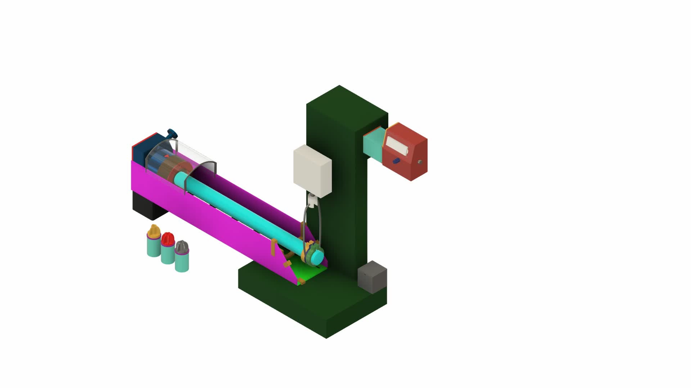
Test Stand Operation
William Wartman

Slide 21
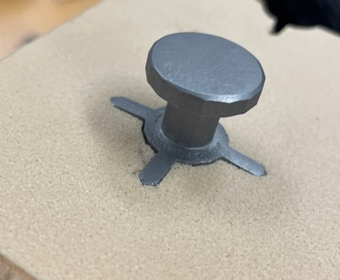
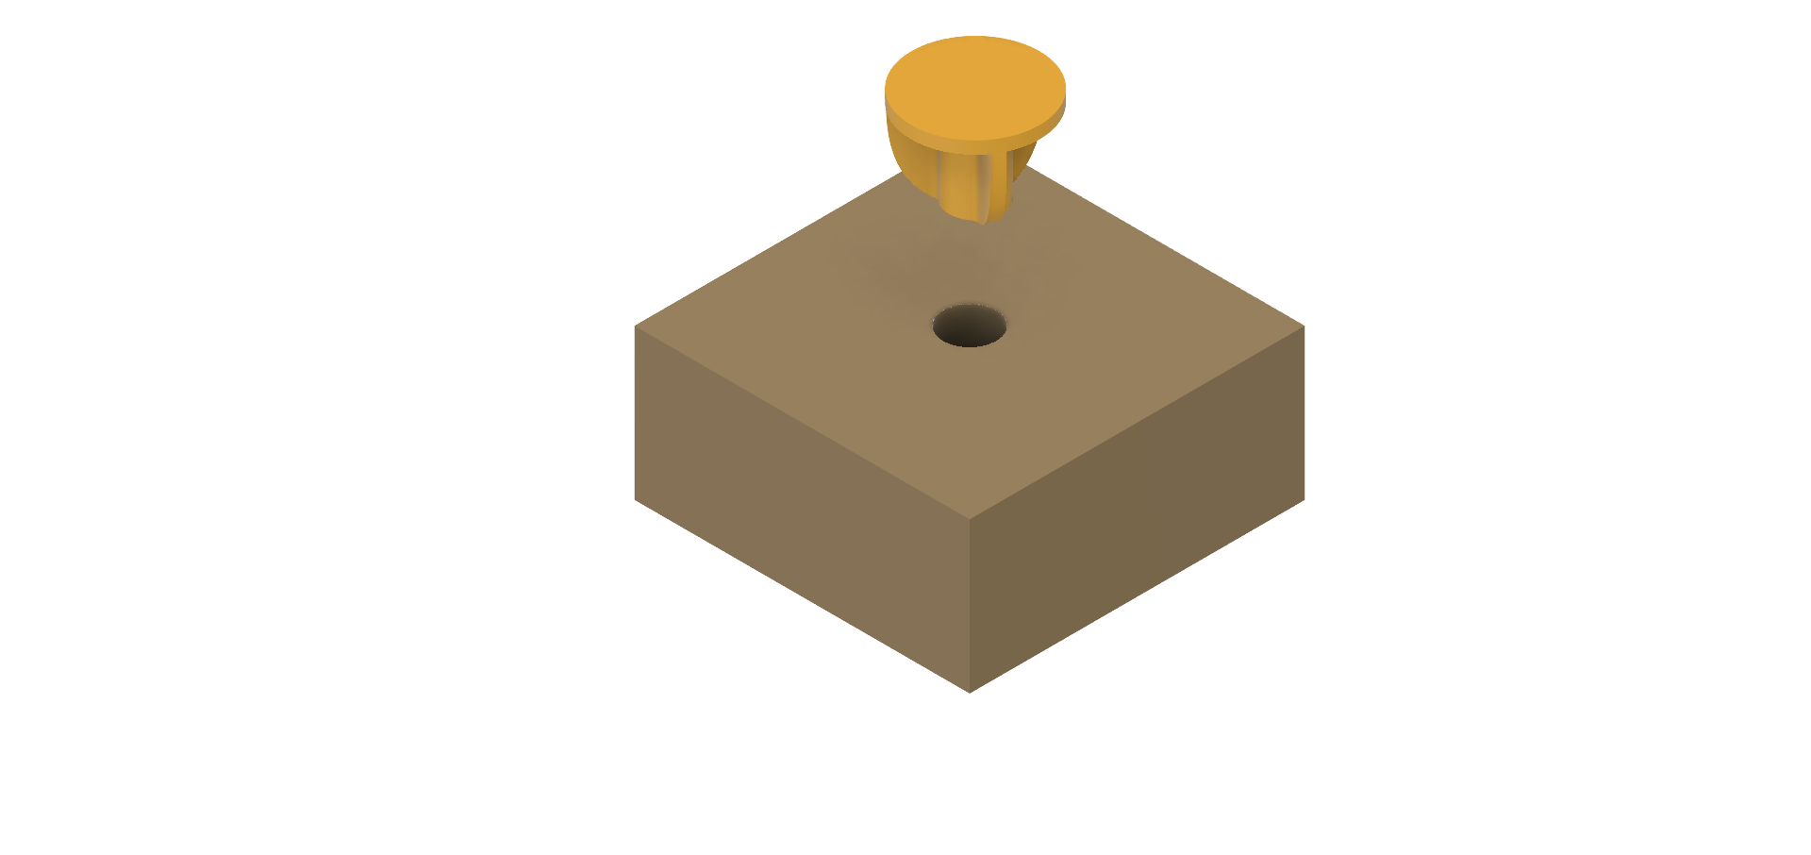
Testing Implantation Methods
William Wartman
Pressing Force
2
Bone Block

Slide 22
Equinox
William Wartman

Slide 23
Backup Slides

Slide 24
Functional Decomposition
Kiersten Cady
Reversible Stemless Shoulder Implant
Stability
Ergonomics
Adaptable

Slide 25
Functional Decomposition
Kiersten Cady
Stability
Hold shoulder
Resist Shear Forces
Resist Rocking Moments
Resist Torque
Ergonomics
Easier to Implant
Adaptable
Variable Sized Implants

Slide 26
Targets and Metrics
Kiersten Cady
Preventing premature implant failure
Resist shear, torque, or rocking moments
Improvements the ease installation

Slide 27
Targets and Metrics
Kiersten Cady
Targets
Resists rocking moments at least 10% better than Equinox
Resists torque at least 10% better than Equinox
Resists shear forces at least 10% better than Equinox
Implantation is at least 10% better than Equinox

Slide 28
Targets and Metrics
Kiersten Cady
Resist Rocking Moments
Moment (Newton-meter)
Resist Shear
Stress (Newton per square meter)
Resist Torque
Easier to Implant
Physical Exertion
Time
Steps
Torque (Newton-meter)

Slide 29
Targets and Metrics
Kiersten Cady
Lifespan
Cost of Manufacturing
Recyclability
90% recyclable
Material composition and overall part density
10-20 years with minimal surgical revisions

Slide 30
Concept Generation
Kiersten Cady
Anti-Problem
Battle of Perspectives
Biomimicry
Material Composition
Fixation Methods
Cylinder Geometry
Fin Geometry

Slide 31
Concept Generation
Kiersten Cady
Medium Fidelity Concepts
Large diameter hollow cylinder with internal fins
Large diameter hollow cylinder with internal cylinder
Small diameter hollow cylinder with four external fins
Small diameter hollow cylinder with five external fins
Small diameter hollow cylinder with internal fins and external fins

Slide 32
Customer Needs
Question | Customer Statement | Interpreted Need
What are the current design’s causes of failure? | Rocking and shear stress. | Increase strength of the interface between bone and implant.
What do you want us to do? | Improve upon the current Exactech’s design. | Development of designs that can be rigorously tested such that they exceed the current design in longevity and resistance to certain forces and moments.
Would fasteners work to secure the implant to the bone? | No, due to the density of bone fasteners would not work. | Other methods of attaching are needed to prevent bone fragmentation.
How should be align implants for testing? | Last year's team made 3D printed punches, you will need something similar. | Design and implement punches to properly align implants with the substitutive bone surface.

Slide 33
Customer Needs continued...
Question | Customer Statement | Interpreted Need
Does a current method of testing, these designs exist? | Last year's team focused on testing their designs using their own methods, you will need to do something similar. | We will need to develop a solid method of testing designs for max shear and bending moment.
What are some ways to imitate bone for implant testing? | Bone block or bone foam. | Bone block or bone foam.
Which factors are important besides the implant bone interface? | Mobility and preventing scapular notching are both important factors. | Our design must consider these two phenomena when designing.
What different configurations are currently available for these implants? | Both inlay and onlay, I would like to see you test both. | Investigate both and compare the results.

Slide 34
Customer Needs continued...
Question | Customer Statement | Interpreted Need
Can cement or epoxy be used to secure the implant to the bone? | No due to revision surgeries. The cement and implant can't always be removed. | No due to revision surgeries. The cement and implant can't always be removed.

Slide 35
Functional Decomposition
Function​ | Stability​ | Ergonomics​ | Adaptable​
Resist Rocking moments​ | X​ | ​ | X​
Resist Shear forces​ | X​ | ​ | X​
Resist Torque​ | X​ | ​ | X​
Easier to Implant​ | ​ | X​ | ​
Variable Sized Implants​ | ​ | X​ | X​

Slide 36
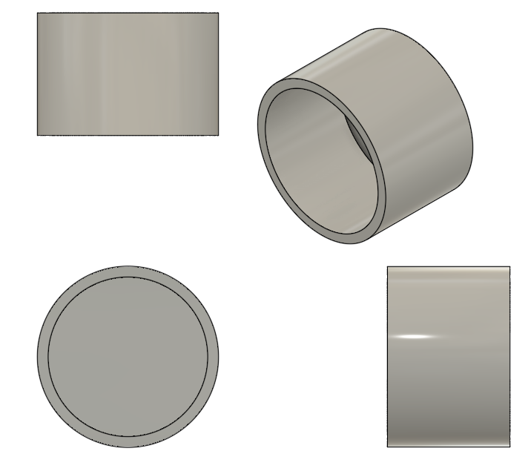
Cup Design
William Wartman

Slide 37
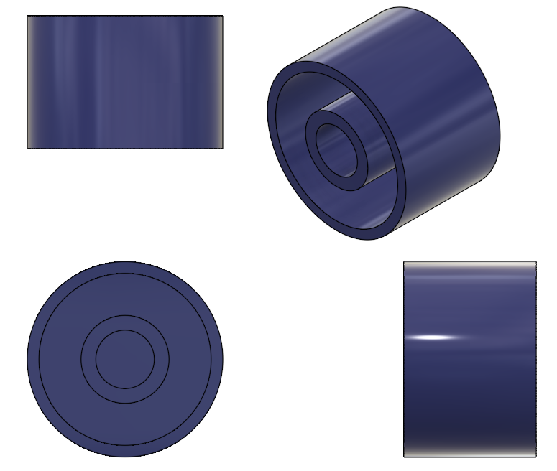
Cup Internal Cylinder Design
William Wartman

Slide 38
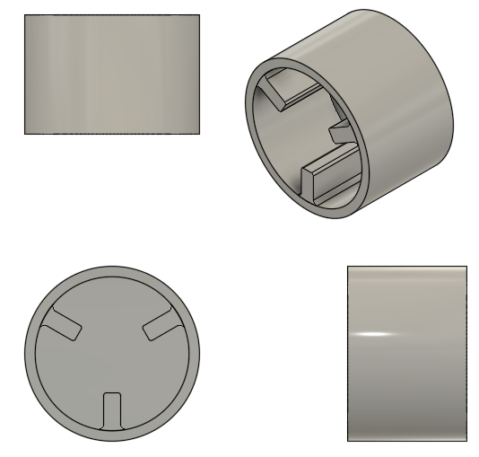
Cup Internal 3 Fin Design
William Wartman

Slide 39
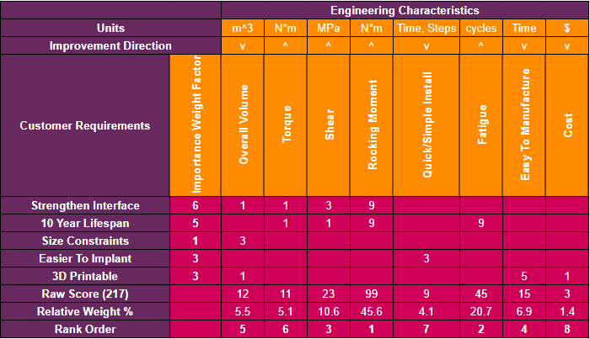
HOQ
William Wartman

Slide 40
Top Five Most Important Engineering Characteristics
William Wartman
Rank Order | 1 | 2 | 3 | 4 | 5
Engineering Characteristic | Rocking Moment | Fatigue | Shear | Easy to Manufacture | Overall Volume

Slide 41
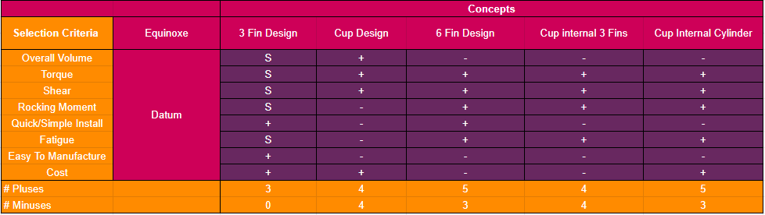
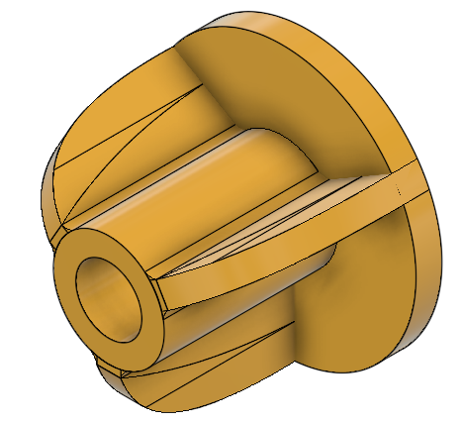
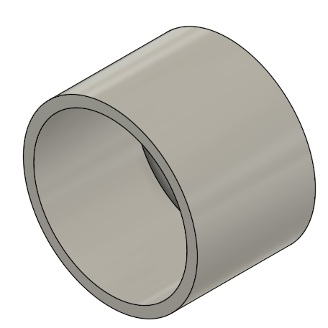
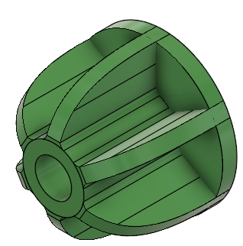
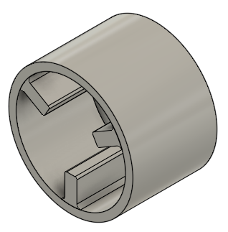
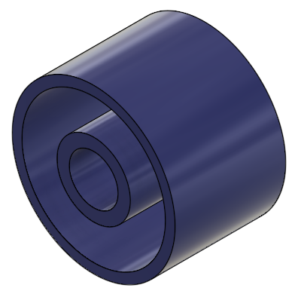
Pugh Chart
William Wartman

Slide 42
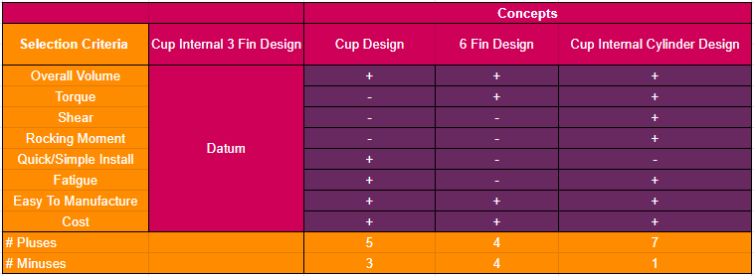
Pugh Chart Continued
William Wartman

Slide 43

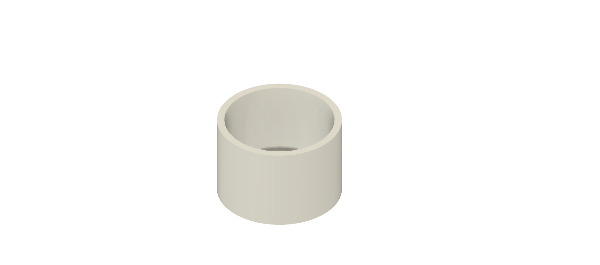
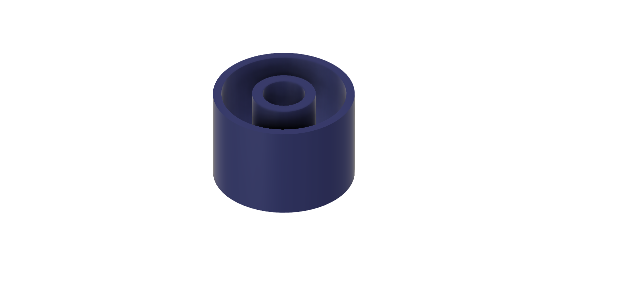
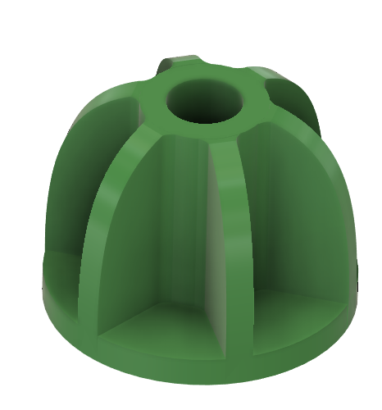
Final Rating Matrix
William Wartman
Cup
6 Fin
Cup Internal Cylinder

Slide 44
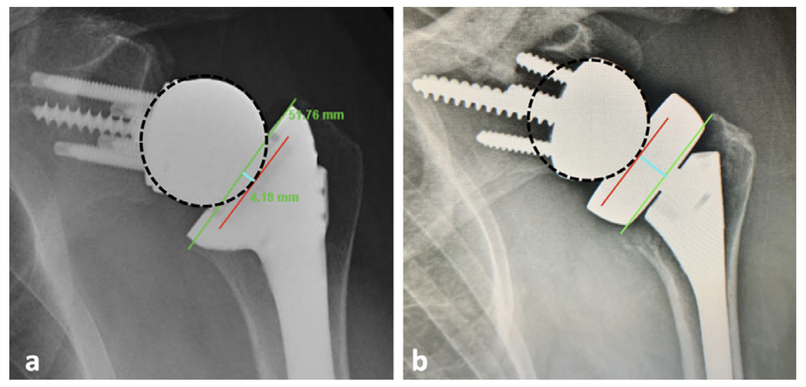
Inlay vs Onlay

Slide 45
College of Engineering Color Palette
1 2 3 4
Pantone: PMS 195 C
RGB: 120, 47, 64
Hex: #782F40
CMYK:19, 90, 50, 55
1 2 3 4
Pantone: Black C
RGB: 0, 0, 0
Hex: #000000
CMYK:0, 0, 0, 100
Garnet
Black
1 2 3 4
RGB: 238, 118, 36
Hex: #EE7624
CMYK:2, 66, 99, 0
1 2 3 4
Pantone: PMS 000C
RGB: 255, 255, 255
Hex: #FFFFFF
CMYK: 0, 0, 0, 0
Fang
Orange
White
Notes:
Avoid 75% Black in B135

Slide 46
Accent Color Palette
1 2 3 4
RGB: 0, 59, 111
Hex: #003B6F
CMYK:
1 2 3 4
RGB: 0, 59, 111
Hex: #003B6F
CMYK:
1 2 3 4
RGB: 251, 236, 93
Hex: #FBEC5D
CMYK:
1 2 3 4
RGB: 219, 215, 210
Hex: #DBD7D2
CMYK:
1 2 3 4
RGB: 251, 236, 93
Hex: #FBEC5D
CMYK:
1 2 3 4
RGB: 219, 215, 210
Hex: #DBD7D2
CMYK:
Tardis Blue
Tardis Blue
Corn
Timberwolf
Corn
Timberwolf
1 2 3 4
RGB: 206, 0, 88
Hex: #CE0058
CMYK: 0, 100, 43, 12
1 2 3 4
RGB: 206, 0, 88
Hex: #CE0058
CMYK: 0, 100, 43, 12
1 2 3 4
RGB: 104, 40, 96
Hex: #682860
CMYK:
1 2 3 4
RGB: 220, 220, 220
Hex: #DCDCDC
CMYK:
Rubine Red
Rubine Red
Imperial
Gainsboro
1 2 3 4
RGB: 72, 146, 155
Hex: #48929b
CMYK:
1 2 3 4
RGB: 64, 224, 208
Hex: #40E0D0
CMYK:
1 2 3 4
RGB: 255, 139, 0
Hex: #FF8B00
CMYK:
Asagi-iro
Turquoise
American Orange
Notes:
Remove American orange add hyperlink grey
Make corn the last for b135
All work in 134 imperial move later
Tardis doesn’t work in b136

Slide 47
F7AB19
D67F15
EE7624
D64615
F73119
Analogous
https://color.adobe.com/create/color-wheel
6E3610
F0A16C
EE7624
6E4931
BASB1C
Monochromatic
A14508
4BED3B
EE7624
250CED
2010A1
Triad
A1470C
FF8C40
EE7624
0098A1
24E2ED
Complementary
28A164
2FED8D
EE7624
0848A1
1871ED
Split Complementary
EDAC2F
3BED93
EE7624
0C6AED
ED2F18
Double Split Complementary
ED660C
C7ED3B
EE7624
0CE1ED
A418ED
Square
BA7E09
87724A
EE7624
60EFCF
09BA61
Compound
AD551A
6E3610
EE7624
FA7625
D46820
Shades
Notes:
These are the variants that work well with Fang Orange. The bolded items show well on the projectors.

Slide 48
85412D
8F3831
782f40
8F3176
792D85
Analogous
https://color.adobe.com/create/color-wheel
C44D69
8E626D
782F40
C48796
451B25
Monochromatic
C43959
78743B
782F40
236178
43A2C4
Triad
C43959
C46078
782F40
25C43D
2F783A
Complementary
93C460
577835
782F40
39C49D
297861
Split Complementary
784435
5A783B
782F40
237860
6E2978
Double Split Complementary
782337
78683b
782F40
237830
293978
Square
AB4D32
DEBAAF
782F40
5D8555
70AB32
Compound
38161E
C44D69
782F40
853447
5E2532
Shades

Slide 49
A105
A105
B135 Stage Left
B135 Stage Right
B136
B134, A105
B135

