Slide 1
Reversible Stemless Shoulder Arthroplasty
Team 1x2
10/17/23

Slide 2
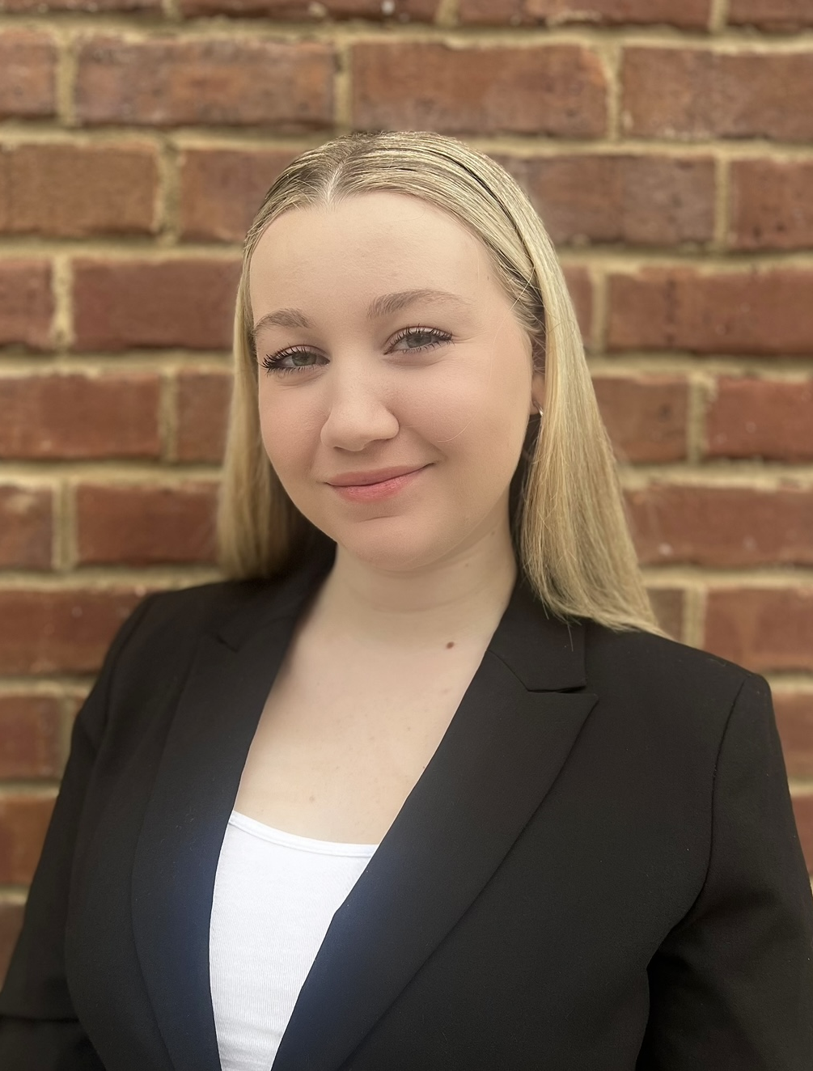
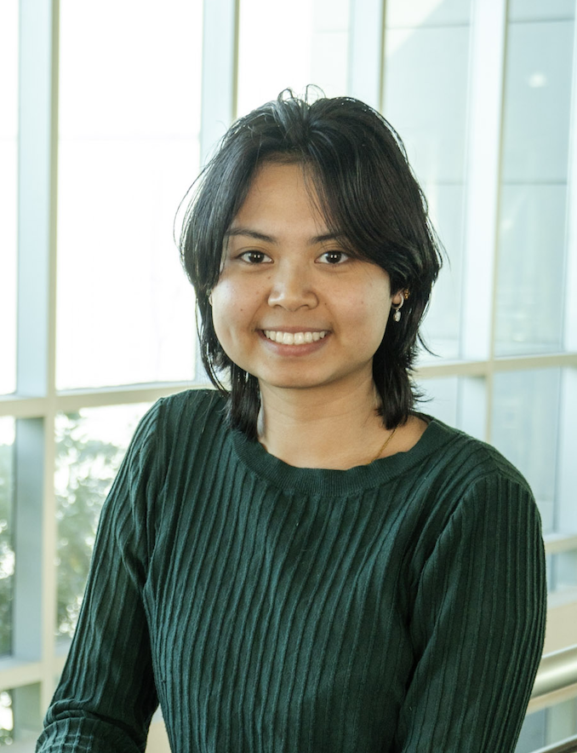
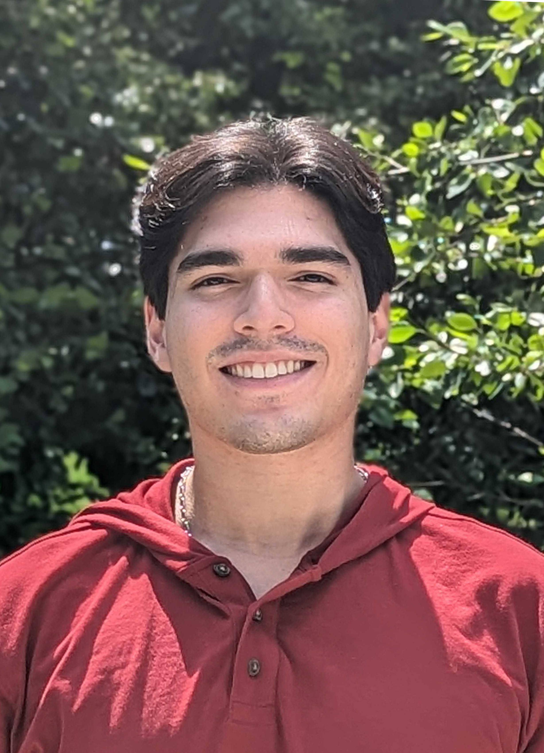
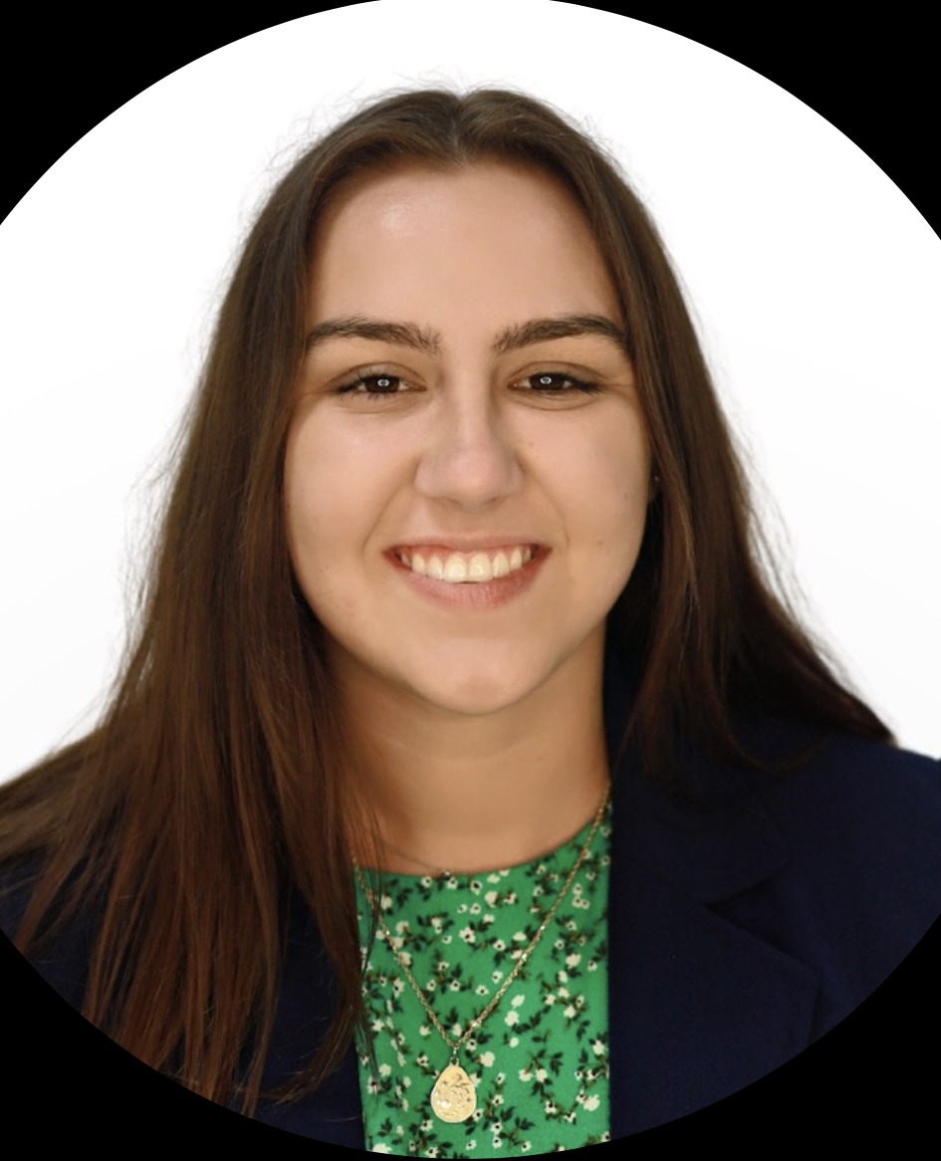
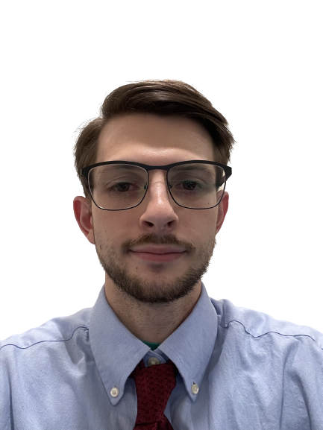

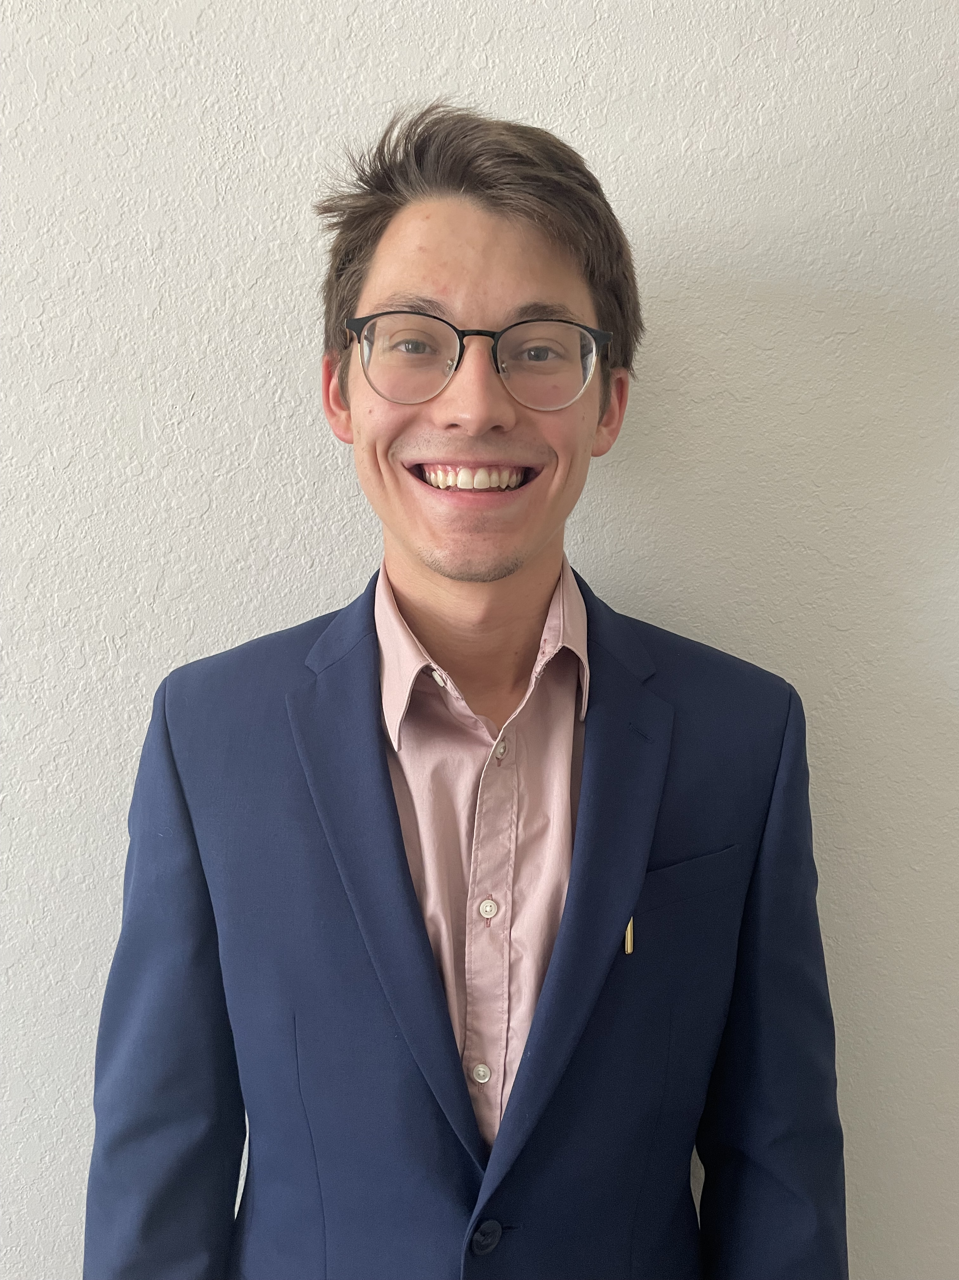
Team Introductions
Kiersten Cady
Kiersten Cady
Mechanical Engineer
Angelina Lanh
Biomedical Engineer
Santiago Lazarte
Biomedical Engineer
John Sorensen
Biomedical Engineer
Taylor Vanderlinden
Biomedical Engineer
William Wartman
Mechanical Engineer
Exactech Team
Notes:
Hello everyone, this is team 1x2 working with Exactech

Slide 3
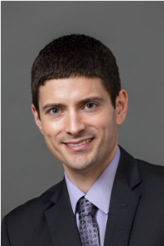
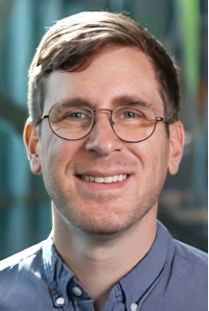
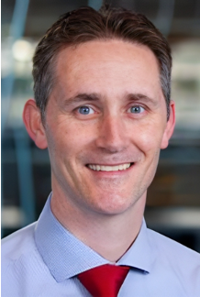
Sponsor and Advisors
Kiersten Cady
Engineering Mentor
Tom Vanasse
Liaison Engineer at Exactech
Academic Advisor
Stephan Acre, Ph.D.
Teaching Faculty III
Academic Advisor
Shayne McConomy, Ph.D.
Teaching Faculty II

Slide 4
Objective
Kiersten Cady
To develop a method of testing reversible stemless shoulder implants
To further explore plausible reasons for dislodgement of the implant from the bone
Finally, to develop a new model that addresses the issue of dislodgement

Slide 5
Background
John Sorensen
Shoulder joint complications are becoming more prevalent, especially with the aging population, diseases, and accidents.
The glenohumeral (shoulder) joint is the most mobile in the body.
Current Models:
  Require extensive bone loss.
  Anatomic Implants typically impede upon range of motion.
  Patients desire for increased range of motions.

Slide 6
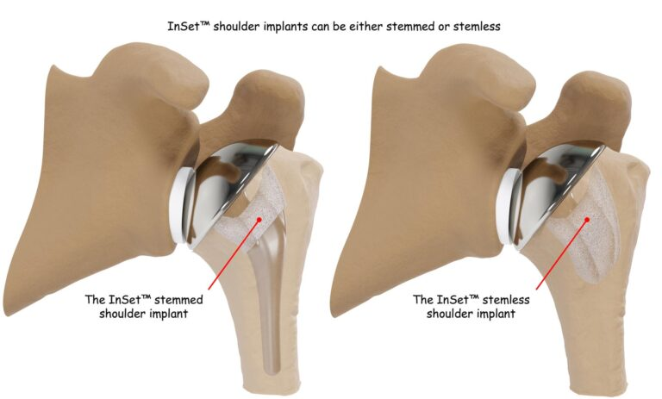
Stemmed vs Stemless
Santiago Lazarte
InSetTM Shoulder Implants
Stemmed shoulder implant
Stemless shoulder implant

Slide 7
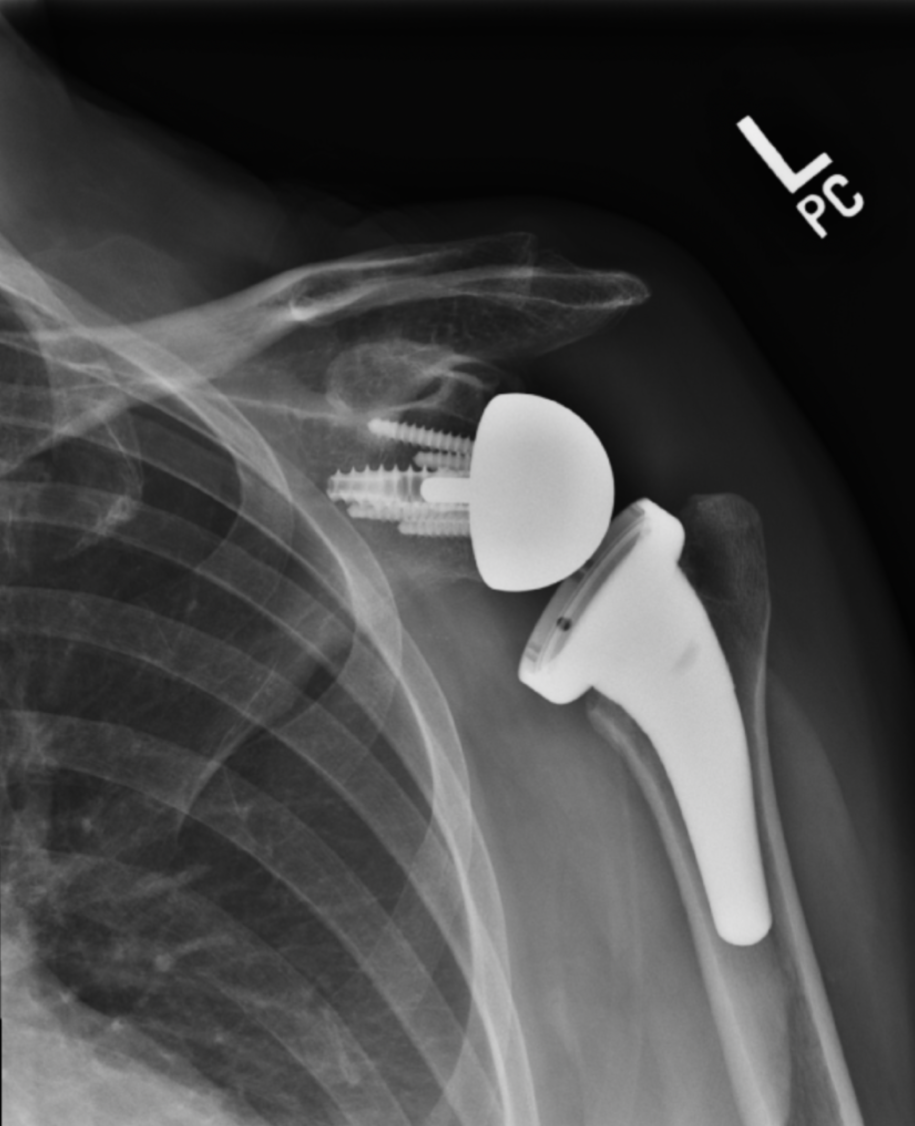
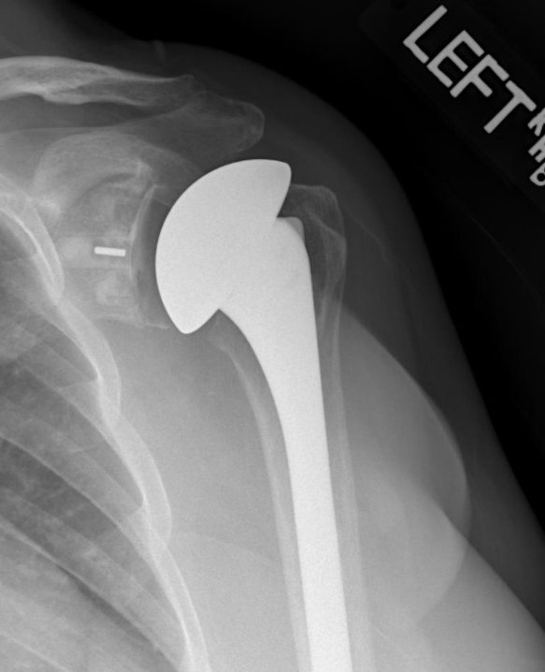
Reverse
Angelina Lanh
Anatomical
Lazarte

Slide 8
Key Goals
William Wartman
Understand methods of implant failure
1
Develop robust and repeatable testing method
2
Address the methods of implant failure in redesign
3
Lengthen overall part lifespan
4
Ease of manufacturing
5

Slide 9
Markets
William Wartman
Primary
  Hospitals
  Biomedical companies
  Private practices
  Exactech
Secondary​
    Health organizations​
    Veteran’s Affairs​
    Physical rehab company
Notes:
Exactech Global Medical Device Company

Slide 10
Assumptions
William Wartman
Current designs and CAD models will be provided by Exactech and will be used as a base design model for iterative testing
All substitutive methods of testing designs will be indicative of human bone and the loads experience by patients in common daily activities

Slide 11
Stakeholders
William Wartman
Dr. Shayne McConomy
Dr. Stephan Acre
Cameron Barnes
Michael Dina
Tyler Ince-Ingram
Caleb Ward
Exactech and its representative Tom Vanasse
Healthcare organizations

Slide 12
Customer Needs
William Wartman
What do you want us to do
Improve upon the current Exactech’s design
Properly understand current limitations and defects and improve the design
Notes:
The customer needs were gathered during a Microsoft Teams meeting with Tom Vanasse, liaison engineer at Exactech. When questioned he supplied a statement that better defined his expectations for our work. After this, an interpretation was generated to help define the construct that is the project. Altogether, these interpretations give vital information on what will be designed and tested but do not define specifically how. This serves to help define the problem while not limiting the team to any singular solution. The most important takeaway from this section is the need for a proper testing method to better understand the current modes of failure, and secondly, a design that is better than the current Exactech model.

Slide 13
Customer Needs Continued
William Wartman
What are the current design’s causes of failure
Rocking and shear stress
Increase strength of the interface between bone and implant
Notes:
The customer needs were gathered during a Microsoft Teams meeting with Tom Vanasse, liaison engineer at Exactech. When questioned he supplied a statement that better defined his expectations for our work. After this, an interpretation was generated to help define the construct that is the project. Altogether, these interpretations give vital information on what will be designed and tested but do not define specifically how. This serves to help define the problem while not limiting the team to any singular solution. The most important takeaway from this section is the need for a proper testing method to better understand the current modes of failure, and secondly, a design that is better than the current Exactech model.

Slide 14
Customer Needs Continued
William Wartman
Can cement or epoxy be used to secure the implant to the bone
No due to revision surgeries. The cement and implant can't always be removed
Exclude all non-reversible instillation methods
Notes:
The customer needs were gathered during a Microsoft Teams meeting with Tom Vanasse, liaison engineer at Exactech. When questioned he supplied a statement that better defined his expectations for our work. After this, an interpretation was generated to help define the construct that is the project. Altogether, these interpretations give vital information on what will be designed and tested but do not define specifically how. This serves to help define the problem while not limiting the team to any singular solution. The most important takeaway from this section is the need for a proper testing method to better understand the current modes of failure, and secondly, a design that is better than the current Exactech model.

Slide 15
Functional Decomposition
Kiersten Cady
Reversible Stemless Shoulder Implant
Stability
Ergonomics
Adaptable
Easier to implant
Hold shoulder
Resist Shear forces
Resist Rocking moments
Variable sized implants
Resist Torque
What does it have to do?
Data Generation
Function Relationships
Major Function (System)
Minor Function (Function)
Cross System Relationships

Slide 16
Overview
William Wartman
Reversible Stemless Shoulder Implants are better
  Better range of motion
  Less scapular notching
Current complication: mechanical instability
Understand the complication and be able to test designs
Design an implant that addresses the complication
Validate that it is better than Exactech's current model
Iterate
Notes:
Reversible stemless shoulder implants are better, they are better for the surgeon, the patient, the wallet, they are better all around, however, there is a flaw. By investigating the situation and the way in which the current design fails we can gather valuable data about the actual causes of failure. The best way to do that is by manipulating the current design until repeatable failure can be achieved in the same manner as that found in current use. Armed with our testing method we can then validate the design by comparing it to the current Exactech design equivalent.

Slide 17
Future Work
Kiersten Cady
Concept Generation
Testing Apparatus
Modeling
Prototyping
Surgeon feedback

Slide 18
References
Equinoxe reverse system. www.exac.com. (2022, July 6).
https://www.exac.com/extremities/equinoxe-reverse-system/
Total shoulder replacement surgery. Shoulder Innovations. (2022, October 31). https://shoulderinnovations.com/total-shoulder-replacement-surgery/
McClintock, Dr. K. (2023, August 2). Pros and cons of reverse shoulder replacement surgery. Kyle McClintock, DO | Orthopedic Surgeon Roseville, CA. https://drmcclintock.com/pros-and-cons-of-reverse-shoulder-replacement-surgery/
Shoulder bones. Joint Preservation Center. (2013, April
5). http://josephbermanmd.com/anatomy-of-the-shoulder/shoulder-bones/

Slide 19
Backup Slides

Slide 20
Customer Needs
Question | Customer Statement | Interpreted Need
What are the current design’s causes of failure? | Rocking and shear stress. | Increase strength of the interface between bone and implant.
What do you want us to do? | Improve upon the current Exactech’s design. | Development of designs that can be rigorously tested such that they exceed the current design in longevity and resistance to certain forces and moments.
Would fasteners work to secure the implant to the bone? | No, due to the density of bone fasteners would not work. | Other methods of attaching are needed to prevent bone fragmentation.
How should be align implants for testing? | Last year's team made 3D printed punches, you will need something similar. | Design and implement punches to properly align implants with the substitutive bone surface.

Slide 21
Customer Needs continued...
Question | Customer Statement | Interpreted Need
Does a current method of testing, these designs exist? | Last year's team focused on testing their designs using their own methods, you will need to do something similar. | We will need to develop a solid method of testing designs for max shear and bending moment.
What are some ways to imitate bone for implant testing? | Bone block or bone foam. | Bone block or bone foam.
Which factors are important besides the implant bone interface? | Mobility and preventing scapular notching are both important factors. | Our design must consider these two phenomena when designing.
What different configurations are currently available for these implants? | Both inlay and onlay, I would like to see you test both. | Investigate both and compare the results.

Slide 22
Customer Needs continued...
Question | Customer Statement | Interpreted Need
Can cement or epoxy be used to secure the implant to the bone? | No due to revision surgeries. The cement and implant can't always be removed. | No due to revision surgeries. The cement and implant can't always be removed.

Slide 23
Functional Decomposition
Function​ | Stability​ | Ergonomics​ | Adaptable​
Resist Rocking moments​ | X​ | ​ | X​
Resist Shear forces​ | X​ | ​ | X​
Resist Torque​ | X​ | ​ | X​
Easier to Implant​ | ​ | X​ | ​
Variable Sized Implants​ | ​ | X​ | X​

Slide 24
Project Scope
Objective
Key Goals
Primary Market
Secondary Market
Assumptions
Stakeholders

Slide 25
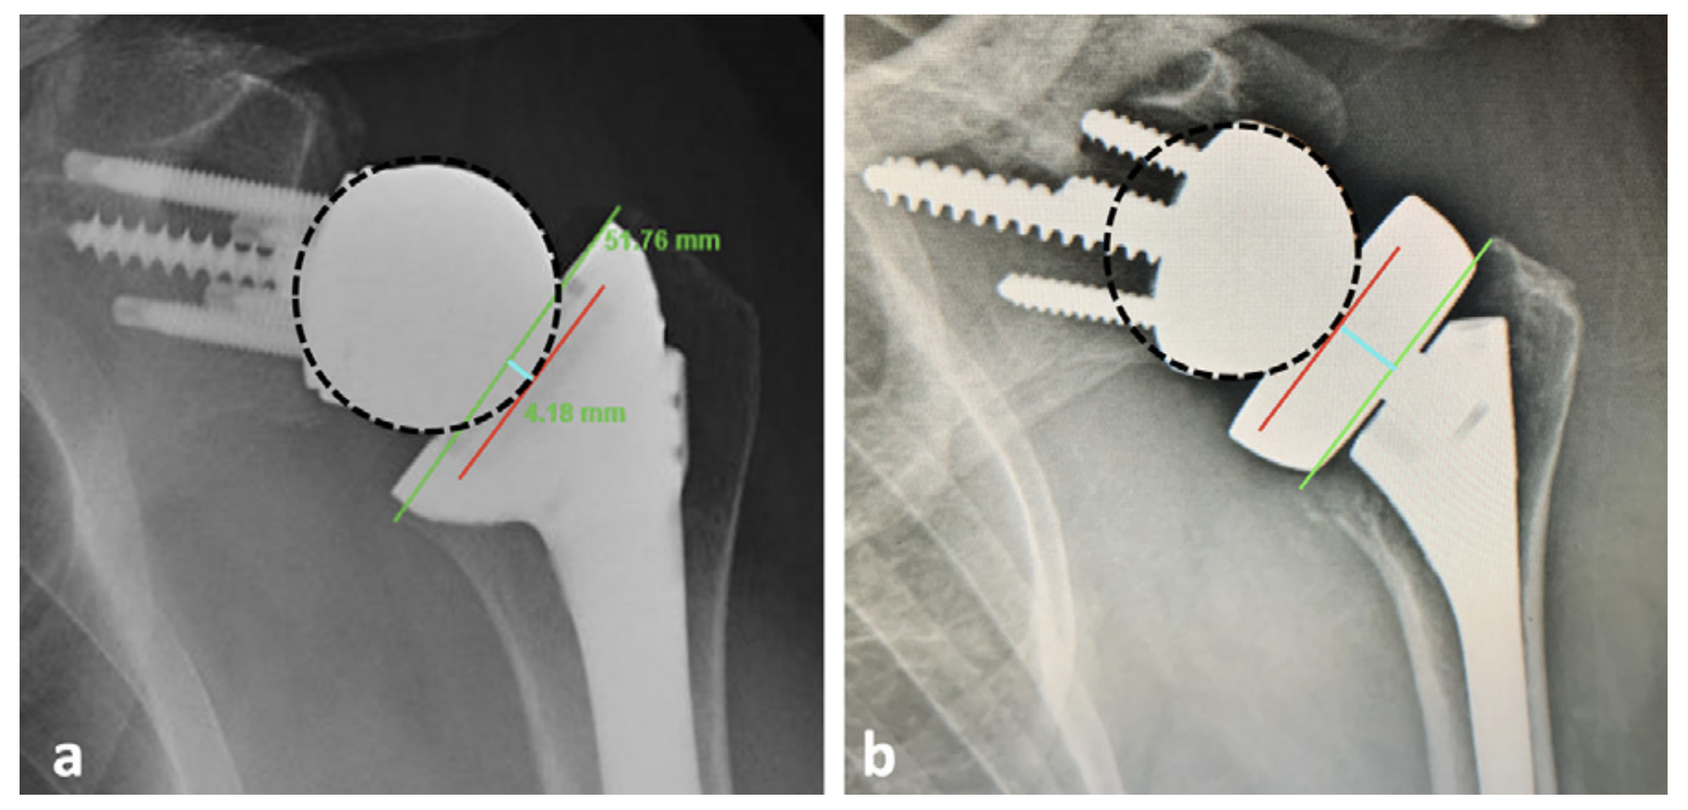
Inlay vs Onlay

Slide 26
College of Engineering Color Palette
1 2 3 4
Pantone: PMS 195 C
RGB: 120, 47, 64
Hex: #782F40
CMYK:19, 90, 50, 55
1 2 3 4
Pantone: Black C
RGB: 0, 0, 0
Hex: #000000
CMYK:0, 0, 0, 100
Garnet
Black
1 2 3 4
RGB: 238, 118, 36
Hex: #EE7624
CMYK:2, 66, 99, 0
1 2 3 4
Pantone: PMS 000C
RGB: 255, 255, 255
Hex: #FFFFFF
CMYK: 0, 0, 0, 0
Fang
Orange
White
Notes:
Avoid 75% Black in B135

Slide 27
Accent Color Palette
1 2 3 4
RGB: 0, 59, 111
Hex: #003B6F
CMYK:
1 2 3 4
RGB: 0, 59, 111
Hex: #003B6F
CMYK:
1 2 3 4
RGB: 251, 236, 93
Hex: #FBEC5D
CMYK:
1 2 3 4
RGB: 219, 215, 210
Hex: #DBD7D2
CMYK:
1 2 3 4
RGB: 251, 236, 93
Hex: #FBEC5D
CMYK:
1 2 3 4
RGB: 219, 215, 210
Hex: #DBD7D2
CMYK:
Tardis Blue
Tardis Blue
Corn
Timberwolf
Corn
Timberwolf
1 2 3 4
RGB: 206, 0, 88
Hex: #CE0058
CMYK: 0, 100, 43, 12
1 2 3 4
RGB: 206, 0, 88
Hex: #CE0058
CMYK: 0, 100, 43, 12
1 2 3 4
RGB: 104, 40, 96
Hex: #682860
CMYK:
1 2 3 4
RGB: 220, 220, 220
Hex: #DCDCDC
CMYK:
Rubine Red
Rubine Red
Imperial
Gainsboro
1 2 3 4
RGB: 72, 146, 155
Hex: #48929b
CMYK:
1 2 3 4
RGB: 64, 224, 208
Hex: #40E0D0
CMYK:
1 2 3 4
RGB: 255, 139, 0
Hex: #FF8B00
CMYK:
Asagi-iro
Turquoise
American Orange
Notes:
Remove American orange add hyperlink grey
Make corn the last for b135
All work in 134 imperial move later
Tardis doesn’t work in b136

Slide 28
F7AB19
D67F15
EE7624
D64615
F73119
Analogous
https://color.adobe.com/create/color-wheel
6E3610
F0A16C
EE7624
6E4931
BASB1C
Monochromatic
A14508
4BED3B
EE7624
250CED
2010A1
Triad
A1470C
FF8C40
EE7624
0098A1
24E2ED
Complementary
28A164
2FED8D
EE7624
0848A1
1871ED
Split Complementary
EDAC2F
3BED93
EE7624
0C6AED
ED2F18
Double Split Complementary
ED660C
C7ED3B
EE7624
0CE1ED
A418ED
Square
BA7E09
87724A
EE7624
60EFCF
09BA61
Compound
AD551A
6E3610
EE7624
FA7625
D46820
Shades
Notes:
These are the variants that work well with Fang Orange. The bolded items show well on the projectors.

Slide 29
85412D
8F3831
782f40
8F3176
792D85
Analogous
https://color.adobe.com/create/color-wheel
C44D69
8E626D
782F40
C48796
451B25
Monochromatic
C43959
78743B
782F40
236178
43A2C4
Triad
C43959
C46078
782F40
25C43D
2F783A
Complementary
93C460
577835
782F40
39C49D
297861
Split Complementary
784435
5A783B
782F40
237860
6E2978
Double Split Complementary
782337
78683b
782F40
237830
293978
Square
AB4D32
DEBAAF
782F40
5D8555
70AB32
Compound
38161E
C44D69
782F40
853447
5E2532
Shades

Slide 30
A105
A105
B135 Stage Left
B135 Stage Right
B136
B134, A105
B135

