Slide 1

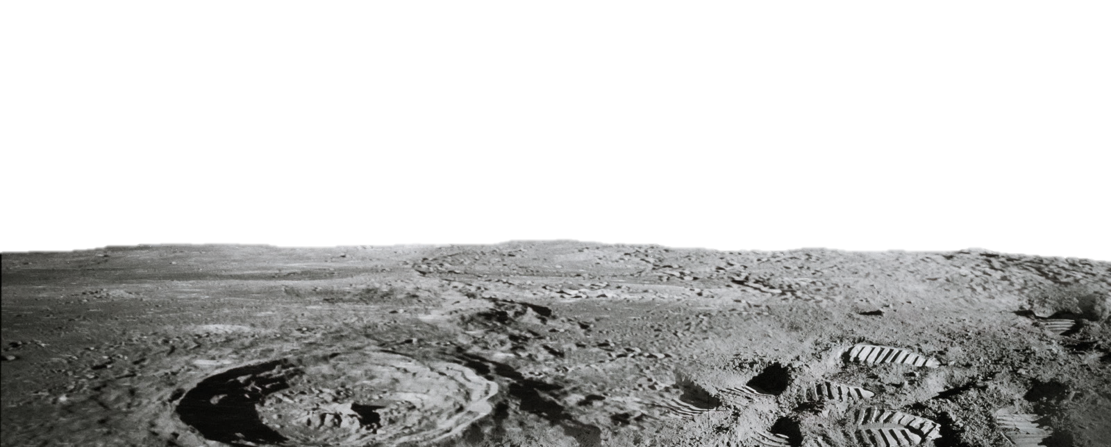
RE-RASSOR: LUNAR SURFACE TRANSPORTER
Team 513
Notes:
Customize your title slide to be appealing to the audience. This is the first thing they see apply some graphic design elements that may summarize your presentation.

Slide 2
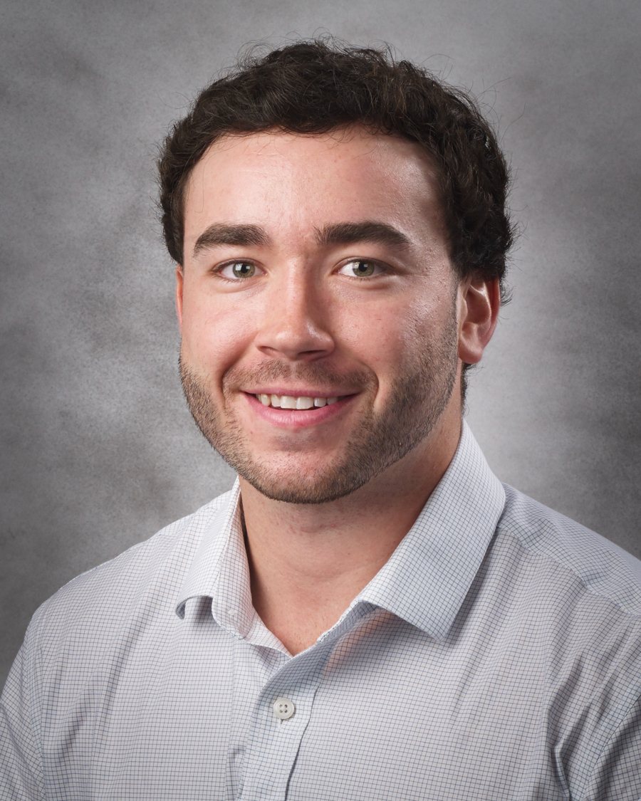

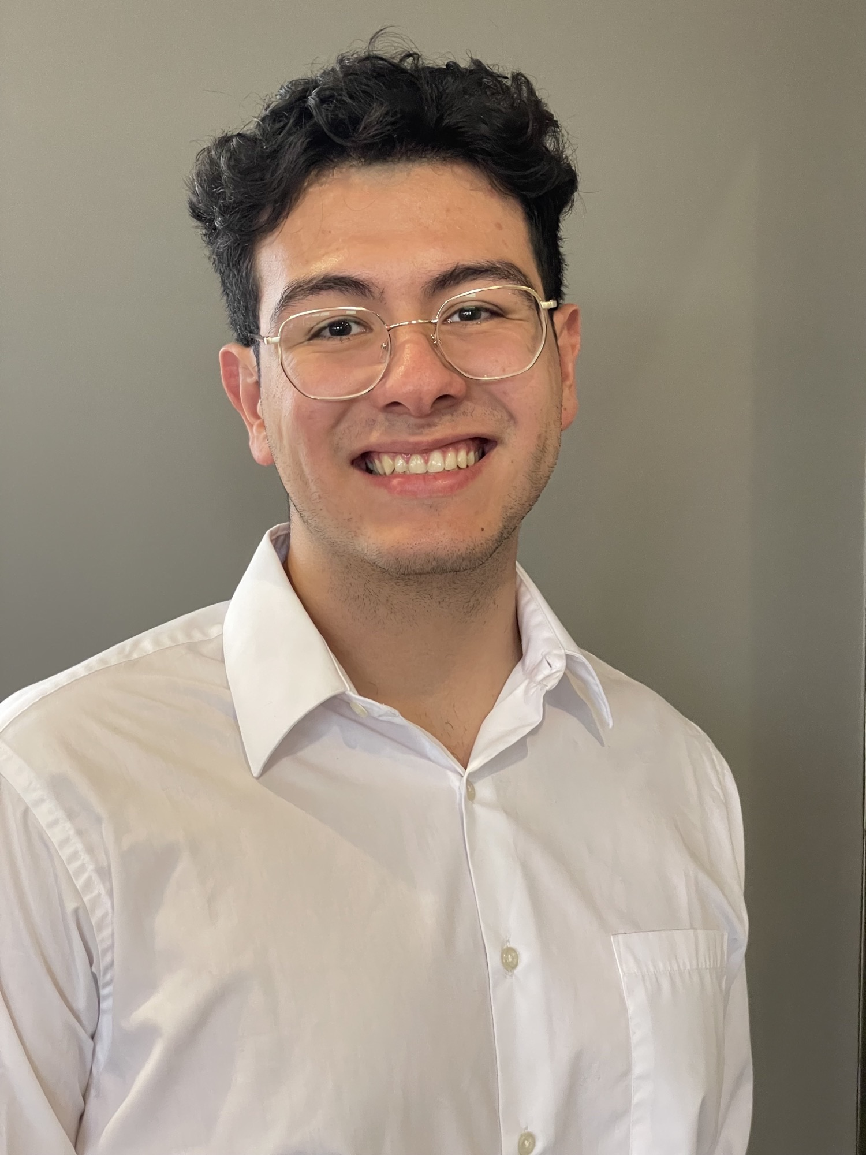

Team 513: Members
Jared Carboy
Systems Engineer
Kaden Lane
Design Engineer
Carlos Sanchez
Mechatronic Engineer
Axcell Vargas
Controls Engineer

Slide 3
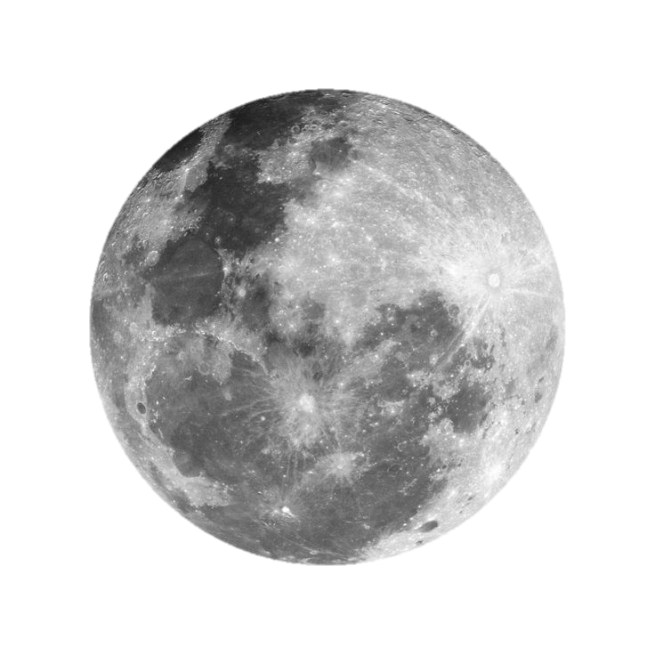
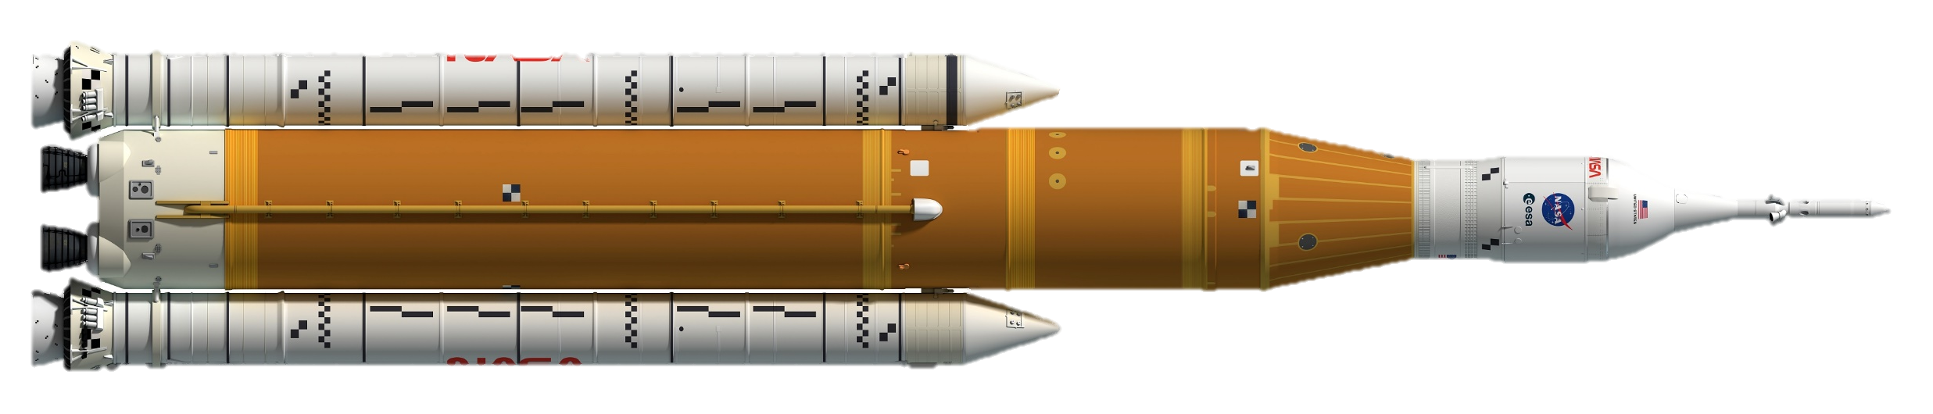

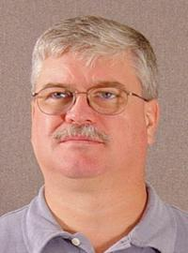


Sponsor & Advisor
Mike Conroy
Engineering Support
Senior Design
Keith Larson
ME Professor
hi

Slide 4
hi

Slide 5
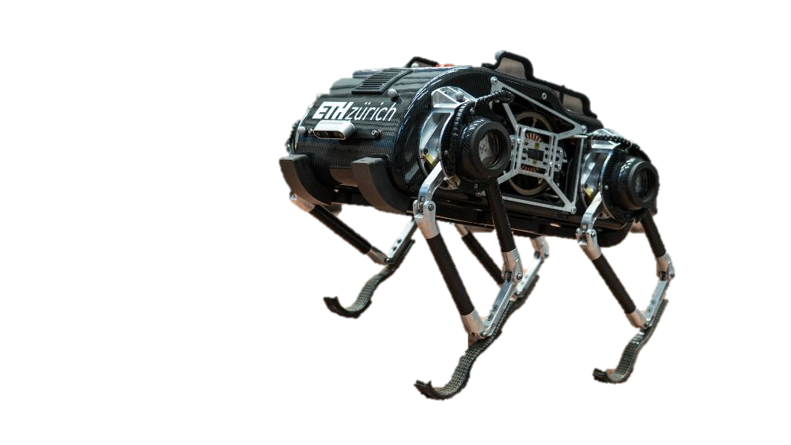
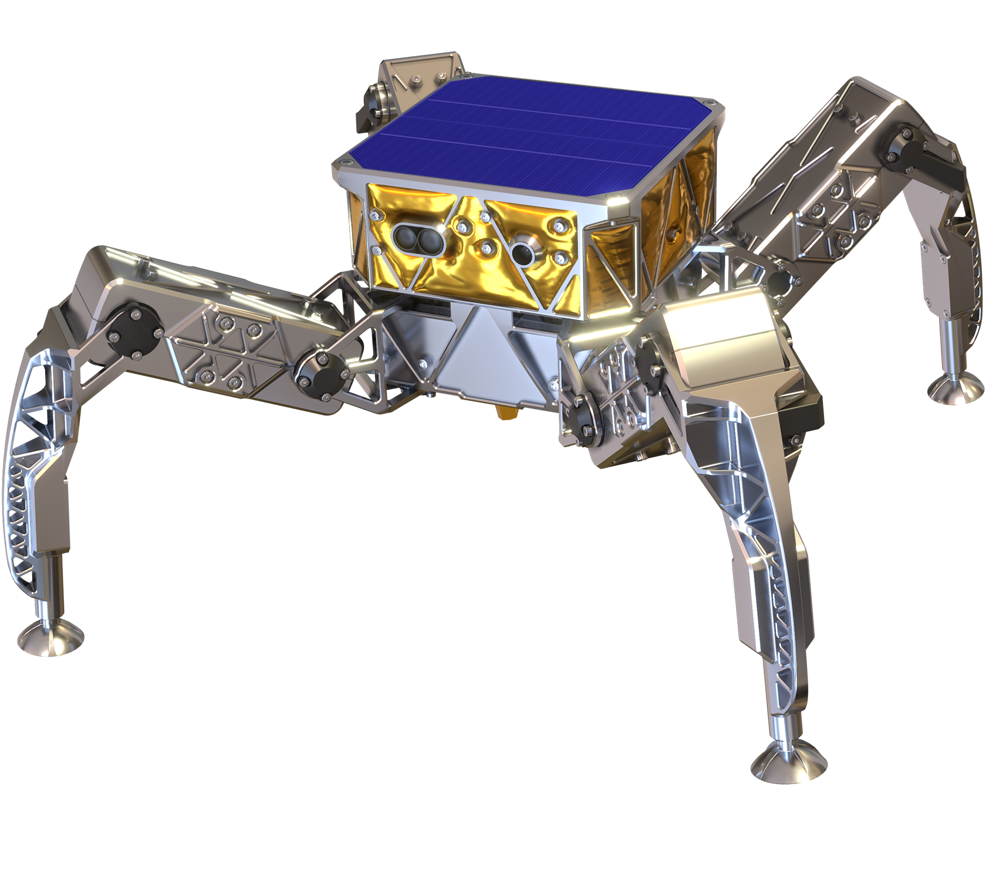
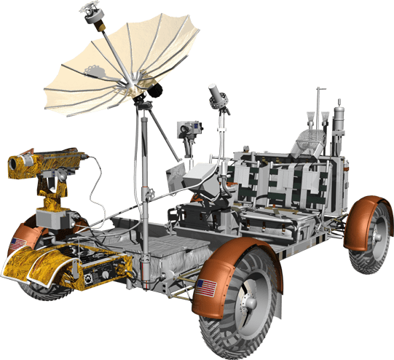
hi
NASA’s 2011 shuttles costed nearly $30,000 per pound of payload to reach low earth orbit
Notes:
Info of space launches
https://www.nbcnews.com/science/space/space-launch-costs-growing-business-industry-rcna23488

Slide 6
hi
NASA’s 2011 shuttles costed nearly $30,000 per pound of payload to reach low earth orbit
Notes:
Info of space launches
https://www.nbcnews.com/science/space/space-launch-costs-growing-business-industry-rcna23488

Slide 7
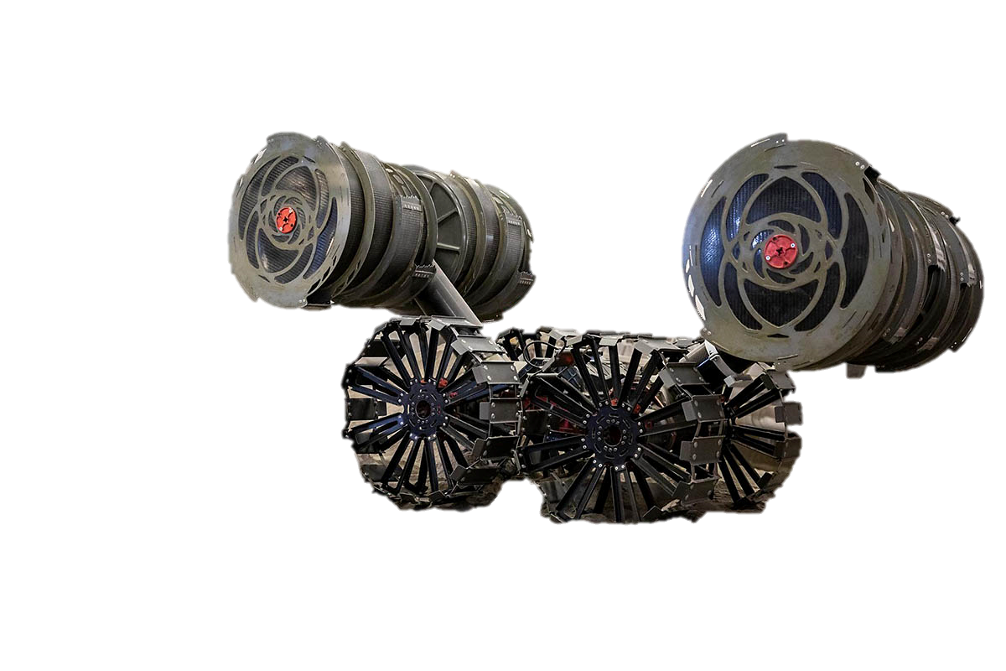
hi
NASA’s 2011 shuttles costed nearly $30,000 per pound of payload to reach low earth orbit
Notes:
Info of space launches
https://www.nbcnews.com/science/space/space-launch-costs-growing-business-industry-rcna23488

Slide 8
Objective
Repurpose the
RE-RASSOR mining robot into a transport system that can lift and move heavy payloads on the moon.
Notes:
Info of space launches
https://www.nbcnews.com/science/space/space-launch-costs-growing-business-industry-rcna23488

Slide 9

FSI wants to make NASA’s RASSOR into a transformable general-purpose platform
Notes:
Info of space launches
https://www.nbcnews.com/science/space/space-launch-costs-growing-business-industry-rcna23488

Slide 10
Objective
Repurpose the
RE-RASSOR mining robot into a transport system that can lift and move heavy payloads on the moon.
Notes:
Info of space launches
https://www.nbcnews.com/science/space/space-launch-costs-growing-business-industry-rcna23488

Slide 11
Objective
Repurpose the
RE-RASSOR mining robot into a transport system that can lift and move heavy payloads on the moon.
Notes:
Info of space launches
https://www.nbcnews.com/science/space/space-launch-costs-growing-business-industry-rcna23488

Slide 12
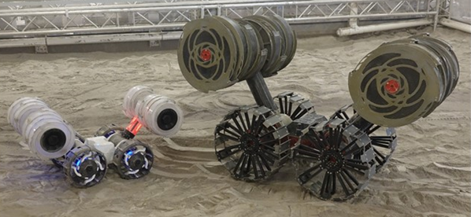

What is RE-RASSOR?

Slide 13
What is RE-RASSOR?
Research and
Education
-
Regolith
Advanced
Surface
System
Operation
Robot

Slide 14

What is RE-RASSOR?
Research and
Education
-
Regolith
Advanced
Surface
System
Operation
Robot

Slide 15

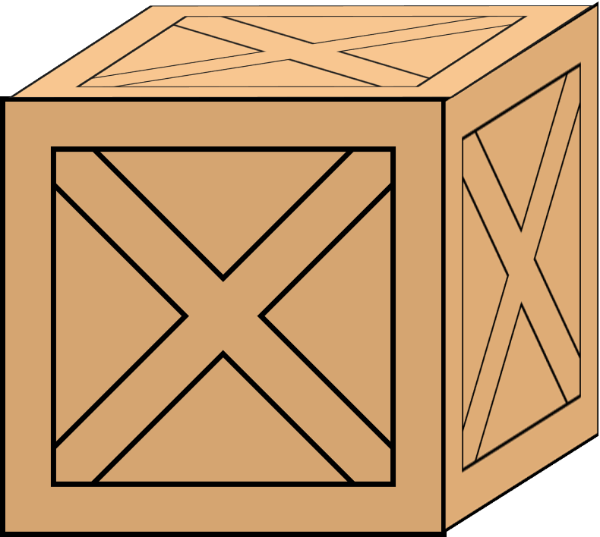



Key Goals
Assumptions
Any payload picked up will have a designed attachment part
3D print all structural parts
HELLO
Use robots in cooperation to pick up the payload
The RE-RASSOR transporter will be used in a classroom setting
Accent1
647 C
Color Values:
RGB 35 97 146
Hex/HTML #236192
CMYK 96 54 5 27
Accent4
2239 C
Color Values:
RGB 0 207 180
Hex/HTML #00CFB4
CMYK 59 0 39 0
Light 1
White
Color Values:
RGB 255 255 255
Hex/HTML #FFFFFF
CMYK 0 0 0 0
Dark 1
100% Black
Color Values:
RGB 0 0 0
Hex/HTML #000000
CMYK 0 0 0 100
Pantone
647 C
Pantone
2239 C
White
Black
Accent 2
2199 C
Color Values:
RGB 0 187 220
Hex/HTML #00BBDC
CMYK 77 0 16 0
Accent5
7535 C
Color Values:
RGB 183 176 156
Hex/HTML #B7B09C
CMYK 10 11 23 19
Light 2
25% Black
Color Values:
RGB 191 191 191
Hex/HTML #bfbfbf
CMYK 0 0 0 25
Dark 2
75 % Black
Color Values:
RGB 64 64 64
Hex/HTML #404040
CMYK 0 0 0 75
Pantone
2199 C
Pantone
7535 C
CoE Lt Gray
CoE Dk Gray
Accent3
1788 C
Color Values:
RGB 238 39 55
Hex/HTML #EE2737
CMYK 0 88 82 0
Accent6
2299 C
Color Values:
RGB 164 210 51
Hex/HTML #A4D233
CMYK 41 0 84 0
Pantone
1788 C
Pantone
2299 C
Notes:
“it is important to note that FSI is planning to add a UCF software engineering team to automate the transport system starting in the spring”

Slide 16
Assumptions
HELLO
The transporter will be traveling on flat surfaces
and inclines up to 5 degrees (maximum ramp slope from ADA)
o
5
Accent1
647 C
Color Values:
RGB 35 97 146
Hex/HTML #236192
CMYK 96 54 5 27
Accent4
2239 C
Color Values:
RGB 0 207 180
Hex/HTML #00CFB4
CMYK 59 0 39 0
Light 1
White
Color Values:
RGB 255 255 255
Hex/HTML #FFFFFF
CMYK 0 0 0 0
Dark 1
100% Black
Color Values:
RGB 0 0 0
Hex/HTML #000000
CMYK 0 0 0 100
Pantone
647 C
Pantone
2239 C
White
Black
Accent 2
2199 C
Color Values:
RGB 0 187 220
Hex/HTML #00BBDC
CMYK 77 0 16 0
Accent5
7535 C
Color Values:
RGB 183 176 156
Hex/HTML #B7B09C
CMYK 10 11 23 19
Light 2
25% Black
Color Values:
RGB 191 191 191
Hex/HTML #bfbfbf
CMYK 0 0 0 25
Dark 2
75 % Black
Color Values:
RGB 64 64 64
Hex/HTML #404040
CMYK 0 0 0 75
Pantone
2199 C
Pantone
7535 C
CoE Lt Gray
CoE Dk Gray
Accent3
1788 C
Color Values:
RGB 238 39 55
Hex/HTML #EE2737
CMYK 0 88 82 0
Accent6
2299 C
Color Values:
RGB 164 210 51
Hex/HTML #A4D233
CMYK 41 0 84 0
Pantone
1788 C
Pantone
2299 C
Notes:
“it is important to note that FSI is planning to add a UCF software engineering team to automate the transport system starting in the spring”

Slide 17
Customer Needs
HI
HELLO
The system will carry a payload maximum of 100 lbs
The system will include 4 robots cooperating
The transport system will attach on to the current robot body
Accent1
647 C
Color Values:
RGB 35 97 146
Hex/HTML #236192
CMYK 96 54 5 27
Accent4
2239 C
Color Values:
RGB 0 207 180
Hex/HTML #00CFB4
CMYK 59 0 39 0
Light 1
White
Color Values:
RGB 255 255 255
Hex/HTML #FFFFFF
CMYK 0 0 0 0
Dark 1
100% Black
Color Values:
RGB 0 0 0
Hex/HTML #000000
CMYK 0 0 0 100
Pantone
647 C
Pantone
2239 C
White
Black
Accent 2
2199 C
Color Values:
RGB 0 187 220
Hex/HTML #00BBDC
CMYK 77 0 16 0
Accent5
7535 C
Color Values:
RGB 183 176 156
Hex/HTML #B7B09C
CMYK 10 11 23 19
Light 2
25% Black
Color Values:
RGB 191 191 191
Hex/HTML #bfbfbf
CMYK 0 0 0 25
Dark 2
75 % Black
Color Values:
RGB 64 64 64
Hex/HTML #404040
CMYK 0 0 0 75
Pantone
2199 C
Pantone
7535 C
CoE Lt Gray
CoE Dk Gray
Accent3
1788 C
Color Values:
RGB 238 39 55
Hex/HTML #EE2737
CMYK 0 88 82 0
Accent6
2299 C
Color Values:
RGB 164 210 51
Hex/HTML #A4D233
CMYK 41 0 84 0
Pantone
1788 C
Pantone
2299 C
Notes:
“it is important to note that FSI is planning to add a UCF software engineering team to automate the transport system starting in the spring”

Slide 18
Customer Needs
HELLO
2m
5m
0.5m
2m
2m
Accent1
647 C
Color Values:
RGB 35 97 146
Hex/HTML #236192
CMYK 96 54 5 27
Accent4
2239 C
Color Values:
RGB 0 207 180
Hex/HTML #00CFB4
CMYK 59 0 39 0
Light 1
White
Color Values:
RGB 255 255 255
Hex/HTML #FFFFFF
CMYK 0 0 0 0
Dark 1
100% Black
Color Values:
RGB 0 0 0
Hex/HTML #000000
CMYK 0 0 0 100
Pantone
647 C
Pantone
2239 C
White
Black
Accent 2
2199 C
Color Values:
RGB 0 187 220
Hex/HTML #00BBDC
CMYK 77 0 16 0
Accent5
7535 C
Color Values:
RGB 183 176 156
Hex/HTML #B7B09C
CMYK 10 11 23 19
Light 2
25% Black
Color Values:
RGB 191 191 191
Hex/HTML #bfbfbf
CMYK 0 0 0 25
Dark 2
75 % Black
Color Values:
RGB 64 64 64
Hex/HTML #404040
CMYK 0 0 0 75
Pantone
2199 C
Pantone
7535 C
CoE Lt Gray
CoE Dk Gray
Accent3
1788 C
Color Values:
RGB 238 39 55
Hex/HTML #EE2737
CMYK 0 88 82 0
Accent6
2299 C
Color Values:
RGB 164 210 51
Hex/HTML #A4D233
CMYK 41 0 84 0
Pantone
1788 C
Pantone
2299 C
Notes:
“it is important to note that FSI is planning to add a UCF software engineering team to automate the transport system starting in the spring”

Slide 19
Customer Needs
HELLO
5m
0.5m
2m
2m
5 cm
2m
Accent1
647 C
Color Values:
RGB 35 97 146
Hex/HTML #236192
CMYK 96 54 5 27
Accent4
2239 C
Color Values:
RGB 0 207 180
Hex/HTML #00CFB4
CMYK 59 0 39 0
Light 1
White
Color Values:
RGB 255 255 255
Hex/HTML #FFFFFF
CMYK 0 0 0 0
Dark 1
100% Black
Color Values:
RGB 0 0 0
Hex/HTML #000000
CMYK 0 0 0 100
Pantone
647 C
Pantone
2239 C
White
Black
Accent 2
2199 C
Color Values:
RGB 0 187 220
Hex/HTML #00BBDC
CMYK 77 0 16 0
Accent5
7535 C
Color Values:
RGB 183 176 156
Hex/HTML #B7B09C
CMYK 10 11 23 19
Light 2
25% Black
Color Values:
RGB 191 191 191
Hex/HTML #bfbfbf
CMYK 0 0 0 25
Dark 2
75 % Black
Color Values:
RGB 64 64 64
Hex/HTML #404040
CMYK 0 0 0 75
Pantone
2199 C
Pantone
7535 C
CoE Lt Gray
CoE Dk Gray
Accent3
1788 C
Color Values:
RGB 238 39 55
Hex/HTML #EE2737
CMYK 0 88 82 0
Accent6
2299 C
Color Values:
RGB 164 210 51
Hex/HTML #A4D233
CMYK 41 0 84 0
Pantone
1788 C
Pantone
2299 C
Notes:
“it is important to note that FSI is planning to add a UCF software engineering team to automate the transport system starting in the spring”

Slide 20
Customer Needs
HELLO
5m
0.5m
2m
0.18m
2m
2m
0.4m
Accent1
647 C
Color Values:
RGB 35 97 146
Hex/HTML #236192
CMYK 96 54 5 27
Accent4
2239 C
Color Values:
RGB 0 207 180
Hex/HTML #00CFB4
CMYK 59 0 39 0
Light 1
White
Color Values:
RGB 255 255 255
Hex/HTML #FFFFFF
CMYK 0 0 0 0
Dark 1
100% Black
Color Values:
RGB 0 0 0
Hex/HTML #000000
CMYK 0 0 0 100
Pantone
647 C
Pantone
2239 C
White
Black
Accent 2
2199 C
Color Values:
RGB 0 187 220
Hex/HTML #00BBDC
CMYK 77 0 16 0
Accent5
7535 C
Color Values:
RGB 183 176 156
Hex/HTML #B7B09C
CMYK 10 11 23 19
Light 2
25% Black
Color Values:
RGB 191 191 191
Hex/HTML #bfbfbf
CMYK 0 0 0 25
Dark 2
75 % Black
Color Values:
RGB 64 64 64
Hex/HTML #404040
CMYK 0 0 0 75
Pantone
2199 C
Pantone
7535 C
CoE Lt Gray
CoE Dk Gray
Accent3
1788 C
Color Values:
RGB 238 39 55
Hex/HTML #EE2737
CMYK 0 88 82 0
Accent6
2299 C
Color Values:
RGB 164 210 51
Hex/HTML #A4D233
CMYK 41 0 84 0
Pantone
1788 C
Pantone
2299 C
Notes:
“it is important to note that FSI is planning to add a UCF software engineering team to automate the transport system starting in the spring”

Slide 21

Critical Targets
Payload to Transporter Connection Load Support
Payload to Transporter Connection Load Support
100 lbs
Payload to Transporter Connection Load Support
Payload to Transporter Connection Accessibility
Payload Vertical Translation
0.3m
Connection is possible when the payload is rotated 0-360°
100 lbs
# of connections
0.3m in Z-axis

Slide 22




Concept Generation
Brain Writing
Biomimicry
Morphological
Chart
Crapshoot

Slide 23
Medium Fidelity Concepts
Pulley system with hook connection mechanism
Multiple robots with ramps wedge beneath payload and lift together
One robot operates as a counterweight for the other to lift payload
One robot tips the payload onto platform of second robot
Four Robots use linear elevator to lift the payload

Slide 24
High Fidelity Concepts

Slide 25




Concept Selection
Pairwise Comparison
House of Quality
Pugh
Chart
Analytical Hierarchy Process
S

Slide 26


Concept Selection
House of Quality
Translate Payload
Payload to Transporter Connection Accessibility

Slide 27
Concept Selection
Pugh Chart

Slide 28
Concept Selection
Pugh Chart

Slide 29
Concept Selection
Pugh Chart

Slide 30
Selected Lifting Mechanism
Shoulder Driven “Five”-bar
Based on already available Motors and joints
5-bar Geometry yields high mechanical advantage
Lifting is not constrained to the vertical axis

Slide 31
Selected Lifting Mechanism
Shoulder Driven “Five”-bar
Based on already available Motors and joints
5-bar Geometry yields high mechanical advantage
Lifting is not constrained to the vertical axis

Slide 32
Selected Lifting Mechanism
Shoulder Driven “Five”-bar
Based on already available Motors and joints
5-bar Geometry yields high mechanical advantage
Lifting is not constrained to the vertical axis
4
3
5
2
6
1

Slide 33
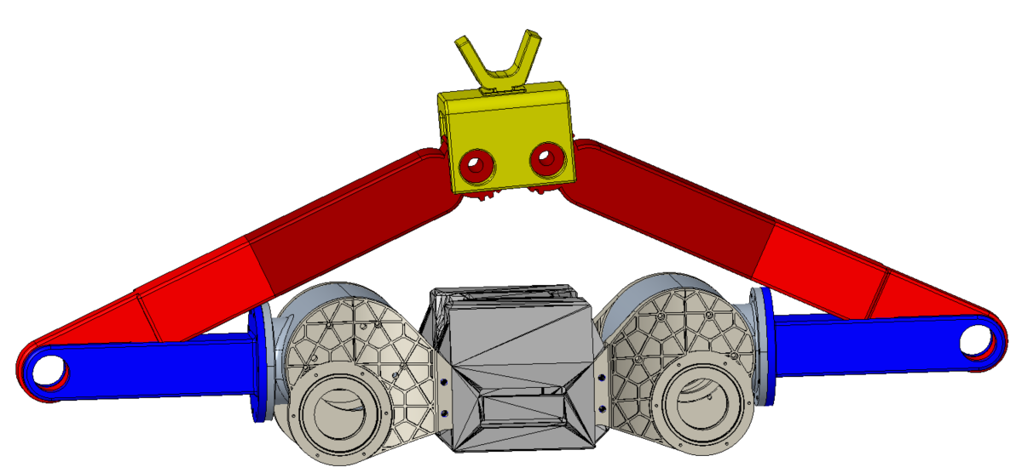
Selected Lifting Mechanism
Shoulder Driven “Five”-bar
Based on already available Motors and joints
5-bar Geometry yields high mechanical advantage
Lifting is not constrained to the vertical axis

Slide 34
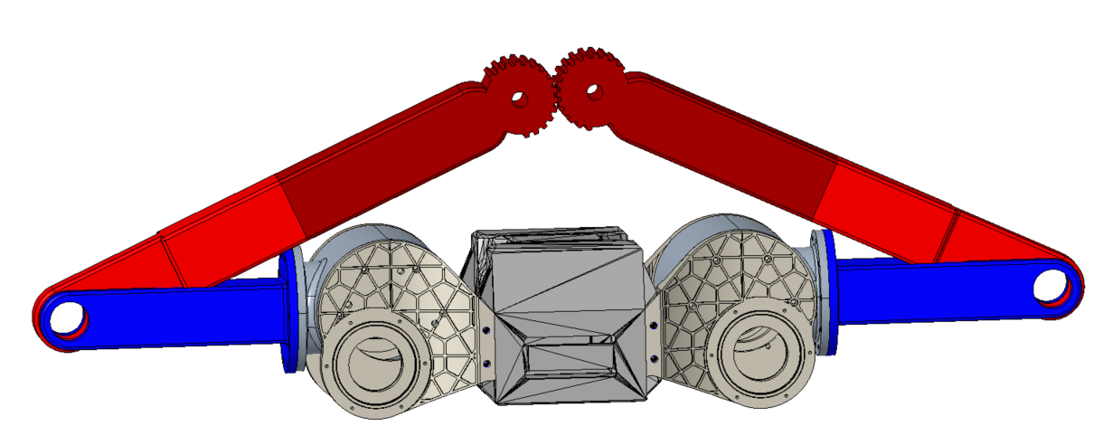
Selected Lifting Mechanism
Shoulder Driven “Five”-bar
Based on already available Motors and joints
5-bar Geometry yields high mechanical advantage
Lifting is not constrained to the vertical axis

Slide 35
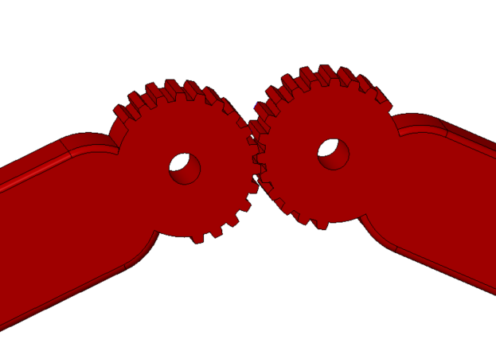
Selected Lifting Mechanism
Shoulder Driven “Five”-bar
Based on already available Motors and joints
5-bar Geometry yields high mechanical advantage
Lifting is not constrained to the vertical axis

Slide 36
Selected Lifting Mechanism
Shoulder Driven “Five”-bar
Based on already available Motors and joints
5-bar Geometry yields high mechanical advantage
Lifting is not constrained to the vertical axis

Slide 37
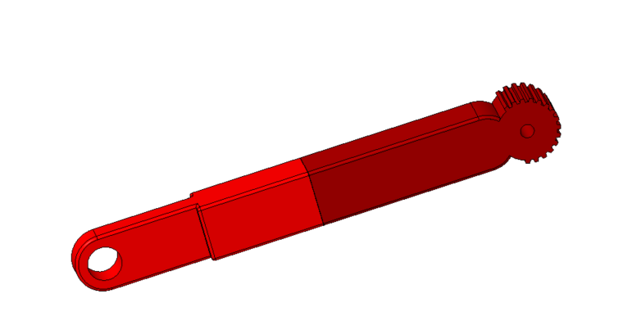
Selected Lifting Mechanism
Shoulder Driven “Five”-bar
Based on already available Motors and joints
5-bar Geometry yields high mechanical advantage
Lifting is not constrained to the vertical axis

Slide 38
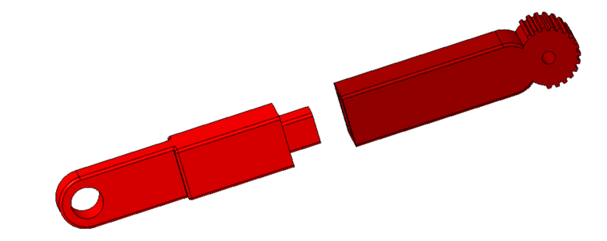
Selected Lifting Mechanism
Shoulder Driven “Five”-bar
Based on already available Motors and joints
5-bar Geometry yields high mechanical advantage
Lifting is not constrained to the vertical axis

Slide 39

Selected Lifting Mechanism
Shoulder Gearbox
Designed by a Senior Design team at Florida Polytechnic
Shoulders output 25 lb-ft of torque
Theoretical minimum lifting force of 88 lbs

Slide 40
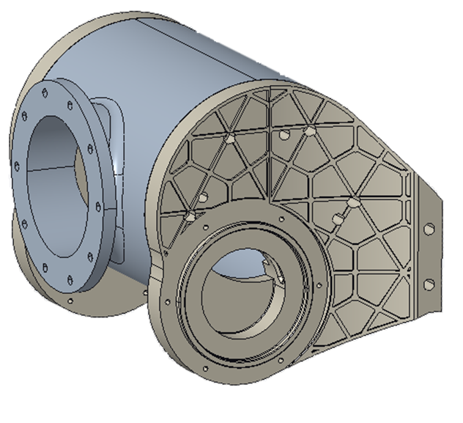
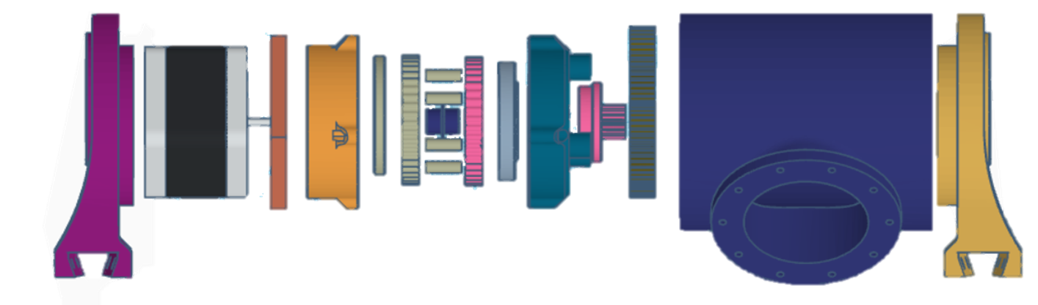
Selected Lifting Mechanism
Shoulder Gearbox
Designed by a Senior Design team at Florida Polytechnic
Shoulders output 25 lb-ft of torque
Theoretical minimum lifting force of 88 lbs

Slide 41
Selected Lifting Mechanism
Shoulder Gearbox
Designed by a Senior Design team at Florida Polytechnic
Shoulders output 25 lb-ft of torque
Theoretical minimum lifting force of 88 lbs

Slide 42
Selected Lifting Mechanism
88 lbs
Shoulder Gearbox
Designed by a Senior Design team at Florida Polytechnic
Shoulders output 25 lb-ft of torque
Theoretical minimum lifting force of 88 lbs
44 lbs
44 lbs
0.6 ft

Slide 43
Selected Payload Connection
V-Shaped Peg Connector
Can be lifted from directly underneath
3 tangent connection points for increased stability
Allows RE-RASSOR to tilt the payload to compensate for incline

Slide 44
Selected Payload Connection
V-Shaped Peg Connector
Can be lifted from directly underneath
3 tangent connection points for increased stability
Allows RE-RASSOR to tilt the payload to compensate for incline
U-Shaped Peg Connector
Can be lifted from directly underneath
Allows RE-RASSOR to tilt the payload to compensate for incline

Slide 45
Selected Payload Connection
V-Shaped Peg Connector
Can be lifted from directly underneath
3 tangent connection points for increased stability
Allows RE-RASSOR to tilt the payload to compensate for incline
U-Shaped Peg Connector
Can be lifted from directly underneath
Allows RE-RASSOR to tilt the payload to compensate for incline

Slide 46
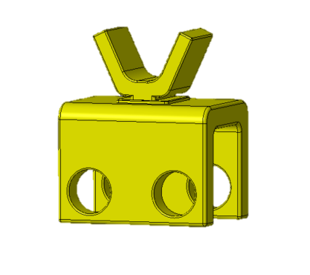
Selected Payload Connection
V-Shaped Peg Connector
Can be lifted from directly underneath
3 tangent connection points for increased stability
Allows RE-RASSOR to tilt the payload to compensate for incline
U-Shaped Peg Connector
Can be lifted from directly underneath
Allows RE-RASSOR to tilt the payload to compensate for incline

Slide 47
Selected Payload Connection

Slide 48
Selected Payload Connection

Slide 49
Lifting Technique
0.25m
0.25m

Slide 50
Lifting Technique

Slide 51
Lifting Technique

Slide 52
Lifting Technique

Slide 53
Weight distribution on incline

Slide 54
Weight distribution on incline
Center of gravity moved closer to the back

Slide 55
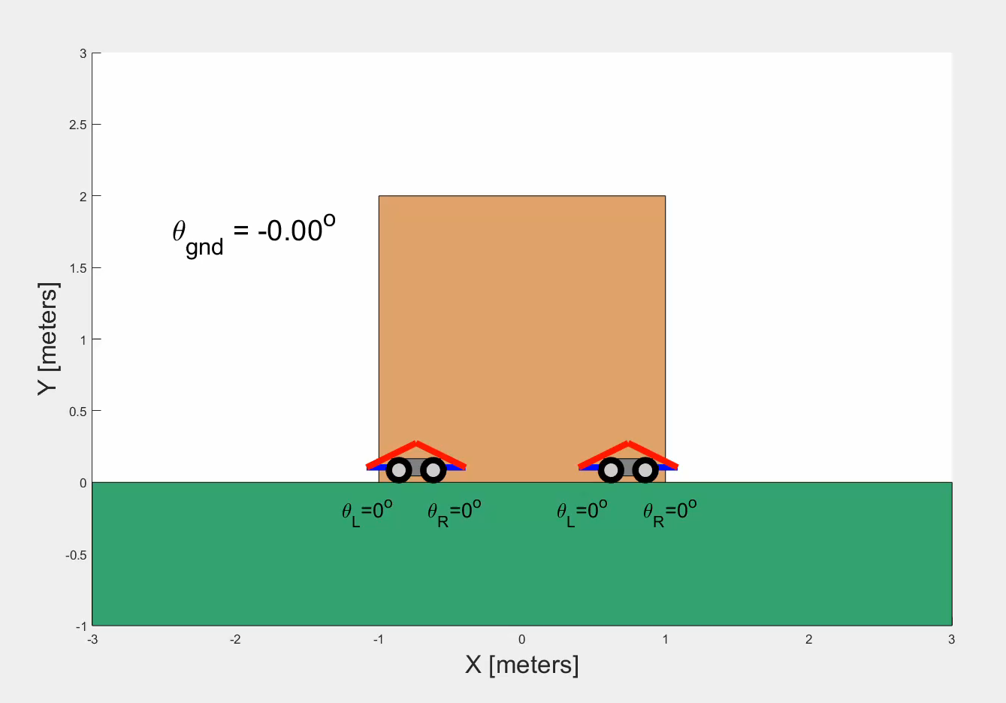
Tipping Prevention
MATLAB Animation
Inverse kinematics of 5-bar corrects 3 degree inclines
Real RE-RASSOR will have an inertial measurement unit to sense inclines

Slide 56
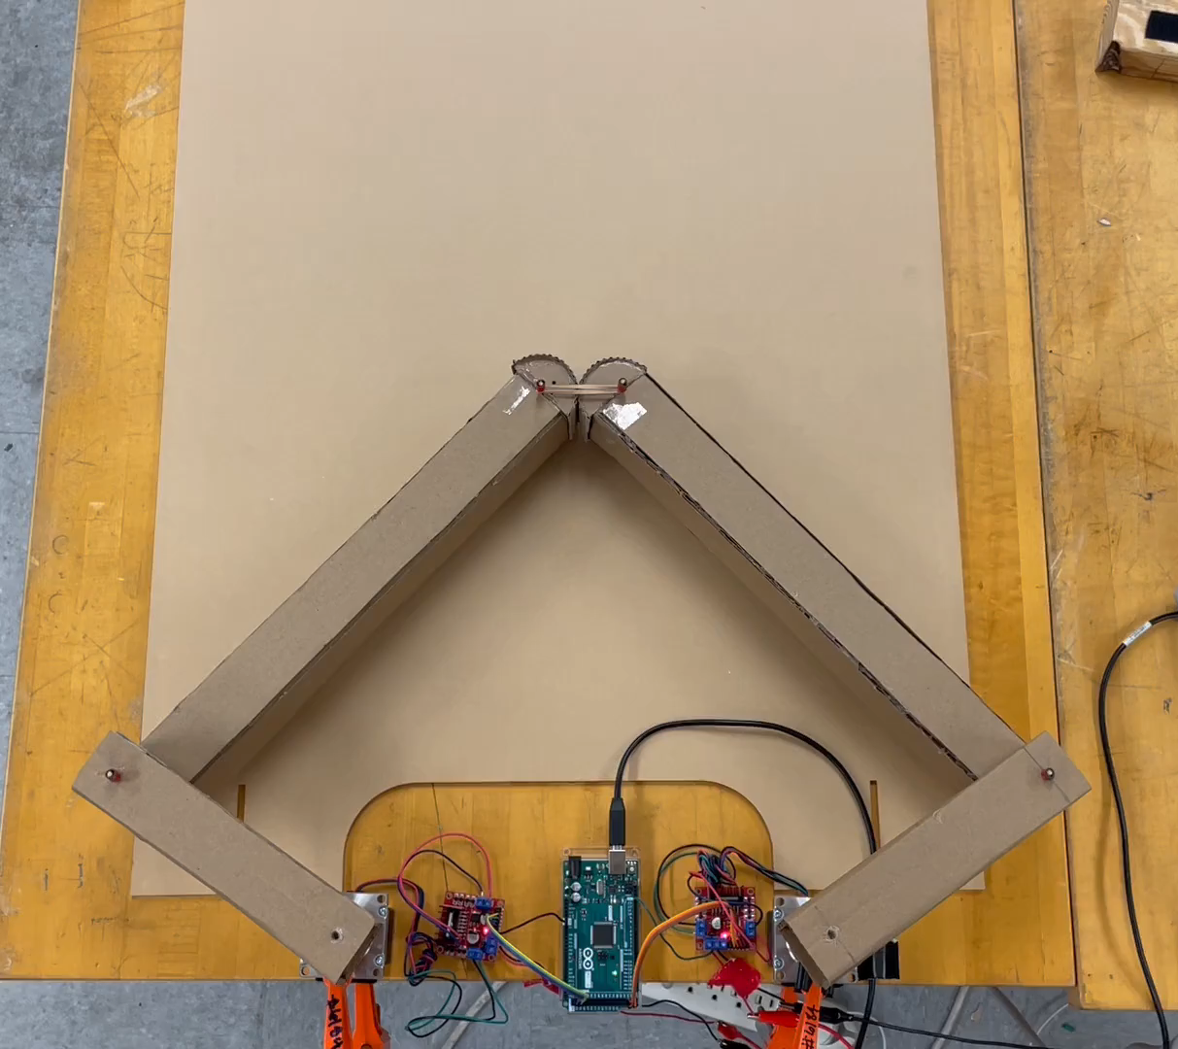
Tipping Prevention
Motor Driven Prototype
Follows path of the MATLAB animation
Determined current stepper motor drivers were unfit

Slide 57
Mechanical Testing

Slide 58
Mechanical Testing
Structural Testing
h
Testing strength and durability of 3D printed components
Increased weight increments of 5 lbs until failure

Slide 59
Mechanical Testing
Torque Testing
h
Confirming shoulder torque from Florida poly sci team
Increase weight increment of 5 lbs until failure

Slide 60
Mechanical Testing
Torque Testing
h
Confirming shoulder torque from Florida poly sci team
Increase weight increment of 5 lbs until failure

Slide 61
Purchasing
Total Budget
Spent
Encumbered
Remaining
$454
$287.39
$88.46
$78.15

Slide 62
Purchasing
Electronics
Fasteners & Hardware
$188.21
47%
$187.64
47%
$24.99
6%
3D Printing Material

Slide 63



Purchasing
3D Printing Material
Electronics
f
Fasteners & Hardware

Slide 64
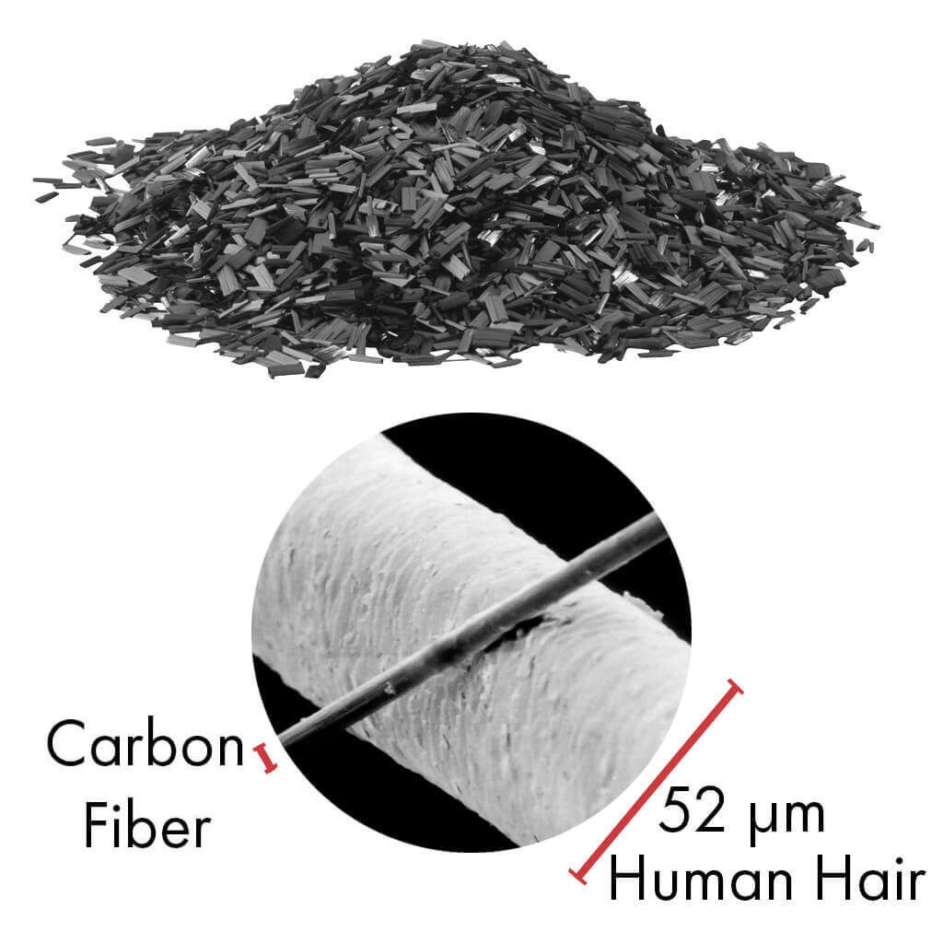
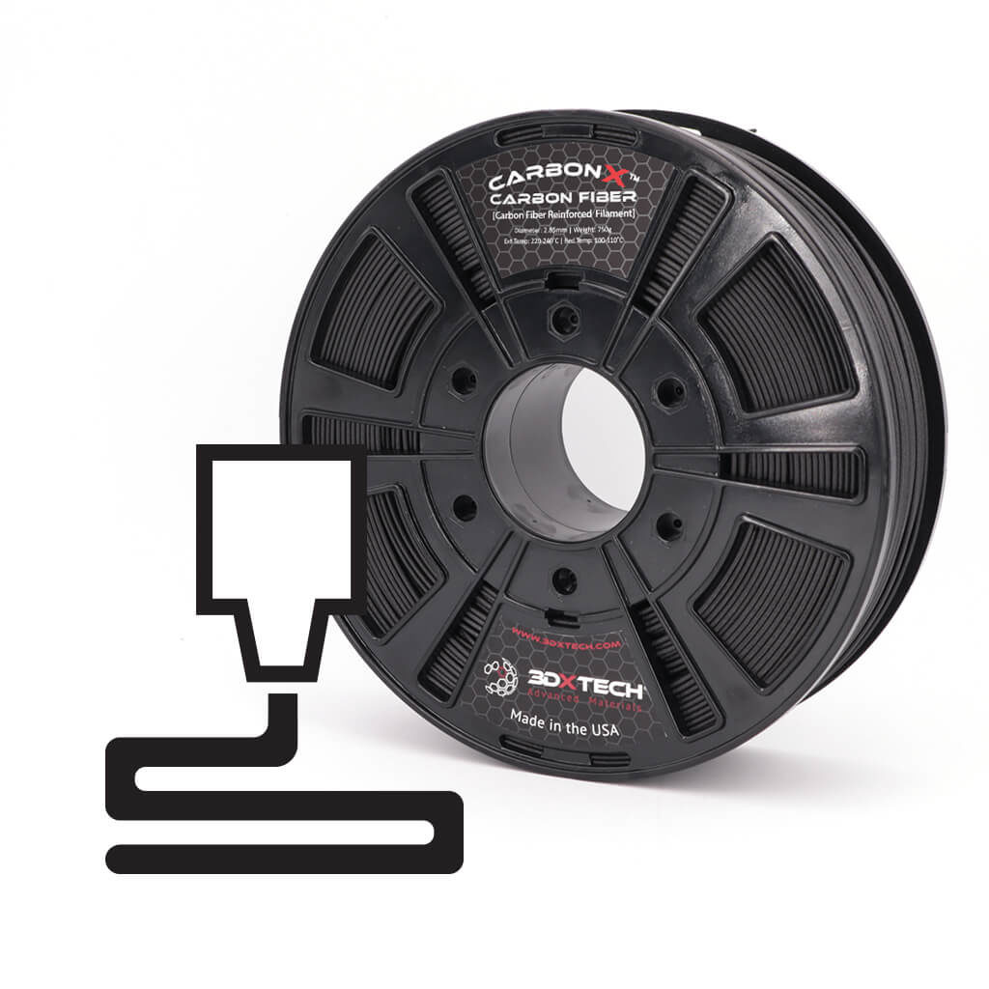
Purchasing
Polycarbonate filament
  High tensile strength
  Extremely high heat deflection
  Low weight
  Impact resistance
  Bends without breaking

Slide 65
Purchasing
3D Printing Material
Electronics
f
Fasteners & Hardware

Slide 66
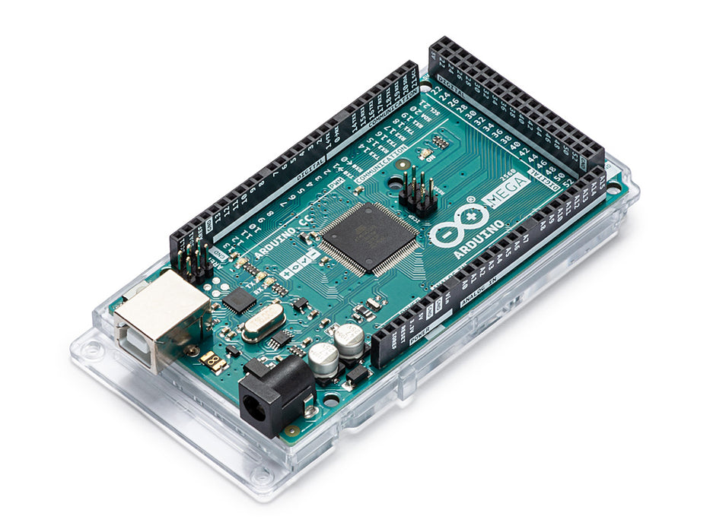
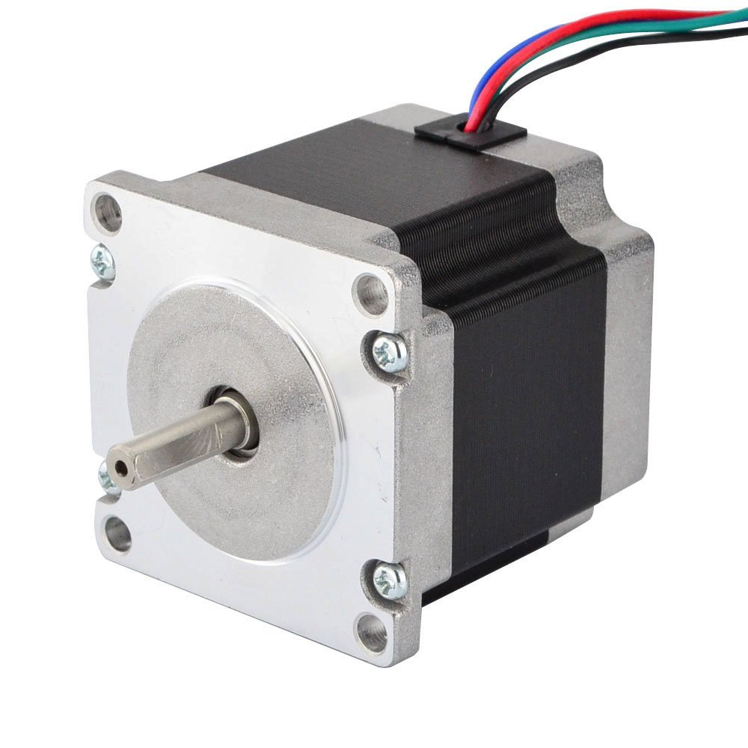
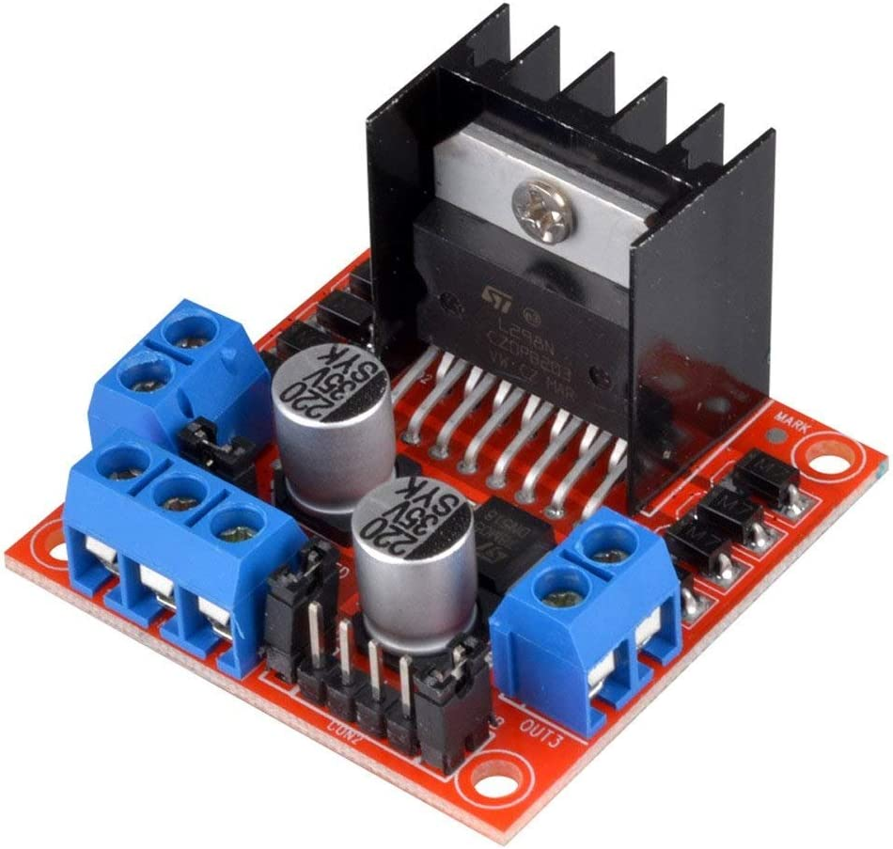
Purchasing
  Electronics
  Purchased
  Arduino Mega 2560
  Nema 23 Stepper Motor
  Wire Pack
  Pending
  Stepper Motor Driver
  IMU

Slide 67
Purchasing
3D Printing Material
Electronics
f
Fasteners & Hardware

Slide 68
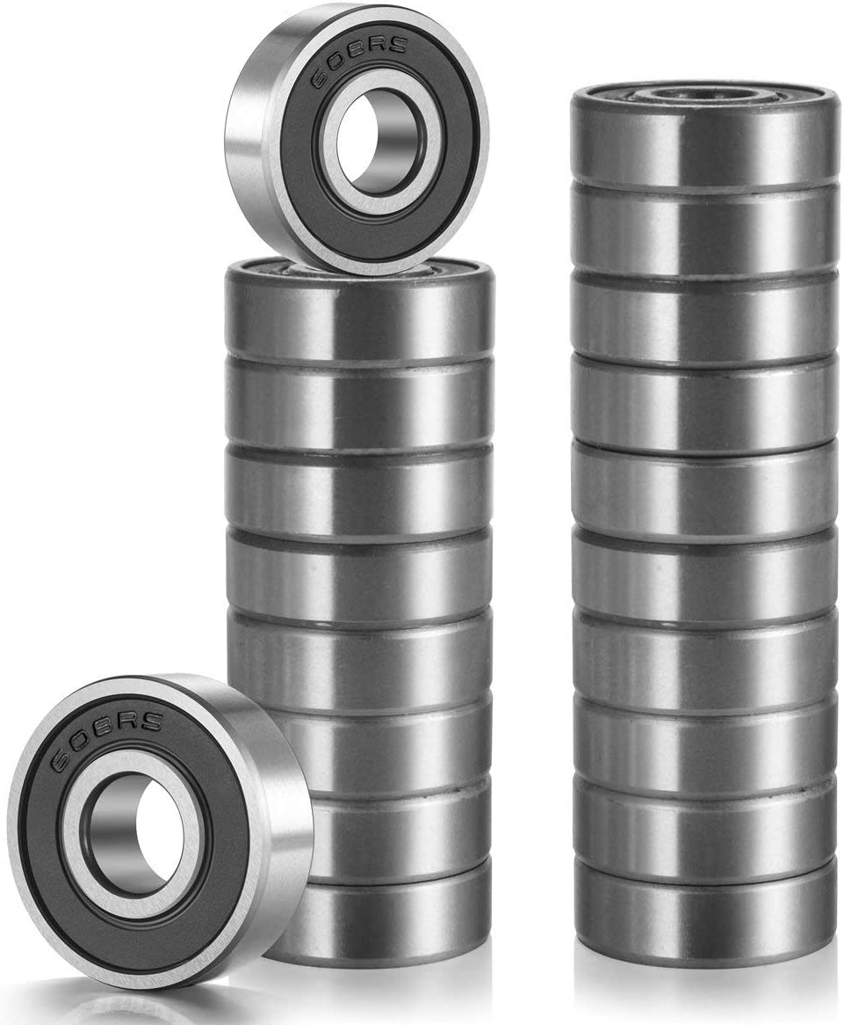
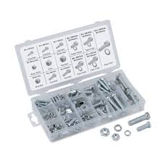
Purchasing
  Assembly Fasteners
  Bearings at joint connections and shoulder assembly
  Assortment pack for full shoulder assembly
  Binding barrels for joint bearing connection

Slide 69

Future Work
3/2
Mechanical Testing
3/10
Finish Controller
3/17
Payload Testing
4/5
Final Design

Slide 70



Future Work
2/2
3D Print Components
Mechanical Testing
Final Design

Slide 71
Future Work
2/2
2/13
Mechanical Testing
Final Design

Slide 72
Future Work
2/2
2/13
2/21
Final Design

Slide 73
Future Work
2/2
2/13
2/21
2/28

Slide 74
Future Work-for website
2/2
Finish purchasing essential components
2/8
Finish building shoulders for single robot, begin tests with single weights
2/20
Finish building second robot and testing apparatus
2/28
Finish electronics and control of the two robot system

Slide 75
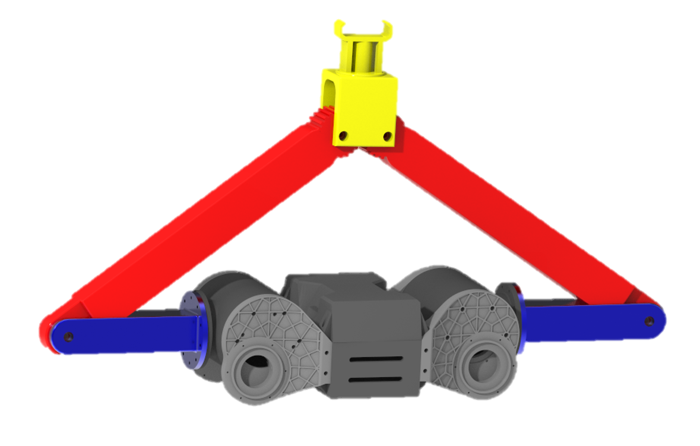
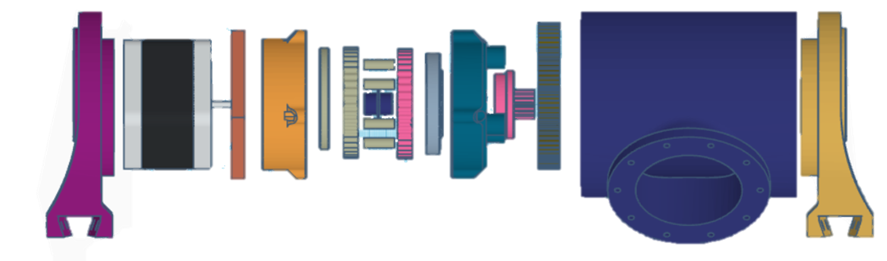
Future Work
3D Print Components
Mechanical Testing
Build Payloads
Final Design

Slide 76
Concept Selection
Pairwise Comparison
House of Quality
Pugh
Chart
Analytical Hierarchy Process
S

Slide 77
Functional Decomposition
Connection
Payload Motion
Control

Slide 78
Targets
Functional Decomposition
RE-RASSOR to Transporter Connection Accessibility
Motor Torque Management
Vertical Translation
Payload Motion
Ease of Attachment
Payload to Transporter Connection Accessibility
Stabilize Payload During Locomotion
Receive Signal
Connection
Payload to Transporter Connection Confirmation
Human Control Accessibility
Send Signal
Payload to Transporter Connection Load Support
Control
Load Support
Microcontroller Communication
Transduce Signal
RE-RASSOR to Transporter Connection Load Support

Slide 79
Critical Targets
Functional Decomposition
Targets
RE-RASSOR to Transporter Connection Accessibility
Motor Torque Management
Vertical Translation
2 min
1 ft
1 ft
Payload Motion
Ease of Attachment
Payload to Transporter Connection Accessibility
Stabilize Payload During Locomotion
360°
10 N
360°
Receive Signal
5v
Connection
Payload to Transporter Connection Confirmation
Human Control Accessibility
Send Signal
Payload to Transporter Connection Load Support
N/A
5v
100 lbs
100 lbs
Control
Load Support
Microcontroller Communication
Transduce Signal
RE-RASSOR to Transporter Connection Load Support
16 bit ADC
25 lbs

Slide 80
Targets
Functional Decomposition
Critical Targets
Payload to Transporter Connection Load Support
Vertical Translation
Payload to Transporter Connection Accessibility
100 lbs
1 ft
360°
Payload to Transporter Connection Load Support
Payload to Transporter Connection Accessibility
Payload Vertical Translation
100 lbs
1 ft
0-360°

Slide 81
Functional Decomposition
Critical Targets
Payload to Transporter Connection Load Support
Vertical Translation
Payload to Transporter Connection Accessibility
100 lbs
1 ft
360°
Payload to Transporter Connection Load Support
Payload to Transporter Connection Accessibility
Payload Vertical Translation
1 ft
0-360°
100 lbs
# of connections

Slide 82
Critical Targets
Payload to Transporter Connection Load Support
Vertical Translation
Payload to Transporter Connection Accessibility
100 lbs
1 ft
360°
Payload to Transporter Connection Load Support
Payload to Transporter Connection Accessiblity
Payload Vertical Translation
0-360°
1ft
100 lbs
# of connections
1 ft in Z-azis

Slide 83
Functional Decomposition
Critical Targets
Payload to Transporter Connection Load Support
Vertical Translation
Payload to Transporter Connection Accessibility
100 lbs
1 ft
360°
Payload to Transporter Connection Load Support
Payload to Transporter Connection Accessiblity
Payload Vertical Translation
1ft
Connection is possible when the payload is rotated 0-360°
100 lbs
# of connections
1 ft in Z-azis

Slide 84
Concept Generation
Brain Writing
Biomimicry
Morphological
Chart
Crapshoot

Slide 85
RE-RASSOR Transporter: Components
Lifting Mechanism
Transporter to RE-RASSOR Connector
Transporter to Payload Connector

Slide 86
RE-RASSOR Transporter: Components
Transporter to RE-RASSOR Connector

Slide 87
RE-RASSOR Transporter: Components
Transporter to RE-RASSOR Connector

Slide 88
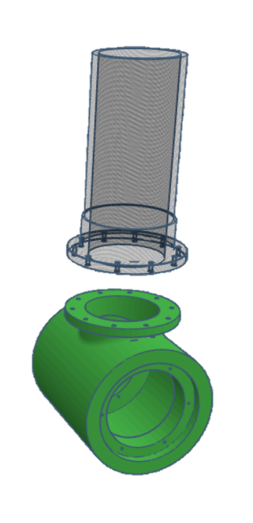
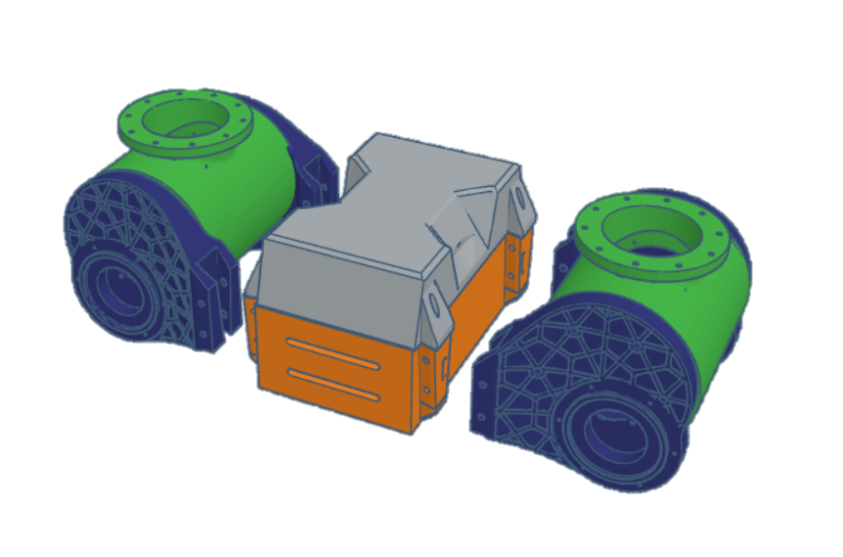
RE-RASSOR Transporter: Components
Transporter to RE-RASSOR Connector
Shoulder Connector

Slide 89
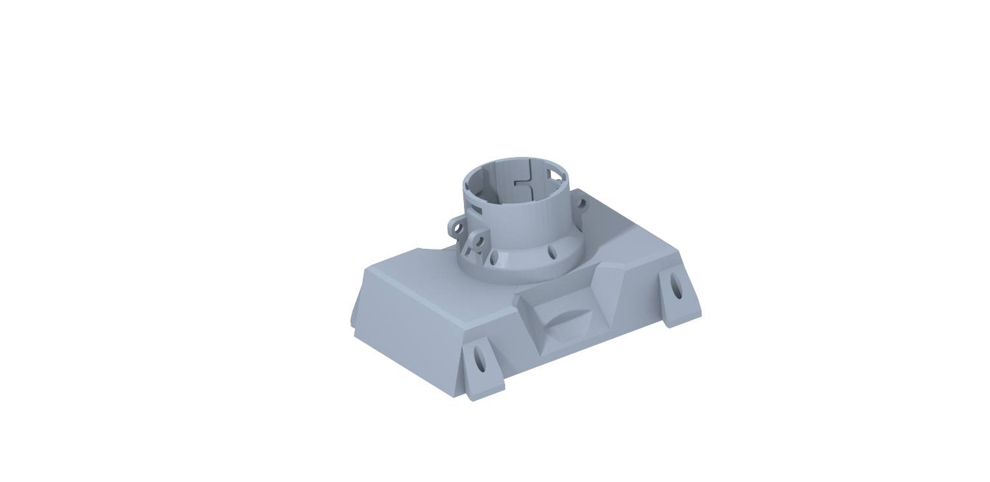
RE-RASSOR Transporter: Components
Transporter to RE-RASSOR Connector
Body Connector

Slide 90
RE-RASSOR Transporter: Components
Lifting Mechanism
Transporter to RE-RASSOR Connector
Transporter to Payload Connector

Slide 91
RE-RASSOR Transporter: Components
Transporter to Payload Connector

Slide 92
RE-RASSOR Transporter: Components
Transporter to Payload Connector

Slide 93

RE-RASSOR Transporter: Components
Transporter to Payload Connector
5m
2m
0.5m
2m
2m

Slide 94
RE-RASSOR Transporter: Components
Transporter to Payload Connector
5m
0.5m
2m
0.18m
2m
2m
0.4m

Slide 95
RE-RASSOR Transporter: Components
Transporter to Payload Connector

Slide 96
RE-RASSOR Transporter: Components
Transporter to Payload Connector

Slide 97
High Fidelity Concepts
Shoulder Driven Five-bar
Based on already available Motors and joints
Load is distributed across motors
Fully enclosed joints

Slide 98
High Fidelity Concepts
Shoulder Driven Five-bar
Based on already available Motors and joints
Load is distributed across motors
Fully enclosed joints

Slide 99
High Fidelity Concepts
Multi-Robot Car Jack
Multiple robots attached mechanisms for lift
High mechanical advantage mechanism
Less chance of longitudinal tipping

Slide 100
High Fidelity Concepts
Multi-Robot Car Jack
Multiple robots attached mechanisms for lift
High mechanical advantage mechanism
Less chance of longitudinal tipping

Slide 101
High Fidelity Concepts
Single robot Car Jack
Simple lifting mechanism with high mechanical advantage
Motor driven vertical translation

Slide 102
High Fidelity Concepts
Single robot Car Jack
Simple lifting mechanism with high mechanical advantage
Motor driven vertical translation

Slide 103
Concept Selection
House of Quality
Translate Payload
Payload to Transporter Connection Accessibility

Slide 104
Final Selection:
Shoulder Driven 5-Bar
Reutilized shoulder joints driving down cost and weight
Less assembly required
Connection mechanism manipulated in two planes
High stability and lifting force

Slide 105
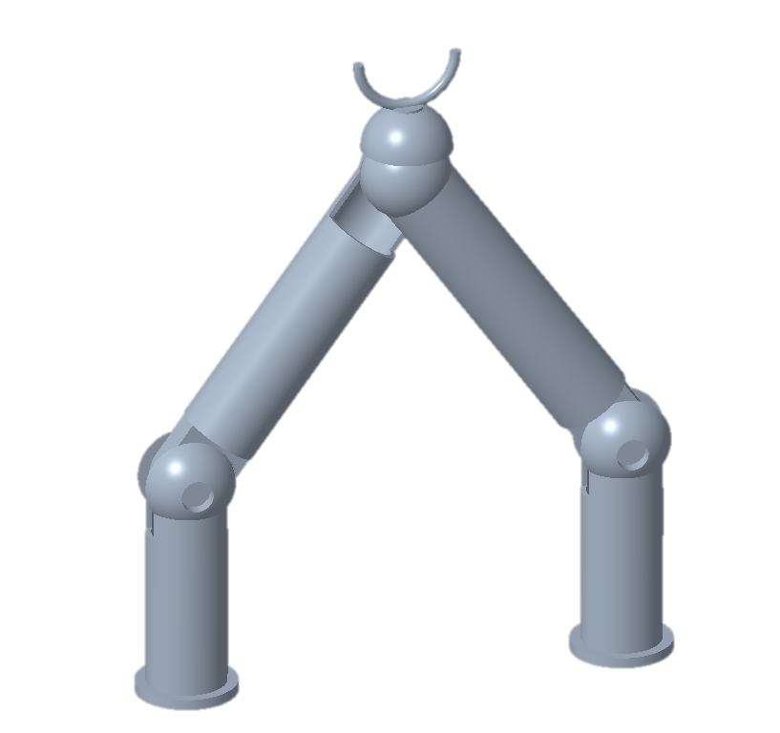
Final Selection:
Shoulder Driven 5-Bar

Slide 106




Future Work
Continue Prototyping
Risk Assessment
Bill of Materials
Spring
Plan

Slide 107
Backup Slides

Slide 108
Next steps
Spring Project Plan
Risk Assessment
Bill of Materials

Slide 109
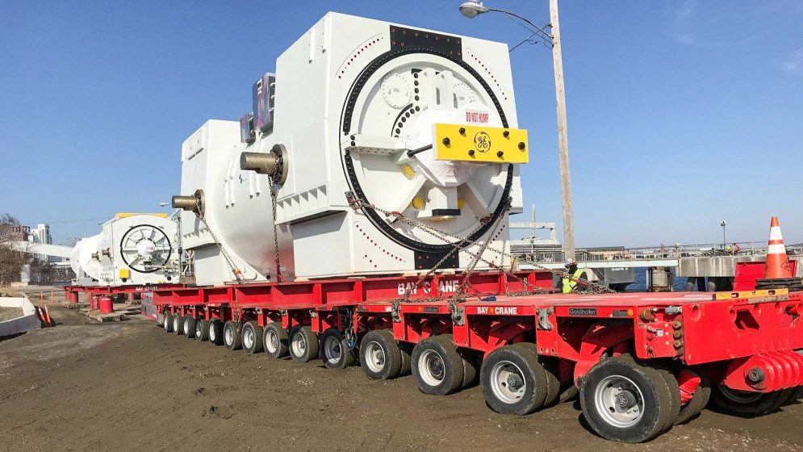

Slide 110
College of Engineering Color Palette
2299 C
Color Values:
RGB 164 210 51
Hex/HTML #A4D233
CMYK 41 0 84 0
1788 C
Color Values:
RGB 238 39 55
Hex/HTML #EE2737
CMYK 0 88 82 0
75% Black
Color Values:
RGB 64 64 64
Hex/HTML #404040
CMYK 0 0 0 75
Pantone
2299 C
Pantone
1788 C
CoE Dk Gray
2239 C
Color Values:
RGB 0 207 180
Hex/HTML #00CFB4
CMYK 59 0 39 0
647 C
Color Values:
RGB 35 97 146
Hex/HTML #236192
CMYK 96 54 5 27
50% Black
Color Values:
RGB 128 128 128
Hex/HTML #808080
CMYK 0 0 0 50
Pantone
2239 C
Pantone
647 C
CoE Md Gray
2199 C
Color Values:
RGB 0 187 220
Hex/HTML #00BBDC
CMYK 77 0 16 0
7535 C
Color Values:
RGB 183 176 156
Hex/HTML #B7B09C
CMYK 10 11 23 19
25% Black
Color Values:
RGB 191 191 191
Hex/HTML #bfbfbf
CMYK 0 0 0 25
Pantone
2199 C
Pantone
7535 C
CoE Lt Gray
Notes:
Theses are the official color palettes of the college of engineering.

Slide 111
PowerPoint Color Theme
Accent1
647 C
Color Values:
RGB 35 97 146
Hex/HTML #236192
CMYK 96 54 5 27
Accent4
2239 C
Color Values:
RGB 0 207 180
Hex/HTML #00CFB4
CMYK 59 0 39 0
Light 1
White
Color Values:
RGB 255 255 255
Hex/HTML #FFFFFF
CMYK 0 0 0 0
Dark 1
100% Black
Color Values:
RGB 0 0 0
Hex/HTML #000000
CMYK 0 0 0 100
Pantone
647 C
Pantone
2239 C
White
Black
Accent 2
2199 C
Color Values:
RGB 0 187 220
Hex/HTML #00BBDC
CMYK 77 0 16 0
Accent5
7535 C
Color Values:
RGB 183 176 156
Hex/HTML #B7B09C
CMYK 10 11 23 19
Light 2
25% Black
Color Values:
RGB 191 191 191
Hex/HTML #bfbfbf
CMYK 0 0 0 25
Dark 2
75 % Black
Color Values:
RGB 64 64 64
Hex/HTML #404040
CMYK 0 0 0 75
Pantone
2199 C
Pantone
7535 C
CoE Lt Gray
CoE Dk Gray
Accent3
1788 C
Color Values:
RGB 238 39 55
Hex/HTML #EE2737
CMYK 0 88 82 0
Accent6
2299 C
Color Values:
RGB 164 210 51
Hex/HTML #A4D233
CMYK 41 0 84 0
Pantone
1788 C
Pantone
2299 C
Notes:
These are the college colors as prioritized within this PowerPoint Template

Slide 112
Notes:
This slide has the rule of third layout tool. The rule thirds layout helps with the sizing of elements.

Slide 113
Notes:
This slide has the rule of third layout tool. The rule thirds layout helps with the sizing of elements.

Slide 120
5m
0.5m
0.375m
2m
0.18m
0.175m
2m
0.4m
2m

Slide 121
5m
0.5m
2m
2m
2m

Slide 123
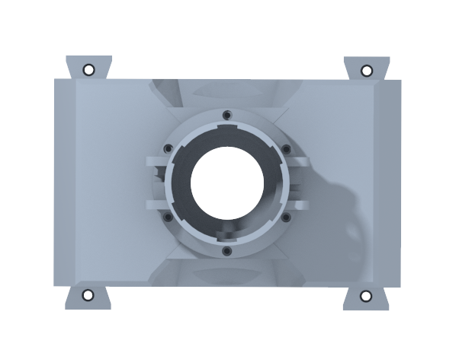
Customer Needs
How far can we stray from the original design?
hi
It is strongly encouraged to use a previously developed coupling design
Accent1
647 C
Color Values:
RGB 35 97 146
Hex/HTML #236192
CMYK 96 54 5 27
Accent4
2239 C
Color Values:
RGB 0 207 180
Hex/HTML #00CFB4
CMYK 59 0 39 0
Light 1
White
Color Values:
RGB 255 255 255
Hex/HTML #FFFFFF
CMYK 0 0 0 0
Dark 1
100% Black
Color Values:
RGB 0 0 0
Hex/HTML #000000
CMYK 0 0 0 100
Pantone
647 C
Pantone
2239 C
White
Black
Accent 2
2199 C
Color Values:
RGB 0 187 220
Hex/HTML #00BBDC
CMYK 77 0 16 0
Accent5
7535 C
Color Values:
RGB 183 176 156
Hex/HTML #B7B09C
CMYK 10 11 23 19
Light 2
25% Black
Color Values:
RGB 191 191 191
Hex/HTML #bfbfbf
CMYK 0 0 0 25
Dark 2
75 % Black
Color Values:
RGB 64 64 64
Hex/HTML #404040
CMYK 0 0 0 75
Pantone
2199 C
Pantone
7535 C
CoE Lt Gray
CoE Dk Gray
Accent3
1788 C
Color Values:
RGB 238 39 55
Hex/HTML #EE2737
CMYK 0 88 82 0
Accent6
2299 C
Color Values:
RGB 164 210 51
Hex/HTML #A4D233
CMYK 41 0 84 0
Pantone
1788 C
Pantone
2299 C
Notes:
“it is important to note that FSI is planning to add a UCF software engineering team to automate the transport system starting in the spring”

Slide 124
Customer Needs
How much will the payload weigh?
Cubic supply crate
Long cylindrical support beam
0.5m
2m
5m
2m
2m
Accent1
647 C
Color Values:
RGB 35 97 146
Hex/HTML #236192
CMYK 96 54 5 27
Accent4
2239 C
Color Values:
RGB 0 207 180
Hex/HTML #00CFB4
CMYK 59 0 39 0
Light 1
White
Color Values:
RGB 255 255 255
Hex/HTML #FFFFFF
CMYK 0 0 0 0
Dark 1
100% Black
Color Values:
RGB 0 0 0
Hex/HTML #000000
CMYK 0 0 0 100
Pantone
647 C
Pantone
2239 C
White
Black
Accent 2
2199 C
Color Values:
RGB 0 187 220
Hex/HTML #00BBDC
CMYK 77 0 16 0
Accent5
7535 C
Color Values:
RGB 183 176 156
Hex/HTML #B7B09C
CMYK 10 11 23 19
Light 2
25% Black
Color Values:
RGB 191 191 191
Hex/HTML #bfbfbf
CMYK 0 0 0 25
Dark 2
75 % Black
Color Values:
RGB 64 64 64
Hex/HTML #404040
CMYK 0 0 0 75
Pantone
2199 C
Pantone
7535 C
CoE Lt Gray
CoE Dk Gray
Accent3
1788 C
Color Values:
RGB 238 39 55
Hex/HTML #EE2737
CMYK 0 88 82 0
Accent6
2299 C
Color Values:
RGB 164 210 51
Hex/HTML #A4D233
CMYK 41 0 84 0
Pantone
1788 C
Pantone
2299 C
Notes:
“it is important to note that FSI is planning to add a UCF software engineering team to automate the transport system starting in the spring”

Slide 125
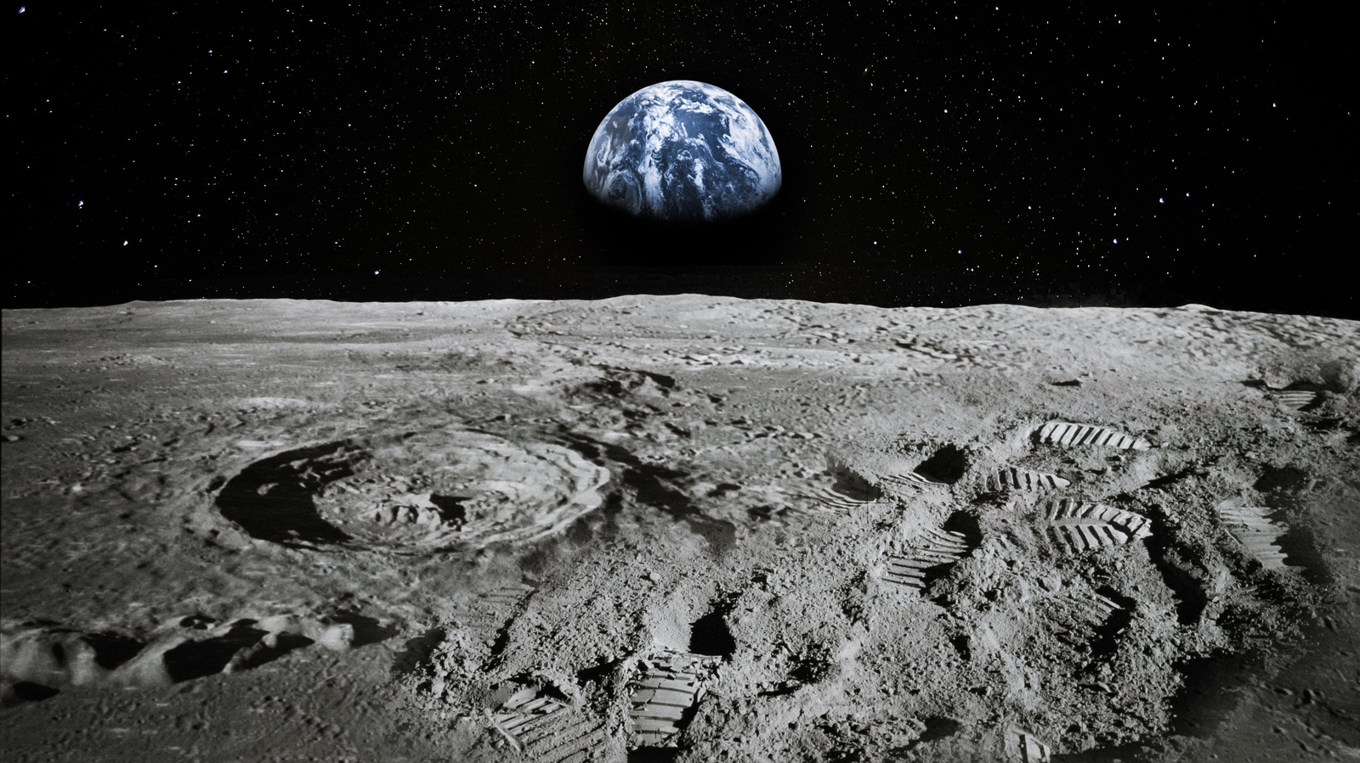
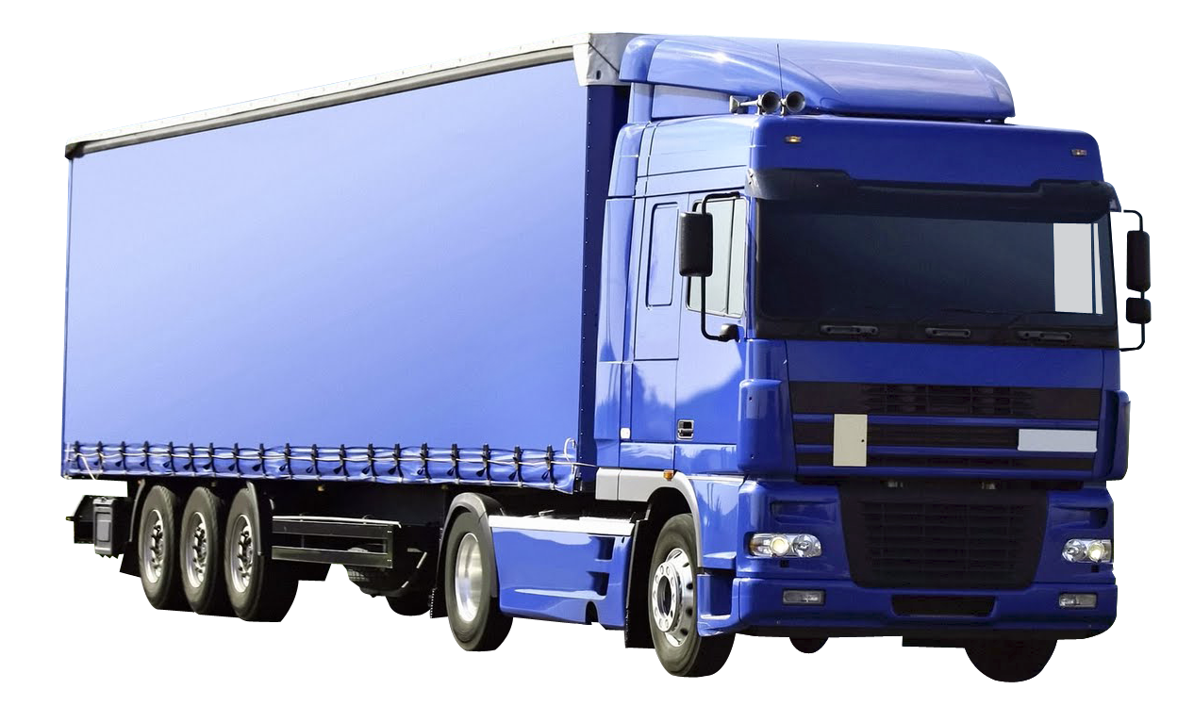
Why use RE-RASSOR?
Accent1
647 C
Color Values:
RGB 35 97 146
Hex/HTML #236192
CMYK 96 54 5 27
Accent4
2239 C
Color Values:
RGB 0 207 180
Hex/HTML #00CFB4
CMYK 59 0 39 0
Light 1
White
Color Values:
RGB 255 255 255
Hex/HTML #FFFFFF
CMYK 0 0 0 0
Dark 1
100% Black
Color Values:
RGB 0 0 0
Hex/HTML #000000
CMYK 0 0 0 100
Pantone
647 C
Pantone
2239 C
White
Black
Accent 2
2199 C
Color Values:
RGB 0 187 220
Hex/HTML #00BBDC
CMYK 77 0 16 0
Accent5
7535 C
Color Values:
RGB 183 176 156
Hex/HTML #B7B09C
CMYK 10 11 23 19
Light 2
25% Black
Color Values:
RGB 191 191 191
Hex/HTML #bfbfbf
CMYK 0 0 0 25
Dark 2
75 % Black
Color Values:
RGB 64 64 64
Hex/HTML #404040
CMYK 0 0 0 75
Pantone
2199 C
Pantone
7535 C
CoE Lt Gray
CoE Dk Gray
Accent3
1788 C
Color Values:
RGB 238 39 55
Hex/HTML #EE2737
CMYK 0 88 82 0
Accent6
2299 C
Color Values:
RGB 164 210 51
Hex/HTML #A4D233
CMYK 41 0 84 0
Pantone
1788 C
Pantone
2299 C

Slide 127
What is RE-RASSOR?
Research and
Education
-
Regolith
Advanced
Surface
System
Operation
Robot
RE-RASSOR
RASSOR

Slide 128
