Slide 1

RE-RASSOR:
LUNAR TRANSPORTER
Team 513
Notes:
Customize your title slide to be appealing to the audience. This is the first thing they see apply some graphic design elements that may summarize your presentation.

Slide 2


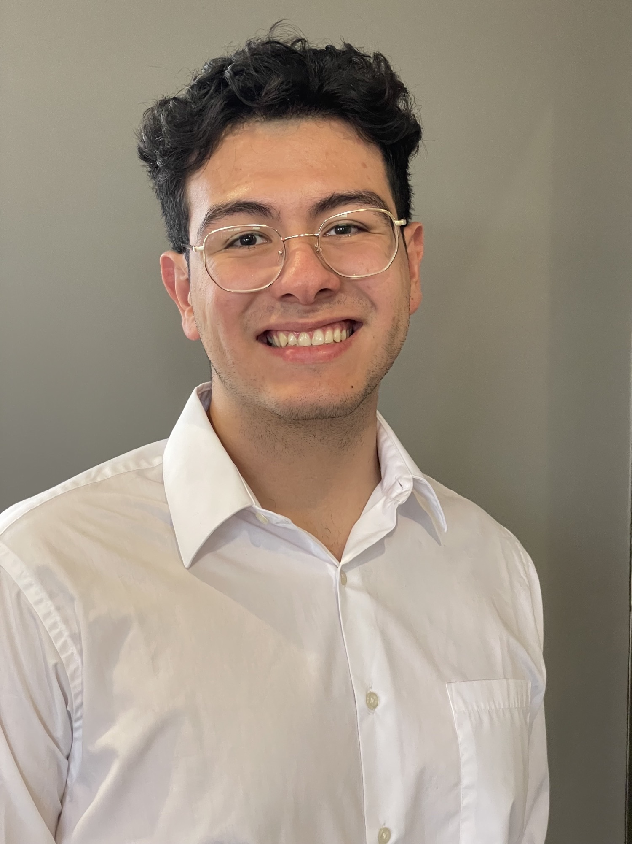

Team 513: Members
Jared Carboy
Systems Engineer
Kaden Lane
Design Engineer
Carlos Sanchez
Mechatronic Engineer
Axcell Vargas
Controls Engineer

Slide 3

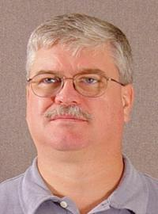


Sponsor & Advisor
Mike Conroy
Engineering Support
Senior Design
Keith Larson
ME Professor

Slide 4
Objective
Repurpose the
RE-RASSOR mining robot into a transport system that can lift and move heavy payloads on the moon.

Slide 5
Objective
Repurpose the
RE-RASSOR mining robot into a transport system that can lift and move heavy payloads on the moon.

Slide 6
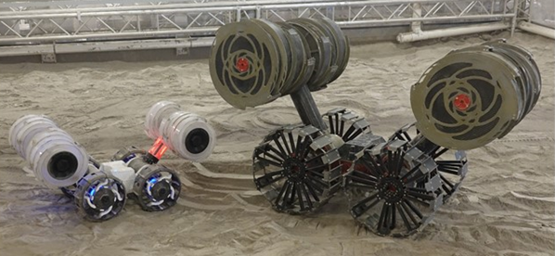
What is RE-RASSOR?
Research and
Education
-
Regolith
Advanced
Surface
System
Operation
Robot
RE-RASSOR
RASSOR

Slide 7



Key goals
3D print all structural parts
Pick up and move a payload
Use robots in cooperation

Slide 8
Customer Needs
How much will the payload weigh?
How many robots need to cooperate?
How will the robots be controlled?
How far can we stray from the original design?
hi
The system will include 4 robots cooperating
The team will develop a human controlled transport mechanism
The transport system will attach on to the current robot body
The system will carry a payload of 100 pounds
Accent1
647 C
Color Values:
RGB 35 97 146
Hex/HTML #236192
CMYK 96 54 5 27
Accent4
2239 C
Color Values:
RGB 0 207 180
Hex/HTML #00CFB4
CMYK 59 0 39 0
Light 1
White
Color Values:
RGB 255 255 255
Hex/HTML #FFFFFF
CMYK 0 0 0 0
Dark 1
100% Black
Color Values:
RGB 0 0 0
Hex/HTML #000000
CMYK 0 0 0 100
Pantone
647 C
Pantone
2239 C
White
Black
Accent 2
2199 C
Color Values:
RGB 0 187 220
Hex/HTML #00BBDC
CMYK 77 0 16 0
Accent5
7535 C
Color Values:
RGB 183 176 156
Hex/HTML #B7B09C
CMYK 10 11 23 19
Light 2
25% Black
Color Values:
RGB 191 191 191
Hex/HTML #bfbfbf
CMYK 0 0 0 25
Dark 2
75 % Black
Color Values:
RGB 64 64 64
Hex/HTML #404040
CMYK 0 0 0 75
Pantone
2199 C
Pantone
7535 C
CoE Lt Gray
CoE Dk Gray
Accent3
1788 C
Color Values:
RGB 238 39 55
Hex/HTML #EE2737
CMYK 0 88 82 0
Accent6
2299 C
Color Values:
RGB 164 210 51
Hex/HTML #A4D233
CMYK 41 0 84 0
Pantone
1788 C
Pantone
2299 C
Notes:
“it is important to note that FSI is planning to add a UCF software engineering team to automate the transport system starting in the spring”

Slide 9

Functional Decomposition
Critical Targets
Payload to Transporter Connection Load Support
Vertical Translation
Payload to Transporter Connection Accessibility
100 lbs
1 ft
360°
Payload to Transporter Connection Load Support
Payload to Transporter Connection Accessibility
Payload Vertical Translation
1ft
Connection is possible when the payload is rotated 0-360°
100 lbs
# of connections
1 ft in Z-axis

Slide 10
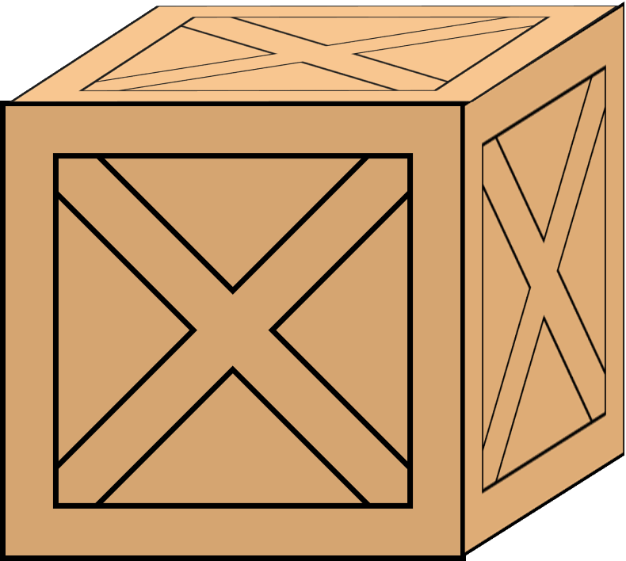
Payloads
2m
5m
0.5m
2m
2m

Slide 11
Payloads
5m
0.5m
2m
2m
2m
5 cm

Slide 12
Payloads
5m
0.5m
2m
0.18m
2m
2m
0.4m

Slide 13
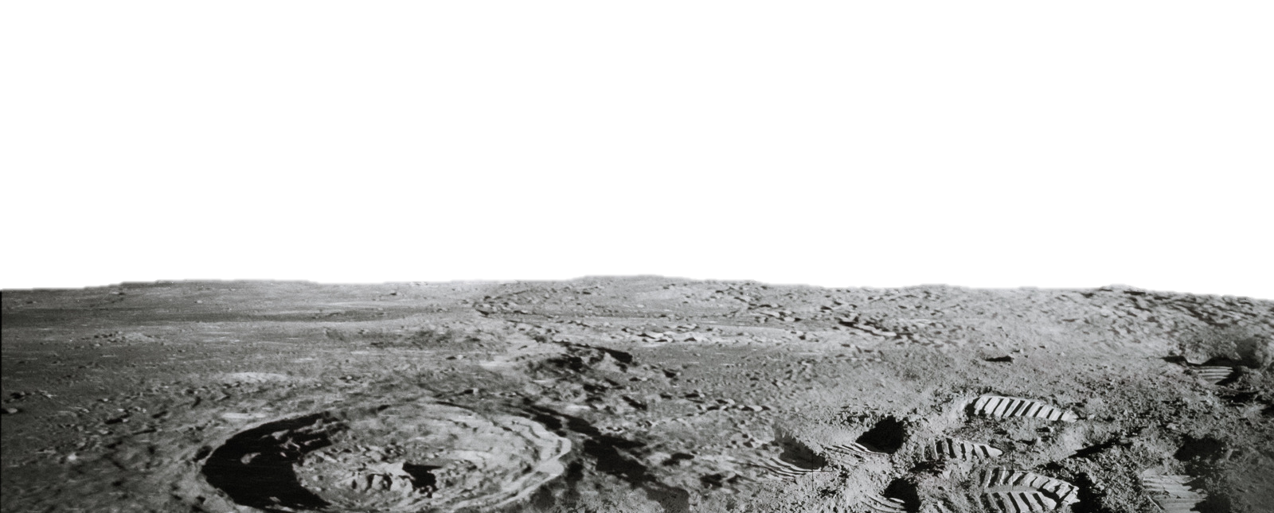
Environment

Slide 14
Environment
Transport Surfaces will be paved

Slide 15
Environment
And have a maximum of 2.5 degree inclines
Transport Surfaces will be paved

Slide 16
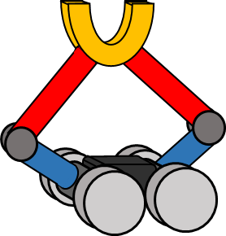
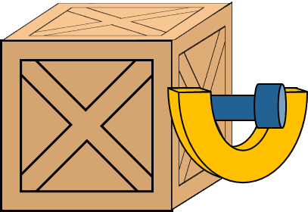
Design Components
Lifting Mechanism
Payload Connector

Slide 17
Selected Lifting Mechanism
Shoulder Driven “Five”-bar
Based on already available Motors and joints
5-bar Geometry yields high mechanical advantage
Lifting is not constrained to the vertical axis

Slide 18
Selected Lifting Mechanism
Shoulder Driven “Five”-bar
Based on already available Motors and joints
5-bar Geometry yields high mechanical advantage
Lifting is not constrained to the vertical axis

Slide 19
Selected Lifting Mechanism
Shoulder Driven “Five”-bar
Based on already available Motors and joints
5-bar Geometry yields high mechanical advantage
Lifting is not constrained to the vertical axis
4
3
5
2
6
1

Slide 20
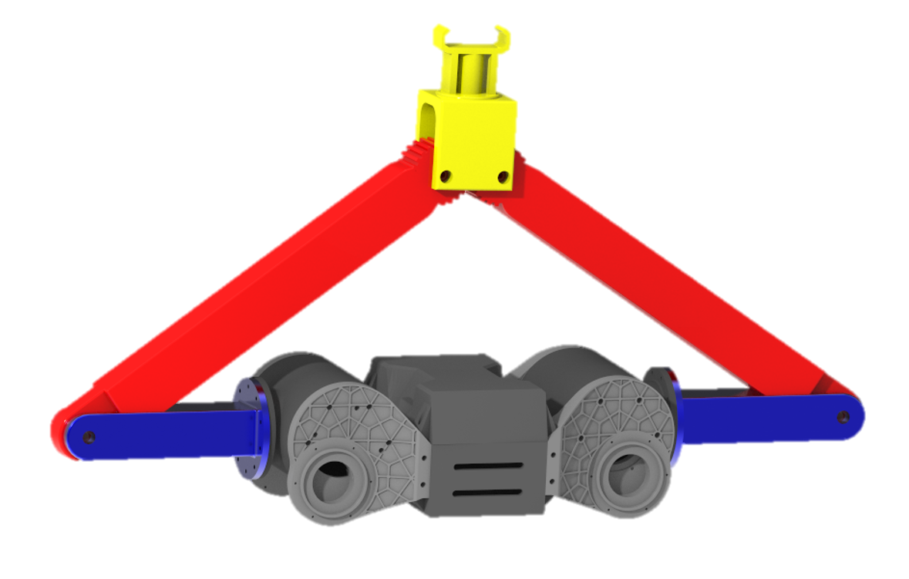
Selected Lifting Mechanism
Shoulder Driven “Five”-bar
Based on already available Motors and joints
5-bar Geometry yields high mechanical advantage
Lifting is not constrained to the vertical axis

Slide 21
Selected Lifting Mechanism
Shoulder Gearbox
Designed by a Senior Design team at Florida Polytechnic
Shoulders output 25 lbs-ft of torque
Theoretical minimum lifting force of 88 lbs

Slide 22
Selected Lifting Mechanism
Shoulder Gearbox
Designed by a Senior Design team at Florida Polytechnic
Shoulders output 25 lbs-ft of torque
Theoretical minimum lifting force of 88 lbs

Slide 23
Selected Lifting Mechanism
88 lbs
Shoulder Gearbox
Designed by a Senior Design team at Florida Polytechnic
Shoulders output 25 lbs-ft of torque
Theoretical minimum lifting force of 88 lbs
44 lbs
44 lbs
0.6 ft

Slide 24
Selected Payload Connection
U-Shaped Peg Connector
Can be lifted from directly underneath
Allows RE-RASSOR to tilt the payload to compensate for incline

Slide 25
Selected Payload Connection
U-Shaped Peg Connector
Can be lifted from directly underneath
Allows RE-RASSOR to tilt the payload to compensate for incline

Slide 26
Selected Payload Connection
U-Shaped Peg Connector
Can be lifted from directly underneath
Allows RE-RASSOR to tilt the payload to compensate for incline

Slide 27
Selected Payload Connection

Slide 28
Selected Payload Connection

Slide 29
Lifting Technique
0.25m
0.25m

Slide 30
Lifting Technique

Slide 31
Lifting Technique

Slide 32
Lifting Technique

Slide 33
Weight distribution on incline
Center of gravity moved closer to the back

Slide 34
Weight distribution on incline
Center of gravity moved closer to the back
Uneven weight distribution

Slide 35
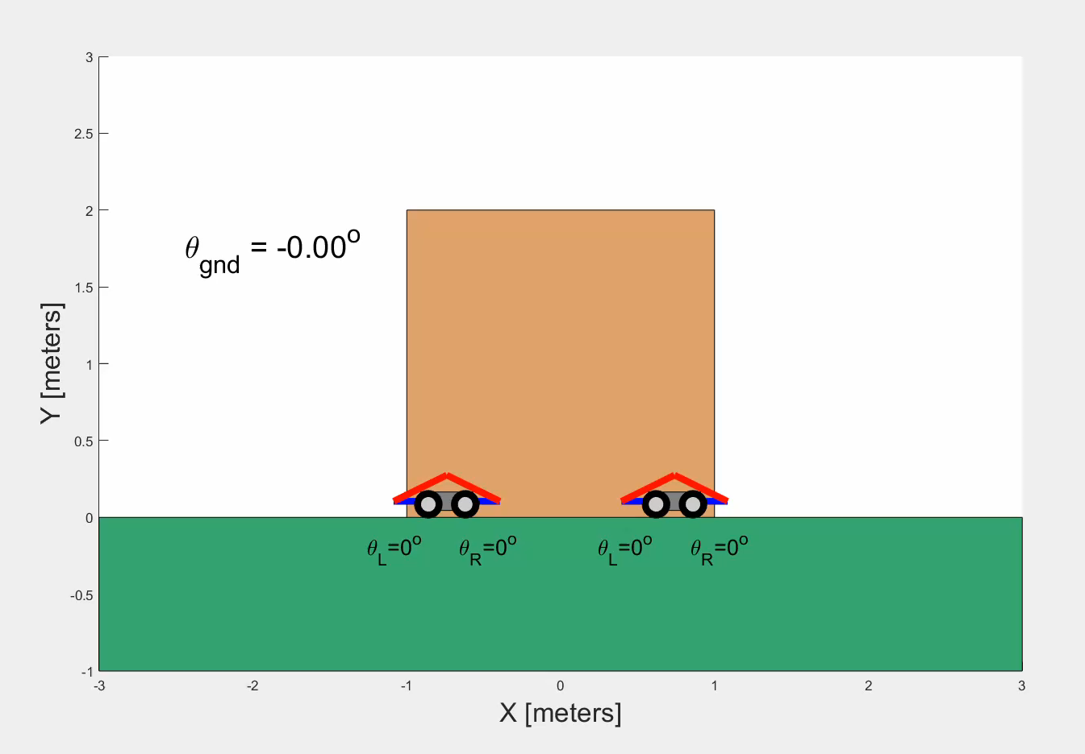
Weight distribution on incline
MATLAB Animation
Inverse kinematics of 5-bar corrects 3 degree inclines
Real RE-RASSOR will have an inertial measurement unit to sense inclines

Slide 36



Purchasing
3D Printing Material
Electrical Components
Fasteners & Hardware

Slide 37
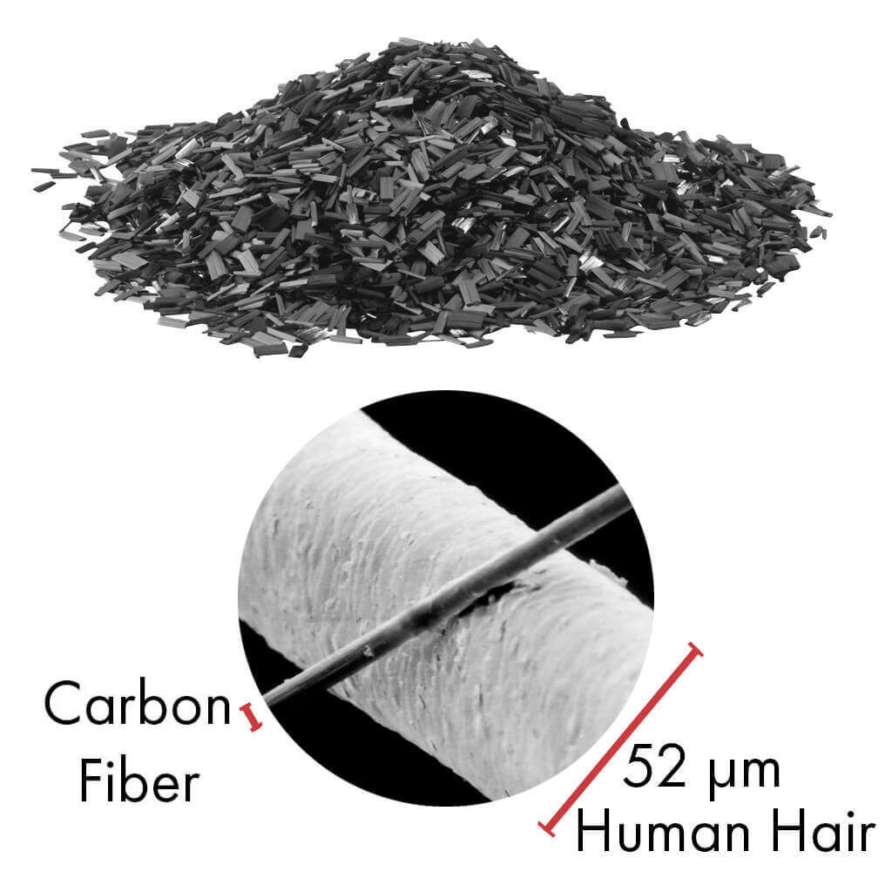
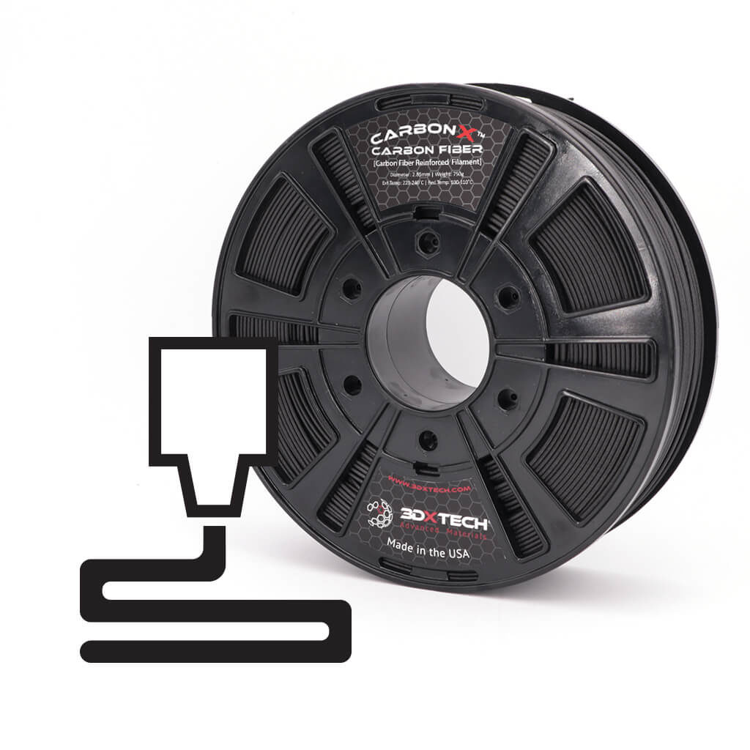
Purchasing
Carbon fiber nylon filament
  High tensile strength and stiffness
  Low weight
  Excellent printability
  Impact resistance

Slide 38
Purchasing
3D Printing Material
Electrical Components
Fasteners & Hardware

Slide 39
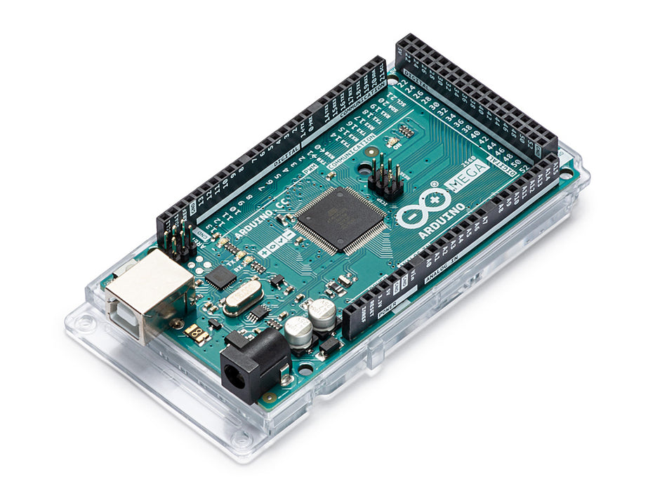
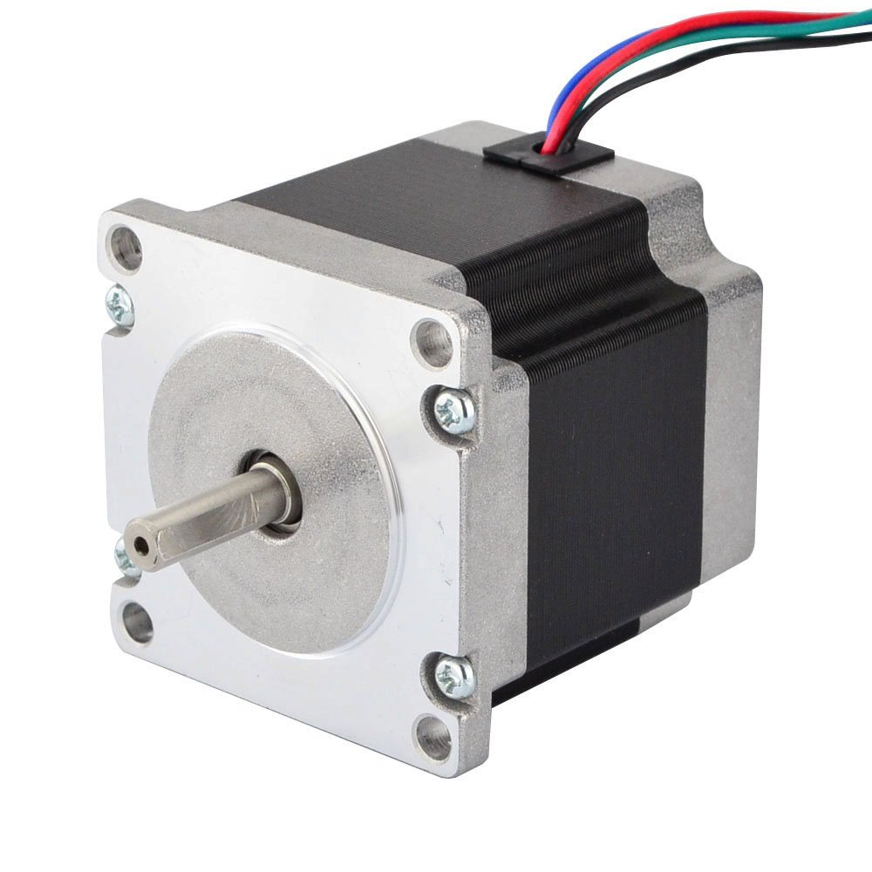
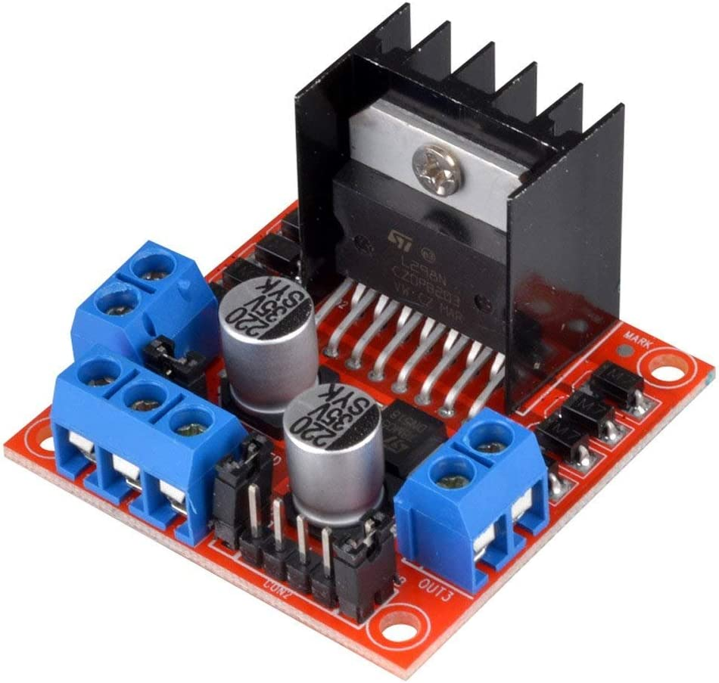
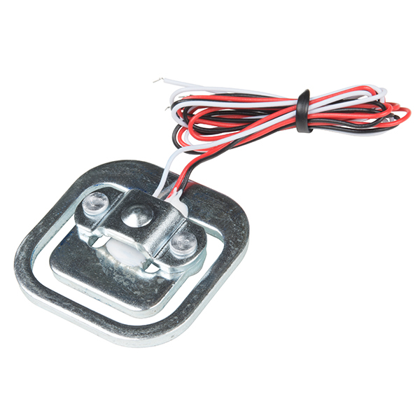
Purchasing
  Arduino Mega 2560
  Nema 23 Stepper Motor
  Stepper Motor Driver
  Load Sensor
  Wiring pack

Slide 40
Purchasing
3D Printing Material
Electrical Components
Fasteners & Hardware

Slide 41
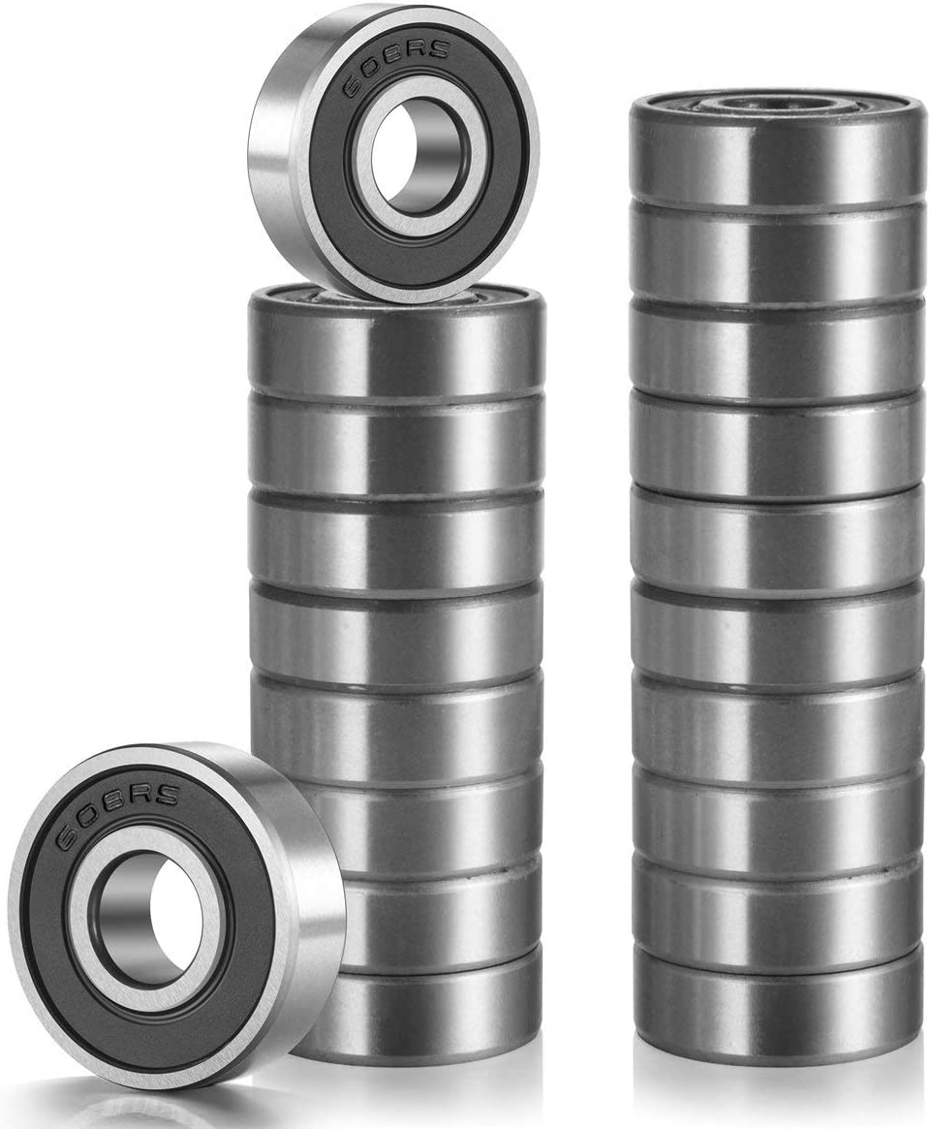
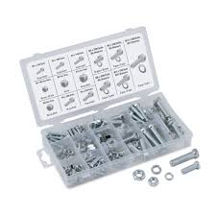
Purchasing
  Nuts and bolts for fastening at joints
  Bearings for smooth rotation about joints
  Screws for woodworking with payloads

Slide 42





Future Work
Finish Purchasing
3D Print Components
Mechanical Testing
Final Design

Slide 43
Future Work
2/2
3D Print Components
Mechanical Testing
Final Design

Slide 44
Future Work
2/2
2/13
Mechanical Testing
Final Design

Slide 45
Future Work
2/2
2/13
2/21
Final Design

Slide 46
Future Work
2/2
2/13
2/21
2/28

Slide 47
Future Work-for website
2/2
Finish purchasing essential components
2/8
Finish building shoulders for single robot, begin tests with single weights
2/20
Finish building second robot and testing apparatus
2/28
Finish electronics and control of the two robot system

Slide 48
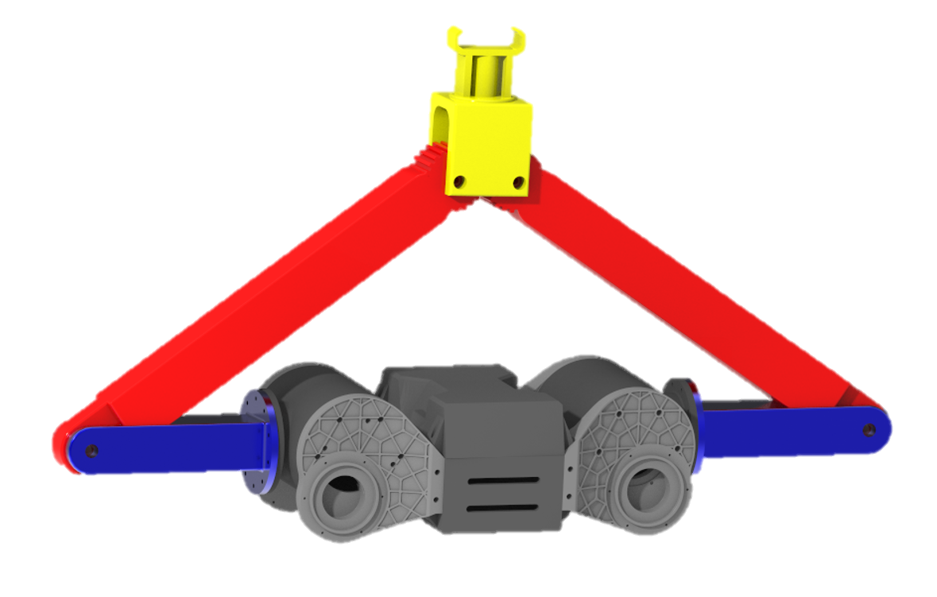
Future Work
3D Print Components
Mechanical Testing
Build Payloads
Final Design

Slide 49






Concept Selection
Pairwise Comparison
House of Quality
Pugh
Chart
Analytical Hierarchy Process
S

Slide 50
Functional Decomposition
Connection
Payload Motion
Control

Slide 51
Targets
Functional Decomposition
RE-RASSOR to Transporter Connection Accessibility
Motor Torque Management
Vertical Translation
Payload Motion
Ease of Attachment
Payload to Transporter Connection Accessibility
Stabilize Payload During Locomotion
Receive Signal
Connection
Payload to Transporter Connection Confirmation
Human Control Accessibility
Send Signal
Payload to Transporter Connection Load Support
Control
Load Support
Microcontroller Communication
Transduce Signal
RE-RASSOR to Transporter Connection Load Support

Slide 52
Critical Targets
Functional Decomposition
Targets
RE-RASSOR to Transporter Connection Accessibility
Motor Torque Management
Vertical Translation
2 min
1 ft
1 ft
Payload Motion
Ease of Attachment
Payload to Transporter Connection Accessibility
Stabilize Payload During Locomotion
360°
10 N
360°
Receive Signal
5v
Connection
Payload to Transporter Connection Confirmation
Human Control Accessibility
Send Signal
Payload to Transporter Connection Load Support
N/A
5v
100 lbs
100 lbs
Control
Load Support
Microcontroller Communication
Transduce Signal
RE-RASSOR to Transporter Connection Load Support
16 bit ADC
25 lbs

Slide 53
Targets
Functional Decomposition
Critical Targets
Payload to Transporter Connection Load Support
Vertical Translation
Payload to Transporter Connection Accessibility
100 lbs
1 ft
360°
Payload to Transporter Connection Load Support
Payload to Transporter Connection Accessibility
Payload Vertical Translation
100 lbs
1 ft
0-360°

Slide 54
Functional Decomposition
Critical Targets
Payload to Transporter Connection Load Support
Vertical Translation
Payload to Transporter Connection Accessibility
100 lbs
1 ft
360°
Payload to Transporter Connection Load Support
Payload to Transporter Connection Accessibility
Payload Vertical Translation
1 ft
0-360°
100 lbs
# of connections

Slide 55
Critical Targets
Payload to Transporter Connection Load Support
Vertical Translation
Payload to Transporter Connection Accessibility
100 lbs
1 ft
360°
Payload to Transporter Connection Load Support
Payload to Transporter Connection Accessiblity
Payload Vertical Translation
0-360°
1ft
100 lbs
# of connections
1 ft in Z-azis

Slide 56
Functional Decomposition
Critical Targets
Payload to Transporter Connection Load Support
Vertical Translation
Payload to Transporter Connection Accessibility
100 lbs
1 ft
360°
Payload to Transporter Connection Load Support
Payload to Transporter Connection Accessiblity
Payload Vertical Translation
1ft
Connection is possible when the payload is rotated 0-360°
100 lbs
# of connections
1 ft in Z-azis

Slide 57


Concept Generation
Brain Writing
Biomimicry
Morphological
Chart
Crapshoot

Slide 58
RE-RASSOR Transporter: Components
Lifting Mechanism
Transporter to RE-RASSOR Connector
Transporter to Payload Connector

Slide 59
RE-RASSOR Transporter: Components
Transporter to RE-RASSOR Connector

Slide 60
RE-RASSOR Transporter: Components
Transporter to RE-RASSOR Connector

Slide 61
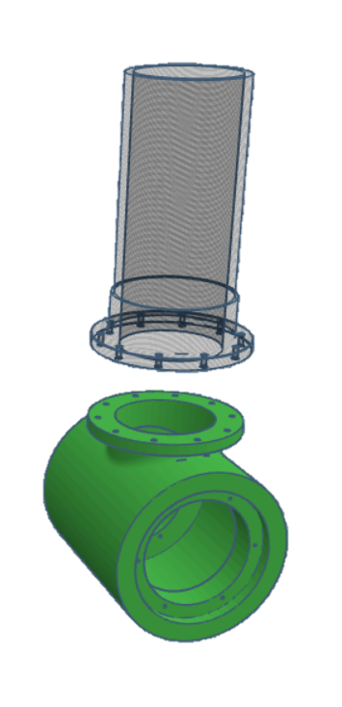
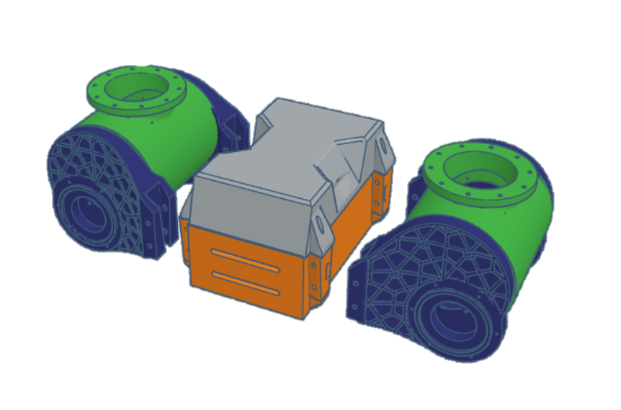
RE-RASSOR Transporter: Components
Transporter to RE-RASSOR Connector
Shoulder Connector

Slide 62
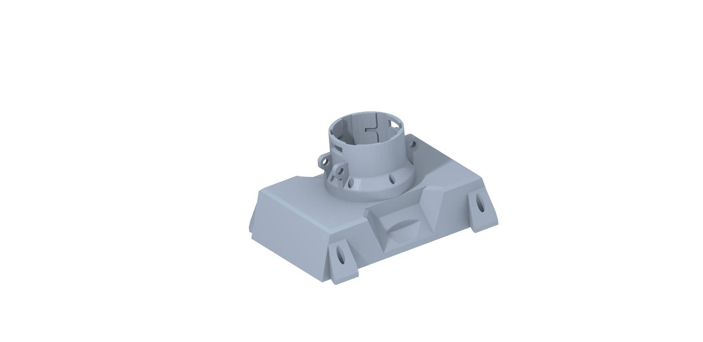
RE-RASSOR Transporter: Components
Transporter to RE-RASSOR Connector
Body Connector

Slide 63
RE-RASSOR Transporter: Components
Lifting Mechanism
Transporter to RE-RASSOR Connector
Transporter to Payload Connector

Slide 64
RE-RASSOR Transporter: Components
Transporter to Payload Connector

Slide 65
RE-RASSOR Transporter: Components
Transporter to Payload Connector

Slide 66

RE-RASSOR Transporter: Components
Transporter to Payload Connector
5m
2m
0.5m
2m
2m

Slide 67
RE-RASSOR Transporter: Components
Transporter to Payload Connector
5m
0.5m
2m
0.18m
2m
2m
0.4m

Slide 68
RE-RASSOR Transporter: Components
Transporter to Payload Connector

Slide 69
RE-RASSOR Transporter: Components
Transporter to Payload Connector

Slide 70
High Fidelity Concepts
Shoulder Driven Five-bar
Based on already available Motors and joints
Load is distributed across motors
Fully enclosed joints

Slide 71
High Fidelity Concepts
Shoulder Driven Five-bar
Based on already available Motors and joints
Load is distributed across motors
Fully enclosed joints

Slide 72
High Fidelity Concepts
Multi-Robot Car Jack
Multiple robots attached mechanisms for lift
High mechanical advantage mechanism
Less chance of longitudinal tipping

Slide 73
High Fidelity Concepts
Multi-Robot Car Jack
Multiple robots attached mechanisms for lift
High mechanical advantage mechanism
Less chance of longitudinal tipping

Slide 74
High Fidelity Concepts
Single robot Car Jack
Simple lifting mechanism with high mechanical advantage
Motor driven vertical translation

Slide 75
High Fidelity Concepts
Single robot Car Jack
Simple lifting mechanism with high mechanical advantage
Motor driven vertical translation

Slide 76
Concept Selection
House of Quality
Translate Payload
Payload to Transporter Connection Accessibility

Slide 77
Final Selection:
Shoulder Driven 5-Bar
Reutilized shoulder joints driving down cost and weight
Less assembly required
Connection mechanism manipulated in two planes
High stability and lifting force

Slide 78
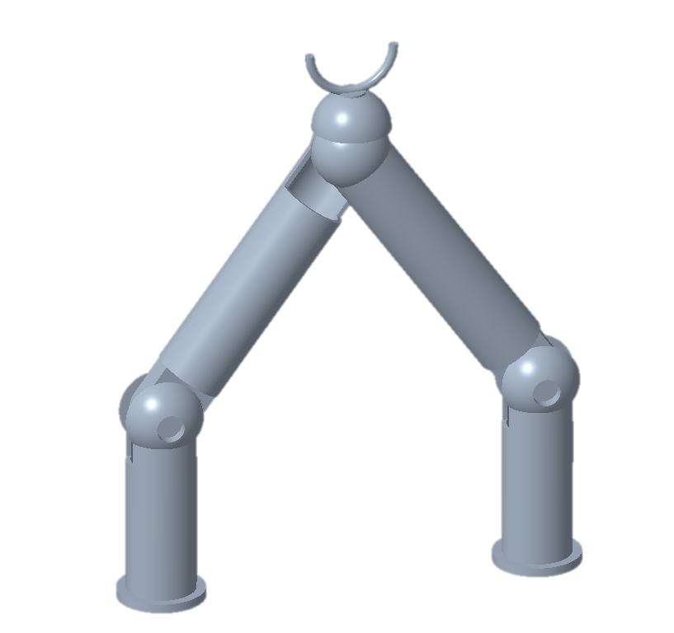
Final Selection:
Shoulder Driven 5-Bar

Slide 79




Future Work
Continue Prototyping
Risk Assessment
Bill of Materials
Spring
Plan

Slide 80
Backup Slides

Slide 81
Next steps
Spring Project Plan
Risk Assessment
Bill of Materials

Slide 82
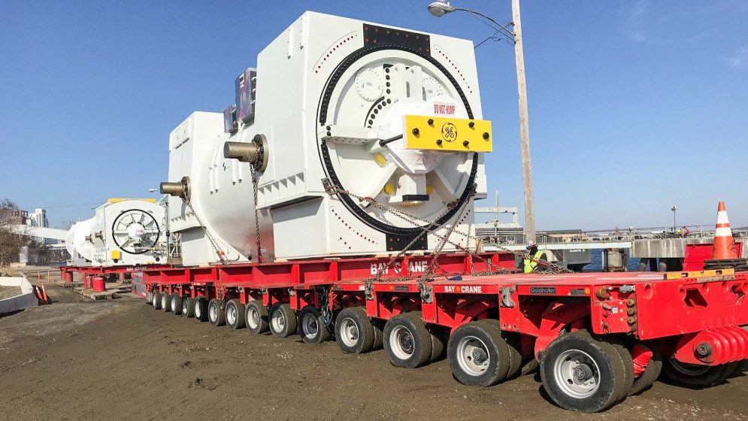

Slide 83
College of Engineering Color Palette
2299 C
Color Values:
RGB 164 210 51
Hex/HTML #A4D233
CMYK 41 0 84 0
1788 C
Color Values:
RGB 238 39 55
Hex/HTML #EE2737
CMYK 0 88 82 0
75% Black
Color Values:
RGB 64 64 64
Hex/HTML #404040
CMYK 0 0 0 75
Pantone
2299 C
Pantone
1788 C
CoE Dk Gray
2239 C
Color Values:
RGB 0 207 180
Hex/HTML #00CFB4
CMYK 59 0 39 0
647 C
Color Values:
RGB 35 97 146
Hex/HTML #236192
CMYK 96 54 5 27
50% Black
Color Values:
RGB 128 128 128
Hex/HTML #808080
CMYK 0 0 0 50
Pantone
2239 C
Pantone
647 C
CoE Md Gray
2199 C
Color Values:
RGB 0 187 220
Hex/HTML #00BBDC
CMYK 77 0 16 0
7535 C
Color Values:
RGB 183 176 156
Hex/HTML #B7B09C
CMYK 10 11 23 19
25% Black
Color Values:
RGB 191 191 191
Hex/HTML #bfbfbf
CMYK 0 0 0 25
Pantone
2199 C
Pantone
7535 C
CoE Lt Gray
Notes:
Theses are the official color palettes of the college of engineering.

Slide 84
PowerPoint Color Theme
Accent1
647 C
Color Values:
RGB 35 97 146
Hex/HTML #236192
CMYK 96 54 5 27
Accent4
2239 C
Color Values:
RGB 0 207 180
Hex/HTML #00CFB4
CMYK 59 0 39 0
Light 1
White
Color Values:
RGB 255 255 255
Hex/HTML #FFFFFF
CMYK 0 0 0 0
Dark 1
100% Black
Color Values:
RGB 0 0 0
Hex/HTML #000000
CMYK 0 0 0 100
Pantone
647 C
Pantone
2239 C
White
Black
Accent 2
2199 C
Color Values:
RGB 0 187 220
Hex/HTML #00BBDC
CMYK 77 0 16 0
Accent5
7535 C
Color Values:
RGB 183 176 156
Hex/HTML #B7B09C
CMYK 10 11 23 19
Light 2
25% Black
Color Values:
RGB 191 191 191
Hex/HTML #bfbfbf
CMYK 0 0 0 25
Dark 2
75 % Black
Color Values:
RGB 64 64 64
Hex/HTML #404040
CMYK 0 0 0 75
Pantone
2199 C
Pantone
7535 C
CoE Lt Gray
CoE Dk Gray
Accent3
1788 C
Color Values:
RGB 238 39 55
Hex/HTML #EE2737
CMYK 0 88 82 0
Accent6
2299 C
Color Values:
RGB 164 210 51
Hex/HTML #A4D233
CMYK 41 0 84 0
Pantone
1788 C
Pantone
2299 C
Notes:
These are the college colors as prioritized within this PowerPoint Template

Slide 85
Notes:
This slide has the rule of third layout tool. The rule thirds layout helps with the sizing of elements.

Slide 86
Notes:
This slide has the rule of third layout tool. The rule thirds layout helps with the sizing of elements.

Slide 93
5m
0.5m
0.375m
2m
0.18m
0.175m
2m
0.4m
2m

Slide 94
5m
0.5m
2m
2m
2m

Slide 96
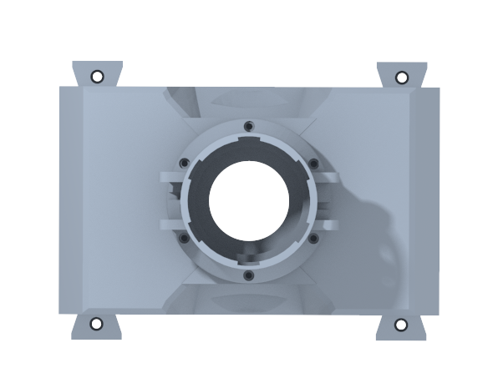
Customer Needs
How far can we stray from the original design?
hi
It is strongly encouraged to use a previously developed coupling design
Accent1
647 C
Color Values:
RGB 35 97 146
Hex/HTML #236192
CMYK 96 54 5 27
Accent4
2239 C
Color Values:
RGB 0 207 180
Hex/HTML #00CFB4
CMYK 59 0 39 0
Light 1
White
Color Values:
RGB 255 255 255
Hex/HTML #FFFFFF
CMYK 0 0 0 0
Dark 1
100% Black
Color Values:
RGB 0 0 0
Hex/HTML #000000
CMYK 0 0 0 100
Pantone
647 C
Pantone
2239 C
White
Black
Accent 2
2199 C
Color Values:
RGB 0 187 220
Hex/HTML #00BBDC
CMYK 77 0 16 0
Accent5
7535 C
Color Values:
RGB 183 176 156
Hex/HTML #B7B09C
CMYK 10 11 23 19
Light 2
25% Black
Color Values:
RGB 191 191 191
Hex/HTML #bfbfbf
CMYK 0 0 0 25
Dark 2
75 % Black
Color Values:
RGB 64 64 64
Hex/HTML #404040
CMYK 0 0 0 75
Pantone
2199 C
Pantone
7535 C
CoE Lt Gray
CoE Dk Gray
Accent3
1788 C
Color Values:
RGB 238 39 55
Hex/HTML #EE2737
CMYK 0 88 82 0
Accent6
2299 C
Color Values:
RGB 164 210 51
Hex/HTML #A4D233
CMYK 41 0 84 0
Pantone
1788 C
Pantone
2299 C
Notes:
“it is important to note that FSI is planning to add a UCF software engineering team to automate the transport system starting in the spring”

Slide 97
Customer Needs
How much will the payload weigh?
Cubic supply crate
Long cylindrical support beam
0.5m
2m
5m
2m
2m
Accent1
647 C
Color Values:
RGB 35 97 146
Hex/HTML #236192
CMYK 96 54 5 27
Accent4
2239 C
Color Values:
RGB 0 207 180
Hex/HTML #00CFB4
CMYK 59 0 39 0
Light 1
White
Color Values:
RGB 255 255 255
Hex/HTML #FFFFFF
CMYK 0 0 0 0
Dark 1
100% Black
Color Values:
RGB 0 0 0
Hex/HTML #000000
CMYK 0 0 0 100
Pantone
647 C
Pantone
2239 C
White
Black
Accent 2
2199 C
Color Values:
RGB 0 187 220
Hex/HTML #00BBDC
CMYK 77 0 16 0
Accent5
7535 C
Color Values:
RGB 183 176 156
Hex/HTML #B7B09C
CMYK 10 11 23 19
Light 2
25% Black
Color Values:
RGB 191 191 191
Hex/HTML #bfbfbf
CMYK 0 0 0 25
Dark 2
75 % Black
Color Values:
RGB 64 64 64
Hex/HTML #404040
CMYK 0 0 0 75
Pantone
2199 C
Pantone
7535 C
CoE Lt Gray
CoE Dk Gray
Accent3
1788 C
Color Values:
RGB 238 39 55
Hex/HTML #EE2737
CMYK 0 88 82 0
Accent6
2299 C
Color Values:
RGB 164 210 51
Hex/HTML #A4D233
CMYK 41 0 84 0
Pantone
1788 C
Pantone
2299 C
Notes:
“it is important to note that FSI is planning to add a UCF software engineering team to automate the transport system starting in the spring”

Slide 98
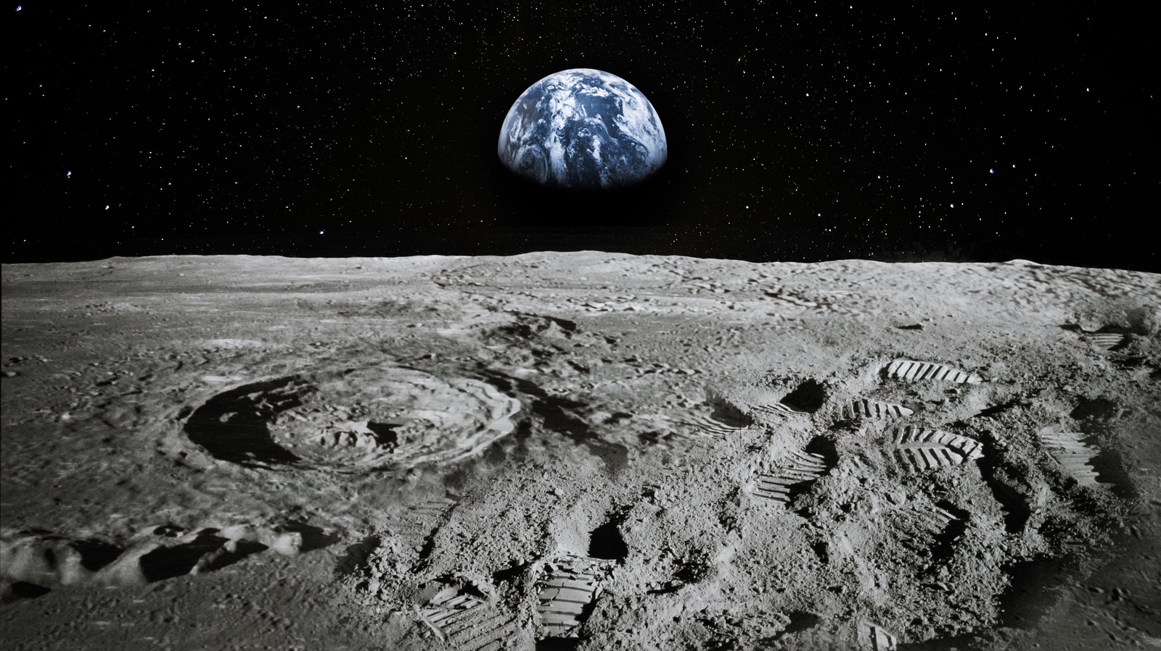
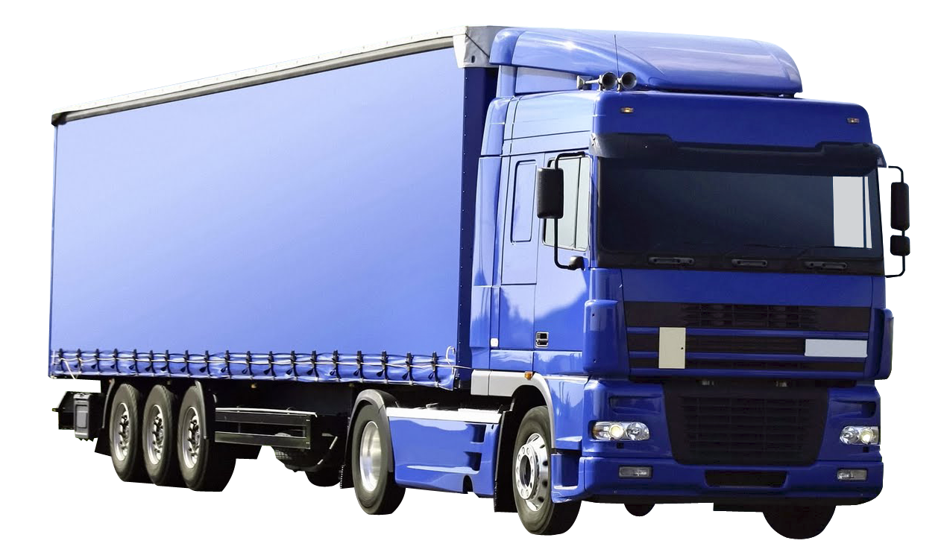
Why use RE-RASSOR?
Accent1
647 C
Color Values:
RGB 35 97 146
Hex/HTML #236192
CMYK 96 54 5 27
Accent4
2239 C
Color Values:
RGB 0 207 180
Hex/HTML #00CFB4
CMYK 59 0 39 0
Light 1
White
Color Values:
RGB 255 255 255
Hex/HTML #FFFFFF
CMYK 0 0 0 0
Dark 1
100% Black
Color Values:
RGB 0 0 0
Hex/HTML #000000
CMYK 0 0 0 100
Pantone
647 C
Pantone
2239 C
White
Black
Accent 2
2199 C
Color Values:
RGB 0 187 220
Hex/HTML #00BBDC
CMYK 77 0 16 0
Accent5
7535 C
Color Values:
RGB 183 176 156
Hex/HTML #B7B09C
CMYK 10 11 23 19
Light 2
25% Black
Color Values:
RGB 191 191 191
Hex/HTML #bfbfbf
CMYK 0 0 0 25
Dark 2
75 % Black
Color Values:
RGB 64 64 64
Hex/HTML #404040
CMYK 0 0 0 75
Pantone
2199 C
Pantone
7535 C
CoE Lt Gray
CoE Dk Gray
Accent3
1788 C
Color Values:
RGB 238 39 55
Hex/HTML #EE2737
CMYK 0 88 82 0
Accent6
2299 C
Color Values:
RGB 164 210 51
Hex/HTML #A4D233
CMYK 41 0 84 0
Pantone
1788 C
Pantone
2299 C

Slide 100
