Slide 1

EZ RASSOR:
LUNAR TRANSPORTER
Team 513
Notes:
Customize your title slide to be appealing to the audience. This is the first thing they see apply some graphic design elements that may summarize your presentation.

Slide 2
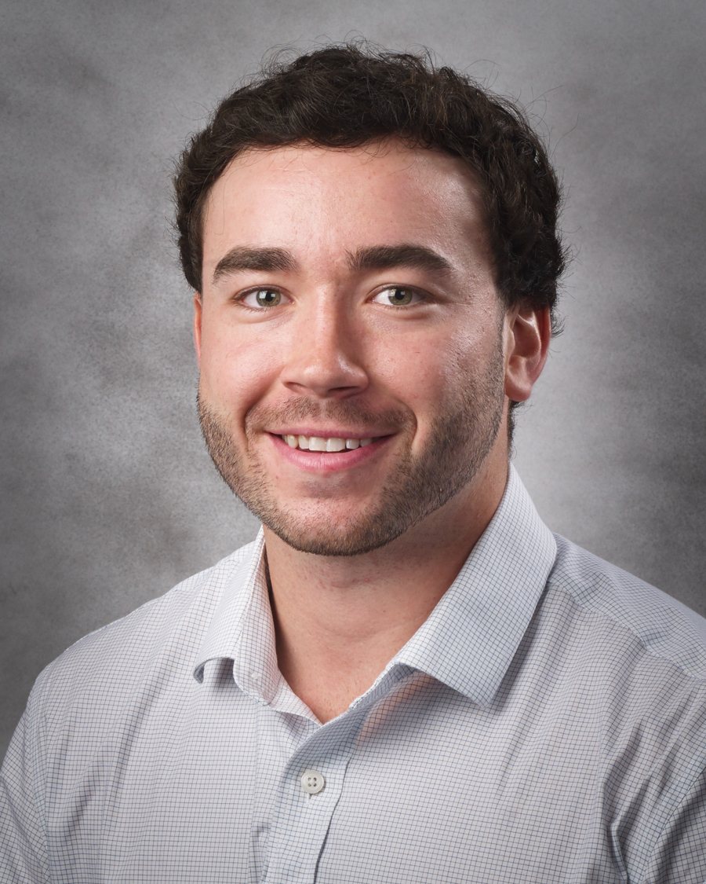

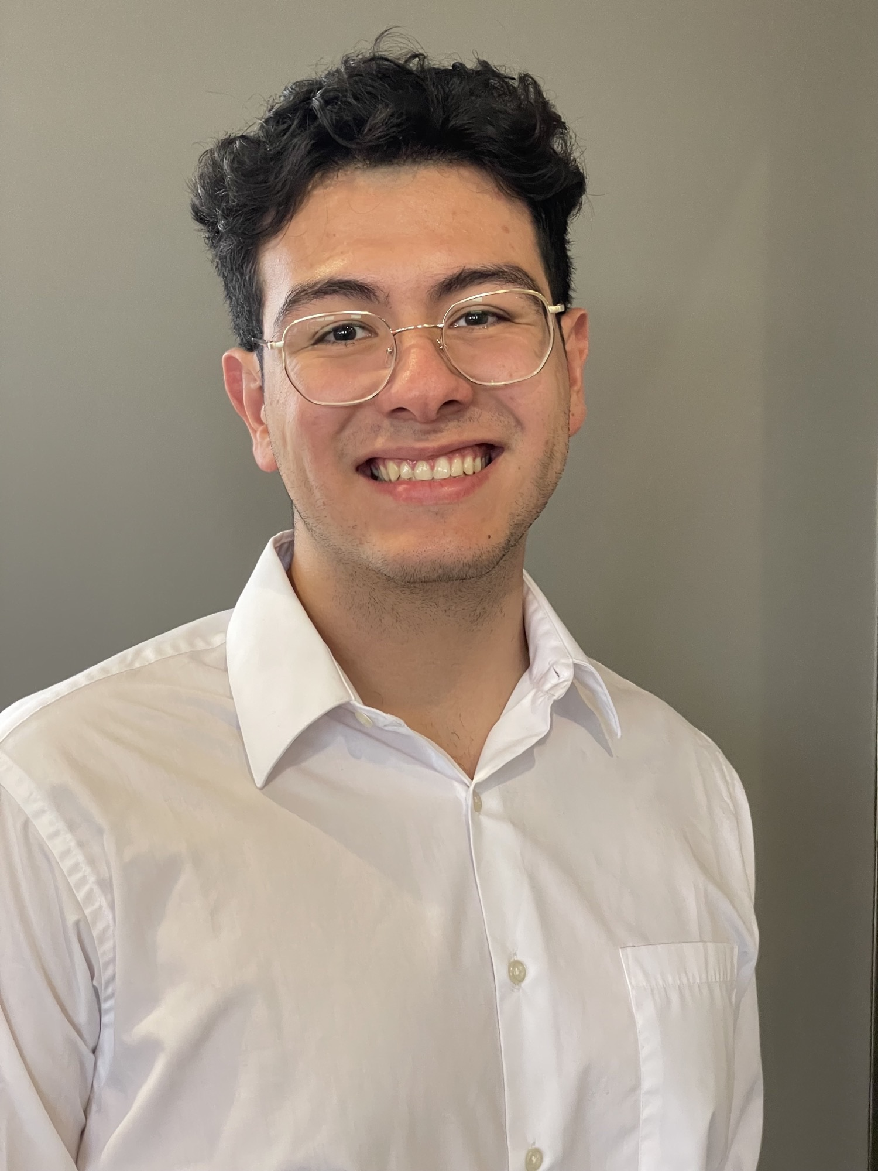
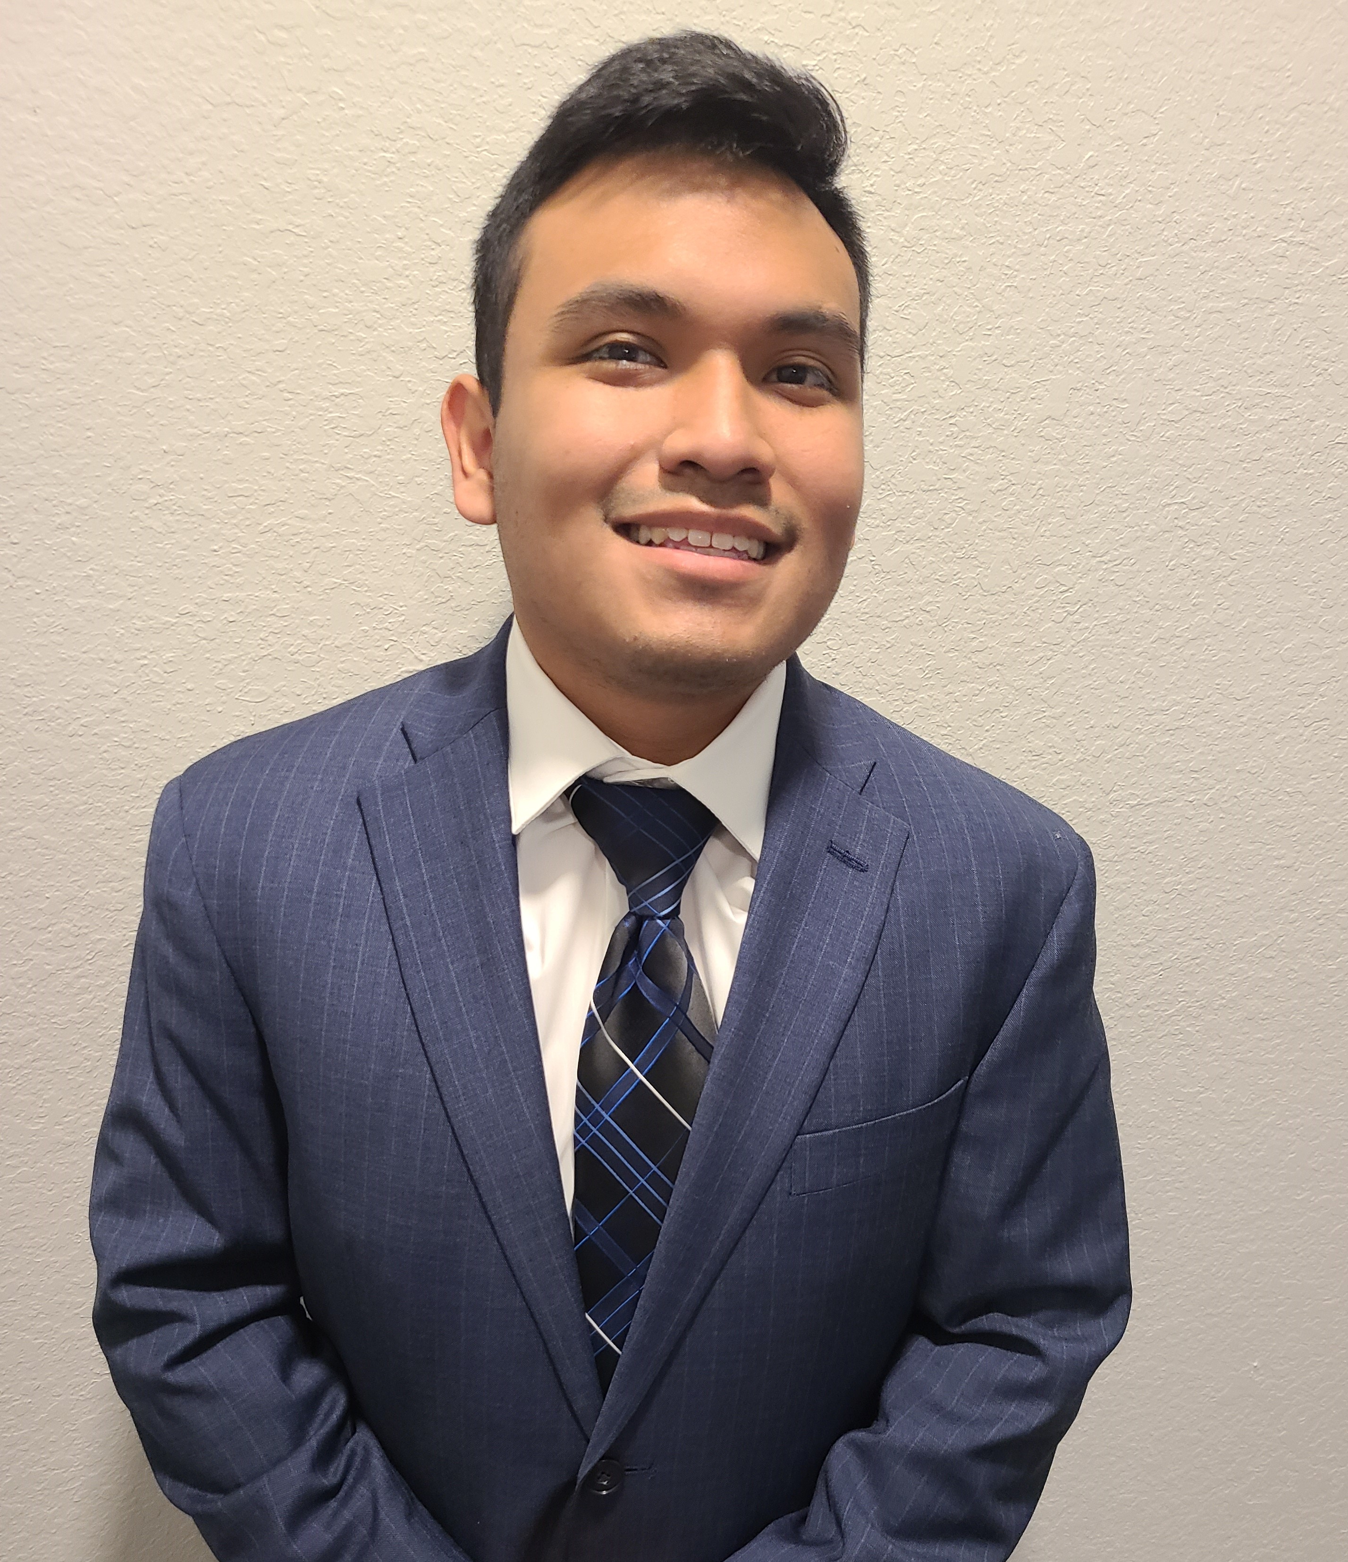
Team 513: Members
Jared Carboy
Systems Engineer
Kaden Lane
Design Engineer
Carlos Sanchez
Mechatronic Engineer
Axcell Vargas
Controls Engineer

Slide 3

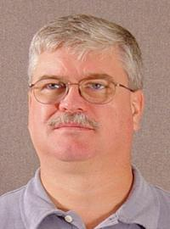


Sponsor & Advisor
Mike Conroy
Engineering Support
Senior Design
Keith Larson
ME Professor

Slide 4
Objective
Repurpose the
RE-RASSOR mining robot into a transport system that can lift and move heavy payloads on the moon.

Slide 5
Objective
Repurpose the
RE-RASSOR mining robot into a transport system that can lift and move heavy payloads on the moon.

Slide 6
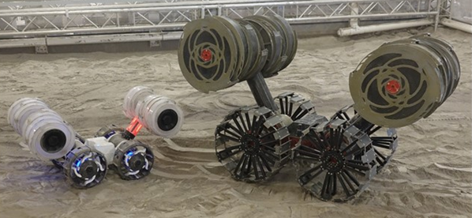
What is RE-RASSOR?
Research and
Education
-
Regolith
Advanced
Surface
System
Operation
Robot
RE-RASSOR
RASSOR

Slide 7



Key goals
3D print all structural parts
Pick up and move a payload
Use robots in cooperation

Slide 8
Customer Needs
How much will the payload weigh?
How many robots need to cooperate?
How will the robots be controlled?
How far can we stray from the original design?
hi
The system will include 4 robots cooperating
The team will develop a human controlled transport mechanism
The transport system will attach on to the current robot body
The system will carry a payload of 100 pounds
Accent1
647 C
Color Values:
RGB 35 97 146
Hex/HTML #236192
CMYK 96 54 5 27
Accent4
2239 C
Color Values:
RGB 0 207 180
Hex/HTML #00CFB4
CMYK 59 0 39 0
Light 1
White
Color Values:
RGB 255 255 255
Hex/HTML #FFFFFF
CMYK 0 0 0 0
Dark 1
100% Black
Color Values:
RGB 0 0 0
Hex/HTML #000000
CMYK 0 0 0 100
Pantone
647 C
Pantone
2239 C
White
Black
Accent 2
2199 C
Color Values:
RGB 0 187 220
Hex/HTML #00BBDC
CMYK 77 0 16 0
Accent5
7535 C
Color Values:
RGB 183 176 156
Hex/HTML #B7B09C
CMYK 10 11 23 19
Light 2
25% Black
Color Values:
RGB 191 191 191
Hex/HTML #bfbfbf
CMYK 0 0 0 25
Dark 2
75 % Black
Color Values:
RGB 64 64 64
Hex/HTML #404040
CMYK 0 0 0 75
Pantone
2199 C
Pantone
7535 C
CoE Lt Gray
CoE Dk Gray
Accent3
1788 C
Color Values:
RGB 238 39 55
Hex/HTML #EE2737
CMYK 0 88 82 0
Accent6
2299 C
Color Values:
RGB 164 210 51
Hex/HTML #A4D233
CMYK 41 0 84 0
Pantone
1788 C
Pantone
2299 C
Notes:
“it is important to note that FSI is planning to add a UCF software engineering team to automate the transport system starting in the spring”

Slide 9
Functional Decomposition
Connection
Payload Motion
Control

Slide 10
Targets
Functional Decomposition
RE-RASSOR to Transporter Connection Accessibility
Motor Torque Management
Vertical Translation
Payload Motion
Ease of Attachment
Payload to Transporter Connection Accessibility
Stabilize Payload During Locomotion
Receive Signal
Connection
Payload to Transporter Connection Confirmation
Human Control Accessibility
Send Signal
Payload to Transporter Connection Load Support
Control
Load Support
Microcontroller Communication
Transduce Signal
RE-RASSOR to Transporter Connection Load Support

Slide 11
Critical Targets
Functional Decomposition
Targets
RE-RASSOR to Transporter Connection Accessibility
Motor Torque Management
Vertical Translation
2 min
1 ft
1 ft
Payload Motion
Ease of Attachment
Payload to Transporter Connection Accessibility
Stabilize Payload During Locomotion
360°
10 N
360°
Receive Signal
5v
Connection
Payload to Transporter Connection Confirmation
Human Control Accessibility
Send Signal
Payload to Transporter Connection Load Support
N/A
5v
100 lbs
100 lbs
Control
Load Support
Microcontroller Communication
Transduce Signal
RE-RASSOR to Transporter Connection Load Support
16 bit ADC
25 lbs

Slide 12
Targets
Functional Decomposition
Critical Targets
Payload to Transporter Connection Load Support
Vertical Translation
Payload to Transporter Connection Accessibility
100 lbs
1 ft
360°
Payload to Transporter Connection Load Support
Payload to Transporter Connection Accessibility
Payload Vertical Translation
100 lbs
1 ft
0-360°

Slide 13
Functional Decomposition
Critical Targets
Payload to Transporter Connection Load Support
Vertical Translation
Payload to Transporter Connection Accessibility
100 lbs
1 ft
360°
Payload to Transporter Connection Load Support
Payload to Transporter Connection Accessibility
Payload Vertical Translation
1 ft
0-360°
100 lbs
# of connections

Slide 14
Critical Targets
Payload to Transporter Connection Load Support
Vertical Translation
Payload to Transporter Connection Accessibility
100 lbs
1 ft
360°
Payload to Transporter Connection Load Support
Payload to Transporter Connection Accessiblity
Payload Vertical Translation
0-360°
1ft
100 lbs
# of connections
1 ft in Z-azis

Slide 15

Functional Decomposition
Critical Targets
Payload to Transporter Connection Load Support
Vertical Translation
Payload to Transporter Connection Accessibility
100 lbs
1 ft
360°
Payload to Transporter Connection Load Support
Payload to Transporter Connection Accessibility
Payload Vertical Translation
1ft
Connection is possible when the payload is rotated 0-360°
100 lbs
# of connections
1 ft in Z-azis

Slide 16




Concept Generation
Brain Writing
Biomimicry
Morphological
Chart
Crapshoot

Slide 17
RE-RASSOR Transporter: Components
Lifting Mechanism
Transporter to RE-RASSOR Connector
Transporter to Payload Connector

Slide 18
RE-RASSOR Transporter: Components
Transporter to RE-RASSOR Connector

Slide 19
RE-RASSOR Transporter: Components
Transporter to RE-RASSOR Connector

Slide 20
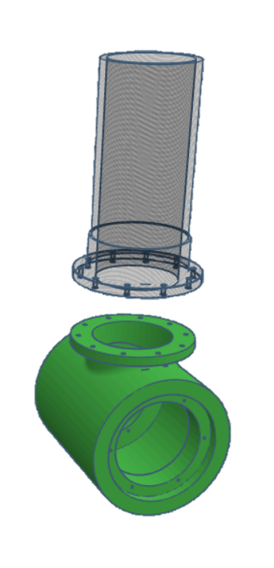
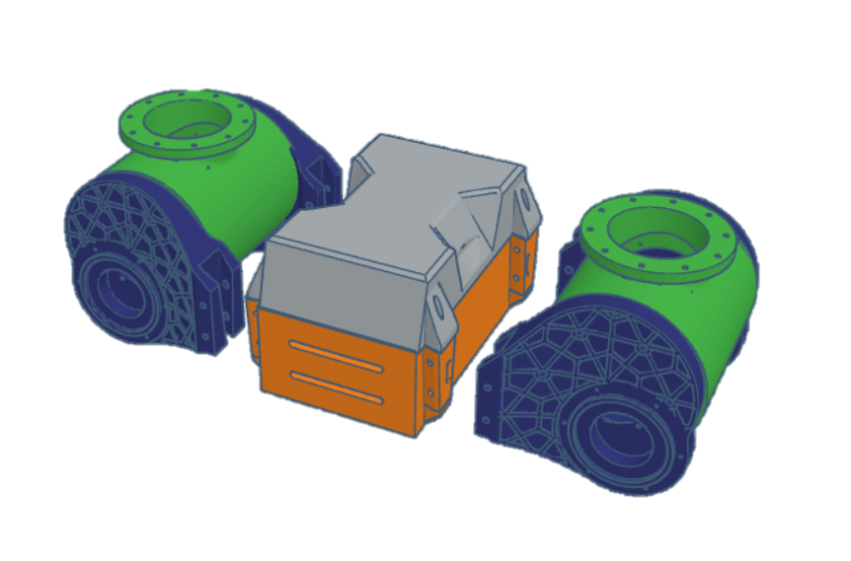
RE-RASSOR Transporter: Components
Transporter to RE-RASSOR Connector
Shoulder Connector

Slide 21
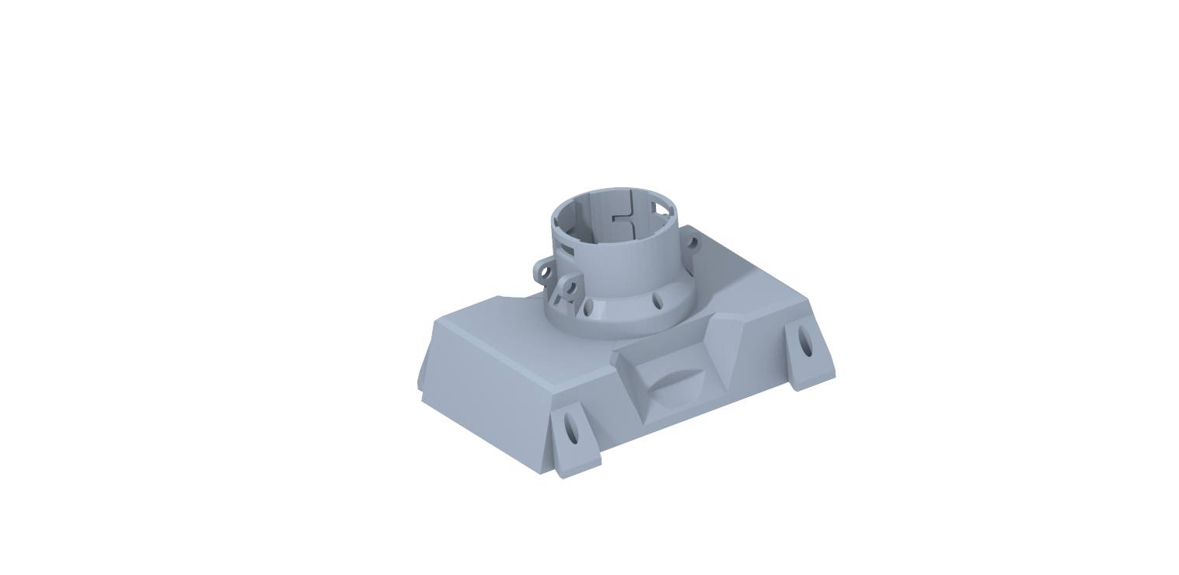
RE-RASSOR Transporter: Components
Transporter to RE-RASSOR Connector
Body Connector

Slide 22
RE-RASSOR Transporter: Components
Lifting Mechanism
Transporter to RE-RASSOR Connector
Transporter to Payload Connector

Slide 23
RE-RASSOR Transporter: Components
Transporter to Payload Connector

Slide 24
RE-RASSOR Transporter: Components
Transporter to Payload Connector

Slide 25

RE-RASSOR Transporter: Components
Transporter to Payload Connector
5m
2m
0.5m
2m
2m

Slide 26
RE-RASSOR Transporter: Components
Transporter to Payload Connector
5m
0.5m
2m
0.18m
2m
2m
0.4m

Slide 27
RE-RASSOR Transporter: Components
Transporter to Payload Connector

Slide 28
RE-RASSOR Transporter: Components
Transporter to Payload Connector

Slide 29
RE-RASSOR Transporter: Components
Transporter to Payload Connector

Slide 30
RE-RASSOR Transporter: Components
Transporter to Payload Connector

Slide 31
Medium Fidelity Concepts
Pulley system with hook connection mechanism
Multiple robots with ramps wedge beneath payload and lift together
One robot operates as a counterweight for the other to lift payload
One robot tips the payload onto platform of second robot
Four Robots use linear elevator to lift the payload

Slide 32
High Fidelity Concepts
Shoulder Driven Five-bar
Based on already available Motors and joints
Load is distributed across motors
Fully enclosed joints

Slide 33
High Fidelity Concepts
Shoulder Driven Five-bar
Based on already available Motors and joints
Load is distributed across motors
Fully enclosed joints

Slide 34
High Fidelity Concepts
Multi-Robot Car Jack
Multiple robots attached mechanisms for lift
High mechanical advantage mechanism
Less chance of longitudinal tipping

Slide 35
High Fidelity Concepts
Multi-Robot Car Jack
Multiple robots attached mechanisms for lift
High mechanical advantage mechanism
Less chance of longitudinal tipping

Slide 36
High Fidelity Concepts
Single robot Car Jack
Simple lifting mechanism with high mechanical advantage
Motor driven vertical translation

Slide 37
High Fidelity Concepts
Single robot Car Jack
Simple lifting mechanism with high mechanical advantage
Motor driven vertical translation

Slide 38




Concept Selection
Pairwise Comparison
House of Quality
Pugh
Chart
Analytical Hierarchy Process
S

Slide 39
Concept Selection
House of Quality
Translate Payload
Payload to Transporter Connection Accessibility

Slide 40
Concept Selection
House of Quality
Translate Payload
Payload to Transporter Connection Accessibility

Slide 41
Concept Selection
House of Quality
Translate Payload
Payload to Transporter Connection Accessibility

Slide 42
Concept Selection
Pugh Chart

Slide 43
Concept Selection
Pugh Chart

Slide 44
Concept Selection
Pugh Chart

Slide 45
Concept Selection
AHP

Slide 46
Final Selection:
Shoulder Driven 5-Bar
Reutilized shoulder joints driving down cost and weight
Less assembly required
Connection mechanism manipulated in two planes
High stability and lifting force

Slide 47
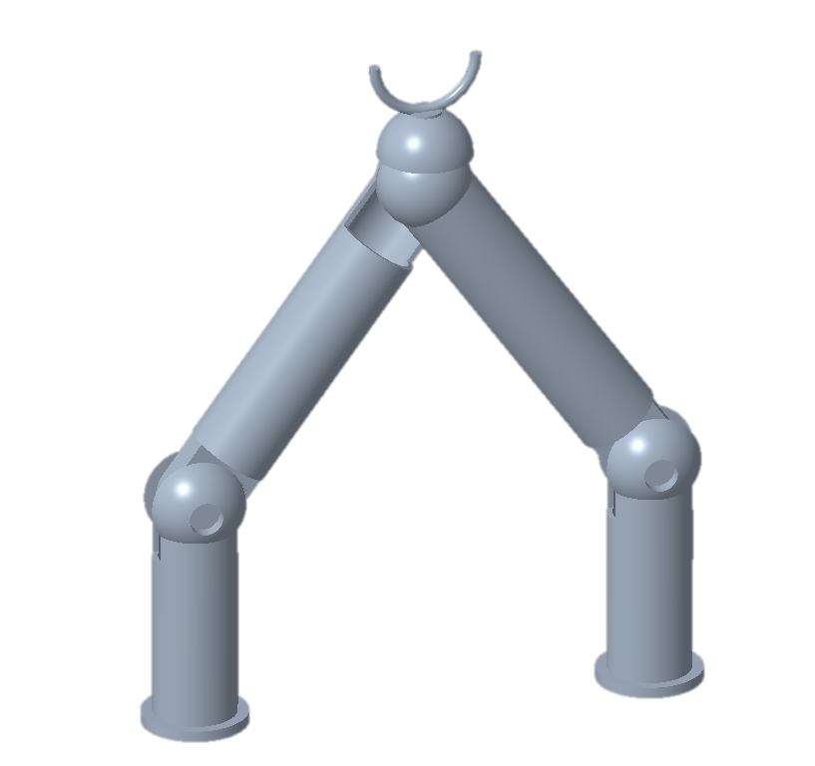
Final Selection:
Shoulder Driven 5-Bar

Slide 48




Future Work
Continue Prototyping
Risk Assessment
Bill of Materials
Spring
Plan

Slide 49
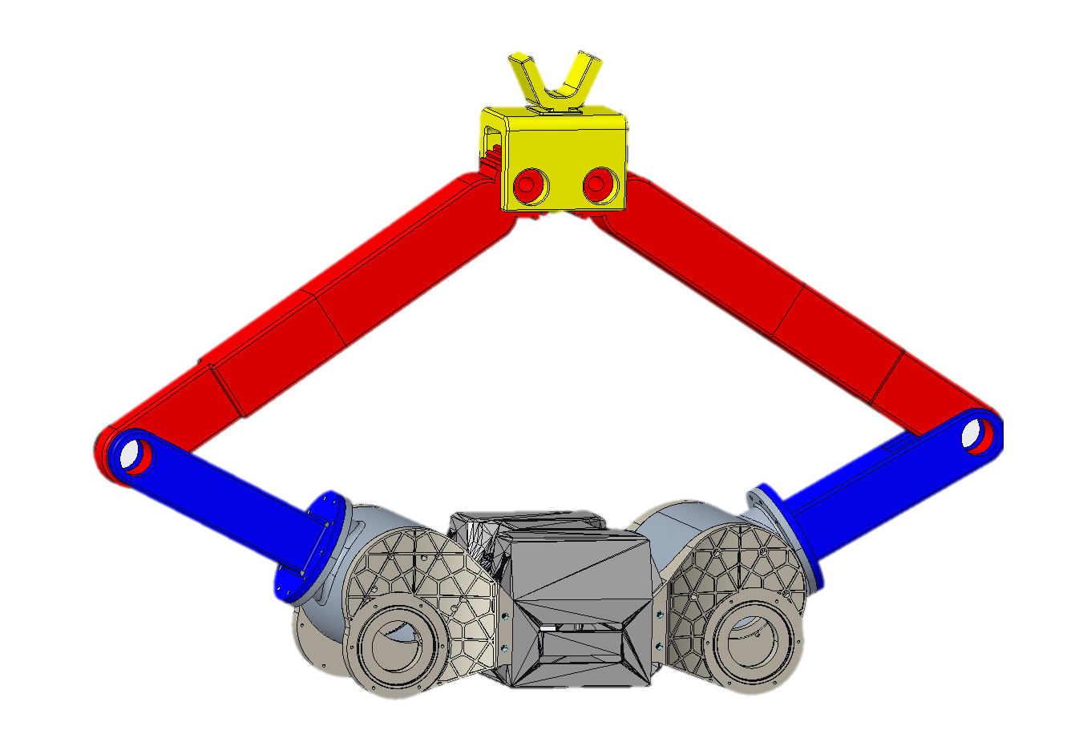
Backup Slides

Slide 50
Next steps
Spring Project Plan
Risk Assessment
Bill of Materials

Slide 51
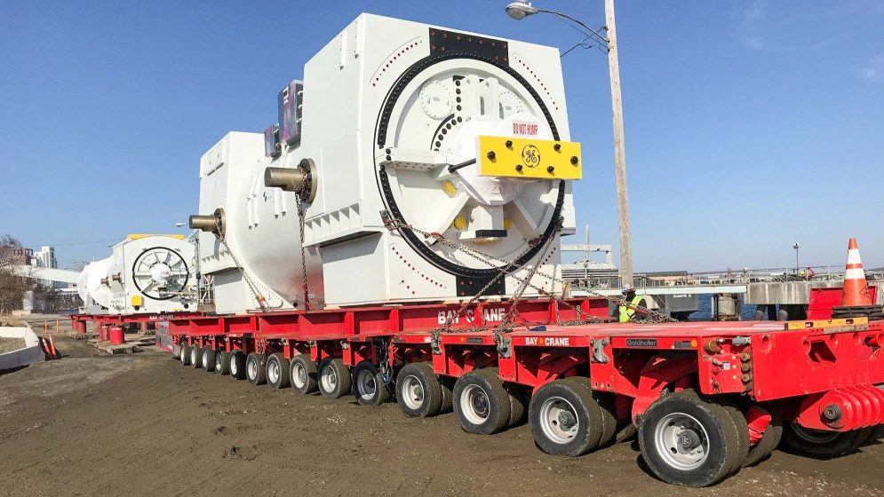

Slide 52
College of Engineering Color Palette
2299 C
Color Values:
RGB 164 210 51
Hex/HTML #A4D233
CMYK 41 0 84 0
1788 C
Color Values:
RGB 238 39 55
Hex/HTML #EE2737
CMYK 0 88 82 0
75% Black
Color Values:
RGB 64 64 64
Hex/HTML #404040
CMYK 0 0 0 75
Pantone
2299 C
Pantone
1788 C
CoE Dk Gray
2239 C
Color Values:
RGB 0 207 180
Hex/HTML #00CFB4
CMYK 59 0 39 0
647 C
Color Values:
RGB 35 97 146
Hex/HTML #236192
CMYK 96 54 5 27
50% Black
Color Values:
RGB 128 128 128
Hex/HTML #808080
CMYK 0 0 0 50
Pantone
2239 C
Pantone
647 C
CoE Md Gray
2199 C
Color Values:
RGB 0 187 220
Hex/HTML #00BBDC
CMYK 77 0 16 0
7535 C
Color Values:
RGB 183 176 156
Hex/HTML #B7B09C
CMYK 10 11 23 19
25% Black
Color Values:
RGB 191 191 191
Hex/HTML #bfbfbf
CMYK 0 0 0 25
Pantone
2199 C
Pantone
7535 C
CoE Lt Gray
Notes:
Theses are the official color palettes of the college of engineering.

Slide 53
PowerPoint Color Theme
Accent1
647 C
Color Values:
RGB 35 97 146
Hex/HTML #236192
CMYK 96 54 5 27
Accent4
2239 C
Color Values:
RGB 0 207 180
Hex/HTML #00CFB4
CMYK 59 0 39 0
Light 1
White
Color Values:
RGB 255 255 255
Hex/HTML #FFFFFF
CMYK 0 0 0 0
Dark 1
100% Black
Color Values:
RGB 0 0 0
Hex/HTML #000000
CMYK 0 0 0 100
Pantone
647 C
Pantone
2239 C
White
Black
Accent 2
2199 C
Color Values:
RGB 0 187 220
Hex/HTML #00BBDC
CMYK 77 0 16 0
Accent5
7535 C
Color Values:
RGB 183 176 156
Hex/HTML #B7B09C
CMYK 10 11 23 19
Light 2
25% Black
Color Values:
RGB 191 191 191
Hex/HTML #bfbfbf
CMYK 0 0 0 25
Dark 2
75 % Black
Color Values:
RGB 64 64 64
Hex/HTML #404040
CMYK 0 0 0 75
Pantone
2199 C
Pantone
7535 C
CoE Lt Gray
CoE Dk Gray
Accent3
1788 C
Color Values:
RGB 238 39 55
Hex/HTML #EE2737
CMYK 0 88 82 0
Accent6
2299 C
Color Values:
RGB 164 210 51
Hex/HTML #A4D233
CMYK 41 0 84 0
Pantone
1788 C
Pantone
2299 C
Notes:
These are the college colors as prioritized within this PowerPoint Template

Slide 54
Notes:
This slide has the rule of third layout tool. The rule thirds layout helps with the sizing of elements.

Slide 55
Notes:
This slide has the rule of third layout tool. The rule thirds layout helps with the sizing of elements.

Slide 62
5m
0.5m
0.375m
2m
0.18m
0.175m
2m
0.4m
2m

Slide 63
5m
0.5m
2m
2m
2m

Slide 65
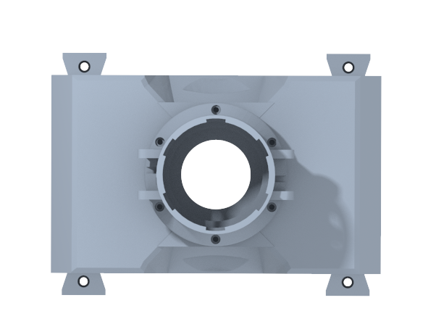
Customer Needs
How far can we stray from the original design?
hi
It is strongly encouraged to use a previously developed coupling design
Accent1
647 C
Color Values:
RGB 35 97 146
Hex/HTML #236192
CMYK 96 54 5 27
Accent4
2239 C
Color Values:
RGB 0 207 180
Hex/HTML #00CFB4
CMYK 59 0 39 0
Light 1
White
Color Values:
RGB 255 255 255
Hex/HTML #FFFFFF
CMYK 0 0 0 0
Dark 1
100% Black
Color Values:
RGB 0 0 0
Hex/HTML #000000
CMYK 0 0 0 100
Pantone
647 C
Pantone
2239 C
White
Black
Accent 2
2199 C
Color Values:
RGB 0 187 220
Hex/HTML #00BBDC
CMYK 77 0 16 0
Accent5
7535 C
Color Values:
RGB 183 176 156
Hex/HTML #B7B09C
CMYK 10 11 23 19
Light 2
25% Black
Color Values:
RGB 191 191 191
Hex/HTML #bfbfbf
CMYK 0 0 0 25
Dark 2
75 % Black
Color Values:
RGB 64 64 64
Hex/HTML #404040
CMYK 0 0 0 75
Pantone
2199 C
Pantone
7535 C
CoE Lt Gray
CoE Dk Gray
Accent3
1788 C
Color Values:
RGB 238 39 55
Hex/HTML #EE2737
CMYK 0 88 82 0
Accent6
2299 C
Color Values:
RGB 164 210 51
Hex/HTML #A4D233
CMYK 41 0 84 0
Pantone
1788 C
Pantone
2299 C
Notes:
“it is important to note that FSI is planning to add a UCF software engineering team to automate the transport system starting in the spring”

Slide 66
Customer Needs
How much will the payload weigh?
Cubic supply crate
Long cylindrical support beam
0.5m
2m
5m
2m
2m
Accent1
647 C
Color Values:
RGB 35 97 146
Hex/HTML #236192
CMYK 96 54 5 27
Accent4
2239 C
Color Values:
RGB 0 207 180
Hex/HTML #00CFB4
CMYK 59 0 39 0
Light 1
White
Color Values:
RGB 255 255 255
Hex/HTML #FFFFFF
CMYK 0 0 0 0
Dark 1
100% Black
Color Values:
RGB 0 0 0
Hex/HTML #000000
CMYK 0 0 0 100
Pantone
647 C
Pantone
2239 C
White
Black
Accent 2
2199 C
Color Values:
RGB 0 187 220
Hex/HTML #00BBDC
CMYK 77 0 16 0
Accent5
7535 C
Color Values:
RGB 183 176 156
Hex/HTML #B7B09C
CMYK 10 11 23 19
Light 2
25% Black
Color Values:
RGB 191 191 191
Hex/HTML #bfbfbf
CMYK 0 0 0 25
Dark 2
75 % Black
Color Values:
RGB 64 64 64
Hex/HTML #404040
CMYK 0 0 0 75
Pantone
2199 C
Pantone
7535 C
CoE Lt Gray
CoE Dk Gray
Accent3
1788 C
Color Values:
RGB 238 39 55
Hex/HTML #EE2737
CMYK 0 88 82 0
Accent6
2299 C
Color Values:
RGB 164 210 51
Hex/HTML #A4D233
CMYK 41 0 84 0
Pantone
1788 C
Pantone
2299 C
Notes:
“it is important to note that FSI is planning to add a UCF software engineering team to automate the transport system starting in the spring”

Slide 67
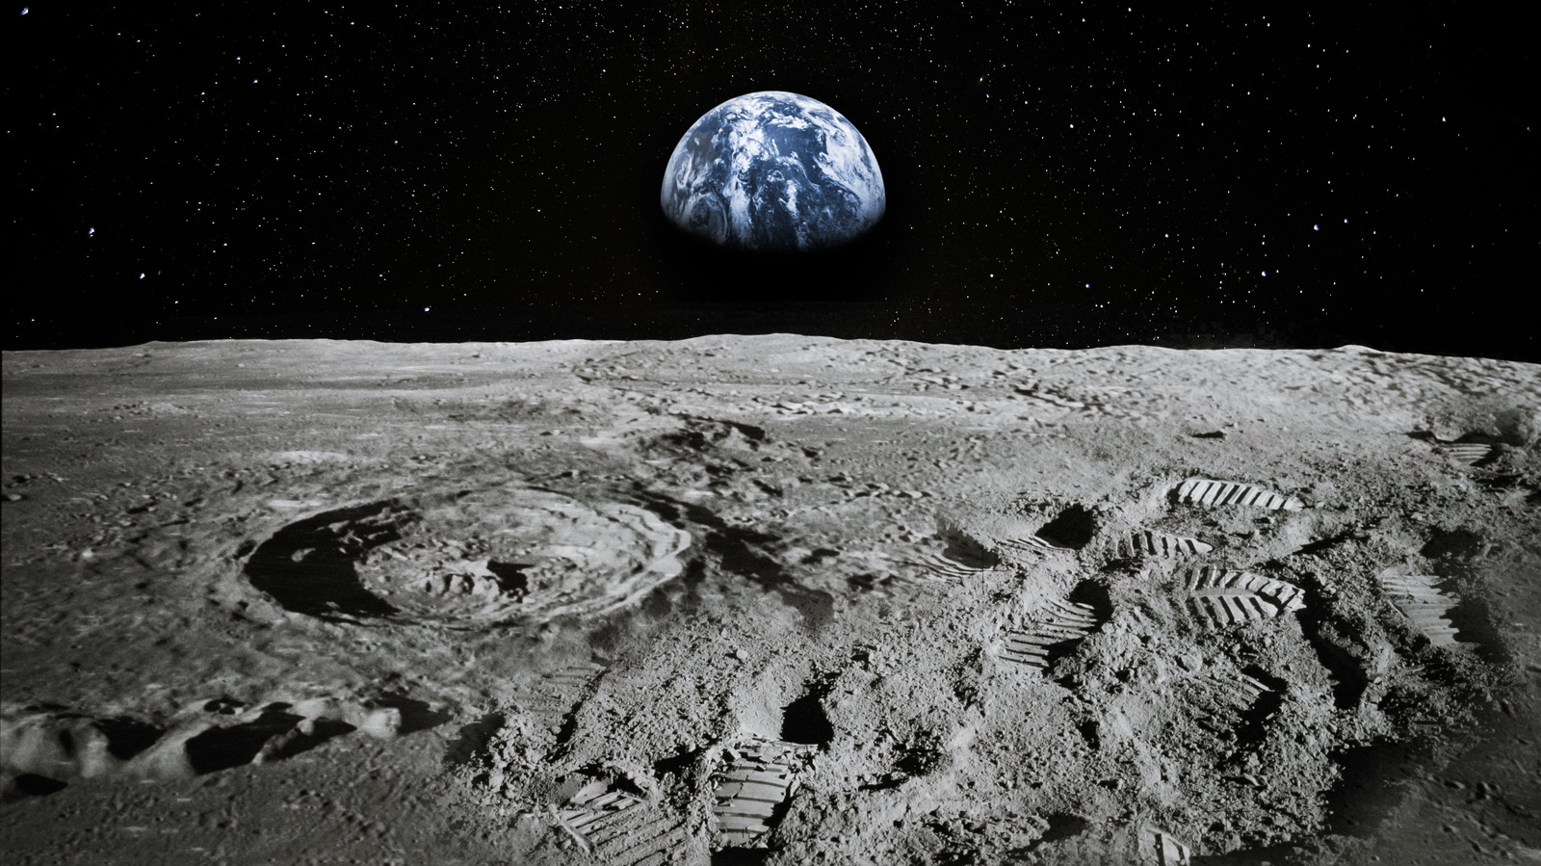
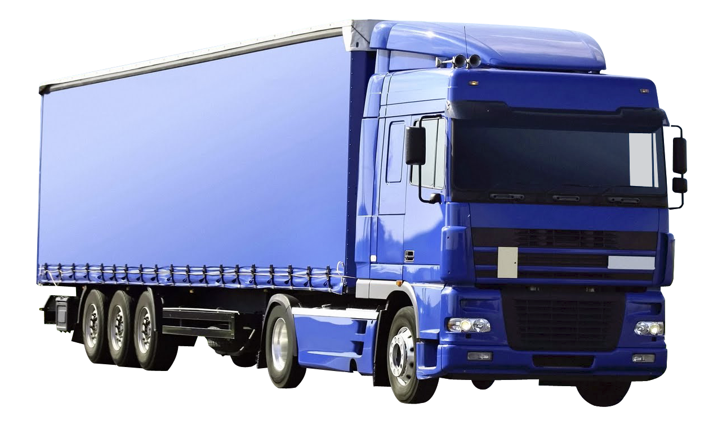
Why use RE-RASSOR?
Accent1
647 C
Color Values:
RGB 35 97 146
Hex/HTML #236192
CMYK 96 54 5 27
Accent4
2239 C
Color Values:
RGB 0 207 180
Hex/HTML #00CFB4
CMYK 59 0 39 0
Light 1
White
Color Values:
RGB 255 255 255
Hex/HTML #FFFFFF
CMYK 0 0 0 0
Dark 1
100% Black
Color Values:
RGB 0 0 0
Hex/HTML #000000
CMYK 0 0 0 100
Pantone
647 C
Pantone
2239 C
White
Black
Accent 2
2199 C
Color Values:
RGB 0 187 220
Hex/HTML #00BBDC
CMYK 77 0 16 0
Accent5
7535 C
Color Values:
RGB 183 176 156
Hex/HTML #B7B09C
CMYK 10 11 23 19
Light 2
25% Black
Color Values:
RGB 191 191 191
Hex/HTML #bfbfbf
CMYK 0 0 0 25
Dark 2
75 % Black
Color Values:
RGB 64 64 64
Hex/HTML #404040
CMYK 0 0 0 75
Pantone
2199 C
Pantone
7535 C
CoE Lt Gray
CoE Dk Gray
Accent3
1788 C
Color Values:
RGB 238 39 55
Hex/HTML #EE2737
CMYK 0 88 82 0
Accent6
2299 C
Color Values:
RGB 164 210 51
Hex/HTML #A4D233
CMYK 41 0 84 0
Pantone
1788 C
Pantone
2299 C

Slide 69
