Slide 1
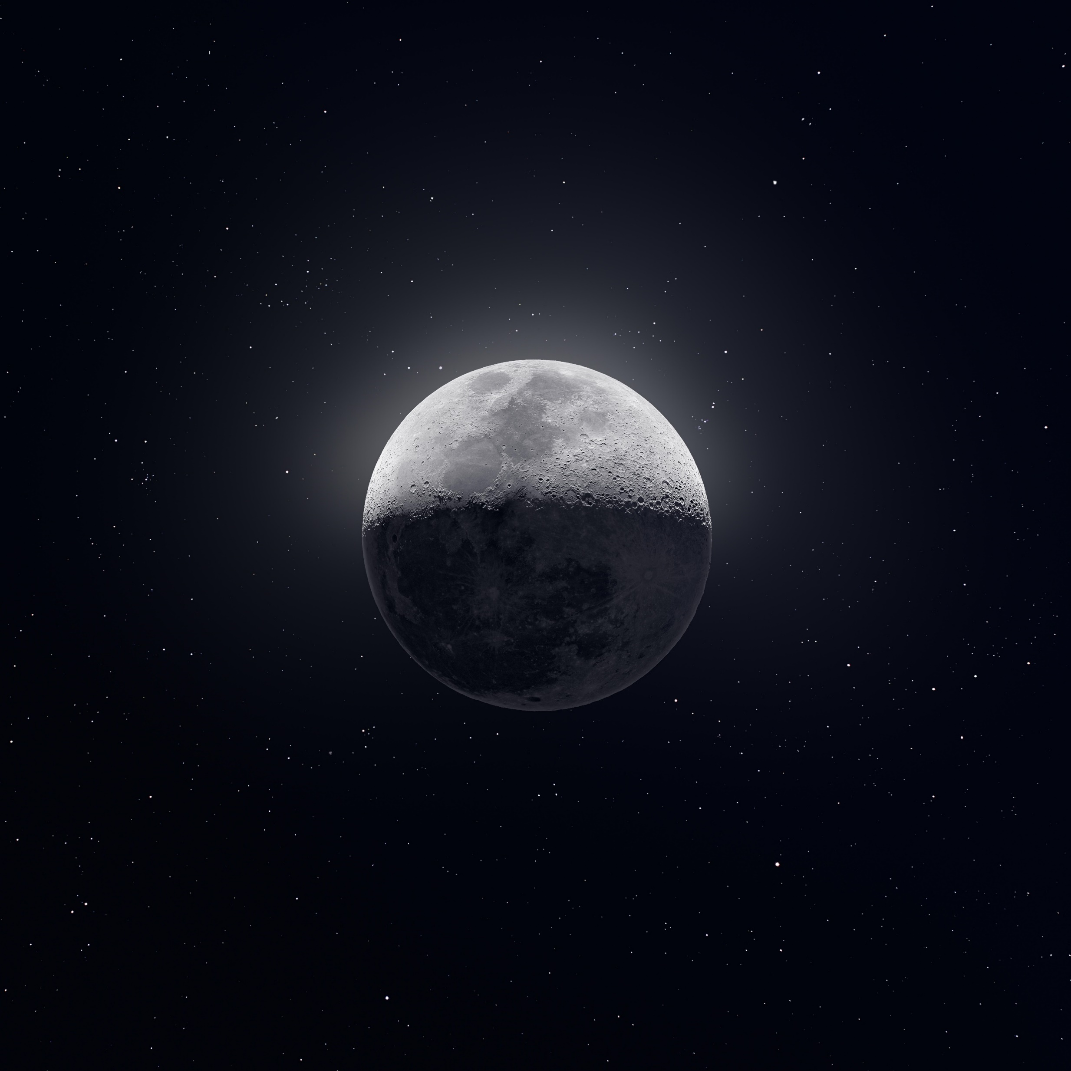
EZ RASSOR:
LUNAR TRANSPORTER
Team 513
Notes:
Customize your title slide to be appealing to the audience. This is the first thing they see apply some graphic design elements that may summarize your presentation.

Slide 2


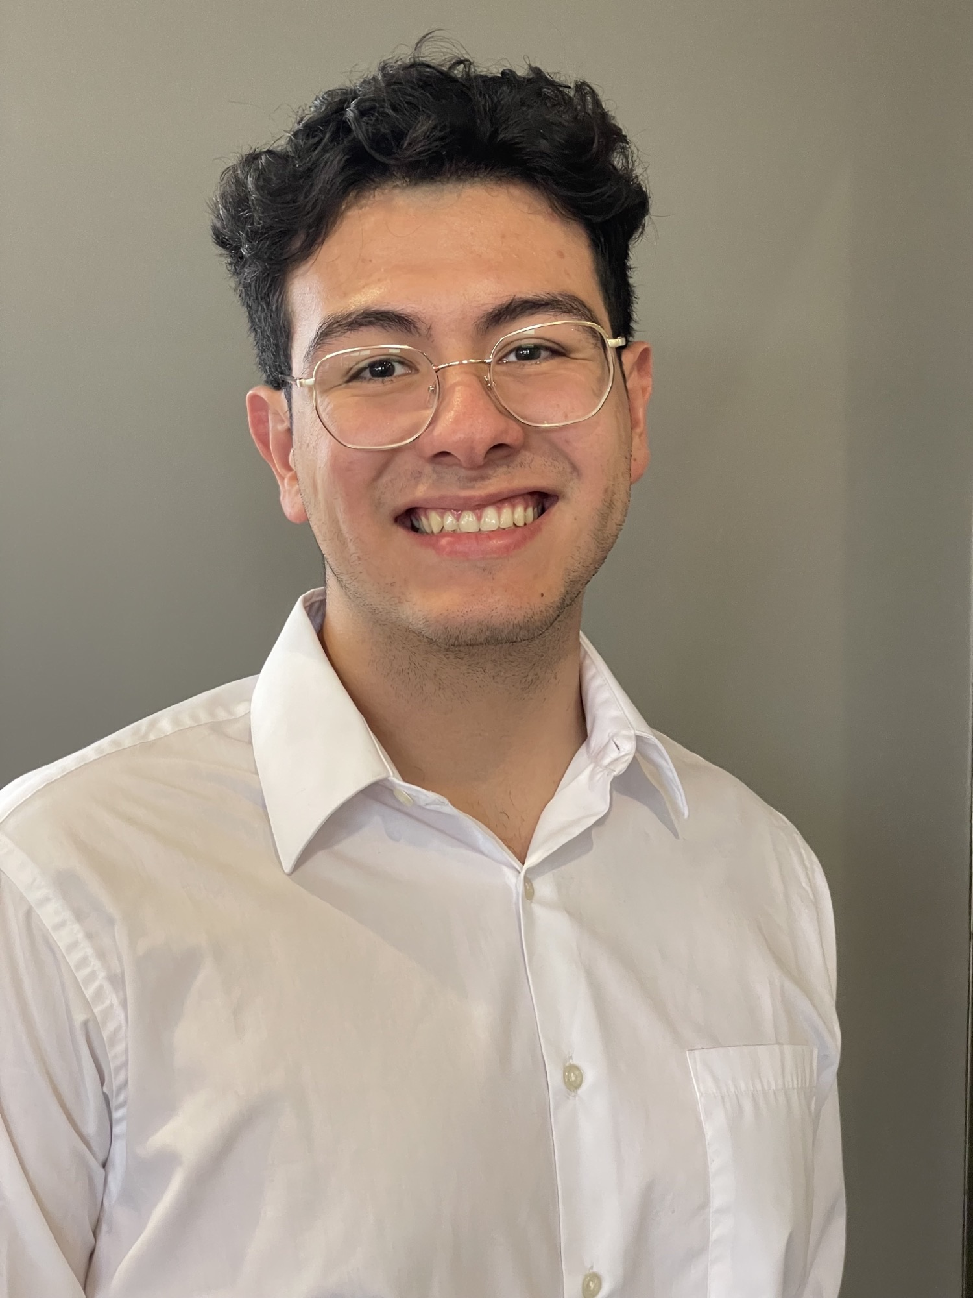

Team 513: Members
Jared Carboy
Systems Engineer
Kaden Lane
Design Engineer
Carlos Sanchez
Mechatronic Engineer
Axcell Vargas
Controls Engineer

Slide 3




Sponsor & Advisor
Mike Conroy
Engineering Support
Senior Design
Keith Larson
ME Professor

Slide 4
Objective
Repurpose the
RE-RASSOR mining robot into a transport system that can lift and move heavy payloads on the moon.

Slide 5
Objective
Repurpose the
RE-RASSOR mining robot into a transport system that can lift and move heavy payloads on the moon.

Slide 6
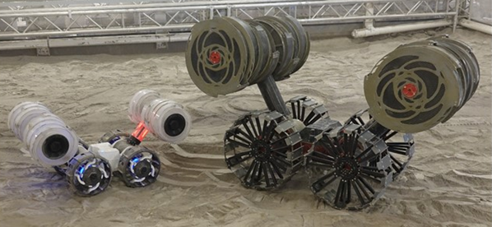
What is RE-RASSOR?

Slide 7
What is RE-RASSOR?
RASSOR

Slide 8
What is RE-RASSOR?
Regolith
Advanced
Surface
System
Operation
Robot
Research and
Education
-
RASSOR

Slide 9
What is RE-RASSOR?
Research and
Education
-
Regolith
Advanced
Surface
System
Operation
Robot
RE-RASSOR
RASSOR

Slide 10
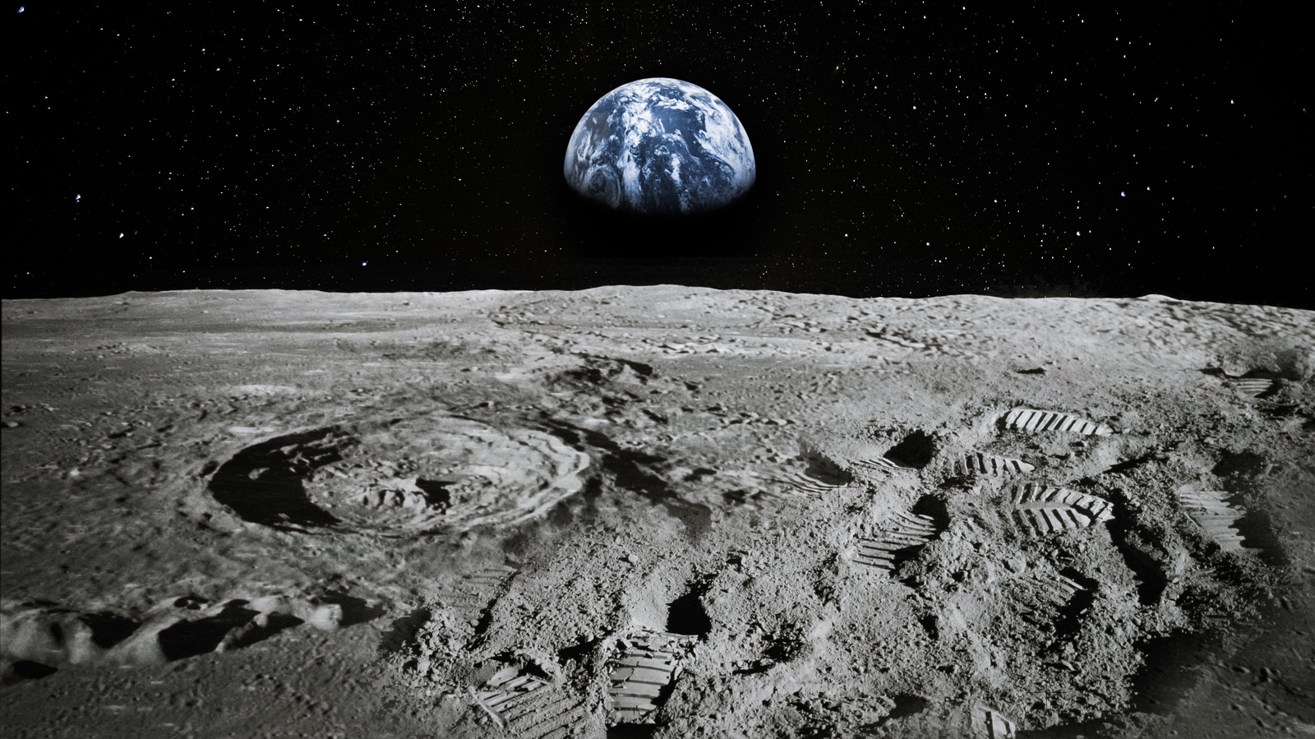
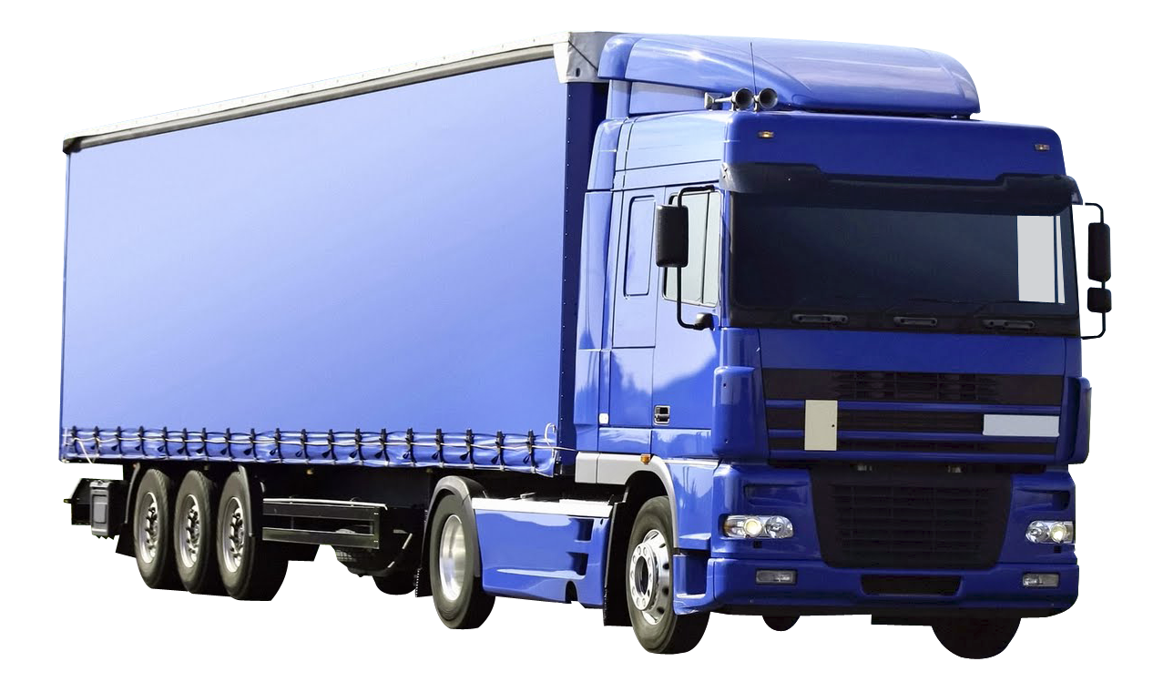
Why use RE-RASSOR?

Slide 11
Why use RE-RASSOR?

Slide 12
Why use RE-RASSOR?
Dedicated Transporter:
Too large
Too heavy

Slide 13
Why use RE-RASSOR?

Slide 14
Why use RE-RASSOR?

Slide 15
Why use RE-RASSOR?

Slide 16
Why use RE-RASSOR?
RE-RASSOR Transporter:
Less space
Lighter
Multipurpose

Slide 17



Key goals
Pick up and move a payload
3D print all structural parts
Use robots in cooperation
Accent1
647 C
Color Values:
RGB 35 97 146
Hex/HTML #236192
CMYK 96 54 5 27
Accent4
2239 C
Color Values:
RGB 0 207 180
Hex/HTML #00CFB4
CMYK 59 0 39 0
Light 1
White
Color Values:
RGB 255 255 255
Hex/HTML #FFFFFF
CMYK 0 0 0 0
Dark 1
100% Black
Color Values:
RGB 0 0 0
Hex/HTML #000000
CMYK 0 0 0 100
Pantone
647 C
Pantone
2239 C
White
Black
Accent 2
2199 C
Color Values:
RGB 0 187 220
Hex/HTML #00BBDC
CMYK 77 0 16 0
Accent5
7535 C
Color Values:
RGB 183 176 156
Hex/HTML #B7B09C
CMYK 10 11 23 19
Light 2
25% Black
Color Values:
RGB 191 191 191
Hex/HTML #bfbfbf
CMYK 0 0 0 25
Dark 2
75 % Black
Color Values:
RGB 64 64 64
Hex/HTML #404040
CMYK 0 0 0 75
Pantone
2199 C
Pantone
7535 C
CoE Lt Gray
CoE Dk Gray
Accent3
1788 C
Color Values:
RGB 238 39 55
Hex/HTML #EE2737
CMYK 0 88 82 0
Accent6
2299 C
Color Values:
RGB 164 210 51
Hex/HTML #A4D233
CMYK 41 0 84 0
Pantone
1788 C
Pantone
2299 C

Slide 18
Key goals
Pick up and move a payload
3D print all structural parts
Use robots in cooperation
Accent1
647 C
Color Values:
RGB 35 97 146
Hex/HTML #236192
CMYK 96 54 5 27
Accent4
2239 C
Color Values:
RGB 0 207 180
Hex/HTML #00CFB4
CMYK 59 0 39 0
Light 1
White
Color Values:
RGB 255 255 255
Hex/HTML #FFFFFF
CMYK 0 0 0 0
Dark 1
100% Black
Color Values:
RGB 0 0 0
Hex/HTML #000000
CMYK 0 0 0 100
Pantone
647 C
Pantone
2239 C
White
Black
Accent 2
2199 C
Color Values:
RGB 0 187 220
Hex/HTML #00BBDC
CMYK 77 0 16 0
Accent5
7535 C
Color Values:
RGB 183 176 156
Hex/HTML #B7B09C
CMYK 10 11 23 19
Light 2
25% Black
Color Values:
RGB 191 191 191
Hex/HTML #bfbfbf
CMYK 0 0 0 25
Dark 2
75 % Black
Color Values:
RGB 64 64 64
Hex/HTML #404040
CMYK 0 0 0 75
Pantone
2199 C
Pantone
7535 C
CoE Lt Gray
CoE Dk Gray
Accent3
1788 C
Color Values:
RGB 238 39 55
Hex/HTML #EE2737
CMYK 0 88 82 0
Accent6
2299 C
Color Values:
RGB 164 210 51
Hex/HTML #A4D233
CMYK 41 0 84 0
Pantone
1788 C
Pantone
2299 C

Slide 19
Key goals
Pick up and move a payload
3D print all structural parts
Use robots in cooperation
Accent1
647 C
Color Values:
RGB 35 97 146
Hex/HTML #236192
CMYK 96 54 5 27
Accent4
2239 C
Color Values:
RGB 0 207 180
Hex/HTML #00CFB4
CMYK 59 0 39 0
Light 1
White
Color Values:
RGB 255 255 255
Hex/HTML #FFFFFF
CMYK 0 0 0 0
Dark 1
100% Black
Color Values:
RGB 0 0 0
Hex/HTML #000000
CMYK 0 0 0 100
Pantone
647 C
Pantone
2239 C
White
Black
Accent 2
2199 C
Color Values:
RGB 0 187 220
Hex/HTML #00BBDC
CMYK 77 0 16 0
Accent5
7535 C
Color Values:
RGB 183 176 156
Hex/HTML #B7B09C
CMYK 10 11 23 19
Light 2
25% Black
Color Values:
RGB 191 191 191
Hex/HTML #bfbfbf
CMYK 0 0 0 25
Dark 2
75 % Black
Color Values:
RGB 64 64 64
Hex/HTML #404040
CMYK 0 0 0 75
Pantone
2199 C
Pantone
7535 C
CoE Lt Gray
CoE Dk Gray
Accent3
1788 C
Color Values:
RGB 238 39 55
Hex/HTML #EE2737
CMYK 0 88 82 0
Accent6
2299 C
Color Values:
RGB 164 210 51
Hex/HTML #A4D233
CMYK 41 0 84 0
Pantone
1788 C
Pantone
2299 C

Slide 20
Key goals
Pick up and move a payload
3D print all structural parts
Use robots in cooperation
Accent1
647 C
Color Values:
RGB 35 97 146
Hex/HTML #236192
CMYK 96 54 5 27
Accent4
2239 C
Color Values:
RGB 0 207 180
Hex/HTML #00CFB4
CMYK 59 0 39 0
Light 1
White
Color Values:
RGB 255 255 255
Hex/HTML #FFFFFF
CMYK 0 0 0 0
Dark 1
100% Black
Color Values:
RGB 0 0 0
Hex/HTML #000000
CMYK 0 0 0 100
Pantone
647 C
Pantone
2239 C
White
Black
Accent 2
2199 C
Color Values:
RGB 0 187 220
Hex/HTML #00BBDC
CMYK 77 0 16 0
Accent5
7535 C
Color Values:
RGB 183 176 156
Hex/HTML #B7B09C
CMYK 10 11 23 19
Light 2
25% Black
Color Values:
RGB 191 191 191
Hex/HTML #bfbfbf
CMYK 0 0 0 25
Dark 2
75 % Black
Color Values:
RGB 64 64 64
Hex/HTML #404040
CMYK 0 0 0 75
Pantone
2199 C
Pantone
7535 C
CoE Lt Gray
CoE Dk Gray
Accent3
1788 C
Color Values:
RGB 238 39 55
Hex/HTML #EE2737
CMYK 0 88 82 0
Accent6
2299 C
Color Values:
RGB 164 210 51
Hex/HTML #A4D233
CMYK 41 0 84 0
Pantone
1788 C
Pantone
2299 C

Slide 21
Customer Needs
How much will the payload weigh?
How many robots need to cooperate?
How will the robots be controlled?
How far can we stray from the original design?
Accent1
647 C
Color Values:
RGB 35 97 146
Hex/HTML #236192
CMYK 96 54 5 27
Accent4
2239 C
Color Values:
RGB 0 207 180
Hex/HTML #00CFB4
CMYK 59 0 39 0
Light 1
White
Color Values:
RGB 255 255 255
Hex/HTML #FFFFFF
CMYK 0 0 0 0
Dark 1
100% Black
Color Values:
RGB 0 0 0
Hex/HTML #000000
CMYK 0 0 0 100
Pantone
647 C
Pantone
2239 C
White
Black
Accent 2
2199 C
Color Values:
RGB 0 187 220
Hex/HTML #00BBDC
CMYK 77 0 16 0
Accent5
7535 C
Color Values:
RGB 183 176 156
Hex/HTML #B7B09C
CMYK 10 11 23 19
Light 2
25% Black
Color Values:
RGB 191 191 191
Hex/HTML #bfbfbf
CMYK 0 0 0 25
Dark 2
75 % Black
Color Values:
RGB 64 64 64
Hex/HTML #404040
CMYK 0 0 0 75
Pantone
2199 C
Pantone
7535 C
CoE Lt Gray
CoE Dk Gray
Accent3
1788 C
Color Values:
RGB 238 39 55
Hex/HTML #EE2737
CMYK 0 88 82 0
Accent6
2299 C
Color Values:
RGB 164 210 51
Hex/HTML #A4D233
CMYK 41 0 84 0
Pantone
1788 C
Pantone
2299 C

Slide 22
Customer Needs
How much will the payload weigh?
How many robots need to cooperate?
How will the robots be controlled?
How far can we stray from the original design?
The system will carry a payload of 100 pounds
Accent1
647 C
Color Values:
RGB 35 97 146
Hex/HTML #236192
CMYK 96 54 5 27
Accent4
2239 C
Color Values:
RGB 0 207 180
Hex/HTML #00CFB4
CMYK 59 0 39 0
Light 1
White
Color Values:
RGB 255 255 255
Hex/HTML #FFFFFF
CMYK 0 0 0 0
Dark 1
100% Black
Color Values:
RGB 0 0 0
Hex/HTML #000000
CMYK 0 0 0 100
Pantone
647 C
Pantone
2239 C
White
Black
Accent 2
2199 C
Color Values:
RGB 0 187 220
Hex/HTML #00BBDC
CMYK 77 0 16 0
Accent5
7535 C
Color Values:
RGB 183 176 156
Hex/HTML #B7B09C
CMYK 10 11 23 19
Light 2
25% Black
Color Values:
RGB 191 191 191
Hex/HTML #bfbfbf
CMYK 0 0 0 25
Dark 2
75 % Black
Color Values:
RGB 64 64 64
Hex/HTML #404040
CMYK 0 0 0 75
Pantone
2199 C
Pantone
7535 C
CoE Lt Gray
CoE Dk Gray
Accent3
1788 C
Color Values:
RGB 238 39 55
Hex/HTML #EE2737
CMYK 0 88 82 0
Accent6
2299 C
Color Values:
RGB 164 210 51
Hex/HTML #A4D233
CMYK 41 0 84 0
Pantone
1788 C
Pantone
2299 C
Notes:
“it is important to note that FSI is planning to add a UCF software engineering team to automate the transport system starting in the spring”

Slide 23

Customer Needs
How much will the payload weigh?
Cubic supply crate
Long cylindrical support beam
0.5m
2m
5m
2m
2m
Accent1
647 C
Color Values:
RGB 35 97 146
Hex/HTML #236192
CMYK 96 54 5 27
Accent4
2239 C
Color Values:
RGB 0 207 180
Hex/HTML #00CFB4
CMYK 59 0 39 0
Light 1
White
Color Values:
RGB 255 255 255
Hex/HTML #FFFFFF
CMYK 0 0 0 0
Dark 1
100% Black
Color Values:
RGB 0 0 0
Hex/HTML #000000
CMYK 0 0 0 100
Pantone
647 C
Pantone
2239 C
White
Black
Accent 2
2199 C
Color Values:
RGB 0 187 220
Hex/HTML #00BBDC
CMYK 77 0 16 0
Accent5
7535 C
Color Values:
RGB 183 176 156
Hex/HTML #B7B09C
CMYK 10 11 23 19
Light 2
25% Black
Color Values:
RGB 191 191 191
Hex/HTML #bfbfbf
CMYK 0 0 0 25
Dark 2
75 % Black
Color Values:
RGB 64 64 64
Hex/HTML #404040
CMYK 0 0 0 75
Pantone
2199 C
Pantone
7535 C
CoE Lt Gray
CoE Dk Gray
Accent3
1788 C
Color Values:
RGB 238 39 55
Hex/HTML #EE2737
CMYK 0 88 82 0
Accent6
2299 C
Color Values:
RGB 164 210 51
Hex/HTML #A4D233
CMYK 41 0 84 0
Pantone
1788 C
Pantone
2299 C
Notes:
“it is important to note that FSI is planning to add a UCF software engineering team to automate the transport system starting in the spring”

Slide 24
Customer Needs
How much will the payload weigh?
How many robots need to cooperate?
How will the robots be controlled?
How far can we stray from the original design?
The system will carry a payload of 100 pounds
Accent1
647 C
Color Values:
RGB 35 97 146
Hex/HTML #236192
CMYK 96 54 5 27
Accent4
2239 C
Color Values:
RGB 0 207 180
Hex/HTML #00CFB4
CMYK 59 0 39 0
Light 1
White
Color Values:
RGB 255 255 255
Hex/HTML #FFFFFF
CMYK 0 0 0 0
Dark 1
100% Black
Color Values:
RGB 0 0 0
Hex/HTML #000000
CMYK 0 0 0 100
Pantone
647 C
Pantone
2239 C
White
Black
Accent 2
2199 C
Color Values:
RGB 0 187 220
Hex/HTML #00BBDC
CMYK 77 0 16 0
Accent5
7535 C
Color Values:
RGB 183 176 156
Hex/HTML #B7B09C
CMYK 10 11 23 19
Light 2
25% Black
Color Values:
RGB 191 191 191
Hex/HTML #bfbfbf
CMYK 0 0 0 25
Dark 2
75 % Black
Color Values:
RGB 64 64 64
Hex/HTML #404040
CMYK 0 0 0 75
Pantone
2199 C
Pantone
7535 C
CoE Lt Gray
CoE Dk Gray
Accent3
1788 C
Color Values:
RGB 238 39 55
Hex/HTML #EE2737
CMYK 0 88 82 0
Accent6
2299 C
Color Values:
RGB 164 210 51
Hex/HTML #A4D233
CMYK 41 0 84 0
Pantone
1788 C
Pantone
2299 C
Notes:
“it is important to note that FSI is planning to add a UCF software engineering team to automate the transport system starting in the spring”

Slide 25
Customer Needs
How much will the payload weigh?
How many robots need to cooperate?
How will the robots be controlled?
How far can we stray from the original design?
The system will include 4 robots cooperating
The system will carry a payload of 100 pounds
Accent1
647 C
Color Values:
RGB 35 97 146
Hex/HTML #236192
CMYK 96 54 5 27
Accent4
2239 C
Color Values:
RGB 0 207 180
Hex/HTML #00CFB4
CMYK 59 0 39 0
Light 1
White
Color Values:
RGB 255 255 255
Hex/HTML #FFFFFF
CMYK 0 0 0 0
Dark 1
100% Black
Color Values:
RGB 0 0 0
Hex/HTML #000000
CMYK 0 0 0 100
Pantone
647 C
Pantone
2239 C
White
Black
Accent 2
2199 C
Color Values:
RGB 0 187 220
Hex/HTML #00BBDC
CMYK 77 0 16 0
Accent5
7535 C
Color Values:
RGB 183 176 156
Hex/HTML #B7B09C
CMYK 10 11 23 19
Light 2
25% Black
Color Values:
RGB 191 191 191
Hex/HTML #bfbfbf
CMYK 0 0 0 25
Dark 2
75 % Black
Color Values:
RGB 64 64 64
Hex/HTML #404040
CMYK 0 0 0 75
Pantone
2199 C
Pantone
7535 C
CoE Lt Gray
CoE Dk Gray
Accent3
1788 C
Color Values:
RGB 238 39 55
Hex/HTML #EE2737
CMYK 0 88 82 0
Accent6
2299 C
Color Values:
RGB 164 210 51
Hex/HTML #A4D233
CMYK 41 0 84 0
Pantone
1788 C
Pantone
2299 C
Notes:
“it is important to note that FSI is planning to add a UCF software engineering team to automate the transport system starting in the spring”

Slide 26

Customer Needs
How many robots need to cooperate?
Using the EZ-RASSOR software to create a simulation of four rovers cooperating using autonomous control
Accent1
647 C
Color Values:
RGB 35 97 146
Hex/HTML #236192
CMYK 96 54 5 27
Accent4
2239 C
Color Values:
RGB 0 207 180
Hex/HTML #00CFB4
CMYK 59 0 39 0
Light 1
White
Color Values:
RGB 255 255 255
Hex/HTML #FFFFFF
CMYK 0 0 0 0
Dark 1
100% Black
Color Values:
RGB 0 0 0
Hex/HTML #000000
CMYK 0 0 0 100
Pantone
647 C
Pantone
2239 C
White
Black
Accent 2
2199 C
Color Values:
RGB 0 187 220
Hex/HTML #00BBDC
CMYK 77 0 16 0
Accent5
7535 C
Color Values:
RGB 183 176 156
Hex/HTML #B7B09C
CMYK 10 11 23 19
Light 2
25% Black
Color Values:
RGB 191 191 191
Hex/HTML #bfbfbf
CMYK 0 0 0 25
Dark 2
75 % Black
Color Values:
RGB 64 64 64
Hex/HTML #404040
CMYK 0 0 0 75
Pantone
2199 C
Pantone
7535 C
CoE Lt Gray
CoE Dk Gray
Accent3
1788 C
Color Values:
RGB 238 39 55
Hex/HTML #EE2737
CMYK 0 88 82 0
Accent6
2299 C
Color Values:
RGB 164 210 51
Hex/HTML #A4D233
CMYK 41 0 84 0
Pantone
1788 C
Pantone
2299 C
Notes:
“it is important to note that FSI is planning to add a UCF software engineering team to automate the transport system starting in the spring”

Slide 27
Customer Needs
How much will the payload weigh?
How many robots need to cooperate?
How will the robots be controlled?
How far can we stray from the original design?
The system will include 4 robots cooperating
The system will carry a payload of 100 pounds
Accent1
647 C
Color Values:
RGB 35 97 146
Hex/HTML #236192
CMYK 96 54 5 27
Accent4
2239 C
Color Values:
RGB 0 207 180
Hex/HTML #00CFB4
CMYK 59 0 39 0
Light 1
White
Color Values:
RGB 255 255 255
Hex/HTML #FFFFFF
CMYK 0 0 0 0
Dark 1
100% Black
Color Values:
RGB 0 0 0
Hex/HTML #000000
CMYK 0 0 0 100
Pantone
647 C
Pantone
2239 C
White
Black
Accent 2
2199 C
Color Values:
RGB 0 187 220
Hex/HTML #00BBDC
CMYK 77 0 16 0
Accent5
7535 C
Color Values:
RGB 183 176 156
Hex/HTML #B7B09C
CMYK 10 11 23 19
Light 2
25% Black
Color Values:
RGB 191 191 191
Hex/HTML #bfbfbf
CMYK 0 0 0 25
Dark 2
75 % Black
Color Values:
RGB 64 64 64
Hex/HTML #404040
CMYK 0 0 0 75
Pantone
2199 C
Pantone
7535 C
CoE Lt Gray
CoE Dk Gray
Accent3
1788 C
Color Values:
RGB 238 39 55
Hex/HTML #EE2737
CMYK 0 88 82 0
Accent6
2299 C
Color Values:
RGB 164 210 51
Hex/HTML #A4D233
CMYK 41 0 84 0
Pantone
1788 C
Pantone
2299 C
Notes:
“it is important to note that FSI is planning to add a UCF software engineering team to automate the transport system starting in the spring”

Slide 28
Customer Needs
How much will the payload weigh?
How many robots need to cooperate?
How will the robots be controlled?
How far can we stray from the original design?
The system will include 4 robots cooperating
The team will develop a human controlled transport mechanism
The system will carry a payload of 100 pounds
Accent1
647 C
Color Values:
RGB 35 97 146
Hex/HTML #236192
CMYK 96 54 5 27
Accent4
2239 C
Color Values:
RGB 0 207 180
Hex/HTML #00CFB4
CMYK 59 0 39 0
Light 1
White
Color Values:
RGB 255 255 255
Hex/HTML #FFFFFF
CMYK 0 0 0 0
Dark 1
100% Black
Color Values:
RGB 0 0 0
Hex/HTML #000000
CMYK 0 0 0 100
Pantone
647 C
Pantone
2239 C
White
Black
Accent 2
2199 C
Color Values:
RGB 0 187 220
Hex/HTML #00BBDC
CMYK 77 0 16 0
Accent5
7535 C
Color Values:
RGB 183 176 156
Hex/HTML #B7B09C
CMYK 10 11 23 19
Light 2
25% Black
Color Values:
RGB 191 191 191
Hex/HTML #bfbfbf
CMYK 0 0 0 25
Dark 2
75 % Black
Color Values:
RGB 64 64 64
Hex/HTML #404040
CMYK 0 0 0 75
Pantone
2199 C
Pantone
7535 C
CoE Lt Gray
CoE Dk Gray
Accent3
1788 C
Color Values:
RGB 238 39 55
Hex/HTML #EE2737
CMYK 0 88 82 0
Accent6
2299 C
Color Values:
RGB 164 210 51
Hex/HTML #A4D233
CMYK 41 0 84 0
Pantone
1788 C
Pantone
2299 C
Notes:
“it is important to note that FSI is planning to add a UCF software engineering team to automate the transport system starting in the spring”

Slide 29


Customer Needs
How will the robots be controlled?
Team 513 will develop a functional human controlled transport mechanism
A software engineering team at UCF will develop a way to automate our design starting spring
Accent1
647 C
Color Values:
RGB 35 97 146
Hex/HTML #236192
CMYK 96 54 5 27
Accent4
2239 C
Color Values:
RGB 0 207 180
Hex/HTML #00CFB4
CMYK 59 0 39 0
Light 1
White
Color Values:
RGB 255 255 255
Hex/HTML #FFFFFF
CMYK 0 0 0 0
Dark 1
100% Black
Color Values:
RGB 0 0 0
Hex/HTML #000000
CMYK 0 0 0 100
Pantone
647 C
Pantone
2239 C
White
Black
Accent 2
2199 C
Color Values:
RGB 0 187 220
Hex/HTML #00BBDC
CMYK 77 0 16 0
Accent5
7535 C
Color Values:
RGB 183 176 156
Hex/HTML #B7B09C
CMYK 10 11 23 19
Light 2
25% Black
Color Values:
RGB 191 191 191
Hex/HTML #bfbfbf
CMYK 0 0 0 25
Dark 2
75 % Black
Color Values:
RGB 64 64 64
Hex/HTML #404040
CMYK 0 0 0 75
Pantone
2199 C
Pantone
7535 C
CoE Lt Gray
CoE Dk Gray
Accent3
1788 C
Color Values:
RGB 238 39 55
Hex/HTML #EE2737
CMYK 0 88 82 0
Accent6
2299 C
Color Values:
RGB 164 210 51
Hex/HTML #A4D233
CMYK 41 0 84 0
Pantone
1788 C
Pantone
2299 C
Notes:
“it is important to note that FSI is planning to add a UCF software engineering team to automate the transport system starting in the spring”

Slide 30
Customer Needs
How much will the payload weigh?
How many robots need to cooperate?
How will the robots be controlled?
How far can we stray from the original design?
The system will include 4 robots cooperating
The team will develop a human controlled transport mechanism
The system will carry a payload of 100 pounds
Accent1
647 C
Color Values:
RGB 35 97 146
Hex/HTML #236192
CMYK 96 54 5 27
Accent4
2239 C
Color Values:
RGB 0 207 180
Hex/HTML #00CFB4
CMYK 59 0 39 0
Light 1
White
Color Values:
RGB 255 255 255
Hex/HTML #FFFFFF
CMYK 0 0 0 0
Dark 1
100% Black
Color Values:
RGB 0 0 0
Hex/HTML #000000
CMYK 0 0 0 100
Pantone
647 C
Pantone
2239 C
White
Black
Accent 2
2199 C
Color Values:
RGB 0 187 220
Hex/HTML #00BBDC
CMYK 77 0 16 0
Accent5
7535 C
Color Values:
RGB 183 176 156
Hex/HTML #B7B09C
CMYK 10 11 23 19
Light 2
25% Black
Color Values:
RGB 191 191 191
Hex/HTML #bfbfbf
CMYK 0 0 0 25
Dark 2
75 % Black
Color Values:
RGB 64 64 64
Hex/HTML #404040
CMYK 0 0 0 75
Pantone
2199 C
Pantone
7535 C
CoE Lt Gray
CoE Dk Gray
Accent3
1788 C
Color Values:
RGB 238 39 55
Hex/HTML #EE2737
CMYK 0 88 82 0
Accent6
2299 C
Color Values:
RGB 164 210 51
Hex/HTML #A4D233
CMYK 41 0 84 0
Pantone
1788 C
Pantone
2299 C
Notes:
“it is important to note that FSI is planning to add a UCF software engineering team to automate the transport system starting in the spring”

Slide 31
Customer Needs
How much will the payload weigh?
How many robots need to cooperate?
How will the robots be controlled?
How far can we stray from the original design?
hi
The system will include 4 robots cooperating
The team will develop a human controlled transport mechanism
The transport system will attach on to the current robot body
The system will carry a payload of 100 pounds
Accent1
647 C
Color Values:
RGB 35 97 146
Hex/HTML #236192
CMYK 96 54 5 27
Accent4
2239 C
Color Values:
RGB 0 207 180
Hex/HTML #00CFB4
CMYK 59 0 39 0
Light 1
White
Color Values:
RGB 255 255 255
Hex/HTML #FFFFFF
CMYK 0 0 0 0
Dark 1
100% Black
Color Values:
RGB 0 0 0
Hex/HTML #000000
CMYK 0 0 0 100
Pantone
647 C
Pantone
2239 C
White
Black
Accent 2
2199 C
Color Values:
RGB 0 187 220
Hex/HTML #00BBDC
CMYK 77 0 16 0
Accent5
7535 C
Color Values:
RGB 183 176 156
Hex/HTML #B7B09C
CMYK 10 11 23 19
Light 2
25% Black
Color Values:
RGB 191 191 191
Hex/HTML #bfbfbf
CMYK 0 0 0 25
Dark 2
75 % Black
Color Values:
RGB 64 64 64
Hex/HTML #404040
CMYK 0 0 0 75
Pantone
2199 C
Pantone
7535 C
CoE Lt Gray
CoE Dk Gray
Accent3
1788 C
Color Values:
RGB 238 39 55
Hex/HTML #EE2737
CMYK 0 88 82 0
Accent6
2299 C
Color Values:
RGB 164 210 51
Hex/HTML #A4D233
CMYK 41 0 84 0
Pantone
1788 C
Pantone
2299 C
Notes:
“it is important to note that FSI is planning to add a UCF software engineering team to automate the transport system starting in the spring”

Slide 32
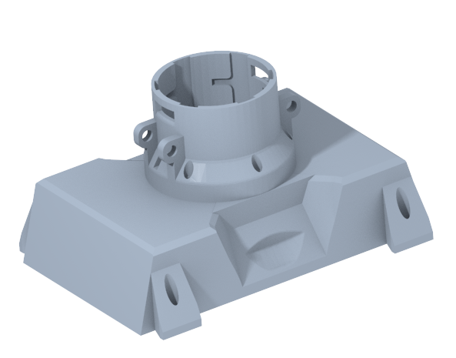
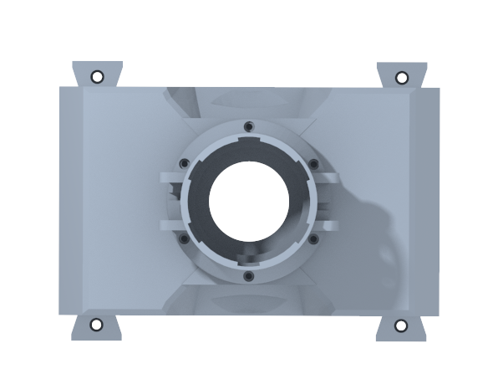
Customer Needs
How far can we stray from the original design?
hi
It is strongly encouraged to use a previously developed coupling design
Accent1
647 C
Color Values:
RGB 35 97 146
Hex/HTML #236192
CMYK 96 54 5 27
Accent4
2239 C
Color Values:
RGB 0 207 180
Hex/HTML #00CFB4
CMYK 59 0 39 0
Light 1
White
Color Values:
RGB 255 255 255
Hex/HTML #FFFFFF
CMYK 0 0 0 0
Dark 1
100% Black
Color Values:
RGB 0 0 0
Hex/HTML #000000
CMYK 0 0 0 100
Pantone
647 C
Pantone
2239 C
White
Black
Accent 2
2199 C
Color Values:
RGB 0 187 220
Hex/HTML #00BBDC
CMYK 77 0 16 0
Accent5
7535 C
Color Values:
RGB 183 176 156
Hex/HTML #B7B09C
CMYK 10 11 23 19
Light 2
25% Black
Color Values:
RGB 191 191 191
Hex/HTML #bfbfbf
CMYK 0 0 0 25
Dark 2
75 % Black
Color Values:
RGB 64 64 64
Hex/HTML #404040
CMYK 0 0 0 75
Pantone
2199 C
Pantone
7535 C
CoE Lt Gray
CoE Dk Gray
Accent3
1788 C
Color Values:
RGB 238 39 55
Hex/HTML #EE2737
CMYK 0 88 82 0
Accent6
2299 C
Color Values:
RGB 164 210 51
Hex/HTML #A4D233
CMYK 41 0 84 0
Pantone
1788 C
Pantone
2299 C
Notes:
“it is important to note that FSI is planning to add a UCF software engineering team to automate the transport system starting in the spring”

Slide 33


Assumptions
Power for the transport mechanism will be supplied by the on-board battery
The payload will have a designed coupling attachment
Accent1
647 C
Color Values:
RGB 35 97 146
Hex/HTML #236192
CMYK 96 54 5 27
Accent4
2239 C
Color Values:
RGB 0 207 180
Hex/HTML #00CFB4
CMYK 59 0 39 0
Light 1
White
Color Values:
RGB 255 255 255
Hex/HTML #FFFFFF
CMYK 0 0 0 0
Dark 1
100% Black
Color Values:
RGB 0 0 0
Hex/HTML #000000
CMYK 0 0 0 100
Pantone
647 C
Pantone
2239 C
White
Black
Accent 2
2199 C
Color Values:
RGB 0 187 220
Hex/HTML #00BBDC
CMYK 77 0 16 0
Accent5
7535 C
Color Values:
RGB 183 176 156
Hex/HTML #B7B09C
CMYK 10 11 23 19
Light 2
25% Black
Color Values:
RGB 191 191 191
Hex/HTML #bfbfbf
CMYK 0 0 0 25
Dark 2
75 % Black
Color Values:
RGB 64 64 64
Hex/HTML #404040
CMYK 0 0 0 75
Pantone
2199 C
Pantone
7535 C
CoE Lt Gray
CoE Dk Gray
Accent3
1788 C
Color Values:
RGB 238 39 55
Hex/HTML #EE2737
CMYK 0 88 82 0
Accent6
2299 C
Color Values:
RGB 164 210 51
Hex/HTML #A4D233
CMYK 41 0 84 0
Pantone
1788 C
Pantone
2299 C

Slide 34
Assumptions
Power for the transport mechanism will be supplied by the on-board battery
The payload will have a designed coupling attachment
Accent1
647 C
Color Values:
RGB 35 97 146
Hex/HTML #236192
CMYK 96 54 5 27
Accent4
2239 C
Color Values:
RGB 0 207 180
Hex/HTML #00CFB4
CMYK 59 0 39 0
Light 1
White
Color Values:
RGB 255 255 255
Hex/HTML #FFFFFF
CMYK 0 0 0 0
Dark 1
100% Black
Color Values:
RGB 0 0 0
Hex/HTML #000000
CMYK 0 0 0 100
Pantone
647 C
Pantone
2239 C
White
Black
Accent 2
2199 C
Color Values:
RGB 0 187 220
Hex/HTML #00BBDC
CMYK 77 0 16 0
Accent5
7535 C
Color Values:
RGB 183 176 156
Hex/HTML #B7B09C
CMYK 10 11 23 19
Light 2
25% Black
Color Values:
RGB 191 191 191
Hex/HTML #bfbfbf
CMYK 0 0 0 25
Dark 2
75 % Black
Color Values:
RGB 64 64 64
Hex/HTML #404040
CMYK 0 0 0 75
Pantone
2199 C
Pantone
7535 C
CoE Lt Gray
CoE Dk Gray
Accent3
1788 C
Color Values:
RGB 238 39 55
Hex/HTML #EE2737
CMYK 0 88 82 0
Accent6
2299 C
Color Values:
RGB 164 210 51
Hex/HTML #A4D233
CMYK 41 0 84 0
Pantone
1788 C
Pantone
2299 C

Slide 35
Assumptions
Power for the transport mechanism will be supplied by the on-board battery
The payload will have a designed coupling attachment
Accent1
647 C
Color Values:
RGB 35 97 146
Hex/HTML #236192
CMYK 96 54 5 27
Accent4
2239 C
Color Values:
RGB 0 207 180
Hex/HTML #00CFB4
CMYK 59 0 39 0
Light 1
White
Color Values:
RGB 255 255 255
Hex/HTML #FFFFFF
CMYK 0 0 0 0
Dark 1
100% Black
Color Values:
RGB 0 0 0
Hex/HTML #000000
CMYK 0 0 0 100
Pantone
647 C
Pantone
2239 C
White
Black
Accent 2
2199 C
Color Values:
RGB 0 187 220
Hex/HTML #00BBDC
CMYK 77 0 16 0
Accent5
7535 C
Color Values:
RGB 183 176 156
Hex/HTML #B7B09C
CMYK 10 11 23 19
Light 2
25% Black
Color Values:
RGB 191 191 191
Hex/HTML #bfbfbf
CMYK 0 0 0 25
Dark 2
75 % Black
Color Values:
RGB 64 64 64
Hex/HTML #404040
CMYK 0 0 0 75
Pantone
2199 C
Pantone
7535 C
CoE Lt Gray
CoE Dk Gray
Accent3
1788 C
Color Values:
RGB 238 39 55
Hex/HTML #EE2737
CMYK 0 88 82 0
Accent6
2299 C
Color Values:
RGB 164 210 51
Hex/HTML #A4D233
CMYK 41 0 84 0
Pantone
1788 C
Pantone
2299 C

Slide 36
Functional Decomposition
Connection
Payload Motion
Control
Accent1
647 C
Color Values:
RGB 35 97 146
Hex/HTML #236192
CMYK 96 54 5 27
Accent4
2239 C
Color Values:
RGB 0 207 180
Hex/HTML #00CFB4
CMYK 59 0 39 0
Light 1
White
Color Values:
RGB 255 255 255
Hex/HTML #FFFFFF
CMYK 0 0 0 0
Dark 1
100% Black
Color Values:
RGB 0 0 0
Hex/HTML #000000
CMYK 0 0 0 100
Pantone
647 C
Pantone
2239 C
White
Black
Accent 2
2199 C
Color Values:
RGB 0 187 220
Hex/HTML #00BBDC
CMYK 77 0 16 0
Accent5
7535 C
Color Values:
RGB 183 176 156
Hex/HTML #B7B09C
CMYK 10 11 23 19
Light 2
25% Black
Color Values:
RGB 191 191 191
Hex/HTML #bfbfbf
CMYK 0 0 0 25
Dark 2
75 % Black
Color Values:
RGB 64 64 64
Hex/HTML #404040
CMYK 0 0 0 75
Pantone
2199 C
Pantone
7535 C
CoE Lt Gray
CoE Dk Gray
Accent3
1788 C
Color Values:
RGB 238 39 55
Hex/HTML #EE2737
CMYK 0 88 82 0
Accent6
2299 C
Color Values:
RGB 164 210 51
Hex/HTML #A4D233
CMYK 41 0 84 0
Pantone
1788 C
Pantone
2299 C

Slide 37
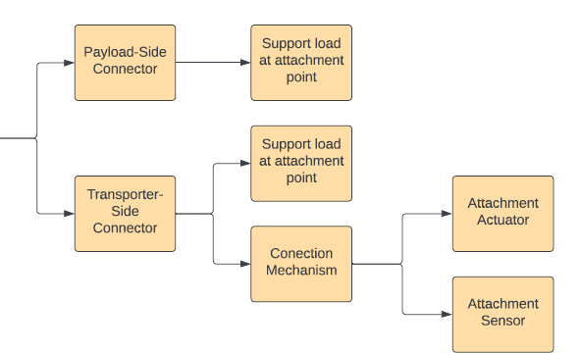
Functional Decomposition
Connection
Accent1
647 C
Color Values:
RGB 35 97 146
Hex/HTML #236192
CMYK 96 54 5 27
Accent4
2239 C
Color Values:
RGB 0 207 180
Hex/HTML #00CFB4
CMYK 59 0 39 0
Light 1
White
Color Values:
RGB 255 255 255
Hex/HTML #FFFFFF
CMYK 0 0 0 0
Dark 1
100% Black
Color Values:
RGB 0 0 0
Hex/HTML #000000
CMYK 0 0 0 100
Pantone
647 C
Pantone
2239 C
White
Black
Accent 2
2199 C
Color Values:
RGB 0 187 220
Hex/HTML #00BBDC
CMYK 77 0 16 0
Accent5
7535 C
Color Values:
RGB 183 176 156
Hex/HTML #B7B09C
CMYK 10 11 23 19
Light 2
25% Black
Color Values:
RGB 191 191 191
Hex/HTML #bfbfbf
CMYK 0 0 0 25
Dark 2
75 % Black
Color Values:
RGB 64 64 64
Hex/HTML #404040
CMYK 0 0 0 75
Pantone
2199 C
Pantone
7535 C
CoE Lt Gray
CoE Dk Gray
Accent3
1788 C
Color Values:
RGB 238 39 55
Hex/HTML #EE2737
CMYK 0 88 82 0
Accent6
2299 C
Color Values:
RGB 164 210 51
Hex/HTML #A4D233
CMYK 41 0 84 0
Pantone
1788 C
Pantone
2299 C

Slide 38
Functional Decomposition
Connection
Payload Motion
Control
Accent1
647 C
Color Values:
RGB 35 97 146
Hex/HTML #236192
CMYK 96 54 5 27
Accent4
2239 C
Color Values:
RGB 0 207 180
Hex/HTML #00CFB4
CMYK 59 0 39 0
Light 1
White
Color Values:
RGB 255 255 255
Hex/HTML #FFFFFF
CMYK 0 0 0 0
Dark 1
100% Black
Color Values:
RGB 0 0 0
Hex/HTML #000000
CMYK 0 0 0 100
Pantone
647 C
Pantone
2239 C
White
Black
Accent 2
2199 C
Color Values:
RGB 0 187 220
Hex/HTML #00BBDC
CMYK 77 0 16 0
Accent5
7535 C
Color Values:
RGB 183 176 156
Hex/HTML #B7B09C
CMYK 10 11 23 19
Light 2
25% Black
Color Values:
RGB 191 191 191
Hex/HTML #bfbfbf
CMYK 0 0 0 25
Dark 2
75 % Black
Color Values:
RGB 64 64 64
Hex/HTML #404040
CMYK 0 0 0 75
Pantone
2199 C
Pantone
7535 C
CoE Lt Gray
CoE Dk Gray
Accent3
1788 C
Color Values:
RGB 238 39 55
Hex/HTML #EE2737
CMYK 0 88 82 0
Accent6
2299 C
Color Values:
RGB 164 210 51
Hex/HTML #A4D233
CMYK 41 0 84 0
Pantone
1788 C
Pantone
2299 C

Slide 39
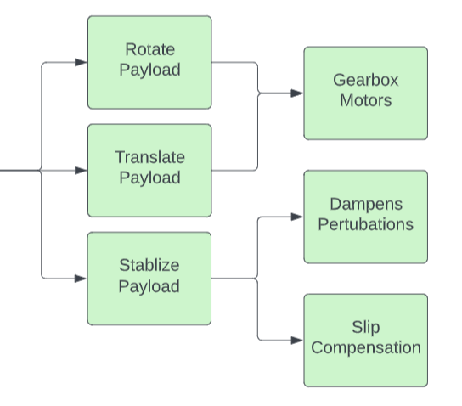
Functional Decomposition
Payload Motion
Accent1
647 C
Color Values:
RGB 35 97 146
Hex/HTML #236192
CMYK 96 54 5 27
Accent4
2239 C
Color Values:
RGB 0 207 180
Hex/HTML #00CFB4
CMYK 59 0 39 0
Light 1
White
Color Values:
RGB 255 255 255
Hex/HTML #FFFFFF
CMYK 0 0 0 0
Dark 1
100% Black
Color Values:
RGB 0 0 0
Hex/HTML #000000
CMYK 0 0 0 100
Pantone
647 C
Pantone
2239 C
White
Black
Accent 2
2199 C
Color Values:
RGB 0 187 220
Hex/HTML #00BBDC
CMYK 77 0 16 0
Accent5
7535 C
Color Values:
RGB 183 176 156
Hex/HTML #B7B09C
CMYK 10 11 23 19
Light 2
25% Black
Color Values:
RGB 191 191 191
Hex/HTML #bfbfbf
CMYK 0 0 0 25
Dark 2
75 % Black
Color Values:
RGB 64 64 64
Hex/HTML #404040
CMYK 0 0 0 75
Pantone
2199 C
Pantone
7535 C
CoE Lt Gray
CoE Dk Gray
Accent3
1788 C
Color Values:
RGB 238 39 55
Hex/HTML #EE2737
CMYK 0 88 82 0
Accent6
2299 C
Color Values:
RGB 164 210 51
Hex/HTML #A4D233
CMYK 41 0 84 0
Pantone
1788 C
Pantone
2299 C

Slide 40
Functional Decomposition
Connection
Payload Motion
Control
Accent1
647 C
Color Values:
RGB 35 97 146
Hex/HTML #236192
CMYK 96 54 5 27
Accent4
2239 C
Color Values:
RGB 0 207 180
Hex/HTML #00CFB4
CMYK 59 0 39 0
Light 1
White
Color Values:
RGB 255 255 255
Hex/HTML #FFFFFF
CMYK 0 0 0 0
Dark 1
100% Black
Color Values:
RGB 0 0 0
Hex/HTML #000000
CMYK 0 0 0 100
Pantone
647 C
Pantone
2239 C
White
Black
Accent 2
2199 C
Color Values:
RGB 0 187 220
Hex/HTML #00BBDC
CMYK 77 0 16 0
Accent5
7535 C
Color Values:
RGB 183 176 156
Hex/HTML #B7B09C
CMYK 10 11 23 19
Light 2
25% Black
Color Values:
RGB 191 191 191
Hex/HTML #bfbfbf
CMYK 0 0 0 25
Dark 2
75 % Black
Color Values:
RGB 64 64 64
Hex/HTML #404040
CMYK 0 0 0 75
Pantone
2199 C
Pantone
7535 C
CoE Lt Gray
CoE Dk Gray
Accent3
1788 C
Color Values:
RGB 238 39 55
Hex/HTML #EE2737
CMYK 0 88 82 0
Accent6
2299 C
Color Values:
RGB 164 210 51
Hex/HTML #A4D233
CMYK 41 0 84 0
Pantone
1788 C
Pantone
2299 C

Slide 41
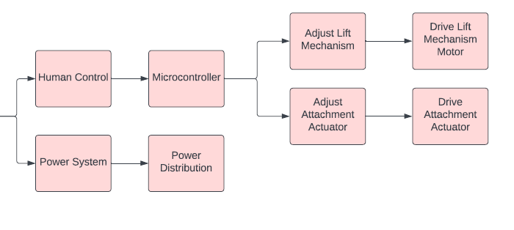
Functional Decomposition
Control
Accent1
647 C
Color Values:
RGB 35 97 146
Hex/HTML #236192
CMYK 96 54 5 27
Accent4
2239 C
Color Values:
RGB 0 207 180
Hex/HTML #00CFB4
CMYK 59 0 39 0
Light 1
White
Color Values:
RGB 255 255 255
Hex/HTML #FFFFFF
CMYK 0 0 0 0
Dark 1
100% Black
Color Values:
RGB 0 0 0
Hex/HTML #000000
CMYK 0 0 0 100
Pantone
647 C
Pantone
2239 C
White
Black
Accent 2
2199 C
Color Values:
RGB 0 187 220
Hex/HTML #00BBDC
CMYK 77 0 16 0
Accent5
7535 C
Color Values:
RGB 183 176 156
Hex/HTML #B7B09C
CMYK 10 11 23 19
Light 2
25% Black
Color Values:
RGB 191 191 191
Hex/HTML #bfbfbf
CMYK 0 0 0 25
Dark 2
75 % Black
Color Values:
RGB 64 64 64
Hex/HTML #404040
CMYK 0 0 0 75
Pantone
2199 C
Pantone
7535 C
CoE Lt Gray
CoE Dk Gray
Accent3
1788 C
Color Values:
RGB 238 39 55
Hex/HTML #EE2737
CMYK 0 88 82 0
Accent6
2299 C
Color Values:
RGB 164 210 51
Hex/HTML #A4D233
CMYK 41 0 84 0
Pantone
1788 C
Pantone
2299 C

Slide 42
Next steps
Targets and Metrics
Concept Generation
Concept Selection

Slide 43
Backup Slides

Slide 45
College of Engineering Color Palette
2299 C
Color Values:
RGB 164 210 51
Hex/HTML #A4D233
CMYK 41 0 84 0
1788 C
Color Values:
RGB 238 39 55
Hex/HTML #EE2737
CMYK 0 88 82 0
75% Black
Color Values:
RGB 64 64 64
Hex/HTML #404040
CMYK 0 0 0 75
Pantone
2299 C
Pantone
1788 C
CoE Dk Gray
2239 C
Color Values:
RGB 0 207 180
Hex/HTML #00CFB4
CMYK 59 0 39 0
647 C
Color Values:
RGB 35 97 146
Hex/HTML #236192
CMYK 96 54 5 27
50% Black
Color Values:
RGB 128 128 128
Hex/HTML #808080
CMYK 0 0 0 50
Pantone
2239 C
Pantone
647 C
CoE Md Gray
2199 C
Color Values:
RGB 0 187 220
Hex/HTML #00BBDC
CMYK 77 0 16 0
7535 C
Color Values:
RGB 183 176 156
Hex/HTML #B7B09C
CMYK 10 11 23 19
25% Black
Color Values:
RGB 191 191 191
Hex/HTML #bfbfbf
CMYK 0 0 0 25
Pantone
2199 C
Pantone
7535 C
CoE Lt Gray
Notes:
Theses are the official color palettes of the college of engineering.

Slide 46
PowerPoint Color Theme
Accent1
647 C
Color Values:
RGB 35 97 146
Hex/HTML #236192
CMYK 96 54 5 27
Accent4
2239 C
Color Values:
RGB 0 207 180
Hex/HTML #00CFB4
CMYK 59 0 39 0
Light 1
White
Color Values:
RGB 255 255 255
Hex/HTML #FFFFFF
CMYK 0 0 0 0
Dark 1
100% Black
Color Values:
RGB 0 0 0
Hex/HTML #000000
CMYK 0 0 0 100
Pantone
647 C
Pantone
2239 C
White
Black
Accent 2
2199 C
Color Values:
RGB 0 187 220
Hex/HTML #00BBDC
CMYK 77 0 16 0
Accent5
7535 C
Color Values:
RGB 183 176 156
Hex/HTML #B7B09C
CMYK 10 11 23 19
Light 2
25% Black
Color Values:
RGB 191 191 191
Hex/HTML #bfbfbf
CMYK 0 0 0 25
Dark 2
75 % Black
Color Values:
RGB 64 64 64
Hex/HTML #404040
CMYK 0 0 0 75
Pantone
2199 C
Pantone
7535 C
CoE Lt Gray
CoE Dk Gray
Accent3
1788 C
Color Values:
RGB 238 39 55
Hex/HTML #EE2737
CMYK 0 88 82 0
Accent6
2299 C
Color Values:
RGB 164 210 51
Hex/HTML #A4D233
CMYK 41 0 84 0
Pantone
1788 C
Pantone
2299 C
Notes:
These are the college colors as prioritized within this PowerPoint Template

Slide 47
Notes:
This slide has the rule of third layout tool. The rule thirds layout helps with the sizing of elements.

Slide 48
Notes:
This slide has the rule of third layout tool. The rule thirds layout helps with the sizing of elements.

Slide 52
Why use RE-RASSOR?
Accent1
647 C
Color Values:
RGB 35 97 146
Hex/HTML #236192
CMYK 96 54 5 27
Accent4
2239 C
Color Values:
RGB 0 207 180
Hex/HTML #00CFB4
CMYK 59 0 39 0
Light 1
White
Color Values:
RGB 255 255 255
Hex/HTML #FFFFFF
CMYK 0 0 0 0
Dark 1
100% Black
Color Values:
RGB 0 0 0
Hex/HTML #000000
CMYK 0 0 0 100
Pantone
647 C
Pantone
2239 C
White
Black
Accent 2
2199 C
Color Values:
RGB 0 187 220
Hex/HTML #00BBDC
CMYK 77 0 16 0
Accent5
7535 C
Color Values:
RGB 183 176 156
Hex/HTML #B7B09C
CMYK 10 11 23 19
Light 2
25% Black
Color Values:
RGB 191 191 191
Hex/HTML #bfbfbf
CMYK 0 0 0 25
Dark 2
75 % Black
Color Values:
RGB 64 64 64
Hex/HTML #404040
CMYK 0 0 0 75
Pantone
2199 C
Pantone
7535 C
CoE Lt Gray
CoE Dk Gray
Accent3
1788 C
Color Values:
RGB 238 39 55
Hex/HTML #EE2737
CMYK 0 88 82 0
Accent6
2299 C
Color Values:
RGB 164 210 51
Hex/HTML #A4D233
CMYK 41 0 84 0
Pantone
1788 C
Pantone
2299 C

Slide 53
