Slide 1
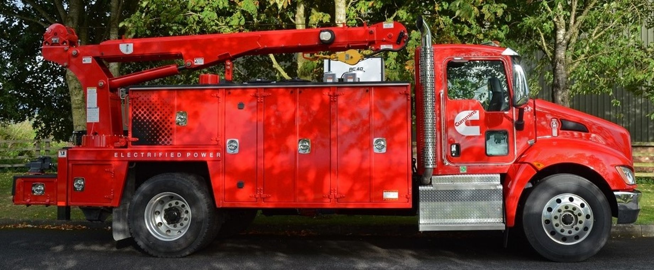
Hybrid Vehicle Battery Cooling
Team 507: Anthony Vicary | Chris Carley | Clayton Carlson | Corey Kelley | Jacob Owens

Slide 2





TEAM 507
Corey Kelley
Systems
Engineer
Clayton Carlson
Thermal Fluid Engineer
Chris Carley
Manufacturing Engineer
Anthony Vicary
Heat Transfer
Engineer
Jacob Owens
Design Engineer

Slide 3




Sponsor and Advisor
Dr. Michael Hayes
Cummins, Inc
Material Engineer
Dr. Juan Ordonez
FAMU-FSU College of Engineering

Slide 4
Project Objective
The objective of this project is to design a cooling method for a hybrid vehicle battery pack that is at least 5% more effective than current industry standards.

Slide 5

Background
Increased emissions standards and improvements in Lithium-Ion Batteries
Lead to development of hybrid and electric trucks

Slide 6
Background
Exposure to high temperatures degrades Lithium-Ion Batteries
Exposure to low temperatures increases internal resistance within battery

Slide 7
Background
Acceleration requires large amounts of power
Large current is produced within the battery and large amount of heat are produced
Cooling methods must keep up with thermal loads

Slide 8
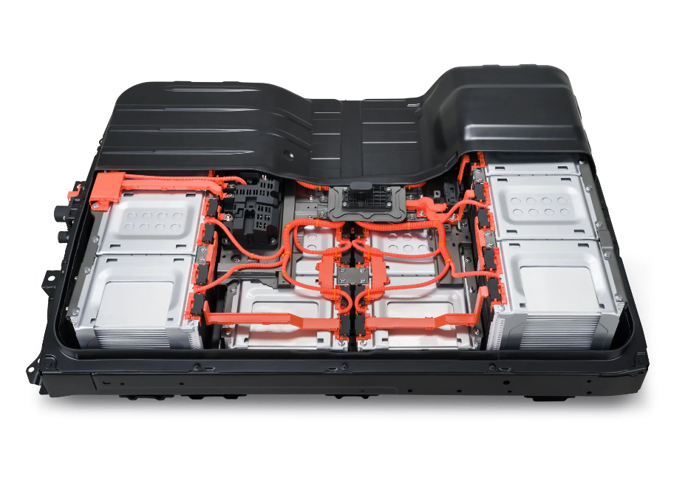
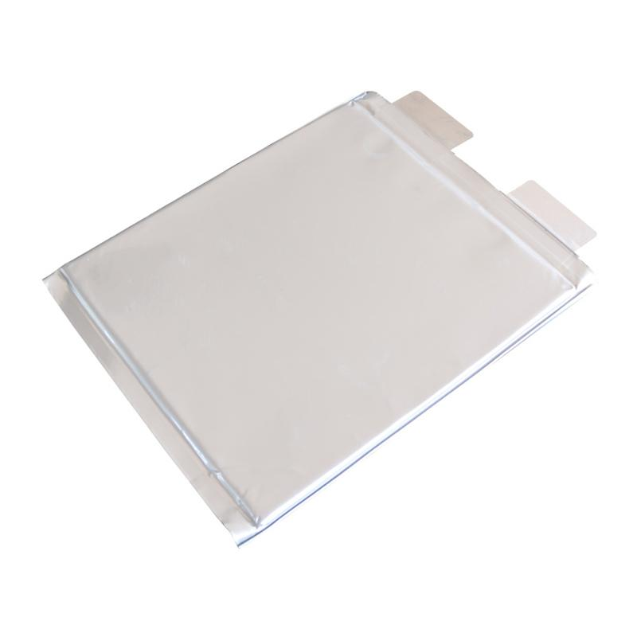
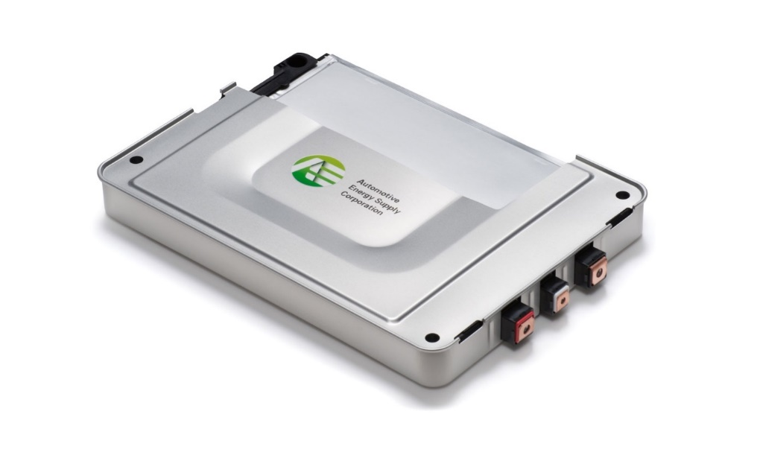
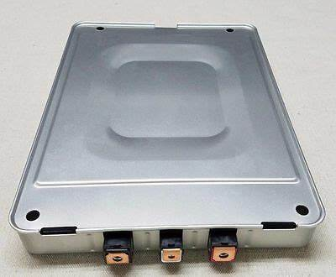
Battery Pack Components
Battery Pack
Module
Pouch Cell

Slide 9
Key Goals
Improve battery cooling effectiveness
Design focuses on innovation at module level
Keep cost of ownership down
Keep battery within efficient operating temperature

Slide 10




Assumptions
Design will be based on a Nissan Leaf pouch cell module
Domain of project will be within battery enclosure
Battery will be subjected to a variety of operating conditions
Not able to physically open a battery module
Notes:
Mention that design will be implemented with 10 kWh battery pack in mind but will be scalable for larger battery packs

Slide 11






Customer Needs
Concept must be lightweight
Works at extreme temperatures
Keep pumping power to a minimum
Handle high heat transfer rates
Implement at module level
Prevents puncture to pouch cells

Slide 12



Functions
Battery Cooling Method
Cool Battery
Safety
Efficiency
Corey Kelley

Slide 13


Heat Transfer: Functions
Cool Battery
Transfer Heat
Corey Kelley

Slide 14

Safety: Functions
Safety
Avoids Puncture
Reduces Thermal Runaway
Withstands Thermal Cycling
Accommodate Swelling
Corey Kelley

Slide 15
Efficiency: Functions
Efficiency
Minimize Weight
Minimize Energy Loss
Corey Kelley

Slide 16



Critical Targets
Temperature
Size
Puncture
Under 40° Celsius
< 30% Volume Increase
110 MPa

Slide 17



Critical Targets
Long Lasting
Weight
Pressure Loss
10 years
20% module weight
1 kPa

Slide 18
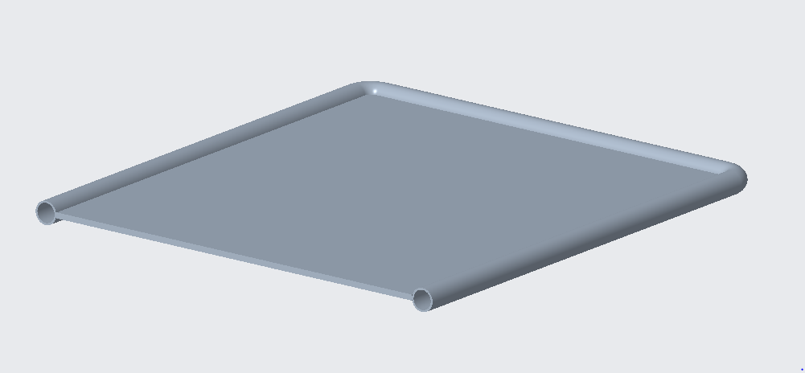
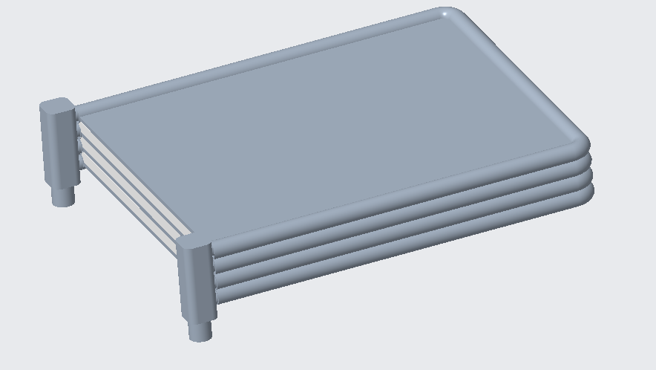
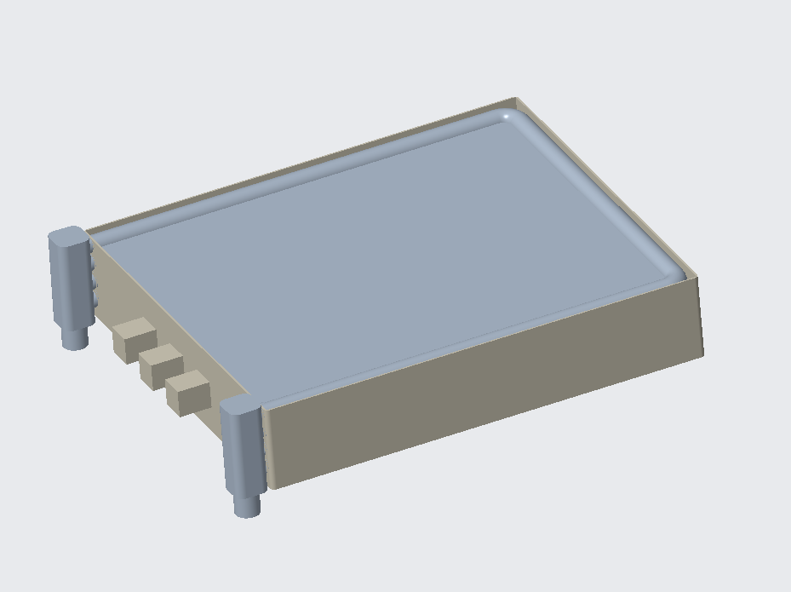
Initial Design: Cooling Pipes around Inner wall of Module
Coolant Channel
Coolant channels fit within module walls
Coolant inlet and outlet

Slide 19
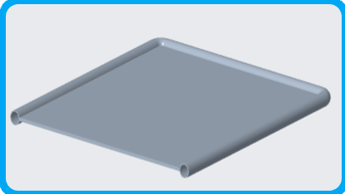
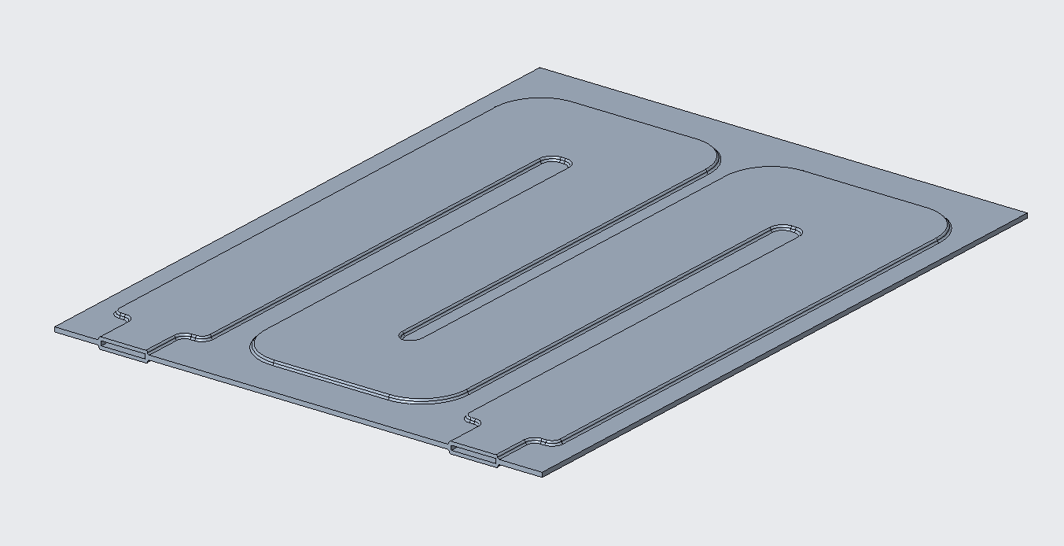
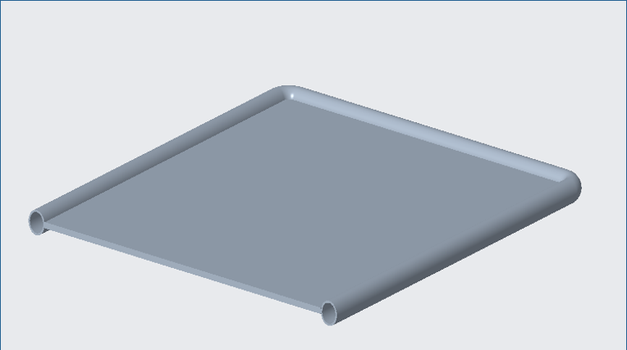
Initial Design
Revised Design

Slide 20
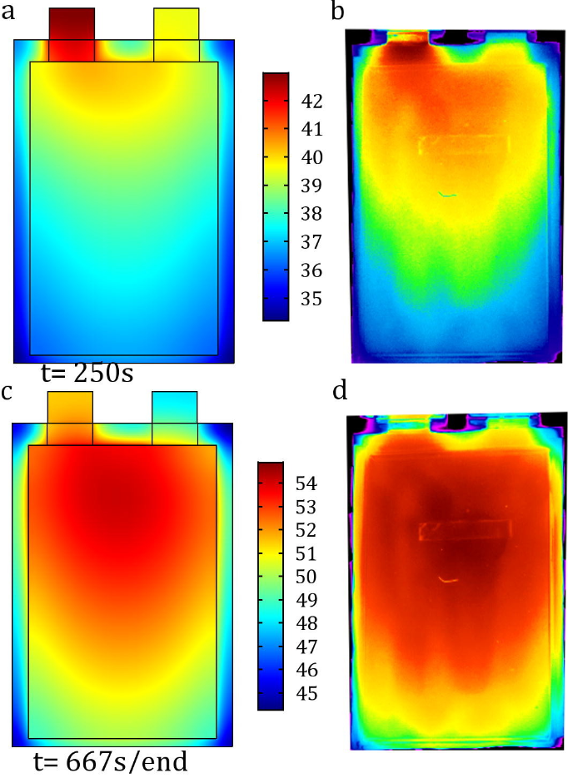
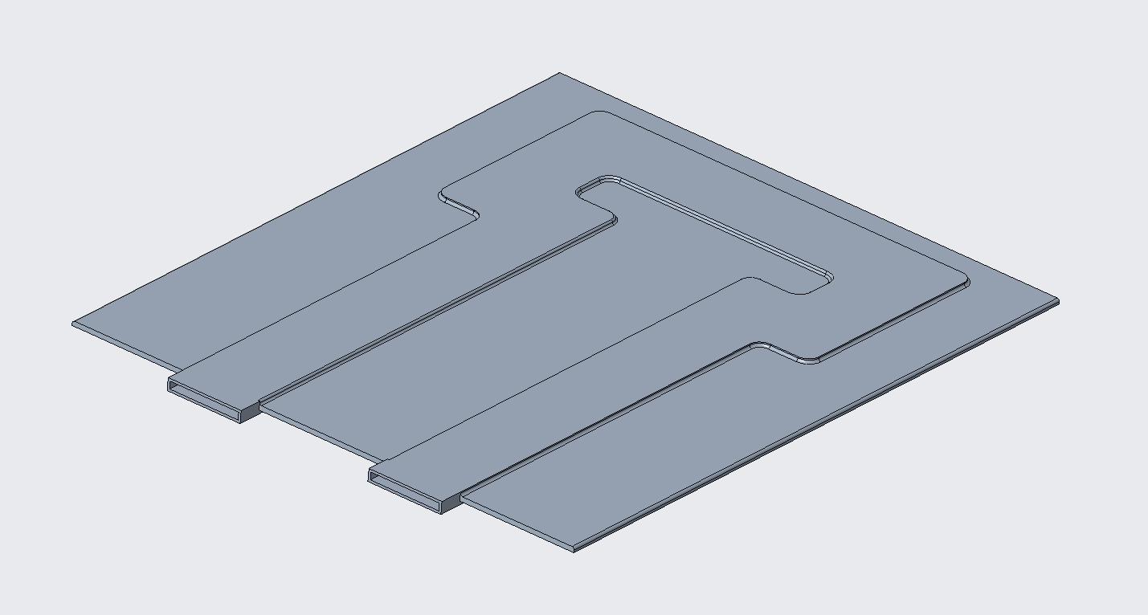
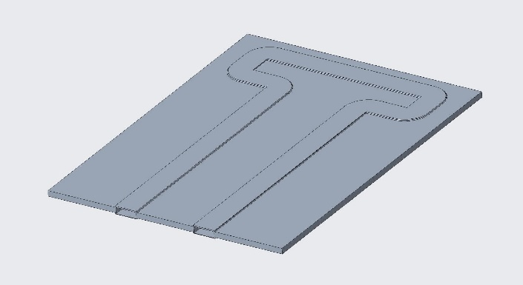
Pressure Loss
Initial Coolant Channel
Optimized Coolant Channel
Universiteit Brussel Research
Flow Rate: 0.2 m/s
Channel Length: 1 m
Pressure loss: 475 pa
Flow Rate: 0.2 m/s
Channel Length: 0.75 m
Pressure loss: 350 pa

Slide 21
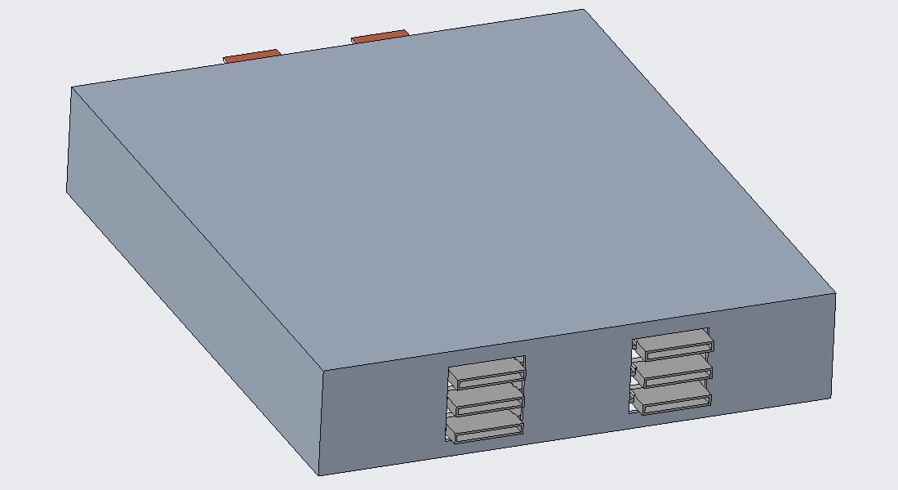
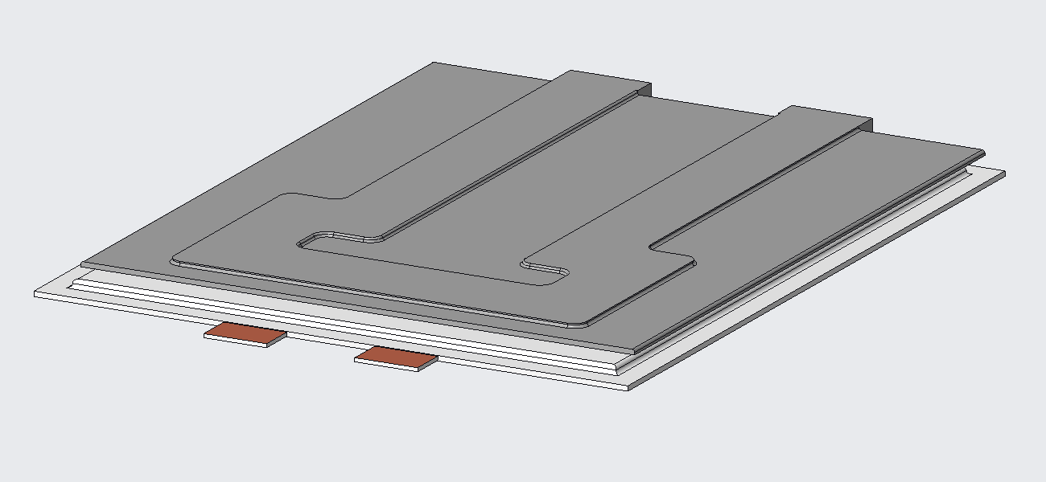
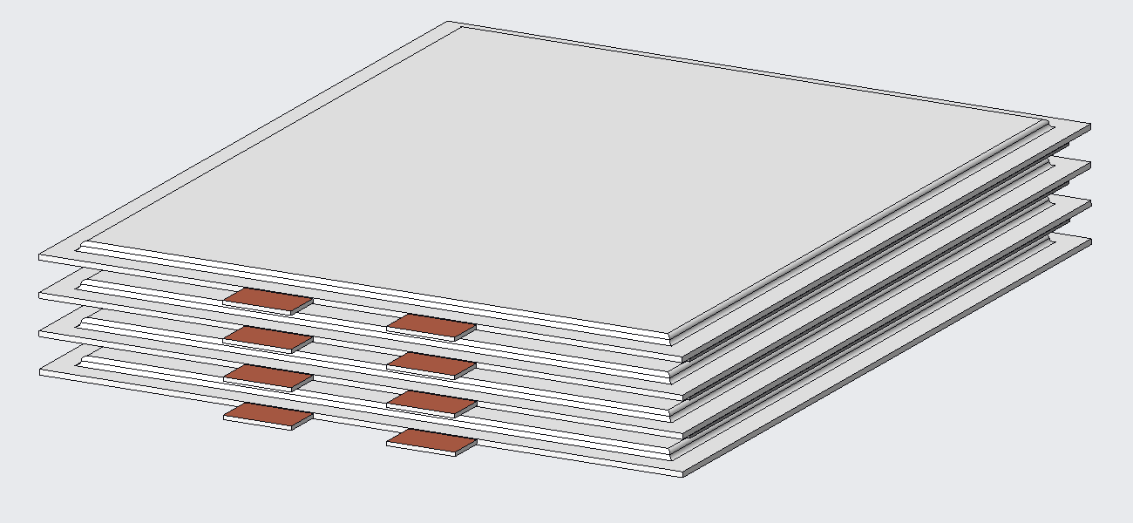
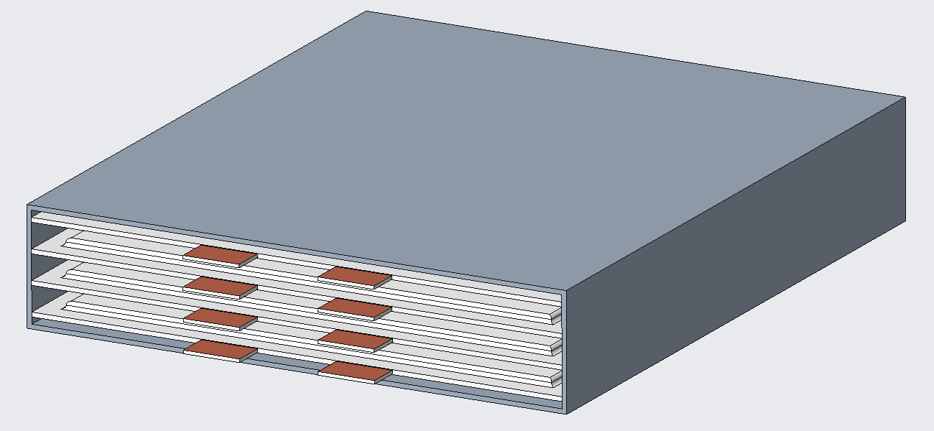
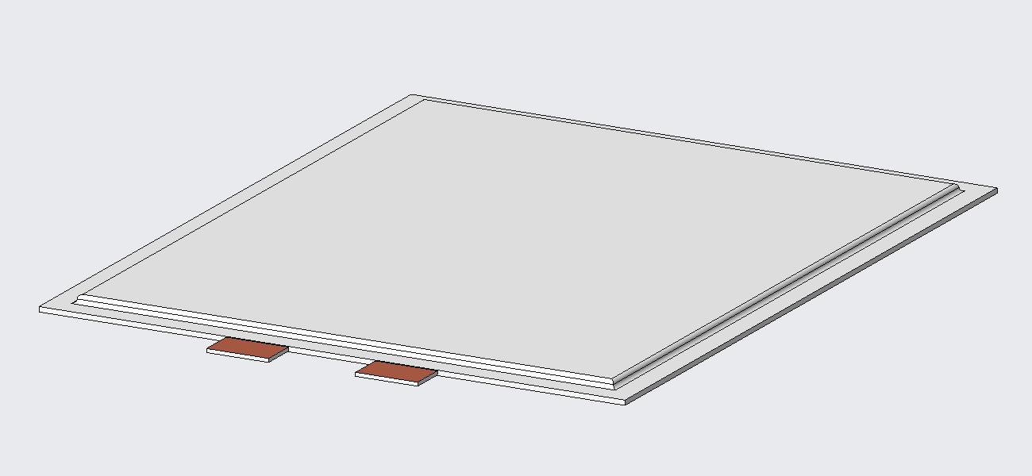
Module Assembly

Slide 22
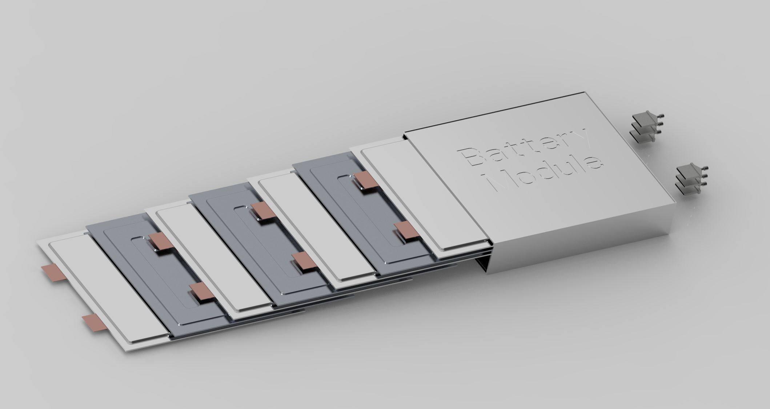
Module Assembly
Inlet/Outlet Push to Connect Fittings
Cold Plate
Pouch Cell
Aluminum Module Housing

Slide 23

Design Parameters
Cold Plate
Module
Dimension: 255x212x5 mm
Weight:
0.30 kg
Dimension: 290x216x50 mm
Weight:
4.72 kg

Slide 24


Physical Prototype
Top Plate
Bottom Plate

Slide 25
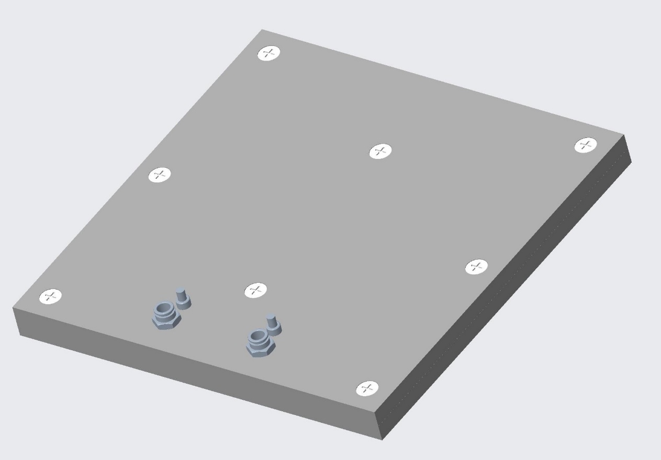
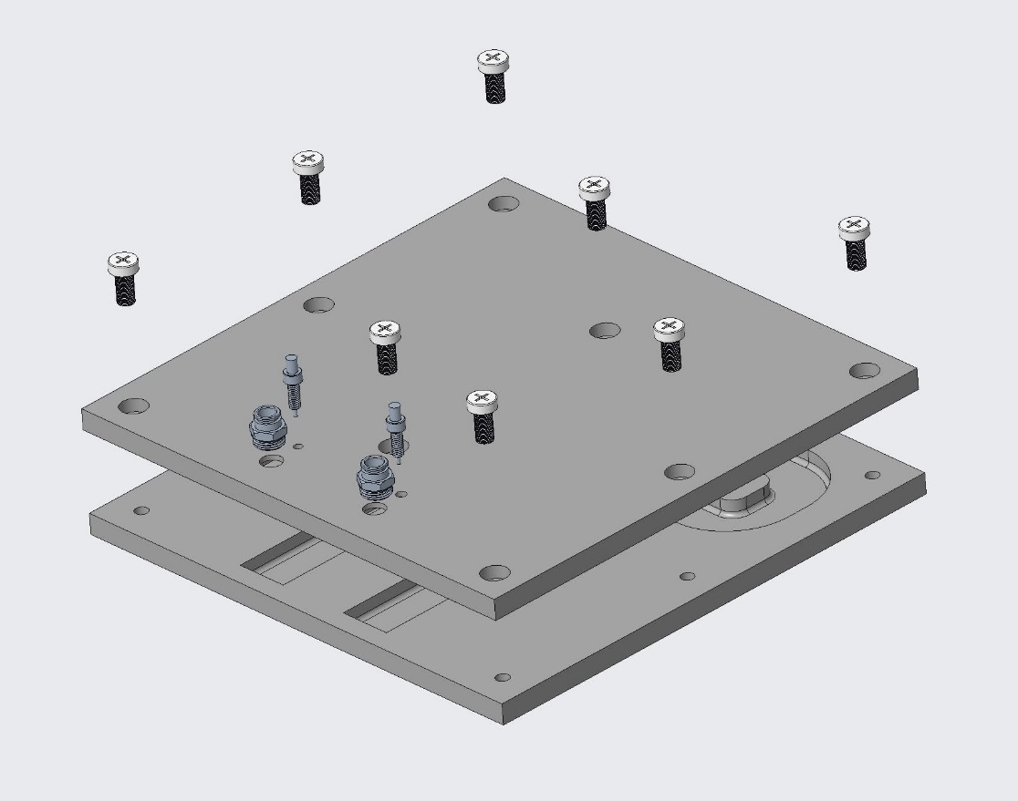
Physical Prototype
Thermocouple Connection
Inlet Connector
Outlet Connector
RTV Gasket Glue

Slide 26
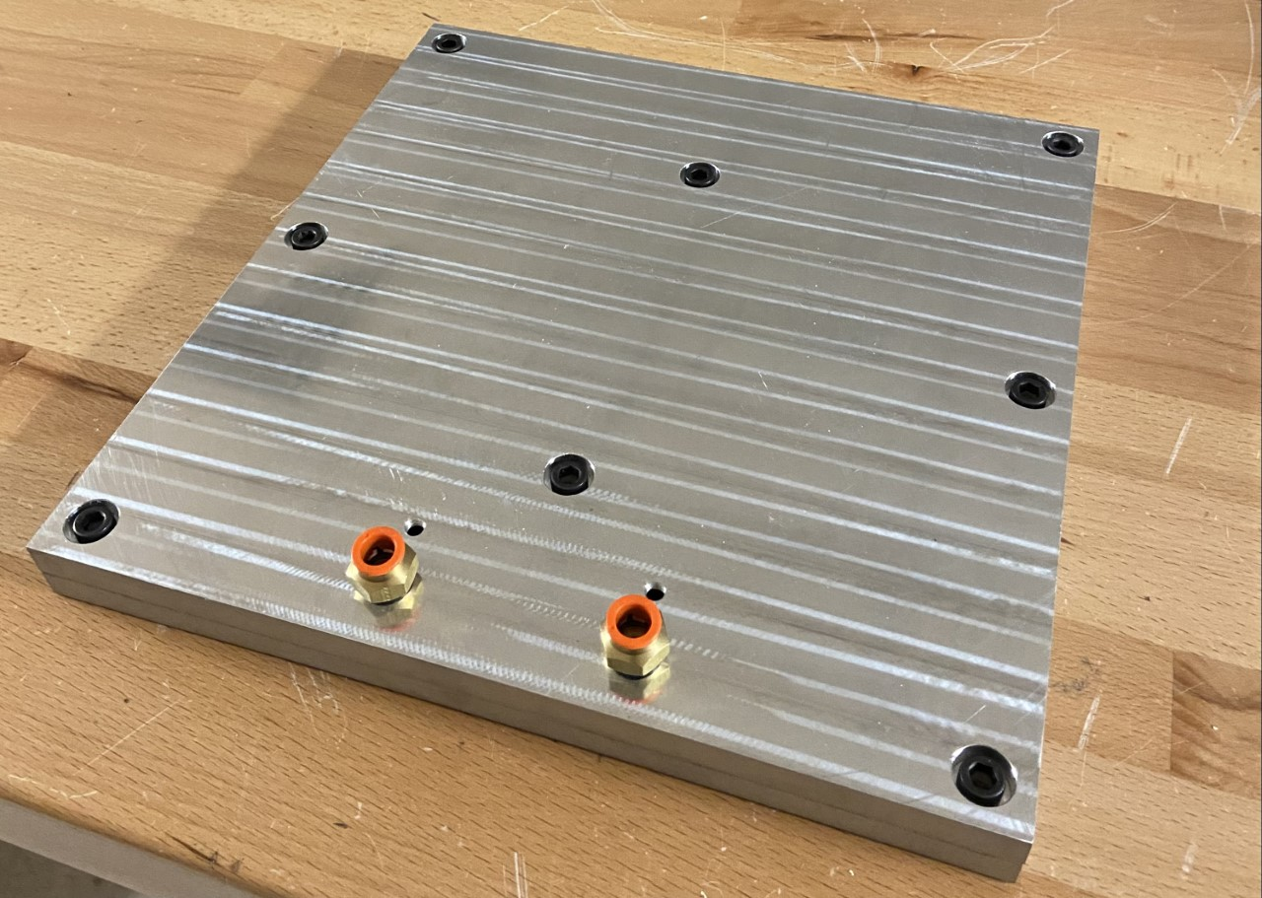
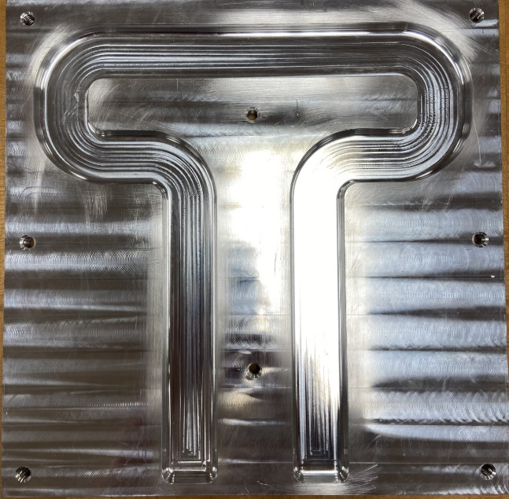
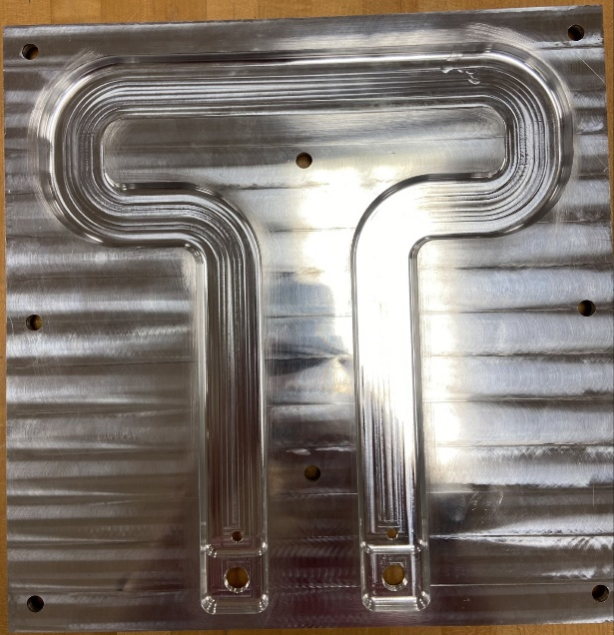
Physical Prototype
Assemble Cold Plate
Bottom Plate
Top Plate

Slide 27
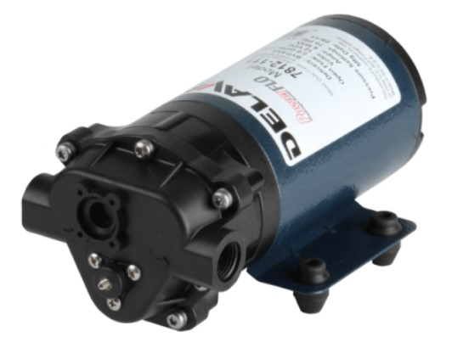
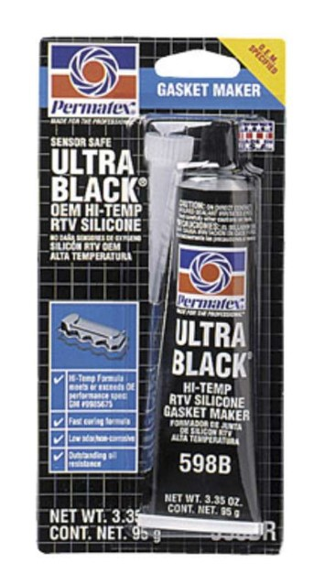
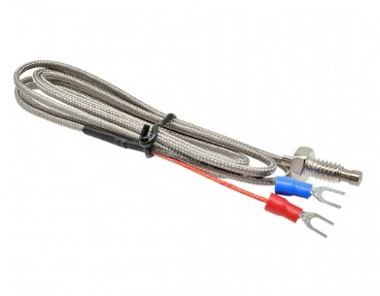
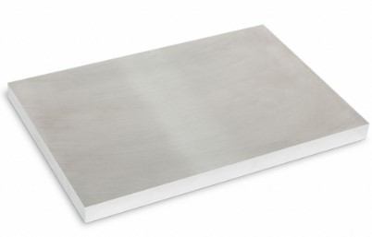
Materials Selection
12V 2 GPM PowerFLO Diaphragm Pump
MAX6675 K-Type Thermocouple
½" Thick 12" x 12" Aluminum Plate
Gasket Glue

Slide 28
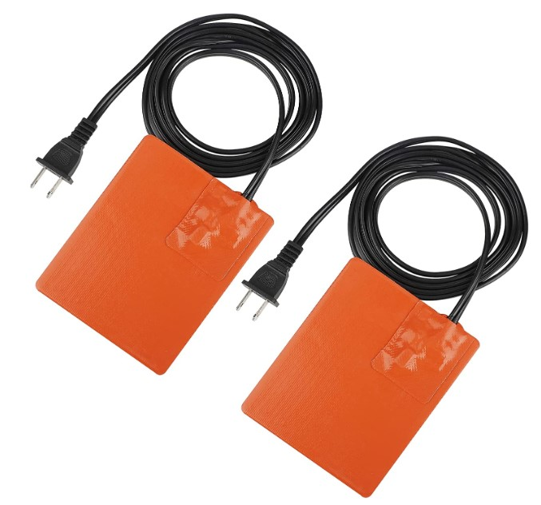
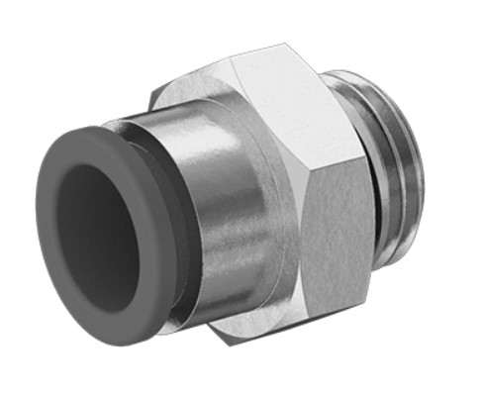
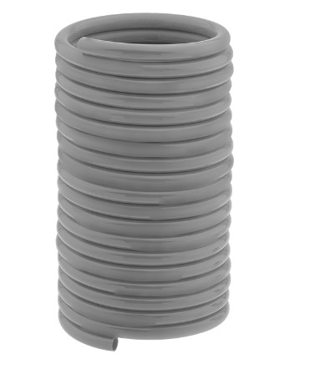
Materials Selection
3D Printer Silicone Heated Pad 120V 150W
Vinyl Tubing
3/8” OD Push to Connect Fittings

Slide 29
Testing
Transient Test
Parameter Matching
Coolant will flow while heating pads are still gaining temperature.
Temperature, mass flow rate, and pressure loss will be found experimentally and be compared to simulation results.
Steady Test
Coolant will flow once heating pads reach steady temperature.

Slide 30


Testing
Module Housing Material
Aluminum
Aluminum
Wood
Wood

Slide 31
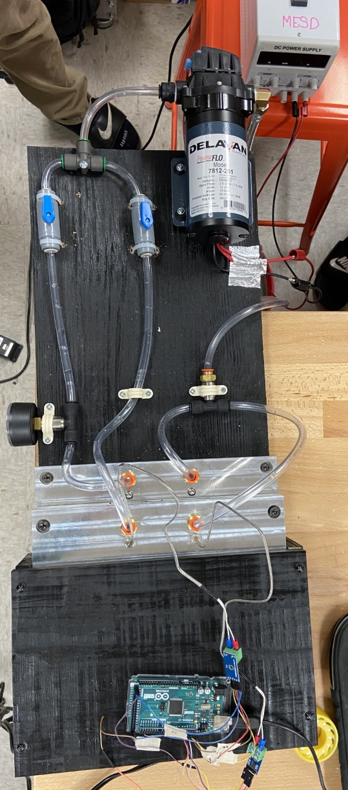
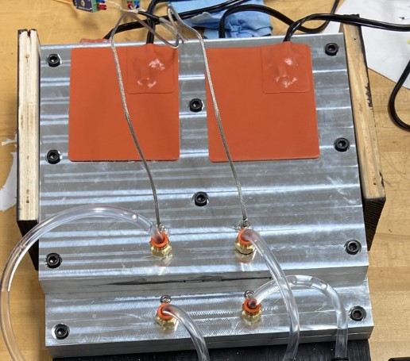
Testing Setup
1
1. Power Supply
2. Pump
2
3. Thermocouple using Arduino
4. Pressure Gauge
4
5. Heating pads inside module
3

Slide 32
Test Results
Initial transient tests indicate 1.25 ˚C difference between inlet and outlet
Steady state results are still being interpreted
Further calibration on thermocouples needed
As testing progresses, different steady state methods will be used

Slide 33
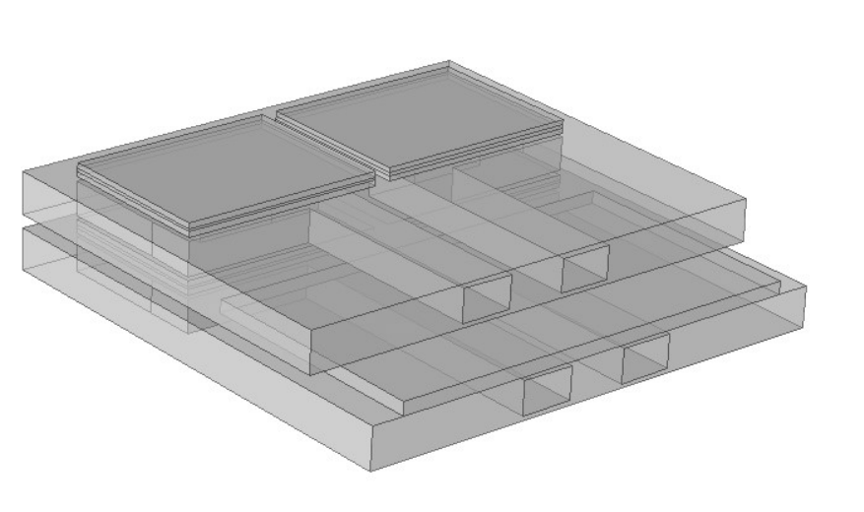
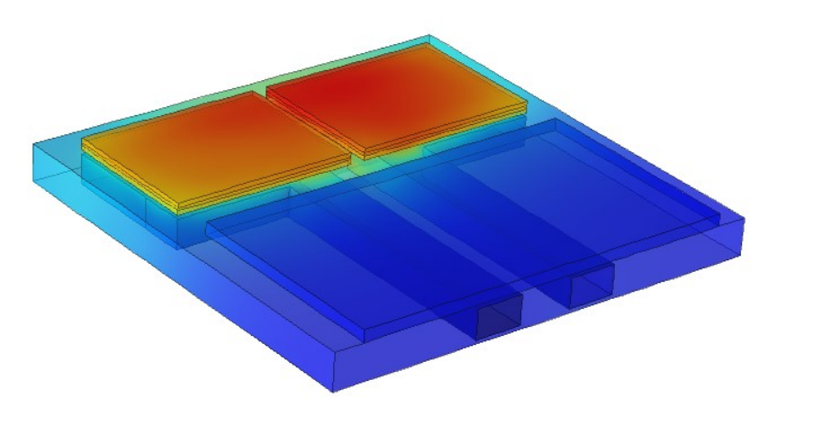
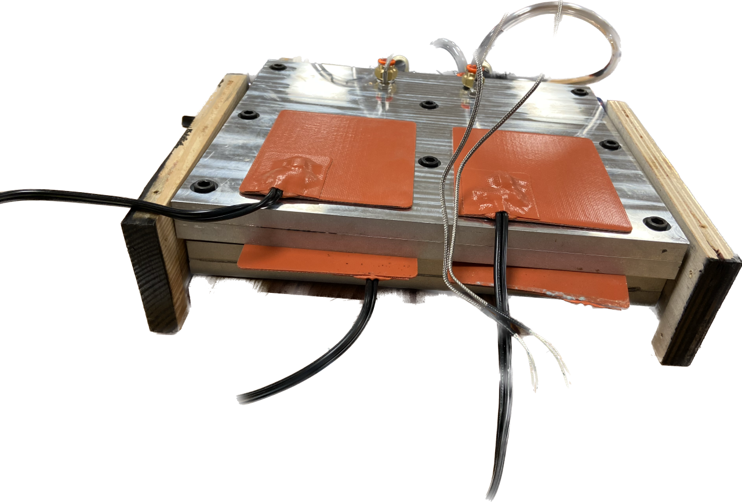
COMSOL Prototype

Slide 34
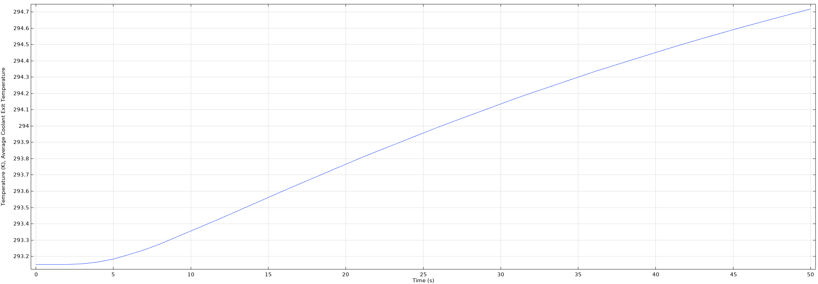
COMSOL Prototype
Transient Simulation
Inlet Temperature
293 K (20°C)
Outlet Temperature
294.7 K (66.8°C)
1.7 ˚C Temperature Increase

Slide 35
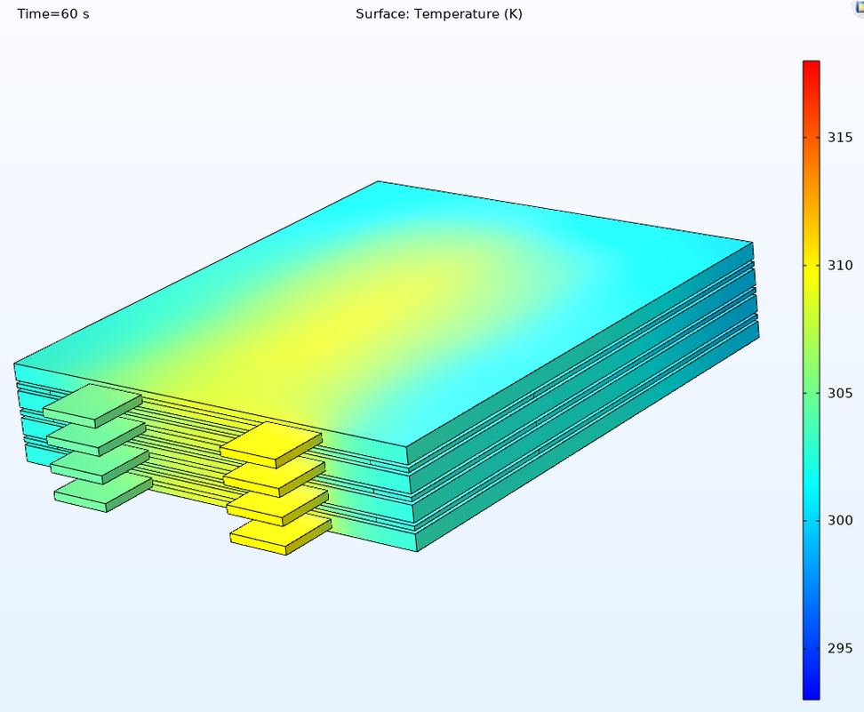
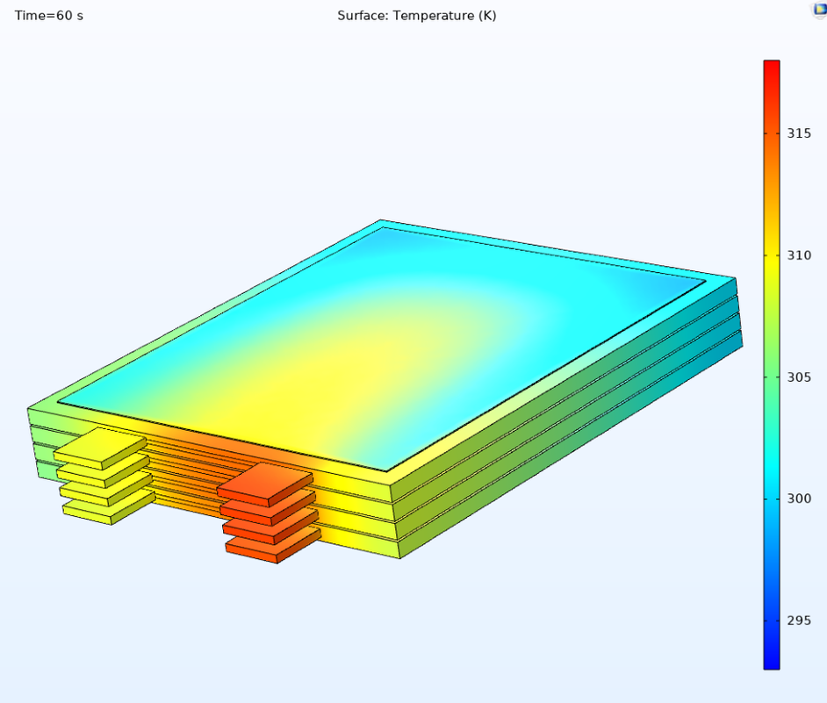
COMSOL Results
Simulation Parameters: 5 C-Rate
60 s
Our Design
Air Cooled
Max Cell Temperature:
35.8°C (309 K)
Max Cell Temperature:
41.9°C (315 K)
Cooling Increase: 17%

Slide 36
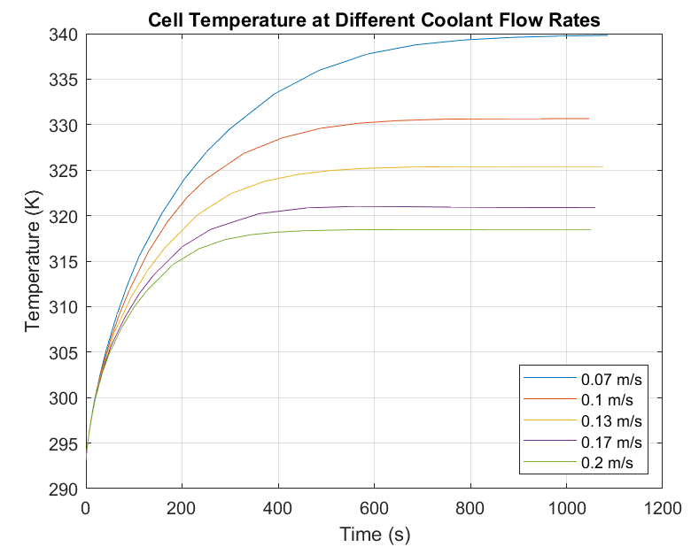
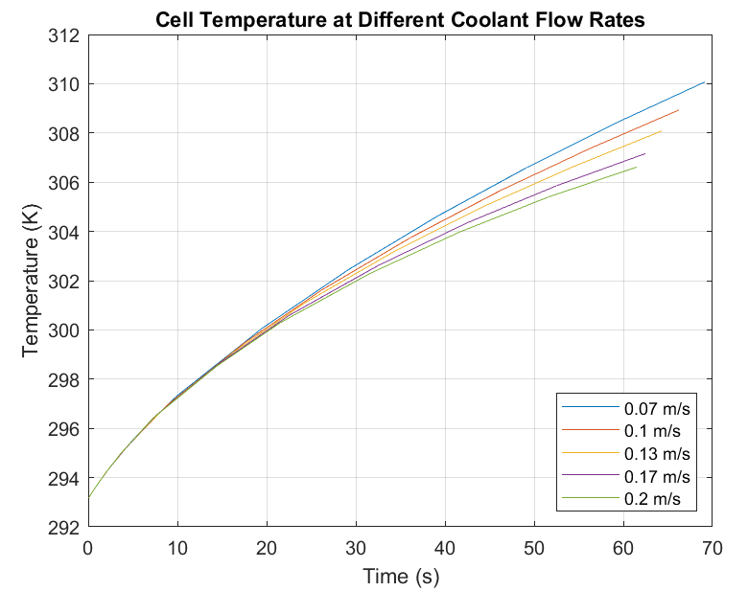
COMSOL Results
Steady State Temperature
Transient Temperature
306.5 K (33.4°C)
317 K (43.8°C)

Slide 37
COMSOL Results
Steady State Temperature
Transient Temperature
340 K (66.8°C)
308.5 K (35.5°C)

Slide 38



Validation
Critical Target
Result
Initial transient tests match with transient comsol simulations. Simulations show temperature target is reached.
Calculations show pressure loss is within 5% of 1 kpa limit.
Calculations show that cooling method is within the 20% of module weight target.
Size target was not met. An increase of 15mm in module height results in a 42% increase in module volume.
Aluminum will not corrode with right coolant, so long lasting target is inconclusive but strong indications that it would be met.
Transient tests prove that temperature target is reached
Temperature
Pressure
Calculations show pressure loss is within 5% of the 1 kPa target
Weight
Cooling design weighed 0.9 kg, under 20% of module
Size
Increased module height 15 mm resulting in a volume increase of 42%
Long Lasting
Aluminum will not corrode with coolant but external factors can impact its quality, leading to inconclusive results

Slide 39
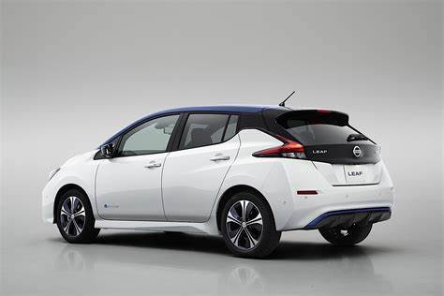
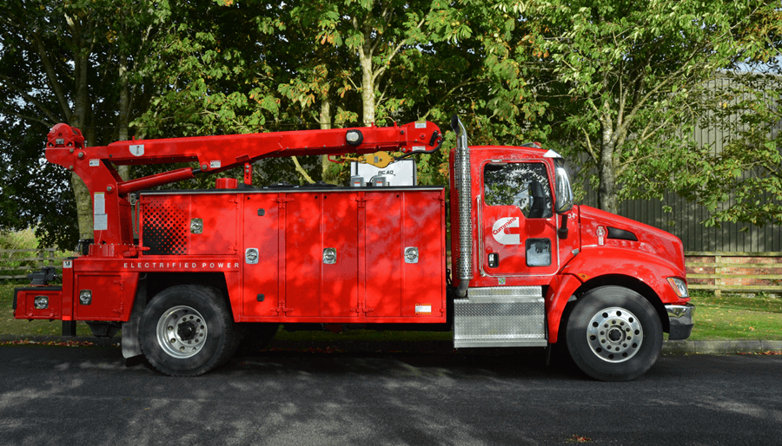
What it all means
We are within 5% of most of our targets using a Nissan Leaf battery for a class 8 vehicle. Most importantly the temperature target is reached.

Slide 40
Budget

Slide 41
Conclusion
Test results show that the design was effective and hit critical goals
For this design to be implemented it would need to be scaled up
More accurate thermocouples and real pouches could give more accurate test results
State of the art methods should be considered

Slide 42



Future Work
Complete Testing
Finish COMSOL Simulations of Prototype
Compare COMSOL to Test Results to Validate Simulations

Slide 43
Thanks for listening
Anthony Vicary
Corey Kelley
Clayton Carlson
Chris Carley
Jacob Owens
Anthony Vicary | Chris Carley | Clayton Carlson | Corey Kelley | Jacob Owens

Slide 44
References
Goutam, S., Nikolian, A., Jaguemont, J., Smekens, J., Omar, N., Van Dan Bossche, P., & Van Mierlo, J. (2017). Three-dimensional electro-thermal model of li-ion pouch cell: Analysis and comparison of cell design factors and model assumptions. Applied Thermal Engineering, 126, 796–808. https://doi.org/10.1016/j.applthermaleng.2017.07.206

Slide 46
Backup Slides

Slide 47
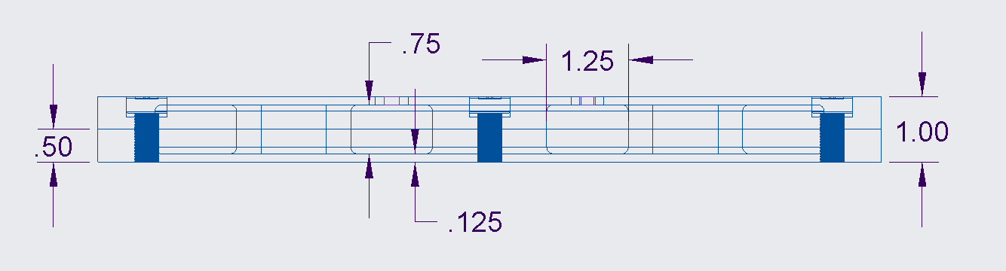
Physical Prototype

Slide 48
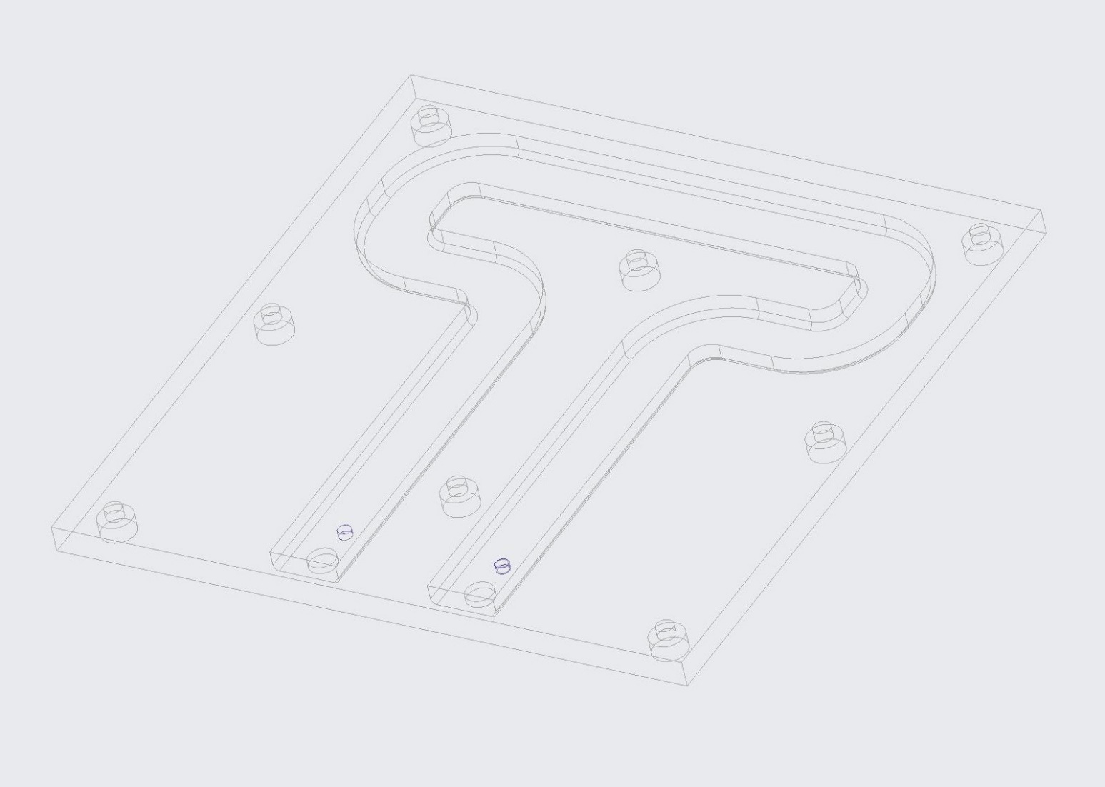
Physical Prototype

Slide 49
Budget Breakdown Sheet
Raw Materials | Hardware | Tubing & Connections | Test Materials
$228.18 | $254.01 | $127.06 | $212.79

Slide 50
Total Spent Sheet
Total Spent | Total Unspent
$822.06 | $1,177.94

Slide 51
Raw Materials Table
Raw Materials
Item | Part Description | Quantity | Unit Cost | Total Cost | Category Cost
1 | Aluminum Plate 6061: T6511, 12 in Overall Lg, 10 in Overall Wd, 0.5 in Thick, Mill, +/-0.009 in, B95 | 2 | $50.49 | $100.98 | $228.18
2 | Aluminum Plate 6061: T6511, 12 in Overall Lg, 12 in Overall Wd, 0.5 in Thick, Mill, +/-0.009 in, B95 | 2 | $63.60 | $127.20

Slide 52
Hardware Table
Hardware
Item | Part Description | Quantity | Unit Cost | Total Cost | Category Cost
1 | 2Pcs Silicone Car Engine Heater Pad - 4" x 5" Self-Adhesive Oil Pan Heater Pad with 194°F Thermal Protector, 120V 150W Car Battery Warmer Pad Engine Block Heater Pad with 68" Long Power Cord (Orange) | 2 | $20.99 | $41.98 | $254.01
2 | BCZAMD 120V 500W Silicone Heating Pad 235 X 235mm Rubber Heater Mat with NTC 100K Thermistor Strong Adhesive for Crealit Ender 3 V2 3S Ender 5 3D Printer Heated Bed | 3 | $35.99 | $107.97
3 | 12V 2 GPM PowerFLO Automatic Demand Diaphragm Pump | 1 | $87.07 | $87.07
4 | 4 Sets DC 3-5V MAX6675 Thermocouple Module and K Type Thermocouple Temperature Sensor Thermocouple Sensor Set M6 Screw with Cable Cord Compatible with Arduino Raspberry Pi | 1 | $16.99 | $16.99

Slide 53
Tubing & Connections Table
Tubing & Connections
Item | Part Description | Quantity | Unit Cost | Total Cost | Order Cost
1 | 25 ft long Nylon Hose | 1 | $58.29 | $58.29 | $127.06
2 | Brass Barbed Hose Fitting for Air and Water Straight Adapter for 5/16" Hose ID, 3/8 NPTF Male | 1 | $18.95 | $18.95
3 | Push-to-Connect Tube Fitting with Universal Thread for Air and Water, Adapter, 3/8" Tube OD x 1/4 Pipe | 6 | $3.65 | $21.90
4 | Shark Industrial Premium Stainless Steel Dishwasher Hose - 10 FT No-Lead Burst Proof Water Supply Line 3/8" comp x 3/8" comp with attached 90 degree 3/8" comp x 3/8" MIP elbow - 10 year warranty | 1 | $12.95 | $12.95
5 | 1/4 in. - 3/8 in. Tubing Bender | 1 | $14.97 | $14.97

Slide 54
Testing Materials Table
Test Materials
Item | Part Description | Quantity | Unit Cost | Total Cost | Order Cost
1 | Ultra Black® Oil Resistant RTV Silicone Gasket Maker, 3.35 Tube | 2 | $14.38 | $28.76 | $212.79
2 | Prestone DEX-COOL Antifreeze+Coolant; Extended Life -1 Gal- Ready to Use, 50/50 | 2.00 | $22.20 | $44.40
3 | Great Value Aluminum Foil, 225 sq ft | 9 | $10.63 | $95.67
4 | Rubbermaid Commercial Products 2.5 Gallon Brute Heavy-Duty, Corrosive-Resistant, Round Bucket, Red FG296300RED | 2 | $21.98 | $43.96

