Slide 1
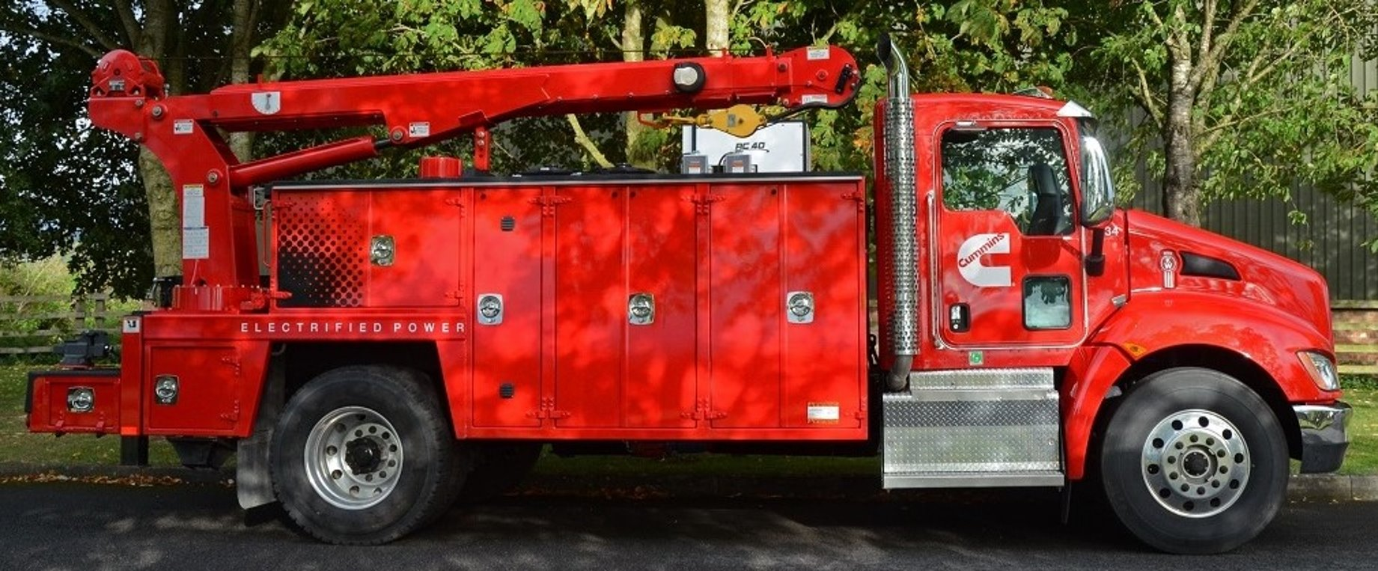
Hybrid Vehicle Battery Cooling
Team 507: Anthony Vicary | Chris Carley | Clayton Carlson | Corey Kelley | Jacob Owens

Slide 2
TEAM 507
Corey Kelley
Systems
Engineer
Clayton Carlson
Thermal Fluid Engineer
Chris Carley
Materials Engineer
Anthony Vicary
Heat Transfer
Engineer
Jacob Owens
Design Engineer

Slide 3
Sponsor and Advisor
Dr. Michael Hayes
Cummins, Inc
Material Engineer
Dr. Juan Ordonez
FAMU-FSU College of Engineering

Slide 4
1st Semester Overview
Objective
Goals
Assumptions
Functions
Customer Needs
Targets

Slide 5
Project Objective
The objective of this project is to design a cooling method for a hybrid vehicle battery pack that is at least 5% more effective than current industry standards.

Slide 6
Key Goals
Improve battery cooling effectiveness by 5%
Design focuses on innovation at module level
Keep cost of ownership down
Keep battery within efficient operating temperature

Slide 7
Assumptions
Design will be based on a Nissan Leaf pouch cell module
Domain of project will be within battery enclosure
Battery will be subjected to a variety of operating conditions
Not able to physically open a battery module
Notes:
Mention that design will be implemented with 10 kWh battery pack in mind but will be scalable for larger battery packs

Slide 8
Customer Needs
Components other than the cell are less than 20% of the weight of the module.
Has the ability to withstand high heat transfer rates.
Performs effectively in extreme temperatures that would cause damage to the battery.
Cooling design has ability to be implemented inside of the battery module.
Design does not require significant pumping power.
Design prevents puncture of pouch cells.
Lowers the risk of thermal runaway
Design has ability to be implemented into Class 8 hybrid Vehicle battery packs.

Slide 9
Functions
Battery Cooling Method
Heat Transfer
Safety
Efficiency

Slide 10
Heat Transfer: Functions
Heat Transfer
Cools Battery

Slide 11
Safety: Functions
Safety
Avoids Puncture
Reduces Thermal Runaway
Withstands Thermal Cycling
Accommodate Swelling

Slide 12
Efficiency: Functions
Efficiency
Minimize Weight
Minimize Energy Loss

Slide 13
Critical Targets
Temperature
Pouch cells do not exceed 40° Celsius
Size
Concept must accommodate for the dimensions of pouch cells
Puncture
Pouches not subjected to more than 110 MPa of stress
Cells we are designing have dimensions of 261x216x7.9mm

Slide 14
Critical Targets
Long Lasting
Should maintain cooling performance for at least 10 years
Weight
Pressure Loss
Concept does not exceed 20% of total module weight
Pressure loss across module is less than 1 kpa

Slide 15
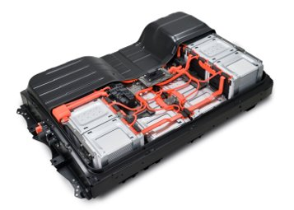
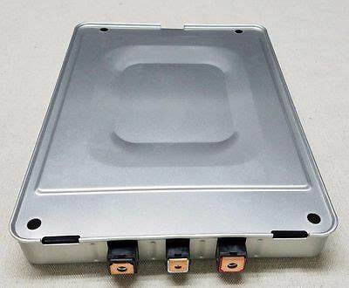
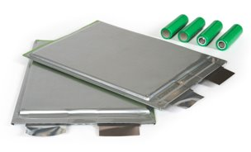
Battery Pack Components
Battery Pack
Module
Cells

Slide 16
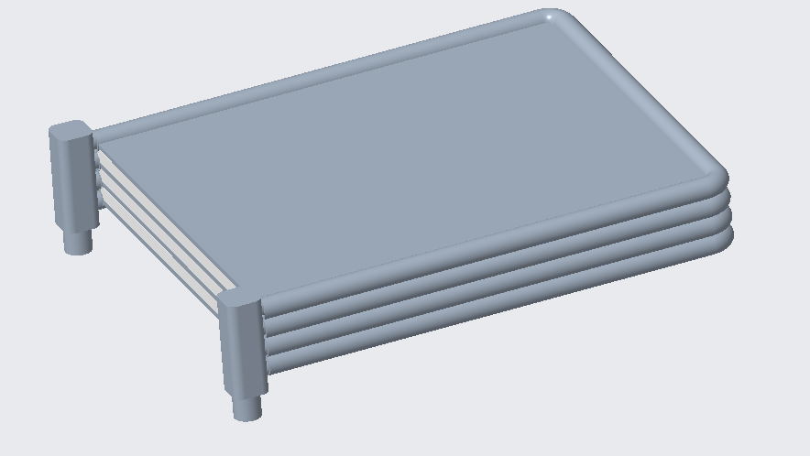
Initial Design: Cooling Pipes around Inner wall of Module
Coolant Channel
Coolant channels fit within module walls
Coolant inlet and outlet

Slide 17
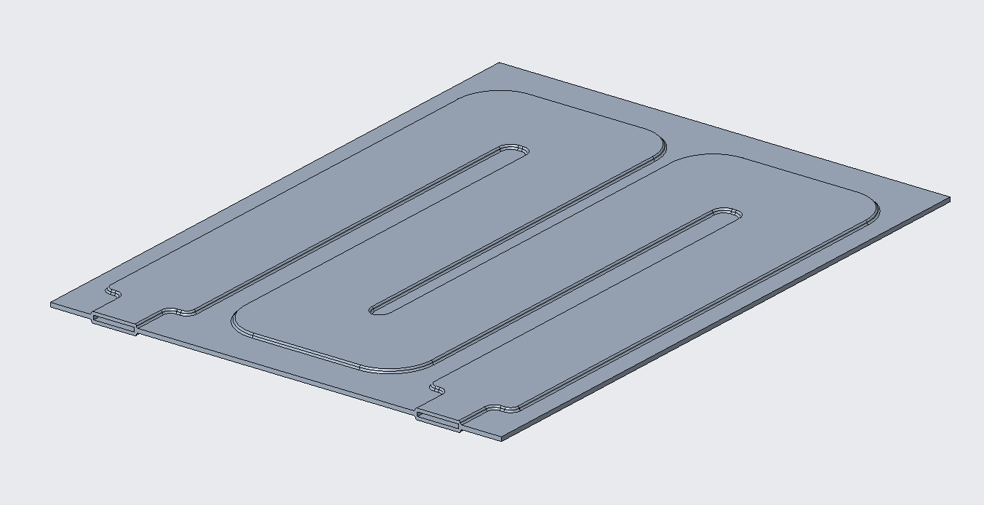
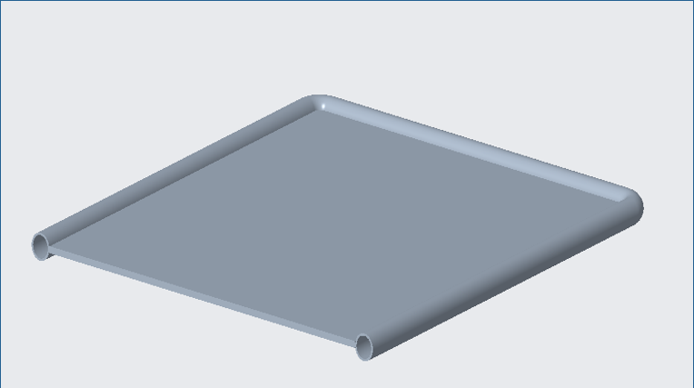
Initial Design
Revised Design

Slide 18
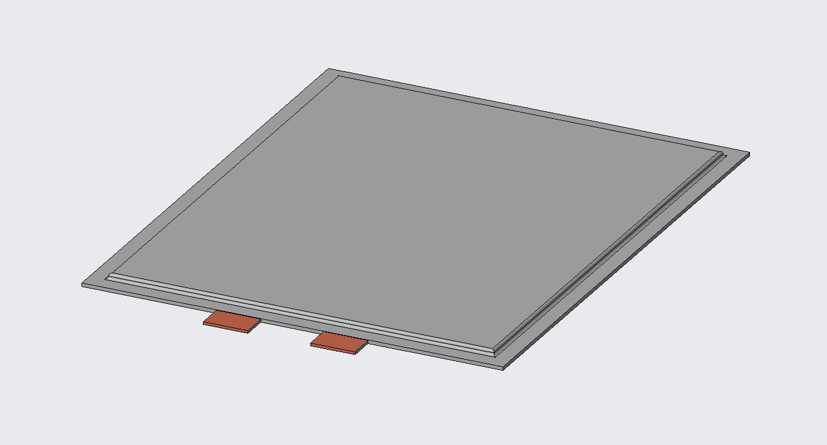
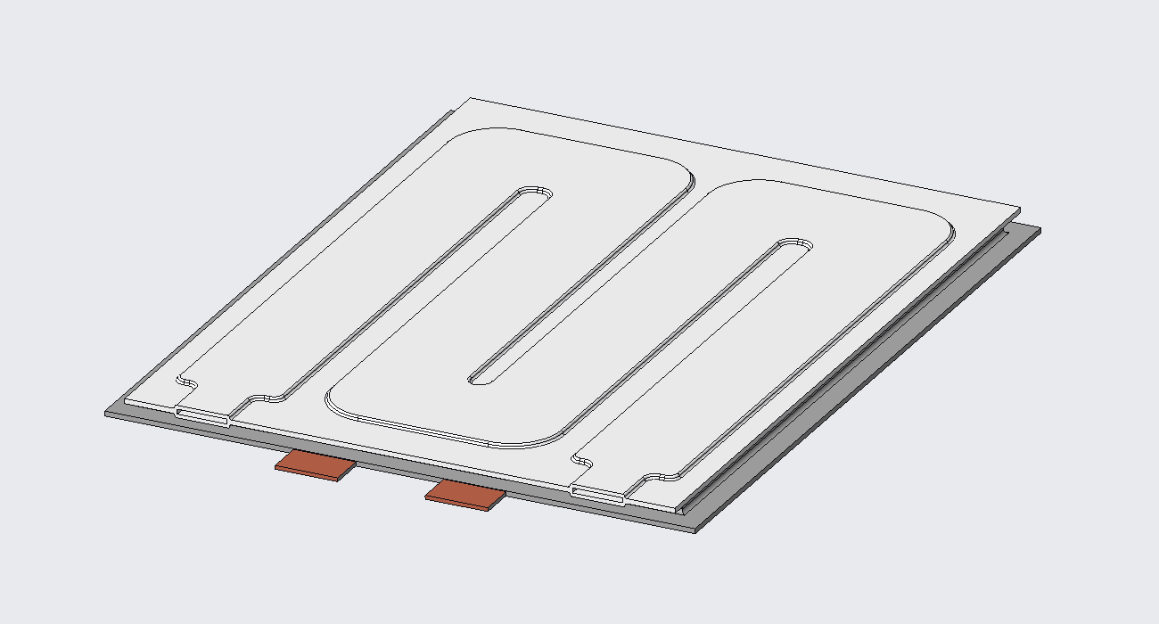
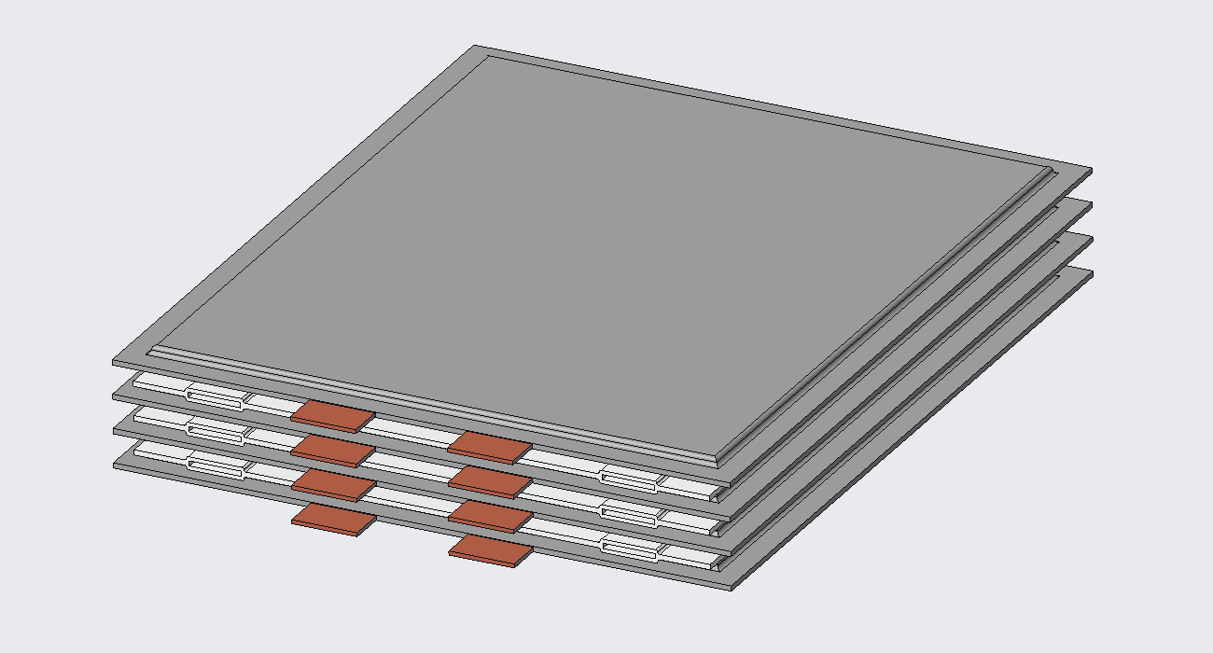
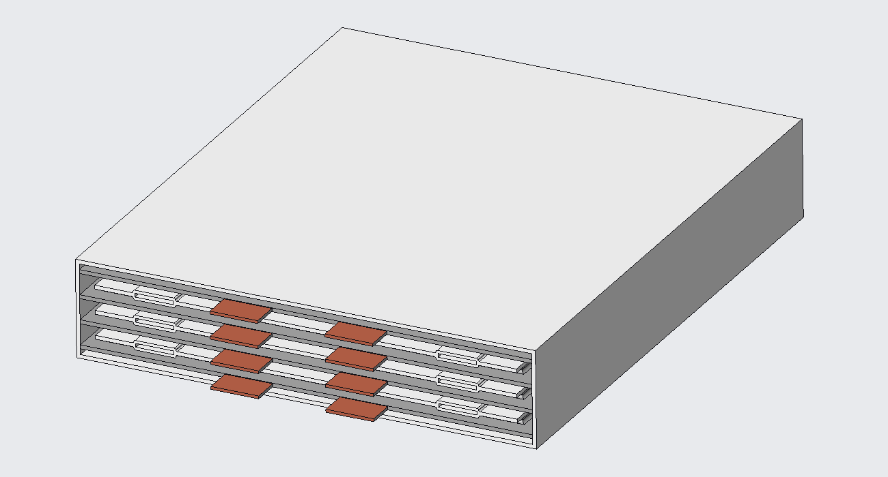
Module Assembly

Slide 19
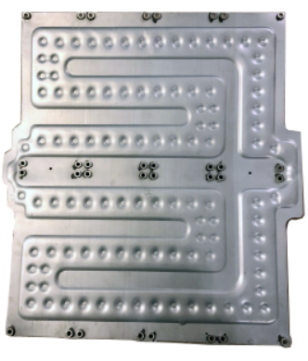
Current Work: Manufacturing
Baknor Thermal
Roll Bonded Cold Plate Manufacturing
Lightweight
Compact
Irregular Shapes
Withstand High Temperature and Pressure
Stamped to Induce Turbulence
FAMU-FSU Machine Shop
Press fit aluminum sheets over pre-shaped pipes
Less contact
Slightly different coolant channel shape

Slide 20
Current Work: COMSOL
The CAD model has been imported into COMSOL for thermal analysis.
COMSOL has a built-in battery module to simulate the heat generation of the pouch cell.
Improved model of heat generation at different C-Rates.

Slide 21
Current Work: Prototype Design
We are unable to acquire the cooling plates that we have determined are essential to the design due to the price.
Physical prototype must imitate the desired concept as closely as possible.
Physical prototype tests will be compared to COMSOL simulation to verify results.

Slide 22
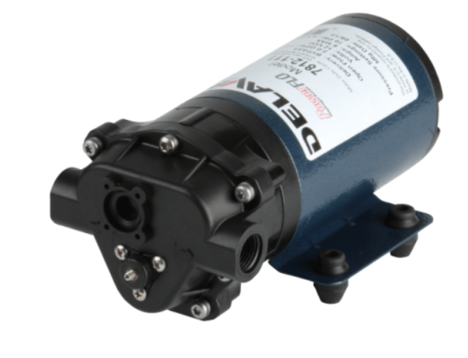
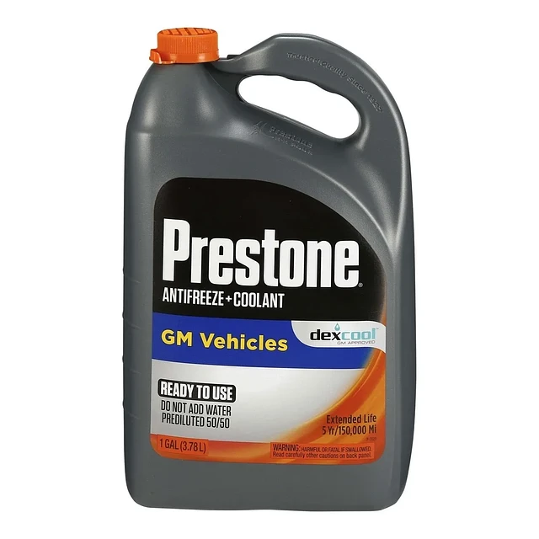
Current Work: Materials Selection
12V 2 GPM PowerFLO Diaphragm Pump
1/16" 6061 Aluminum Sheet
Purple Antifreeze

Slide 23
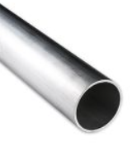
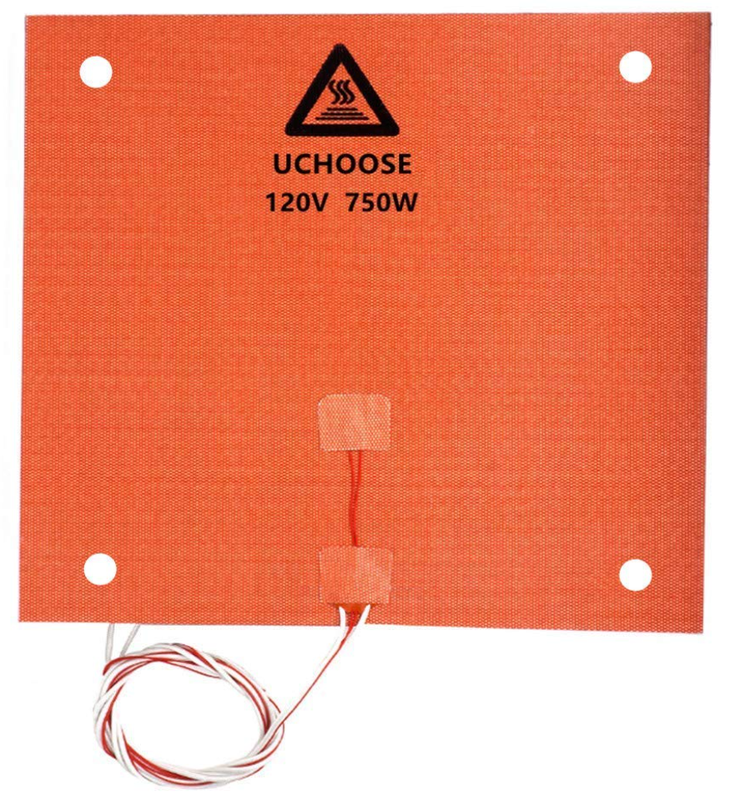
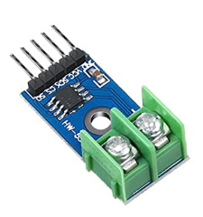
Current Work: Materials Selection
3/8" Aluminum Piping
3D Printer Silicone Heated Pad 120V 750W
MAX6675 K-Type Thermocouple

Slide 24
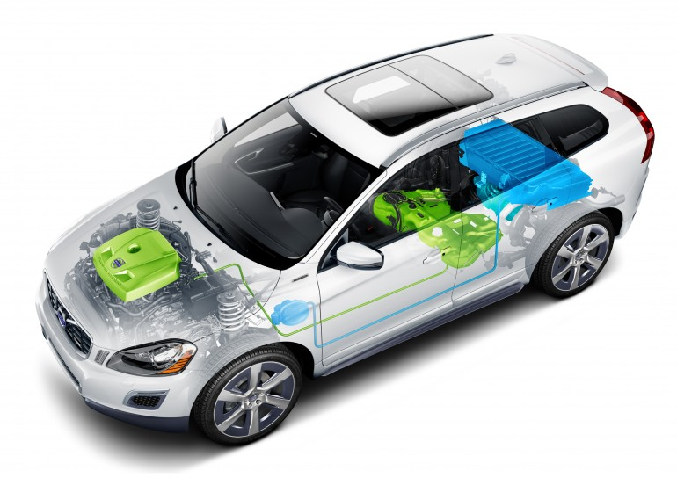
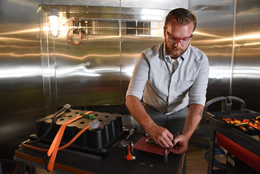
Future Work
Prototyping & Testing
Finish CFD Analysis
Verify Results

Slide 25
References
Baknor thermal management, heat sinks, liquid cold plates & more. Baknor Thermal Management, Heat Sinks, Liquid Cold Plates & More. (n.d.). Retrieved January 25, 2023, from https://www.baknorthermal.com/
Electric Vehicle Lithium-Ion Battery: Innovation: Nissan Motor Corporation Global Website. Innovation | Nissan Motor Corporation Global Website. (n.d.). Retrieved January 25, 2023, from https://www.nissan-global.com/EN/INNOVATION/TECHNOLOGY/ARCHIVE/LI_ION_EV/
Cummins zero emissions road map. (2022, March 23). Cummins Inc. Retrieved October 10, 2022, from https://www.cummins.com/news/2022/03/23/cummins-zero-emissions-road-map
Pachpute, S. (2022b, August 9). Battery Cooling Techniques in Electric Vehicle ·. CFD Flow Engineering. Retrieved October 10, 2022, from https://cfdflowengineering.com/battery-cooling-techniques-in-electric-vehicle/

Slide 27
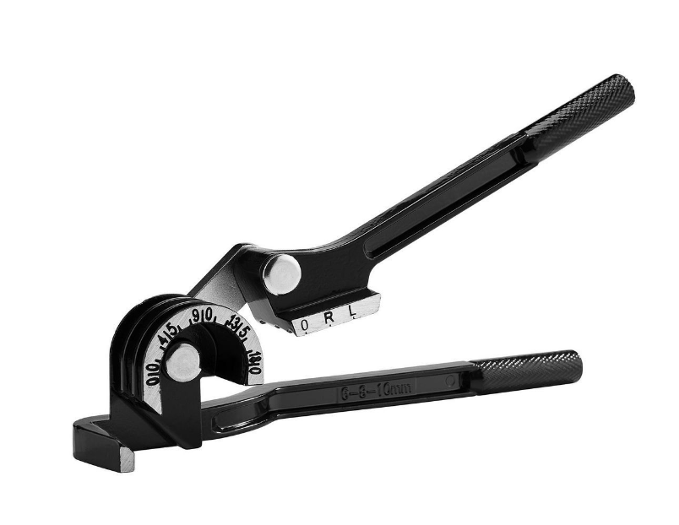
Current Work: Materials Selection
12V 2 GPM PowerFLO Diaphragm Pump
Pipe Bender
1/16" 6061 Aluminum Sheet
Purple Antifreeze
3D Printer Silicone Heated Pad 120V 750W

Slide 28
Goals and Assumptions
Goals
Keep battery within efficient temperature range
Improve cooling effectiveness by 5%
Design focuses on innovation at module level
Assumptions
Domain of project is within the battery pack
Battery is subject to a variety of conditions
Not able to open physical battery modules

