Slide 1
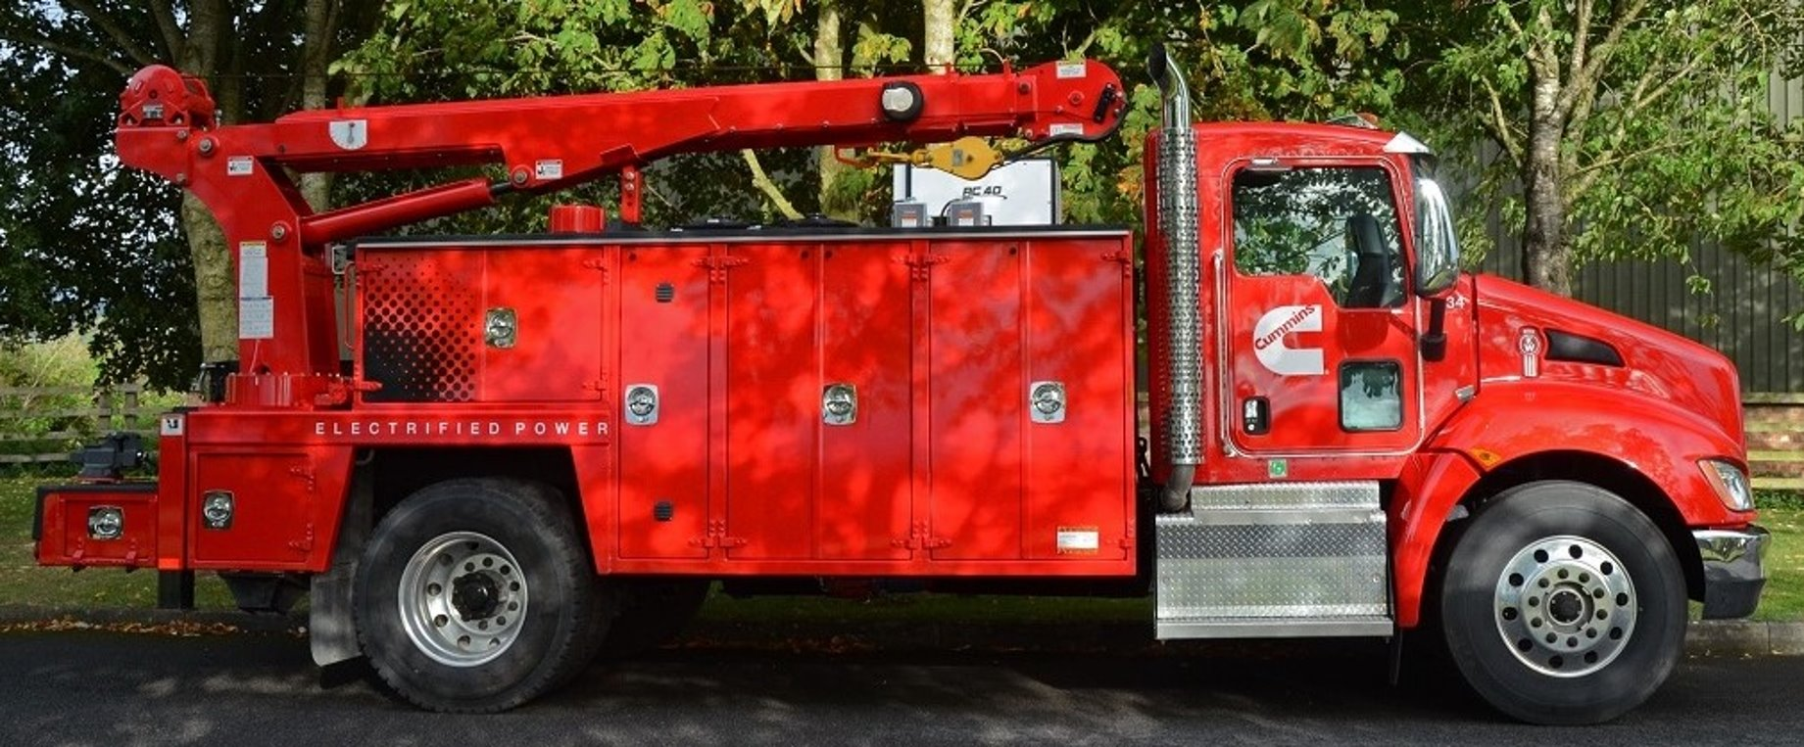
Hybrid Vehicle Battery Cooling
Team 507: Anthony Vicary | Chris Carley | Clayton Carlson | Corey Kelley | Jacob Owens

Slide 2
TEAM 507
Corey Kelley
Systems
Engineer
Clayton Carlson
Thermal Fluid Engineer
Chris Carley
Materials Engineer
Anthony Vicary
Heat Transfer
Engineer
Jacob Owens
Design Engineer

Slide 3
VDR 1 Review
Objective
Goals
Assumptions
Functions

Slide 4
Project Objective
The objective of this project is to develop a cooling method for a hybrid vehicle battery pack that is at least 5% more effective than current industry standards

Slide 5
Goals and Assumptions
Goals
Keep battery within efficient temperature range
Improve cooling effectiveness by 5%
Desing focuses on innovation at module level
Assumptions
Domain of project is within the battery module
Battery is subject to a variety of conditions
Not able to open battery modules

Slide 6
Functions
Battery Cooling Method
Heat Transfer
Safety
Efficiency

Slide 7
Heat Transfer: Functions
Heat Transfer
Cools Battery

Slide 8
Safety: Functions
Safety
Avoids Puncture
Reduces Thermal Runaway
Withstands Thermal Cycling
Accommodate Swelling

Slide 9
Efficiency: Functions
Efficiency
Minimize Weight
Minimize Energy Loss

Slide 10
Critical Targets
Temperature
Pouch cells do not exceed 40° Celsius
Size
Concept must accommodate for the dimensions of pouch cells
Puncture
Pouches not subjected to more than 110 MPa of stress
Cells we are designing around are 261x216x7.9mm

Slide 11
Critical Targets
Long Lasting
Should maintain cooling performance for at least 10 years
Weight
Pressure Loss
Concept does not exceed 20% of total weight of module
Pressure loss across module is less than 1 kpa

Slide 12
Concept Generation Methods
Biomimicry
General Brainstorming
Crap shoot

Slide 13
Medium Fidelity
Using salt hydrate phase change materials (PCM) to absorb heat
Coolant channel that snakes between the cells and outputs to a heat sink
Cooling plates in between modules with coolant flowing between them
Angle slits on the modules to increase the amount of airflow into the modules
Cabinet based holding for pouch cells with gap in between each cell to allow for coolant flow

Slide 14
High Fidelity Concepts
Route liquid cooling pipes around the inner shell of module wall with aluminum plates between cells to transfer heat to pipes.
Create thermal paste packs that increase contact area between cells and module walls
Layer highly thermally conductive tape between cells to transfer heat to the side of the module to which the coolant channels are connected

Slide 15
Concept Selection: House of Quality
Temperature
Minimize Cost of Ownership
Thermal Cycling
Accommodates Swelling
Puncture Force

Slide 16
Concept Selection: Final Pugh Chart

Slide 17
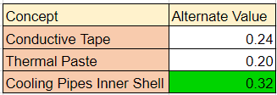
Concept Selection: AHP
Critical Engineering Characteristics
Temperature
Thermal Cycling
Puncture
Adds Minimal Volume
Cooling Pipes Inner Shell had Highest alternate value

Slide 18
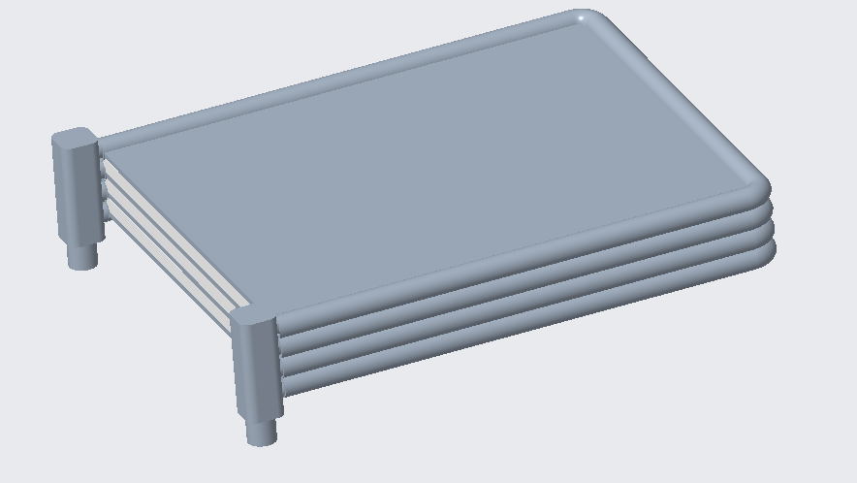
Final Selection: Cooling Pipes around inner wall of Module
Coolant Channel
Coolant inlet and outlet
Coolant channels fit within module walls

Slide 19
Current Work: Benchmarking
Nissan leaf modules act as a good benchmark due to their simplicity
These modules increase in temperature approximately 0.75° Fahrenheit per second at a C-rate of 10

Slide 20
Current Work: Simscape Modeling
Using pre-existing battery behavior data
Assuming perfectly insulated module
Assuming battery cell configuration of Nissan Leaf

Slide 21
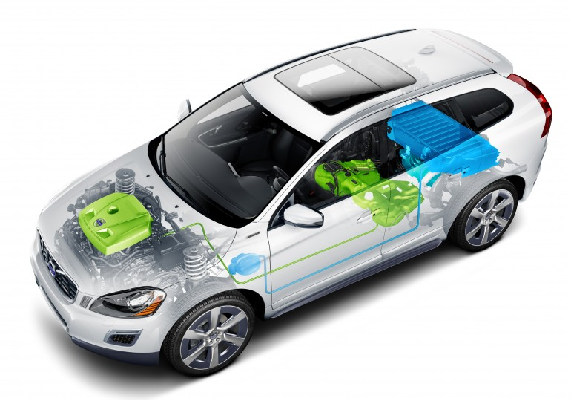
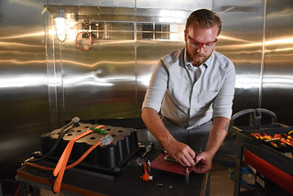
Future Work
Materials Selection
Prototyping
CFD Analysis
Optimization

Slide 22
References
https://www.electricbike.com/building-a-safe-high-amp-battery-pack-from-flat-pouch-cells/
https://pushevs.com/2018/01/29/2018-nissan-leaf-battery-real-specs/
https://www.envision-aesc.com/en/product/liion_ev
https://www.nrel.gov/docs/fy08osti/42469.pdf
https://mynissanleaf.com/viewtopic.php?t=26379#:~:text=So%20the%20maximum%20temperature%20where,67))%20degrees%20F.

Slide 24
Backup Slides

