Slide 1
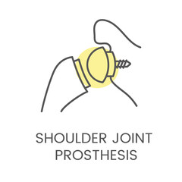
Team 114
Notes:
Customize your title slide to be appealing to the audience. This is the first thing they see apply some graphic design elements that may summarize your presentation.

Slide 2
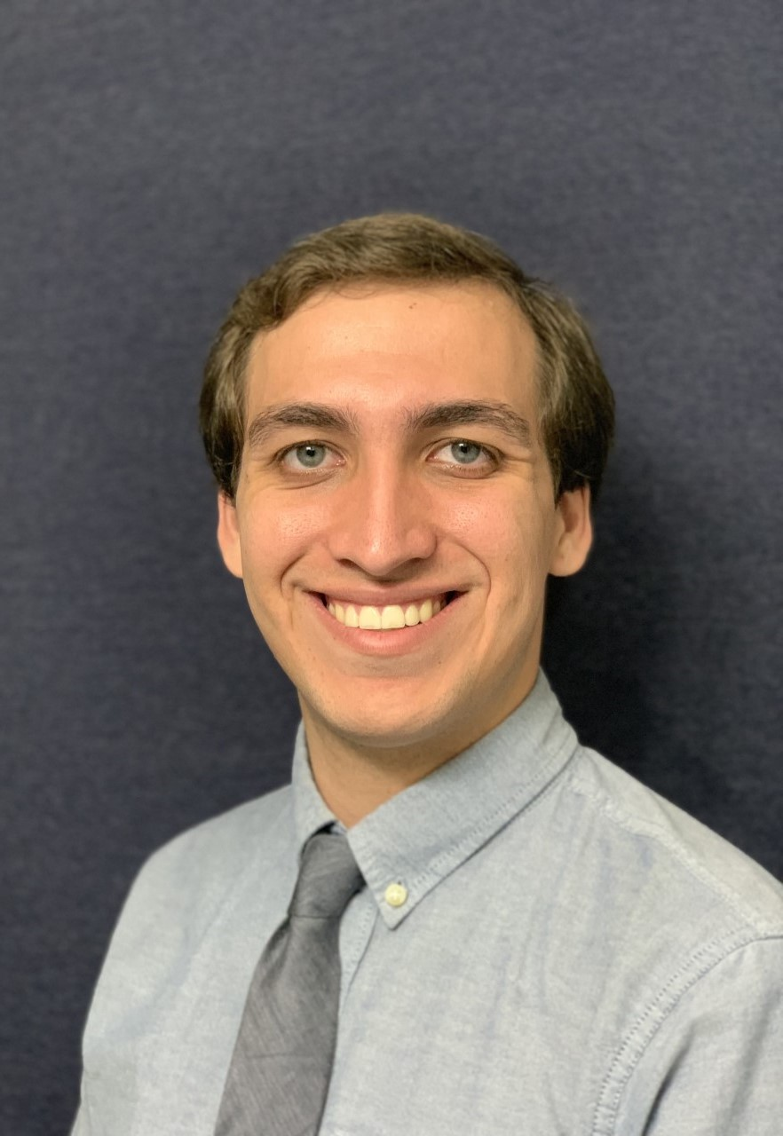


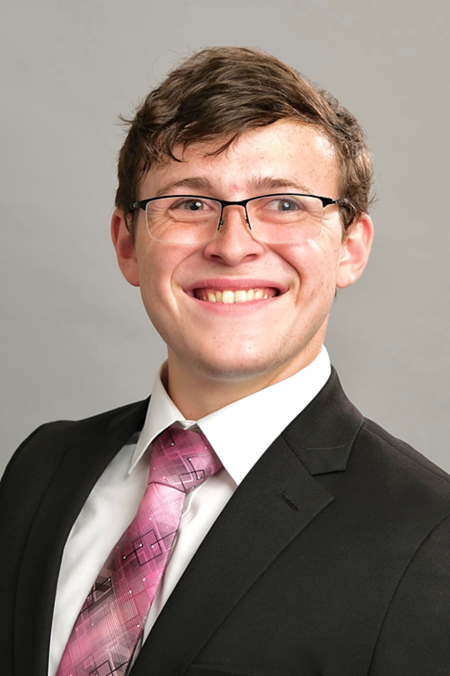


Team Members
Valeria Aguilera
William Crittenden
Alexandra Nowzamani
Ethan Corey
Matthew Mohammed
Nickolas Wolniewicz

Slide 3

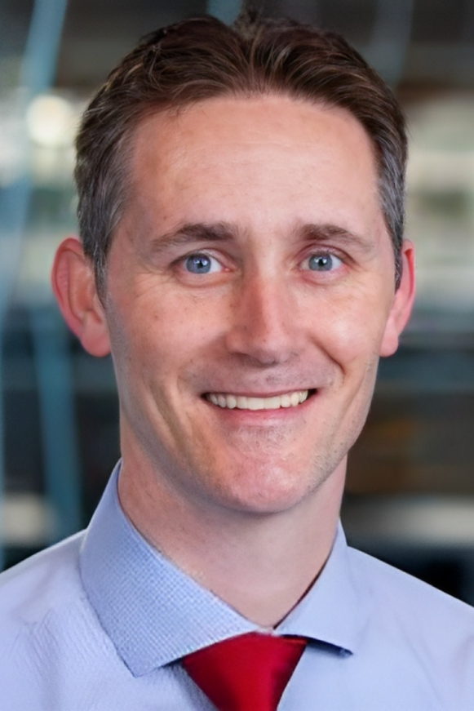
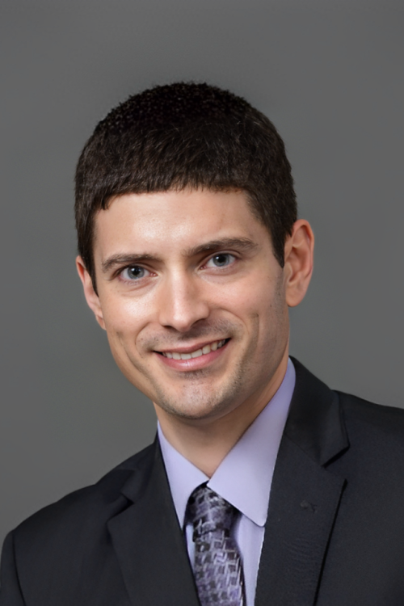

Sponsor and Advisors
Academic Advisor
Shayne McConomy, Ph.D.
Professor, FAMU – FSU Engineering
Project Sponsor
Tom Vanasse,
Director of Engineering, Exactech
Academic Advisor
Stephen Arce, Ph.D.
Professor, FAMU – FSU Engineering

Slide 4

Project Objective
The objective of this project is to design a stemless reverse shoulder prosthetic to reduce micromotion and formulate a series of tests to appropriately evaluate the design.

Slide 5

Total Shoulder Replacement
Purpose:
To reduce shoulder pain and restore mobility and range of motion by replacing portions of the shoulder joint with an artificial implant.

Slide 6

Key Goals
Induces no immune response.
Implant has Young's modulus approximately: 10-30 GPa.
Pore sizes approximately: 600 µm.
Neck-shaft angle: 135° to 145°.
Humeral Head radius between 20-25 mm.
Insertion requires less than: 1 MPa.
Maximum Length of design: 70 mm.
Glenosphere size: 40-42 mm.

Slide 7

Customer Needs
Prevents lever out
Prevents micromotion
No device failure
No bone fracture
Easy revision
Immune response
Ease of implantation

Slide 8
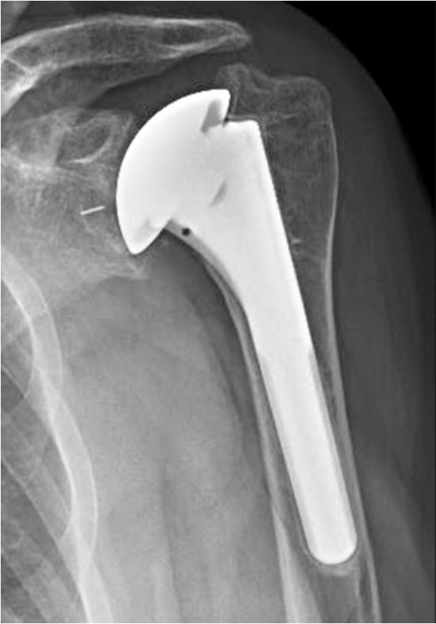
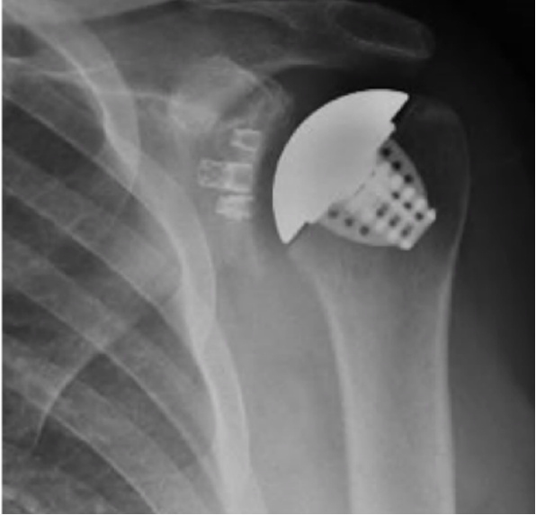
Types of Implants
Stemmed Implant
Stemless Implant

Slide 9
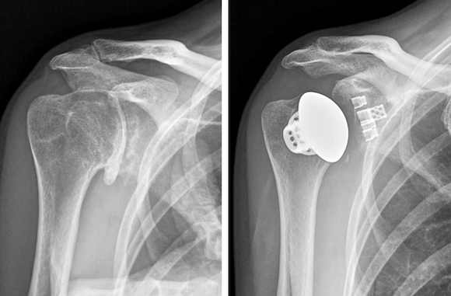
Stemless Shoulder Implant
Benefits:
More Anatomic.
Reduces Stress Shielding.
Less Bone Removal.
Good Mid to Long-Term Results.

Slide 10
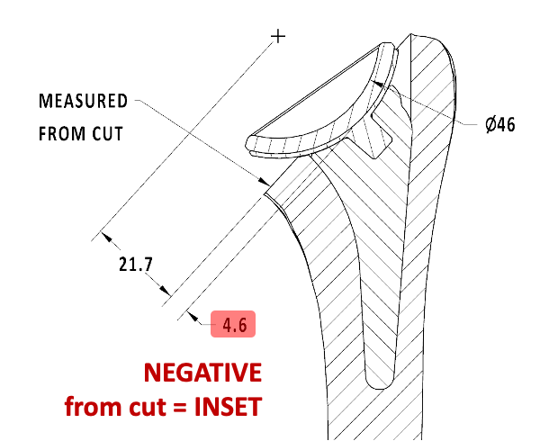
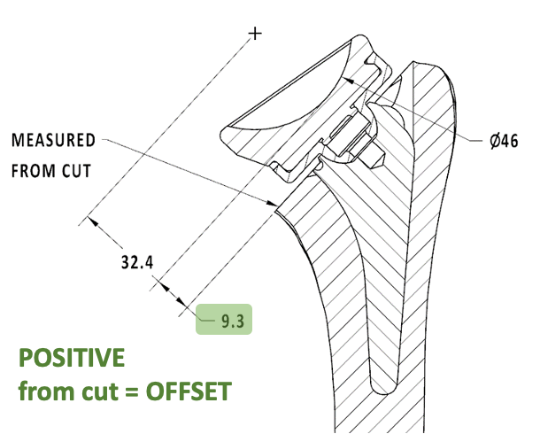
Inlay vs. Onlay
Inlay - the lowest point of the humeral tray sits at or below the humeral cut.
Onlay - the lowest point of the humeral tray sits above the humeral cut.
Inlay
Onlay

Slide 11
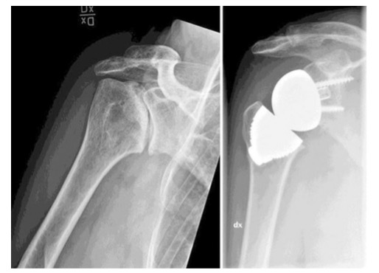
Reverse Stemless Shoulder Implant
Potential Benefits:
Prevents rotator cuff damage.
Better mechanics for your rotator cuff.
Uses mainly the deltoid instead.

Slide 12

Research Update
Interview with Mr. Thomas Vanasse
Toured Exactech Facility in Gainsville, FL

Slide 13
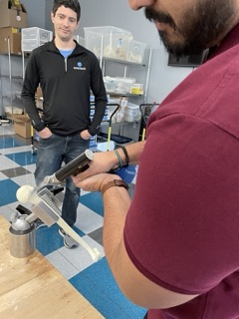
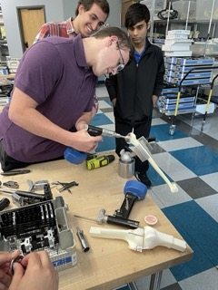
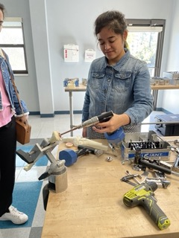
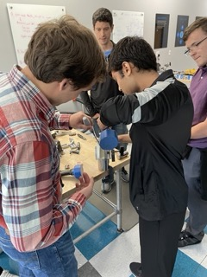
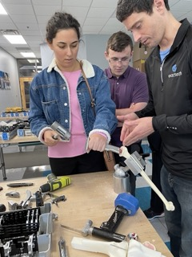
Research Update Cont'd

Slide 14

Mind Map
Primary Characteristics
  Biomechanics
  Manufacturability
  Marketability
  Surgery
  Biocompatibility
  Implant Design

Slide 15
Increased angle of insertion
Decreasing Lateral Offset
Surface porosity
Impaction (press-fit)
Autograft
Pegged
Surface Coating
Anchor
Keeled
Cage
Augmented
Increased Diameter or Length
Humeral Tray
Glenoid Component
Peripheral Screws
Decreased micromotion
Facilitated Bone growth
Compression
Insertion Technique
Fins
Onlay
Screws
Cup
Inlay
Neck-shaft angle
Increase range of motion
Attachment
Cage
Recovery
Glenosphere
New
Biomechanics
Short time
Minimal bone removal
Unlinked joint
Hemisphere
Increased Lateral Offset
Surgery
Already owned
Equipment
Patents
Sphere
Irregular
Cost
Cold Shoulders
Implant Design
Single Linked Joint
Methods
Manufacturability
“Hinge”
3D printing
Forging
Regulations
Porosity
Casting
Molding
IDE
Made with Exactech parts
Reverse Stemless
ISO 104933
FDA
Biocompatibility
Modifications
Vitamin E
Single design
510(k)
Marketability
Biomaterials
Surface Coatings
Hydroxyapatite
Universal
Versatility
Sizes
All types
Immune response
Bone Ingrowth
Ceramics
Bone
On-growth
Reverse stemless
Improved quality of life
Practicality
Adaptability
Dual Design
Composites
Polymers
Metals
Easier revision
Short Surgery time
CoCrMo
Anatomical Stemless
Bone stability
Landscape
Review
Polyethylene
Ti-6Al-4V
Increased range of motion
Elastomeric polyamide
Painless arm usage

Slide 16


Concept Generation
Crapshoot Method:
Allows for concepts to be quickly generated.
Concepts are capable of being creative.
Many concepts may be difficult to implement.
Forced Analogy:
Allows for concepts to be derived from only 2 words.
Creates concepts without previous bias.
Concepts are usually unrealistic.

Slide 17
Crapshoot Method Examples:
A ratcheting system to secure glenoid component.
A spring component to reduce dislocation.
Coating the base to increase native tissue affinity.

Slide 18
Forced Analogy Method Examples:
Increasing or decreasing the cage radius.
Parabolic-shaped glenoid or head component.
Modular head or adjustable glenoid during surgery.

Slide 19
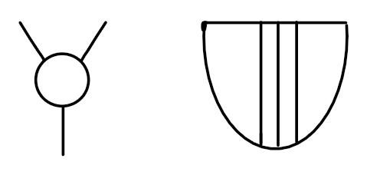
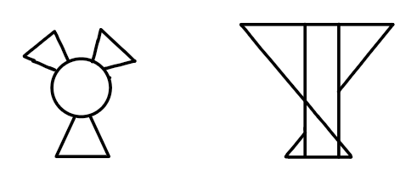
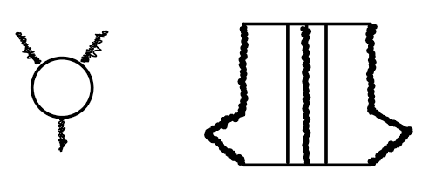
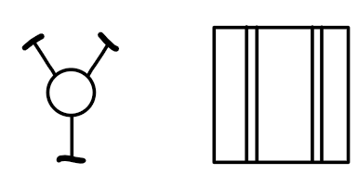
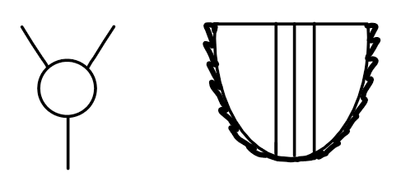
Concepts
Exactech Design
Twist/Screw
Anchor
Pugh Chart
Rigid
T-Shaped

Slide 20

Concept Selection
Generated
Concepts
House of Quality
Pugh Chart

Slide 21

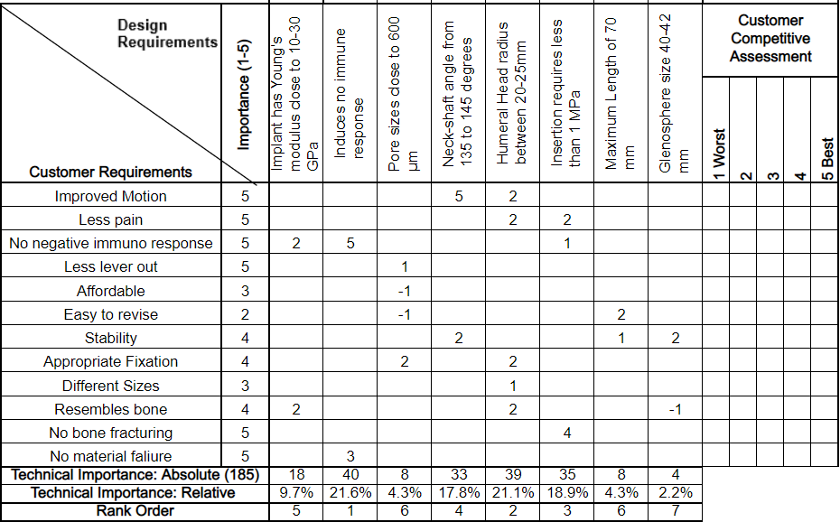
House of Quality

Slide 22

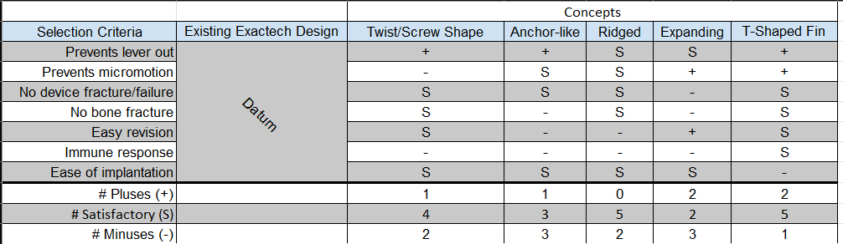
Pugh Chart Part 1

Slide 23
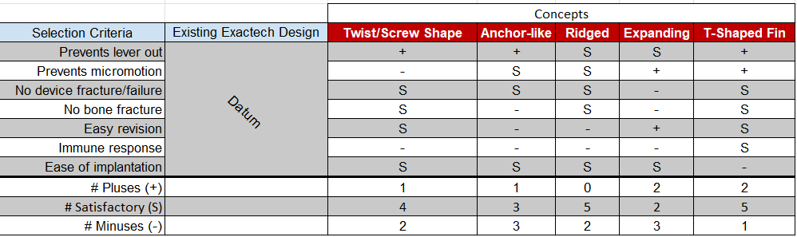
Pugh Chart Part 2

Slide 24
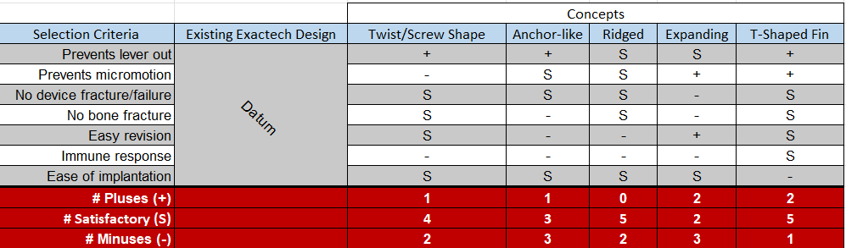
Pugh Chart Part 3

Slide 25
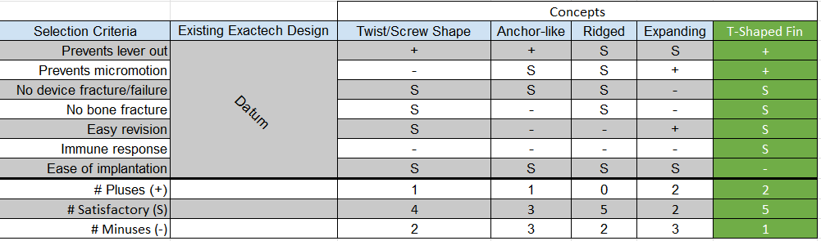
Pugh Chart Part 4

Slide 26
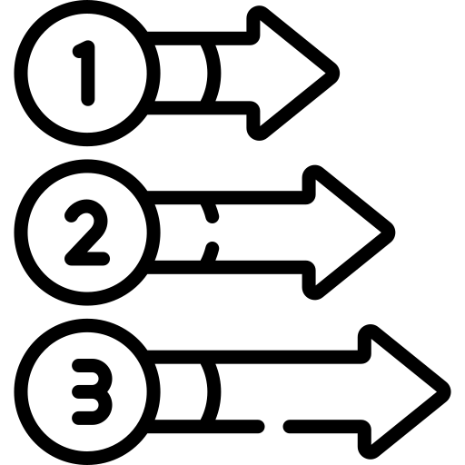

Next Steps
Build CAD models.
Build and test PLA prototypes.
Build and test aluminum prototypes.

