Slide 1



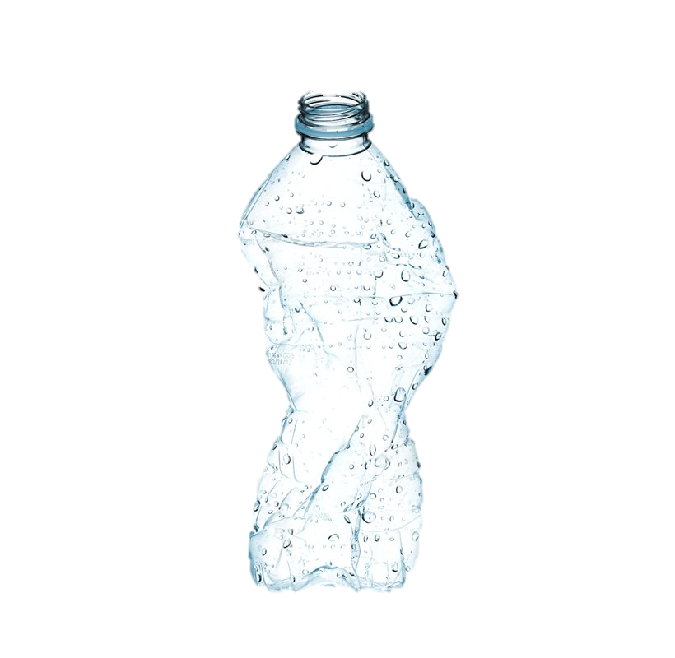
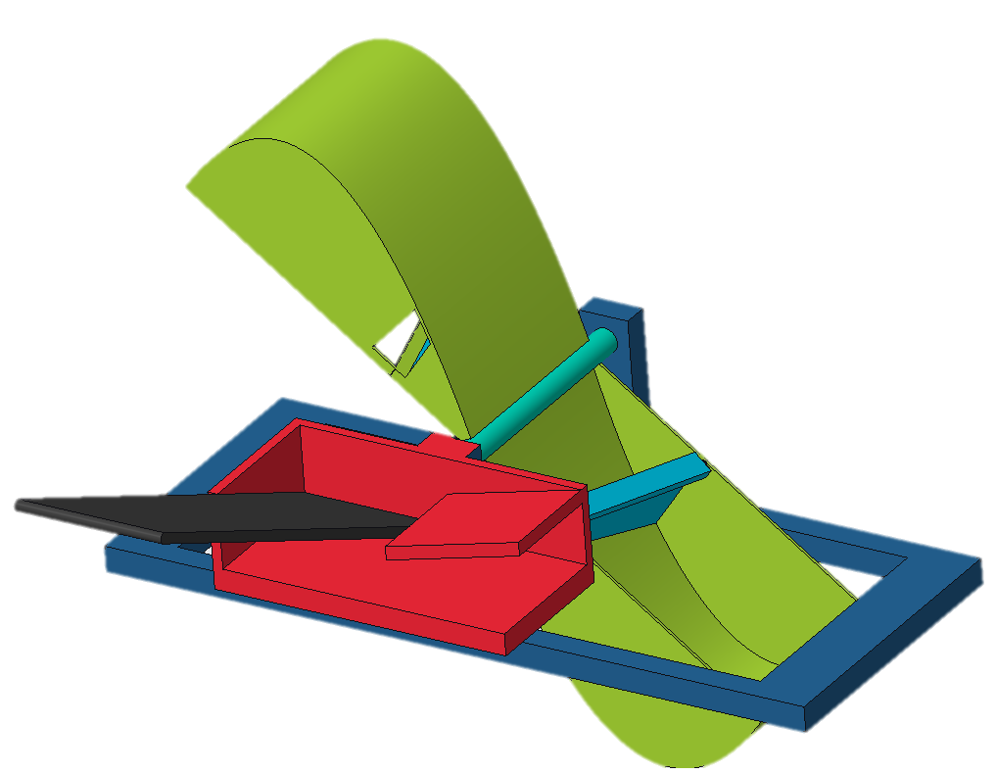






1
Yamaha Rightwaters Trash Interceptor
Team 518 | Jonathan Draigh | Emily Haggard | Mohamad Kassem | Martin Senf | Andrew Walker
OBJECTIVE
To implement an effective land-based trash interceptor that collects debris – primarily plastic waste – in storm drains to prevent it from entering waterways
Motivation
80% of trash comes within 1-2 hours of a storm
3 lbs of fish for 1 lb of plastic, by 2050, estimated to be a 1:1 ratio
Key Goals
Scalable
Expendable
Economical
Deployable​
Key Components
Solar Powered
Conveyor Belt
Basket Wheel
Remote Control
Reservoirs
Vertical Expansion 2-7 ft
50lb weight limit per person
Horizontal
Expansion
3ft – 20ft
Collects
20lb of trash at a time
700lb-ft to
move 50lbs
trash in 60s
Order Parts
Assemble Model
Finalize Power
System
Test & Validate
Retest & Validate

