Slide 1
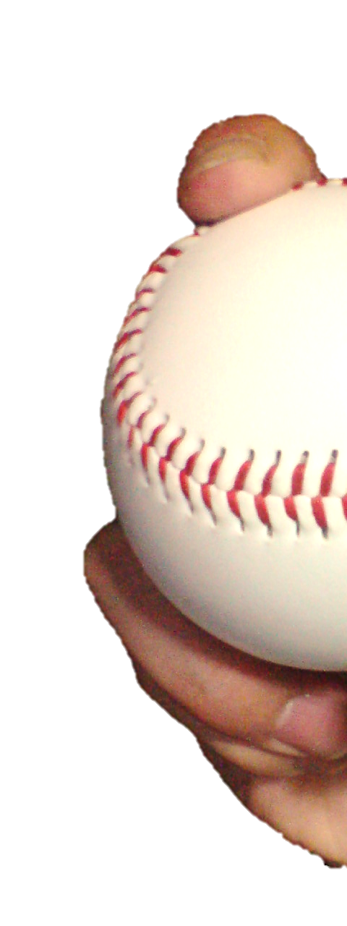
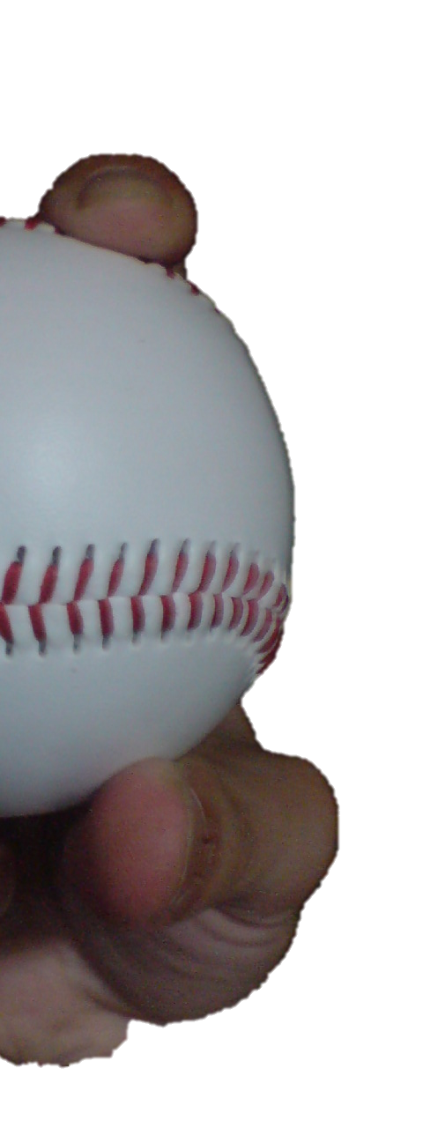
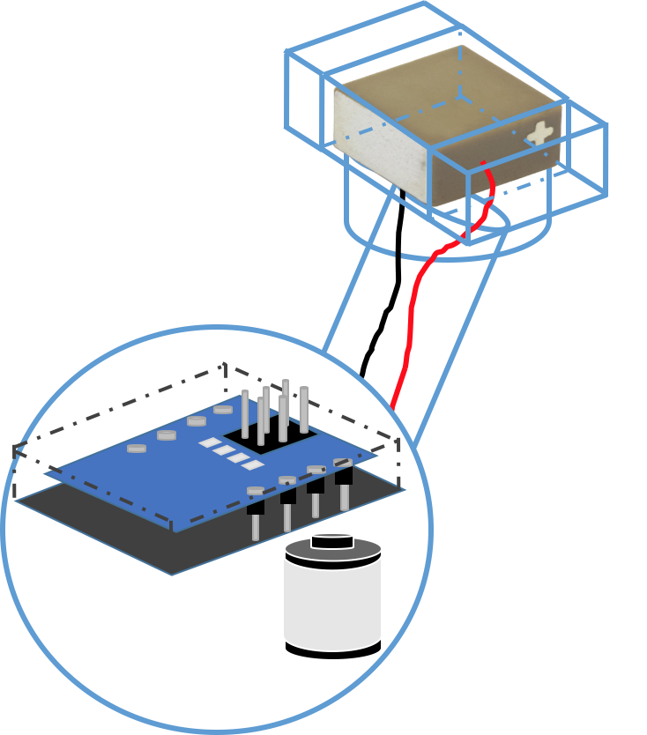




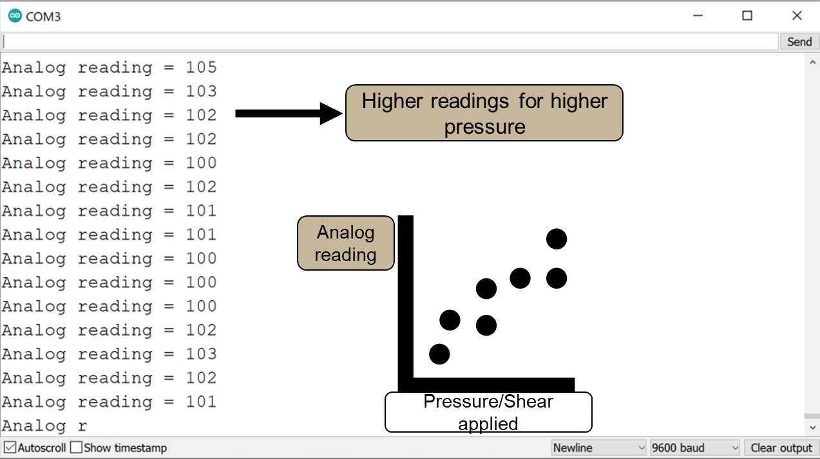
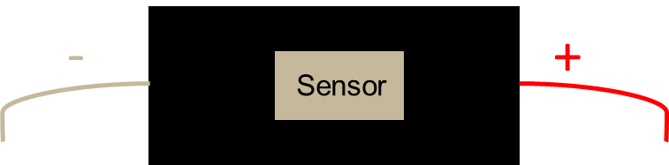

Team 516: Instrumented Baseball
David Adams | Mathew Brown | Riley Ferrer | Yanni Giannareas | Charles Whitaker
Objective
Specifications
Integrate technology to measure dynamic fingertip forces on a baseball.
Our key goals are to develop an accurate method of measurement, maintain the original characteristics of the ball, and facilitate access to the gathered data.
Measures fingertip forces up to 117N.
Plots data to user for a time period of 2 seconds.
Moment of inertia equal to 81.56 ± 5% kg•mm² to replicate an official baseball.
Between 4 and 5 cm² of fingertip application area.
Gathers data at a frequency higher than 10 kHz.
Background
Key Components
Today, baseball is all about analytics. Developing technology that describes a currently unknown measurement will introduce a new research topic in which pitchers might enhance their throwing mechanics.
Piezoelectric sensors
3D-printed housing
Markets
Arduino Bluno Nano
Lithium-ion battery
Indications
Initial Prototyping
Future Work
Bluetooth Testing
System Integration
Force application
Sensor
Testing
Housing Prototype
15 mm
Notes:
Maybe Place Icons and Words for future work, kinda like how Christina did it
Maybe We Add A Primary Market Section or Primary & Secondary
Didn’t change colot pallet yet but just made all the same for now and did a general layout of what I think would look good for us to do what we want

