Slide 1

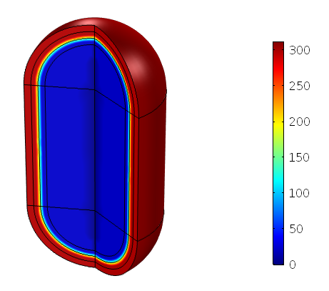

In-Space Cryogenic Propellent Storage Container
Team 512: Anna Gilliard, Liam McConnell, Samantha Myers, Brandon Young
Objective
Create a long-term storage solution for cryogenic propellent such as liquid hydrogen or liquid oxygen. A longer storage time under cryogenic temperature and pressure leads to the possibility of longer missions.
Background
Geometry: spherical, pill shape
Insulation: reflective mli, vacuum
Material: steel, aluminum
Cryogenics: hydrogen, nitrogen
Kelvin
Targets & Metrics
Withstand 6 Gs of force
Maintain structural integrity for 14 days
Maintain a pressure of 80-90 psi
Allow a minimum of 10 kJ of energy per day into the system
Key Goals
Maintain fuel temperature
Maintain pressure
Reduce heat transfer
Reduce fuel loss
Develop a prototype
Boil off
MLI
Assumptions
Testing with nitrogen
Tank will be utilized in space and Earth environments
Hypothetical lunar mission
Cross section
of the tank wall
Inner layer of tank
Outer layer of tank
Order parts
Assemble prototype
Begin testing
Analyze results
Final report

Slide 2
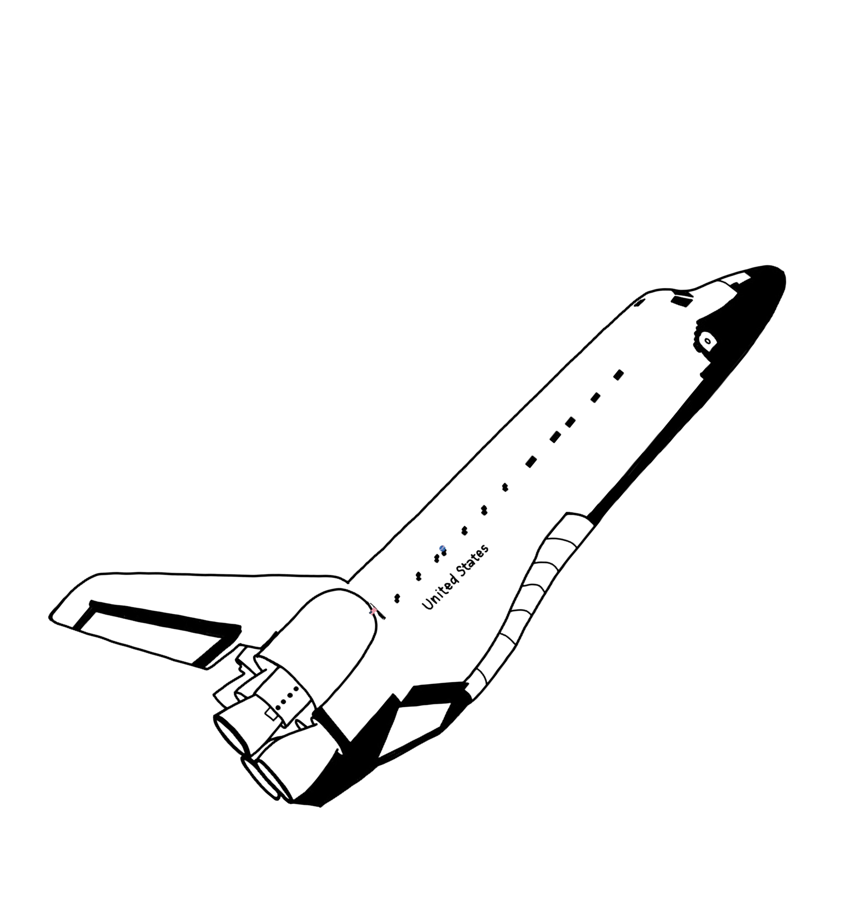
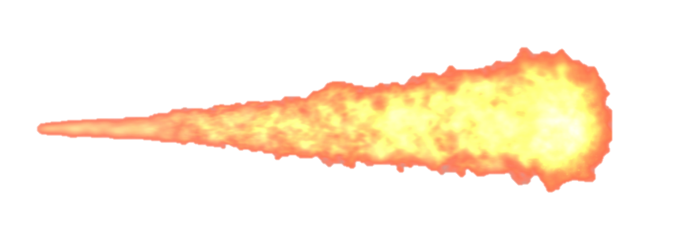
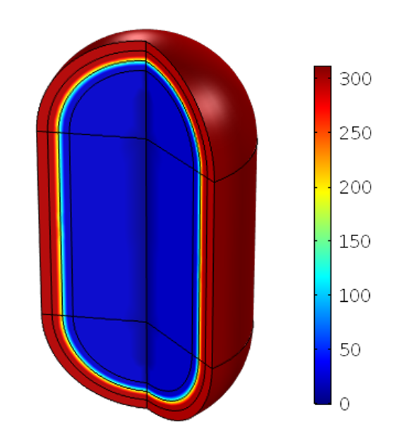
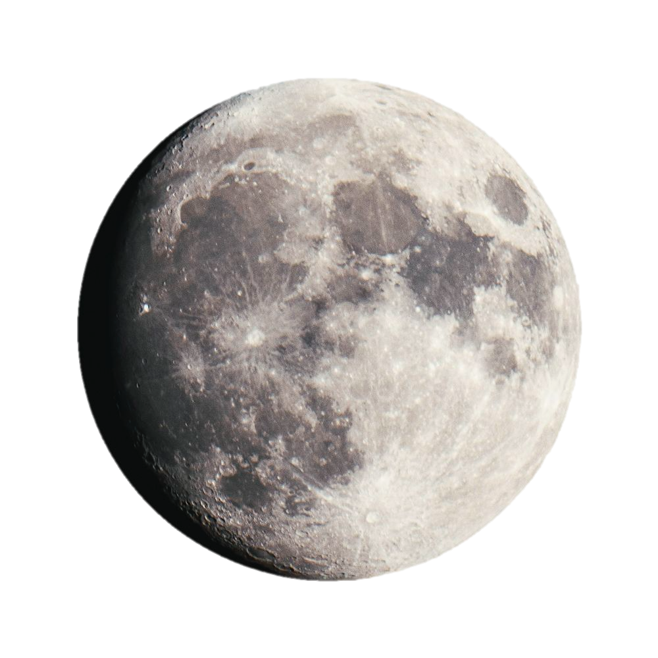
In-Space Cryogenic Propellent Storage Container
Team 512: Anna Gilliard, Liam McConnell, Samantha Myers, Brandon Young
Objective
Create a long-term storage solution for cryogenic propellent such as liquid hydrogen or liquid oxygen that will result in longer storage time under cryogenic temperature and pressure leading to the possibility of longer missions.
Boil off
MLI
Targets and Metrics
Key Goals
Withstand 6 Gs of force
Maintain fuel temperature
Cross section
of the tank wall
Maintain structural integrity for 14 days
Maintain pressure
Maintain a pressure of 80-90 psi
Reduce heat transfer
Reduce fuel loss
Allow a maximum of 10 kJ of energy per day into system
Develop a prototype
Inner layer of tank
Outer layer of tank
Kelvin
Material: 316 Steel
Pressure: 80-90 psi
Temperature: 77.8 K (nitrogen)
Insulation: Multi-Layer with vacuum
Outer surface: Reflective layer
350
300
250
200
150
100
50
Order parts
Assemble prototype
Begin testing
Analyze results
Final report

Slide 3
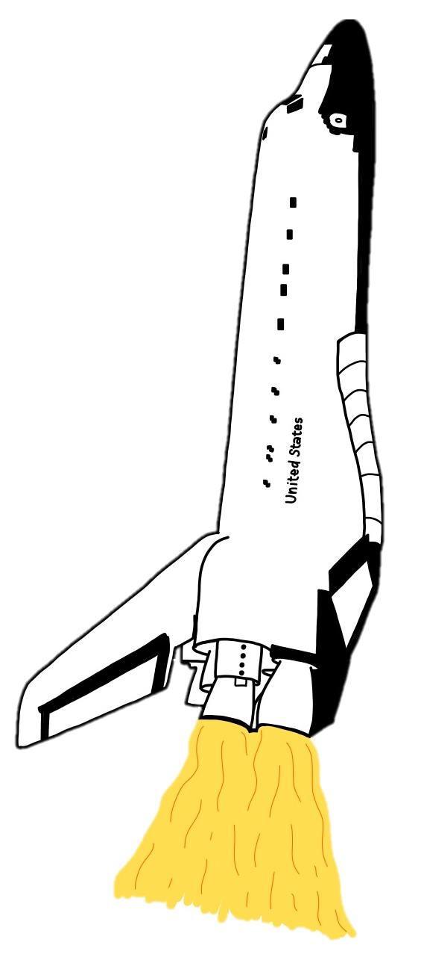

In-Space Cryogenic Propellent Storage Container
Team 512: Anna Gilliard, Liam McConnell, Samantha Myers, Brandon Young
Objective
Develop a long-term storage solution for cryogenic propellent in space, such as liquid hydrogen or liquid oxygen, that will result in longer storage time under the proper temperature and pressure, leading to the possibility of longer missions.
Key Goals
Boil off
Final Concept
MLI
FEA Model
Maintain fuel temperature | Maintain pressure Reduce heat transfer | Reduce fuel loss
Develop a prototype
Kelvin
350
Cross section
of the tank wall
300
250
200
Targets and Metrics
150
100
Withstand 6 Gs of force | Maintain structural integrity for 14 days | Allow a maximum of 10 kJ of energy per day into the system | Maintain a pressure of 80-90 psi
50
Inner layer of tank
Outer layer of tank
Material of Tank: 316 Stainless Steel
Internal Pressure Range: 80-90 psi (LN), 14.5-72.5 psi (LH₂)
Fluid Temperature: 77.8 K (LN), 20 K (LH₂)
Ambient Temperature: Earth: 293.15 K, Moon: 89.8-379.8 K
Insulation: Multi-Layer with Vacuum
Outer Surface: Reflective Layer
Order parts
Assemble prototype
Begin testing
Analyze results
Final report

Slide 4
In-Space Cryogenic Propellent Storage Container
Team 512: Anna Gilliard, Liam McConnell, Samantha Myers, Brandon Young
Objective
Develop a long-term storage solution for cryogenic propellent to maintain the fluid at proper conditions to allow for longer space missions.
Key Goals
Final Concept
FEA Model
Maintain fuel temperature | Maintain pressure Reduce heat transfer | Reduce fuel loss
Develop a prototype
Boil off
MLI
Kelvin
350
Cross section
of the tank wall
300
Targets and Metrics
250
Withstand 6 Gs of force | Maintain structural integrity for 14 days | Allow a maximum of 10 kJ of energy per day into the system
Maintain a pressure of 80-90 psi
200
150
100
Inner layer of tank
Outer layer of tank
50
Nitrogen
Hydrogen
Material of Tank: 316 Stainless Steel
Ambient Temperature: Earth: 293.15 K, Moon: 89.8-379.8 K
Insulation: Multi-Layer with Vacuum
Outer Surface: Reflective Layer
Pressure: 80-90 psi
Temperature: 77.8 K
Pressure: 14.5-72.5 psi
Temperature: 20 K
Order parts
Assemble prototype
Begin testing
Analyze results
Final report

Slide 5
In-Space Cryogenic Propellent Storage Container
Team 512: Anna Gilliard, Liam McConnell, Samantha Myers, Brandon Young
Objective
Develop a long-term storage solution for cryogenic propellent in space, such as liquid hydrogen or liquid oxygen, that will result in longer storage time under the proper temperature and pressure, leading to the possibility of longer missions.
FEA Model
Key Goals
Targets and Metrics
Kelvin
Maintain fuel temperature | Maintain pressure Reduce heat transfer | Reduce fuel loss
Develop a prototype
Withstand 6 Gs of force | Maintain structural integrity for 14 days | Allow a maximum of 10 kJ of energy per day into the system | Maintain a pressure of 80-90 psi
Boil off
Final Concept
MLI
Material of Tank: 316 Stainless Steel
Internal Pressure Range: 80-90 psi (LN), 14.5-72.5 psi (LH₂)
Fluid Temperature: 77.8 K (LN), 20 K (LH₂)
Ambient Temperature: Earth: 293.15 K, Moon: 89.8-379.8 K
Insulation: Multi-Layer with Vacuum
Outer Surface: Reflective Layer
Cross section
of the tank wall
Inner layer of tank
Outer layer of tank
Order parts
Assemble prototype
Begin testing
Analyze results
Final report

Slide 6

In-Space Cryogenic Propellent Storage Container
Team 512: Anna Gilliard, Liam McConnell, Samantha Myers, Brandon Young
Assumptions
Objective
Create a long-term storage solution for cryogenic propellent such as liquid hydrogen or liquid oxygen. A longer storage time under cryogenic temperature and pressure leads to the possibility of longer missions.
Testing with nitrogen
Tank will be utilized in space and Earth environments
Boil off
MLI
Used on a lunar mission
Key Goals
Kelvin
Maintain fuel temperature
Cross section
of the tank wall
Maintain pressure
Reduce heat transfer
Reduce fuel loss
Develop a prototype
Inner layer of tank
Outer layer of tank
Targets and Metrics
Withstand 6 Gs of force
Maintain structural integrity for 14 days
Maintain a pressure of 80-90 psi
Allow a minimum of 10 kJ of energy per day into system
Order parts
Assemble prototype
Begin testing
Analyze results
Final report

Slide 7
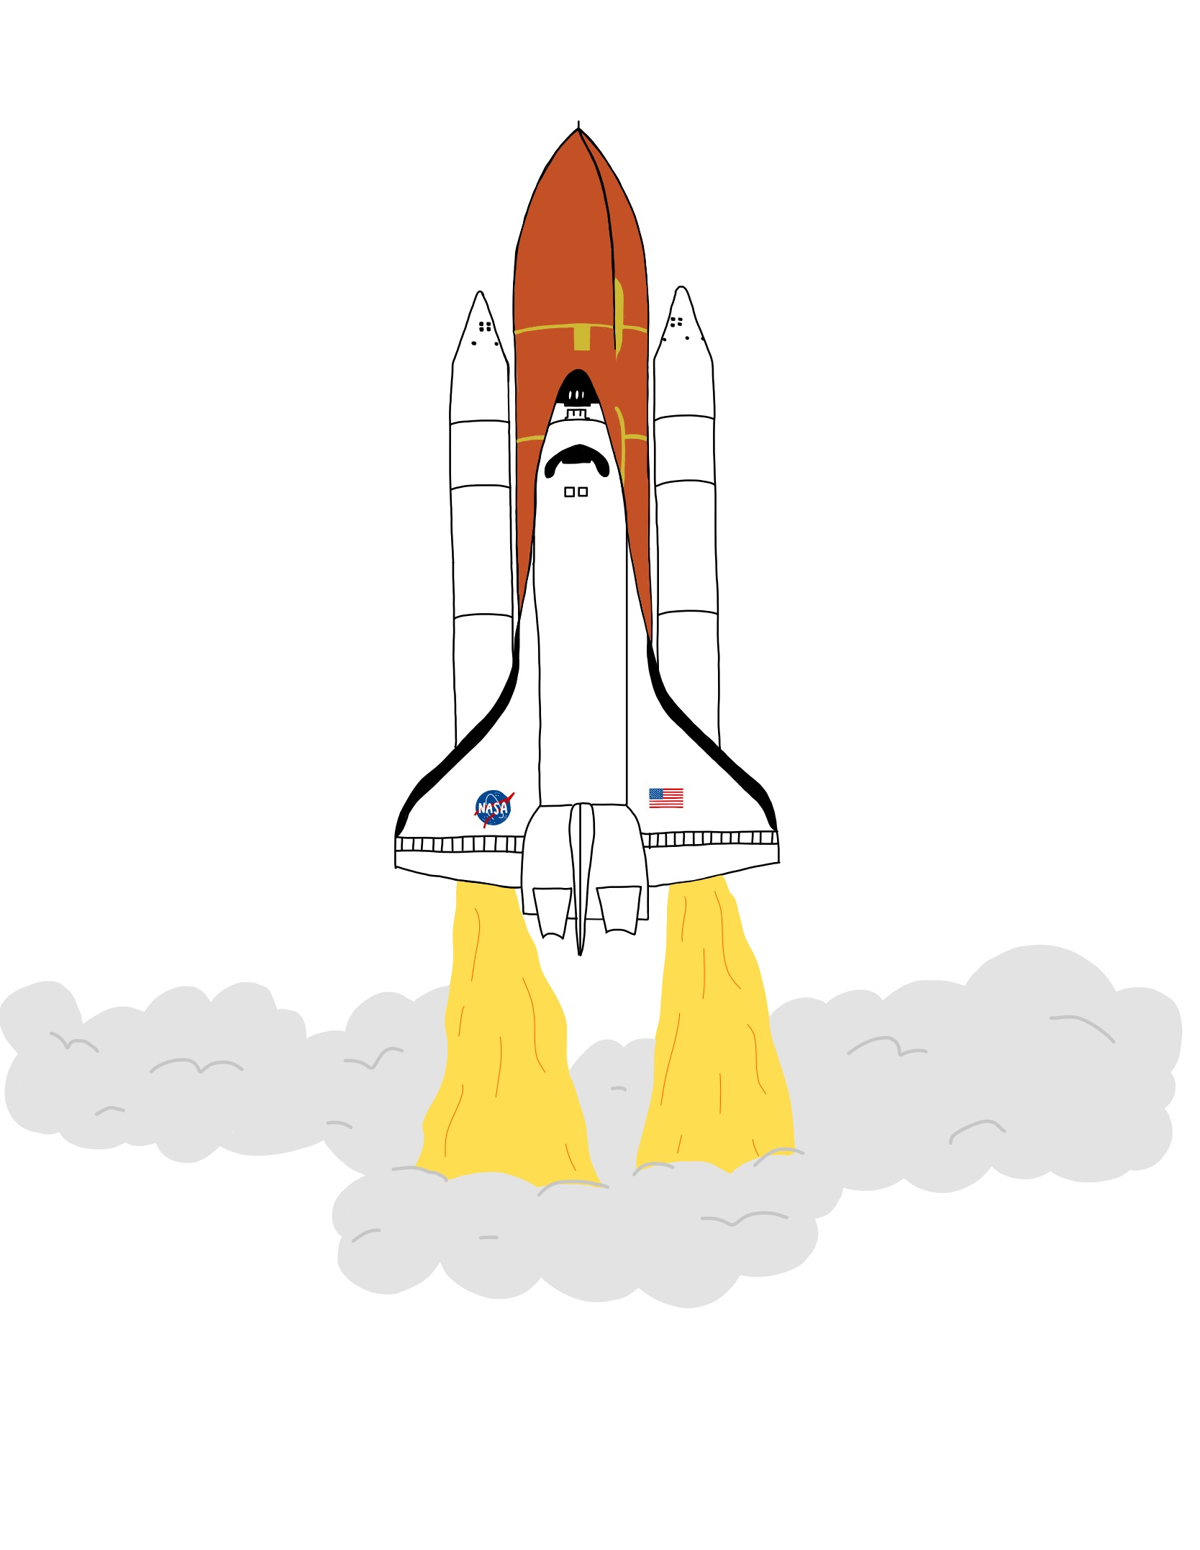
In-Space Cryogenic Propellent Storage Container
Team 512: Anna Gilliard, Liam McConnell, Samantha Myers, Brandon Young
Objective
Create a long-term storage solution for cryogenic propellent such as liquid hydrogen or liquid oxygen. A longer storage time under cryogenic temperature and pressure leads to the possibility of longer missions.
Boil off
MLI
Key Goals
Kelvin
Maintain fuel temperature
Cross section
of the tank wall
Maintain pressure
Reduce heat transfer
Reduce fuel loss
Develop a prototype
Inner layer of tank
Outer layer of tank
Targets and Metrics
Assumptions
Withstand 6 Gs of force
Testing with nitrogen
Maintain structural integrity for 14 days
Tank will be utilized in space and Earth environments
Maintain a pressure of 80-90 psi
Used on a lunar mission
Allow a minimum of 10 kJ of energy per day into system
Order parts
Assemble prototype
Begin testing
Analyze results
Final report

Slide 8
Notes
Objective stated across the top?
Pictures/figures (no 3d pie chart)
  Useless if it is too small to read
  Show don’t tell? (use arrows)
300 words more or less
Want to have a general theme in a one sentence takeaway
Use Arial font

Slide 9
This PowerPoint template is set up to make it easier to format your poster.
Final poster size is 36 inches wide by 24 inches tall. Leave a one inch white margin on all sides – the printer is not able to print to the edges. This format is set up to allow the one-inch margin.
The paper size exceeds that which most desktop printers can accommodate. If you are printing proofs, save the files as pdf and “reduce to fit” or choose to “tile” when you send the file to the printer.
It is suggested that you adopt this 4-column format for your poster presentation, but it is not required. The format allows you flexibility – you can span two or three or even four columns with photos and graphics. When you are presenting your text, following a flow from the top left to the bottom right will help your audience interpret your presentation.
Recommended fonts are Arial for headlines and accent text and Times New Roman for paragraphs. The serif font, Times New Roman, increases readability of large amounts of text.
To create the title of your poster, select the text box tool and click at the top of the poster. Click on the edge of the text box until the dotted margin appears then drag from the corner of text box until it fits from one side of the poster to the other. Type your title text here. Headline font size will be around 72 points. The subhead text box (under the title text box) with its font size around 48 points.
Save your PowerPoint poster file as a PDF and email both the PowerPoint and the PDF to MarComm Staff: trisha@eng.famu.fsu.edu, and herring@eng.famu.fsu.edu
Marketing & Communications Print Hours are:
Tuesday & Wednesday: 2pm-4pm
Thursday, 11am-3pm
Unfortunately, we can no longer allow users to bring files to us on USB flash drives due to the prevalence of malicious software. We will give you access to webmail on the PC or Mac desktop so that you can save your file to the hard drive and open to review for cross-platform, font and software version conflicts.
It takes an average of 10-15 minutes to print most 24”x 36” posters. If you have used 100% ink coverage, and/or a lot of images, it will take longer to spool and print. We recommend a white background, with no edge-to-edge background images.
DESIGN NOTE: If you are creating a poster from resources other than individual PPT slides, please re-size all images to 100% of the desired placed size before inserting, to prevent raster image processing (RIP) problems. Image resolution should be no bigger than 300dpi; 150dpi is preferred.
FYI. Use only one of the college logos provided:

Slide 10
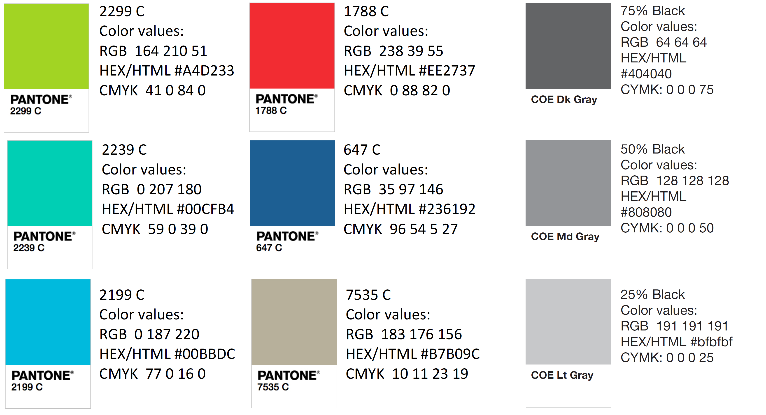
Color Palette

