Slide 1

ENVIRONMENTALLY CONTROLLED TEST CHAMBER
Nicholas Blenker | Tucker Hall | David Wilson
TEAM 503

Slide 2



Meet Team 503
Nicholas Blenker
David Wilson
Tucker Hall
Tucker Hall
Design Engineer
Controls Engineer
Systems Engineer
Nicholas Blenker

Slide 3

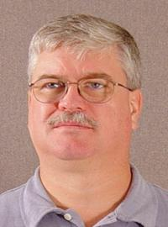
Sponsor & Advisor
William Bilbow
Keith Larson
Danfoss
FAMU-FSU College of Engineering
Nicholas Blenker

Slide 4
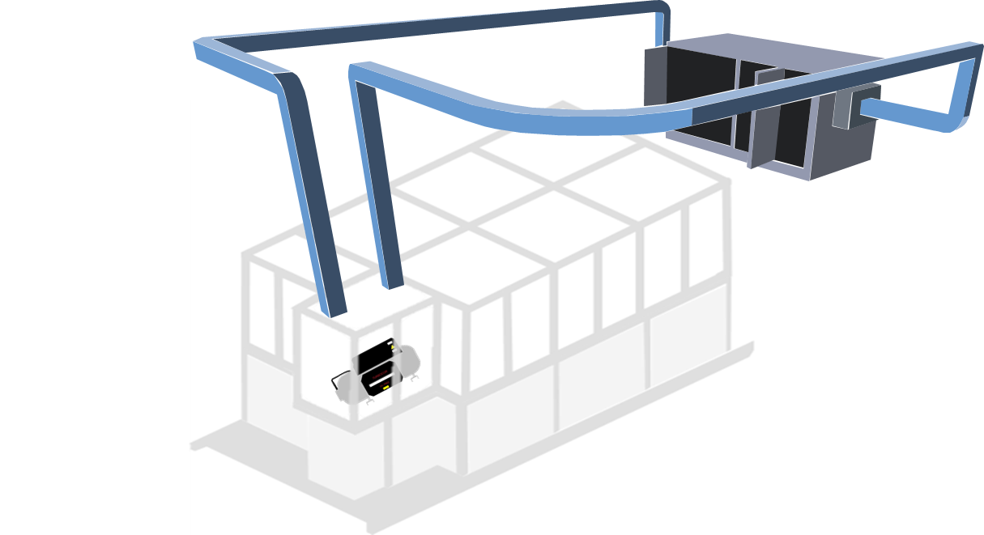
Project Objective
Validate the existing design of an environmental testing chamber and deliver an assembly that regulates its internal temperature and humidity for use in a laboratory environment.
Nicholas Blenker

Slide 5




Project Background
Project Start
2019
Covid
Created a Bill of Materials
CAD and
Calculations
Danfoss Project Approval
Nicholas Blenker

Slide 6
Covid

Slide 7
Motivation
DUCTWORK
TREATED AIR
AIR HANDLING
UNIT
RETURN AIR
CONTROL
VOLUME
CHAMBER
COMPRESSOR
Presenter

Slide 8




Assumptions
The test rig will rest on a flat and level surface
The size of the compressor is unchanging
Conductive heat from the compressor is negligible
The existing support has adequate load capacity
Nicholas Blenker

Slide 9
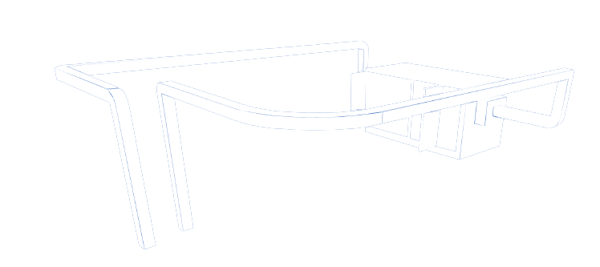



Key Goals
Validate
Finalize
Implement
Nicholas Blenker

Slide 10



Targets & Metrics
Support
Accessibility
Control
Nicholas Blenker

Slide 11





Key Targets & Metrics
Support
Function | Target | Metric
Maintain Structural Stability | 10 lbs | Weight
Support Airducts and Equipment | 5 lbs | Weight
Nicholas Blenker

Slide 12








Key Targets & Metrics
Control
Control
Function | Target | Metric
Monitor Temperature and Humidity | 1% | Temp/RH
Add & Remove Heat | 10°C ≤ T ≤ 50°C | Temperature
Increase & Decrease Humidity | 0-95% RH | Relative Humidity
Regulate Air Circulation | 1m³/min | Volumetric Flow Rate
Nicholas Blenker

Slide 13


Key Targets & Metrics
Control
Control
Function | Target | Metric
Monitor Temperature and Humidity | 1% | Temp/RH
Add & Remove Heat | 10°C ≤ T ≤ 50°C | Temperature
Increase & Decrease Humidity | 0-95% RH | Relative Humidity
Regulate Air Circulation | 1m³/min | Volumetric Flow Rate
Nicholas Blenker

Slide 14
Key Targets & Metrics
Control
Control
Function | Target | Metric
Monitor Temperature and Humidity | 1% | Temp/RH
Add & Remove Heat | 10°C ≤ T ≤ 50°C | Temperature
Increase & Decrease Humidity | 0-95% RH | Relative Humidity
Regulate Air Circulation | 1m³/min | Volumetric Flow Rate
Nicholas Blenker

Slide 15
Key Targets & Metrics
Control
Control
Function | Target | Metric
Monitor Temperature and Humidity | 1% | Temp/RH
Add & Remove Heat | 10°C ≤ T ≤ 50°C | Temperature
Increase & Decrease Humidity | 0-95% RH | Relative Humidity
Regulate Air Circulation | 1m³/min | Volumetric Flow Rate
Nicholas Blenker

Slide 16




Key Targets & Metrics
Accessibility
Function | Target | Metric
Allow Access from All Sides | 3 Sides | Accessible Sides
Enable Efficient Exchange of Compressor(s) | 15 minutes | Time
Provide Clear View of Compressor | 360° Visibility | Degrees of visibility
Adjust Temperature and Humidity | No Human Interaction | Human Interaction
Nicholas Blenker

Slide 17



Concept Generation
Brainstorm
Anti-Problem
Biomimicry
Nicholas Blenker

Slide 18

Concept Generation
AHU Placement | Duct Attachment | Infiltration Seals | Other Features
Floor-Mounted | Fixed Overhead Ducts | Puddy | Duct Dips with Valves
Wall-Mounted | Detachable Side Ducts | Rubber Inserts | Duct Close-Off
Morphological Chart
Tucker Hall

Slide 19
Concept Generation
AHU Placement | Duct Attachment | Infiltration Seals | Other Features
Floor-Mounted | Fixed Overhead Ducts | Puddy | Duct Dips with Valves
Wall-Mounted | Detachable Side Ducts | Rubber Inserts | Duct Close-Off
Morphological Chart
Tucker Hall

Slide 20
Concept Generation
AHU Placement | Duct Attachment | Infiltration Seals | Other Features
Floor-Mounted | Fixed Overhead Ducts | Puddy | Duct Dips with Valves
Wall-Mounted | Detachable Side Ducts | Rubber Inserts | Duct Close-Off
Morphological Chart
Tucker Hall

Slide 21



Concept Selection
Pairwise Comparison
Pugh
Chart
Q
S
+
-
House
of Quality
Analytical Hierarchy Chart
-
S
-
Tucker Hall

Slide 22

Concept Selection
Results
Floor-Mounted AHU with Detachable Side Ducts, Rubber Inserts, and Dips Inside Ductwork
1
1
Wall-Mounted AHU with Detachable Overhead Ducts, Puddy Seals, and Dips Inside Ductwork
2
2
1
Floor-Mounted AHU with Detachable Overhead Ducts, Rubber Inserts, and Close-Off Inside Ductwork
3
3
1
Tucker Hall

Slide 23
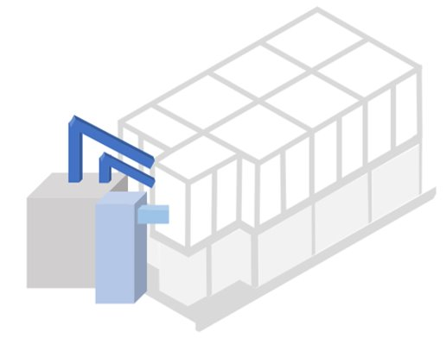
Key Changes
Screw-On Side Ducts​
1
1
29,000 BTU Chiller
2
2
Industrial Humidifier
3
3
Floor-Mounted AHU
4
4
Tucker Hall

Slide 24
Key Changes
1
1
Screw-On Side Ducts
- Easily removable
- More accessible
- Reduced length of ductwork
- Increased portability
1
Tucker Hall

Slide 25
Key Changes
2
29,000 BTU A/C
- More versatile
- Most value (power vs cost)
- Compensates for leaks &
infiltration
- Decreases time response
- Built-in ductwork
2
Tucker Hall

Slide 26
Key Changes
1
4
3
Industrial Humidifier
- Ensures 95% RH
- Large tank
- Decreases time response
- Automated control system
3
Tucker Hall

Slide 27
Key Changes
1
4
Floor-Mounted AHU
- Limited wall space
- Suggested by lab staff
- Reduced length of ductwork
- Increased portability
4
Tucker Hall

Slide 28




Proposed Materials
1 x 29,000 BTU Portable A/C
3 x Electric Strip Heaters
1 x Industrial Humidifier
4 x Humidity Sensors
4 x Temperature Sensors
1 x Arduino Mega
1 x Duct Sealant
1 x Duct Take-Off
1 x Clear Vinyl
1 x Rubber Sealing Strips
1 x Foam Sealing Strips
1 x Ambient Air Adapter
1 x Pack of Wires
1 x Fiberglass Insulation
David Wilson

Slide 29
Risk Analysis
Steps/Features
Effects
Actions
Heating Strips
Humidifying
Cooling
Controls/Wiring
David Wilson
29

Slide 30
Risk Analysis
Steps/Features
Effects
Actions
Heating Strips
Humidifying
Cooling
Controls/Wiring
Burns/Fire
Electric Shock
Equipment Failure
Property Damage
David Wilson
30

Slide 31
Risk Analysis
Steps/Features
Effects
Actions
Heating Strips
Humidifying
Cooling
Controls/Wiring
Burns/Fire
Electric Shock
Equipment Failure
Property Damage
PPE & Caging
Collection System
Electrical Tape
Float Switches
David Wilson
31

Slide 32
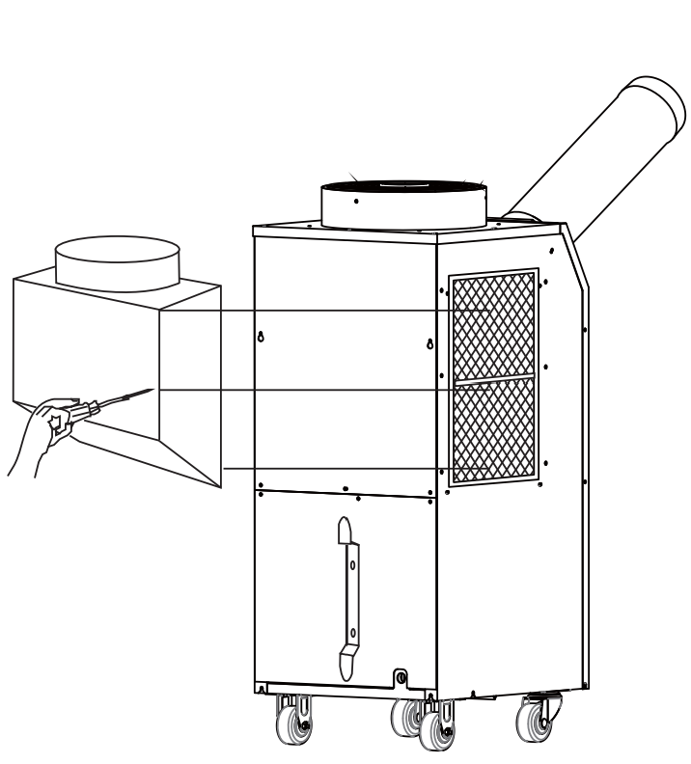
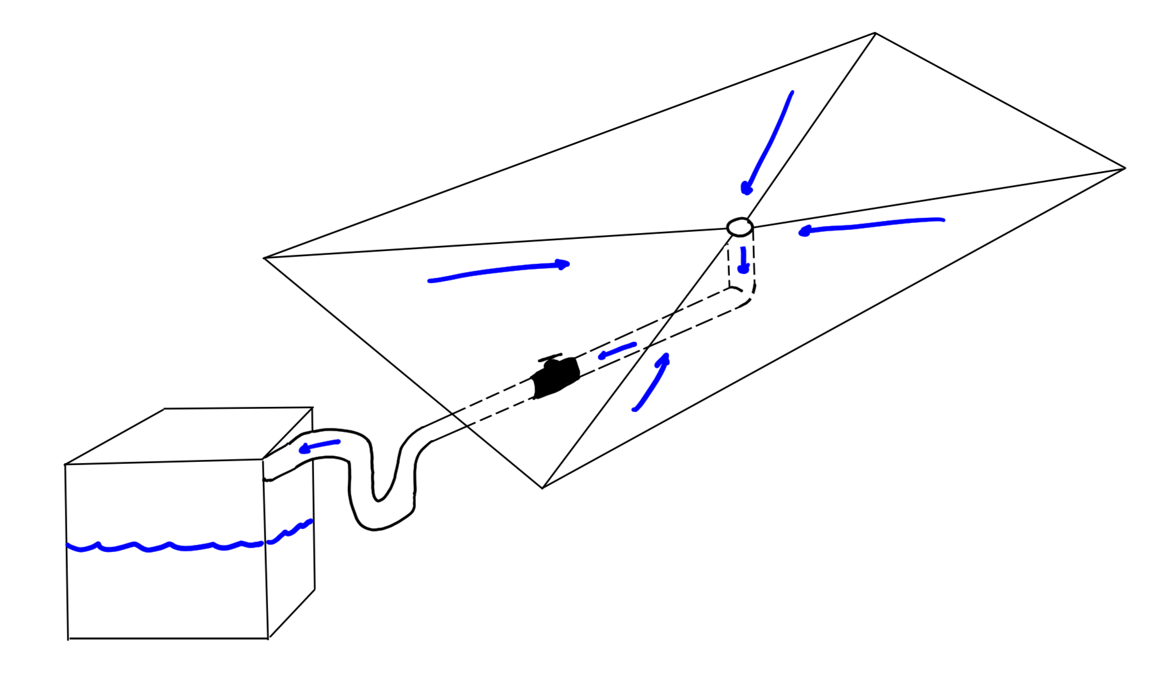
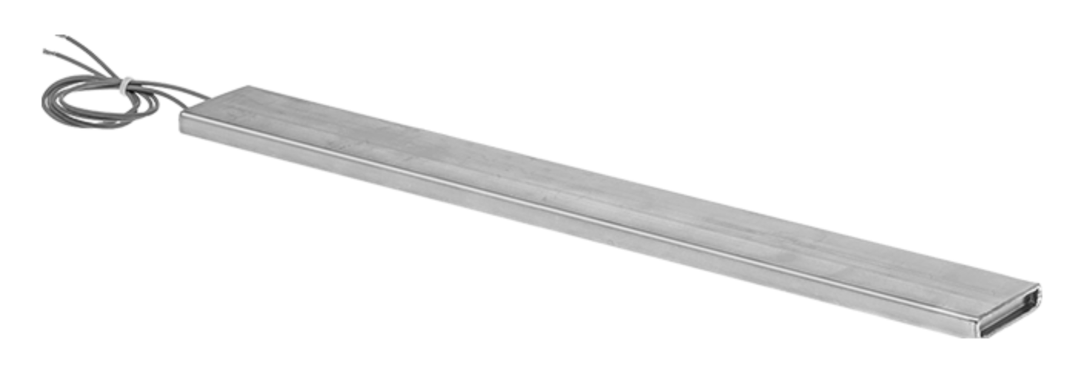
Design Changes
Air Adapter for Humidifier
Condensation Collection System
Waterproof Electric Heaters
Control Changes Over 110°F
A/C is Turned Off
Heat Vented to Cool
David Wilson
32

Slide 33

Updated Materials
1 x Industrial Humidifier
4 x Humidity Sensors
4 x Temperature Sensors
1 x 29,000 BTU Portable A/C
3 x Electric Strip Heaters
1 x Arduino Mega
1 x Duct Sealant
6 x Duct Take-Offs
1 x Clear Vinyl
1 x Rubber Sealing Strips
1 x Foam Sealing Strips
1 x Ambient Air Adapter
1 x Pack of Wires
1 x Fiberglass Insulation
1 x 16,800 BTU Portable A/C
2 x Waterproof Electric Strip Heaters
2 x Plastic Totes
1 x Circulation Pump
3 x Float Switches
1 x Tubing
1 x Plywood Base
4 x Cart Wheels
David Wilson
33

Slide 34
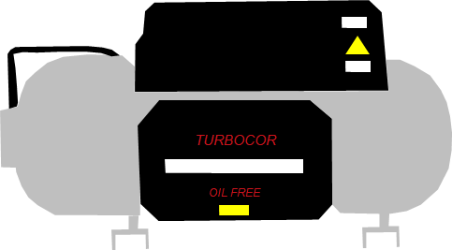

Prototype Sketch
Chamber Length: 40"
Height: 47"
Waterproof Heaters
Depth: 28"
Industrial Humidifier
Portable
Floor-Mounted
A/C Unit
Approximate Volume: 30 ft³
David Wilson
34

Slide 35

Ordered Materials
Expensive Items
A/C Unit - $2,942.55
Ambient Air Adapter - $424
Humidifier - $307.38
Approved BOM
Total Part Cost | $ 4,164.88
Total Shipping Cost | $ 97.84
Total Labor Cost | -
Total Taxes | $ 250.51
Total Cost | $ 4,513.23
Cost Budget Ratio | 90%
Total Cost $ 4,513.23
= 90%
Budget $ 5,000.00
David Wilson
35

Slide 36
Material Summary
Incidental Items
Flex Duct
Screws, Wing Nuts, Washers
Temperature Controller
Circulation Pump
P-Trap
Float Switches
Complete BOM
Total Part Cost | $ 4,428.48
Total Shipping Cost | $ 106.73
Total Labor Cost | -
Total Taxes | $ 265.71
Total Cost | $ 4,798.74
Cost Budget Ratio | 96%
COE Machine Shop
Drilling Holes in Plexiglass
Cutting Vinyl
David Wilson
36

Slide 37



Future Work
Receive Materials
Program & Tune Controls
Test Components
Oversee Installation
David Wilson

Slide 38
Timeline
Design Review 5
Engineering Design Day
(April 7th, 2022)
Receive Materials
Programming
Testing/Tuning
Incidental Materials
Implementation
Presentation
February
Today
March
April
David Wilson

Slide 39
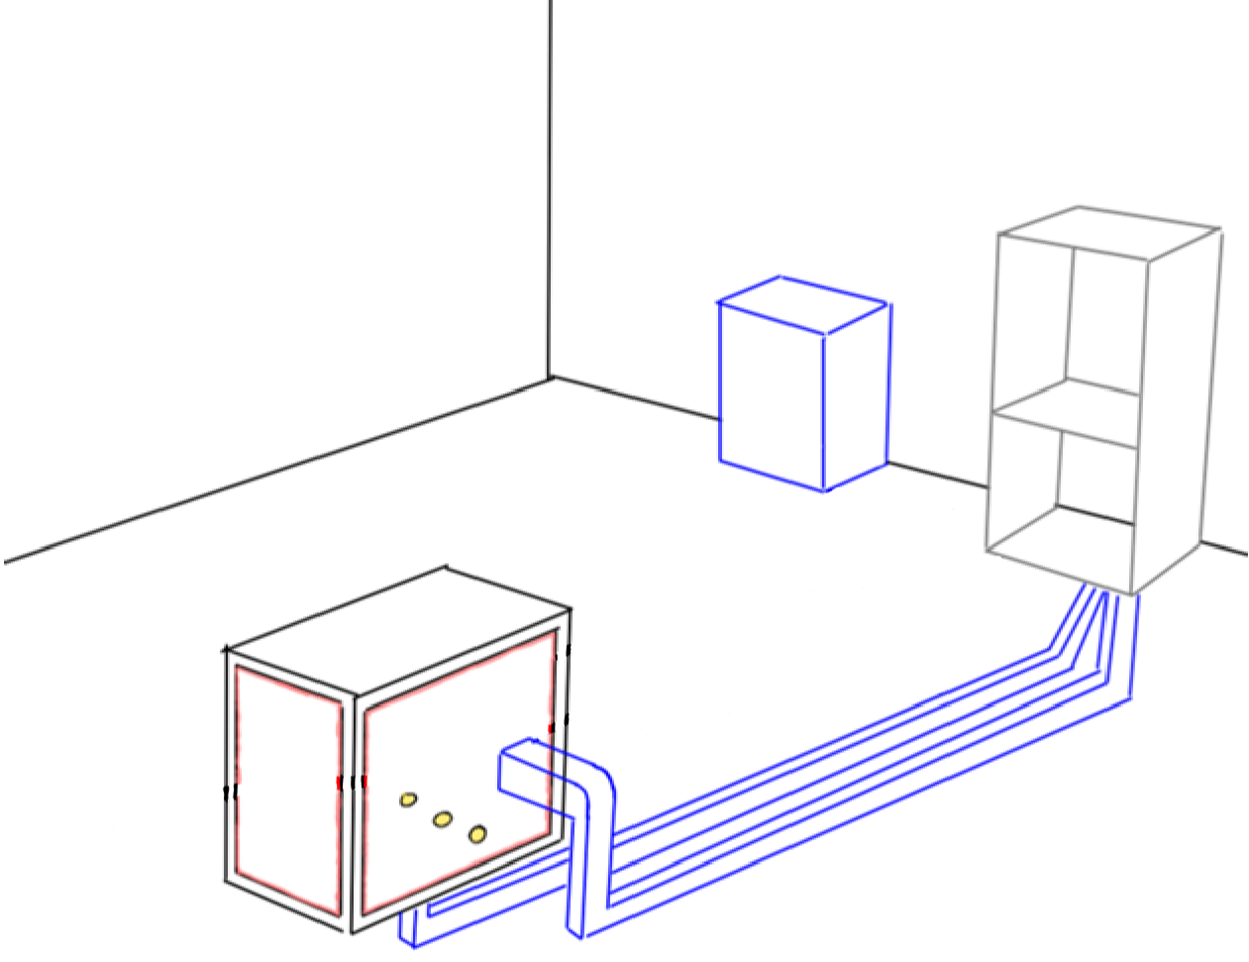


Final Selection
Floor-Mounted AHU
.
Floor-Mounted AHU
Fixed Side Ducts
Fixed Side Ducts
Rubber Inserts
Rubber Inserts
Dips Inside Ductwork
Dips Inside Ductwork
Tucker Hall

Slide 40

Final Selection
Floor-Mounted AHU
Floor-Mounted AHU
Fixed Side Ducts
Fixed Side Ducts
Rubber Inserts
Rubber Inserts
Dips Inside Ductwork
Dips Inside Ductwork
Tucker Hall

Slide 41
Final Selection
Floor-Mounted AHU
Floor-Mounted AHU
Fixed Side Ducts
Fixed Side Ducts
Rubber Inserts
Rubber Inserts
Dips Inside Ductwork
Dips Inside Ductwork
Tucker Hall

Slide 42
Final Selection
Floor-Mounted AHU
Floor-Mounted AHU
Fixed Side Ducts
Fixed Side Ducts
Rubber Inserts
Rubber Inserts
Dips Inside Ductwork
Dips Inside Ductwork
Tucker Hall

Slide 43
Concept Generation
Brainstorm
Anti-Problem
Biomimicry
Morphological Chart
Nicholas Blenker

Slide 44
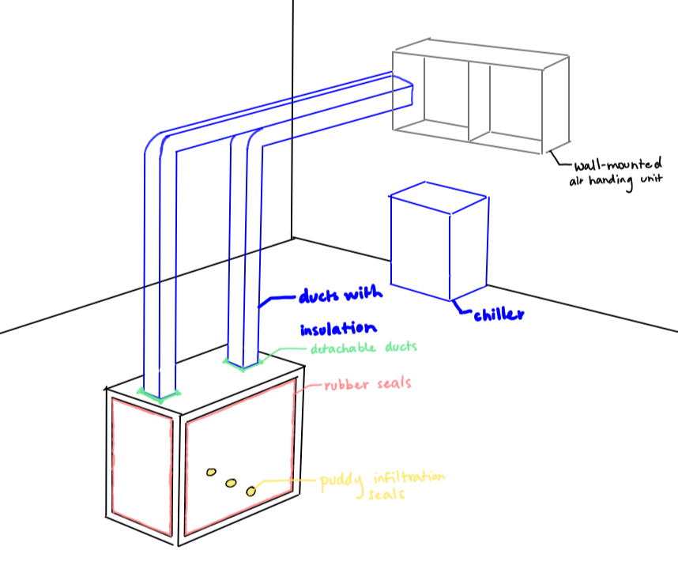
High Fidelity
Wall-Mounted AHU with Detachable
Overhead Ducts, Puddy Infiltration
Seals, and Dips Inside Ductwork
Floor-Mounted AHU with Fixed Side Ducts, Rubber Inserts, and Dips Inside Ductwork
Floor-Mounted AHU with Detachable Overhead Ducts, Rubber Inserts, and a Close-Off Inside Ductwork
Nicholas Blenker

Slide 45
High Fidelity
Wall-Mounted AHU with Detachable Overhead Ducts, Puddy Infiltration Seals, and Dips Inside Ductwork
Floor-Mounted AHU with Fixed Side
Ducts, Rubber Inserts, and Dips Inside
Ductwork
Floor-Mounted AHU with Detachable Overhead Ducts, Rubber Inserts, and a Close-Off Inside Ductwork
Nicholas Blenker

Slide 46
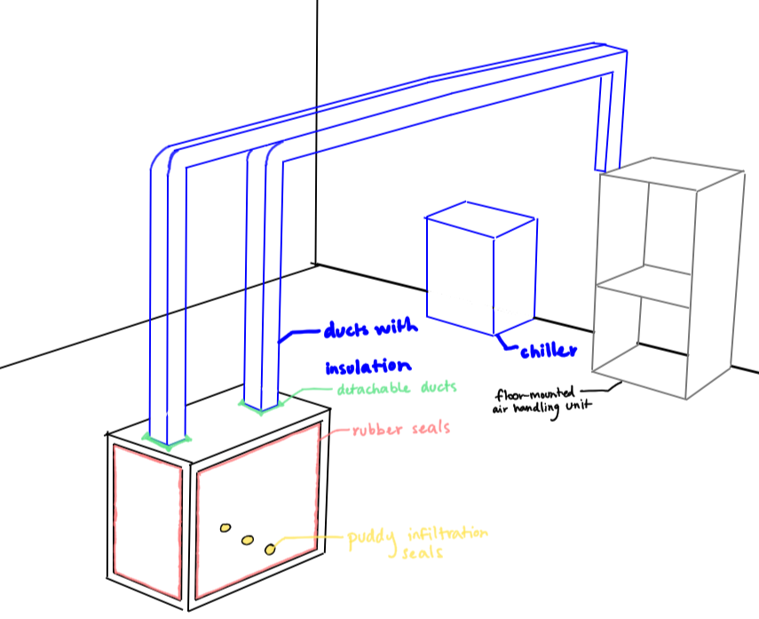
High Fidelity
Wall-Mounted AHU with Detachable Overhead Ducts, Puddy Infiltration Seals, and Dips Inside Ductwork
Floor-Mounted AHU with Detachable Side Ducts, Rubber Inserts, and Dips Inside Ductwork
Floor-Mounted AHU with Detachable
Overhead Ducts, Rubber Inserts, and a
Close-Off Inside Ductwork
Nicholas Blenker

Slide 47
Key Targets & Metrics
Control
Control
Function | Target | Metric
Monitor Temperature and Humidity | 1% | Temp/RH
Add & Remove Heat | 10°C ≤ T ≤ 50°C | Temperature
Increase & Decrease Humidity | 0-95% RH | Relative Humidity
Regulate Air Circulation | 1m³/min | Volumetric Flow Rate
Nicholas Blenker

Slide 48

Key Targets & Metrics
Accessibility
Function | Target | Metric
Allow Access from All Sides | 3 Sides | Accessible Sides
Enable Efficient Exchange of Compressor(s) | 15 minutes | Time
Provide Clear View of Compressor | 360° Visibility | Degrees of visibility
Adjust Temperature and Humidity | No Human Interaction | Human Interaction
Nicholas Blenker

Slide 49
Risk Analysis
Step/Feature Investigated | Potential Failure Mode | Potential Failure Effects | Potential Causes | Current Controls | Action(s) Taken
Electric Heating Strips | Accidental Contact | Burns | User Error | Warning Label | Added Caging
 | Getting Wet | Electric Shock, Equipment Failure | Condensation Buildup, Lack of Collection | Elevated Stands | PPE, Added Collection System
 | Fire | Burns, Equipment & Property Damage | Short Circuit | Insulated Wiring, Temperature Sensors | Added Electrical Tape
David Wilson
49

Slide 50
Risk Analysis
Step/Feature Investigated | Potential Failure Mode | Potential Failure Effects | Potential Causes | Current Controls | Action(s) Taken
Humidifying | Condensation Pooling | Electric Shock, Equipment Failure | Condensation Buildup, Lack of Collection | Foam Padding, Sensors | PPE, Collection System, Float Switch
Cooling | Ambient conditions above 113°F | Equipment Failure | Overheating, Failure to Cut Off | Arduino Control | Decreased Cut-Off Temperature
Controls/Wiring | Gets wet | Fire, Equipment Failure | Poor Connections, Condensation | Insulated Wiring, Temperature Sensors | Added Electrical Tape
David Wilson
50

Slide 51
Key Changes
Screw-On Side Ducts​
1
Screw-On Side Ducts
- Easily removable
- More accessible
- Reduced length of ductwork
- Increased portability
3
Industrial Humidifier
- Ensures 95% RH
- Large tank
- Decreases time response
- Automated control system
4
29,000 BTU A/C
- More versatile
- Most value (power vs cost)
- Compensates for leaks &
infiltration
- Decreases time response
- Built-in ductwork
2
Floor-Mounted AHU
- Limited wall space
- Suggested by lab staff
- Reduced length of ductwork
- Increased portability
1
1
29,000 BTU Chiller
2
2
Industrial Humidifier
3
3
Floor-Mounted AHU
4
4
Tucker Hall

Slide 52



ENVIRONMENTALLY CONTROLLED TEST CHAMBER
Nicholas Blenker
njb17@my.fsu.edu
Tucker Hall
tdh16c@my.fsu.edu
David Wilson
dhw18@my.fsu.edu
TEAM 503

Slide 53
References

Slide 54
Concept Selection
Engineering Characteristics
Provide Support
Regulate Air Circ.
Change Temp. & Humidity
Provide Access
Display
Conditions
Automate Control
Provide Visibility
Provide Clearance
Monitor
Conditions
Tucker Hall

Slide 55
Concept Selection
Engineering Characteristics
Change Temp. & Humidity
1
2
House of Quality
Automate Control
3
Monitor
Conditions
Provide Access
4
Pairwise Comparison
Regulate Air Circ.
5
Tucker Hall

Slide 56

Concept Selection
Change Temp. & Humidity
1
2
Automate Control
Pugh Chart
Winning Design
3
Monitor
Conditions
Provide Access
4
Analytical Hierarchy
Regulate Air Circ.
5
Tucker Hall

Slide 57
Key Changes
Things That Have Changed
Wall-Mounted AHU
Floor-Mounted AHU
Crane Outside Chamber
Crane Inside Chamber
Could use interior plexiglass
Cannot use interior
plexiglass
Visit to Danfoss
Communication with Lab Staff
David Wilson

Slide 58

Key Targets & Metrics
Function | Target | Metric
Maintain Structural Stability | 0% | Deformation
Support Airducts and Equipment | 5 lbs | Weight
Monitor Temperature and Humidity | 1°C
Add & Remove Heat | 10°C ≤ T ≤ 50°C | Temperature
Increase & Decrease Humidity | 0-95% RH | Relative Humidity
Regulate Air Circulation | 1m³/min | Volumetric Flow Rate
Allow Access from All Sides | 3 Sides | Accessible Sides
Enable Efficient Exchange of Compressor(s) | 15 minutes | Time
Provide Clear View of Compressor | 360° Visibility | Degrees of visibility
Adjust Temperature and Humidity | No Human Interaction | Human Interaction
Support
Control
Accessibility
Nicholas Blenker

Slide 59
Concept Selection
Engineering Characteristics
Pairwise Comparison
House of Quality
Pairwise Comparison
Change Temp
& Humidity
Change Temp
& Humidity
1
1
Automate
Control
Automate
Control
2
2
Monitor
Conditions
Monitor
Conditions
3
3
Provide
Clearance
Display
Conditions
4
4
Provide
Access
Provide
Access
5
5
Regulate Air
Circulation
Regulate Air
Circulation
6
6
Provide
Visibility
Provide
Clearance
7
7
Provide
Support
Provide
Visibility
8
8
Display
Conditions
Provide
Support
9
9
David Wilson

Slide 60
Concept Selection
Engineering Characteristics
Pairwise Comparison
House of Quality
Pairwise Comparison
Change Temp
& Humidity
Change Temp
& Humidity
1
1
Automate
Control
Automate
Control
2
2
Monitor
Conditions
Monitor
Conditions
3
3
Provide
Clearance
Display
Conditions
4
4
Provide
Access
Provide
Access
5
5
Regulate Air
Circulation
Regulate Air
Circulation
6
6
Provide
Visibility
Provide
Clearance
7
7
Provide
Support
Provide
Visibility
8
8
Display
Conditions
Provide
Support
9
9
David Wilson

Slide 61
Concept Selection
Engineering Characteristics
Pairwise Comparison
House of Quality
Pairwise Comparison
Change Temp
& Humidity
Change Temp
& Humidity
1
1
Automate
Control
Automate
Control
2
2
Monitor
Conditions
Monitor
Conditions
3
3
Provide
Clearance
Display
Conditions
4
4
Provide
Access
Provide
Access
5
5
Regulate Air
Circulation
Regulate Air
Circulation
6
6
Provide
Visibility
Provide
Clearance
7
7
Provide
Support
Provide
Visibility
8
8
Display
Conditions
Provide
Support
9
9
David Wilson

Slide 62
Concept Selection
Pairwise Comparison
Pugh Chart
2
1
3
VS
8 Concepts
4
5
Existing Design
6
7
8
6
VS
Top 3
7
1
Least Polarizing
8
7: Floor-Mounted AHU with
Detachable Overhead Ducts, Rubber
Inserts, and a Close-Off Inside Ductwork
Winning Design
David Wilson

Slide 63
Concept Selection
Pairwise Comparison
Pugh Chart
2
1
3
VS
8 Concepts
4
5
Existing Design
6
7
8
6
VS
Top 3
7
1
Least Polarizing
8
7: Floor-Mounted AHU with
Detachable Overhead Ducts, Rubber
Inserts, and a Close-Off Inside Ductwork
Winning Design
David Wilson

Slide 64
Concept Selection
Pairwise Comparison
Pugh Chart
2
1
3
VS
8 Concepts
4
5
Existing Design
6
7
8
6
VS
Top 3
7
1
Least Polarizing
8
Floor-Mounted AHU with Fixed Side Ducts, Rubber Inserts, and Dips Inside Ductwork
Winning Design
David Wilson

Slide 65
Risk Analysis
Step/Feature Investigated | Potential Failure Mode | Potential Failure Effects | Potential Causes | Current Controls | Action(s) Taken
Electric Heating Strips | Accidental Contact | Burns | User Error | Warning Label | Added Caging
 | Getting Wet | Electric Shock, Equipment Failure | Condensation Buildup, Lack of Collection | Elevated Stands | PPE, Added Collection System
 | Fire | Burns, Equipment & Property Damage | Short Circuit | Insulated Wiring, Temperature Sensors | Added Electrical Tape
65

Slide 66
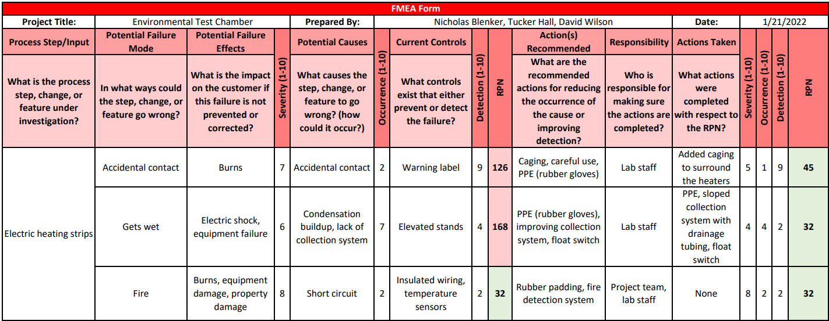
Risk Analysis
66

Slide 67
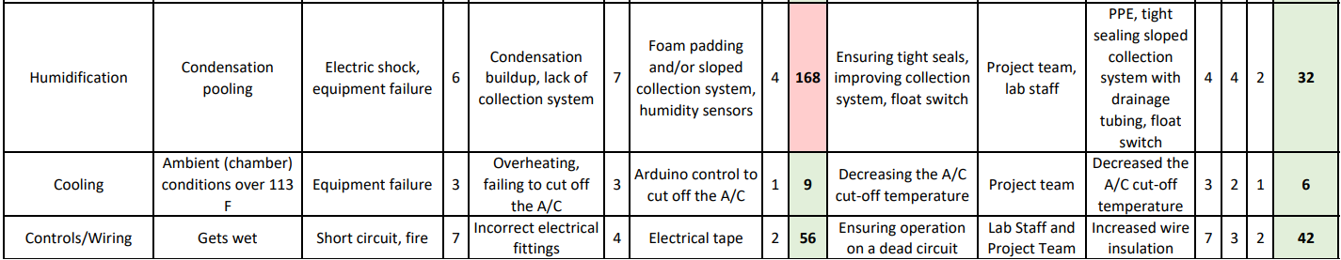
Risk Analysis
67

Slide 68
Risk Analysis
68

Slide 69
Risk Analysis
69

Slide 70
Functional Decomposition
Accessibility
Support
Control
Presenter

Slide 71
Functional Decomposition
Environmentally Controlled Testing Chamber
Support
Control
Accessibility
Maintains Climate Stability
Control Temperature
Maintains Structural Stability
Support Airducts and Equipment
Control Humidity
Chamber
Climate Control
Presenter

Slide 72
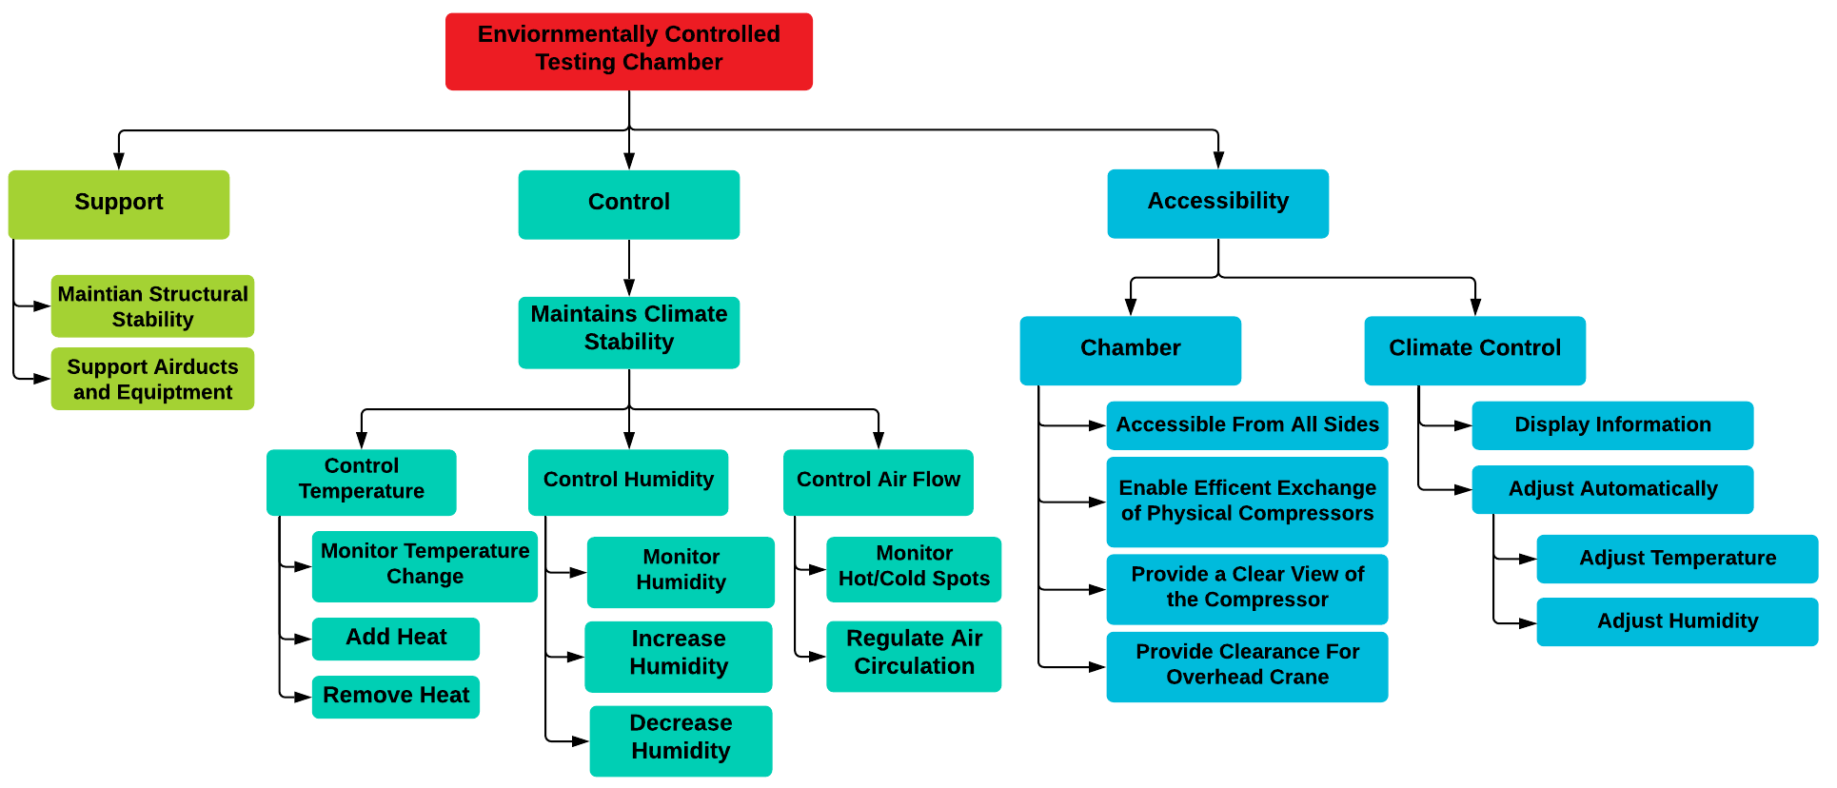
Functional Decomposition
Presenter

Slide 73


Key Goals – SAE Standards
Presenter

Slide 74
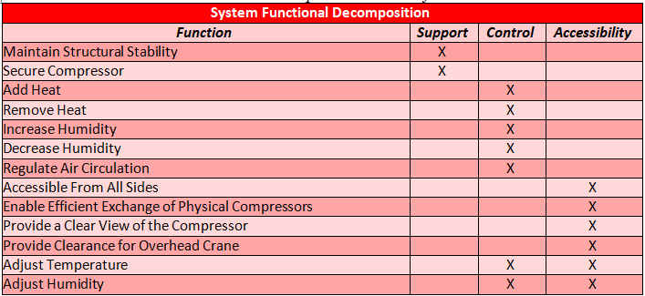
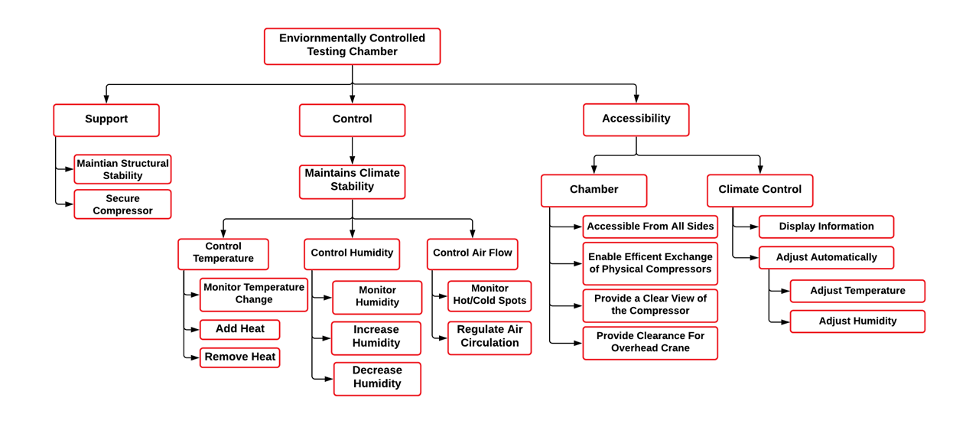
Functional Decomposition
Cross Reference Chart
Hierarchy Flow Chart
Presenter

Slide 75

Targets & Metrics
Support
Function | Target | Metric
Maintain Structural Stability | 0% | Deformation
Support Airducts and Equipment | 5 lbs | Weight
Nicholas Blenker

Slide 76




Targets & Metrics
Control
Function | Target | Metric
Monitor Temperature | 1°C | Temperature
Monitor Humidity
Add Heat | 10°C ≤ T ≤ 50°C | Temperature
Remove Heat
Increase Humidity | 0-95% RH | Relative Humidity
Decrease Humidity
Monitor Hot & Cold Spots | 3 sensors | Sensors
Regulate Air Circulation | 1m³/min | Volumetric Flow Rate
10°C
50°C
0%
95%
Nicholas Blenker

Slide 77
Targets & Metrics
Control
Function | Target | Metric
Monitor Temperature | 1°C | Temperature
Monitor Humidity
Add Heat | 10°C ≤ T ≤ 50°C | Temperature
Remove Heat
Increase Humidity | 0-95% RH | Relative Humidity
Decrease Humidity
Monitor Hot & Cold Spots | 3 sensors | Sensors
Regulate Air Circulation | 1m³/min | Volumetric Flow Rate
Nicholas Blenker

Slide 78
Targets & Metrics
Control
Function | Target | Metric
Monitor Temperature | 1°C | Temperature
Monitor Humidity
Add Heat | 10°C ≤ T ≤ 50°C | Temperature
Remove Heat
Increase Humidity | 0-95% RH | Relative Humidity
Decrease Humidity
Monitor Hot & Cold Spots | 3 sensors | Sensors
Regulate Air Circulation | 1m³/min | Volumetric Flow Rate
Nicholas Blenker

Slide 79
Targets & Metrics
Accessibility
Function | Target | Metric
Allow access from all sides | 3 sides | Accessible Sides
Enable efficient exchange of compressor | 15 minutes | Time
Provide clear view of the compressor | 360° visibility | Degrees of Visibility
Provide clearance for overhead crane | 30 cm | Distance
Display Information | Yes | Display
Adjust Temperature | No human interaction | Human Interaction
Adjust Humidity
Nicholas Blenker

Slide 80


Targets & Metrics
Accessibility
Function | Target | Metric
Allow access from all sides | 3 sides | Accessible Sides
Enable efficient exchange of compressor | 15 minutes | Time
Provide clear view of the compressor | 360° visibility | Degrees of Visibility
Provide clearance for overhead crane | 30 cm | Distance
Display Information | Yes | Display
Adjust Temperature | No human interaction | Human Interaction
Adjust Humidity
Nicholas Blenker

Slide 81

Targets & Metrics
Accessibility
Function | Target | Metric
Allow access from all sides | 3 sides | Accessible Sides
Enable efficient exchange of compressor | 15 minutes | Time
Provide clear view of the compressor | 360° visibility | Degrees of Visibility
Provide clearance for overhead crane | 30 cm | Distance
Display Information | Yes | Display
Adjust Temperature | No human interaction | Human Interaction
Adjust Humidity
25%
40°C
10°C
50°C
0%
95%
Nicholas Blenker

Slide 82
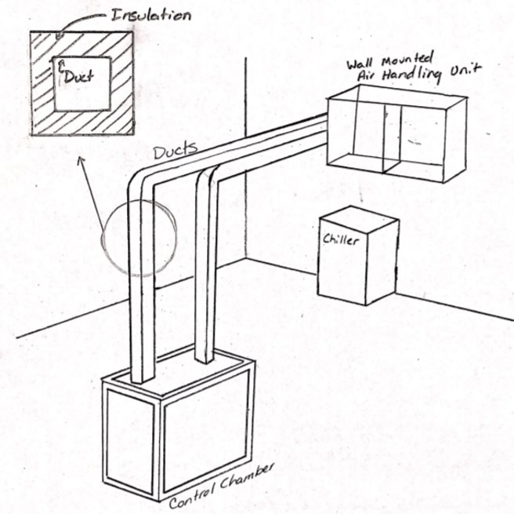
Medium Fidelity
Wall-Mounted AHU with Duct Insulation
Wall-Mounted AHU with Increased Wall Thickness
Wall-Mounted AHU with Heater Inside Duct
Wall-Mounted AHU with Hotplate and Water Dropper Humidifier
Wall-Mounted AHU with Vein-Like Inner Chamber Surface
Nicholas Blenker

Slide 83
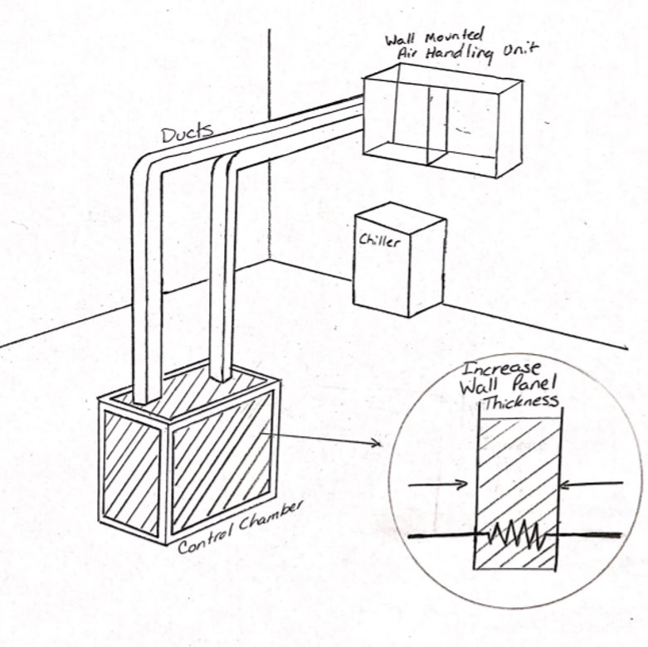
Medium Fidelity
Wall-Mounted AHU with Duct Insulation
Wall-Mounted AHU with Increased Wall
Thickness
Wall-Mounted AHU with Heater Inside Duct
Wall-Mounted AHU with Hotplate and Water Dropper Humidifier
Wall-Mounted AHU with Vein-Like Inner Chamber Surface
Nicholas Blenker

Slide 84
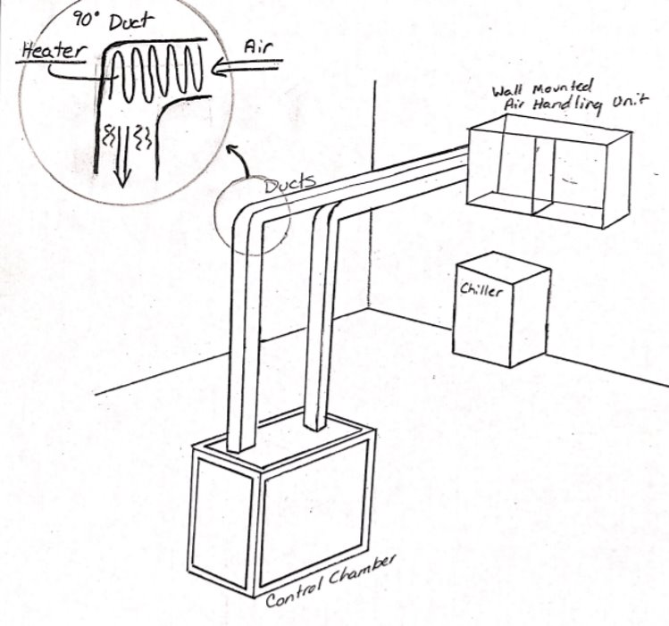
Medium Fidelity
Wall-Mounted AHU with Duct Insulation
Wall-Mounted AHU with Increased Wall Thickness
Wall-Mounted AHU with Heater Inside
Duct
Wall-Mounted AHU with Hotplate and Water Dropper Humidifier
Wall-Mounted AHU with Vein-Like Inner Chamber Surface
Nicholas Blenker

Slide 85
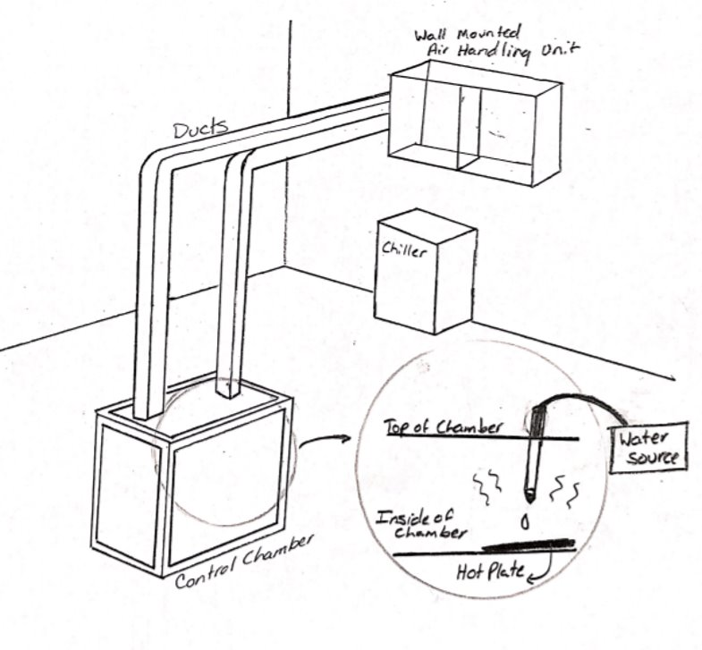
Medium Fidelity
Wall-Mounted AHU with Duct Insulation
Wall-Mounted AHU with Increased Wall Thickness
Wall-Mounted AHU with Heater Inside Duct
Wall-Mounted AHU with Hotplate and
Water Dropper Humidifier
Wall-Mounted AHU with Vein-Like Inner Chamber Surface
Nicholas Blenker

Slide 86
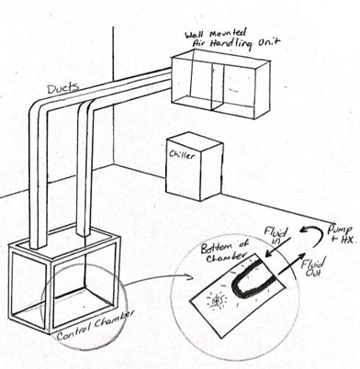
Medium Fidelity
Wall-Mounted AHU with Duct Insulation
Wall-Mounted AHU with Increased Wall Thickness
Wall-Mounted AHU with Heater Inside Duct
Wall-Mounted AHU with Hotplate and Water Dropper Humidifier
Wall-Mounted AHU with Vein-Like
Chamber Surface
Nicholas Blenker

Slide 87
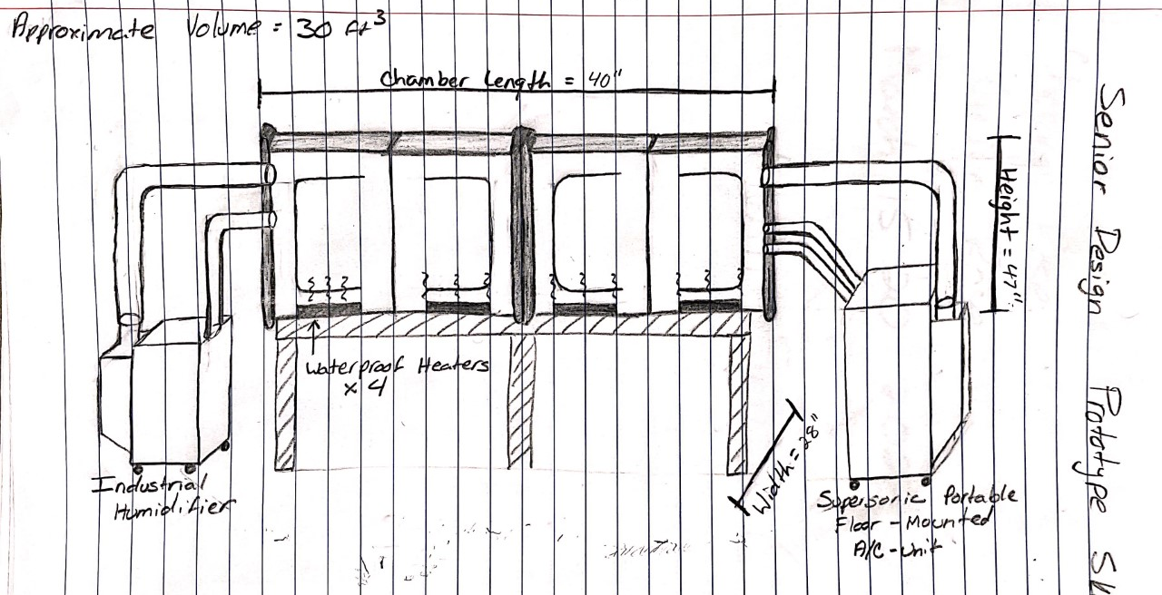
Should we also try to add the
condensation bit?
Prototype Sketch
Approximate Volume: 30 ft^3
Chamber Length: 40 inches
Height: 47 inches
Waterproof Heaters x4
Width: 28 inches
Industrial Humidifier
Supersonic Portable Floor – Mounted
A/C - Unit
David Wilson
87

Slide 88
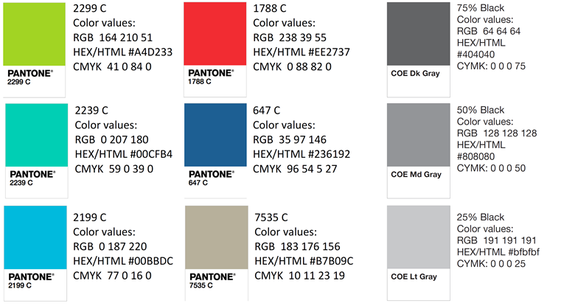
Color Palette
(FAMU not UM)

Slide 89







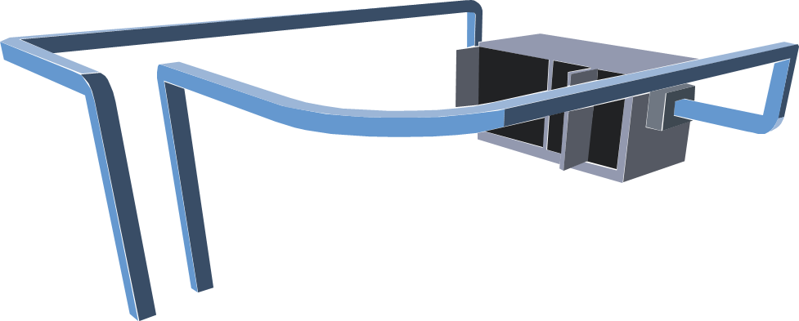

Team 503 Icons

Slide 90
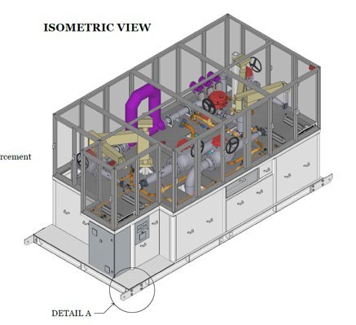
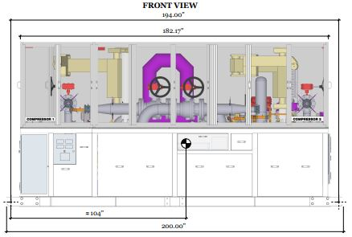
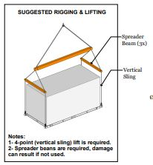
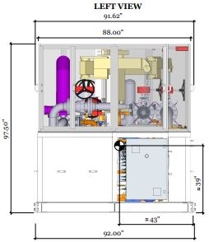
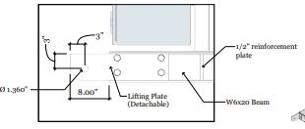
Views of Chamber

Slide 91





Logos

Slide 92
Tool kit
Summary Box
Text box 1
Outlined Text box

Slide 93
APA Tables
Category 1 | Category 2 | Category 3 | Category 4 | Category 5
Item 1
Item 2
Item 3
Item 4
 | Category 2 |  | Category 3
Category 1 | subcategory 1 | subcategory 2 | subcategory 3 | subcategory 4
Item 1
Item 2
Item 3
Item 4

