Slide 1
ENVIRONMENTALLY CONTROLLED TEST CHAMBER
Nicholas Blenker | Tucker Hall | David Wilson
TEAM 503

Slide 2
Meet Team 503
Nicholas Blenker
Tucker Hall
David Wilson
Tucker Hall
Design Engineer
Systems Engineer
Controls Engineer
Team 503

Slide 3
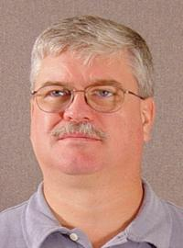
Sponsor & Advisor
William Bilbow
Keith Larson
Danfoss
FAMU-FSU College of Engineering
Nicholas Blenker

Slide 4
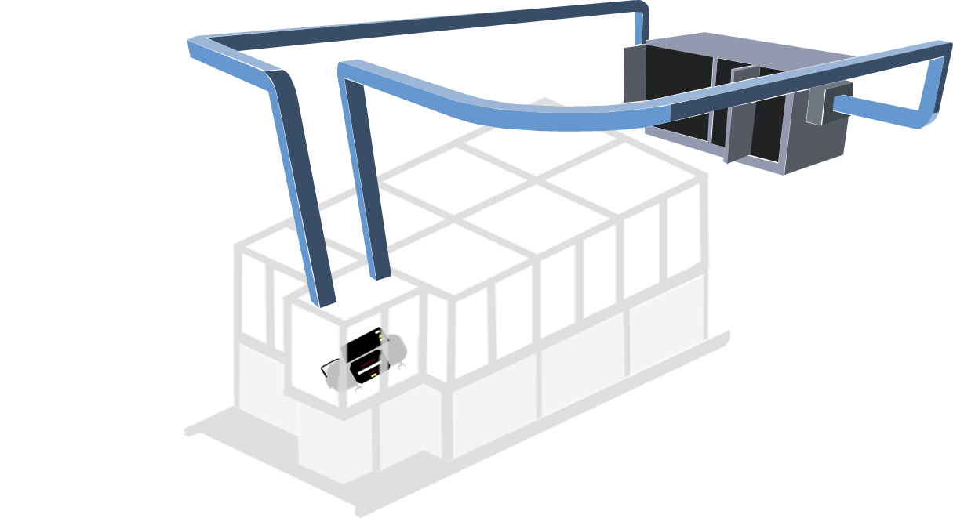
Project Objective
Validate the existing design of an environmental testing chamber and deliver an assembly that regulates its internal temperature and humidity for use in a laboratory environment
Nicholas Blenker

Slide 5
Project Background
Project Start
2019
Created a Bill of Materials
CAD and
Calculations
Danfoss Project Approval
Nicholas Blenker

Slide 6
Motivation
DUCTWORK
TREATED AIR
AIR HANDLING
UNIT
RETURN AIR
CONTROL
VOLUME
CHAMBER
COMPRESSOR
Nicholas Blenker

Slide 7
Assumptions
The test rig will rest on a flat and level surface
The size of the compressor is unchanging
Conductive heat from the compressor is negligible
The existing support has adequate load capacity
Nicholas Blenker

Slide 8
Key Goals
Validate
Finalize
Implement
Nicholas Blenker

Slide 9
Targets & Metrics
Support
Accessibility
Control
Nicholas Blenker

Slide 10
Targets & Metrics
Support
Function | Target | Metric
Maintain Structural Stability | 0% | Deformation
Support Airducts and Equipment | 5 lbs | Weight
Nicholas Blenker

Slide 11
Targets & Metrics
Control
Function | Target | Metric
Monitor Temperature | 1°C | Temperature
Monitor Humidity
Add Heat | 10°C ≤ T ≤ 50°C | Temperature
Remove Heat
Increase Humidity | 0-95% RH | Relative Humidity
Decrease Humidity
Monitor Hot & Cold Spots | 3 sensors | Sensors
Regulate Air Circulation | 1m³/min | Volumetric Flow Rate
10°C
50°C
0%
95%
Nicholas Blenker

Slide 12
Targets & Metrics
Control
Function | Target | Metric
Monitor Temperature | 1°C | Temperature
Monitor Humidity
Add Heat | 10°C ≤ T ≤ 50°C | Temperature
Remove Heat
Increase Humidity | 0-95% RH | Relative Humidity
Decrease Humidity
Monitor Hot & Cold Spots | 3 sensors | Sensors
Regulate Air Circulation | 1m³/min | Volumetric Flow Rate
Nicholas Blenker

Slide 13
Targets & Metrics
Control
Function | Target | Metric
Monitor Temperature | 1°C | Temperature
Monitor Humidity
Add Heat | 10°C ≤ T ≤ 50°C | Temperature
Remove Heat
Increase Humidity | 0-95% RH | Relative Humidity
Decrease Humidity
Monitor Hot & Cold Spots | 3 sensors | Sensors
Regulate Air Circulation | 1m³/min | Volumetric Flow Rate
Nicholas Blenker

Slide 14
Targets & Metrics
Accessibility
Function | Target | Metric
Allow access from all sides | 3 sides | Accessible Sides
Enable efficient exchange of compressor | 15 minutes | Time
Provide clear view of the compressor | 360° visibility | Degrees of Visibility
Provide clearance for overhead crane | 30 cm | Distance
Display Information | Yes | Display
Adjust Temperature | No human interaction | Human Interaction
Adjust Humidity
Nicholas Blenker

Slide 15
Targets & Metrics
Accessibility
Function | Target | Metric
Allow access from all sides | 3 sides | Accessible Sides
Enable efficient exchange of compressor | 15 minutes | Time
Provide clear view of the compressor | 360° visibility | Degrees of Visibility
Provide clearance for overhead crane | 30 cm | Distance
Display Information | Yes | Display
Adjust Temperature | No human interaction | Human Interaction
Adjust Humidity
Nicholas Blenker

Slide 16
Targets & Metrics
Accessibility
Function | Target | Metric
Allow access from all sides | 3 sides | Accessible Sides
Enable efficient exchange of compressor | 15 minutes | Time
Provide clear view of the compressor | 360° visibility | Degrees of Visibility
Provide clearance for overhead crane | 30 cm | Distance
Display Information | Yes | Display
Adjust Temperature | No human interaction | Human Interaction
Adjust Humidity
25%
40°C
10°C
50°C
0%
95%
Nicholas Blenker

Slide 17
Concept Generation
Brainstorm
Anti-Problem
Biomimicry
Morphological Chart
Nicholas Blenker

Slide 18
Medium Fidelity
Wall-Mounted AHU with Duct Insulation
Wall-Mounted AHU with Increased Wall Thickness
Wall-Mounted AHU with Heater Inside Duct
Wall-Mounted AHU with Hotplate and Water Dropper Humidifier
Wall-Mounted AHU with Vein-Like Inner Chamber Surface
Nicholas Blenker

Slide 19
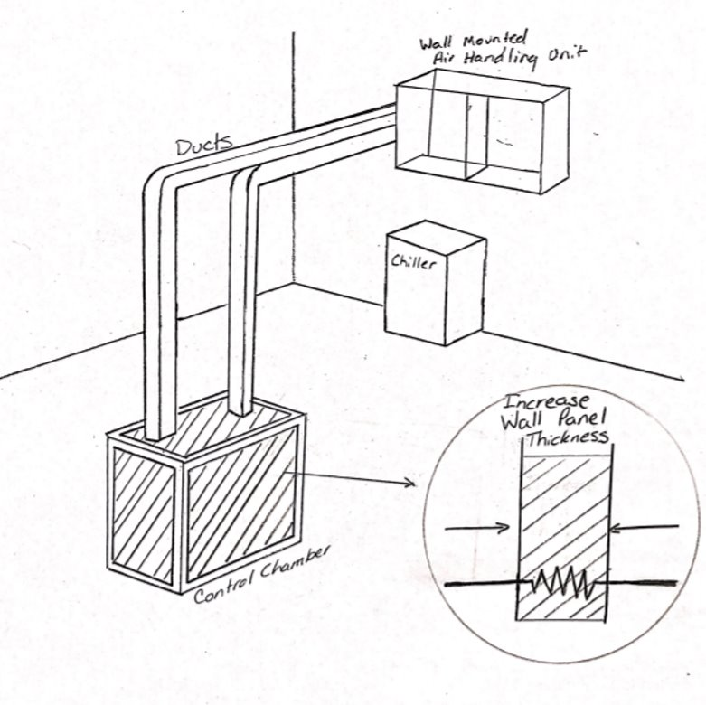
Medium Fidelity
Wall-Mounted AHU with Duct Insulation
Wall-Mounted AHU with Increased Wall
Thickness
Wall-Mounted AHU with Heater Inside Duct
Wall-Mounted AHU with Hotplate and Water Dropper Humidifier
Wall-Mounted AHU with Vein-Like Inner Chamber Surface
Nicholas Blenker

Slide 20
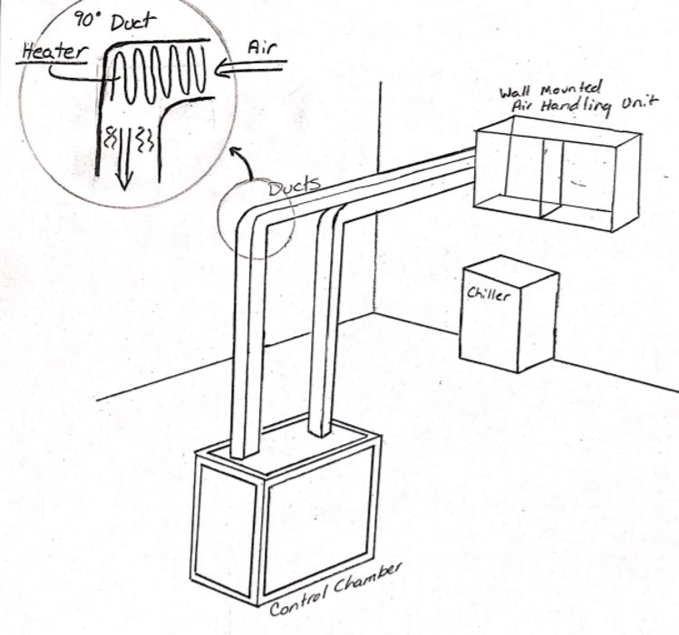
Medium Fidelity
Wall-Mounted AHU with Duct Insulation
Wall-Mounted AHU with Increased Wall Thickness
Wall-Mounted AHU with Heater Inside
Duct
Wall-Mounted AHU with Hotplate and Water Dropper Humidifier
Wall-Mounted AHU with Vein-Like Inner Chamber Surface
Nicholas Blenker

Slide 21
Medium Fidelity
Wall-Mounted AHU with Duct Insulation
Wall-Mounted AHU with Increased Wall Thickness
Wall-Mounted AHU with Heater Inside Duct
Wall-Mounted AHU with Hotplate and
Water Dropper Humidifier
Wall-Mounted AHU with Vein-Like Inner Chamber Surface
Nicholas Blenker

Slide 22
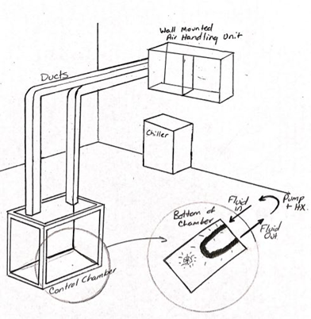
Medium Fidelity
Wall-Mounted AHU with Duct Insulation
Wall-Mounted AHU with Increased Wall Thickness
Wall-Mounted AHU with Heater Inside Duct
Wall-Mounted AHU with Hotplate and Water Dropper Humidifier
Wall-Mounted AHU with Vein-Like
Chamber Surface
Nicholas Blenker

Slide 23
High Fidelity
Wall-Mounted AHU with Detachable
Overhead Ducts, Puddy Infiltration
Seals, and Dips Inside Ductwork
Floor-Mounted AHU with Fixed Side Ducts, Rubber Inserts, and Dips Inside Ductwork
Floor-Mounted AHU with Detachable Overhead Ducts, Rubber Inserts, and a Close-Off Inside Ductwork
Nicholas Blenker

Slide 24
High Fidelity
Wall-Mounted AHU with Detachable Overhead Ducts, Puddy Infiltration Seals, and Dips Inside Ductwork
Floor-Mounted AHU with Fixed Side
Ducts, Rubber Inserts, and Dips Inside
Ductwork
Floor-Mounted AHU with Detachable Overhead Ducts, Rubber Inserts, and a Close-Off Inside Ductwork
Nicholas Blenker

Slide 25
High Fidelity
Wall-Mounted AHU with Detachable Overhead Ducts, Puddy Infiltration Seals, and Dips Inside Ductwork
Floor-Mounted AHU with Fixed Side Ducts, Rubber Inserts, and Dips Inside Ductwork
Floor-Mounted AHU with Detachable
Overhead Ducts, Rubber Inserts, and a
Close-Off Inside Ductwork
Nicholas Blenker

Slide 26
Concept Selection
Pairwise Comparison
Pugh
Chart
Q
S
+
-
House
of Quality
Analytical Hierarchy Chart
-
S
-
David Wilson

Slide 27
Concept Selection
Engineering Characteristics
Provide Support
Regulate Air Circ.
Change Temp. & Humidity
Provide Access
Display
Conditions
Automate Control
Provide Visibility
Provide Clearance
Monitor
Conditions
David Wilson

Slide 28
Concept Selection
Engineering Characteristics
Pairwise Comparison
House of Quality
Pairwise Comparison
Change Temp
& Humidity
Change Temp
& Humidity
1
1
Automate
Control
Automate
Control
2
2
Monitor
Conditions
Monitor
Conditions
3
3
Provide
Clearance
Display
Conditions
4
4
Provide
Access
Provide
Access
5
5
Regulate Air
Circulation
Regulate Air
Circulation
6
6
Provide
Visibility
Provide
Clearance
7
7
Provide
Support
Provide
Visibility
8
8
Display
Conditions
Provide
Support
9
9
David Wilson

Slide 29
Concept Selection
Engineering Characteristics
Pairwise Comparison
House of Quality
Pairwise Comparison
Change Temp
& Humidity
Change Temp
& Humidity
1
1
Automate
Control
Automate
Control
2
2
Monitor
Conditions
Monitor
Conditions
3
3
Provide
Clearance
Display
Conditions
4
4
Provide
Access
Provide
Access
5
5
Regulate Air
Circulation
Regulate Air
Circulation
6
6
Provide
Visibility
Provide
Clearance
7
7
Provide
Support
Provide
Visibility
8
8
Display
Conditions
Provide
Support
9
9
David Wilson

Slide 30
Concept Selection
Engineering Characteristics
Pairwise Comparison
House of Quality
Pairwise Comparison
Change Temp
& Humidity
Change Temp
& Humidity
1
1
Automate
Control
Automate
Control
2
2
Monitor
Conditions
Monitor
Conditions
3
3
Provide
Clearance
Display
Conditions
4
4
Provide
Access
Provide
Access
5
5
Regulate Air
Circulation
Regulate Air
Circulation
6
6
Provide
Visibility
Provide
Clearance
7
7
Provide
Support
Provide
Visibility
8
8
Display
Conditions
Provide
Support
9
9
David Wilson

Slide 31
Concept Selection
Pairwise Comparison
Pugh Chart
2
1
3
VS
8 Concepts
4
5
Existing Design
6
7
8
6
VS
Top 3
7
1
Least Polarizing
8
7: Floor-Mounted AHU with
Detachable Overhead Ducts, Rubber
Inserts, and a Close-Off Inside Ductwork
Winning Design
David Wilson

Slide 32
Concept Selection
Pairwise Comparison
Pugh Chart
2
1
3
VS
8 Concepts
4
5
Existing Design
6
7
8
6
VS
Top 3
7
1
Least Polarizing
8
7: Floor-Mounted AHU with
Detachable Overhead Ducts, Rubber
Inserts, and a Close-Off Inside Ductwork
Winning Design
David Wilson

Slide 33
Concept Selection
Pairwise Comparison
Pugh Chart
2
1
3
VS
8 Concepts
4
5
Existing Design
6
7
8
6
VS
Top 3
7
1
Least Polarizing
8
Floor-Mounted AHU with Fixed Side Ducts, Rubber Inserts, and Dips Inside Ductwork
Winning Design
David Wilson

Slide 34
Concept Selection
Analytical Hierarchy
Floor-Mounted AHU with Fixed Side Ducts, Rubber Inserts, and Dips Inside Ductwork
1
1
Wall-Mounted AHU with Detachable Overhead Ducts, Puddy Seals, and Dips Inside Ductwork
2
2
1
Floor-Mounted AHU with Detachable Overhead Ducts, Rubber Inserts, and Close-Off Inside Ductwork
3
3
1
David Wilson

Slide 35
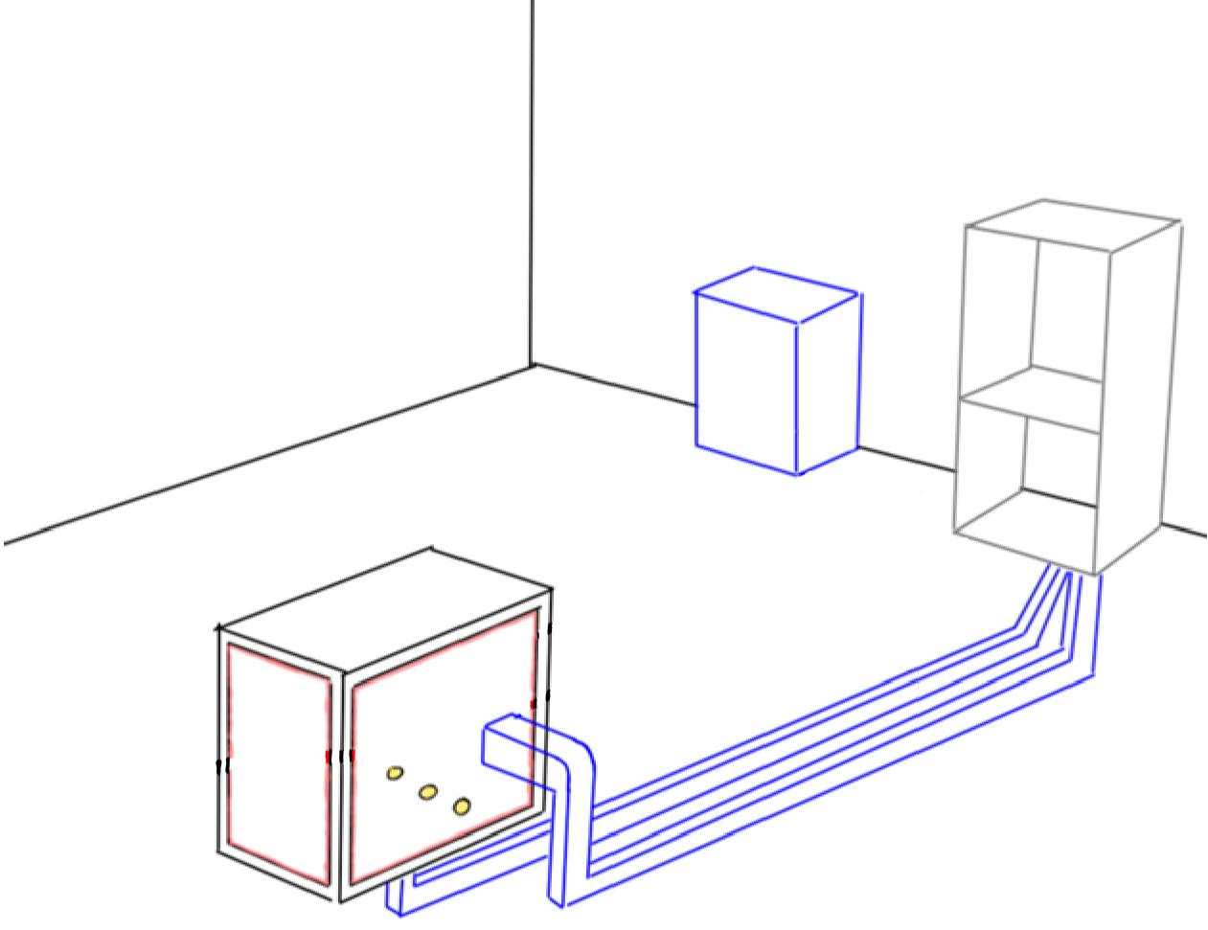
Final Selection
Floor-Mounted AHU
.
Floor-Mounted AHU
Fixed Side Ducts
Fixed Side Ducts
Rubber Inserts
Rubber Inserts
Dips Inside Ductwork
Dips Inside Ductwork
David Wilson

Slide 36
Final Selection
Floor-Mounted AHU
Floor-Mounted AHU
Fixed Side Ducts
Fixed Side Ducts
Rubber Inserts
Rubber Inserts
Dips Inside Ductwork
Dips Inside Ductwork
David Wilson

Slide 37
Final Selection
Floor-Mounted AHU
Floor-Mounted AHU
Fixed Side Ducts
Fixed Side Ducts
Rubber Inserts
Rubber Inserts
Dips Inside Ductwork
Dips Inside Ductwork
David Wilson

Slide 38
Final Selection
Floor-Mounted AHU
Floor-Mounted AHU
Fixed Side Ducts
Fixed Side Ducts
Rubber Inserts
Rubber Inserts
Dips Inside Ductwork
Dips Inside Ductwork
David Wilson

Slide 39
Initial Design
Things That Have Changed
Wall-Mounted AHU
Floor-Mounted AHU
Crane Outside Chamber
Crane Inside Chamber
Could use interior plexiglass
Cannot use interior
plexiglass
David Wilson

Slide 40
Future Work
Evaluate
Design
Order
Materials
Project
Approval
Implement Design
David Wilson

Slide 41
Timeline
Fall Semester
Prototype no. 1
VDR2
Bill of Materials
Risk Assessment
November
December
David Wilson

Slide 42
Timeline
Spring Semester Timeline
Spring Semester
VDR3
CAD
Automation
VDR4
3D Printing
Prototype no. 2
Testing
Presentation
January
February
March
April
May
David Wilson

Slide 43
Functional Decomposition
Accessibility
Support
Control
Presenter

Slide 44
Functional Decomposition
Environmentally Controlled Testing Chamber
Support
Control
Accessibility
Maintains Climate Stability
Control Temperature
Maintains Structural Stability
Support Airducts and Equipment
Control Humidity
Chamber
Climate Control
Presenter

Slide 45
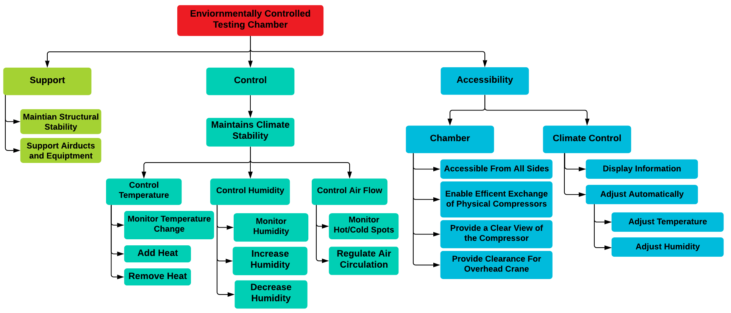
Functional Decomposition
Presenter

Slide 46
Key Goals – SAE Standards
Presenter

Slide 47
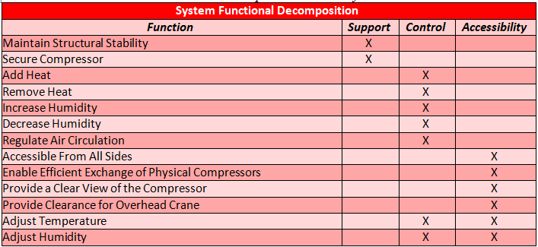
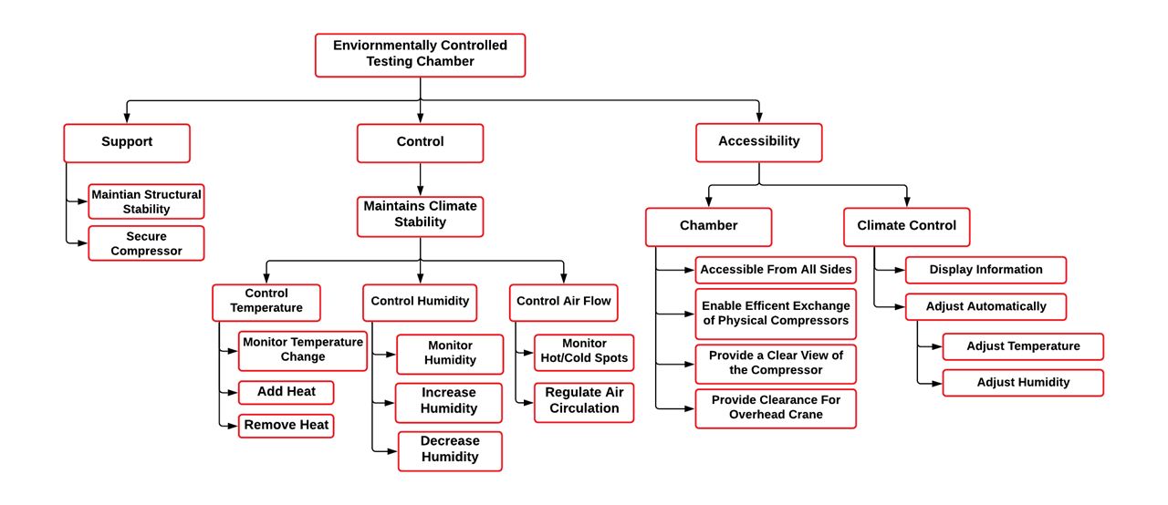
Functional Decomposition
Cross Reference Chart
Hierarchy Flow Chart
Presenter

Slide 48
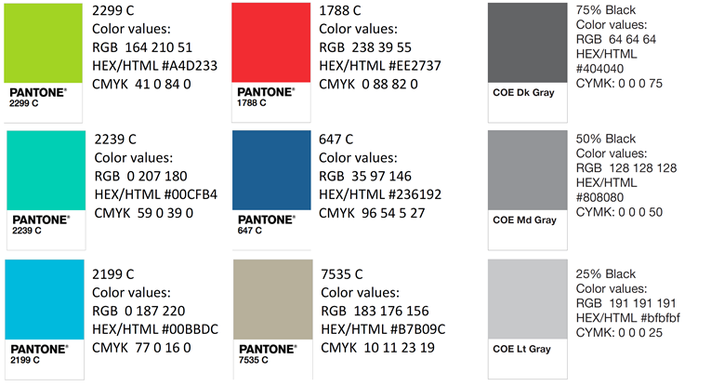
Color Palette

Slide 49
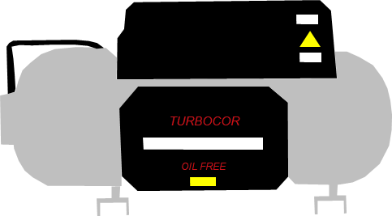
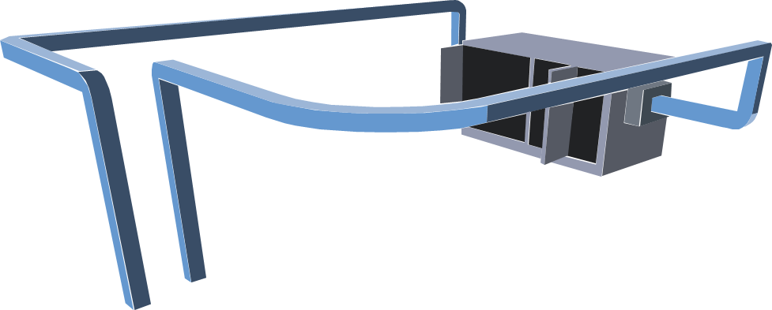
Team 503 Icons

Slide 50
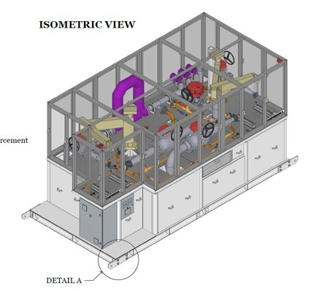
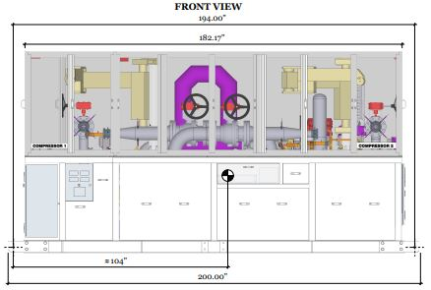
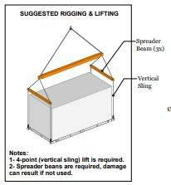
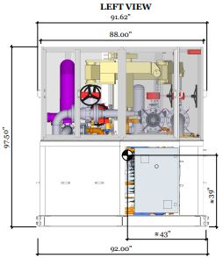
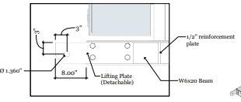
Views of Chamber

Slide 51
Logos

Slide 52
Tool kit
Summary Box
Text box 1
Outlined Text box

Slide 53
APA Tables
Category 1 | Category 2 | Category 3 | Category 4 | Category 5
Item 1
Item 2
Item 3
Item 4
 | Category 2 |  | Category 3
Category 1 | subcategory 1 | subcategory 2 | subcategory 3 | subcategory 4
Item 1
Item 2
Item 3
Item 4

