Slide 1

ENVIRONMENTALLY CONTROLLED TEST CHAMBER
Nicholas Blenker | Tucker Hall | David Wilson
TEAM 503

Slide 2



Meet Team 503
Nicholas Blenker
Tucker Hall
David Wilson
Tucker Hall
Design Engineer
Systems Engineer
Controls Engineer

Slide 3


Sponsor & Advisor
William Bilbow
Keith Larson
Danfoss
FAMU-FSU College of Engineering

Slide 4
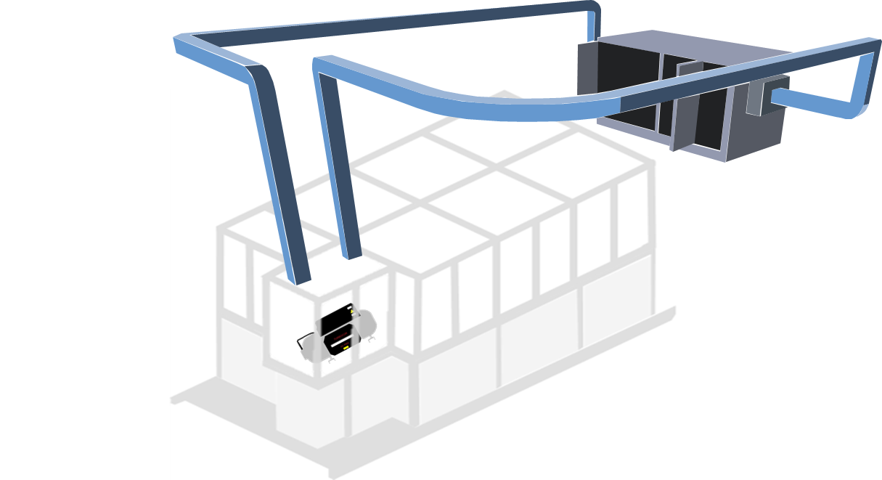
Original Design
DUCTWORK
TREATED AIR
AIR HANDLING
UNIT
RETURN AIR
CONTROL
VOLUME
CHAMBER
COMPRESSOR

Slide 5
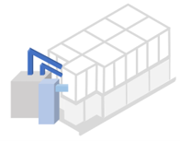

New Design
Key Changes
2
Floor-Mounted AHU​
Detachable Side Ducts​
29,000 BTU A/C​
Industrial Humidifier
1
3
4

Slide 6
Reasoning
Floor-Mounted AHU
Very limited wall space available
Suggested by lab staff
Significantly reduced length of ductwork
  Decreases heat transfer with surroundings
Increased mobility/portability
1

Slide 7
Reasoning
2
Detachable Side Ducts
Ductwork easily removable
Side ducts are more accessible
Significantly reduced length of ductwork
  Decreases heat transfer with surroundings
Increased mobility/portability

Slide 8
Reasoning
3
29,000 BTU A/C
More versatile
Most value in terms of power versus cost
  Only ~$500 more than 1/2 as powerful
Compensates for leaks, infiltration, and other possible issues
Decreases time to desired conditions
Comes with built-in ductwork
3

Slide 9
Reasoning
4
Industrial Humidifier
Ensures that 95% RH can be reached
Comes with large tank
  Doesn't need to be refilled often
Ensures that any condition can be met within 15 minutes
Features built-in automated control system

Slide 10
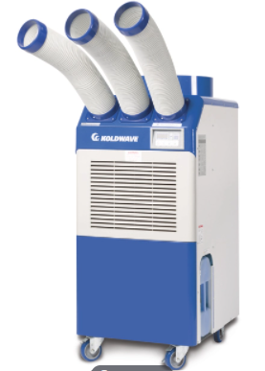
Air Cooled Portable AC
Vendor: NorthStock
Quantity: 1
Features:
  29,000 BTU, 230V/1P/60Hz
  0-30 C spot cooling
  Ambient air: 45 C max
Cost: $3,456.99
Link: Click Here
10

Slide 11
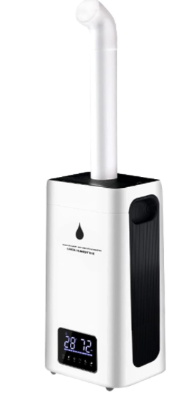
Industrial Humidifier
Vendor: Amazon
Quantity: 1
Features:
  45-95% RH, 24L Tank
  110V
  Intelligent control system
Cost: $289.98
Link: Click Here
11

Slide 12
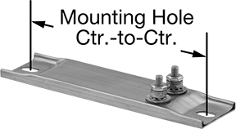
Electric Strip Heaters
Vendor: McMaster-Carr
Quantity: 2/3
Features:
  500W, no controller
  120V/1P
  8" x 1.5" x 0.3125"
Cost: $42.86 ea ($126.58)
Link: Click Here
12

Slide 13
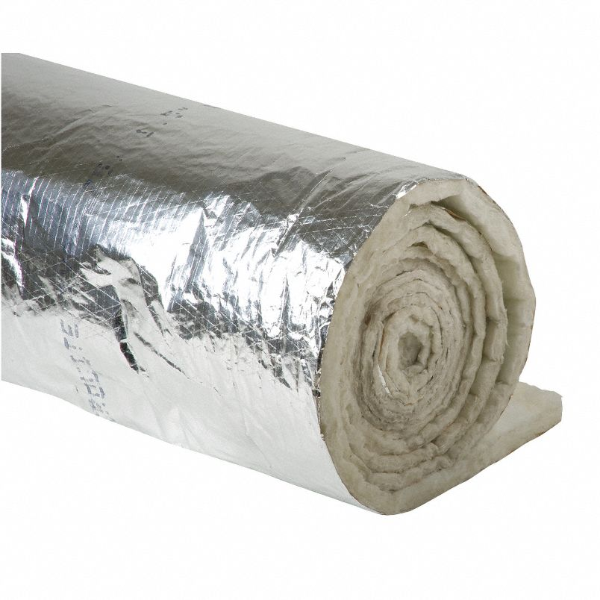
Fiberglass Duct Insulation
Vendor: Grainger
Quantity: 1
Features:
  0.75 lb density
  48" wide, 25' long
  R-value: 4.2
Cost: $67.54
Link: Click Here
13

Slide 14
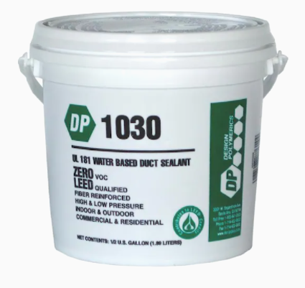
Duct Sealant
Vendor: Lowe's
Quantity: 1
Features:
  Fiber reinforced, water-based, high velocity
  Joints, seams, penetrations
Cost: $16.58
Link: Click Here
14

Slide 15
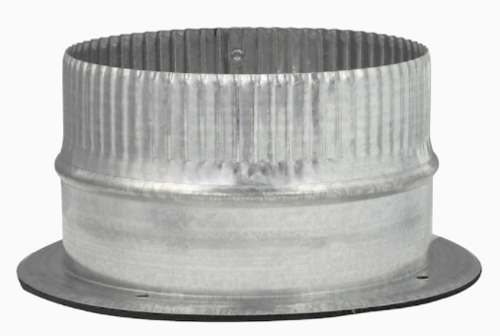
Duct Take-Off
Vendor: Lowe's
Quantity: 3
Features:
  Fits 6" duct
  Galvanized steel
  Airtight adhesive gasket
Cost: $8.98 ea ($26.94)
Link: Click Here
15

Slide 16
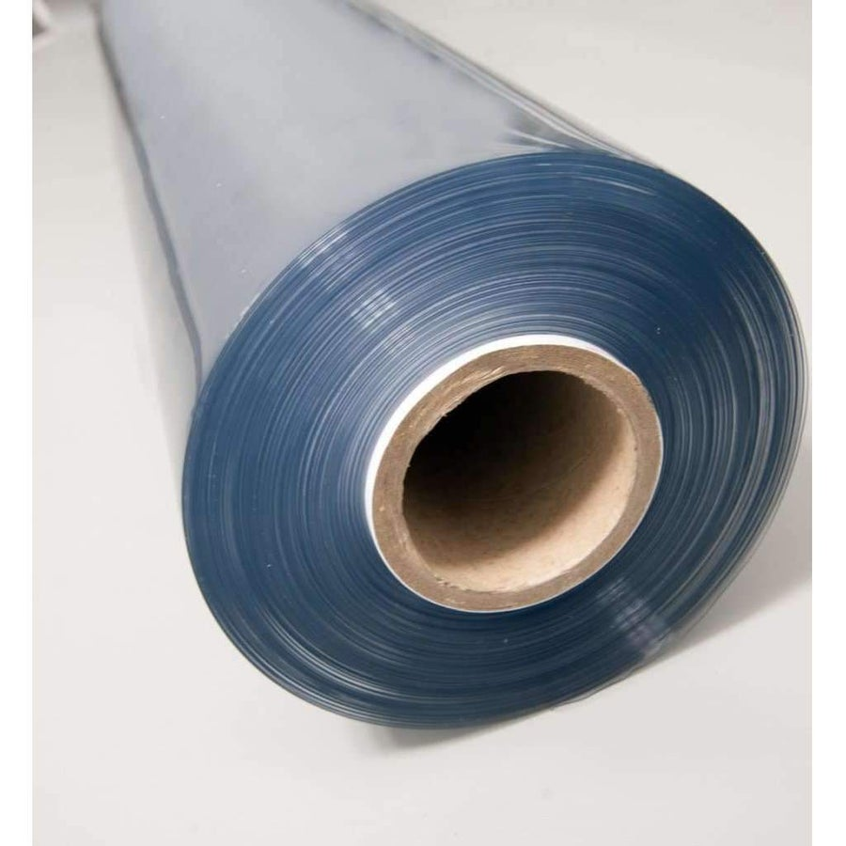
Clear Vinyl
Vendor: MarineVinylFabric
Quantity: 3 (yards)
Features:
  54" wide, 80 gauge/2 mm
  Marine grade, durable, flexible
Cost: $26.95 ea ($80.85)
Link: Click Here
16

Slide 17
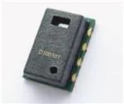
Temperature & Humidity Sensor
Vendor: TTI
Quantity: 4
Features:
  +/- 0.3 C
  -40 C ≤ T ≤ 125 C
  +/- 3% RH (0-100%)
Cost: $8.02 ea ($32.08)
Link: Click Here
17

Slide 18
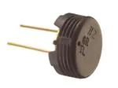
Humidity Sensor
Vendor: TTI
Quantity: 4
Features:
  Analog output
  +/- 1% error
  1% to 99% RH
Cost: $5.39 ea ($21.56)
Link: Click Here
18

Slide 19
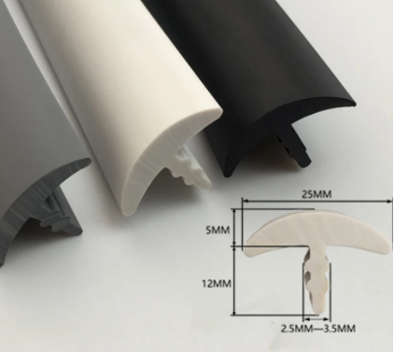
T-shaped Rubber Sealing Strips
Vendor: AliExpress
Quantity: 1
Features:
  Sound insulation
  Waterproof
  Dustproof sealing strip
Cost: $30.75
Link: Click Here
19

Slide 20
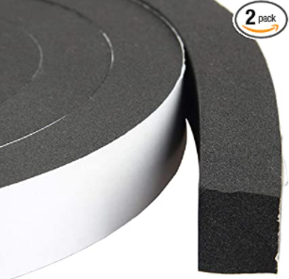
Foam Sealing Strip
Vendor: Amazon
Quantity: 2
Features:
  1" x 0.75" x 13'
  Waterproof, high density
  Single-sided adhesive
Cost: $20.79 ea ($41.58)
Link: Click Here
20

Slide 21

Arduino Mega
Vendor: Amazon
Quantity: 1
Features:
  USB connector
  Arduino IDE compatible
  5V operating voltage
Cost: $17.49
Link: Click Here
21

Slide 22
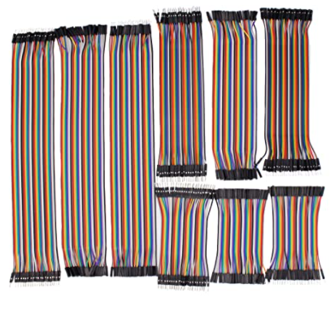
Breadboard Jumper Wires
Vendor: Amazon
Quantity: 1
Features:
  Insulation Material: PVC
  Conductor material: Copper tinned
  Of multiple variety
Cost: $17.99
Link: Click Here
22

Slide 23
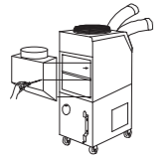
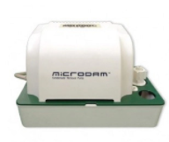
Unfinalized Items
Condensate pump*
Vendor: Koldwave
Quantity: 1
Features:
  Removes existing condensation from the system
  Makes the system more efficient
Cost: $439.45
Link: Click Here
* Not sure if necessary
* Can select other cheaper options
Ambient air adapter
Vendor: Koldwave
Quanity: 1
Features:
  Fits over the intake air vent
  Would attach to the chamber via ductwork, creating a closed-loop system
  Eliminates the issue of pressurization
Cost: Unknown (awaiting response)
23

Slide 24
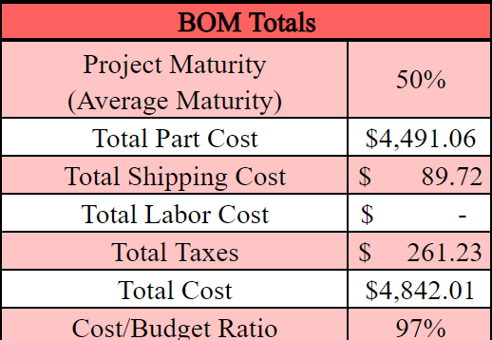
Summary
Biggest Spenders:
AC Unit: $3,457
Humidifier: $290
Strip Heaters: $126
Total does not account for the two unfinalized items
Total Cost $ 4,842.01
= Cost Ratio 97%
Approximated Budget $ 5,000.00
24

Slide 25
Meeting Notes
Perform Hazard Assessment
Complete FMEA
Risk Factors
  Condensation
    Fires
    Electric shock
  Heating Strips
    Fire
    Temperature accuracy
Mobilize System
  Simple plywood stand with wheels
  Reduces electrical risk

