Slide 1

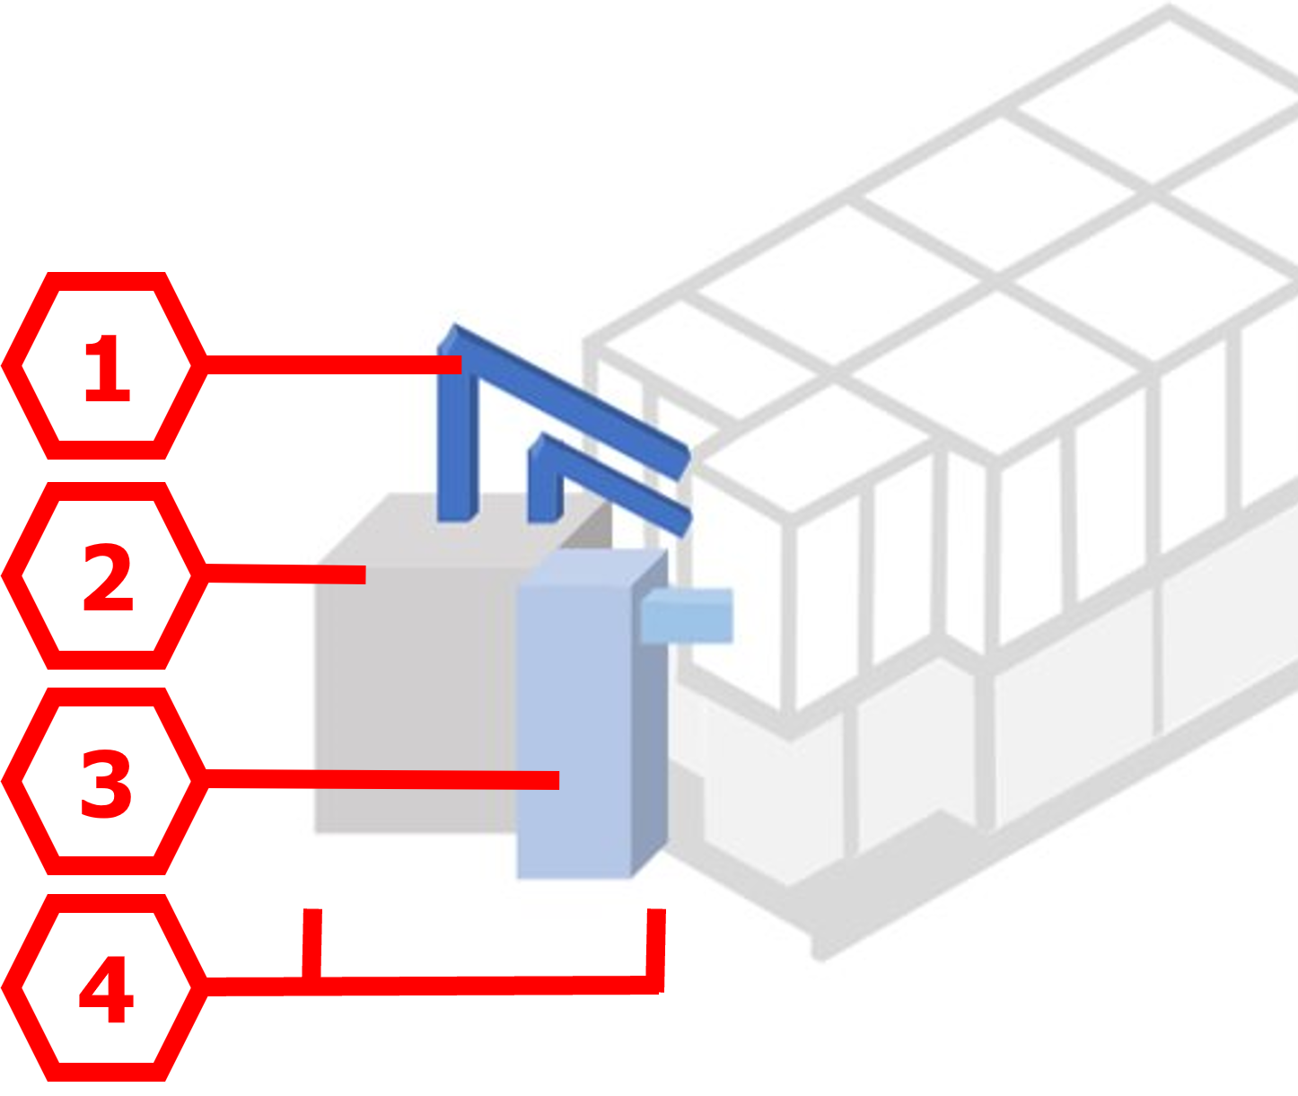

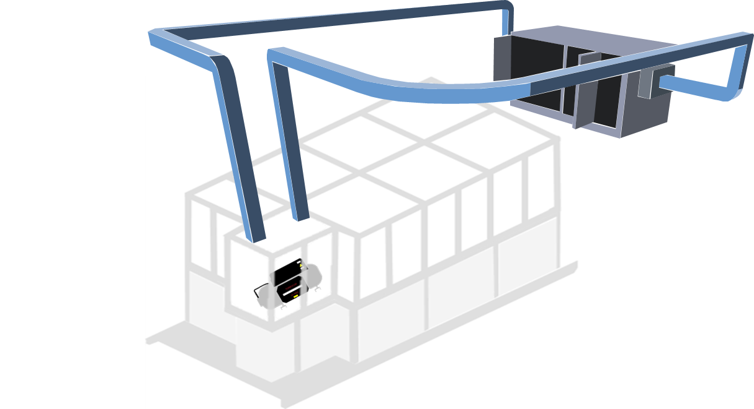



Environmental Test Chamber
Team 503 | Nicholas Blenker | Tucker Hall | David Wilson
Sponsor: William Bilbow | Advisor: Keith Larson
Key Parts
Final Design
Air Conditioning Unit:
Cools from 45° to 0° Celsius
Heating Strips:
Heat can reach 65° Celsius
Humidifier:
Ranges from 0% to 100% relative humidity
Collection System:
Funnels condensation and refills the humidifier tank
Controller:
Centralizes and automates system control
Design Changes
Initial Design
2
1
Floor-Mounted AHU
Detachable Side Ducts
16,800 BTU A/C
Industrial Humidifier
2
DUCTWORK
TREATED AIR
3
RETURN AIR
AIR
HANDLING
UNIT
4
CONTROL
VOLUME
4
COMPRESSOR
CHAMBER
Targets
Applications
10°C ≤ T ≤ 50°C
0% ≤ RH ≤ 95%
Within 1% of desired
values
Compressor exchange
within 15 minutes
No human interaction
Automotive testing
Weapons testing
Electronics testing
Perishable food storage
Medical product testing
The objective of this project is to validate the existing design and deliver an assembly that regulates temperature and humidity for use in a laboratory environment

