Slide 1
Material Handling of Ceramics
VDR2
Team 502: Makada Browne, Erich Noack, Charles Stubbs, Amelia Veith
Notes:
Greet everyone

Slide 2

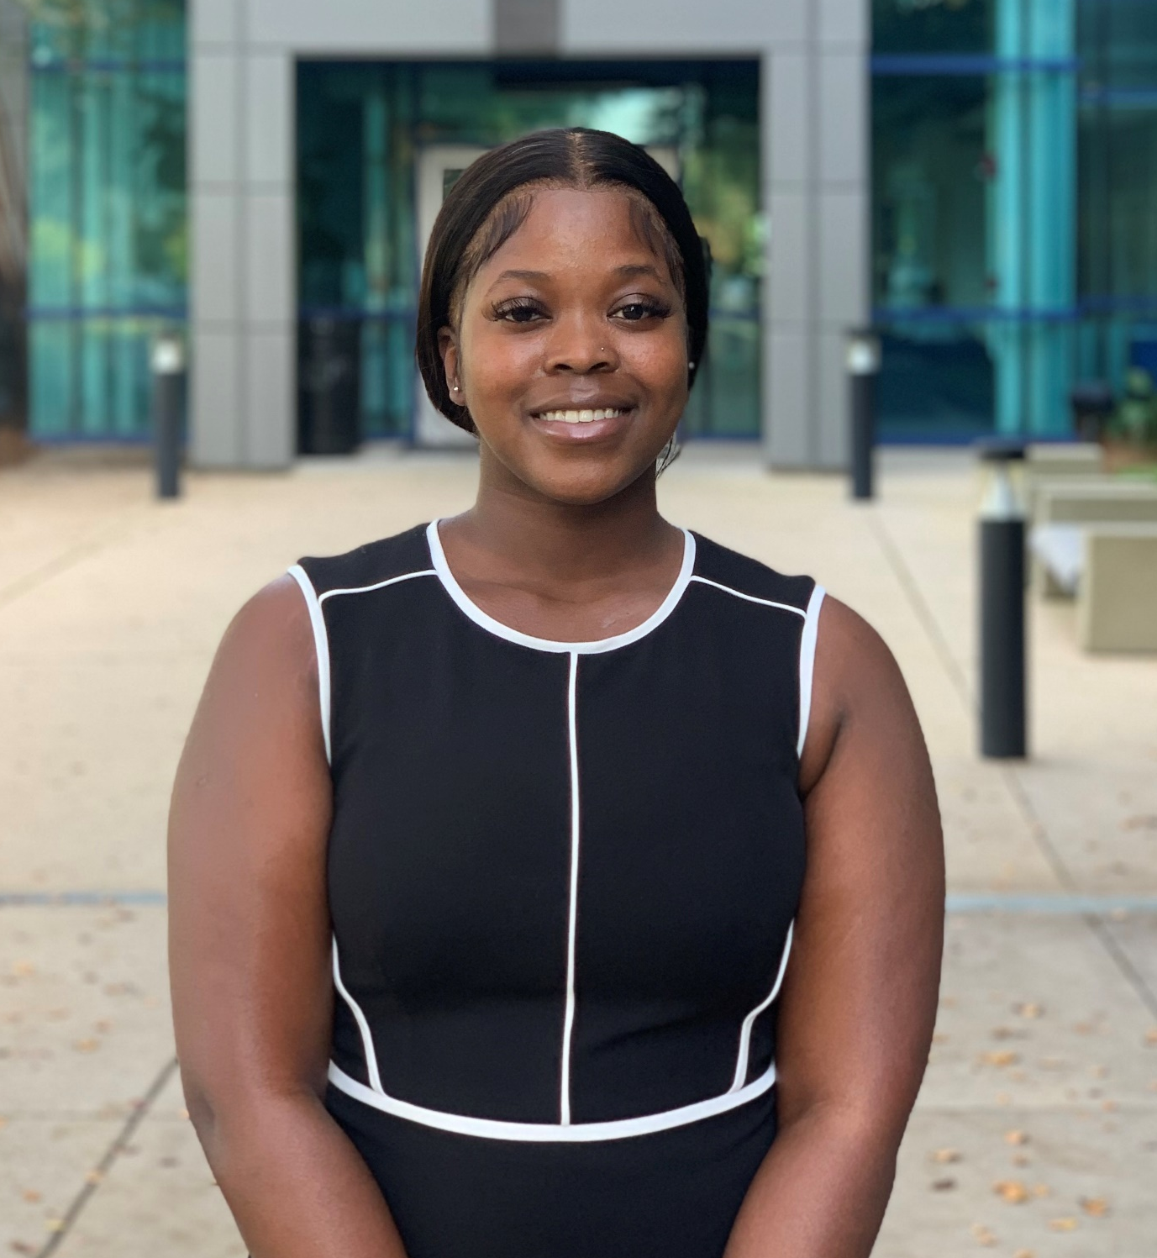
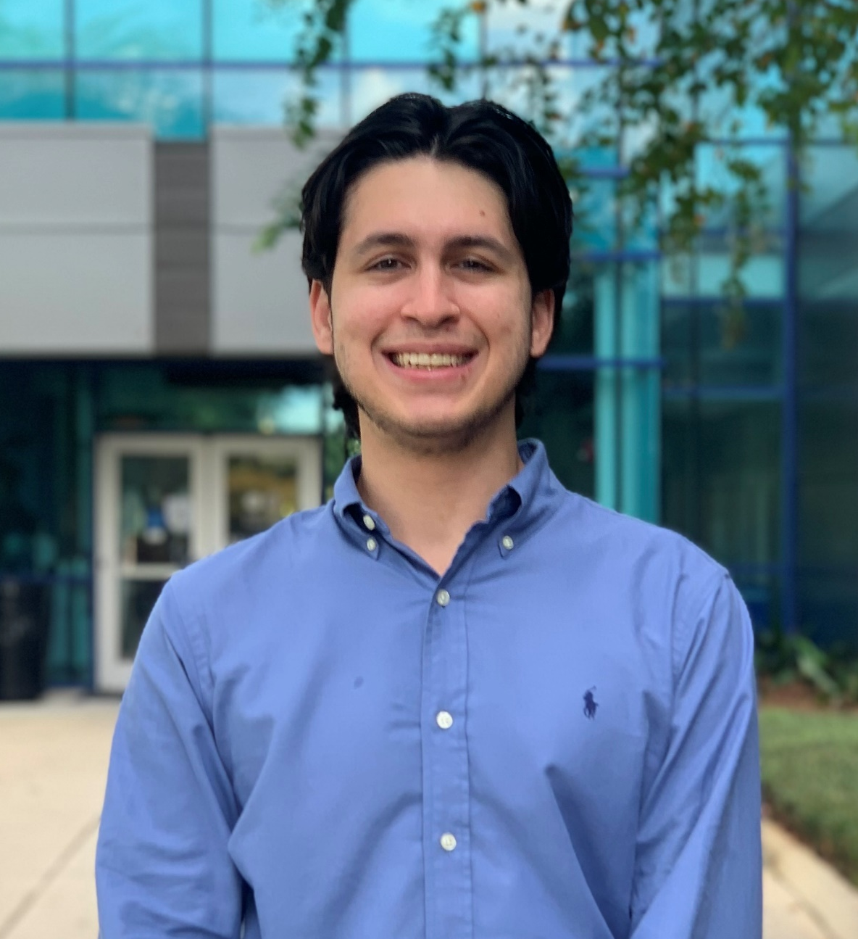
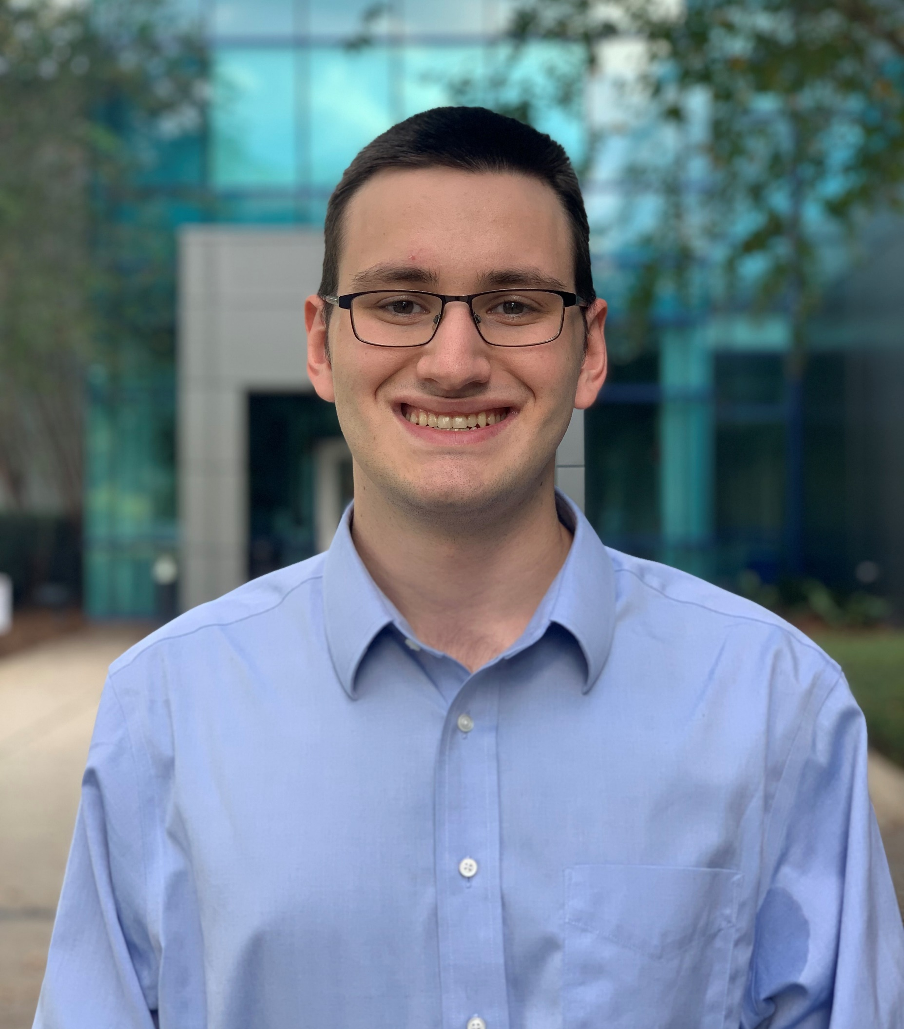
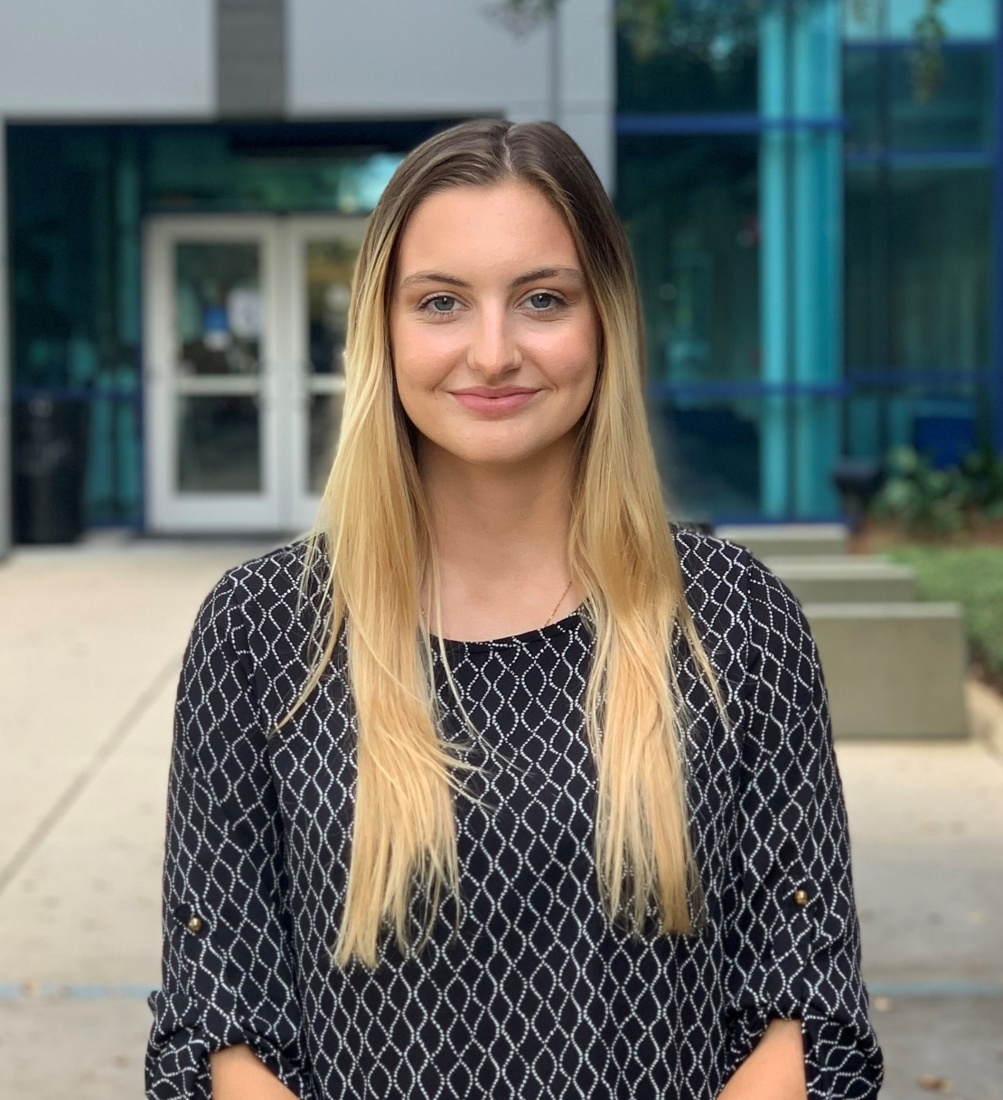
Team Members
Makada Browne
Erich Noack
Charles Stubbs
Amelia Veith
Facilities Engineer
Design Engineer
Test Engineer
Quality Control Engineer
Team 502
Notes:
Facilities Engineer – Responsible for planning
Design Engineer – Research and develop ideas for new product
Test Engineer – Responsible for all test planning, conducting and reporting activites
Quality Control – Responsible for ensuring smooth operation and functionality
Industrial Engineering – Makada Browne
Mechanical Engineering – Erich Noack, Charles Stubbs, Amelia Veith

Slide 3
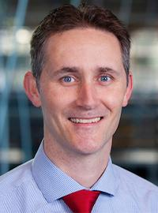
Advisor
Dr. Shayne McConomy
-B.S. Mechanical Engineering, Florida State University, 2004
-M.S. Automotive engineering, Clemson University, 2014
-PhD. Automotive Engineering, Clemson University, 2015
Erich Noack
Notes:
We would like to thank Dr. McConomy for organizing this project and getting us in touch with Corning.

Slide 4

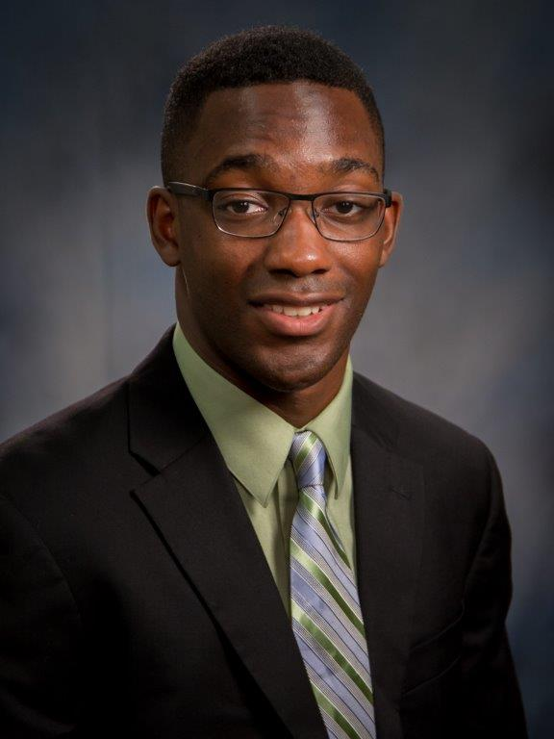
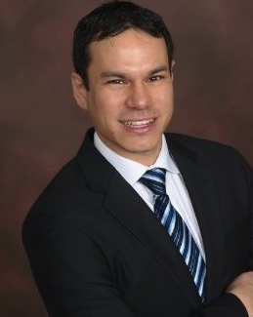
Sponsor
Tevin Smith
-Process Engineer at Corning
-B.S., Material Engineering, Rensselaer Polytechnic Institute (RPI)
-Point of Contact for Team 502
Alexander Richter
-Sr. Process Engineer at Corning
-PhD. Chemical Engineering NC State
-Point of Contact for Team 502
Erich Noack
Notes:
We would also to thank our project sponsors with Corning: Tevin Smith and Alexander Richter.

Slide 5
Project Brief
-The project team will propose and demonstrate alternative, advantaged material handling approaches.
-Corning has provided Team 502 with a variety of fired ceramic sample “blanks”.
15 in.
17 in.
Erich Noack

Slide 6
Manufacturing Process
Mixing
Cutting
Handling
Extruding
Firing
Finishing
Erich Noack
Notes:
This is the manufacturing process for Corning’s ceramic filters

Slide 7
Handling
Erich Noack
Notes:
After firing, the filters have to be relocated for finishing, this is where the part damage is introduced. The rubber grippers in contact with the ceramic cause these cracks during manufacturing

Slide 8
Part Damage
Erich Noack
Notes:
The blue spots indicate where damage is introduced from the contact the grippers make with the ceramic substrates. As the grippers engage with the part, the stresses applied will fracture the skin due to the cell walls buckling from high forces.

Slide 9


Objective
Develop an alternative method for handling ceramic substrates that eliminates damage to the part
Erich Noack

Slide 10



Current Work
Targets & Metrics
Concept Generation
Concept Selection
Benchmarking & Research
Meet with Sponsor
Erich Noack

Slide 11
Targets and Metrics
Force
18 in
18 in
Part Displacement
Support Part Load

Slide 12
Targets and Metrics
Force
18 in
18 in
Part Displacement
Support Part Load

Slide 13
Targets and Metrics
Range of 0° - 90°
Pressure
Regulate Applied Pressure
Orientation Versatility

Slide 14

Targets and Metrics
Misalignment/Slippage= 0in
Time = 1sec
Engagement Time
Misalignment & Slippage

Slide 15
Critical Targets
Metrics | Objective Targets | Stretch Targets
Displacement with Part | 18 in | 36 in
Supported Load | 40 lbs | 50 lbs
Applied Pressure | < 90% of part strength | < 10% of part strength
Angular Loading Range | 90 deg | 180 deg
Engagement Time | 2 secs | 1 sec
Part Misalignment | 39 mil | 0 in
Part Slippage | 39 mil | 0 in
Erich Noack
Notes:
Critical Targets​
Supported load: 40lbs​
Applied pressure: TBD​
Angular loading range: 90° across roll, pitch, and yaw​
Engagement time: 1 sec​
Part misalignment: 0.5in​
Part slippage: <1mm​
Motion with part: >1.5ft in vertical and horizontal directions

Slide 16







Concept Generation
Biomimicry
Brainstorming
Morphological
Chart
Charles Stubbs
Notes:
After targets and metrics, our team went into the concept generation phase. We used a handful of methods to manage our process here. When using biomimicry we thought about how elements of nature approach handling fragile materials and maintaining grip. During the brainstorming sessions we attempted to think imaginatively about how to solve the problem. We continued coming up with concepts through the morphological chart

Slide 17
Concept 1
Vibration-Based Adhesion
Vibrating flexible disc adheres to part
Creates gas lubricated film between part surface and disk
Pulling force induced perpendicular to part surface
Charles Stubbs

Slide 18
Concept 2
Flexible Membrane Suction Cavity Grippers
Suction pads adapt to ceramic’s surface
Vacuum behind pad membrane creates suction force on part
Flexible membrane suction tool array
Charles Stubbs
17

Slide 19
Concept 3
Vacuum Suction Grippers
Powered by pneumatics
Vacuum suction cup array
Charles Stubbs

Slide 20
Concept 4
Cable Tension Grippers
Cables connected to a central motor
Cable tension wraps gripper pads around the part surface
Charles Stubbs

Slide 21
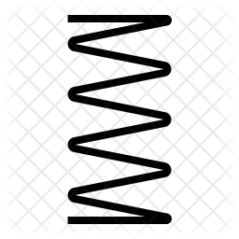
Concept 5
Parallel Sensor Grippers
Parallel grippers equipped with force detection sensors
Spring loaded hinged flaps
Charles Stubbs

Slide 22
Concept 6
Three Point Sensor Grippers
Grippers equipped with internal proximity sensors
Three points of contact 120° about the central part axis
Charles Stubbs

Slide 23
Concept 7
Air Filled Cushion Grippers
Air filled cushioned bags sandwich part
Pump controls air pressure in cushioned bags
Parallel points of contact
Charles Stubbs

Slide 24
Concept 8
Gecko Adhesive Grippers
Flexible Gecko skin inspired dry adhesive
Air-filled capsules mold the gripper to ceramic’s shape
Charles Stubbs

Slide 25
House of Quality
Customer Requirements | Importance Weight Factor
Eliminate Part Damage | 7
Pick and Place | 5
Handle Two Orientations | 4
Travel along Two Axes | 4
Eliminate Slippage | 3
Testable Proof of Concept | 3
Reliable Process | 1
Durable | 1
Charles Stubbs

Slide 26
House of Quality
Engineering Characteristics
Applied Pressure
Engagement Time
Supported Load
Angular
Loading Range
Part Slippage
Part Displacement
Part Misalignment
Durability
psi
seconds
lbs
deg
inches
inches
inches
10⁹ Cycles
Charles Stubbs

Slide 27
House of Quality
1st
Engineering Characteristics
Supported Load
2nd
3rd
4th
Part Slippage
Part Misalignment
Applied Pressure
5th
6th
Angular
Loading Range
Part Displacement
7th
8th
Engagement Time
Durability
Charles Stubbs

Slide 28
Datum
Parallel Gripper Array
Grippers pinch ceramic and support with friction
Arrays of grippers arranged on opposite sides
Charles Stubbs

Slide 29
Pugh Chart
1st Pugh Chart
3rd Pugh Chart
Concept | #
Vibrating Flexible Disc Tool | 1
Flexible Suction-Based Grippers | 2
Vacuum Suction Grippers | 3
Tensioned Cable Grippers | 4
Parallel Padded Grippers with Sensor Feedback | 5
Three Point Padded Grippers with Sensor Feedback | 6
Air Filled Cushions Sandwich Part | 7
Gecko Dry Adhesive Gripper | 8
Parallel Gripper Array | 9
Pluses | Minuses | Sames
2 | 4 | 0
3 | 3 | 0
4 | 2 | 0
3 | 3 | 0
5 | 0 | 1
5 | 0 | 1
3 | 3 | 0
5 | 1 | 0
0 | 0 | 6
Pluses | Minuses | Sames
- | - | -
- | - | -
1 | 3 | 2
1 | 4 | 1
0 | 0 | 6
0 | 1 | 5
- | - | -
- | - | -
- | - | -
Charles Stubbs
28
Notes:
My apologies but we made a mistake here. On the First Pugh Chart the Pluses and Minuses are switched but the following bars indicate performance with red being the worst, followed by yellow and green being what we chose to move forward with.

Slide 30
AHP
Criteria Weight Vector
Final Rating Matrix
Legend
# | Concept
3 | Vacuum Gripper
5 | Parallel Sensing Gripper
6 | Three Point Sensing Gripper
Normalized Weight
0.418
0.237
0.068
0.098
0.143
0.036
Concepts
Criteria
Applied Pressure
Supported Load
Angular Loading Range
Part Slippage
Part Displacement
Part Misalignment
3 | 5 | 6
0.057 | 0.295 | 0.649
0.633 | 0.260 | 0.106
0.056 | 0.242 | 0.702
0.429 | 0.143 | 0.429
0.143 | 0.429 | 0.429
0.057 | 0.295 | 0.649
Charles Stubbs

Slide 31
Alternative Values
Legend
# | Concept
3 | Vacuum Gripper
5 | Parallel Sensing Gripper
6 | Three Point Sensing Gripper
Alternative Value Table
Concept | Alternative Value
3 | 0.247
5 | 0.278
6 | 0.475
Charles Stubbs

Slide 32
Final Selection
Three Point Sensing Grippers
Charles Stubbs

Slide 33




Future Work
Risk Assessment
Bill of Materials
Spring Project Plan
Meet with Sponsor
Charles Stubbs

Slide 34
Thank You
Makada Browne
Erich Noack
Charles Stubbs
Amelia Veith
msb16f@my.fsu.edu
ean18f@my.fsu.edu
ces17f@my.fsu.edu
afv17@my.fsu.edu

Slide 35
Backup Slides

Slide 36
Mixing
`
Amelia Veith
Notes:
High Quality materials are blended into a homogeneous mixture
High temp, low-expansion materials, allowing them to survive extreme engine conditions
Mixture is blended into a paste like substance

Slide 37
Functional Decomposition
Handler
Move
Support
Navigate
Power
Makada Browne

Slide 38
Functional Decomposition
Move
Rotate
Translate
Makada Browne

Slide 39
Extruding
Amelia Veith
Notes:
The substance is fed into a screw extruder and through a honeycomb die creating parallel

Slide 40
Assumptions
Physical Properties of Solid Ceramics
Cylindrical Extrusions
Solution will not Leverage Existing Process
Automated Process
Makada Browne
Notes:
Properties of ceramics no ductility, highly brittle
Cylindrical – these filters come in many shapes and sizes but the ceramic filters we are focusing on are cylinders
Automated Process- Our design must not interfere with their current process (queue times, delay in production)
Solution will not leverage existing process-

Slide 41
Key Goals
Implementable in Manufacturing
Eliminate Part Damage
Test with Samples
Makada Browne

Slide 42







Customer Needs
Ask Questions
Tabulate & Interpret
Develop Customer Needs
Makada Browne
Notes:
We establish our Customer needs to better define the customer expectations for the project outcome. We wrote down some questions to identify these needs. We started by asking questions and then translating the responses into customer statements. We put these into a large table and then further refine the requirements into customer needs.

Slide 43
Customer Needs
1. Eliminates ceramic part damage
2. Pick and Place Capability
&
4. Produce and qualify results
3. Can manipulate part from horizontal and vertical orientations
Makada Browne
Notes:
Further needs include: accommodates reduced strength materials, capable of handling ceramics throughout the finishing process, allows for movement across at least two perpendicular axes. Order indicates priority

Slide 44
Handler
Move
Support
Navigate
Power
Orient Part
Secure Part
Locate Part
Receive Power
Rotate
Orient to Part
Release Part
Locate Destination
Convert Power
Lift Part
Carry Part Load
Process Signals
Translate
Place Part
Regulate
Applied Forces
Travel with Part
Notes:
We use functional decomposition to breakdown the project into the smallest possible functions. We then relate those functions to each other, as in place them in systems and functions. Then we create a hierarchy flow chart composed of our individual function blocks, this demonstrates how the functions will precede each other functionally.

Slide 45
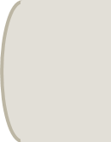
Cutting
Amelia Veith
Notes:
Then each piece is cut into the specific length, as set by the manufacturer

Slide 46
Firing
Amelia Veith
Notes:
After being cut, the filters are sent through a kiln and fired until they are a brittle ceramic filter

Slide 47


Project Description
-Alternative systems for handling fragile ceramic substrates.
-Incorporate in the manufacturing process.
-Reduces damage to parts.

Slide 48

Project Scope – Markets
Primary Markets
Ceramic Substrate Manufacturers – specifically Corning
Secondary Markets
Other manufacturing markets
Ex. Computer chips, satellite components, glassware, etc.

Slide 49

Project Scope – Stakeholders
Corning Incorporated
-Tevin Smith, Alexander Richter
FAMU-FSU College of Engineering
-Dr. Shayne McConomy (Senior Design Professor)
-Dr. Simone Peterson Hruda (Ceramics Expert)
General Stakeholders

Slide 50

Project Scope – Assumptions
Characteristic of Solid Ceramics
Cylindrical Extrusions
Solution will not leverage existing process
Automated Process

Slide 51
Handler
Move
Support
Navigate
Power
Orient part
Secure part
Locate part
Receive power
Rotate
Orient to part
Release part
Locate destination
Convert power into actuation
Send signals
Lift part
Process signals
Carry part load
Avoid collisions
Transduce signals
Translate
Place part
Receive Signals
Regulate applied pressure
Travel with part
Compute signals
51

Slide 52
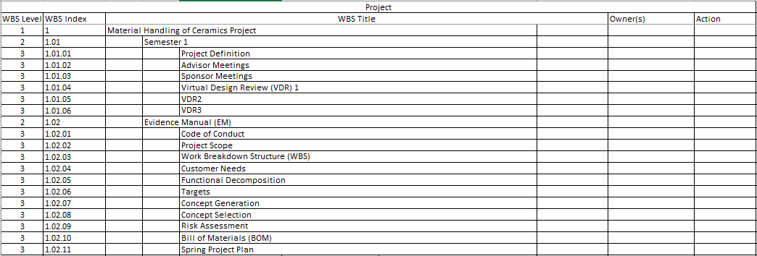
Work Breakdown Structure – 3d level

Slide 53
Customer Needs Full Table
# | Our Questions | Customer Answers | Interpreted Need
1 | Where on the surfaces is damage consistently observed? | Damage caused by robot handling is specifically observed in the center location of the part, as robot EOAT grippers typically engage the skin near the center. | The solution avoids damaging the center of the ceramic part skin.
2 | At what point in the manufacturing process is damage occurring? | The damage is occurring when parts are handled by robots through the Finishing process steps (after parts are Fired). | The solution is capable of handling ceramics throughout the finishing process.
3 | Are there any size constraints for the project? | There are no specific constraints for size. | The solution is of reasonable size.
4 | Are there any weight constraints for the project? | There are no specific constraints for weight. | The solution is of reasonable weight.
5 | Are there any power constraints for the project? | There are no specific constraints for power. | The solution has reasonable power requirements.
6 | Are there publicly available specifications similar to the samples provided? | Yes, see document attached for mechanical properties specific to each product family of the samples provided. | The project is intended for materials close to the specifications given.

Slide 54
Customer Needs Full Table (cont.)
# | Our Questions | Customer Answers | Interpreted Need
7 | Are there any movement limitations for the prototype? | Movement should be evaluated across at least 2 axes (horizontal, vertical movement) while part is being handled. | The project allows for movement along two perpendicular axes.
8 | Is there an audible noise level limit? | Corning follows the OSHA standard when it comes to audible noise level limit, which is no more than an average of 85 dB over 8 hours. | The project complies with OSHA standards.
9 | What should we consider the state of the part just prior to handling? | Parts can be in either horizontal or vertical orientation prior to handling. | The solution handles parts from horizontal and vertical orientations.
10 | Is there any induced motion, or is the part laying still? | The part is typically laying still on a part nest sitting on a conveyor prior to handling. | The solution maneuvers parts from a still position relative to the surface it is on.
11 | What is the most important thing you want out of this project? | At minimum, an option or path forward that reduces part handling or processing damage, based on research and data. | The solution developed reduces part damage.

Slide 55
Customer Needs Full Table (cont.)
# | Our Questions | Customer Answers | Interpreted Need
12 | What is the most important thing you want out of this project? | At minimum, an option or path forward that reduces part handling or processing damage, based on research and data. | The core concept selected for the project is supported by credible research and data.
13 | How would you define success for this project? | Success would be a built prototype and zero part damage indicated in results of data with repeatable results and a reliable process. | The project final deliverable includes a functional prototype to eliminate part damage.
14 | How would you define success for this project? | Success would be a built prototype and zero part damage indicated in results of data with repeatable results and a reliable process. | The project test reports indicate repeatable results and a reliable process.
15 | Is there an induced vibrational frequency/amplitude to avoid? | Our processes are not impacted by vibrational frequency/amplitude, avoidance of induced vibrational frequency/amplitudes should not be required. | The project is reasonably unaffected by ordinary vibrations.

Slide 56
Customer Needs Full Table (cont.)
# | Our Questions | Customer Answers | Interpreted Need
16 | What impact do you want the project to have on the manufacturing process? | The product is not intended to go directly into the process but solely purpose as a proof of concept. | The project demonstrates proof of concept.
17 | Can you elaborate on the need for this solution? | As the porosity of the ceramic materials increases, the part strength will decrease. Future parts are expected to decrease in porosity for improving other properties. | The solution accommodates reduced strength materials.
18 | How is the problem being handled currently? | Several methods currently exist; roller grippers that contact the skin of the part, rubber and foam padding, vacuum handling. | The solution leverages success from existing methods.
19 | Are we providing a mechanism or material? | The project is very unique in the aspect that it is open to you all. The last thing we want to do is provide a prescription to the problem. | The solution is imaginative.

Slide 57
Customer Needs Full Table (cont.)
# | Our Questions | Customer Answers | Interpreted Need
20 | What is the main issue you are trying to solve here? | The main challenge is the isostatic strength measurement for how strong the part is prior to shipping out, damage observed for lower strength, fragile, and lower porosity parts. | The evaluation of success for the project considers isostatic strength and porosity.
21 | Does the solution need to be automated? | It does not have to be automated, looking for pick and place for one axis or two, linear servo to move around. | The project relocates parts across one or more axes.
22 | Is there a specific surface dedicated for handling the parts? | It does not matter what surfaces or edges to pick up. | The solution interfaces with the part on a part surface.

Slide 58


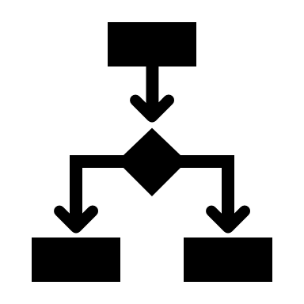

Functional Decomposition
Identify Needs
Identify Functions
Relate
Create Hierarchy Flow Chart
Notes:
We use functional decomposition to breakdown the project into the smallest possible functions. We then relate those functions to each other, as in place them in systems and functions. Then we create a hierarchy flow chart composed of our individual function blocks, this demonstrates how the functions will precede each other functionally.

Slide 59
Functional Decomposition Cross Reference Table
Functions | Systems
 | Move | Support | Navigate | Power
Rotate | X |  | X
Orient part | X
Orient to part | X
Translate | X |  | X
Lift part | X | X | X
Place part | X |  | X
Travel with part | X |  | X
Secure part | X | X
Release part | X
Carry part load |  | X
Regulate applied pressure | X | X
Locate part |  |  | X
Locate destination |  |  | X
Avoid collisions | X |  | X
Receive power |  |  |  | X
Convert power into actuation | X | X |  | X
Process signals | X |  | X | X
Send signals | X |  |  | X
Transduce signals |  |  |  | X
Receive signals |  |  | X | X
Compute signals | X |  | X | X

Slide 60
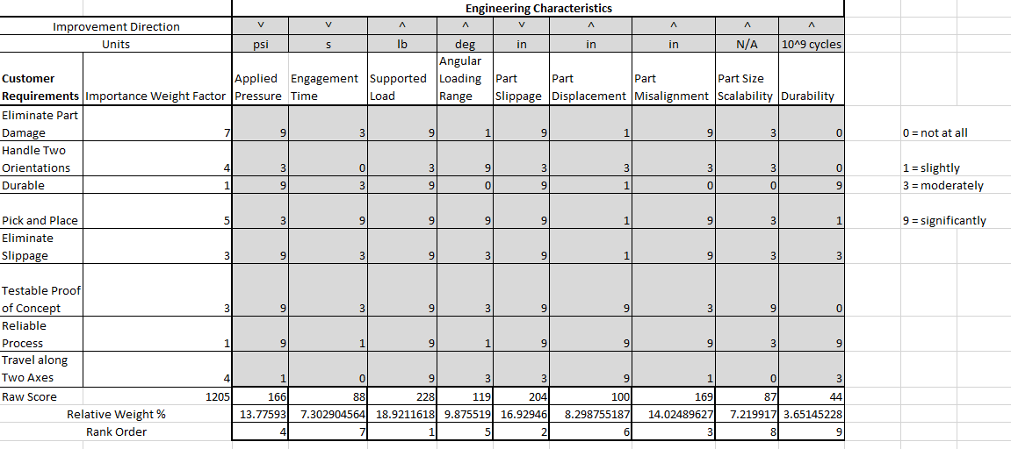
Hoq – full table

Slide 61
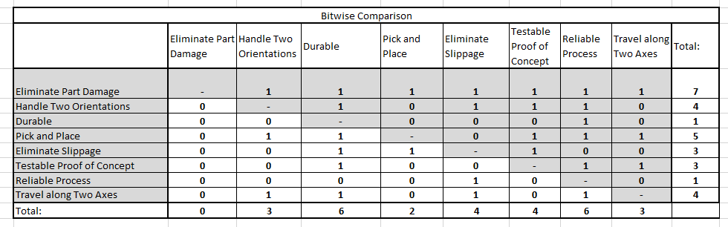
Bitwise comparison – full table

Slide 62
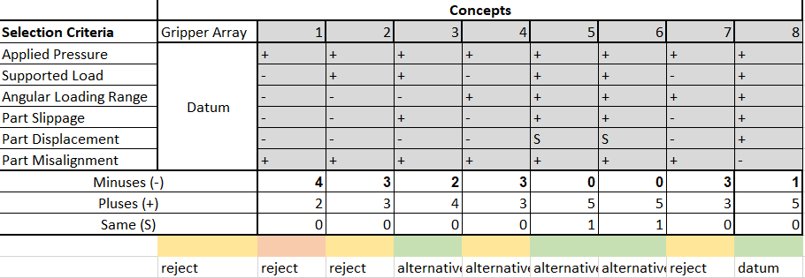
Pugh Chart 1– full table

Slide 63
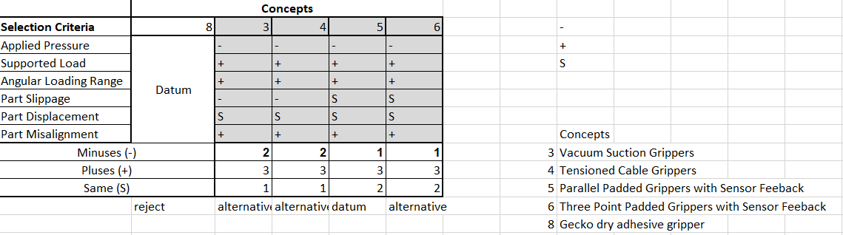
Pugh Chart 2– full table

Slide 64
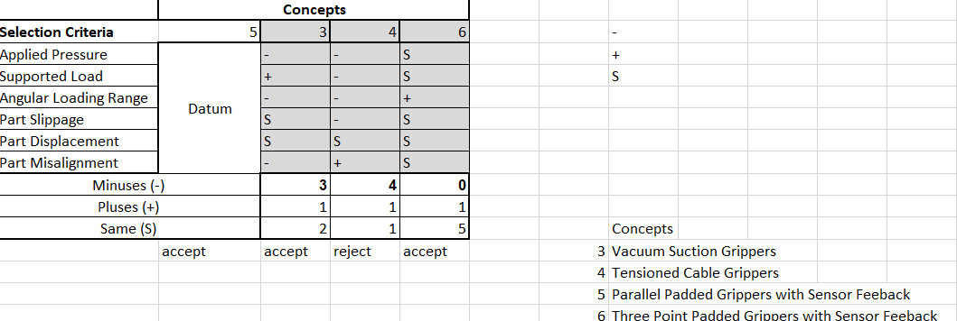
Pugh Chart 3– full table

Slide 65
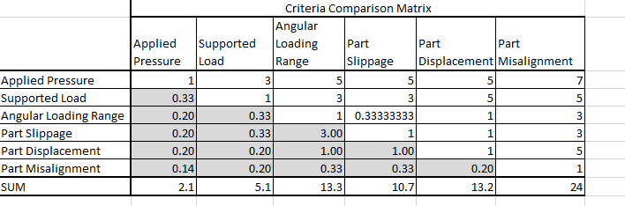
AHP Criteria Comparison– full table

Slide 66
Standard Shapes
Summary Box
Text box 1
Outlined Text Box

Slide 67




Approved Logos

Slide 68
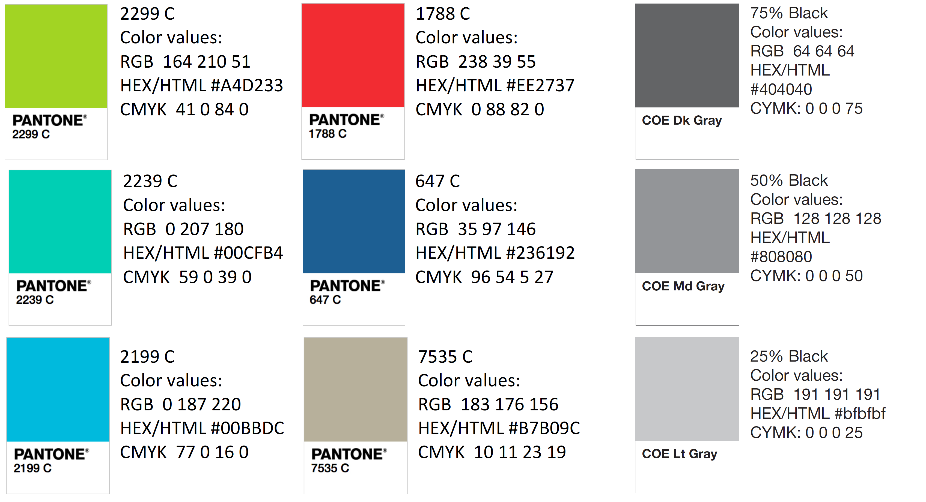
Color Palette

Slide 69
APA Tables
Category 1 | Category 2 | Category 3 | Category 4 | Category 5
Item 1
Item 2
Item 3
Item 4
 | Category 2 |  |  | Category 3
Category 1 | subcategory 1 | subcategory 2 |  | subcategory 1 | subcategory 2
Item 1
Item 2
Item 3
Item 4

