Slide 1
Material Handling of Ceramics
VDR1
Team 502: Makada Browne, Erich Noack, Charles Stubbs, Amelia Veith
Notes:
Greet everyone

Slide 2

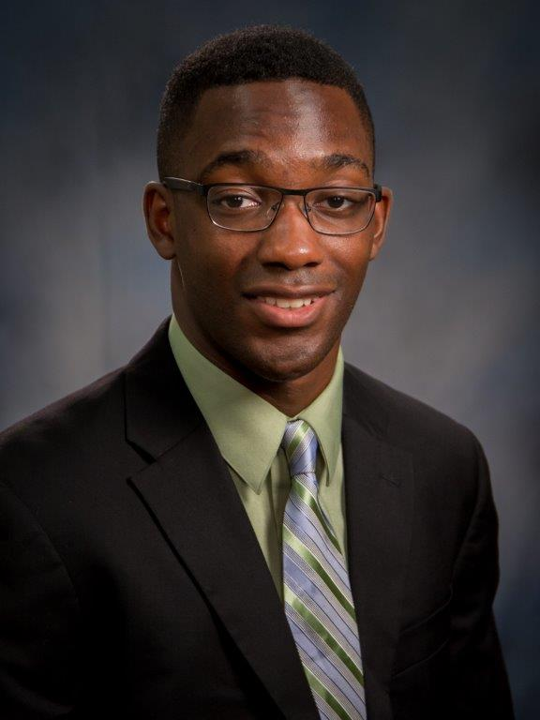
Sponsor
Tevin Smith
-Process Engineer at Corning
-B.S., Material Engineering, Rensselaer Polytechnic Institute (RPI)
-Point of Contact for Team 502
Team 502

Slide 3

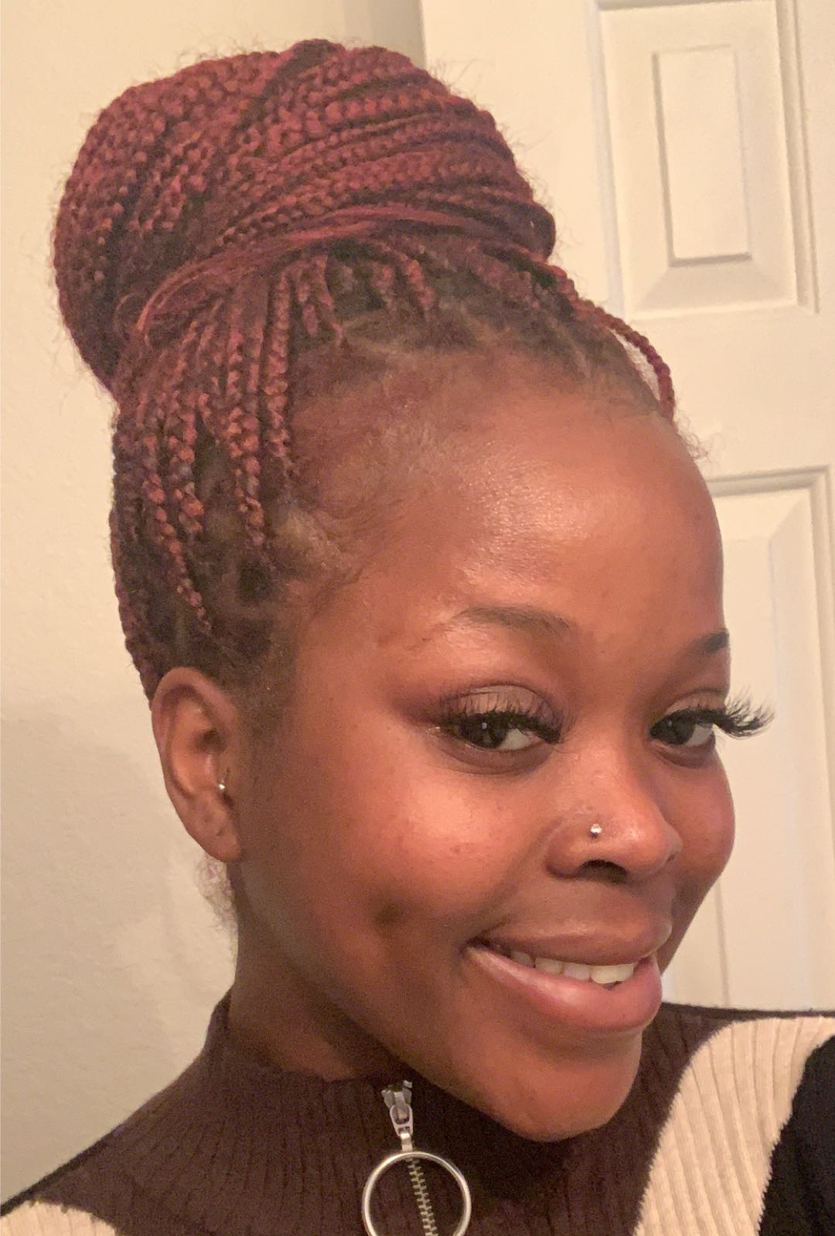



Team Members
Makada Browne
Erich Noack
Charles Stubbs
Amelia Veith
Facilities Engineer
Design Engineer
Test Engineer
Quality Control Engineer
Team 502

Slide 4

Project Brief
-The project team will propose and demonstrate alternative, advantaged material handling approaches that reduce or eliminate part damage, suitable for use on an automated production line.
-Corning has provided Team 502 with a variety of fired ceramic “blanks” representing the state of product as it moves through the downstream processes.
Amelia Veith

Slide 5

Project Background
Amelia Veith

Slide 6
Project Background
Amelia Veith

Slide 7
Project Background
Amelia Veith

Slide 8


Objective
Develop an alternative method for handling ceramic substrates that eliminates damage to the part
Makada Browne

Slide 9


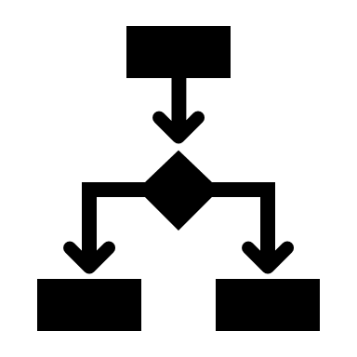

Current Work
Project Scope
Customer Needs
Functional
Decomposition
Makada Browne

Slide 10






Project Scope
Description
Key Goals
Markets
Assumptions
Stakeholders
Makada Browne

Slide 11
Project Scope – Description
-Alternative systems for handling fragile ceramic substrates.
-Team must design an element to be incorporated in the manufacturing process.
-Reduces damage to parts while they are moving through the manufacturing stages.
Makada Browne

Slide 12
Project Scope – Key Goals
Innovative Ideas
Reduced Damage
Autonomous
Process
Functional End Result
Erich Noack

Slide 13
Project Scope – Markets
Primary Markets
Ceramic Substrate Manufacturers – specifically Corning
Secondary Markets
Other manufacturing markets
Ex. Computer chips, satellite components, glassware, etc.
Erich Noack

Slide 14
Project Scope – Assumptions
Characteristic of Solid Ceramics
Cylindrical Extrusions
Solution will not leverage existing process
Automated Process
Erich Noack

Slide 15
Project Scope – Stakeholders
Corning Incorporated
-Tevin Smith, Alexander Richter
FAMU-FSU College of Engineering
-Dr. Shayne McConomy (Senior Design Professor)
-Dr. Simone Peterson Hruda (Ceramics Expert)
General Stakeholders
Erich Noack

Slide 16






Customer Needs
Ask Questions
Tabulate & Interpret
Develop Customer Needs
Charles Stubbs
Notes:
We establish our Customer needs to better define the customer expectations for the project outcome. We wrote down some questions to identify these needs. We started by asking questions and then translating the responses into customer statements. We put these into a large table and then further refine the requirements into customer needs.

Slide 17
Customer Needs
1. Eliminates ceramic part damage
2. Pick and Place capability
3. Handles parts from horizontal and vertical orientations
4. Repeatable, reliable results
Charles Stubbs
Notes:
Further needs include: accommodates reduced strength materials, capable of handling ceramics throughout the finishing process, allows for movement across at least two perpendicular axes

Slide 18



Functional Decomposition
Identify Needs
Identify Functions
Relate
Create Hierarchy Flow Chart
Charles Stubbs
Notes:
We have begun working Functional decomposition, and we have some examples of first draft functions. Fow now, I am just going to discuss how it works. We use functional decomposition to breakdown the project into the smallest possible functions. We then relate those functions to each other, as in place them in systems and functions. Then we create a hierarchy flow chart composed of our individual function blocks, this demonstrates how the functions will precede each other functionally.

Slide 19
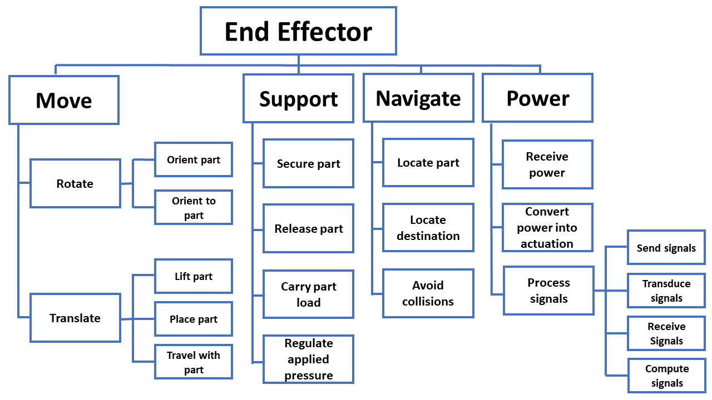
Functional Decomposition
Charles Stubbs
Notes:
We have begun working Functional decomposition, and we have some examples of first draft functions. Fow now, I am just going to discuss how it works. We use functional decomposition to breakdown the project into the smallest possible functions. We then relate those functions to each other, as in place them in systems and functions. Then we create a hierarchy flow chart composed of our individual function blocks, this demonstrates how the functions will precede each other functionally.

Slide 20



Future Work
Concept Selection
Targets & Metrics
Concept Generation
Charles Stubbs
Notes:
Looking forward, in Targets and metrics we identify targets for how we want the functions to perform and metrics for how to validate those targets. We will then go through concept generation where we generate abstract ideas and potential solutions to our design problem. We have already started this and it will be an ongoing process until concept selection. We will generate a minimum of 100 possible concepts. After creating a list of concepts we will go through a selection process of the major and most practical solutions by Going through a HoQ, Pugh Chart and then AHP. Generating matrices and quantititatively evaluating the proposed concepts through comparison.

Slide 21
Thank You

Slide 22
Backup Slides

Slide 23
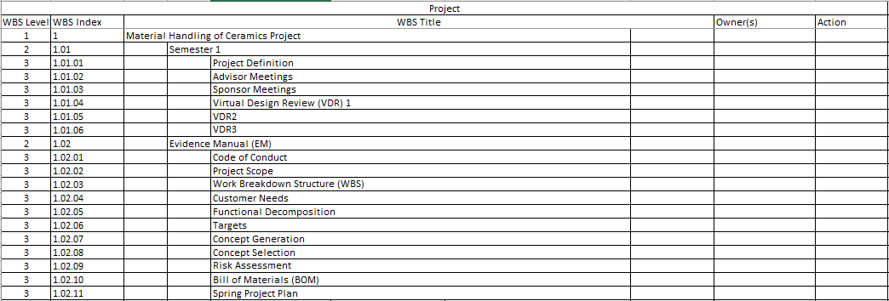
Work Breakdown Structure – 3d level

Slide 24
Customer Needs Full Table
# | Our Questions | Customer Answers | Interpreted Need
1 | Where on the surfaces is damage consistently observed? | Damage caused by robot handling is specifically observed in the center location of the part, as robot EOAT grippers typically engage the skin near the center. | The solution avoids damaging the center of the ceramic part skin.
2 | At what point in the manufacturing process is damage occurring? | The damage is occurring when parts are handled by robots through the Finishing process steps (after parts are Fired). | The solution is capable of handling ceramics throughout the finishing process.
3 | Are there any size constraints for the project? | There are no specific constraints for size. | The solution is of reasonable size.
4 | Are there any weight constraints for the project? | There are no specific constraints for weight. | The solution is of reasonable weight.
5 | Are there any power constraints for the project? | There are no specific constraints for power. | The solution has reasonable power requirements.
6 | Are there publicly available specifications similar to the samples provided? | Yes, see document attached for mechanical properties specific to each product family of the samples provided. | The project is intended for materials close to the specifications given.

Slide 25
Customer Needs Full Table (cont.)
# | Our Questions | Customer Answers | Interpreted Need
7 | Are there any movement limitations for the prototype? | Movement should be evaluated across at least 2 axes (horizontal, vertical movement) while part is being handled. | The project allows for movement along two perpendicular axes.
8 | Is there an audible noise level limit? | Corning follows the OSHA standard when it comes to audible noise level limit, which is no more than an average of 85 dB over 8 hours. | The project complies with OSHA standards.
9 | What should we consider the state of the part just prior to handling? | Parts can be in either horizontal or vertical orientation prior to handling. | The solution handles parts from horizontal and vertical orientations.
10 | Is there any induced motion, or is the part laying still? | The part is typically laying still on a part nest sitting on a conveyor prior to handling. | The solution maneuvers parts from a still position relative to the surface it is on.
11 | What is the most important thing you want out of this project? | At minimum, an option or path forward that reduces part handling or processing damage, based on research and data. | The solution developed reduces part damage.

Slide 26
Customer Needs Full Table (cont.)
# | Our Questions | Customer Answers | Interpreted Need
12 | What is the most important thing you want out of this project? | At minimum, an option or path forward that reduces part handling or processing damage, based on research and data. | The core concept selected for the project is supported by credible research and data.
13 | How would you define success for this project? | Success would be a built prototype and zero part damage indicated in results of data with repeatable results and a reliable process. | The project final deliverable includes a functional prototype to eliminate part damage.
14 | How would you define success for this project? | Success would be a built prototype and zero part damage indicated in results of data with repeatable results and a reliable process. | The project test reports indicate repeatable results and a reliable process.
15 | Is there an induced vibrational frequency/amplitude to avoid? | Our processes are not impacted by vibrational frequency/amplitude, avoidance of induced vibrational frequency/amplitudes should not be required. | The project is reasonably unaffected by ordinary vibrations.

Slide 27
Customer Needs Full Table (cont.)
# | Our Questions | Customer Answers | Interpreted Need
16 | What impact do you want the project to have on the manufacturing process? | The product is not intended to go directly into the process but solely purpose as a proof of concept. | The project demonstrates proof of concept.
17 | Can you elaborate on the need for this solution? | As the porosity of the ceramic materials increases, the part strength will decrease. Future parts are expected to decrease in porosity for improving other properties. | The solution accommodates reduced strength materials.
18 | How is the problem being handled currently? | Several methods currently exist; roller grippers that contact the skin of the part, rubber and foam padding, vacuum handling. | The solution leverages success from existing methods.
19 | Are we providing a mechanism or material? | The project is very unique in the aspect that it is open to you all. The last thing we want to do is provide a prescription to the problem. | The solution is imaginative.

Slide 28
Customer Needs Full Table (cont.)
# | Our Questions | Customer Answers | Interpreted Need
20 | What is the main issue you are trying to solve here? | The main challenge is the isostatic strength measurement for how strong the part is prior to shipping out, damage observed for lower strength, fragile, and lower porosity parts. | The evaluation of success for the project considers isostatic strength and porosity.
21 | Does the solution need to be automated? | It does not have to be automated, looking for pick and place for one axis or two, linear servo to move around. | The project relocates parts across one or more axes.
22 | Is there a specific surface dedicated for handling the parts? | It does not matter what surfaces or edges to pick up. | The solution interfaces with the part on a part surface.

