Slide 1
Material Handling of Ceramics
DR6
Team 502
Makada Browne | Erich Noack | Charles Stubbs | Amelia Veith
Notes:
Greet everyone

Slide 2
Team Members
Makada Browne
Erich Noack
Charles Stubbs
Amelia Veith
Industrial Engineer
Mechanical Engineer
Mechanical Engineer
Mechanical Engineer
Departments of Mechanical Engineering and Industrial Engineering
Team 502
Notes:
Facilities Engineer – Responsible for planning
Design Engineer – Research and develop ideas for new product
Test Engineer – Responsible for all test planning, conducting and reporting activites
Materials Analysis Engineer– Responsible for material selection and analysis
Industrial Engineering – Makada Browne
Mechanical Engineering – Erich Noack, Charles Stubbs, Amelia Veith

Slide 3
Sponsor & Advisor
Tevin Smith
Process Engineer at
Corning Incorporated
Alexander Richter
Process Engineer at
Corning Incorporated
Dr. Shayne McConomy
FAMU-FSU
College of Engineering
Departments of Mechanical Engineering and Industrial Engineering
Notes:
We would like to thank Dr. McConomy for organizing this project and getting us in touch with Corning.

Slide 4
Objective
Propose and develop an alternative solution for successful manipulation of ceramic parts without observed damage
Makada Browne
Departments of Mechanical Engineering and Industrial Engineering

Slide 5
Manufacturing Process
Mixing
Cutting
Handling
Extruding
Firing
Finishing
Makada Browne
Departments of Mechanical Engineering and Industrial Engineering
Notes:
This is the manufacturing process for Corning’s ceramic filters

Slide 6
Ceramic Filters
After the firing process and before the finishing process
Brittle, low impact strength and very thin cell walls
Samples vary in weight and size, dimensions are proportional
7.5 - 15 in.
4 - 17 in.
Makada Browne
Departments of Mechanical Engineering and Industrial Engineering

Slide 7
Key Goals
Eliminate Part Damage
Test with Part Samples
Lean Manufacturing System
Pick and Place Capability
Makada Browne
Departments of Mechanical Engineering and Industrial Engineering
Notes:
Eliminate Part Damage
Implementable in Manufacturing – ideally we would like to create a system that weaves seamlessly into a current manufacturing process
Lean Manufacturing System – In addition to creating something that is implementable in manufacturing we also want our system to demonstrate a lean manufacturing system, meaning it aims to reduce times within the production system
Our final key goal is to test our design with the part samples provided by corning

Slide 8
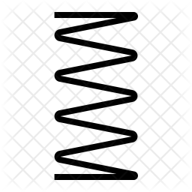
Concept Selection
Three Point Gripper
Parallel Sensing Grippers
Vacuum Suction Grippers
​
​
1st
3rd
2nd
Makada Browne
Departments of Mechanical Engineering and Industrial Engineering
Notes:
After going through concept selection using tools such as the pugh chart, analytical hierarchy process, and house of quality, we arrived at a ranking of our top three concepts; first being the three point sensing gripper, then the parallel sensing gripper, and third the vacuum suction grippers. We decided to move forward with our three point sensing concept and go into 3D modeling

Slide 9
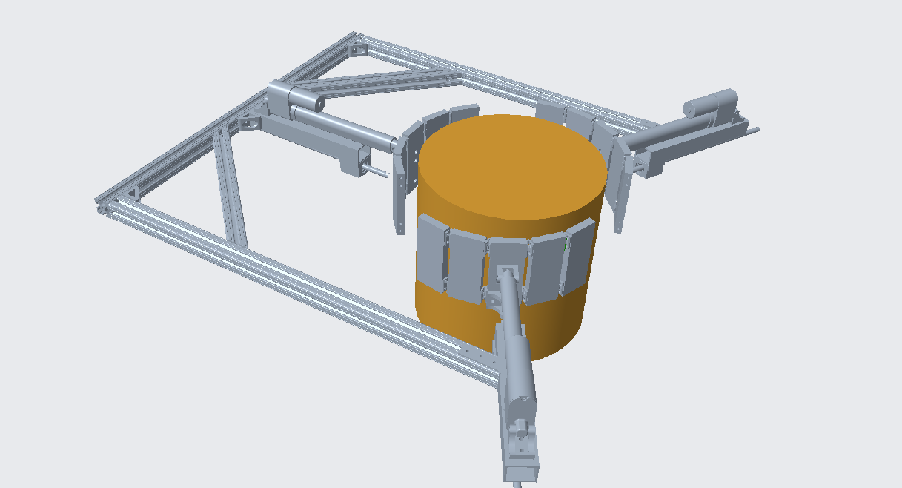
Final Design
Erich Noack
Departments of Mechanical Engineering and Industrial Engineering

Slide 10
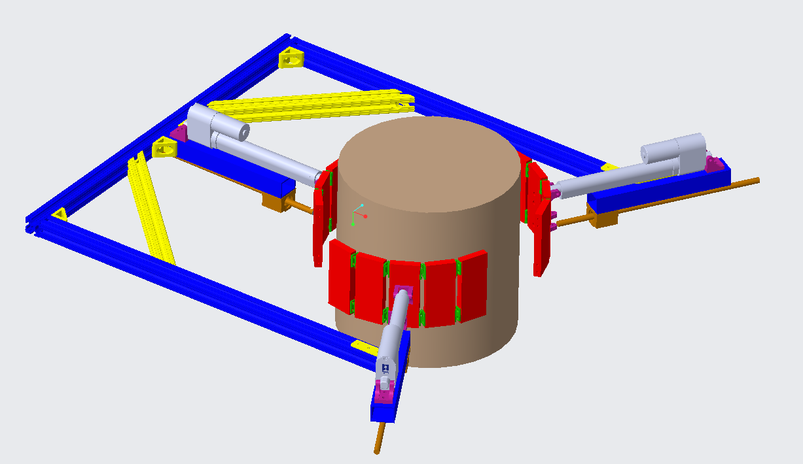
Final Design - Functional Diagram
Linear actuators were added to improve power transmission and control.
Erich Noack
Departments of Mechanical Engineering and Industrial Engineering

Slide 11
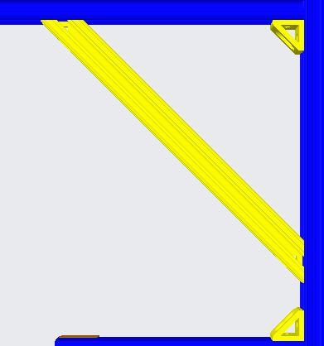
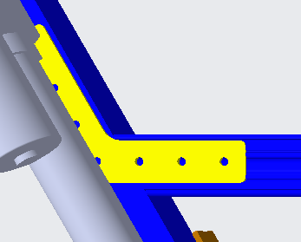
Final Design - Functional Diagram
Diagonal supporting members and gussets were added to support the right angle of the chassis
Brackets were added for support of 120-degree angle for the linear actuator mounting bars.
Erich Noack
Departments of Mechanical Engineering and Industrial Engineering

Slide 12
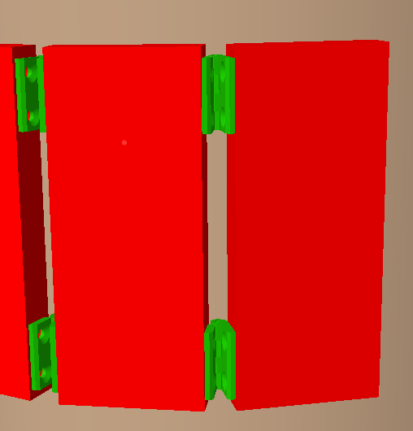
Final Design - Functional Diagram
Hinged flaps were added to accommodate various diameters of ceramics and increase surface contact area.
Erich Noack
Departments of Mechanical Engineering and Industrial Engineering

Slide 13
Final Design - Functional Diagram
Hardware was needed to secure the linear actuators to the mounting bars, and for alignment and support.
Erich Noack
Departments of Mechanical Engineering and Industrial Engineering

Slide 14
Design Iterations
Vertical Chassis Design
DC Motor
Curved Grippers
Sideways Chassis Design
Linear Actuator
Hinged Flaps
Amelia Veith
Departments of Mechanical Engineering and Industrial Engineering
Notes:
Considering the potential flaws from looking at the prototype, we started to make some morefocused design changes. Some of the changes for the design began with considering how to improve the implementation. We chose to reorient the chassis over the length of the part to improve the approach and reduce the moment created for horizontal cases. We also chose to transition to a mechanism with linear actuators to accomplish that concentric motion from before. These will be capable of supporting higher loads statically and dynamically at the cost of movement time. Our next iteration of design also includes multiple pads for each of the gripper that will try to approach the geometry of the surface of the part. This is very important for force distribution. Matching the contour as much as possible will be an important thing to work on for the final design. There will also be compression springs that will be attached to collars on the grippers’ linear rails. These spring linkages will have adjustable links for different size cylinders and the benefit to the design will be the ability to change the stiffness wrt the compliance desired for the grippers.

Slide 15
System Flow
Turned on, proximity sensor begins reading range
When in range, gripper begins closing in
Once gripper touches the ceramic, force sensors begin providing feedback
Off/ Idle
Gripper disengages, leaving undamaged substrate at new location
Test fixture is used to move the substrate along with chassis
Desired force is reached, grippers stop closing in
Amelia Veith
Departments of Mechanical Engineering and Industrial Engineering
Notes:
Considering the potential flaws from looking at the prototype, we started to make some morefocused design changes. Some of the changes for the design began with considering how to improve the implementation. We chose to reorient the chassis over the length of the part to improve the approach and reduce the moment created for horizontal cases. We also chose to transition to a mechanism with linear actuators to accomplish that concentric motion from before. These will be capable of supporting higher loads statically and dynamically at the cost of movement time. Our next iteration of design also includes multiple pads for each of the gripper that will try to approach the geometry of the surface of the part. This is very important for force distribution. Matching the contour as much as possible will be an important thing to work on for the final design. There will also be compression springs that will be attached to collars on the grippers’ linear rails. These spring linkages will have adjustable links for different size cylinders and the benefit to the design will be the ability to change the stiffness wrt the compliance desired for the grippers.

Slide 16
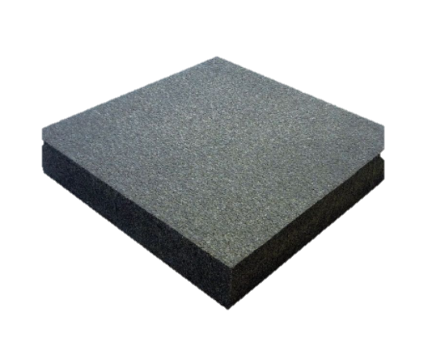
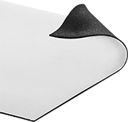
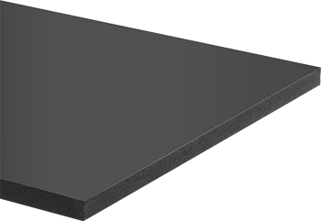
Material Selection
Polyurethane Foam
PORON Microcellular Urethane
Fabric-Faced Wear-Resistant
Amelia Veith
Departments of Mechanical Engineering and Industrial Engineering

Slide 17
Material Selection
PORON Microcellular Urethane
Fabric-Faced Wear-Resistant
Amelia Veith
Departments of Mechanical Engineering and Industrial Engineering

Slide 18
Industrial Operations
Finances
Cycle time
Increase in Overhead cost
Less than or equal to 30 seconds per filter
Facility Layout
Quality
Optimize on current layout
Decrease in scrap rate
Makada Browne
Departments of Mechanical Engineering and Industrial Engineering

Slide 19
Targets and Metrics
Part Displacement
Support Part Load
Regulate Pressure
Part
Slippage
Part Orientation
Engagement Time
18 in
Force
90°
1 sec
Pressure
0.5 in
18 in
Charles Stubbs
Departments of Mechanical Engineering and Industrial Engineering
Notes:
Combining these key goals with the customer needs, we created targets and metrics to measure the success of our design. The first one is part displacement meaning we want to be able to move the part 18 inches horizontally and vertically. Our next metric is the device should be able to carry the payload of a target of up to 40 pounds. While being able to withstand the load is important, it is equally as important that we regulate the pressure exerted on the part as the gripper closes in so we don’t create damage during engagement. Additionally, we created a target for part misalignment, which we want to be 0 mili-inches to prevent slippage. Furthermore, since our parts could be horizontal or vertical we needed to accommodate for both orientations, leading us to create a target of 90 degrees. Although this is a range, the expected orientation will be known for the actual implementation. Our last target ties to our key goal of a lean manufacturing system as we want our engagement time to be 1 second or less.

Slide 20
Test Operation – Phase 1
Targets Evaluated
Regulate Pressure
Engagement Time
Pressure
1 sec
Charles Stubbs
Departments of Mechanical Engineering and Industrial Engineering
Notes:
Combining these key goals with the customer needs, we created targets and metrics to measure the success of our design. The first one is part displacement meaning we want to be able to move the part 18 inches horizontally and vertically. Our next metric is the device should be able to carry the payload of a target of up to 40 pounds. While being able to withstand the load is important, it is equally as important that we regulate the pressure exerted on the part as the gripper closes in so we don’t create damage during engagement. Additionally, we created a target for part misalignment, which we want to be 0 mili-inches to prevent slippage. Furthermore, since our parts could be horizontal or vertical we needed to accommodate for both orientations, leading us to create a target of 90 degrees. Although this is a range, the expected orientation will be known for the actual implementation. Our last target ties to our key goal of a lean manufacturing system as we want our engagement time to be 1 second or less.

Slide 21
Test Operation – Phase 2
Targets Evaluated
Support Part Load
Part Displacement
18 in
Force
18 in
Charles Stubbs
Departments of Mechanical Engineering and Industrial Engineering
Notes:
Combining these key goals with the customer needs, we created targets and metrics to measure the success of our design. The first one is part displacement meaning we want to be able to move the part 18 inches horizontally and vertically. Our next metric is the device should be able to carry the payload of a target of up to 40 pounds. While being able to withstand the load is important, it is equally as important that we regulate the pressure exerted on the part as the gripper closes in so we don’t create damage during engagement. Additionally, we created a target for part misalignment, which we want to be 0 mili-inches to prevent slippage. Furthermore, since our parts could be horizontal or vertical we needed to accommodate for both orientations, leading us to create a target of 90 degrees. Although this is a range, the expected orientation will be known for the actual implementation. Our last target ties to our key goal of a lean manufacturing system as we want our engagement time to be 1 second or less.

Slide 22
Test Operation – Phase 3
Targets Evaluated
Part
Slippage
Engagement Time
0.5 in
1 sec
Charles Stubbs
Departments of Mechanical Engineering and Industrial Engineering
Notes:
Combining these key goals with the customer needs, we created targets and metrics to measure the success of our design. The first one is part displacement meaning we want to be able to move the part 18 inches horizontally and vertically. Our next metric is the device should be able to carry the payload of a target of up to 40 pounds. While being able to withstand the load is important, it is equally as important that we regulate the pressure exerted on the part as the gripper closes in so we don’t create damage during engagement. Additionally, we created a target for part misalignment, which we want to be 0 mili-inches to prevent slippage. Furthermore, since our parts could be horizontal or vertical we needed to accommodate for both orientations, leading us to create a target of 90 degrees. Although this is a range, the expected orientation will be known for the actual implementation. Our last target ties to our key goal of a lean manufacturing system as we want our engagement time to be 1 second or less.

Slide 23
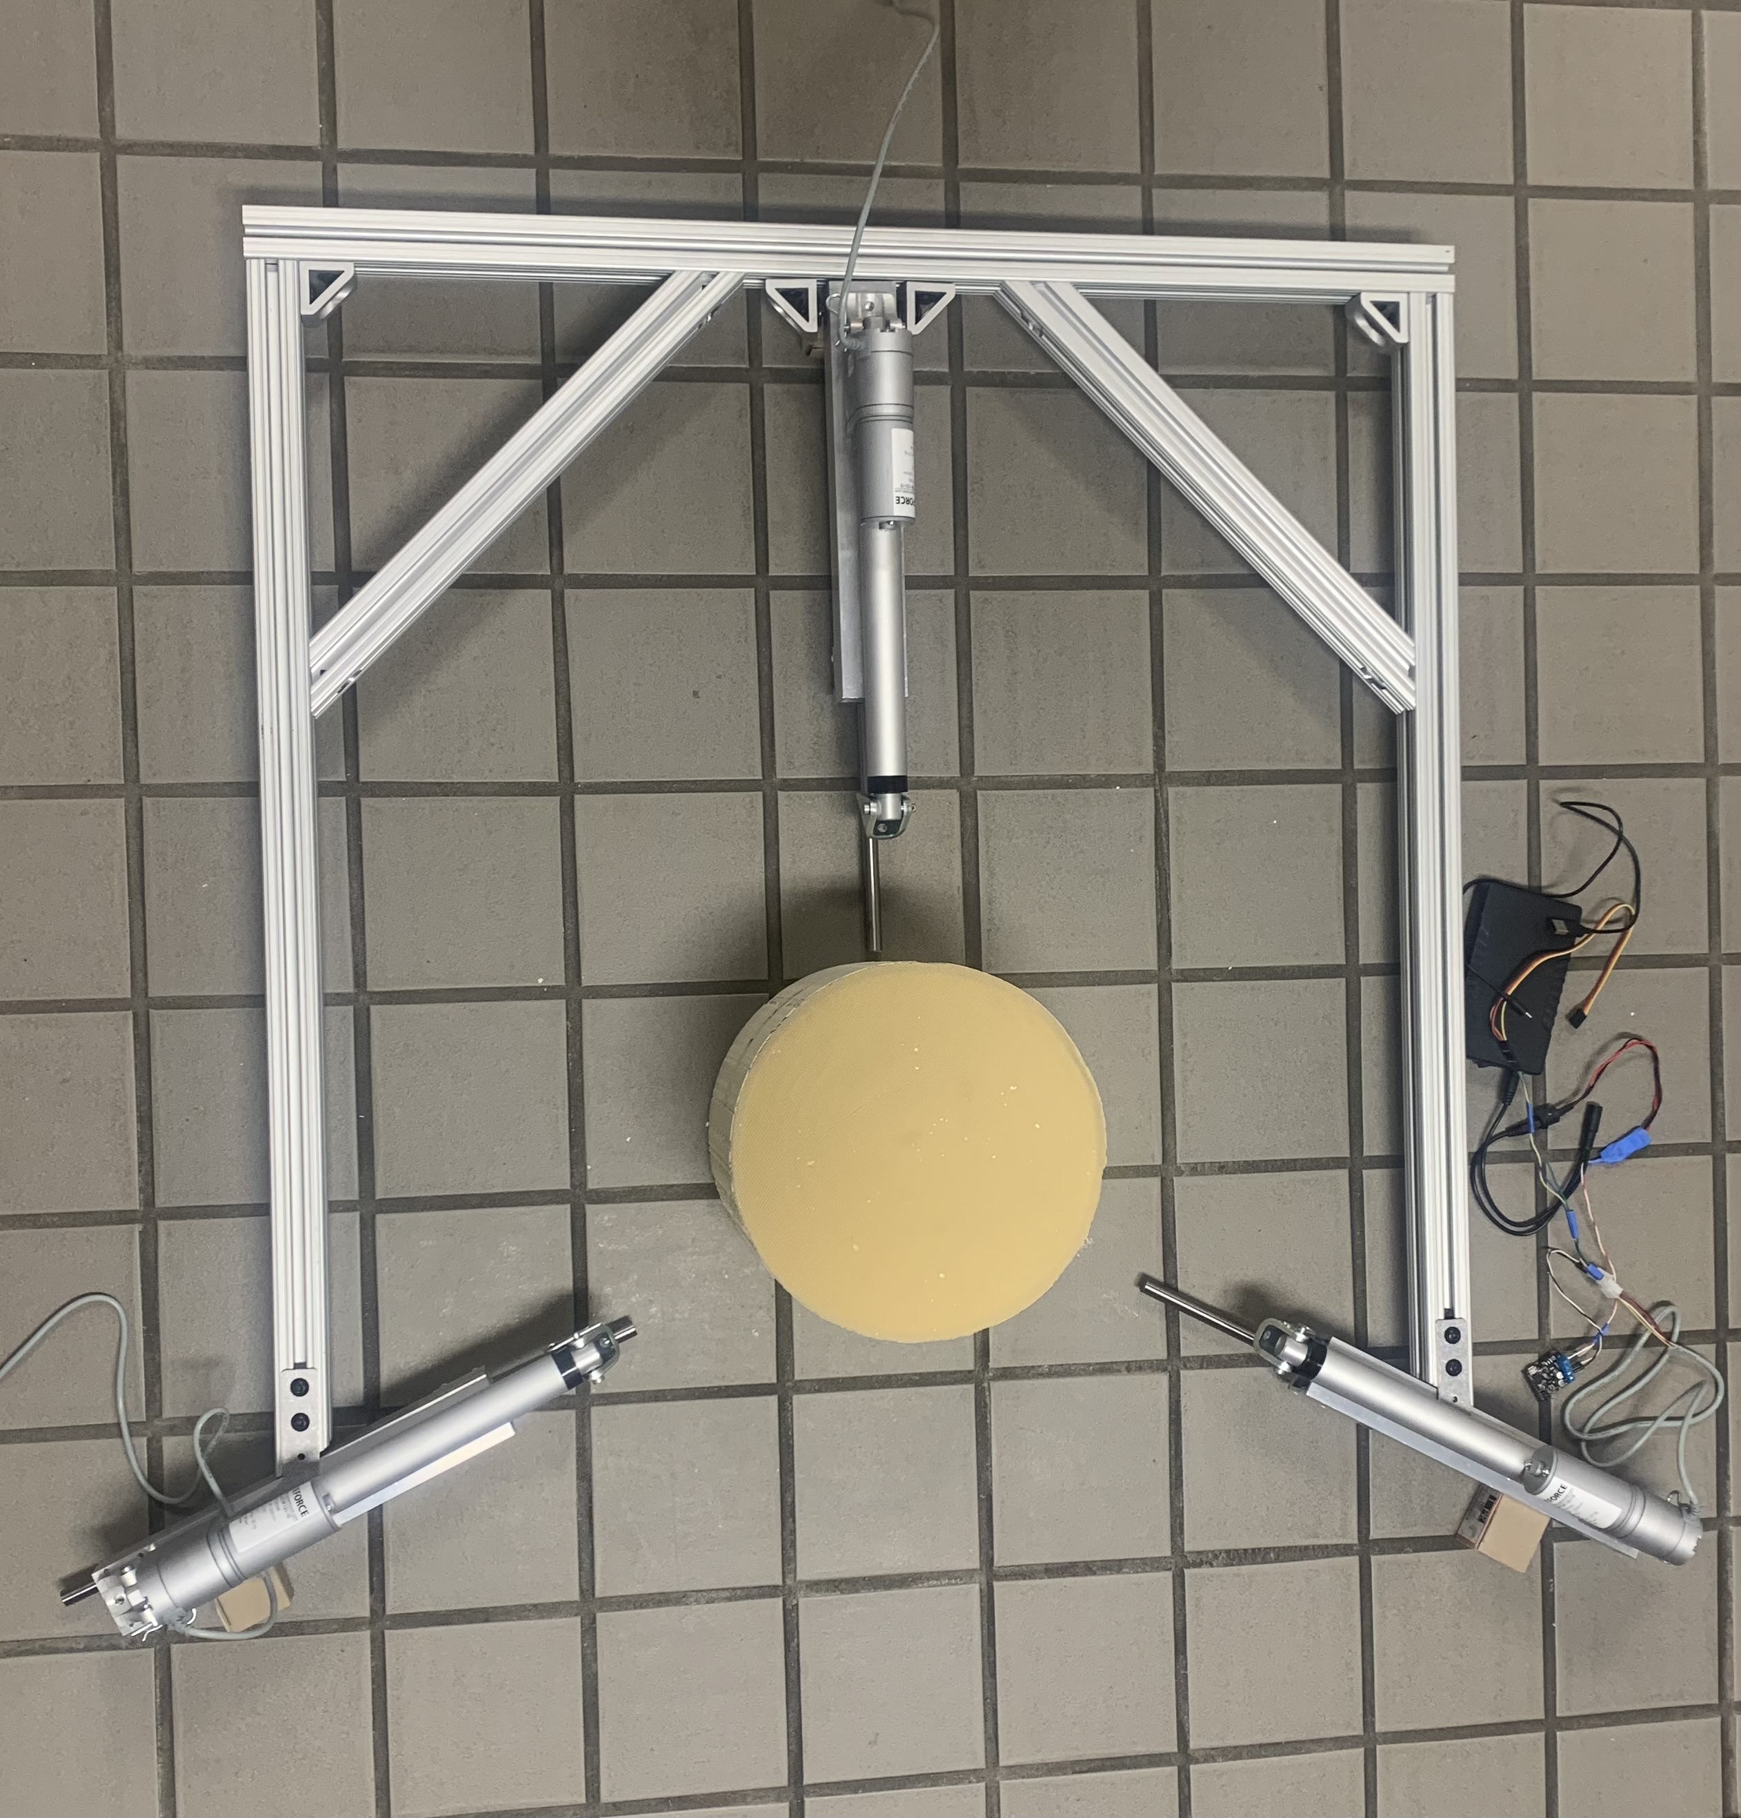
Current State
Fabrication of flaps and foam padding
Force sensor calibration
Proximity sensor housing
Hardware/electronic housing
Controller gains tuning
Charles Stubbs
Departments of Mechanical Engineering and Industrial Engineering

Slide 24
Lessons Learned
Order parts quicker
Better communication
Time management
Team member responsibility
Amelia Veith
Departments of Mechanical Engineering and Industrial Engineering

Slide 25
Thank You
Makada Browne
Erich Noack
Charles Stubbs
Amelia Veith
msb16f@my.fsu.edu
ean18f@my.fsu.edu
ces17f@my.fsu.edu
afv17@my.fsu.edu
Departments of Mechanical Engineering and Industrial Engineering

