Slide 1
ESD- Vision Impaired Technology
Team 522

Slide 2
Team Introductions
David Alicea
Field/Test Engineer and Quality Control
Madison Jaffe​
Project Manager and Discussion Lead
Nicolas Garcia
Design Engineer and Resource Manager
Ethan Saffer
Systems/Design
Engineer
David Alicea

Slide 3
Advisors
Shayne McConomy
FAMU-FSU College of Engineering
Department of Mechanical Engineering
Michael Devine
Florida State University
Jim Moran College of Entrepreneurship
Jerris Hooker
FAMU-FSU College of Engineering
Department of Electrical Engineering
David Alicea

Slide 4
Synopsis: VDR1
Project Description:
Improving the quality of daily life for the visually impaired.
Key Goals:
Aids the visually impaired in daily activities.
Assist people who are visually impaired to become more active.
Keep the visually impaired safe while executing relatively complex tasks.
David Alicea

Slide 5
Synopsis: VDR1
Markets:
Primary market: People with severe visual impairment or total lack of vision, Rehabilitation and treatment centers.
Secondary market: Autonomous Systems, State-local Departments of Transportation.
Assumptions:
Users are mostly unaware of objects in new surroundings.
Users have undergone Orientation and Mobility training/rehabilitation.
The visually impaired are not fully comfortable in current society.
David Alicea

Slide 6
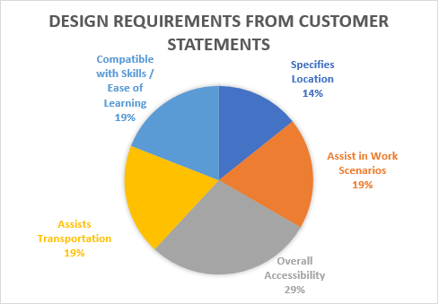
Interpreted Customer Needs
1. Helps Avoid Ground Irregularities
2. Allows for Location Awareness
3. Recognizes Surrounding Objects
4. Notify Emergency Contacts
5. Intuitive with O & M Training
6. Identifies and Reads Text
7. Priced for Low-Income Households
David Alicea

Slide 7
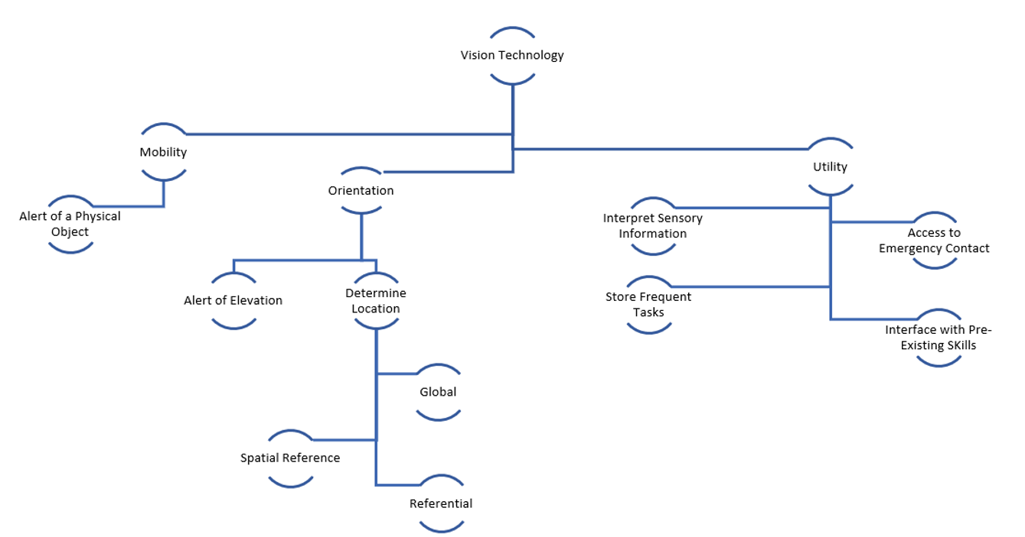
Functional Decomposition
David Alicea

Slide 8
Targets and Metrics
Function | Target | Metric
Alert of Elevation* | 0.25 to 12 inches | Distance
Determine Location* | Margin of error of at most 16 feet | Distance
Alert of Physical Object* | 65 inches | Distance
Identify Possible Threats* | Up to 60 miles per hour | Velocity
Access Emergency Contact | 15 seconds | Time
Interpret Sensory Information* | 7 seconds | Time
Store Frequent Tasks | 1 GB | Memory Allocation
Interface with Pre-Existing Skills | 70% | User Satisfaction
Compete within Market | 20% | Price Range USD ($)
Remain Lightweight | <5.1 lb | Weight
Remain Discrete | 70% | User Approval
David Alicea

Slide 9
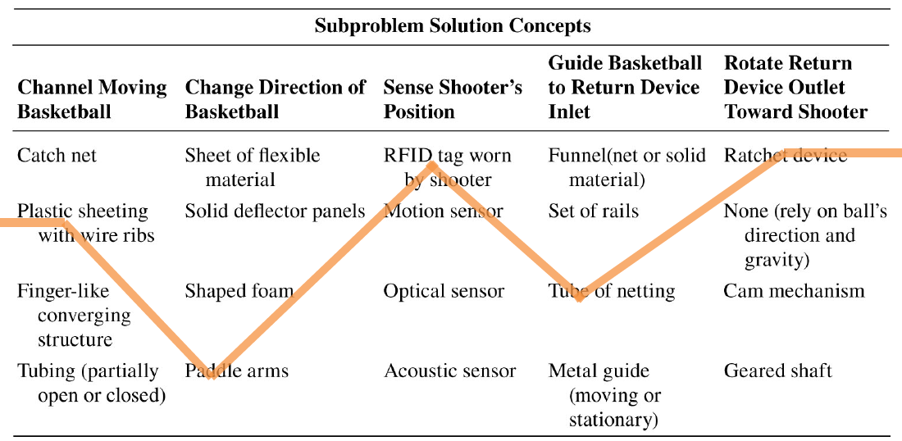
Concept Generation
Three methods were used to develop over 100 potential design ideas.
Crap shoot
Morphological Chart
Biomimicry
David Alicea

Slide 10
Morphological Chart
Alert of Elevation | Determine Location | Alert of Physical Object | Inform of Possible Threats | Interpret Sensory Information
Sensor | GPS Through Wi-Fi/Internet Signal | Distance Sensor | Heat | Camera
Cane/Stick | GPS w/ Maps Downloaded | Velocity Sensor | Vibrate | Text conversion
 | Camera to Read Street Signs and Other Landmarks | Lidar | Noise | Live imaging scanned to a PDF document
 | Memory Storage of Previous Paths |  | Poke | Text to Braille
David Alicea

Slide 11
Medium Fidelity Concepts
Smart Watch:
sensor and computer to indicate where the user is
haptic feedback provided through vibration on wrist.
Smart cane:
haptic feedback voice-activated
phone compatible.
Eyeglass Attachment:
sensor and GPS for user location
Audio feedback through glass-mounted earpiece.
Smart cane:
audio feedback
Tactile or voice-activation
phone compatible
camera to interpret the environment
Smartphone app:
Lidar
user information through haptics
computer and GPS track and locate user.
David Alicea

Slide 12
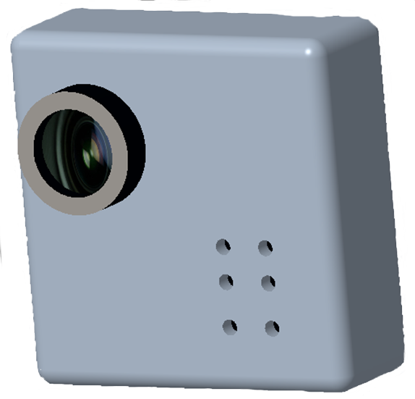
1. High Fidelity Concepts
Ultrasonic sensor on shirt or breast pocket, information relayed wirelessly to an attachment on a white cane. Haptic feedback provided through vibrations on cane.
David Alicea

Slide 13
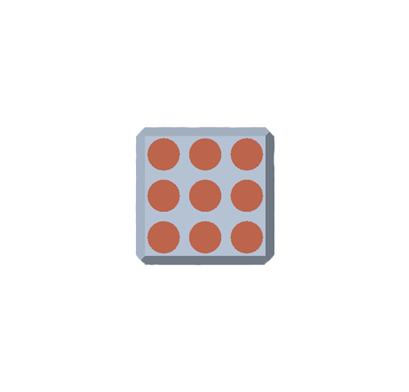
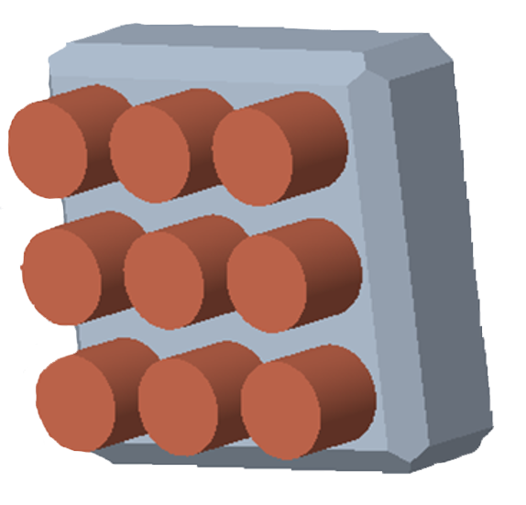
2. High Fidelity Concepts
Handheld 3x3 pin grid system with feedback from ultrasonic sensor, alerts user of relative distance depending on which pin is pressed down and how intensely.
David Alicea

Slide 14
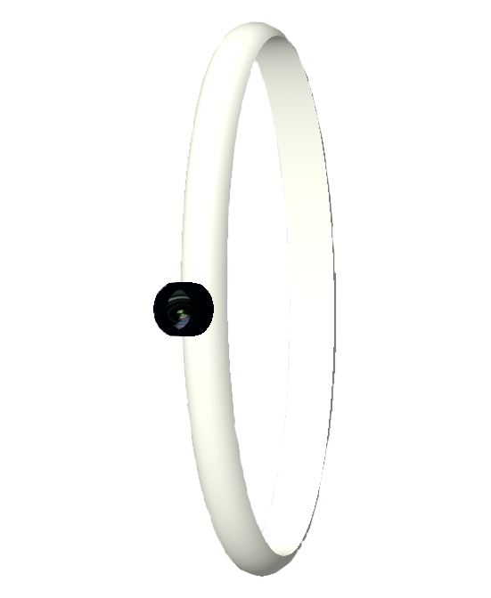
3. High Fidelity Concepts
Watch with ultrasonic sensor which provides haptic feedback when detecting objects.
GPS tracks user's paths and uses vibrational haptic feedback to keep them on their path.
David Alicea

Slide 15
Concept Selection

Slide 16
Importance Weight Factor
Interpreted Customer Needs
Recognizes Surrounding Objects
Intuitive with O&M Training
Notify Emergency Contact
Importance Weight Factor
Priced for Low-Income Households
Helps Avoid Ground Irregularities
Identifies and Reads Text
Allows for Location Detection
Nicolas Garcia

Slide 17
House of Quality
Nicolas Garcia

Slide 18
Pugh Chart
Nicolas Garcia

Slide 19
Pugh Chart 2
Nicolas Garcia

Slide 20
Analytical Hierarchy Process
Criteria Comparison Matrix [C]
 | Alert of Elevation | Determine Location | Interpret Sensory Information | Access Emergency Information | Interface with pre-existing skills | Store Frequent Tasks | Alert of Physical Objects | Inform User of Possible Threats
Alert of Elevation | 1.00 | 1.00 | 0.33 | 5.00 | 1.00 | 3.00 | 0.33 | 1.00
Determine Location | 1.00 | 1.00 | 0.33 | 5.00 | 1.00 | 3.00 | 1.00 | 1.00
Interpret Sensory Information | 3.00 | 3.00 | 1.00 | 5.00 | 3.00 | 5.00 | 1.00 | 1.00
Access Emergency Information | 0.20 | 0.20 | 0.20 | 1.00 | 0.20 | 1.00 | 0.33 | 0.20
Interface with Pre-existing Skills | 1.00 | 1.00 | 0.33 | 5.00 | 1.00 | 3.00 | 0.33 | 1.00
Store Frequent Tasks | 0.33 | 0.33 | 0.20 | 1.00 | 0.33 | 1.00 | 0.33 | 0.33
Alert of Physical Objects | 3.00 | 1.00 | 1.00 | 3.00 | 3.00 | 3.00 | 1.00 | 1.00
Inform User of Possible Threats | 1.00 | 1.00 | 1.00 | 5.00 | 1.00 | 3.00 | 1.00 | 1.00
Sum | 10.53 | 8.53 | 4.40 | 30.00 | 10.53 | 22.00 | 5.33 | 6.53
Nicolas Garcia

Slide 21
Analytical Hierarchy Process
 | Sensor Pin Chip | Sensor Watch | Haptic Smart Cane
Alert of Elevation | 0.11 | 0.11 | 0.78
Determine Location | 0.16 | 0.19 | 0.66
Interpret Sensory Information | 0.45 | 0.45 | 0.09
Access Emergency Contact | 0.20 | 0.20 | 0.60
Interface with Pre-existing Skills | 0.14 | 0.14 | 0.71
Store Frequent Tasks | 0.33 | 0.33 | 0.33
Alert of a Physical Object | 0.43 | 0.14 | 0.43
Inform User of Possible Threats | 0.33 | 0.33 | 0.33
Nicolas Garcia

Slide 22
Analytical Hierarchy Process
Criteria Comparison Matrix [C]
Functions | Criteria Weights{W}
Alert of Elevation | 0.11
Determine Location | 0.13
Interpret Sensory Information | 0.24
Access Emergency Contact | 0.03
Interface With Pre-Existing Skills | 0.11
Store Frequent Tasks | 0.04
Alert of Physical Object | 0.19
Inform User of Possible Threats | 0.15
Sum | 1.00
Nicolas Garcia

Slide 23
Final Selection
Our final selection was ranked:
Haptic Smart Cane
Sensor Pin Chip
Sensor Watch
#1
Haptic Smart Cane
#2
Sensor Pin Chip
#3
Sensor Watch
Nicolas Garcia

Slide 24
Reference
[1] McConomy, S. (2020, November 11). Engineering Characteristics, Functions, Targets, and Metric. FAMU-FSU College of Engineering.
[2] Queen, K. (2016, June). 7 Ways to Make Communities More Livable for People With Vision or Hearing Impairments. AARP.
Nicolas Garcia

Slide 25
Questions?
Nicolas Garcia

Slide 27
APPENDIX

Slide 28
Functional Decomposition
 | Orientation | Mobility | Utility
Alert of Elevation | X | X
Determine Location | X | X
Alert of Physical Object | X | X
Inform User of Possible Threats |  | X | X
Access to Emergency Contact |  |  | X
Interpret Sensory information |  |  | X
Store Frequent Tasks | X |  | X
Interface With Pre-Existing Skills |  |  | X
David Alicea

Slide 29
Binary Comparison Chart
Interprted Customer Needs | 1 | 2 | 3 | 4 | 5 | 6 | 7 | Total 1
1. Helps Avoid Ground Irregularities | - | 1 | 0 | 0 | 0 | 0 | 1 | 2
2. Allows for Location Awareness | 0 | - | 0 | 1 | 0 | 1 | 0 | 2
3. Recognizes Surrounding Objects | 1 | 1 | - | 1 | 1 | 1 | 1 | 6
4. Notify Emergency Contacts | 1 | 0 | 0 | - | 1 | 0 | 1 | 3
5. Intuitive with O & M Training | 1 | 1 | 0 | 0 | - | 1 | 1 | 4
6. Identifies and Reads Text | 1 | 0 | 0 | 1 | 0 | - | 0 | 2
7. Priced for low-income households | 0 | 1 | 0 | 1 | 0 | 1 | - | 3
Total: | 4 | 4 | 0 | 4 | 2 | 4 | 4 | 6

Slide 30
Engineering |  | Concepts
Characteristics | Orcam MyEye2 | Sensor Pin Chip | Pin Matrix Haptics | Sensor Watch | GPS App | GPS Watch | Haptic Smart Cane | Smart Glasses | Audio Feedback Cane
Alert of Elevation | Datum | + | + | + | - | - | + | S | +
Determine Location |  | S | S | + | + | + | + | + | +
Interpret Sensory Information |  | - | - | - | - | + | S | - | S
Access Emergency Contact |  | S | S | S | + | - | + | - | +
Interface With Pre-Existing Skills |  | S | + | + | S | S | + | S | S
Store Frequent Tasks |  | + | S | S | S | - | S | - | +
Alert of Physical Object |  | + | + | + | - | + | - | + | -
Inform User of Possible Threats |  | + | + | + | + | + | - | + | +
# of Pluses |  | 4 | 4 | 5 | 3 | 4 | 4 | 3 | 5
# of Minuses |  | 2 | 1 | 1 | 3 | 3 | 2 | 3 | 1

Slide 31
Engineering |  | Concepts
Characteristics | GPS Watch | Sensor Pin Chip | Sensor Watch | GPS App | Haptic Smart Cane | Smart Glasses | Audio Feedback Cane
Alert of Elevation | Datum | + | + | S | + | S | +
Determine Location |  | - | - | S | - | S | -
Interpret Sensory Information |  | + | + | S | + | + | +
Access Emergency Contact |  | S | S | + | S | S | -
Interface With Pre-Existing Skills |  | S | + | + | + | S | +
Store Frequent Tasks |  | + | S | S | S | S | S
Alert of Physical Object |  | + | + | - | + | + | +
Inform User of Possible Threats |  | + | + | - | + | + | +
# of Pluses |  | 5 | 5 | 2 | 5 | 3 | 5
# of Minuses |  | 1 | 1 | 2 | 1 | 0 | 2

Slide 32
Engineering Concepts
Units |  | Inches | Latitude/Longitude | Seconds | Seconds | Minutes | GB | Seconds | Seconds
Customer Requirements | Importance Weight Factor | Alert of Elevation | Determine Location | Interpret Sensory Information | Access Emergency Contact | Interface With Pre-Existing Skills | Store Frequent Tasks | Alert of Physical Object | Inform User of Possible Threats
1. Helps Avoid Ground Irregularities | 2 | 9 | 5 | 9 | - | 7 | 1 | 7 | 9
2. Allows for Location Awareness | 2 | 9 | 9 | 9 | - | 1 | 1 | 7 | 3
3. Recognizes Surrounding Objects | 6 | 7 | 7 | 9 | - | 3 | 5 | 9 | 3
4. Notify Emergency Contacts | 3 | 1 | 5 | - | 9 | 1 | 3 | 1 | 1
5. Intuitive with O & M Training | 4 | 5 | 5 | 5 | 3 | 9 | 3 | 3 | 1
6. Identifies and Reads Text | 2 | - | - | 5 | 1 | - | 5 | - | -
7. Priced for low-income households | 3 | - | - | - | - | - | - | - | -
Raw Score (629) | N/A | 101 | 85 | 122 | 41 | 73 | 65 | 97 | 43
Relative Weight % |  | 16.1 | 13.5 | 19.4 | 6.5 | 11.6 | 10.3 | 15.4 | 6.8
Rank Order |  | 2 | 4 | 1 | 8 | 5 | 6 | 3 | 7

Slide 33
Development of Candidate Set of Criteria Weights {W}
Criteria Comparison Matrix [C]
 | Alert of Elevation | Determine Location | Interpret Sensory Information | Acccess Emergency Contact | Interface With Pre-Existing Skills | Store Fequent tasks | Alert of Physical Objects | Inform User of Possible Threats
Alert of Elevation | 1.00 | 1.00 | 0.33 | 5.00 | 1.00 | 3.00 | 0.33 | 1.00
Determine Location | 1.00 | 1.00 | 0.33 | 5.00 | 1.00 | 3.00 | 1.00 | 1.00
Interpret Sensory Information | 3.00 | 3.00 | 1.00 | 5.00 | 3.00 | 5.00 | 1.00 | 1.00
Access Emergency Contact | 0.20 | 0.20 | 0.20 | 1.00 | 0.20 | 1.00 | 0.33 | 0.20
Interface With Pre-Existing Skills | 1.00 | 1.00 | 0.33 | 5.00 | 1.00 | 3.00 | 0.33 | 1.00
Store Frequent Tasks | 0.33 | 0.33 | 0.20 | 1.00 | 0.33 | 1.00 | 0.33 | 0.33
Alert of Physical Object | 3.00 | 1.00 | 1.00 | 3.00 | 3.00 | 3.00 | 1.00 | 1.00
Inform User of Possible Threats | 1.00 | 1.00 | 1.00 | 5.00 | 1.00 | 3.00 | 1.00 | 1.00
Sum | 10.53 | 8.53 | 4.40 | 30.00 | 10.53 | 22.00 | 5.33 | 6.53

Slide 34
Development of Candidate Set of Criteria Weights {W}
Criteria Comparison Matrix [C]
 | Alert of Elevation | Determine Location | Interpret Sensory Information | Acccess Emergency Contact | Interface With Pre-Existing Skills | Store Fequent tasks | Alert of Physical Objects | Inform User of Possible Threats | Criteria Weights{W}
Alert of Elevation | 0.09 | 0.12 | 0.08 | 0.17 | 0.09 | 0.14 | 0.06 | 0.15 | 0.11
Determine Location | 0.09 | 0.12 | 0.08 | 0.17 | 0.09 | 0.14 | 0.19 | 0.15 | 0.13
Interpret Sensory Information | 0.28 | 0.35 | 0.23 | 0.17 | 0.28 | 0.23 | 0.19 | 0.15 | 0.24
Access Emergency Contact | 0.02 | 0.02 | 0.05 | 0.03 | 0.02 | 0.05 | 0.06 | 0.03 | 0.03
Interface With Pre-Existing Skills | 0.09 | 0.12 | 0.08 | 0.17 | 0.09 | 0.14 | 0.06 | 0.15 | 0.11
Store Frequent Tasks | 0.03 | 0.04 | 0.05 | 0.03 | 0.03 | 0.05 | 0.06 | 0.05 | 0.04
Alert of Physical Object | 0.28 | 0.12 | 0.23 | 0.10 | 0.28 | 0.14 | 0.19 | 0.15 | 0.19
Inform User of Possible Threats | 0.09 | 0.12 | 0.23 | 0.17 | 0.09 | 0.14 | 0.19 | 0.15 | 0.15
Sum | 1.00 | 1.00 | 1.00 | 1.00 | 1.00 | 1.00 | 1.00 | 1.00 | 1.00

Slide 35
Weighted Sum Vector | Criteria Weights{W} | Consistency vector
0.94 | 0.11 | 8.37
1.07 | 0.13 | 8.32
2.02 | 0.24 | 8.57
0.29 | 0.03 | 8.23
0.94 | 0.11 | 8.37
0.35 | 0.04 | 8.32
1.61 | 0.19 | 8.61
1.22 | 0.15 | 8.32
# of criteria | RI value | Average Consistency | Consistency Index | Consistency Ratio
8.00 | 1.40 | 8.39 | 0.06 | 0.04

Slide 36
Development of Candidate Set of Criteria Weights {W} ALERT OF ELEVATION | Alert of Elevation
Criteria Comparison Matrix [C]
 | Sensor Pin Chip | Sensor Watch | Haptic Smart Cane
Sensor Pin Chip | 1.00 | 1.00 | 0.14
Sensor Watch | 1.00 | 1.00 | 0.14
Haptic Smart Cane | 7.00 | 7.00 | 1.00
Sum | 9.00 | 9.00 | 1.29

Slide 37
Development of Candidate Set of Criteria Weights {W}
Criteria Comparison Matrix [C]
 | Sensor Pin Chip | Sensor Watch | Haptic Smart Cane | Design Alternative Priorities {Pi}
Sensor Pin Chip | 0.11 | 0.11 | 0.11 | 0.11
Sensor Watch | 0.11 | 0.11 | 0.11 | 0.11
Haptic Smart Cane | 0.78 | 0.78 | 0.78 | 0.78
Sum | 1.00 | 1.00 | 1.00 | 1.00

Slide 38
Weighted Sum Vector | Design Alternative Priorities | Consistency vector
0.33 | 0.11 | 3.00
0.33 | 0.11 | 3.00
2.33 | 0.78 | 3.00
# of criteria | RI value | Average Consistency | Consistency Index | Consistency Ratio
3.00 | 0.52 | 3.00 | 0.00 | 0.00

Slide 39
Development of Candidate Set of Criteria Weights {W} | Determine Location
Criteria Comparison Matrix [C]
 | Sensor Pin Chip | Sensor Watch | Haptic Smart Cane
Sensor Pin Chip | 1.00 | 1.00 | 0.20
Sensor Watch | 1.00 | 1.00 | 0.33
Haptic Smart Cane | 5.00 | 3.00 | 1.00
Sum | 7.00 | 5.00 | 1.53

Slide 40
Development of Candidate Set of Criteria Weights {W}
Criteria Comparison Matrix [C]
 | Sensor Pin Chip | Sensor Watch | Haptic Smart Cane | Design Alternative Priorities {Pi}
Sensor Pin Chip | 0.14 | 0.20 | 0.13 | 0.16
Sensor Watch | 0.14 | 0.20 | 0.22 | 0.19
Haptic Smart Cane | 0.71 | 0.60 | 0.65 | 0.66
Sum | 1.00 | 1.00 | 1.00 | 1.00

Slide 41
Weighted Sum Vector | Design Alternative Priorities | Consistency vector
0.48 | 0.16 | 3.01
0.56 | 0.19 | 3.01
2.00 | 0.66 | 3.06
# of criteria | RI value | Average Consistency | Consistency Index | Consistency Ratio
3.00 | 0.52 | 3.00 | 0.00 | 0.00

Slide 42
Development of Candidate Set of Criteria Weights {W} | Interpret Sensory Information
Criteria Comparison Matrix [C]
 | Sensor Pin Chip | Sensor Watch | Haptic Smart Cane
Sensor Pin Chip | 1.00 | 1.00 | 5.00
Sensor Watch | 1.00 | 1.00 | 5.00
Haptic Smart Cane | 0.20 | 0.20 | 1.00
Sum | 2.20 | 2.20 | 11.00

Slide 43
Development of Candidate Set of Criteria Weights {W}
Criteria Comparison Matrix [C]
 | Sensor Pin Chip | Sensor Watch | Haptic Smart Cane | Design Alternative Priorities {Pi}
Sensor Pin Chip | 0.45 | 0.45 | 0.45 | 0.45
Sensor Watch | 0.45 | 0.45 | 0.45 | 0.45
Haptic Smart Cane | 0.09 | 0.09 | 0.09 | 0.09
Sum | 1.00 | 1.00 | 1.00 | 1.00

Slide 44
# of criteria | RI value | Average Consistency | Consistency Index | Consistency Ratio
3.00 | 0.52 | 3.00 | 0.00 | 0.00
Weighted Sum Vector | Design Alternative Priorities | Consistency vector
1.36 | 0.45 | 3.00
1.36 | 0.45 | 3.00
0.27 | 0.09 | 3.00

Slide 45
Development of Candidate Set of Criteria Weights {W} | Access Emergency Contact
Criteria Comparison Matrix [C]
 | Sensor Pin Chip | Sensor Watch | Haptic Smart Cane
Sensor Pin Chip | 1.00 | 1.00 | 0.33
Sensor Watch | 1.00 | 1.00 | 0.33
Haptic Smart Cane | 3.00 | 3.00 | 1.00
Sum | 5.00 | 5.00 | 1.67

Slide 46
Development of Candidate Set of Criteria Weights {W}
Criteria Comparison Matrix [C]
 | Sensor Pin Chip | Sensor Watch | Haptic Smart Cane | Design Alternative Priorities {Pi}
Sensor Pin Chip | 0.20 | 0.20 | 0.20 | 0.20
Sensor Watch | 0.20 | 0.20 | 0.20 | 0.20
Haptic Smart Cane | 0.60 | 0.60 | 0.60 | 0.60
Sum | 1.00 | 1.00 | 1.00 | 1.00

Slide 47
# of criteria | RI value | Average Consistency | Consistency Index | Consistency Ratio
3.00 | 0.52 | 3.00 | 0.00 | 0.00
Weighted Sum Vector | Design Alternative Priorities | Consistency vector
0.60 | 0.20 | 3.00
0.60 | 0.20 | 3.00
1.80 | 0.60 | 3.00

Slide 48
Development of Candidate Set of Criteria Weights {W} | Interface With Pre-Existing Skills
Criteria Comparison Matrix [C]
 | Sensor Pin Chip | Sensor Watch | Haptic Smart Cane
Sensor Pin Chip | 1.00 | 1.00 | 0.20
Sensor Watch | 1.00 | 1.00 | 0.20
Haptic Smart Cane | 5.00 | 5.00 | 1.00
Sum | 7.00 | 7.00 | 1.40

Slide 49
Development of Candidate Set of Criteria Weights {W}
Criteria Comparison Matrix [C]
 | Sensor Pin Chip | Sensor Watch | Haptic Smart Cane | Design Alternative Priorities {Pi}
Sensor Pin Chip | 0.14 | 0.14 | 0.14 | 0.14
Sensor Watch | 0.14 | 0.14 | 0.14 | 0.14
Haptic Smart Cane | 0.71 | 0.71 | 0.71 | 0.71
Sum | 1.00 | 1.00 | 1.00 | 1.00

Slide 50
Weighted Sum Vector | Design Alternative Priorities | Consistency vector
0.43 | 0.14 | 3.00
0.43 | 0.14 | 3.00
2.14 | 0.71 | 3.00
# of criteria | RI value | Average Consistency | Consistency Index | Consistency Ratio
3.00 | 0.52 | 3.00 | 0.00 | 0.00

Slide 51
Development of Candidate Set of Criteria Weights {W} | Store Frequent Tasks
Criteria Comparison Matrix [C]
 | Sensor Pin Chip | Sensor Watch | Haptic Smart Cane
Sensor Pin Chip | 1.00 | 1.00 | 1.00
Sensor Watch | 1.00 | 1.00 | 1.00
Haptic Smart Cane | 1.00 | 1.00 | 1.00
Sum | 3.00 | 3.00 | 3.00

Slide 52
Development of Candidate Set of Criteria Weights {W}
Criteria Comparison Matrix [C]
 | Sensor Pin Chip | Sensor Watch | Haptic Smart Cane | Design Alternative Priorities {Pi}
Sensor Pin Chip | 0.33 | 0.33 | 0.33 | 0.33
Sensor Watch | 0.33 | 0.33 | 0.33 | 0.33
Haptic Smart Cane | 0.33 | 0.33 | 0.33 | 0.33
Sum | 1.00 | 1.00 | 1.00 | 1.00

Slide 53
# of criteria | RI value | Average Consistency | Consistency Index | Consistency Ratio
3.00 | 0.52 | 3.00 | 0.00 | 0.00
Weighted Sum Vector | Design Alternative Priorities | Consistency vector
1.00 | 0.33 | 3.00
1.00 | 0.33 | 3.00
1.00 | 0.33 | 3.00

Slide 54
Development of Candidate Set of Criteria Weights {W} | Alert of Physical Object
Criteria Comparison Matrix [C]
 | Sensor Pin Chip | Sensor Watch | Haptic Smart Cane
Sensor Pin Chip | 1.00 | 3.00 | 1.00
Sensor Watch | 0.33 | 1.00 | 0.33
Haptic Smart Cane | 1.00 | 3.00 | 1.00
Sum | 2.33 | 7.00 | 2.33

Slide 55
Development of Candidate Set of Criteria Weights {W}
Criteria Comparison Matrix [C]
 | Sensor Pin Chip | Sensor Watch | Haptic Smart Cane | Design Alternative Priorities {Pi}
Sensor Pin Chip | 0.43 | 0.43 | 0.43 | 0.43
Sensor Watch | 0.14 | 0.14 | 0.14 | 0.14
Haptic Smart Cane | 0.43 | 0.43 | 0.43 | 0.43
Sum | 1.00 | 1.00 | 1.00 | 1.00

Slide 56
Weighted Sum Vector | Design Alternative Priorities | Consistency vector
1.29 | 0.43 | 3.00
0.43 | 0.14 | 3.00
1.29 | 0.43 | 3.00
# of criteria | RI value | Average Consistency | Consistency Index | Consistency Ratio
3.00 | 0.52 | 3.00 | 0.00 | 0.00

Slide 57
Development of Candidate Set of Criteria Weights {W} | Inform User of Possible Threats
Criteria Comparison Matrix [C]
 | Sensor Pin Chip | Sensor Watch | Haptic Smart Cane
Sensor Pin Chip | 1.00 | 1.00 | 1.00
Sensor Watch | 1.00 | 1.00 | 1.00
Haptic Smart Cane | 1.00 | 1.00 | 1.00
Sum | 3.00 | 3.00 | 3.00

Slide 58
Development of Candidate Set of Criteria Weights {W}
Criteria Comparison Matrix [C]
 | Sensor Pin Chip | Sensor Watch | Haptic Smart Cane | Design Alternative Priorities {Pi}
Sensor Pin Chip | 0.33 | 0.33 | 0.33 | 0.33
Sensor Watch | 0.33 | 0.33 | 0.33 | 0.33
Haptic Smart Cane | 0.33 | 0.33 | 0.33 | 0.33
Sum | 1.00 | 1.00 | 1.00 | 1.00

Slide 59
# of criteria | RI value | Average Consistency | Consistency Index | Consistency Ratio
3.00 | 0.52 | 3.00 | 0.00 | 0.00
Weighted Sum Vector | Design Alternative Priorities | Consistency vector
1.00 | 0.33 | 3.00
1.00 | 0.33 | 3.00
1.00 | 0.33 | 3.00

Slide 60
 | Sensor Pin Chip | Sensor Watch | Haptic Smart Cane
Alert of Elevation | 0.11 | 0.11 | 0.78
Determine Location | 0.16 | 0.19 | 0.66
Interpret Sensory Information | 0.45 | 0.45 | 0.09
Access Emergency Contact | 0.20 | 0.20 | 0.60
Interface With Pre-Existing Skills | 0.14 | 0.14 | 0.71
Store Frequent Tasks | 0.33 | 0.33 | 0.33
Alert of Physical Object | 0.43 | 0.14 | 0.43
Inform User of Possible Threats | 0.33 | 0.33 | 0.33
Concept | Alternative Value
Sensor Pin Chip | 0.27
Sensor Watch | 0.24
Haptic Smart Cane | 0.49

Slide 61
Standard Shapes
Summary Box
Text box 1
Outlined Text Box

Slide 62
Approved Logos

Slide 64
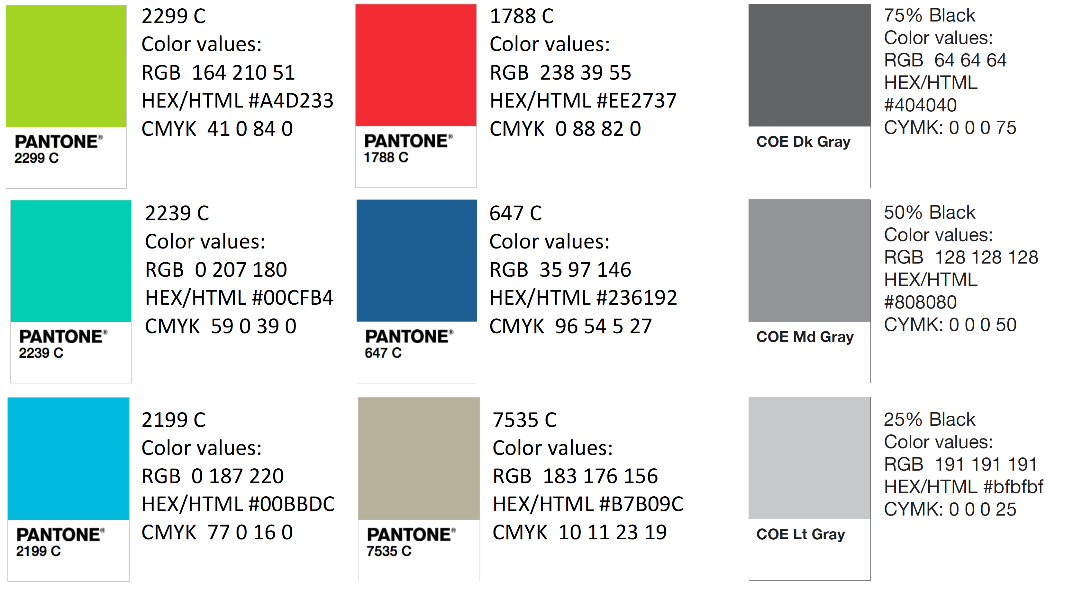
Color Palette

Slide 65
APA Tables
Category 1 | Category 2 | Category 3 | Category 4 | Category 5
Item 1
Item 2
Item 3
Item 4
 | Category 2 |  |  | Category 3
Category 1 | subcategory 1 | subcategory 2 |  | subcategory 1 | subcategory 2
Item 1
Item 2
Item 3
Item 4

