Slide 1
ESD- Vision Impaired Technology
Team 522

Slide 2




Team Introductions
Madison Jaffe​
Project Manager and Discussion Lead
Nicolas Garcia
Design Engineer and Resource Manager
Ethan Saffer
Systems/Design
Engineer
David Alicea
Field/Test Engineer and Quality Control
Madison Jaffe

Slide 3
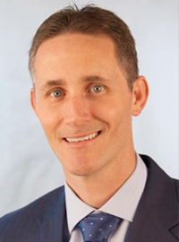


Advisors
Shayne McConomy
(850) 410-6624
smcconomy@eng.famu.fsu.edu
Michael Devine
(850) 410-6378
mdevine@eng.famu.fsu.edu
Jerris Hooker
(850) 410-6463
hooker@eng.famu.fsu.edu
Madison Jaffe

Slide 4
Project Brief
The visually impaired are deprived of sensory information and need some form of technology to interpret it.
Madison Jaffe

Slide 5
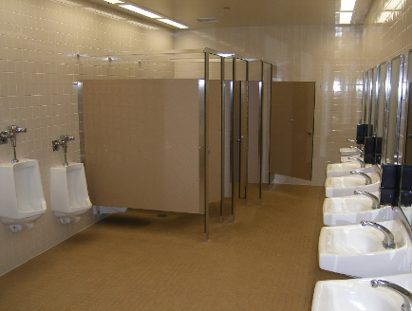
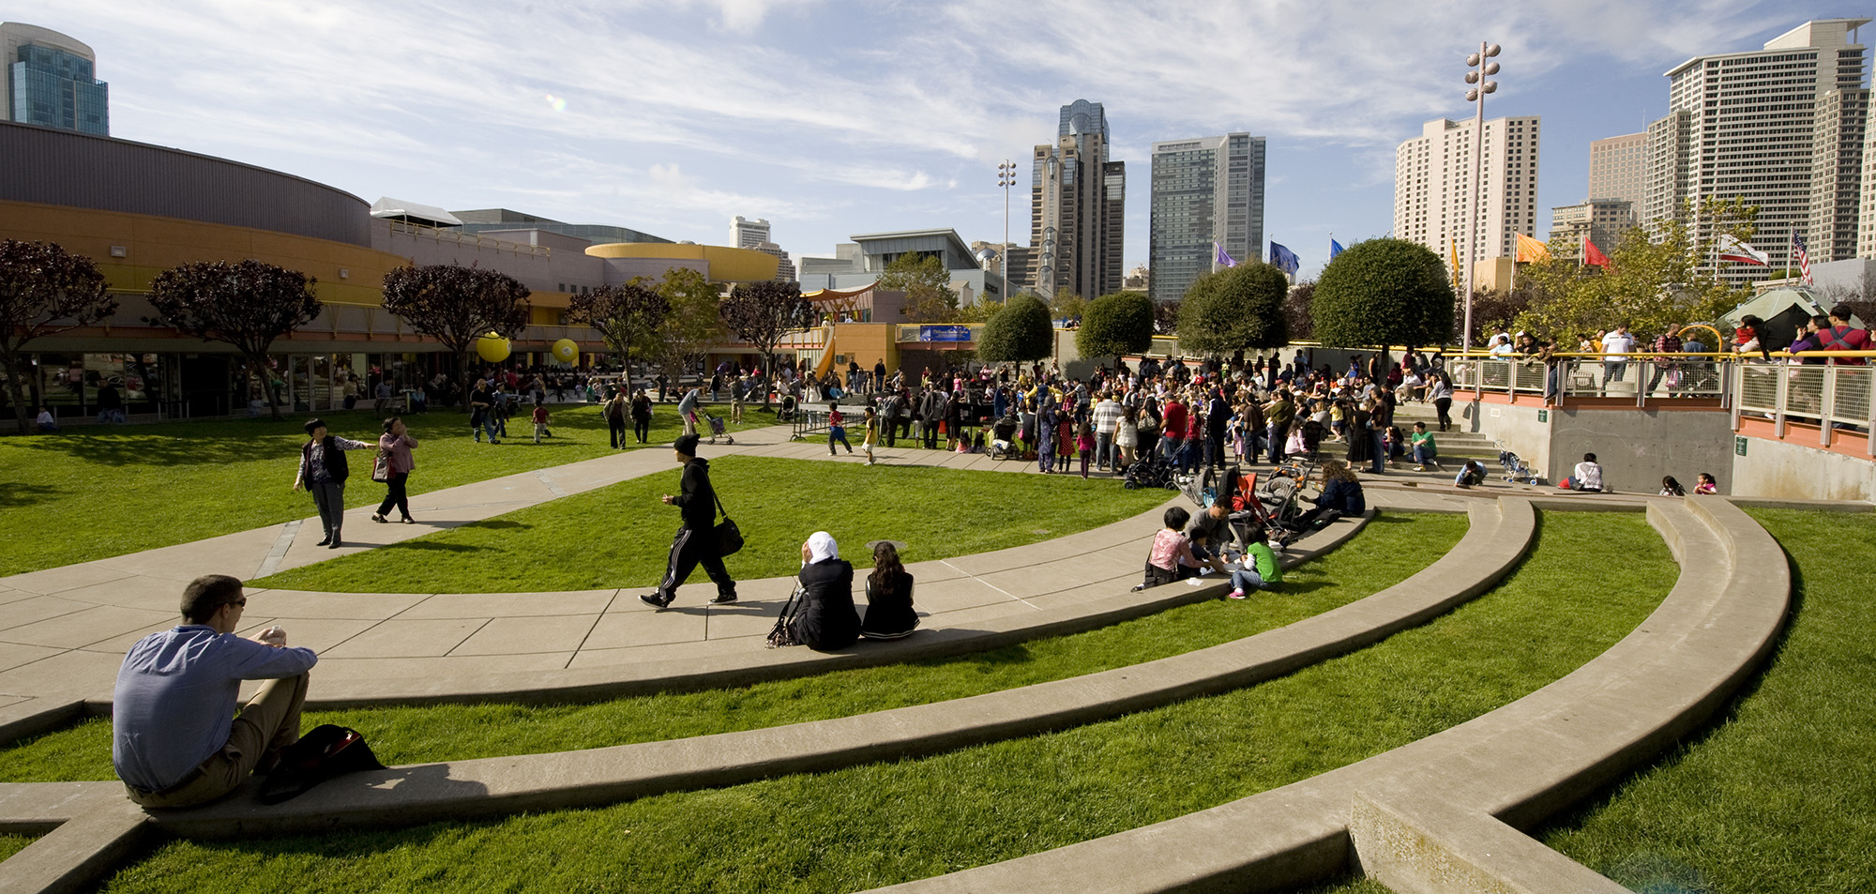
Objective
The objective of the project is to utilize technology to improve the quality of daily life for those who are visually impaired.
https://mjmmg.com/approach/
Madison Jaffe

Slide 6
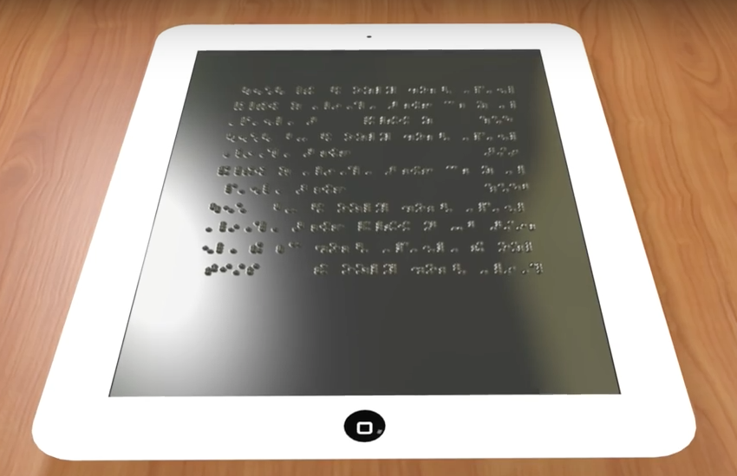

Project Background
Technology
https://www.reachoutradio.org/post/enabled-1706-high-techlow-tech-assistive-devices-01302017
Population
https://www.maxiaids.com/?idstore=1&category=blind/low_vision
Madison Jaffe

Slide 7

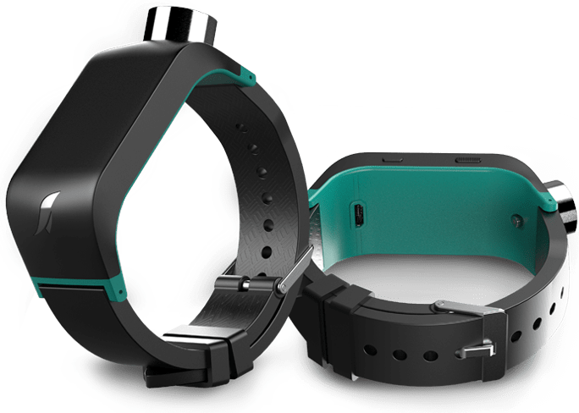
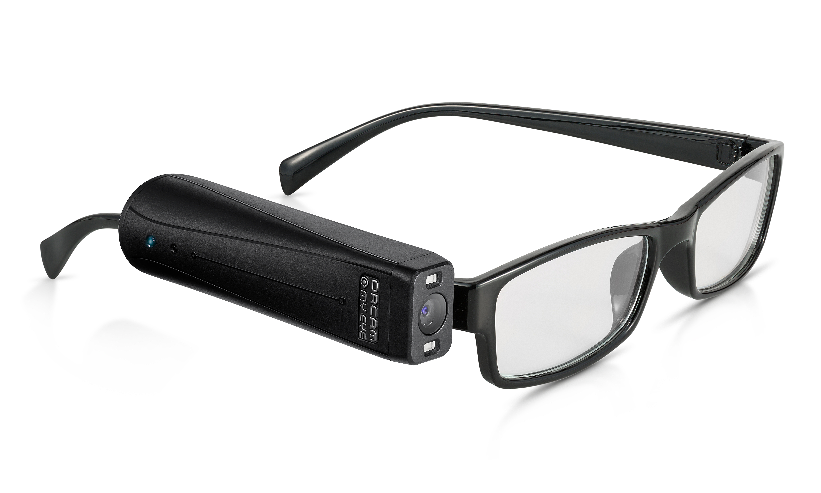
Project Background
Current Products
White Cane
Sunu Band
OrCam MyEye 2
https://www.orcam.com/en/blog/using-orcam-accessibility-technology-trip-to-mobile-world-congress/
https://www.healthproductsforyou.com/p-graham-field-lumex-folding-blind-canes.html
https://www.sunu.com/es/index
Madison Jaffe

Slide 8

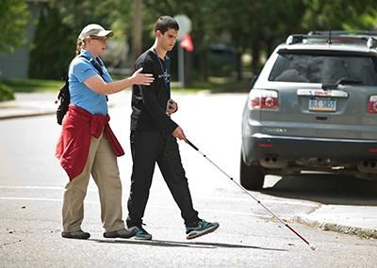
Project Background
Orientation & Mobility Training
https://familyconnect.org/education/expanded-core-curriculum/orientation-and-mobility/
https://www.pinterest.com/pin/400187116861412008/?nic_v2=1a7211dnu
Madison Jaffe

Slide 9
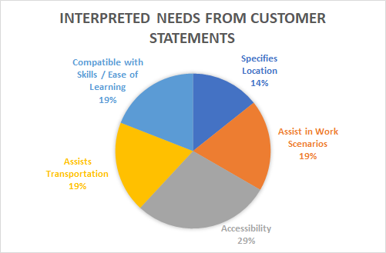
Customer Needs
The interpreted needs :
More mobility
Promotes independence
The ability to maintain/obtain employment
Design to be affordable or cheaper than similar options
Ethan Saffer

Slide 10
Project Scope
Assumptions
Key Goals
Market
Stakeholders
Ethan Saffer

Slide 11
Assumptions
The visually impaired are unable to gather sufficient information to discern their surroundings.
Users have undergone Orientation and Mobility training/rehabilitation.
The visually impaired are not fully comfortable in current society.
Simple interface, does not require visual assistance in its use.
Ethan Saffer

Slide 12
Key Goals
Develop a technology that aids the visually impaired in daily activities.
Create a product that will allow people who are visually impaired to become more active.
Keep the visually impaired safe while executing relatively complex tasks.
Cost-efficient and reliable.
Ethan Saffer

Slide 13
Market
Primary market
  People with severe visual impairment or total lack of vision.
Rehabilitation and treatment centers.
Secondary market:
  People with poor/low vision to the point where they are unable to be independent.
State-local Departments of Transportation.
Ethan Saffer

Slide 14
Stakeholders
Shayne McConomy (Advisor) | (850) 410-6624 | smcconomy@eng.famu.fsu.edu
Michael Devine (Advisor) | (850) 410-6378 | mdevine@eng.famu.fsu.edu
Jerris Hooker (Advisor) | (850) 410-6463 | hooker@eng.famu.fsu.edu
FSU-FAMU College of Engineering
Jeff Whitehead (Visually Impairment Rehabilitator/Potential Tester) | (407) 883-7107 | Jeffwhitehead@dbs.sldoe.org
Ethan Saffer

Slide 15
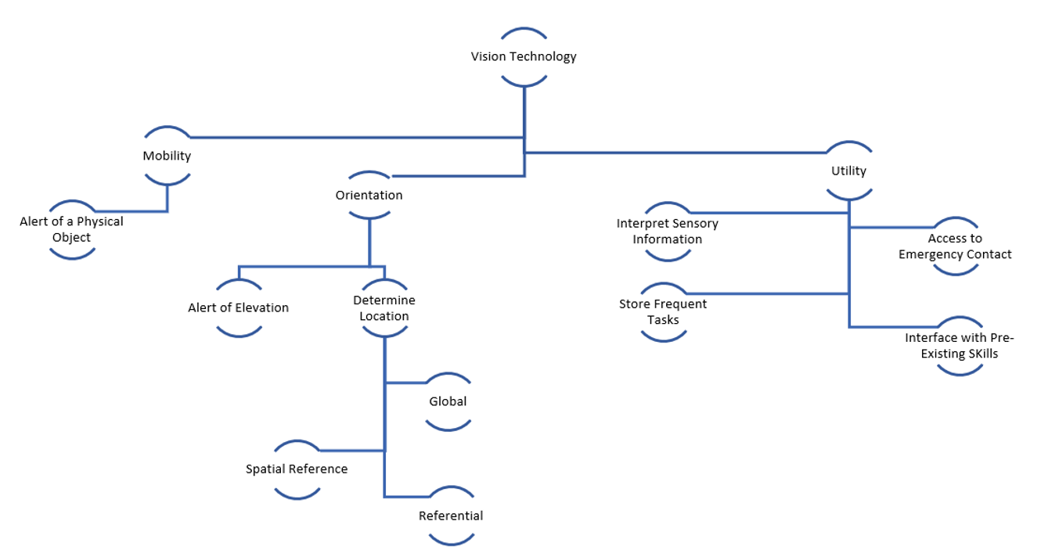
Functional Decomposition
Ethan Saffer

Slide 16
Functional Decomposition
 | Orientation | Mobility | Utility
Alert of Elevation | X | X
Determine Location | X | X
Alert of Physical Object | X | X
Inform User of Possible Threats |  | X | X
Access to Emergency Contact |  |  | X
Interpret Sensory information |  |  | X
Store Frequent Tasks | X |  | X
Interface With Pre-Existing Skills |  |  | X
Ethan Saffer

Slide 17
Questions
Questions may be asked now.

Slide 18
Reference
Blind vs. Visually Impaired: What's the Difference?: IBVI: Blog. (2020, April 02). Retrieved September 25, 2020, from https://ibvi.org/blog/blind-vs-visually-impaired-whats-the-difference/
Blindness Statistics. (n.d.). Retrieved October 12, 2020, from https://www.nfb.org/resources/blindness-statistics

Slide 22
Backup Slides

Slide 25
Standard Shapes
Summary Box
Text box 1
Outlined Text Box

Slide 26




Approved Logos

Slide 27
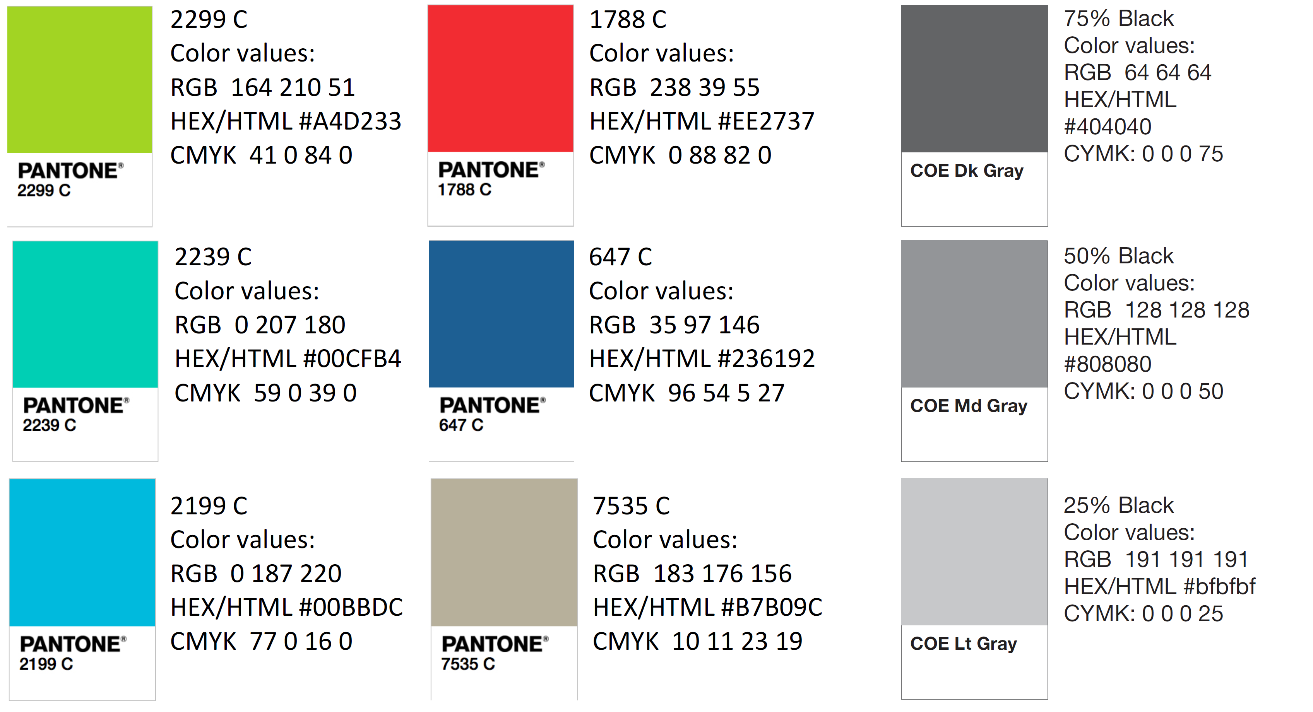
Color Palette

Slide 28
APA Tables
Category 1 | Category 2 | Category 3 | Category 4 | Category 5
Item 1
Item 2
Item 3
Item 4
 | Category 2 |  |  | Category 3
Category 1 | subcategory 1 | subcategory 2 |  | subcategory 1 | subcategory 2
Item 1
Item 2
Item 3
Item 4

