Slide 1
M.E.N.D - Technology for the Visually Impaired

Slide 2
The Team
Madison Jaffe​
Project Manager and Manufacturing/Controls Engineer
David Alicea
Field/Test Engineer and Quality Control
Nicolas Garcia
Webmaster, Design Engineer and Resource Manager
Ethan Saffer
Systems/Design
Engineer

Slide 3
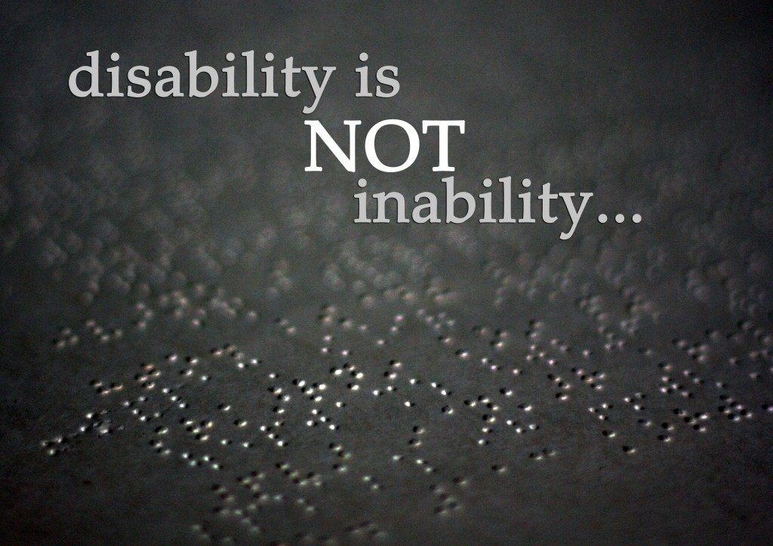
Problem
The visually impaired have limited aid in current society. This leaves many of them dependent on others and unemployed.
Current resources on the market are not affordable or effective for the average income of visually impaired individuals.
https://wheelysportygirl.wordpress.com/2014/10/09/a-wheely-bright-future-for-disabled-sports-lovers-in-cambridgeshire/
David Alicea

Slide 4
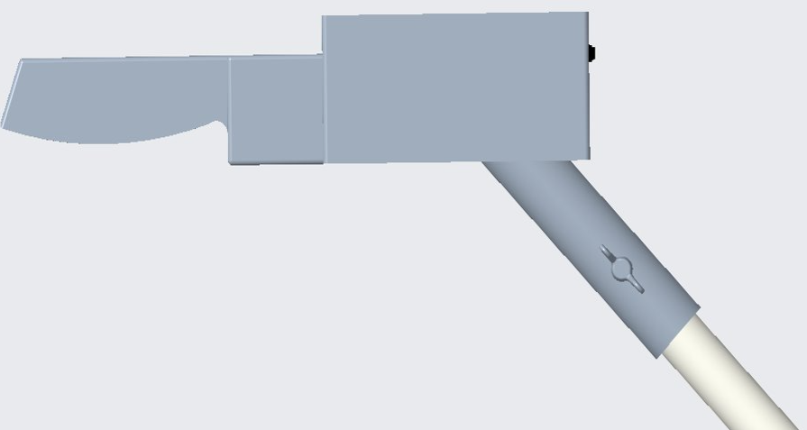
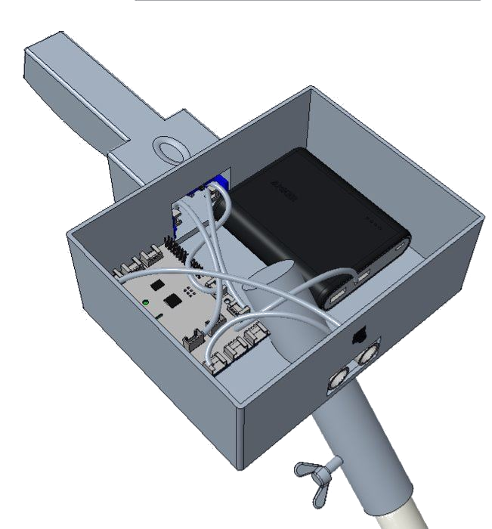
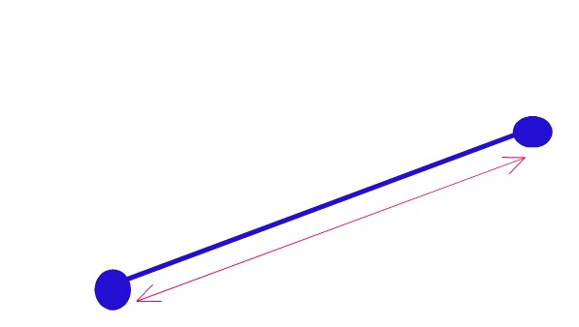
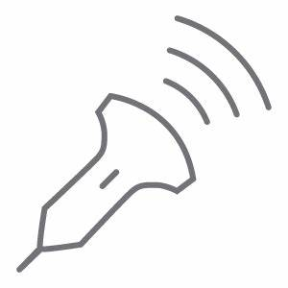
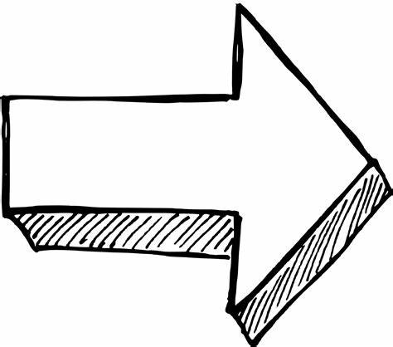
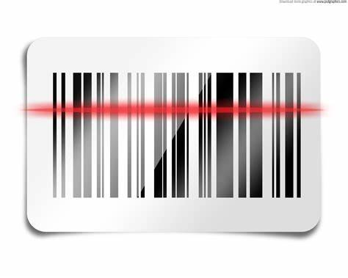
Our Solution - HapTac
Our product attaches to the standard white cane.
HapTac allows for the visually impaired to sense and scan objects in front of them.
Device is designed to feel organic, while also identifying objects accurately.
Madison Jaffe
Sense
Determine
Alert
Sense
Determine
Alert
Sense
Sense
The ultrasonic sensor will sense an object up to 3 meters away.
The Raspberry Pi will interpret the sensed information to calculate the proximity to an object.
Haptic feedback will alert the user with multiple motors with intensity based on distance.
The ultrasonic sensor will sense an object up to 3 meters away.
The Raspberry Pi will interpret the sensed information to calculate the proximity to an object.
Haptic feedback will alert the user with multiple motors with intensity based on distance.
Scan
Identify
Notify
Scan
Identify
Notify
The camera can be activated to scan the desired products.
The camera can be activated to scan the desired products.

Slide 5
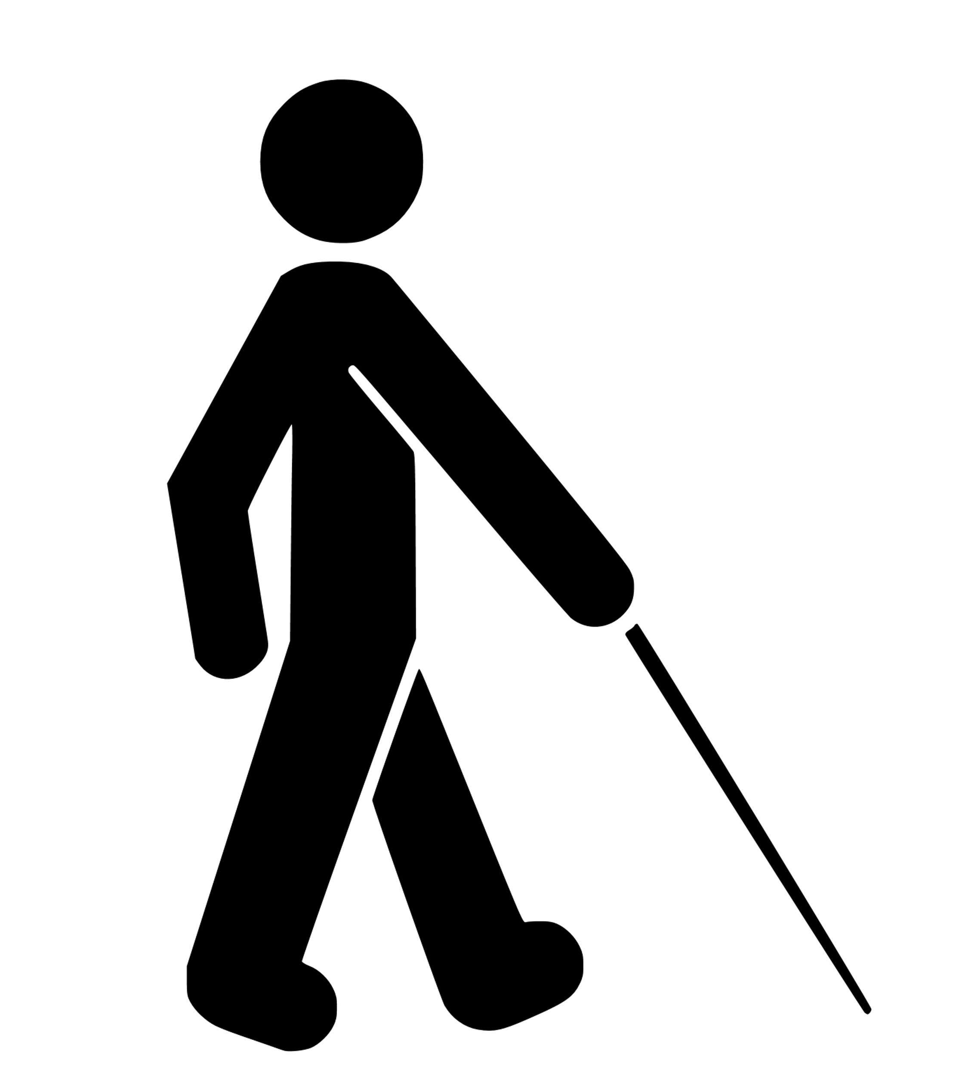
Functions
Madison Jaffe

Slide 6
Functions
Sense
The ultrasonic sensor will sense an object up to 3 meters away.
Madison Jaffe

Slide 7
Functions
Sense
Determine
The ultrasonic sensor will sense an object up to 3 meters away.
The Raspberry Pi will interpret the sensed information to calculate the proximity to an object.
Madison Jaffe

Slide 8
Functions
Sense
Determine
Alert
The ultrasonic sensor will sense an object up to 3 meters away.
The Raspberry Pi will interpret the sensed information to calculate the proximity to an object.
Haptic feedback will alert the user with multiple motors with intensity based on distance.
Madison Jaffe

Slide 9
Functions
Sense
Determine
Alert
The ultrasonic sensor will sense an object up to 3 meters away.
The Raspberry Pi will interpret the sensed information to calculate the proximity to an object.
Haptic feedback will alert the user with multiple motors with intensity based on distance.
Scan
The camera can be activated to scan the desired products.
Madison Jaffe

Slide 10
Functions
Sense
Determine
Alert
The ultrasonic sensor will sense an object up to 3 meters away.
The Raspberry Pi will interpret the sensed information to calculate the proximity to an object.
Haptic feedback will alert the user with multiple motors with intensity based on distance.
Scan
Identify
The camera can be activated to scan the desired products.
At least 500 stored products will be in the memory of the Raspberry Pi to identify the product.
Madison Jaffe

Slide 11
Functions
Sense
Determine
Alert
The ultrasonic sensor will sense an object up to 3 meters away.
The Raspberry Pi will interpret the sensed information to calculate the proximity to an object.
Haptic feedback will alert the user with multiple motors with intensity based on distance.
Scan
Identify
Notify
The camera can be activated to scan the desired products.
At least 500 stored products will be in the memory of the Raspberry Pi to identify the product.
Haptic feedback will
notify the user when the product has been identified and a speaker will relay the product name.
Madison Jaffe

Slide 12
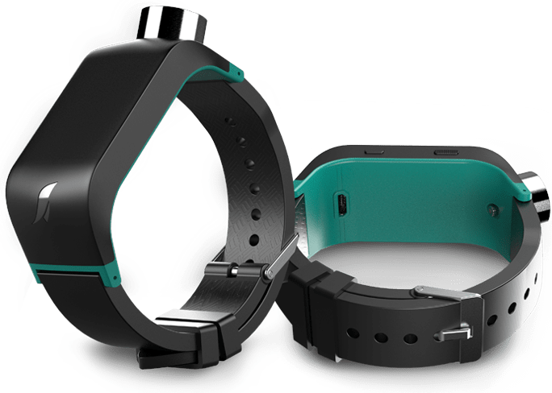
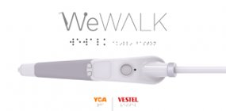
Competition
White Cane $30
Sunu Band $299
WeWalk $599
https://athome.medline.com/en/medline-white-cane-for-blind-vision-impaired-1ct-mdswhtcane
https://www.sunu.com/es/index
https://webrazzi.com/en/2020/05/01/wewalk-investment-750k/
David Alicea

Slide 13
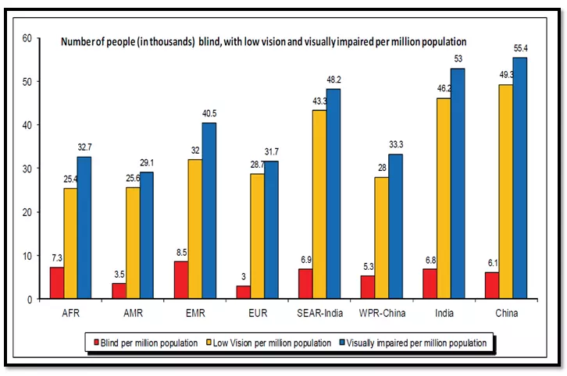
Market Size
Globally, there are 285 million visually impaired people.
39 million are blind
In the U.S, there are 12 million visually impaired people.
https://www.sitepoint.com/how-many-users-need-accessible-websites/
David Alicea

Slide 14
Business Model
We offer the ability to identify items and detect obstacles above the waist.
Suite of functions with a higher cost-benefit than competitors.
Sell directly to consumers through website/hotline.
Sell to partnered rehabilitation centers.
Price as-is:
$299
First-Year Projected Profit:
$20,853
Assuming 10% monthly growth rate
Ethan Saffer

Slide 15
Plan For Growth
Reinvest the profit generated in first year into the company.
Cut out printed circuit board supplier and generate an in-house development team with own proprietary PCB system.
This will increase our profit margins by 17%
Our cost of development will drop 20% to $200
Reinvest profit generated by third year into the company.
Rent out commercial warehouse (5,000 SF)
Cut out manufacturer and generate in-house team to develop product
Hire more employees to keep up with demand
Ethan Saffer

Slide 16
Long Term Sales
3 Year Sales Projection
Projected Revenue
$594,631
Projected Profit
$184,543
5 Year Sales Projection
Projected Revenue
$1,807,101
Projected Profit
$250,639
35% Growth from Year 3
Ethan Saffer

Slide 17
Thank you from M.E.N.D - HapTac
David Alicea
Field/Test Engineer and Quality Control
Daa16@my.fsu.edu
Madison Jaffe​
Project Manager and Manufacturing/Controls Engineer
Msj16d@my.fsu.edu
Nicolas Garcia
Webmaster, Design Engineer and Resource Manager
Ng16m@my.fsu.edu
Ethan Saffer
Systems and Design
Engineer
Ers16c@my.fsu.edu
Ethan Saffer

Slide 20
APPENDIX

Slide 21
Year 1 Profit Estimate

Slide 22
Year 3 Profit Estimate

Slide 23
Year 5 Profit Estimate

Slide 24
Camera Identification - AlexNet
8-layer identification software.
Capable of adding new items to its memory.
Low power draw to extend battery life
David Alicea

Slide 25
Projections
Our prototype is projected to be completed, tested, and validated by April 2021.
Sales will begin in the United States market.
We expect to expand to a global market, increasing potential clientele roughly 3800%.
Nicolas Garcia

Slide 26
Timeline
9/8 Start Project
2/8 Order Parts
4/16 Final Product
9/24 Customer Needs
11/6 Concept Selection
12/13 Business Model Canvas
10/15 Concept Generation
3/12 Testing and Validation
3/20 Reiterate Design
10/23 Florida Division of Blind Services
Nicolas Garcia

