Slide 1
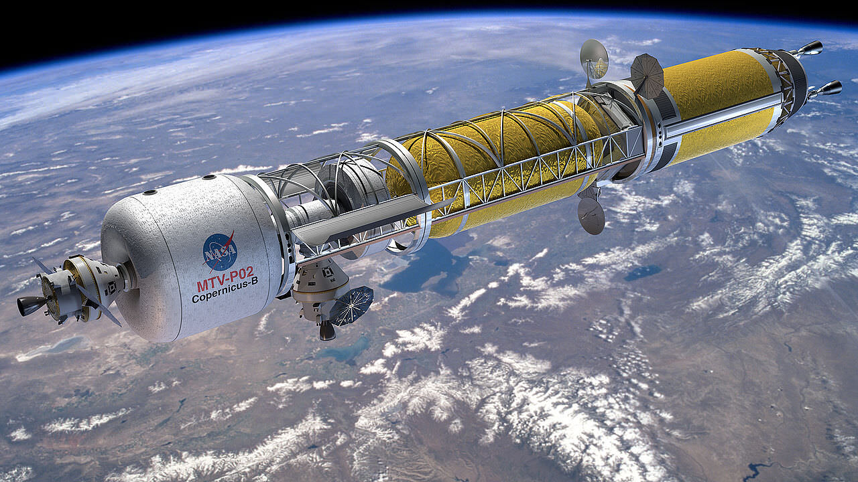
Team 514: Hydrogen Pre-Heater in the Nuclear Thermal Rocket Simulation
Michael Corak
Kevin Hartzog
Fisher Hillburn
Jordan Weid
Notes:
https://www.asme.org/topics-resources/content/the-future-of-nuclear-rockets-for-space-travel

Slide 2
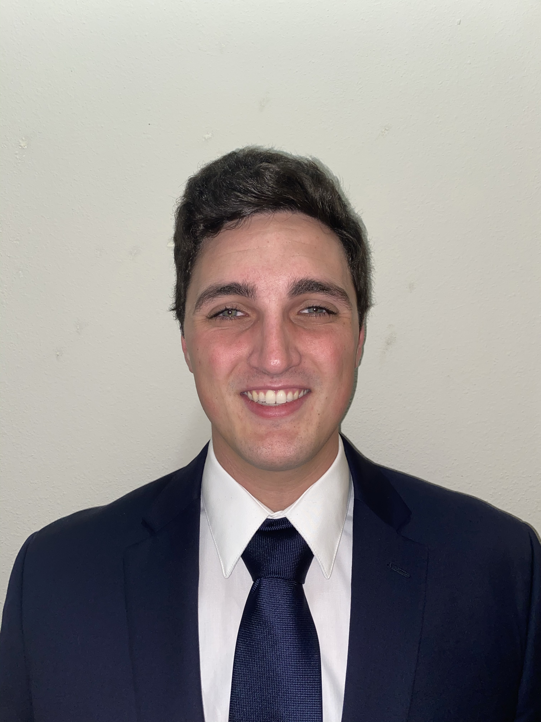
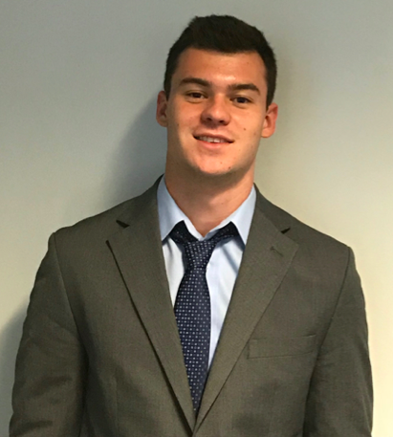

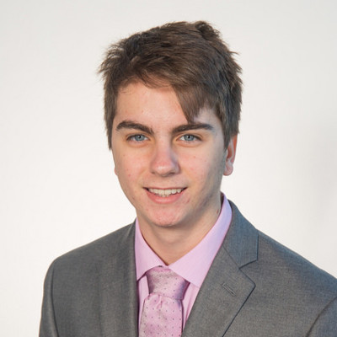
Team Introductions
Michael Corak
Project & Aero-Thermal
Engineer
Kevin Hartzog
Project Manager &
Aero-Thermal analysis
Fisher Hillburn
Mechanical Design &
Systems Engineer
Jordan Weid
Simulation/Structural
Design Engineer
Kevin Hartzog

Slide 3
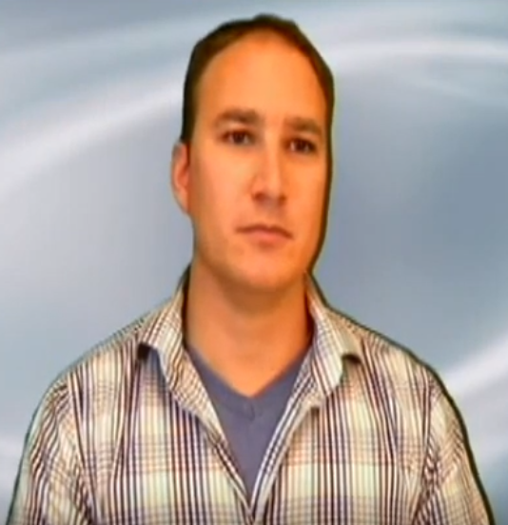
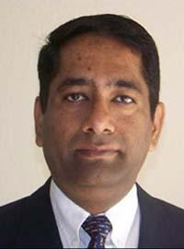
Sponsor and Advisor
Engineering Mentor
Michael Schoenfeld
Nuclear Systems Team Lead
Academic Advisor
Rajan Kumar, Ph.D.
Associate Professor
Kevin Hartzog

Slide 4
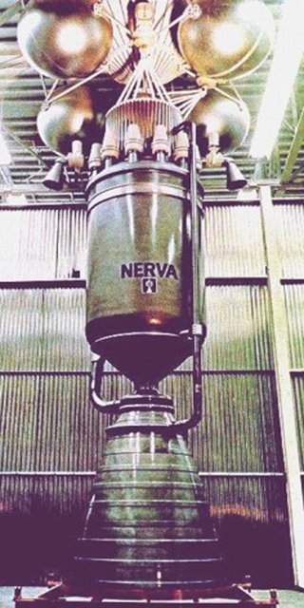
Project Background
History
  1960's – Inception of Nuclear Thermal Propulsion (NTP) and The Nuclear Engine for Rocket Vehicle Application (NERVA)
  1970's – NERVA program shut down
  Renewed interest in NTP in 2019
Kevin Hartzog
Notes:
https://www.nasa.gov/centers/marshall/news/news/releases/2014/ntrees.html

Slide 5
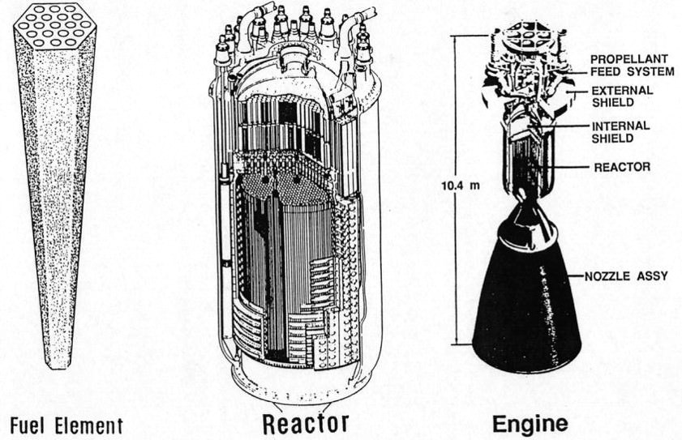
Project Background
Theory behind Nuclear Thermal Propulsion(NTP)
Kevin Hartzog
Notes:
http://toughsf.blogspot.com/2019/09/nter-nuclear-thermal-electric-rocket.html

Slide 6
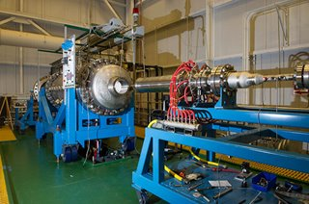
Project Background
Nuclear Thermal Rocket Element Environment Simulator (NTREES) at NASA's Marshall Space Flight Center (MSFC)
Temperatures up to 2,200 K
Kevin Hartzog
Notes:
https://www.nasa.gov/centers/marshall/news/news/releases/2014/ntrees.html

Slide 7


Project Background
Existing test article design
Simulate nuclear heating - volumetric phenomenon
Induction Coils
Hydrogen Flow
Kevin Hartzog

Slide 8
Project Background
Motivation
  Simulate the conditions found at any length of test article
50 inches
Distance (in)
Standard Uranium core size
20 inches
NTREES test article size
Temperature(K)
Kevin Hartzog

Slide 9
Objective
Provide independent control and feedback of hydrogen inlet temperature
Robust functionality that can withstand harsh and time varying conditions
Integrate with existing system with minimal negative effects
Kevin Hartzog

Slide 10
Scope
Assumptions:
  Will not control pressure or flow rate of the hydrogen
  Compressibility effects will be neglected
  All heat transfer will occur in the testing region
  Radiation will not be modeled
  Conceptual design will be completed by the end of the fall semester
Key Goals:
  Independent control over the inlet temperature of the hydrogen
  Broad range of control over the pre-heater
  Allowing the user to easily measure the surrounding conditions
  Robust system to handle extreme temps
  Seamless integration into the surrounding subsystems
Michael Corak

Slide 11
Markets
Primary Markets
  NASA
Secondary Markets
  Induction Heating
  Aerospace Research Labs
  Material Processing Facilities
  Electric Appliance Companies
  Plastics Processing Facilities
Michael Corak

Slide 12
Customer Needs
Able to incorporate device into test chamber
Heat fluid to ~2200K
Independently control the temperature of the pre-heater
Monitor physical conditions
Michael Corak

Slide 13
Functional Decomp
Goal: Design heating device with independent user control
Through use of a hierarchy chart, needed systems, functions, and subfunctions were derived.
Michael Corak

Slide 14
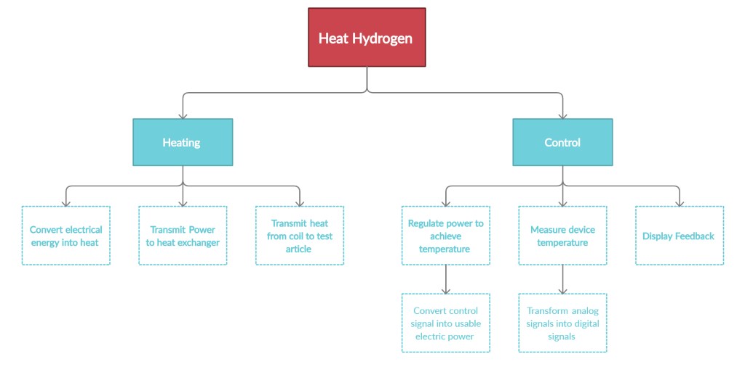
Hierarchy Chart
Michael Corak

Slide 15
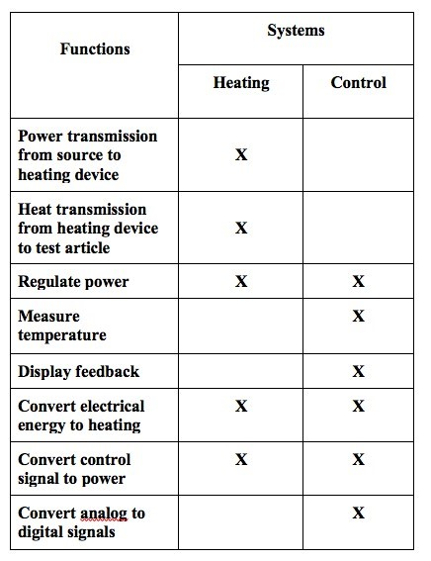
Cross-Reference Table
Michael Corak

