Slide 1
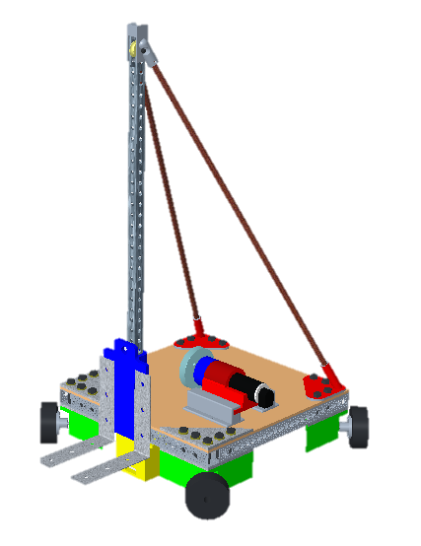
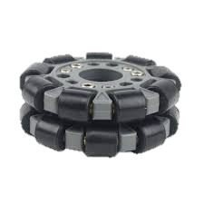
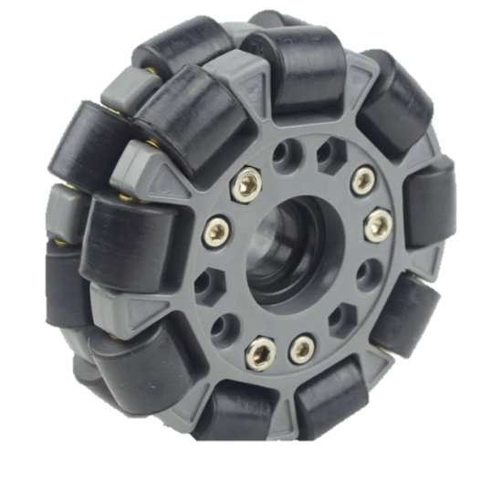
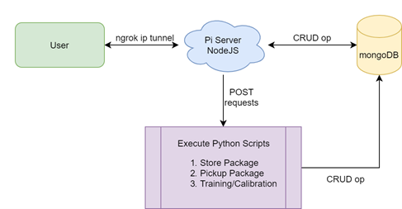
Team 311: Autonomous Material Handling Robot
Sebastian Muriel, Alexandar Jen, Walter Caldwell, Tony Zheng
Objective
1. Forklift-style package manipulation
The objective of this project is to create a partially autonomous material handling robot that works in a dark warehouse with conditions unfavorable to human workers.
2. Infrared line following
1
3. Pulley-motor connection for lifting
3
Project Background
4. Independently controlled omni-directional wheels
6
Dark warehouses with increased automation are more cost effective overtime.
Many warehouse injuries related to overexertion/bodily reactions, contact with equipment, and forklifts.
Estimated average electricity consumption of 6.6kWh per square foot for a warehouse, or roughly 23.7 MJ per square foot.
5. Raspberry pi sends data to Arduino from sensors to initiate package retrieval.
5
6. Pi camera scans QR code and initiates pick up.
2
4
The user wirelessly connects to the pi server using the ip tunnel. The NodeJS then communicates the command desired by the user and executes it in the Mongodb database. The result status is then sent back through the tunnel to update the user.
Goals
Autonomous movement
Safely lift 25 pound load
Dark warehouse navigation
Retrieve and deliver packages to specified drop off location
Obstacle Detection
Notes:
Objective
Background/ Motivation
Assumptions
Functional Decomposition
Critical targets
Locomotion
Omni-directional wheels
Power Supply
Motors
Manipulation
Forks
Pulley
Slider
Navigation
Line path
Ultrasonic Sensor
Infrared Sensor
Pi camera + wide lense
Inventory Tracking
Arduino
Raspberry pi
QR code

