Slide 1

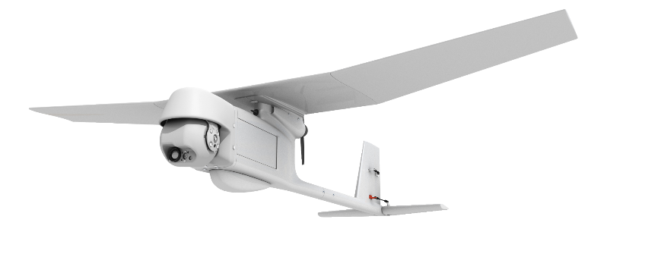
Lightweight UAV
Team 518
Clayton Cooley, Taylor Jacobs, Zachary Noay, Brenden Richman, Brian Thervil
1

Slide 2





Team Introduction
Taylor Jacobs
Flight Dynamics Engineer
Mechanical Engineering
Clayton Cooley
Test Engineer
Mechanical Engineering
Zachary Noay
Embedded Systems Engineer
Electrical Engineering
Brian Thervil
Software/System Integration Engineer
Electrical Engineering
Brenden Richman
CAD/Materials Engineer
Mechanical Engineering

Slide 3


Sponsor and Advisor
A global security company that provides innovative solutions worldwide.
Jennifer Tecson
Dr. Rajan Kumar
Manager of Engineering
FSU Electrical Engineering Graduate
Research in Aerodynamics, Experimental Fluid Mechanics, and Flow Diagnostics
Zachary Noay

Slide 4
Project Objective
The objective of this project is to decrease the weight and increase the flight time of a fixed wing UAV for military video surveillance.​
Zachary Noay

Slide 5
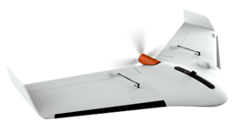
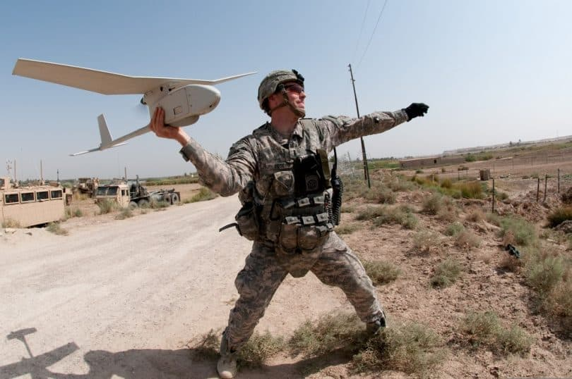
Past Work
Project Charter
Customer Needs
Functional Decomposition
Key Goals
3D printed construction
Increase flight time to weight ratio
Provide adequate surveillance
Zachary Noay
5

Slide 6

Targets and Metrics
RQ-11B Raven
Wingspan: 4.5ft (1.4m)
Length: 3.0ft (0.9m)
Weight: 4.2lbs (1.9kg)
Endurance: 60-90 min
RQ-11B Raven
Zachary Noay

Slide 7
Targets and Metrics
Function | Metric | Target
Send Commands | Range | 10 kilometers
Receive Data | Range | 10 kilometers
Accelerate | Thrust source increases | Thrust source > 50%
Decelerate | Thrust source decreases | Thrust source < 50%
Adjust Roll, Pitch, Yaw | Articulate ailerons, elevators, and rudders | -45°<=Ailerons <=45° -45°<=Elevators<=45° -45°<=Rudder <= 45°
Power Payload | Delivers power to payload and components | Voltage > 2.0 V
Record Data | Video Quality | Resolution >=480p
Orient Payload | Ruler | 360 degrees
*Generate Lift | Airfoil produces greater lift force than gross weight | *Lift >=18.68 Newtons
House Hardware | Volume | <=0.30 m³
*Couple Payload | Payload attaches to drone | *>=160 g *<=200 g
*Endurance | Time while airborne | *>=60 minutes
Carry by Backpack | Stored Drone Dimensions | Stored Width <= 0.762 m Stored Length <=0.508 m
 | Stored Drone Dimensions | >=30 km/hour
 | Cruising Speed of UAV | Hand Take off
 | Take off procedure | >=152.4 m
 | Cruising altitude | *<=1.905 kg
Zachary Noay

Slide 8
Concept Generation
Zachary Noay
8

Slide 9

Concept Generation
Crapshoot method
Forced Analogy
Morphological Chart
Clayton Cooley

Slide 10
Crap Shoot
Allows quick generation of vastly different concepts
Ideas generated can be very creative
Concepts are often far-fetched or impossible to design
Clayton Cooley

Slide 11
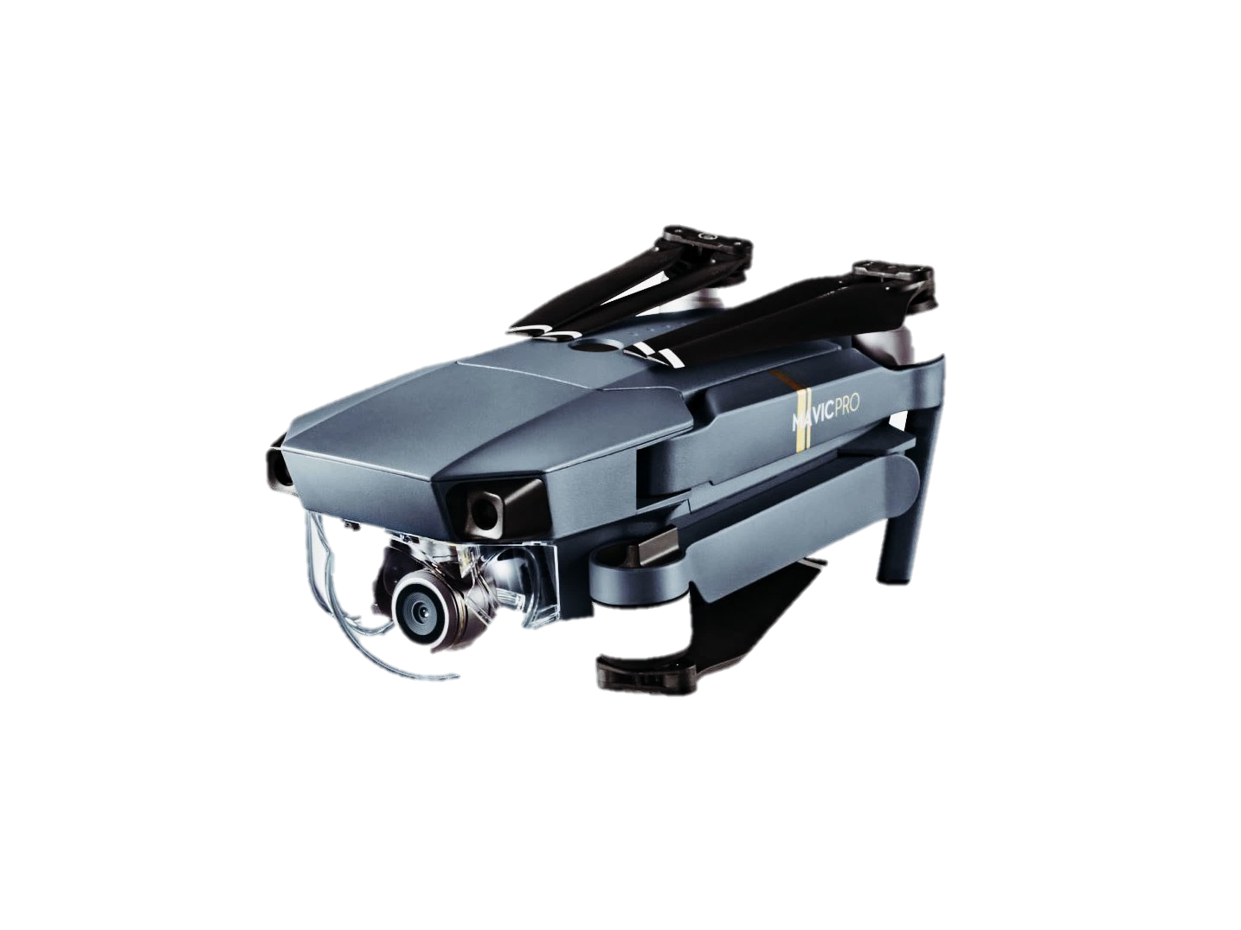
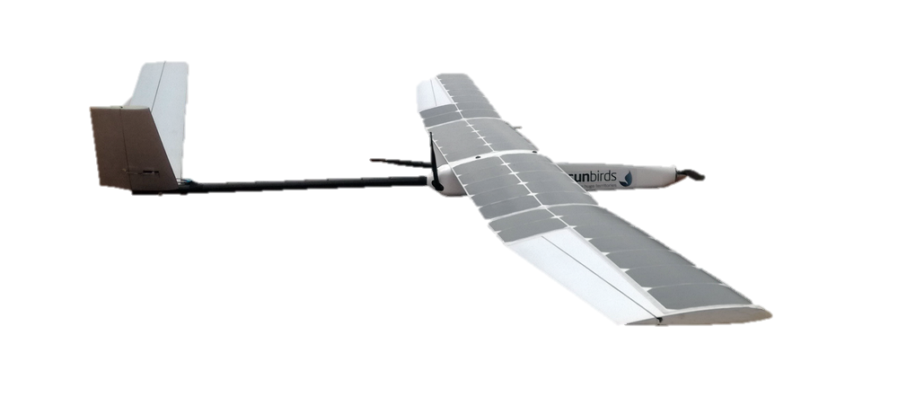
Crap Shoot: Examples
UAV is foldable and can be carried like a backpack
Drone has solar panels on wing to increase flight time
UAV can absorb power from lightning strikes
Clayton Cooley

Slide 12
Forced Analogy
Produces concepts that normally wouldn’t be thought of
Causes team to think outside the box by creating concepts based off only two words
Concepts generated are often unrealistic
Clayton Cooley

Slide 13
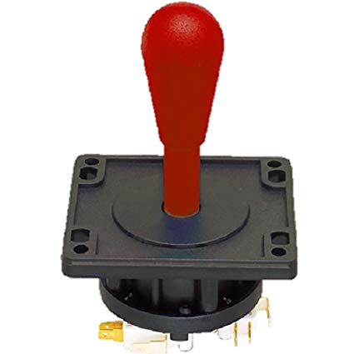
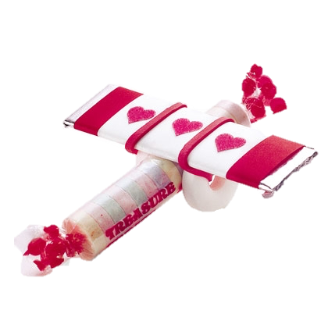
Forced Analogy: Examples
Controls are drastically simplified to increase battery life
UAV has low density components to help reduce weight
Wings of UAV are molded from candy and the fuselage is composed of candy wrapper to save weight
Clayton Cooley

Slide 14
Morphological Chart
Allows concepts to be generated quickly by listing different design solutions for each component in a chart
Generates realistic concepts but they are often highly similar
Produces less creative concepts than previous methods
Wing Location | Tail Type (Empennage) | Fuselage | Payload Location
Low Wing | T Tail | Elongated | Outboard of fuselage
Mid Wing | H Tail | Underwing | Inboard of fuselage
High Wing | V Tail |  | Protruding from fuselage
 | Fuselage Mount
Concept
Clayton Cooley
14

Slide 15
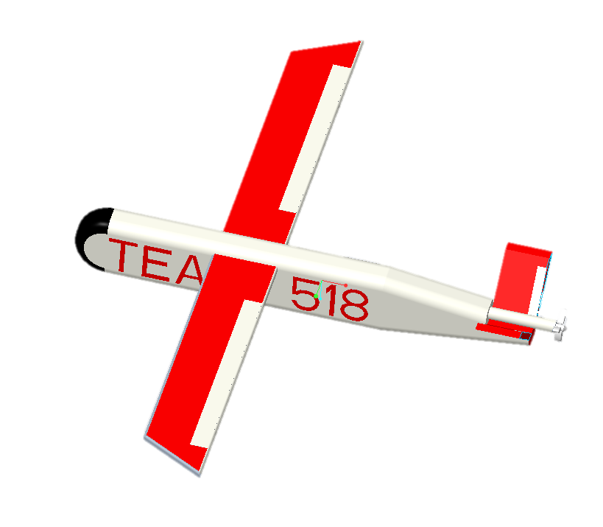
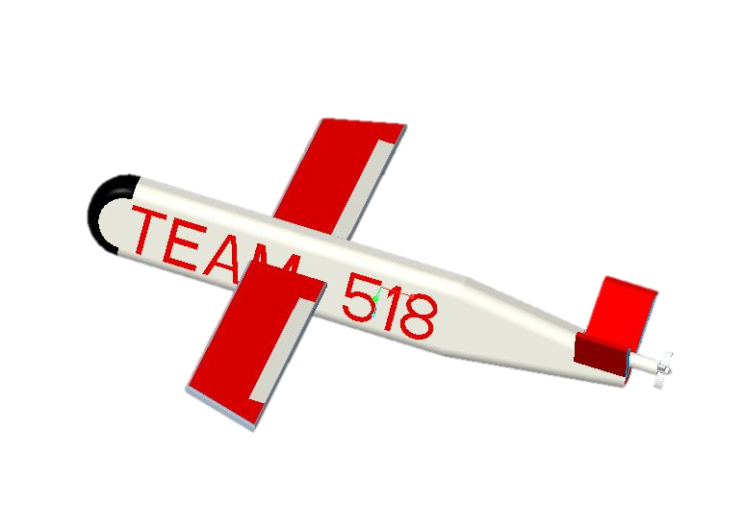
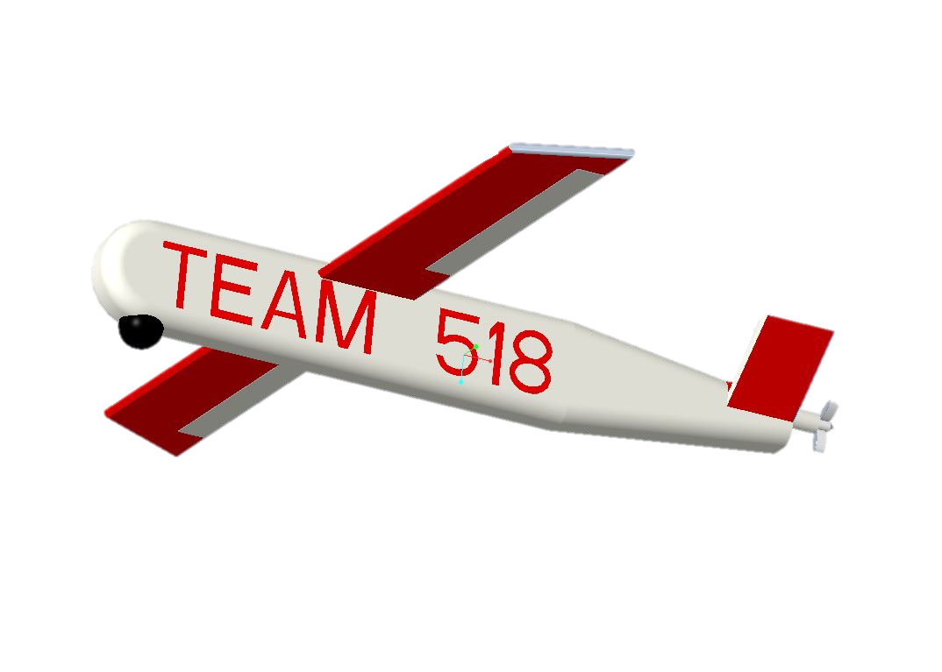
Concept Generation
Inboard Payload
Inboard Payload
High wing
Elongated
Fuselage
Elongated Fuselage
V Tail
High wing
Protruding Payload
Elongated Fuselage
V Tail
Mid Wing
V Tail
Concept 1
Concept 2
Concept 3
Clayton Cooley

Slide 16
Concept 1
High wing design great for stability
Inboard payload and elongated fuselage for minimal drag
V-Tail offers reduced weight
Inboard Payload
Elongated Fuselage
High wing
V Tail
Clayton Cooley

Slide 17
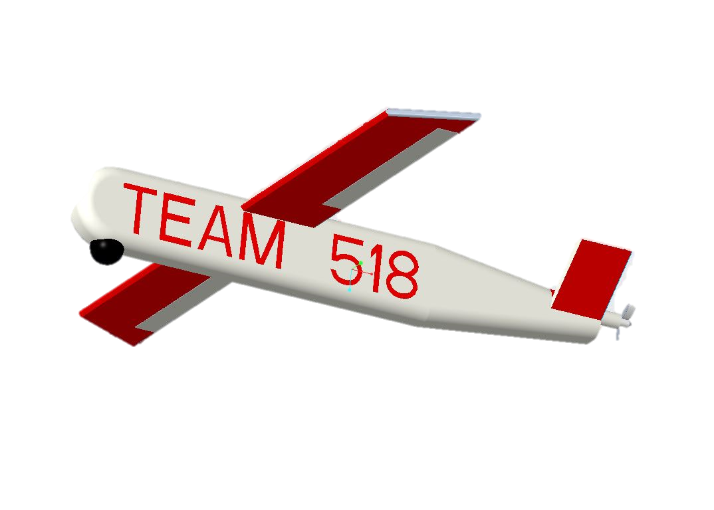
Concept 2
High wing location
Protruded payload for increased view angles
High wing
Protruding Payload
Elongated Fuselage
V Tail
Clayton Cooley

Slide 18
Concept 3
Mid wing design offers maneuverability
Offers least amount of drag
Inboard Payload
Elongated
Fuselage
V Tail
Mid Wing
Clayton Cooley

Slide 19
Concept Selection
Clayton Cooley
19

Slide 20
Concept Selection
House of Quality |  | Engineering Characteristics
Improvement Direction |  | ↓ | ↑ | ↓ | ↓ | ↓ | ↓ | ↑ | ↑ | ↓ | ↑ | ↑ | ↓ | ↑ | ↑ | ↑
Units |  | Kg | sec | m | m | g | n/a | n/a | N | m² | m³ | n/a | m/s | m | m | deg
Customer Requirements | Importance Weight Factor | Empty Weight | Endurance | Wingspan | Length | Payload Weight | Drag coefficient | Weather Resistance | Wing Rigidity | Radar Footprint | Material Durability | Payload Mount Exchangeable | Velocity | Altitude | Signal Range | Payload Orientation Control
Gross weight lighter than reference UAV | 5 | 9 |  | 3 | 3 | 9 | 1 |  |  |  | 1 | 3 | 3 | 3 | 1
Drone operates in light storm weather | 1 |  |  |  |  |  |  | 9 | 3 |  | 3 | 1 |  |  | 1
Flight time is equal or greater than reference UAV | 3 | 3 | 9 | 3 |  | 3 | 9 |  |  |  |  |  | 3 |  | 1
Drone's scale is equal or less than reference | 3 | 3 | 3 | 9 | 9 |  |  |  | 1 | 9 |  |  | 3 | 1
UAV is user controlled | 7 |  |  |  |  |  |  |  |  |  |  |  |  |  | 3 | 3
Operates in U.S. climate range | 1 |  |  |  |  |  |  | 3 | 1 |  | 3
Drone provides adequate surveillance | 6 |  | 3 | 3 | 3 | 9 | 3 |  | 1 | 1 | 1 | 3 | 3 | 3 | 3 | 9
3D printing utilized for construction | 2 | 3 | 6 | 1 | 1 |  | 1 |  | 3 |  | 3 |  |  | 1
Raw Score | 470 | 69 | 48 | 53 | 44 | 54 | 34 | 12 | 13 | 27 | 17 | 16 | 33 | 20 | 30 | 21
Relative Weight % |  | 0.15 | 0.10 | 0.11 | 0.09 | 0.11 | 0.07 | 0.03 | 0.03 | 0.06 | 0.04 | 0.03 | 0.07 | 0.04 | 0.06 | 0.04
Rank Order |  | 1 | 4 | 3 | 5 | 2 | 6 | 15 | 14 | 9 | 12 | 13 | 7 | 11 | 8 | 10
Brenden Richman

Slide 21
Concept Selection: Pugh Charts
Inboard Payload
Selection Criteria | Datum | Concepts
 | RQ-11B Raven | 1 HW-VT-EF-IP | 2 HW-VT-EF-PP | 3 MW-VT-EF-IP | 4 MW-VT-EF-PP | 5 MW-VT-UW-IP
Empty Weight | Datum | + | + | + | + | +
Endurance |  | S | S | - | - | -
Wingspan |  | + | + | S | S | -
Length |  | - | + | - | - | +
Payload Weight |  | + | S | + | + | +
Drag coefficient |  | - | - | + | S | S
# of pluses |  | 3 | 3 | 3 | 2 | 3
# of minuses |  | 2 | 1 | 2 | 2 | 2
Elongated
Fuselage
V Tail
Mid Wing
Concept 3
Brenden Richman

Slide 22
Concept Selection: Pugh Charts
Pugh Iteration 2
High wing
Selection Criteria | Datum | Concepts
 | Concept 3 MW-VT-EF-IP | 1 HW-VT-EF-IP | 2 HW-VT-EF-PP | 4 MW-VT-EF-PP | 5 MW-VT-UW-IP
Empty Weight | Datum | S | S | S | +
Endurance |  | + | + | S | S
Wingspan |  | + | + | S | S
Length |  | S | + | + | +
Payload Weight |  | S | + | + | S
Drag coefficient |  | + | + | + | -
# of pluses |  | 3 | 5 | 3 | 2
# of minuses |  | 1 | 0 | 0 | 1
Protruding Payload
Elongated Fuselage
V Tail
Concept 2
Brenden Richman

Slide 23
Concept Selection:
Criteria Pairwise Comparison
[C] | Empty Weight | Endurance | Wingspan | Length | Payload Weight | Drag coefficient
Empty Weight | 1.000 | 7.000 | 5.000 | 5.000 | 3.000 | 7.000
Endurance | 0.143 | 1.000 | 3.000 | 5.000 | 0.333 | 3.000
Wingspan | 0.200 | 0.333 | 1.000 | 3.000 | 0.333 | 3.000
Length | 0.200 | 0.200 | 0.333 | 1.000 | 0.111 | 0.333
Payload Weight | 0.333 | 3.000 | 3.000 | 9.000 | 1.000 | 5.000
Drag coefficient | 0.143 | 0.333 | 0.333 | 3.000 | 0.200 | 1.000
Sum | 2.019 | 11.867 | 12.667 | 26.000 | 4.978 | 19.333
Normalized[C] | Empty Weight | Endurance | Wingspan | Length | Payload Weight | Drag coefficient | Criteria Weights {W}
Empty Weight | 0.495 | 0.590 | 0.395 | 0.192 | 0.603 | 0.362 | 0.439
Endurance | 0.071 | 0.084 | 0.237 | 0.192 | 0.067 | 0.155 | 0.134
Wingspan | 0.099 | 0.028 | 0.079 | 0.115 | 0.067 | 0.155 | 0.091
Length | 0.099 | 0.017 | 0.026 | 0.038 | 0.022 | 0.017 | 0.037
Payload Weight | 0.165 | 0.253 | 0.237 | 0.346 | 0.201 | 0.259 | 0.243
Drag coefficient | 0.071 | 0.028 | 0.026 | 0.115 | 0.040 | 0.052 | 0.055
Sum | 1 | 1 | 1 | 1 | 1 | 1 | 1
Normalize
Brenden Richman

Slide 24
Concept Selection:
Analytical Hierarchy Process (AHP)
Normalized[C] | Empty Weight | Endurance | Wingspan | Length | Payload Weight | Drag coefficient | Criteria Weights {W}
Empty Weight | 0.495 | 0.590 | 0.395 | 0.192 | 0.603 | 0.362 | 0.439
Endurance | 0.071 | 0.084 | 0.237 | 0.192 | 0.067 | 0.155 | 0.134
Wingspan | 0.099 | 0.028 | 0.079 | 0.115 | 0.067 | 0.155 | 0.091
Length | 0.099 | 0.017 | 0.026 | 0.038 | 0.022 | 0.017 | 0.037
Payload Weight | 0.165 | 0.253 | 0.237 | 0.346 | 0.201 | 0.259 | 0.243
Drag coefficient | 0.071 | 0.028 | 0.026 | 0.115 | 0.040 | 0.052 | 0.055
Sum | 1 | 1 | 1 | 1 | 1 | 1 | 1
Consistency Check
{Ws} = [C]{W} Weighted Sum Vector | {W} Criteria Weights | Cons = {Ws}./{W} Consistency Vector
3.135 | 0.439 | 7.133
0.900 | 0.134 | 6.696
0.581 | 0.091 | 6.410
0.227 | 0.037 | 6.189
1.672 | 0.243 | 6.870
0.352 | 0.055 | 6.353
Average Consistency | 6.609
Consistency Index | 0.122
Consistency Ratio | 0.097
Is Comparison Consistent | Yes
Brenden Richman

Slide 25
Concept Selection: AHP Continued
Alternative Values
Final Rating Matrix
Concept | Alternative Value
HW-VT-EF-IP Concept 1 | 0.233
HW-VT-EF-PP Concept 2 | 0.355
MW-VT-EF-IP Concept 3 | 0.180
MW-VT-EF-PP Concept 4 | 0.233
 | HW-VT-EF-IP Concept 1 | HW-VT-EF-PP Concept 2 | MW-VT-EF-IP Concept 3 | MW-VT-EF-PP Concept 4
Empty Weight | 0.130 | 0.224 | 0.161 | 0.484
Endurance | 0.300 | 0.499 | 0.095 | 0.106
Wingspan | 0.395 | 0.395 | 0.092 | 0.118
Length | 0.129 | 0.388 | 0.179 | 0.304
Payload Weight | 0.159 | 0.501 | 0.077 | 0.263
Drag coefficient | 0.283 | 0.122 | 0.473 | 0.122
Brenden Richman

Slide 26
Selected Concept
High wing
High flight stability
Large viewing range for surveillance
Low drag coefficient
Protruding Payload
Elongated Fuselage
V Tail
Brenden Richman

Slide 27
Presentation Summary
Decrease the weight and increase the flight time of a fixed wing UAV
Critical targets and metrics were generate lift, couple payload, and endurance
Concepts generated using crapshoot, forced analogy, and morphological chart
Selected concept was Concept 2 for its flight stability, large viewing range for surveillance, and low drag coefficient
Brenden Richman

Slide 28
References
Americans with Disabilities Act (ADA) Standards. (2010). D.C., Washington, United States.
Hall, N. (Ed.). (2015, May 05). Thrust to Weight Ratio. Cleveland, Ohio, United States.
M2-D Stabilized EO-IR FLIR UAV Drone unmanned thermal Camera Gimbal. (n.d.). Retrieved from SPI Infrared: https://www.x20.org/m2-d-stabilized-eo-ir-flir-uav-flir-thermal-camera-gimbal/
Radio Spectrum Allocation. (2019, May 07). Retrieved from Federal Communications Commission: https://transition.fcc.gov/oet/spectrum/table/fcctable.pdf
U.S. Army Unmanned Aircraft Systems Roadmap 2010-2035. (n.d.). Fort Rucker, Alabama, United States.
UAS: RQ-11B Raven. (n.d.). Retrieved from AeroVironment: https://www.avinc.com/images/uploads/product_docs/Raven_Datasheet_2019_v1.pdf

Slide 29
Team 518
Lightweight UAV
Questions
Clayton Cooley
Taylor Jacobs Zachary Noay
Brenden Richman Brian Thervil
29

Slide 30
Backup Slides

Slide 31
Pairwise Comparison of Customer Needs
Pairwise Comparison | Gross weight lighter than reference UAV | Drone operates in light storm weather | Flight time is equal or greater than reference UAV | Drone's scale is equal or less than reference | UAV is user controlled | Operates in U.S. climate range | Drone provides adequate surveillance | 3D printing utilized for construction | Total
Gross weight lighter than reference UAV | - | 0 | 0 | 0 | 1 | 0 | 1 | 0 | 2
Drone operates in light storm weather | 1 | - | 1 | 1 | 1 | 0 | 1 | 1 | 6
Flight time is equal or greater than reference UAV | 1 | 0 | - | 0 | 1 | 0 | 1 | 1 | 4
Drone's scale is equal or less than reference | 1 | 0 | 1 | - | 1 | 0 | 1 | 0 | 4
UAV is user controlled | 0 | 0 | 0 | 0 | - | 0 | 0 | 0 | 0
Operates in U.S. climate range | 1 | 1 | 1 | 1 | 1 | - | 1 | 0 | 6
Drone provides adequate surveillance | 0 | 0 | 0 | 0 | 1 | 0 | - | 0 | 1
3D printing utilized for construction | 1 | 0 | 0 | 1 | 1 | 1 | 1 | - | 5
Total | 5 | 1 | 3 | 3 | 7 | 1 | 6 | 2 | -
31

Slide 32
Complete Targets and Metrics
Function | Metric | Target
Send Commands | Range | 10 kilometers
Receive Data | Range | 10 kilometers
Accelerate | Thrust source increases | Thrust source > 50%
Decelerate | Thrust source decreases | Thrust source < 50%
Adjust Roll, Pitch, Yaw | Articulate ailerons, elevators, and rudders | -45°<=Ailerons <=45° -45°<=Elevators<=45° -45°<=Rudder <= 45°
Power Payload | Delivers power to payload and components | Voltage > 2.0 V
Record Data | Video Quality | Resolution >=480p
Orient Payload | Range of angle orientation | 360 degrees
*Generate Lift | *Airfoil produces greater lift force than gross weight | *Lift >=18.68 Newtons
House Hardware | Volume | <=0.30 m³
Function | Metric | Target
*Couple Payload | *Payload mass | *>=160 g *<=200 g
*Endure | *Time while airborne | *>=60 minutes
Carry by Backpack | Stored Drone Dimensions | Stored Width <= 0.762 m Stored Length <=0.508 m
 | Cruising Speed of UAV | >=30 km/hour
 | Take off procedure | Hand Take off
 | Cruising altitude | >=152.4 m
 | *Gross mass | *<=1.905 kg
 | Operation altitude | >= 100 ft <= 500 ft
Speed | Speedometer | >31 km/h <81 km/h
Communication (RF Chip) | Frequency band | 5GHz Band
Vibrational Sensor | Gyro for the drone | Digital Resolution: 10bit
Micro-USB adapter | Communication between programmer | UART Communication
Battery | Powers the drone | >= 850mA 4s 120c
Stores Data | Volume of Data | Stores 128kB data
Resistors | Size | Package Type <= 603
Capacitor | Size | Package Type <= 603
Control Motor | Variable Resistor | Slide Variable Resistor
Control Wings | Variable Resistor | Slide Variable Resistor
32

Slide 33
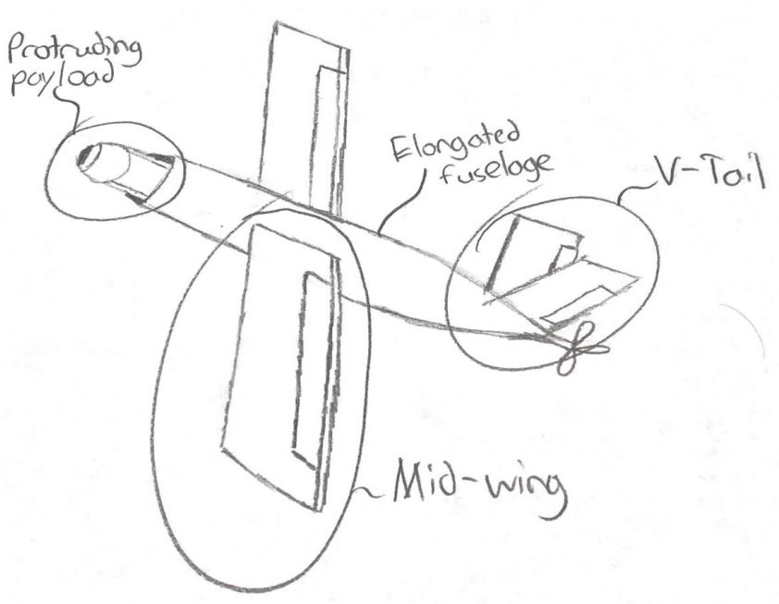
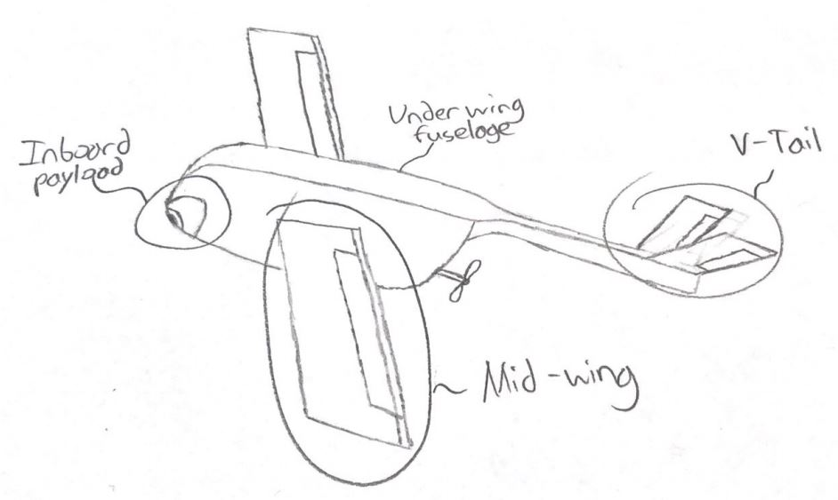
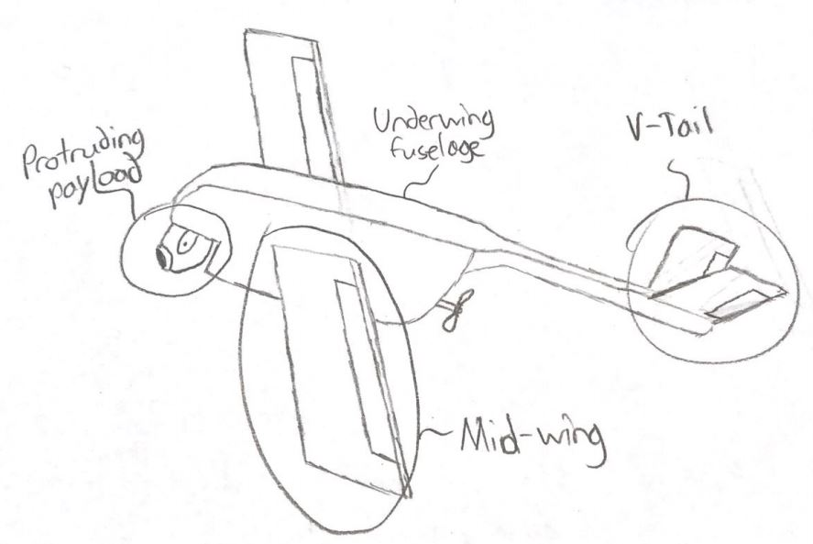
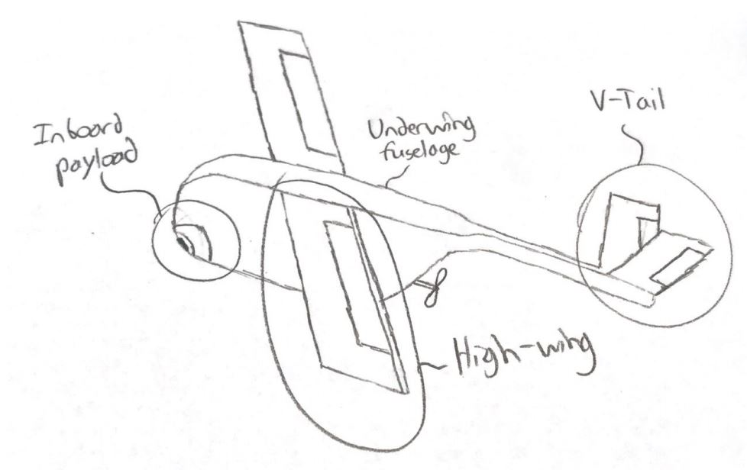
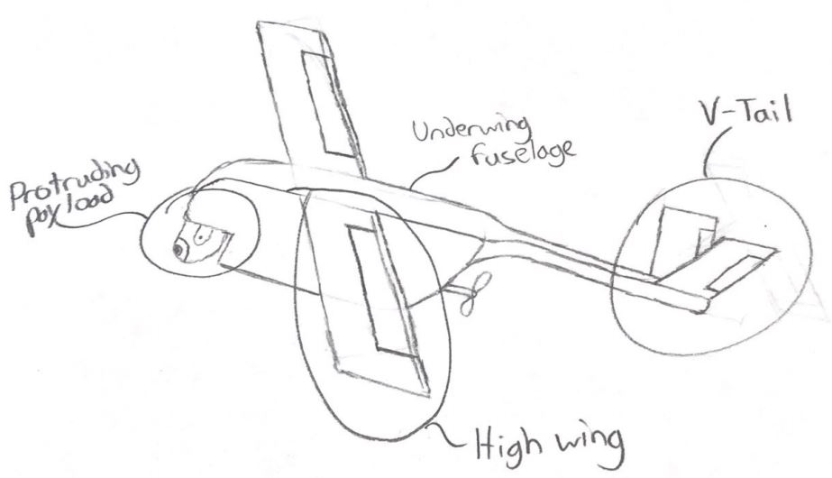
Other Concepts
33

Slide 34
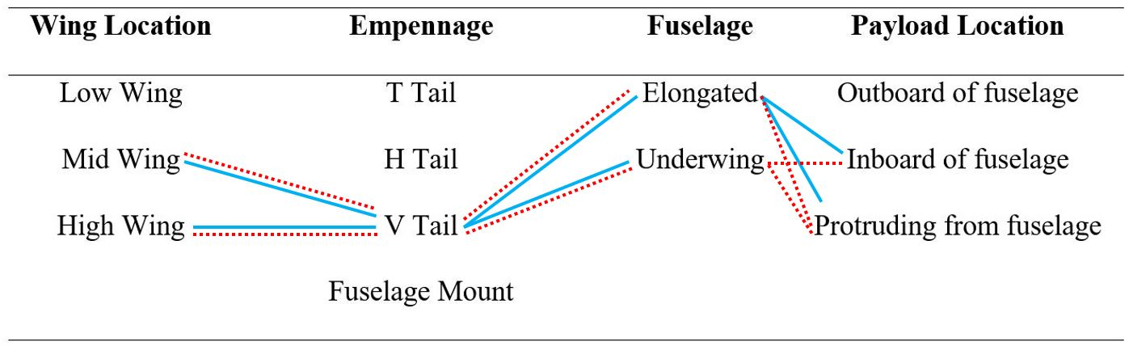
Morphological Chart Paths
34

Slide 35
Function | Metric | Target
Send Commands | Range | 10 kilometers
Receive Data | Range | 10 kilometers
Accelerate | Thrust source increases | Thrust source > 50%
Decelerate | Thrust source decreases | Thrust source < 50%
Adjust Roll, Pitch, Yaw | Articulate ailerons, elevators, and rudders | -45°<=Ailerons <=45° -45°<=Elevators<=45° -45°<=Rudder <= 45°
Power Payload | Delivers power to payload and components | Voltage > 2.0 V
Record Data | Video Quality | Resolution >=480p
Orient Payload | Range of angle orientation | 360 degrees
Function | Metric | Target
*Generate Lift | *Airfoil produces greater lift force than gross weight | *Lift >=18.68 Newtons
House Hardware | Volume | <=0.30 m³
*Couple Payload | *Payload weight | *>=160 g *<=200 g
*Endure | *Time while airborne | *>=60 minutes
Carry by Backpack | Stored Drone Dimensions | Stored Width <= 0.762 m Stored Length <=0.508 m
 | Cruising Speed of UAV | >=30 km/hour
 | Take off procedure | Hand Take off
 | Cruising altitude | >=152.4 m
 | *Gross weight | *<=1.905 kg

