Slide 1
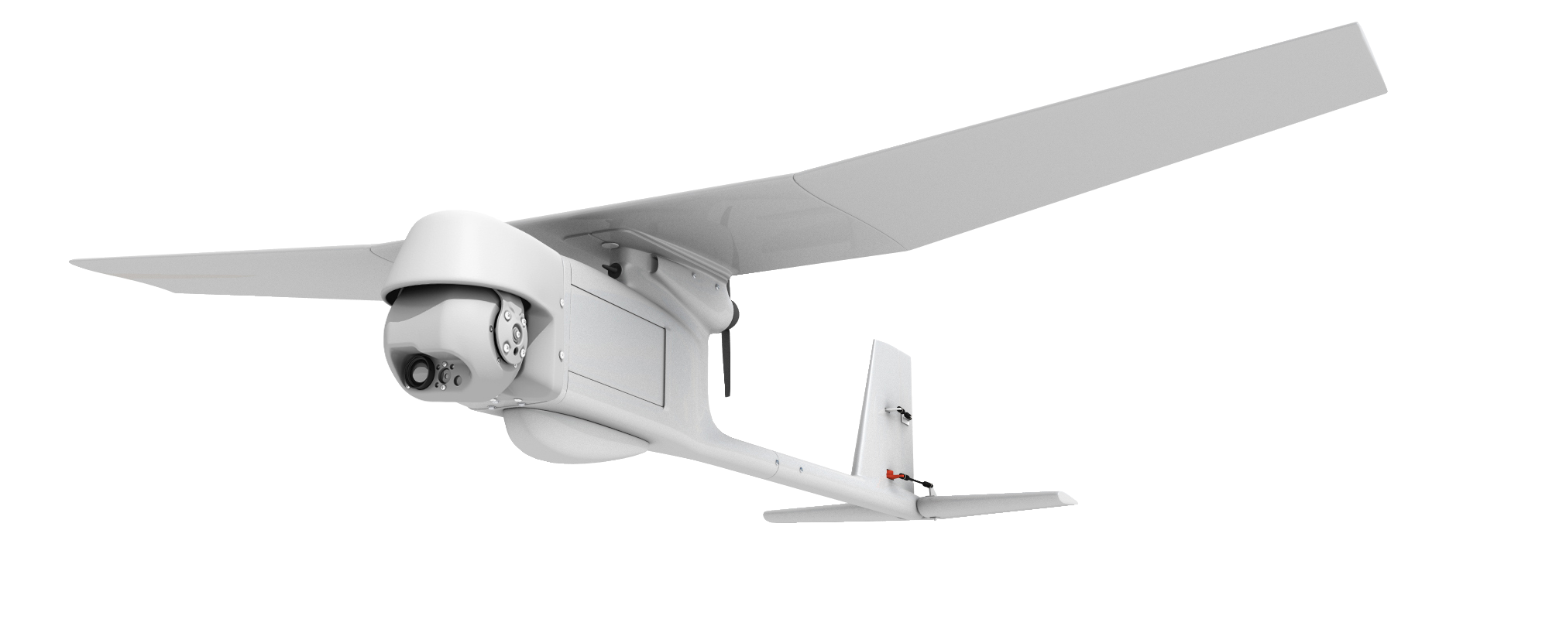
Lightweight UAV
Team 518
Clayton Cooley
Taylor Jacobs
Zachary Noay
Brenden Richman
Brian Thervil
15-Oct-19

Slide 2
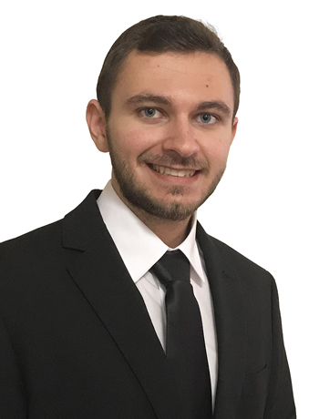
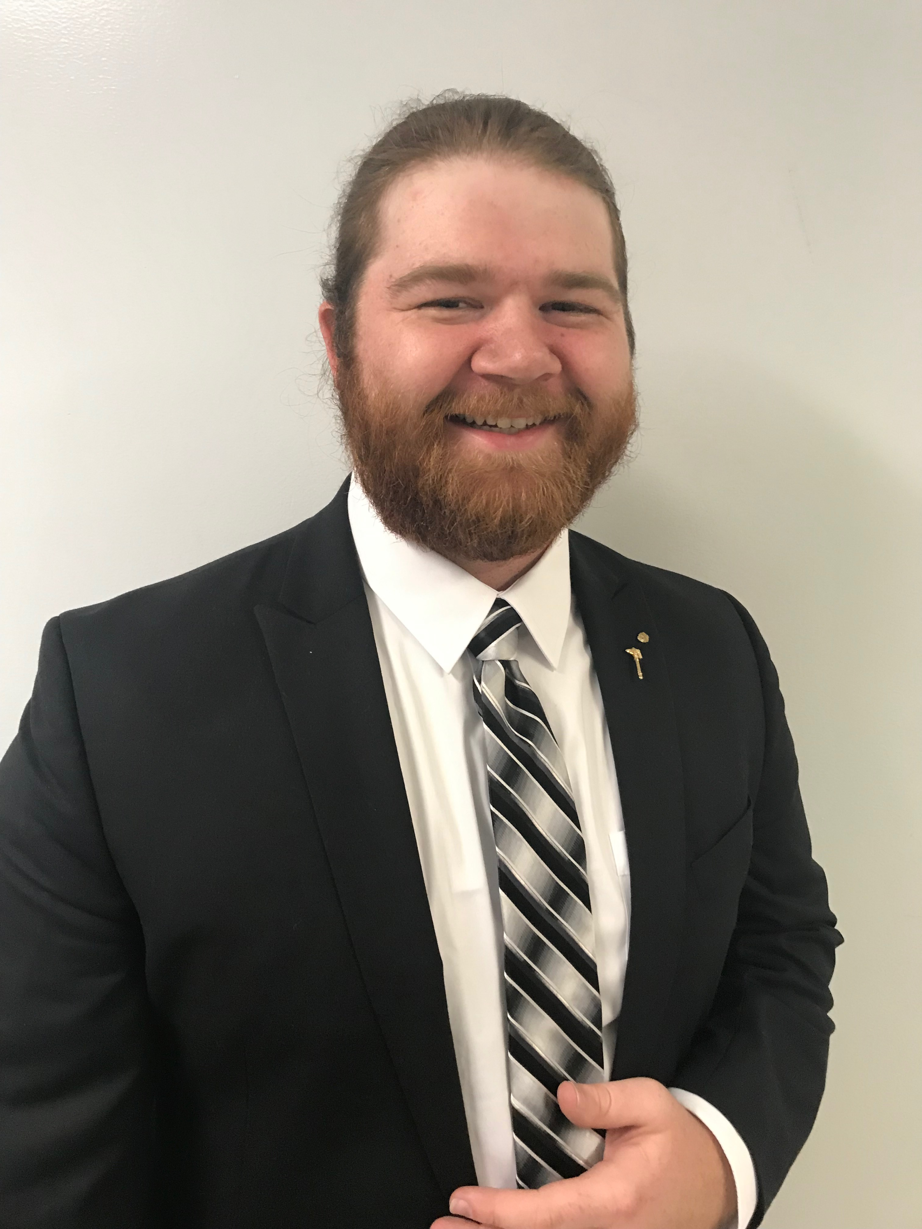
Team Introduction
Clayton Cooley
Test Engineer
Mechanical Engineering
Taylor Jacobs
Flight Dynamics Engineer
Mechanical Engineering
Zachary Noay
Embedded Systems Engineer
Electrical & Computer Engineering
Brenden Richman
CAD/Materials Engineer
Mechanical Engineering
Brian Thervil
Software/System Integration Engineer
Electrical & Computer Engineering

Slide 3
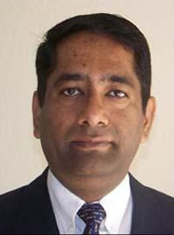
Sponsor and Advisor
A global security company that provides innovative solutions worldwide.
Jennifer Tecson
Dr. Rajan Kumar
Manager of Engineering
FSU Electrical Engineering Graduate
Research in Aerodynamics, Experimental Fluid Mechanics, and Flow Diagnostics
Taylor Jacobs

Slide 4
Objective
The objective of this project is to decrease the weight and increase the flight time of a fixed wing UAV for military video surveillance.
Taylor Jacobs

Slide 5
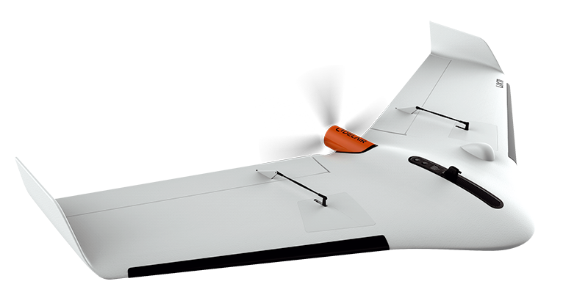
UAV
UAV stands for Unmanned Aerial Vehicle
Often called a drone and remotely controlled
Two main types
Fixed Wing
Quadcopter
Taylor Jacobs
5

Slide 6
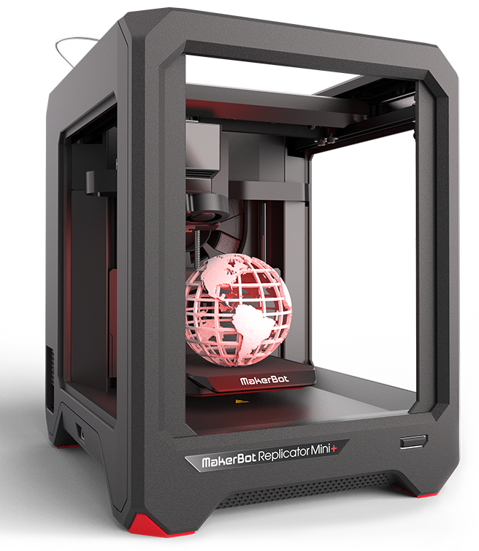
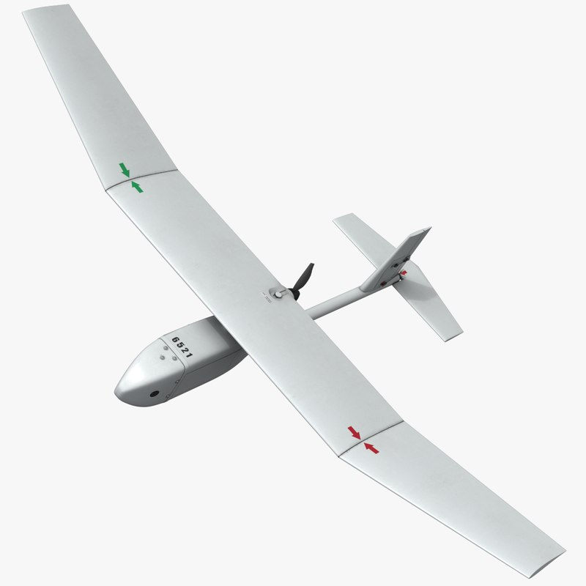
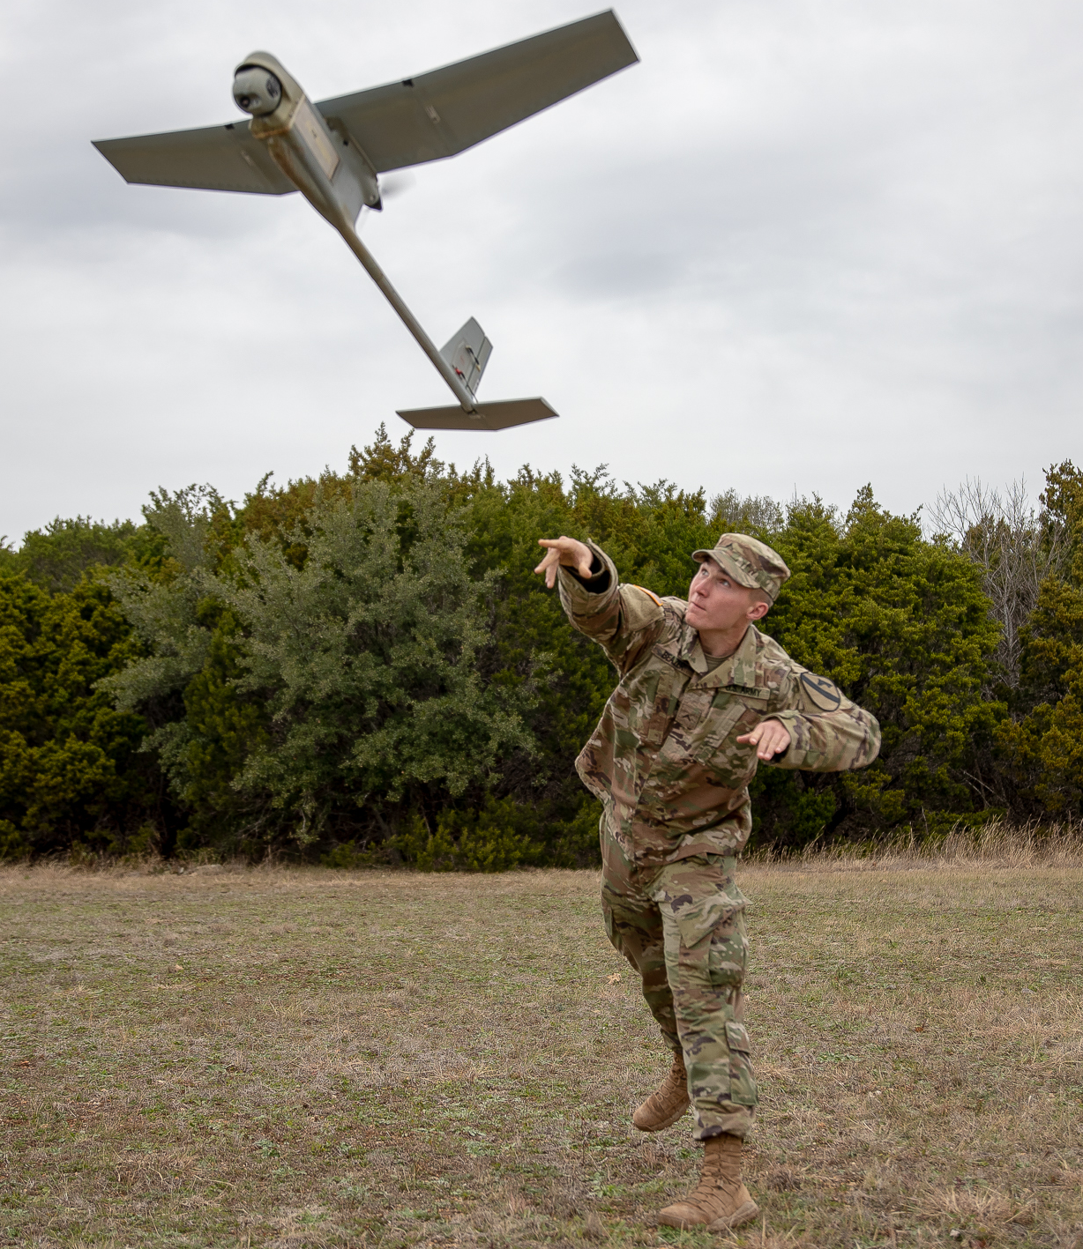
Project Background
Develop a fixed wing UAV utilizing 3D printed components and embedded wiring to reduce weight.
Pick a reference UAV as a basis and alter designs, components, and parameters to achieve the greatest flight duration to weight ratio.
The UAV will be portable to be deployed as a close-range surveillance tool for soldiers.
Taylor Jacobs

Slide 7
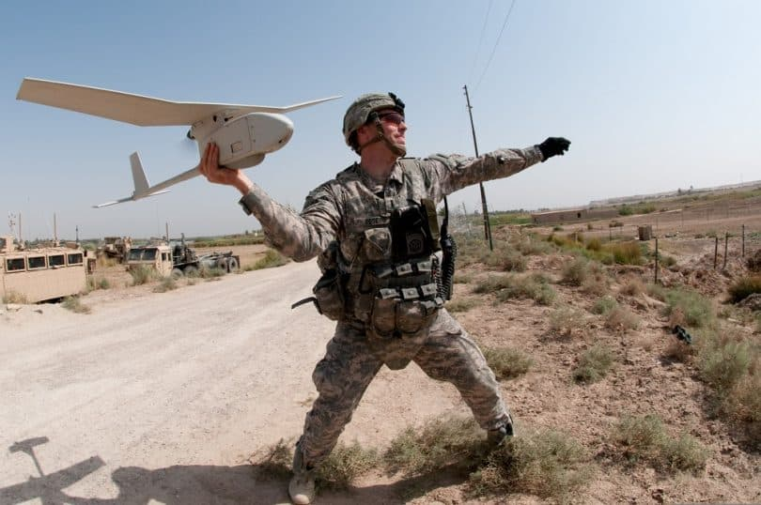
Markets
Primary Market
U.S. Government and Military Personnel
Secondary Market
Small Companies
Enthusiasts
Agriculture and other industries
Taylor Jacobs

Slide 8
Assumptions
Used in Earth’s atmosphere
Operate in open areas
Payload will weigh less than 1 pound
Maximum flight time will be 1 hour or less
UAV will comply to Category 1 specifications
UAV will be user-controlled
Goals
3D printed construction
Increase flight time to weight ratio
Taylor Jacobs

Slide 9
Assumptions
Used in Earth’s atmosphere
Operate in open areas
Payload will weigh less than 1 pound
Maximum flight time will be 1 hour or less
UAV will comply to Category 1 specifications
UAV will be user-controlled
Goals
3D printed construction
Increase flight time to weight ratio
Taylor Jacobs

Slide 10
Assumptions
Used in Earth’s atmosphere
Operate in open areas
Payload will weigh less than 1 pound
Maximum flight time will be 1 hour or less
UAV will comply to Category 1 specifications
UAV will be user-controlled
Goals
3D printed construction
Increase flight time to weight ratio
Taylor Jacobs

Slide 11
Customer Needs
Taylor Jacobs
11

Slide 12
Question
Interpreted Need
Is the purpose of this lightweight drone to fly for longer periods, carry items for transport, have increased velocity, etc.?
The drone’s gross weight is lighter than a specified reference drone
Brian Thervil

Slide 13
Question
Interpreted Need
Is the purpose of this lightweight drone to fly for longer periods, carry items for transport, have increased velocity, etc.?
The drone’s gross weight is lighter than a specified reference drone
The drone chassis/body is constructed and hardware components are purchased.
Is the team provided a drone to utilize for this project or should one be designed and constructed?
Brian Thervil

Slide 14
Question
Interpreted Need
Is the purpose of this lightweight drone to fly for longer periods, carry items for transport, have increased velocity, etc.?
The drone’s gross weight is lighter than a specified reference drone
The drone chassis/body is constructed and hardware components are purchased.
Is the team provided a drone to utilize for this project or should one be designed and constructed?
The drone withstands standard/common flight weather conditions.
Should the drone be able to withstand wet weather conditions, such as rain or mist from water?
Brian Thervil

Slide 15
Question
Interpreted Need
What is the desired flight time of the drone under its full capacity, e.g. full velocity, full load, etc. depending on purpose?
Drone flight time is same or greater than reference drone.
Brian Thervil

Slide 16
Question
Interpreted Need
What is the desired flight time of the drone under its full capacity, e.g. full velocity, full load, etc. depending on purpose?
Drone flight time is same or greater than reference drone.
What are the legal regulations for this project that we must abide by?
The drone meets FAA and U.S. DOT requirements.
Brian Thervil

Slide 17
Question
Interpreted Need
What is the desired flight time of the drone under its full capacity, e.g. full velocity, full load, etc. depending on purpose?
Drone flight time is same or greater than reference drone.
What are the legal regulations for this project that we must abide by?
The drone meets FAA and U.S. DOT requirements.
Should the drone be constructed of 3D printed material or is that a secondary goal to being lightweight?
Drone chassis/parts are constructed of 3D printed materials.
Brian Thervil

Slide 18
Question
Interpreted Need
What is the expected size of the drone in reference to current drones on the market?
The drone is smaller than double of the reference drone.
Brian Thervil

Slide 19
Question
Interpreted Need
What is the expected size of the drone in reference to current drones on the market?
The drone is smaller than double of the reference drone.
What are the desired flight climates for the lightweight UAV?
Drone operates in U.S. climate conditions.
Brian Thervil

Slide 20
Question
Interpreted Need
What is the expected size of the drone in reference to current drones on the market?
The drone is smaller than double of the reference drone.
What are the desired flight climates for the lightweight UAV?
Drone operates in U.S. climate conditions.
What are the expected operation circumstances of this UAV, should it be autonomous or user controlled?
The drone is user controlled.
Brian Thervil

Slide 21
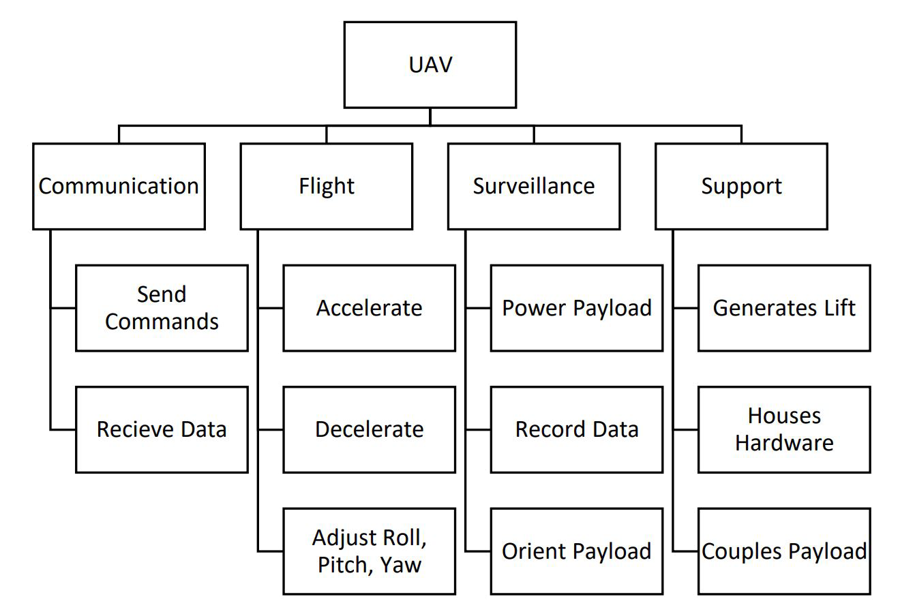
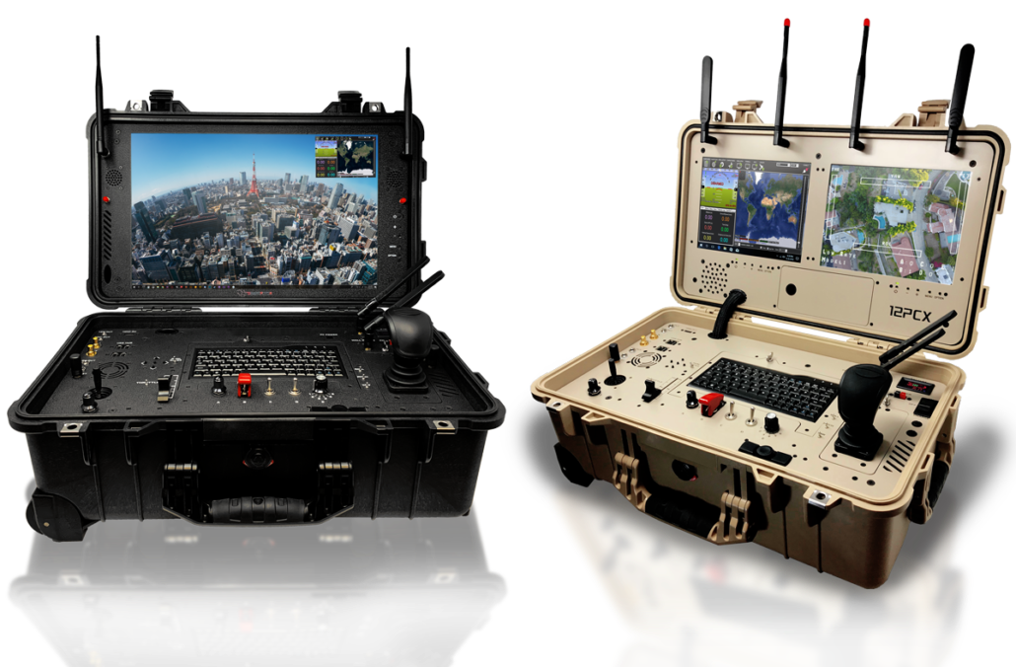
UAV Functional Decomposition
Brian Thervil
21

Slide 22
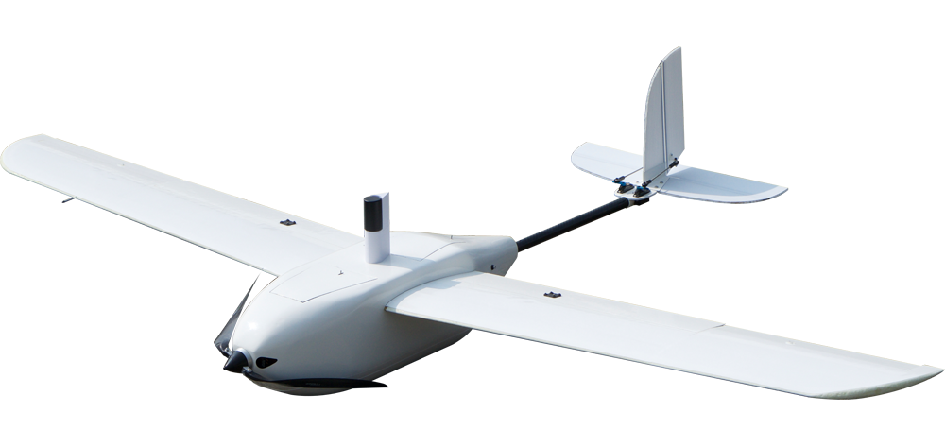
UAV Functional Decomposition
Brian Thervil
22

Slide 23
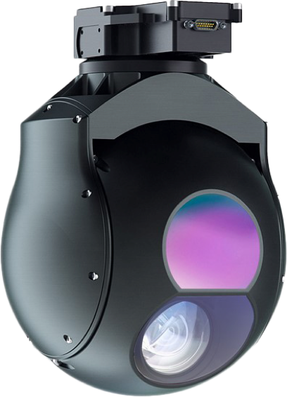
UAV Functional Decomposition
Brian Thervil
23

Slide 24
UAV Functional Decomposition
Brian Thervil
24

Slide 25
Cross Reference
Function: | Communication | Flight | Surveillance | Support
Communication | X | X | X
Flight | X | X |  | X
Surveillance | X |  | X
Support |  | X | X | X
Brian Thervil

Slide 26
Project Summary
Perform light-weighting techniques to design a UAV for surveillance applications.
Increase UAV flight time to weight ratio.
Ability to fly under normal conditions.
Follow all FAA and U.S. DOT regulations.
UAV is user controlled.
Brian Thervil

Slide 27
References
Classification of the Unmanned Aerial Systems. (n.d.). Retrieved September 30, 2019, from https://www.e-education.psu.edu/geog892/node/5.
Omega. (n.d.). The UAV - The Future Of The Sky. Retrieved September 30, 2019, from https://www.theuav.com/.
United States Department of Transportation. (2019, March 11). Educational Users. Retrieved September 30, 2019, from https://www.faa.gov/uas/educational_users/.
Brian Thervil
Notes:
Not this slide will advance on default after 2 seconds. If you would like to change this then go to the transition tab and under timing change the advance slide settings.

Slide 28
Questions
Clayton Cooley
Taylor Jacobs
Zachary Noay
Brenden Richman
Brian Thervil
Lightweight UAV
Team 518
Notes:
Not this slide will advance on default after 2 seconds. If you would like to change this then go to the transition tab and under timing change the advance slide settings.

Slide 29
Backup Slides

Slide 30
Key Goals
3D printed construction
Increase flight time to UAV weight ratio

Slide 31
Question | Customer Response | Interpreted Need
What are the legal regulations for this project that we must abide by? FAA, U.S. DOT, other countries regulations, etc.? | The drone should follow any and all required government regulations. | The drone meets Federal Aviation Administration (FAA) and U.S. Department of Transportation (U.S. DOT) requirements.
Should the drone be constructed of 3D printed material or is that a secondary goal to being lightweight? | The team has access to the CAD software and 3D printing materials. | Drone chassis/parts are constructed of 3D printed materials.
What is the expected size of the drone in reference to current drones on the market? | The design team has full control over the reference and product specifications | The drone is smaller than double of the reference drone.
What are the desired flight climates for the lightweight UAV? | Drone should be comparable to current drones but will not be physically used by Northrop Grumman. | Drone operates in U.S. climate conditions.
What are the expected operation circumstances of this UAV, should it be autonomous or user controlled? | The team’s timeline does not account for autonomous control and user controlled is a better option. | The drone is user controlled.

Slide 32
Question | Customer Response | Interpreted Need
Is the purpose of this lightweight drone to fly for longer periods, carry items for transport, have increased velocity, etc.? | The success will be judged by weight reduction to a reference drone. | The drone’s gross weight is lighter than a specified reference drone
Is the team provided a drone to utilize for this project or should one be designed and constructed? | The senior design team has control over this, but they have access to construction resources. | The drone chassis/body is constructed and hardware components purchased.
Should the drone be able to withstand wet weather conditions, such as rain or mist from water? Is weatherproofing a vital aspect of this project? | The drone should be able to withstand weather conditions related to where the senior design team thinks it will be used. | The drone withstands standard/common flight weather conditions.
What is the desired flight time of the drone under its full capacity, e.g. full velocity, full load, etc. depending on purpose? | The success will be judged by weight reduction to reference drone. | Drone flight time is same or greater than reference drone.

Slide 33
Stakeholders
Northrop Grumman
Dr. Shayne McConomy
Dr. Rajan Kumar
Dr. Jerris Hooker
Dr. Camilo Ordonez

Slide 34
Category 1 Drone
Gross Weight: <20 lbs
Operating Altitude: <1200 ft
Airspeed: <100 Knots (115 mph)

Slide 35
Future Work
Generate Concepts
Concept Selection Process
Prototyping

Slide 36
Lightweight UAV
Questions
Clayton Cooley
Taylor Jacobs
Zachary Noay
Brenden Richman
Brian Thervil
Team 518

Slide 37
Standard Shapes
Summary Box
Text box 1
Outlined Text Box

Slide 38
Approved Logos

Slide 39
Color Palette

Slide 40
APA Tables
Category 1 | Category 2 | Category 3 | Category 4 | Category 5
Item 1
Item 2
Item 3
Item 4
 | Category 2 |  |  | Category 3
Category 1 | subcategory 1 | subcategory 2 |  | subcategory 1 | subcategory 2
Item 1
Item 2
Item 3
Item 4

