Slide 1
FAMU-FSU Parade Float
Team 511: Danielle Carr, Brianna Gann, Christian Kinlaw, Tarick Walcott
Notes:
Do I leave it as a lil square or extend it??

Slide 2
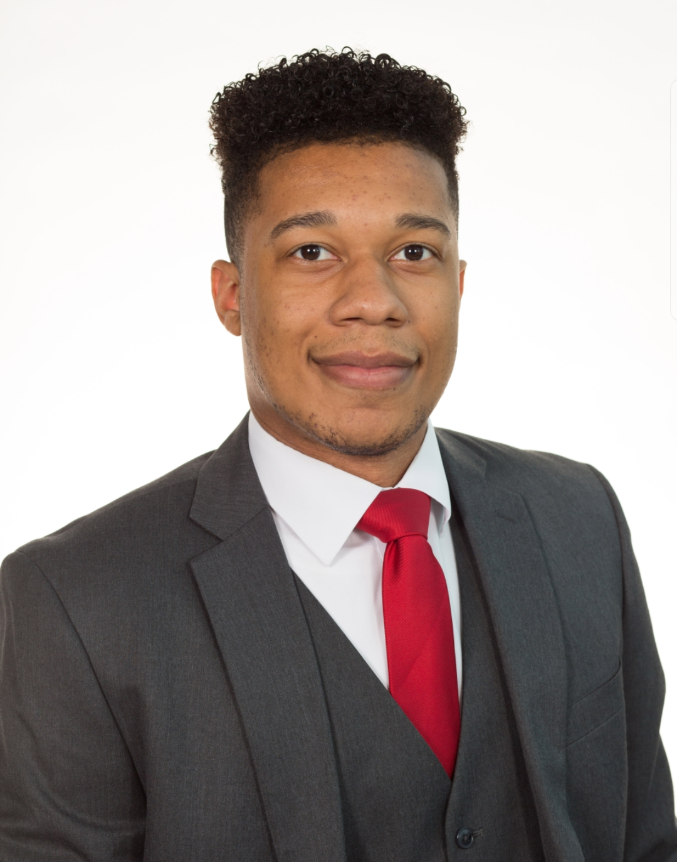
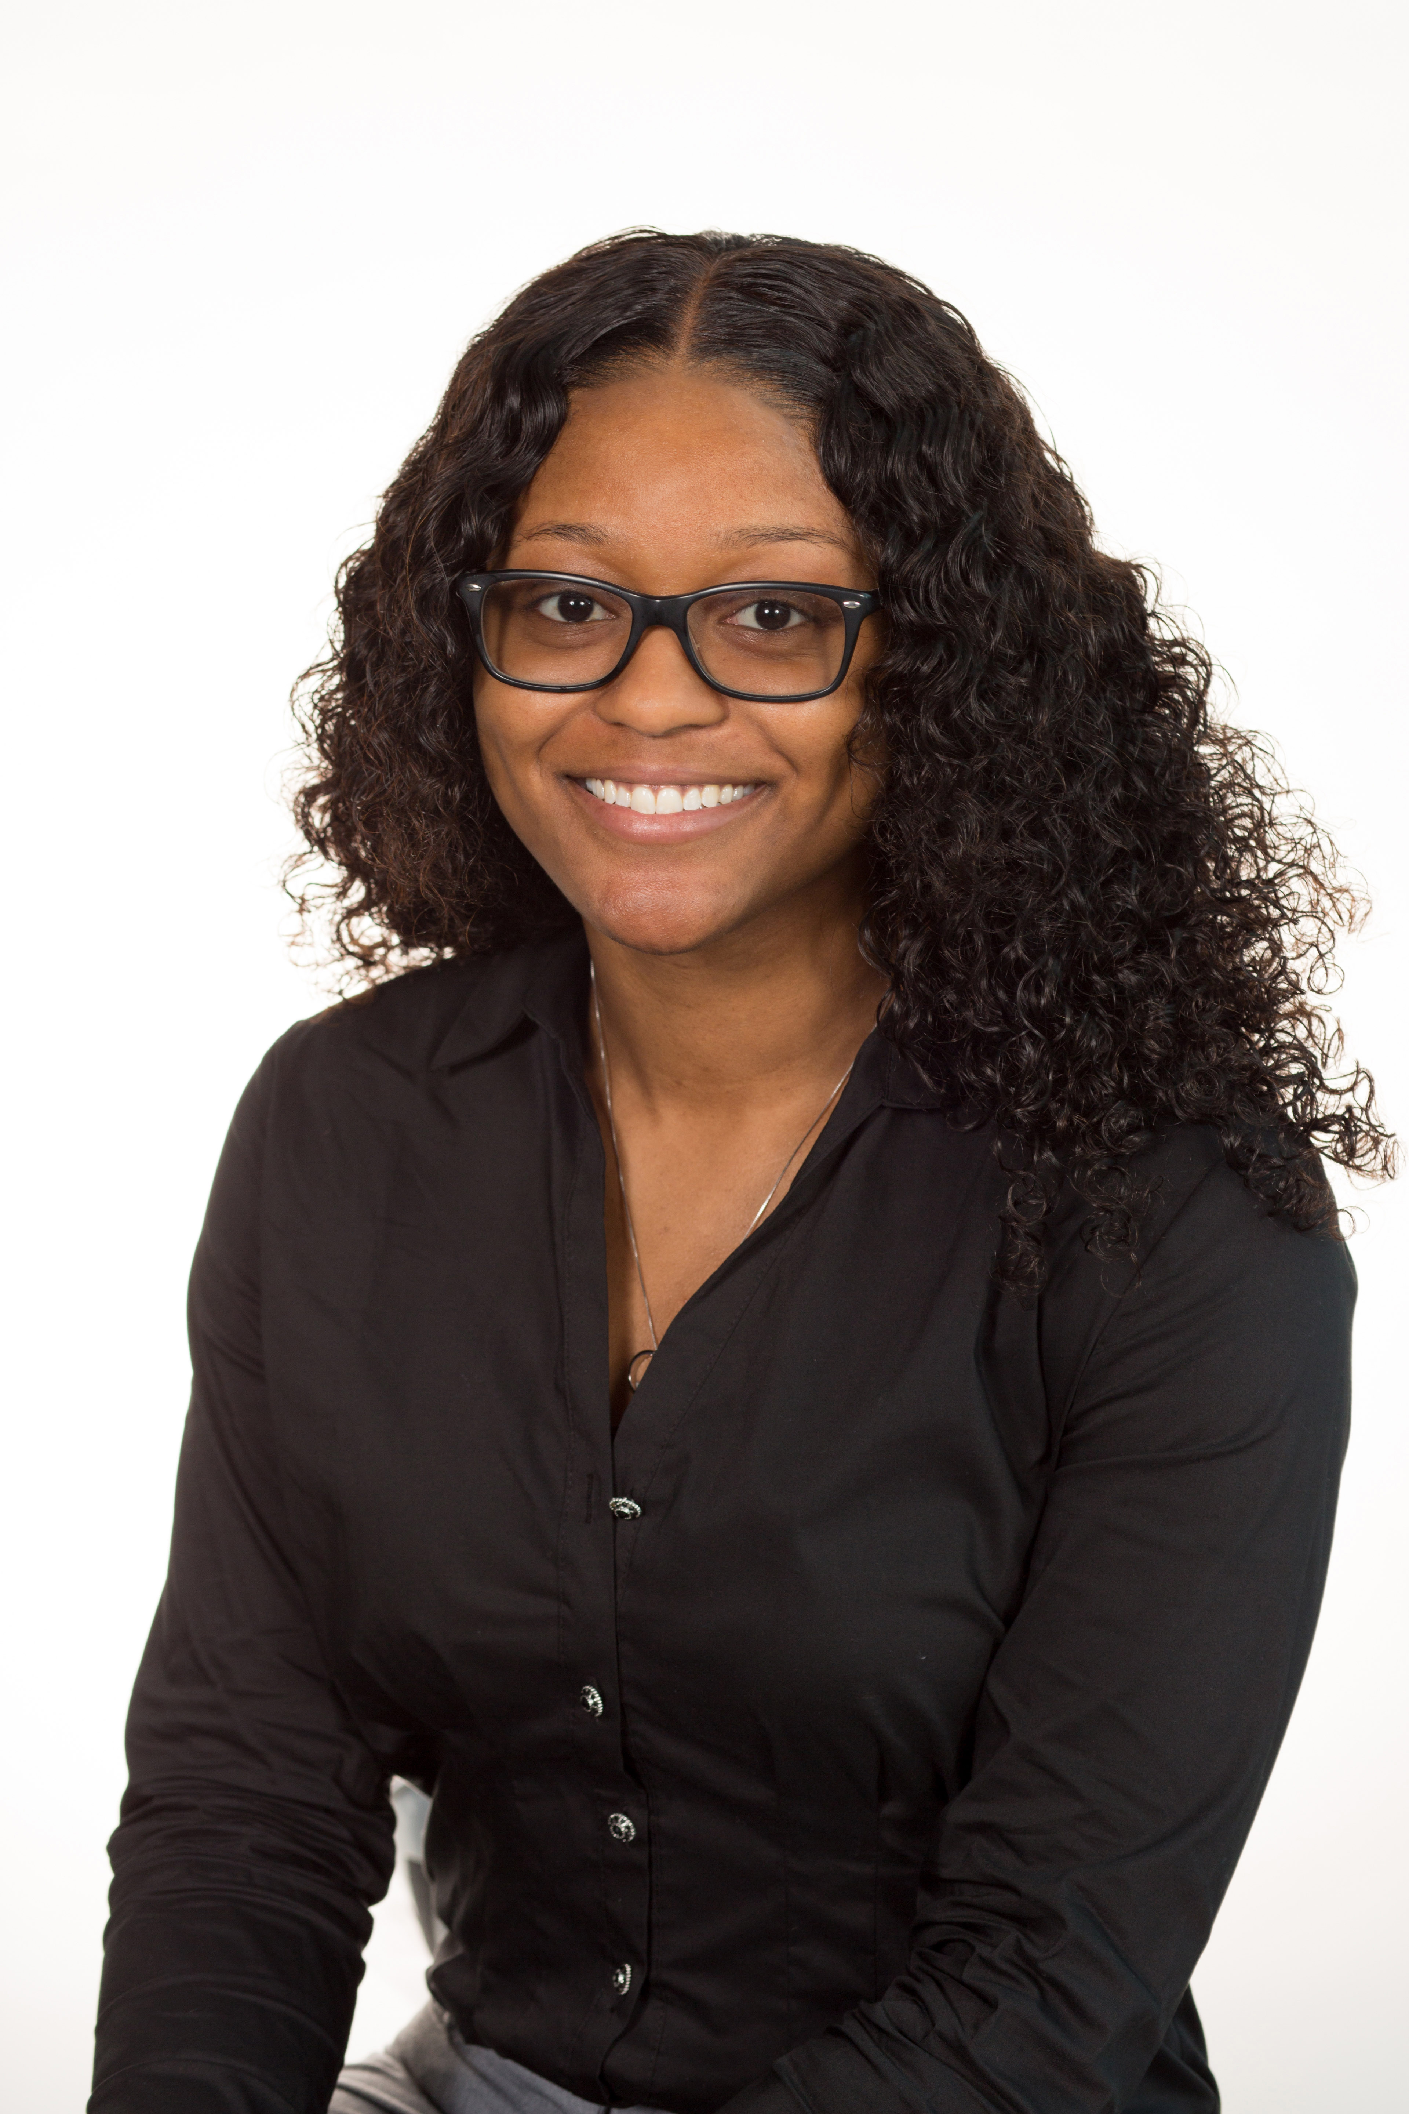
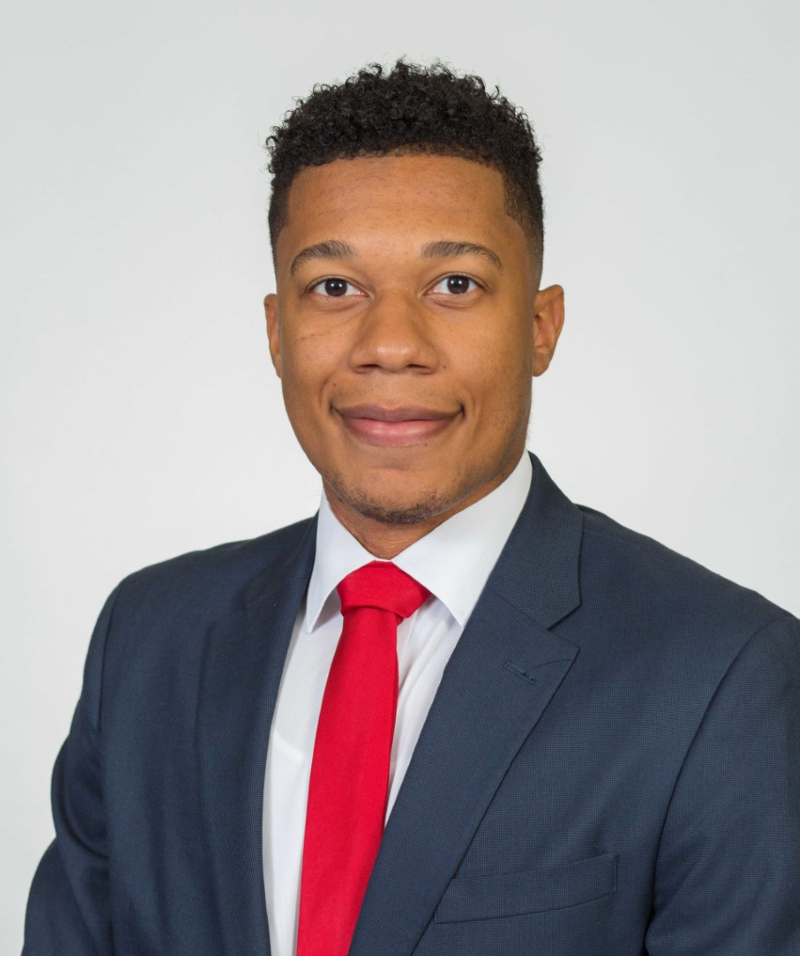
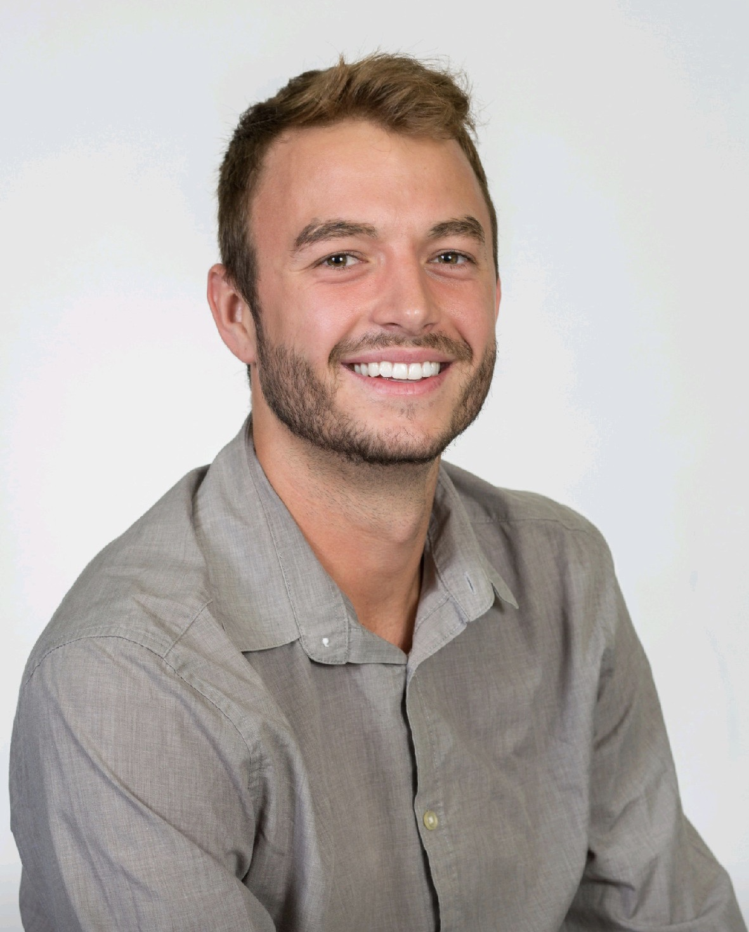
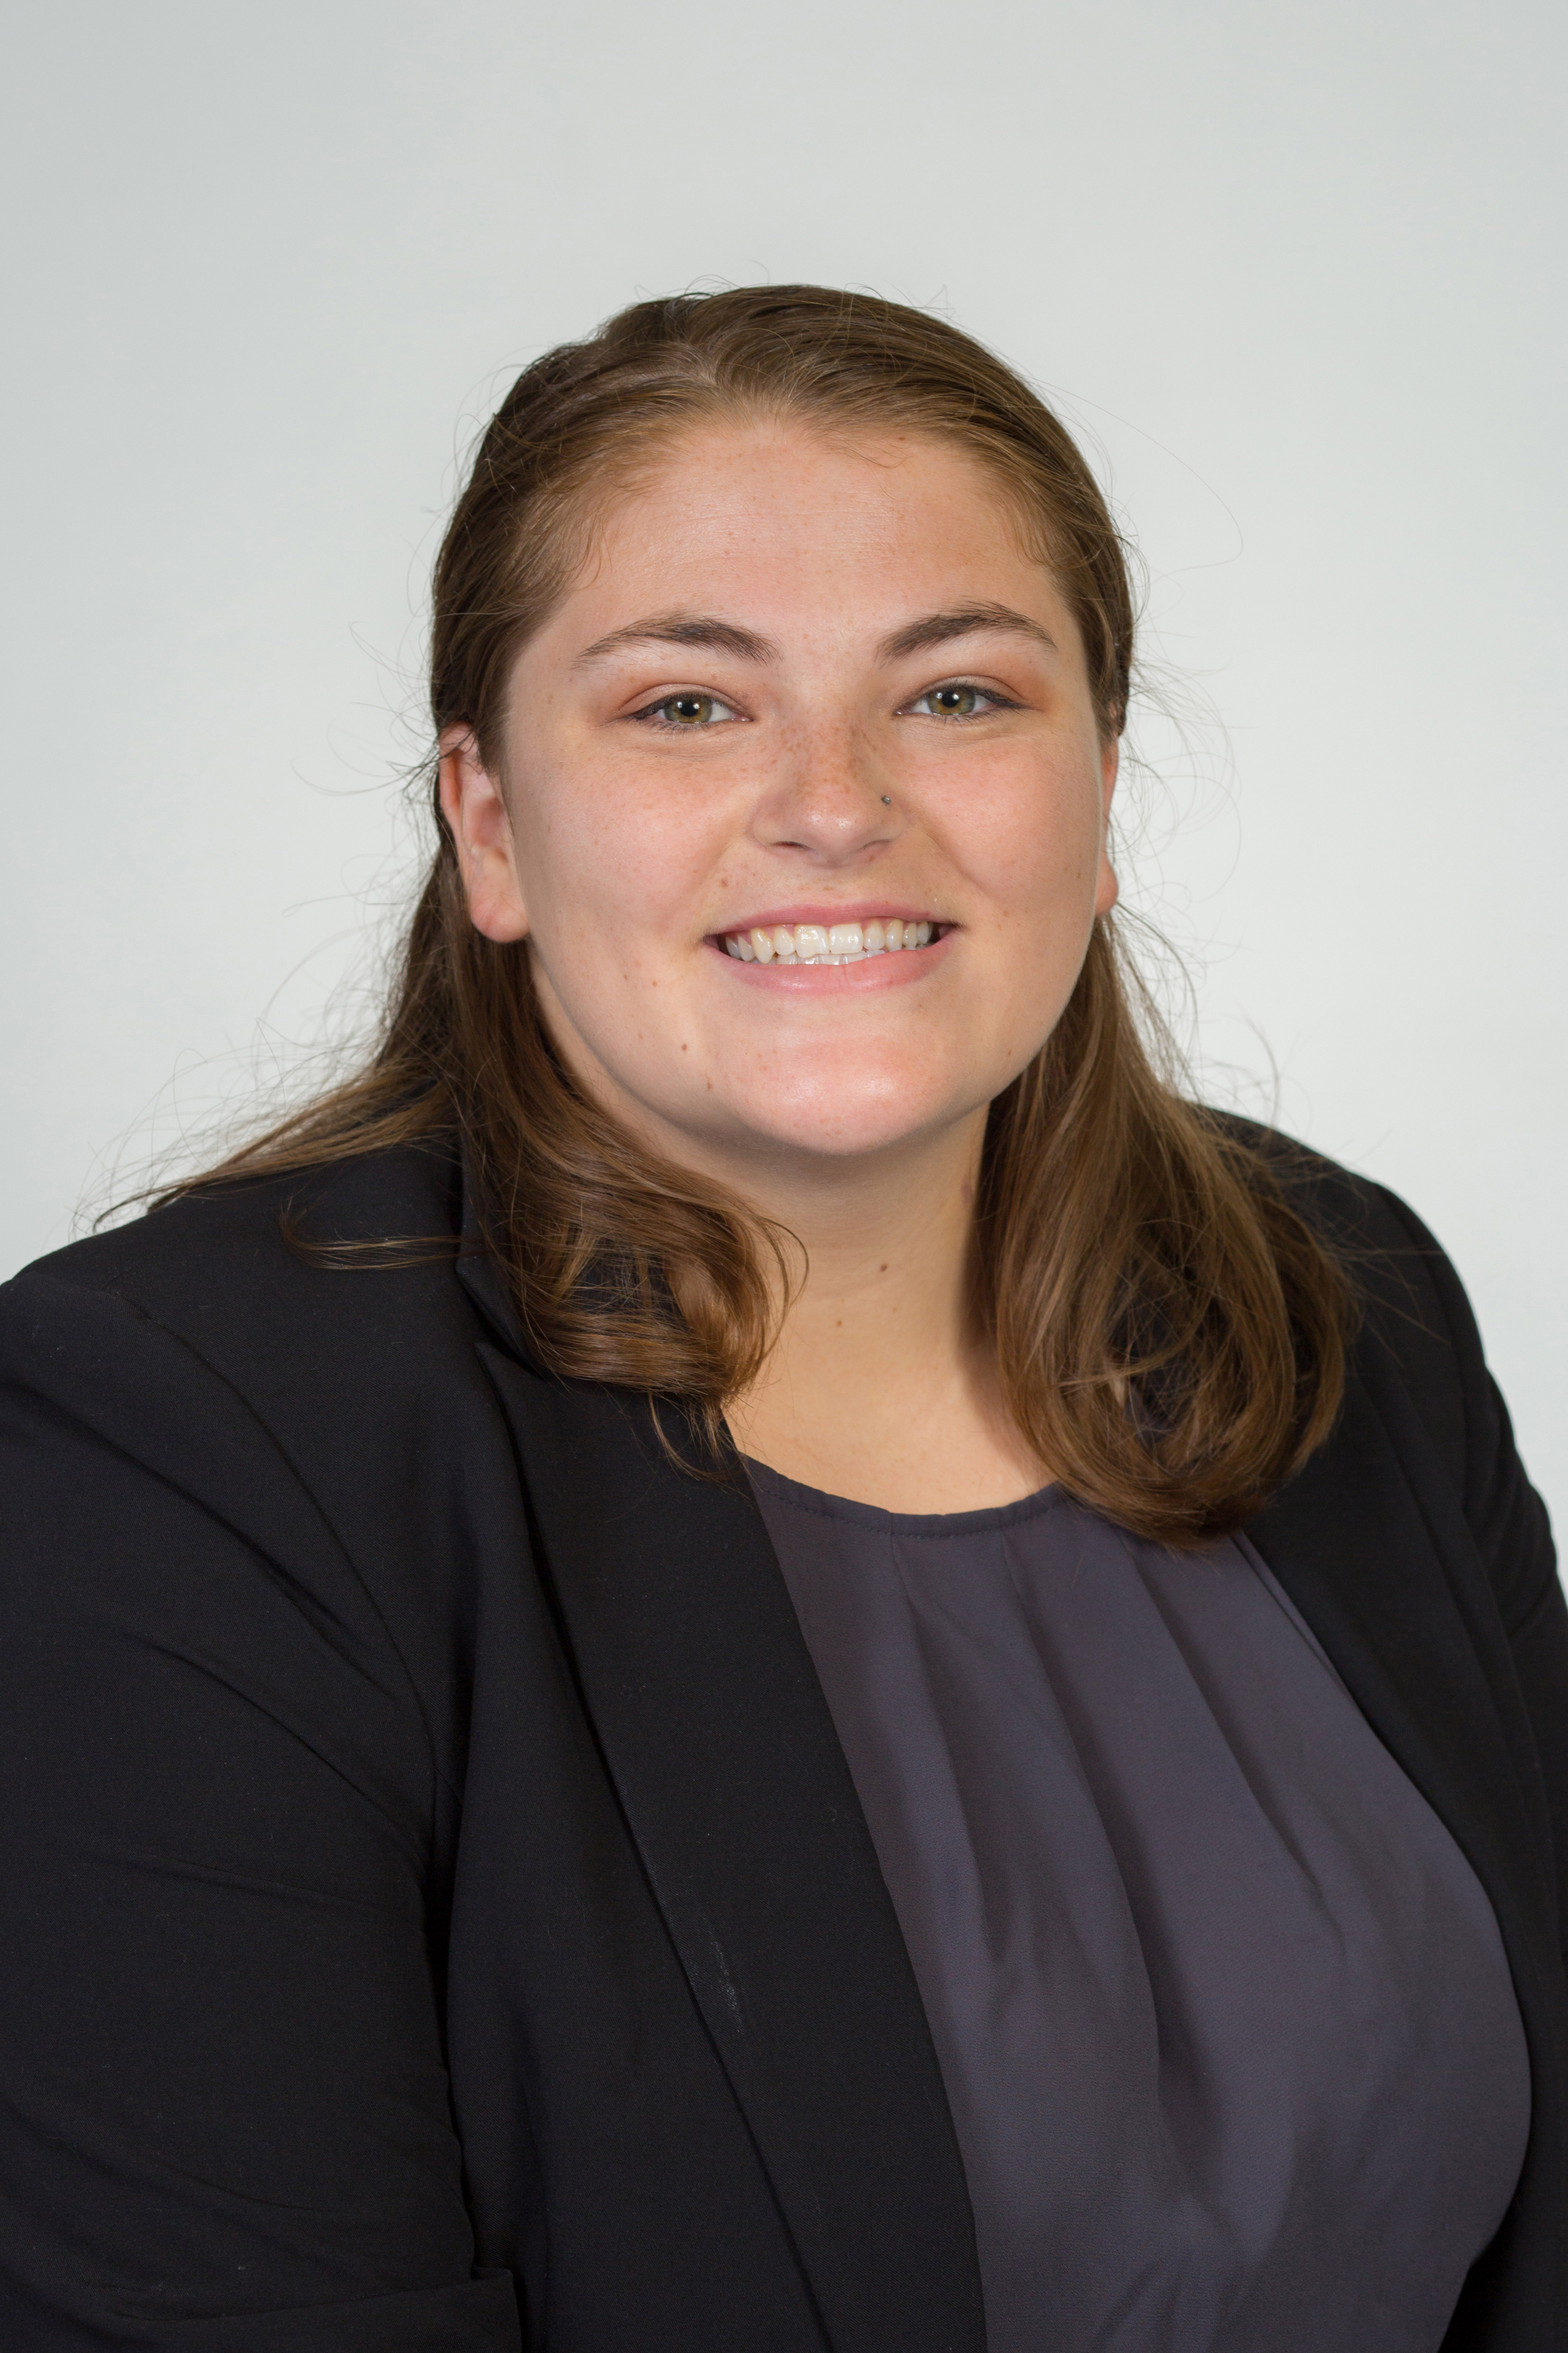
Team Introductions
Tarick Walcott
Mechanical Design Engineer
Danielle Carr
Systems Engineer
Christian Kinlaw
Design Engineer
Brianna Gann
Project Manager

Slide 3
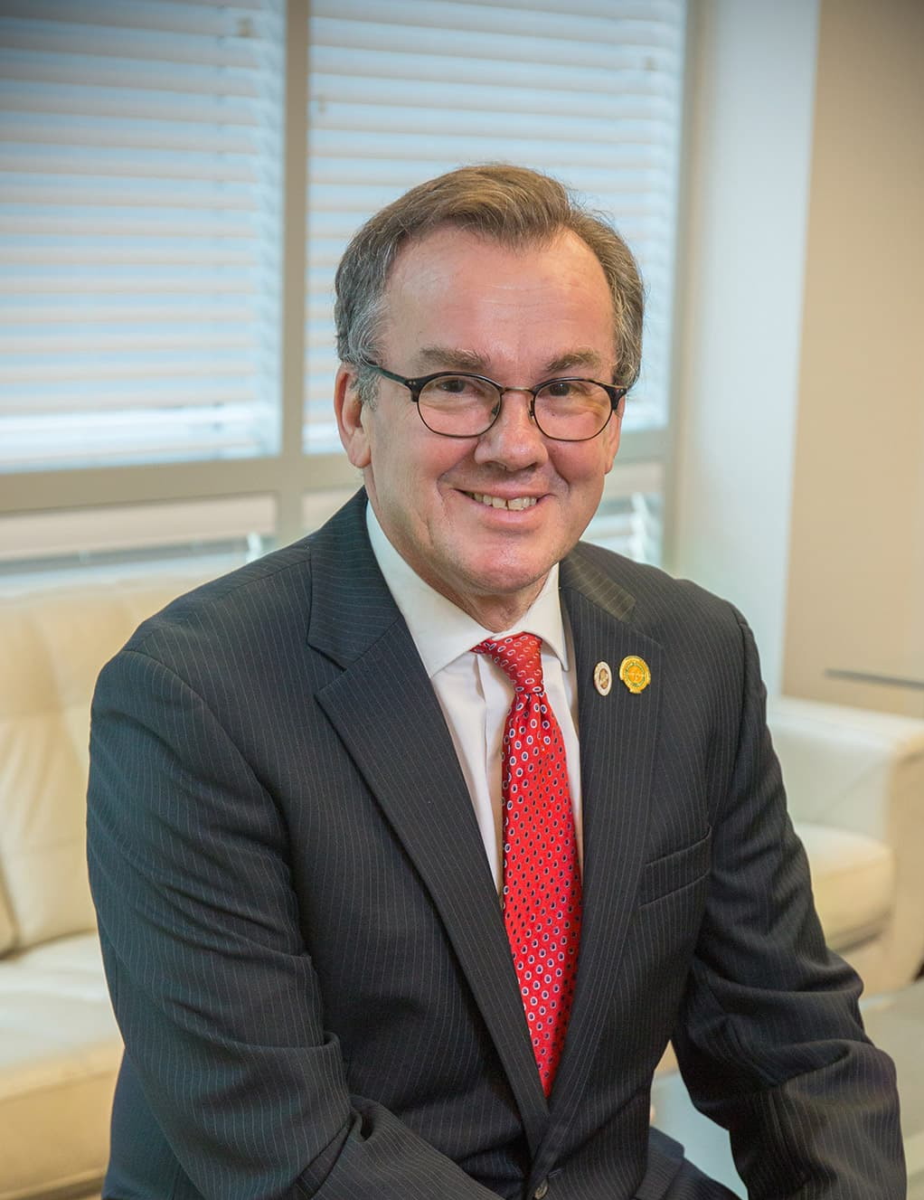
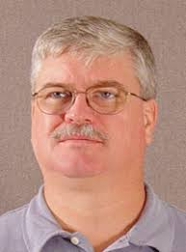
Sponsors & Advisor
Dean J. Murray Gibson
Sponsor
Mrs. Faye Gibson
Sponsor
Keith Larson
Advisor
Tarick Walcott
Notes:
Add mcconomy

Slide 4
Objective
The objective of this project is to design and build a parade float that represents the FAMU-FSU College of Engineering.
Danielle Carr

Slide 5
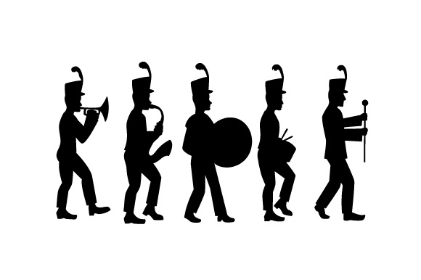
Key Goals
Display FAMU-FSU College of Engineering disciplines
Reusable
Capable of participating in multiple parades
Capture attention
Danielle Carr

Slide 6
Previous Work
Project Scope
Concept Generation
Concept Selection
CAD Design
Danielle Carr

Slide 7
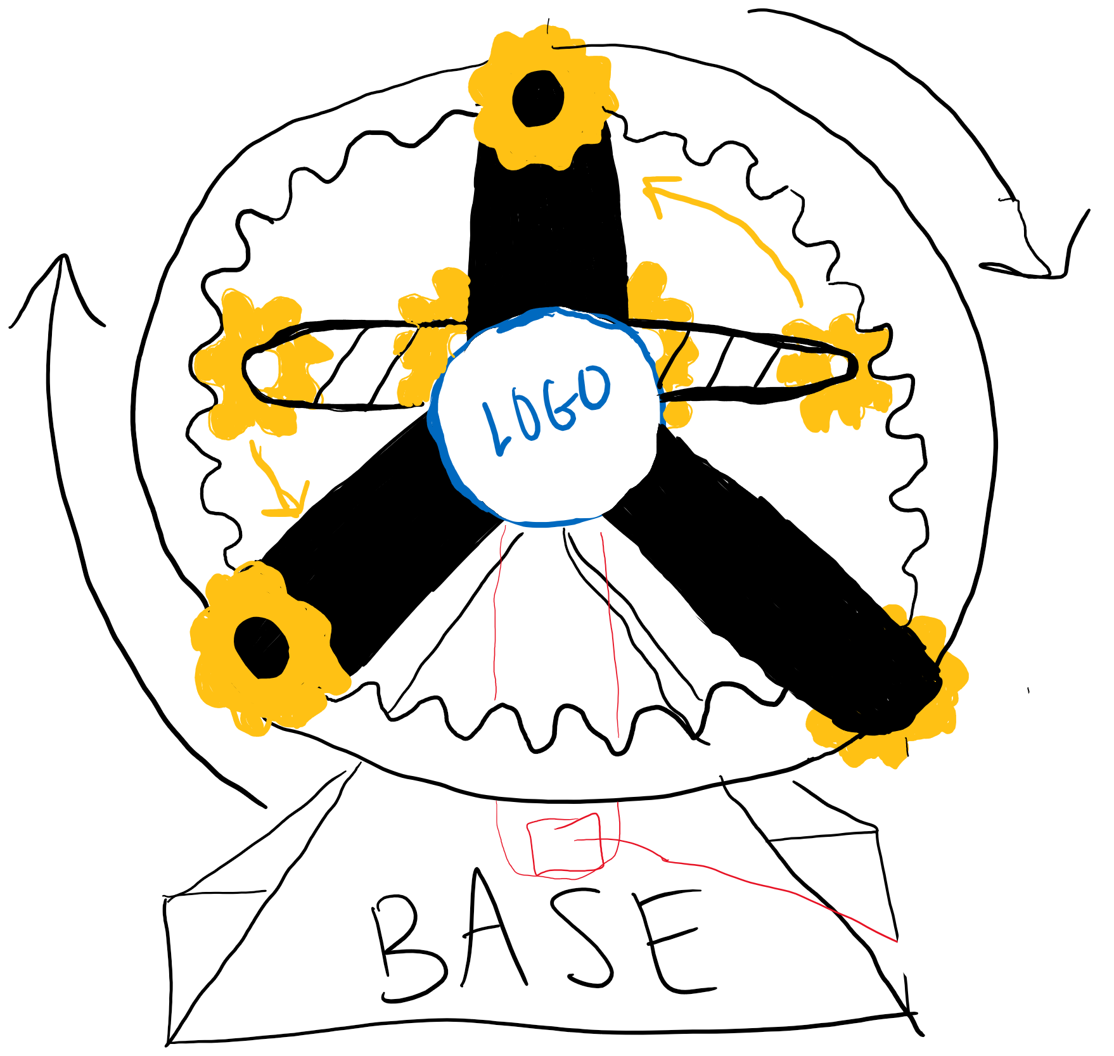
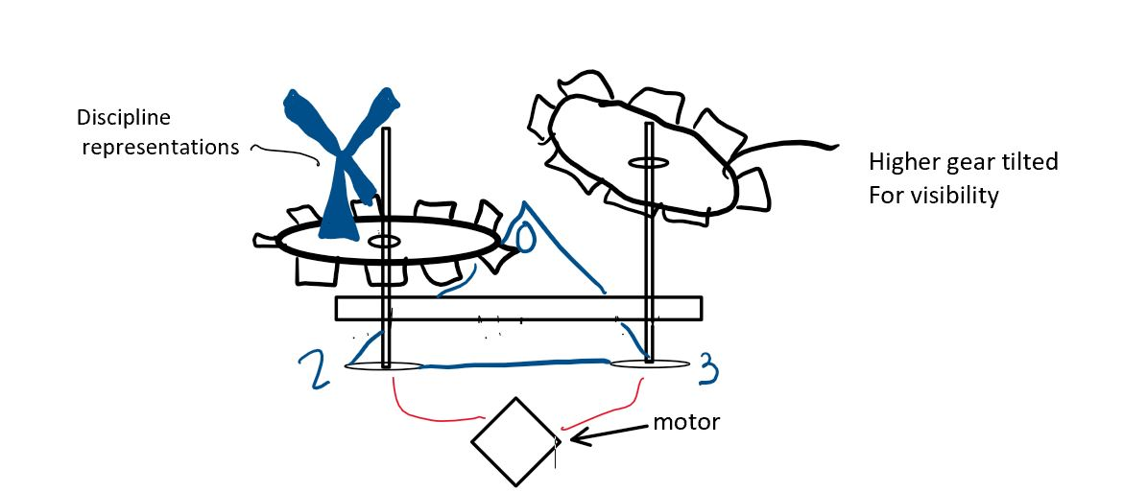
Concept Generation
Upgrades to more chaotic motion, attention grabbing & “whimsical” nature
Planetary Gear Motion
Fidget Ferris Wheel
Gear-Go-Round
Gear Pendulum
Concept 1
Concept 3
Concept 2
Concept 4
Danielle Carr
Notes:
Presented some of the previous designs such as the merry go round, sponsors said they were looking for something with more chaotic motion….

Slide 8
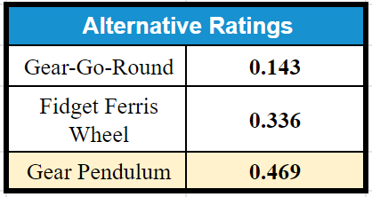
Concept Selection
Concept Selection Tools used:
House of Quality
Pugh Charts
Analytical Hierarchy Process
Weight was most critical criteria in the selection process
Final Rating matrix identified Gear Pendulum as the selected concept
Danielle Carr
Notes:
On what qualities

Slide 9
Physical Prototype
3D Printed prototype created based on initial CAD
Troubleshoot gear connections and scaling and try different ideas
Staples for cotter pins
Thickness for each gear
Tarick Walcott
Notes:
Gear connections tried cotter pins using staples!

Slide 10
Updated Design
Changed shape of top of base
Size and connection of gears
Decreased length and width base
Tarick Walcott
Notes:
Hard to see in a big picture sense, so we are going to zoom in to see it in detail

Slide 11
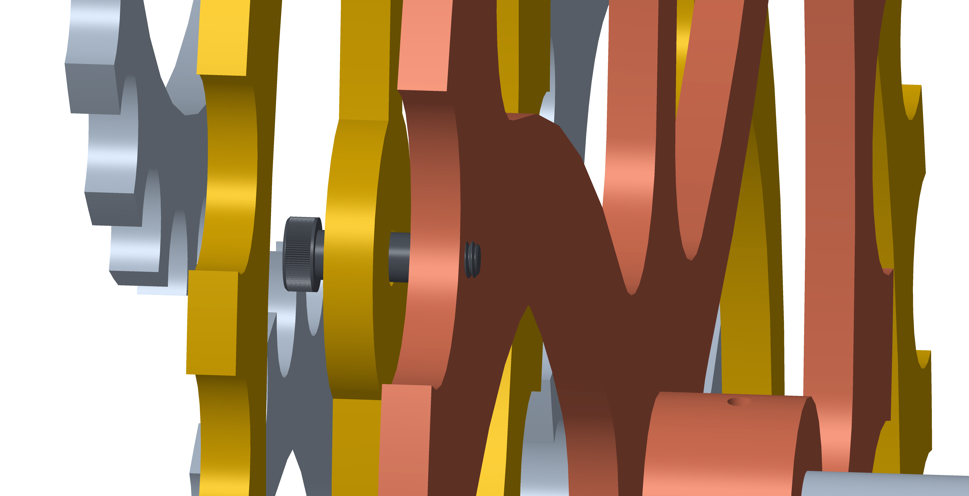
Gear Connections
Side View of large central gear (red) and middle tier gear (yellow)
Before prototyping:
static axles connected to each gear
difficult to manufacture
After prototyping:
Shoulder bolts to connect gears
Distance between gears is kept using Teflon spacers
Tarick Walcott

Slide 12
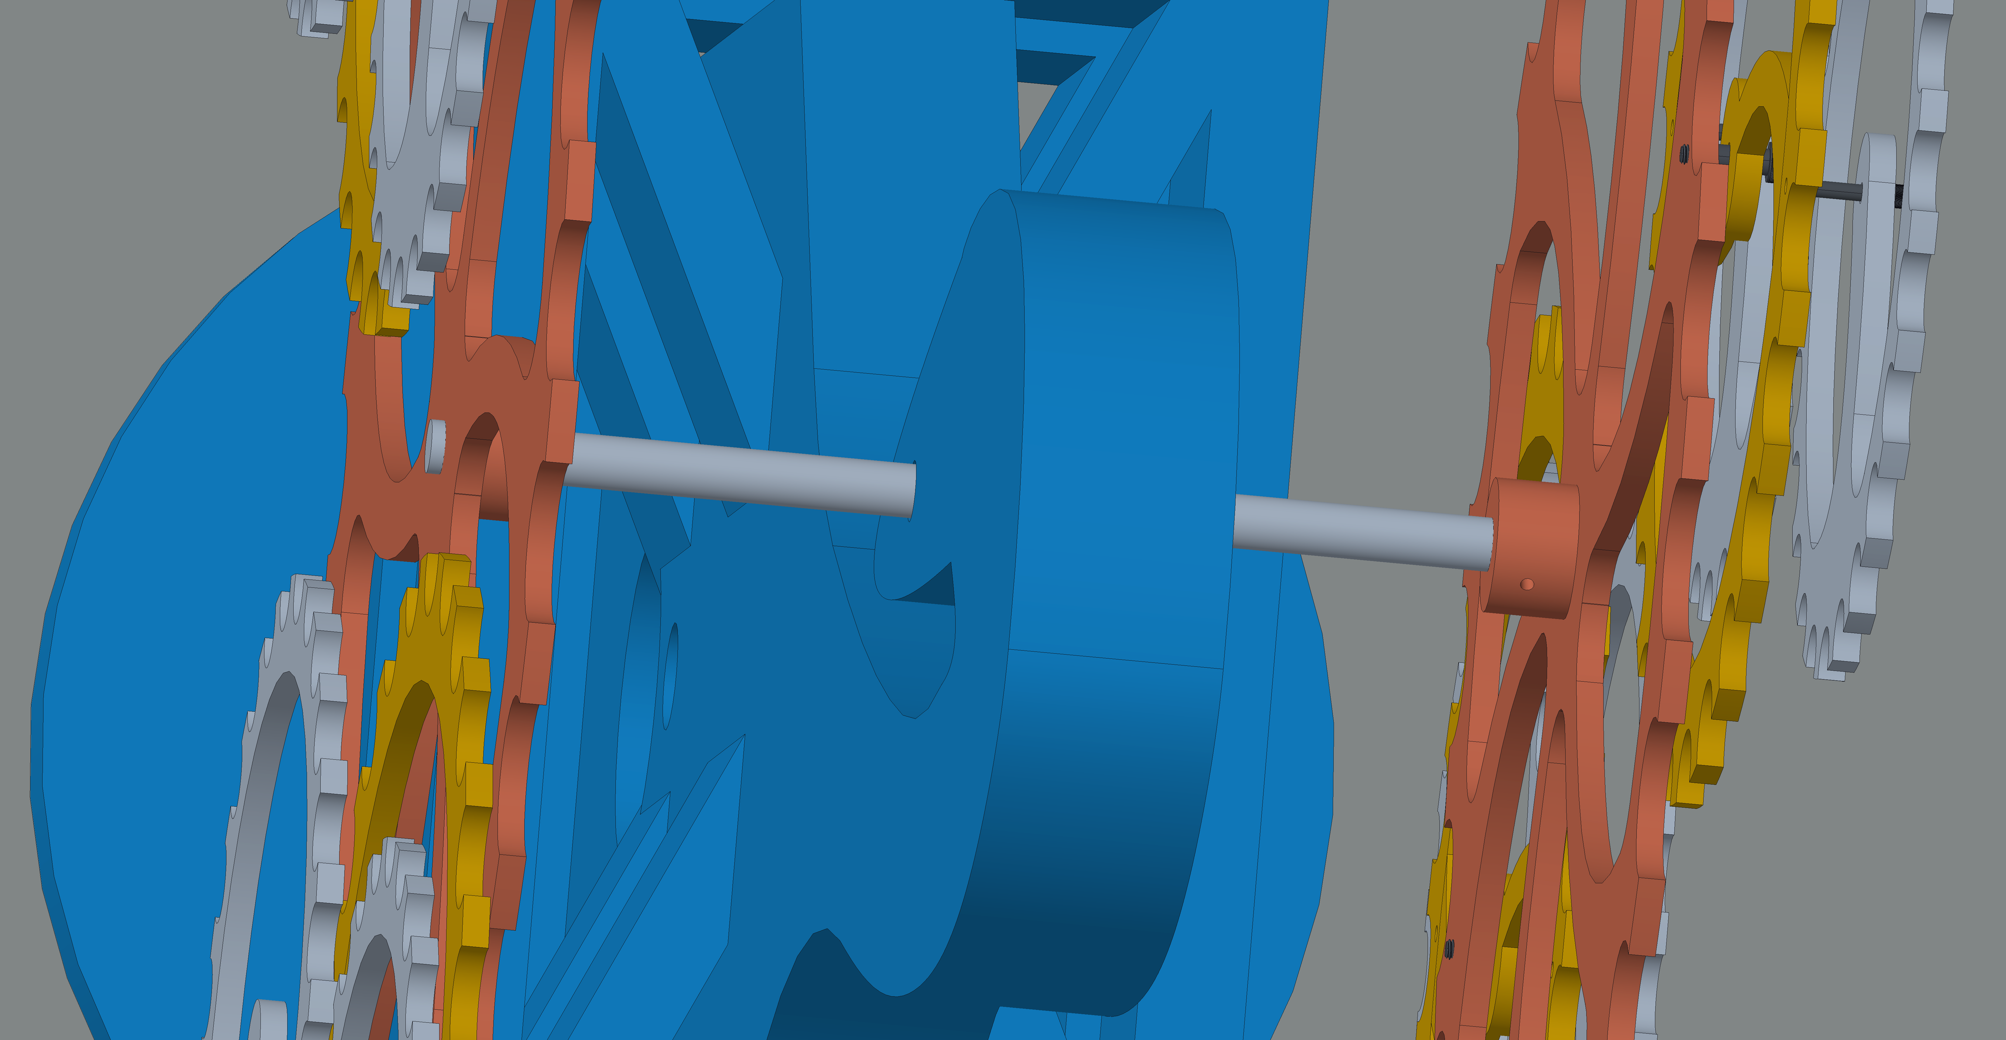
Powering the Pendulum
Pendulum will be powered by a motor and pulley system
Motor housed in base and connected to central axle with pulley/belt
Low rpm motor because weight distribution aides rotation
Top view of pendulum
Tarick Walcott

Slide 13
Securing the Sculpture
Bottom of pendulum base
4 Low-Strength Steel Hex Head Screws
Attaches structure base directly to trailer bed
4 Metal sleeves in trailer bed
Flying buttress doubles as design and side support
Tarick Walcott

Slide 14
Material Selection
Weight was the most important characteristic in the concept selection
Using the dimensions determined after prototyping, a over-estimated weight analysis was conducted
Compared acrylic, wood, and aluminum for display gear material
Material for base selected as wood for manufacturing and cost purposes
Gear Material:
Acrylic
Lightweight
Transparent → Parade audience can see tiered gears moving past one another
Comes colored
Weather resistant
Tarick Walcott

Slide 15
Updating Bill of Materials
Pendulum, supports, screws, manufacturing
Continuous updates while solidifying design
Does not include additional elements or any college branding materials
Tarick Walcott

Slide 16
Future Work
FEA Analysis with updates
Risk Assessment
Order Parts/Manufacturing Plan
Assemble Pendulum for float
Danielle Carr
Notes:
Solidify Design is where we can make any small asjustments after prodotyping

Slide 17
Key Points
Prototype was printed and assembled to troubleshoot potential problems and update design
More supportive connections were selected for the gear connections as well as the base to the trailer
Material selected for the base is wood and the gears will be colored acrylic
FEA on updated design is being conducted and analyzed
Ordering parts for the pendulum will follow this analysis
Danielle Carr

Slide 18
References
Florida State University. (n.d.). Homecoming: Florida State University. Retrieved from https://homecoming.fsu.edu/about-homecoming.
FAMU Homecoming 2019. (n.d.). Retrieved from http://www.homecomingonthehill.com/.
Roy, D. (2012, September 10). Cognition. Retrieved from http://www.woodthatworks.com/kinetic-sculptures/cognition.html.
State Library and Archives of Florida. (n.d.). Float in Florida State University's Homecoming parade - Tallahassee, Florida. Retrieved from https://www.floridamemory.com/items/show/74829.
State Library and Archives of Florida. (n.d.). Close-up view showing FAMU students working on a float for the homecoming parade in Tallahassee. Retrieved from https://www.floridamemory.com/items/show/274060.
Danielle Carr
Notes:
Not this slide will advance on default after 2 seconds. If you would like to change this then go to the transition tab and under timing change the advance slide settings.

Slide 19
Thank you!
Team 511: Danielle Carr, Brianna Gann, Christian Kinlaw, Tarick Walcott

Slide 20
Backup Sildes
Supporting Slides to the content above.

Slide 21
Customer Needs
Question | Customer Statement | Interpreted Need
What should this project be able to do? | The float needs to be pulled up hills and turn corners. | The float tolerates large inclines.
 |  | The float navigates typical street roads with ease.
 | The float needs to represent the FAMU-FSU College of Engineering. | The float represents FAMU and FSU as well as all disciplines of engineering.
 | The float needs to be used for longer than one year. | The float resists failure.
 |  | The float operates normally in outdoor weather conditions.
What are some of the things you would like this project to do? | The float needs to be easy to store and parts can be replaced. | The parts on the float are interchangeable.
 | The float needs to be used in multiple parades. | The float specifications envelop multiple parade constraints.

Slide 22
Cross-Reference Matrix
 | Navigate Routes | Display Visual Elements | Protect Infrastructure
Regulate velocity | X
Turn | X
Accelerate | X
Decelerate | X
Regulate Stability | X
Secure Elements | X
Support Weight Distribution | X |  | X
Display Engineering Disciplines |  |  | X
Present College Branding |  | X
Highlight College Success Statistics |  | X
Capture Attention |  | X
Move objects of Visual Interest |  | X
Generate Motion |  | X
Supply Power | X | X
Resist Failure |  |  | X
Withstand Outdoor Weather Conditions |  |  | X
Maintain Storable Size |  |  | X

Slide 23
Functional Decomposition

Slide 24
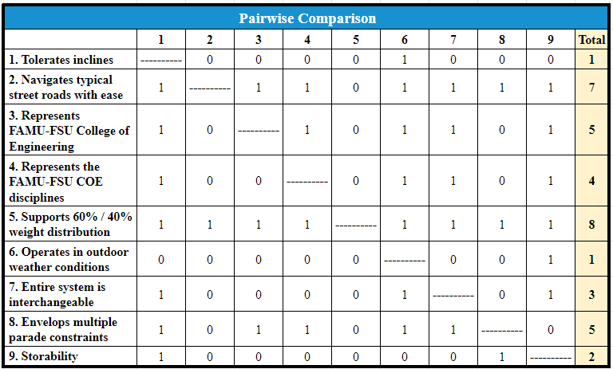
Pairwise Comparison

Slide 25
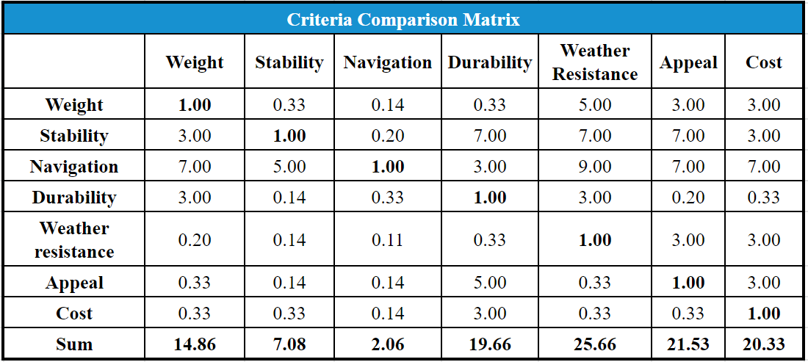
Criteria Comparison Matrix

Slide 26
Concept Generation
Concept 1:
Planetary Gear Motion
Visual Elements to Represent Disciplines Planetary-Go-Round
Disciplines | Elements
Biomedical | Syringes
Chemical | Periodic Table Elements
Civil/ Environmental | Road Map/Solar Panels
Computer | Floppy Discs
Electrical | Batteries
Industrial | Conveyor Belt Roller Coaster
Mechanical | Cars
Danielle Carr
Notes:
- Maybe we can show the original images and then show the updated concepts. May help with reaching the time limit

Slide 27
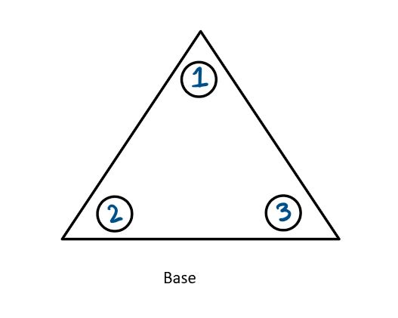
Concept Generation
Concept 2:
Gear-Go-Round
Visual Elements to Represent Disciplines Gear-Go-Round
Disciplines | Elements
Biomedical | DNA Strands
Chemical | Beakers
Civil/ Environmental | Bridges/Solar Panels
Computer | 3D Printed Motherboard
Electrical | Circuit Designs
Industrial | Blueprints
Mechanical | Gears
Danielle Carr
Notes:
- Maybe we can show the original images and then show the updated concepts. May help with reaching the time limit

Slide 28
Concept Generation
Concept 3:
Fidget Ferris Wheel
Visual Elements to Represent Disciplines Fidget Ferris Wheel
Disciplines | Elements
Biomedical | Small Prosthetics
Chemical | Chemical Structures
Civil/ Environmental | Buildings/Wind Turbines
Computer | Binary Numbers
Electrical | LED Lights
Industrial | Machine Belt
Mechanical | Gears
Danielle Carr
Notes:
- Maybe we can show the original images and then show the updated concepts. May help with reaching the time limit

Slide 29
Concept Generation
Concept 4:
The Gear Pendulum
Visual Elements to Represent Disciplines Gear Pendulum
Disciplines | Elements
Biomedical | DNA Strands
Chemical | Atom Molecule Structures
Civil/ Environmental | Bridge/Windmill
Computer | Motherboard
Electrical | Motherboard
Industrial | Blueprints
Mechanical | Gears
Danielle Carr
Notes:
- Maybe we can show the original images and then show the updated concepts. May help with reaching the time limit

Slide 30
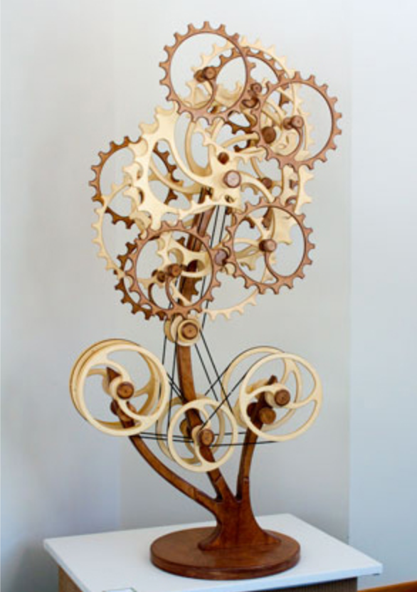
Gear Pendulum Inspiration

Slide 31
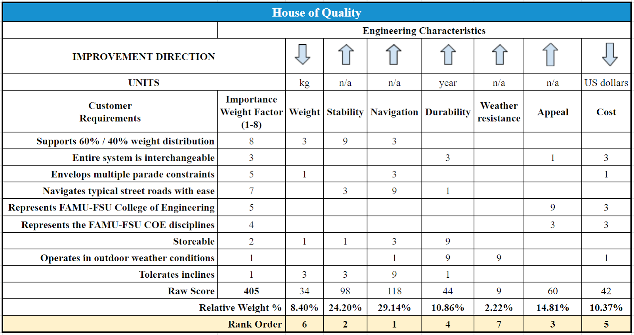
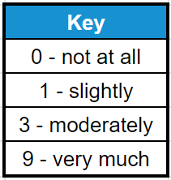
House of Quality
Notes:
Maybe talk about the pairwise comparison first before diving into the talk about the HOQ
Add image of the table for HOQ

Slide 32
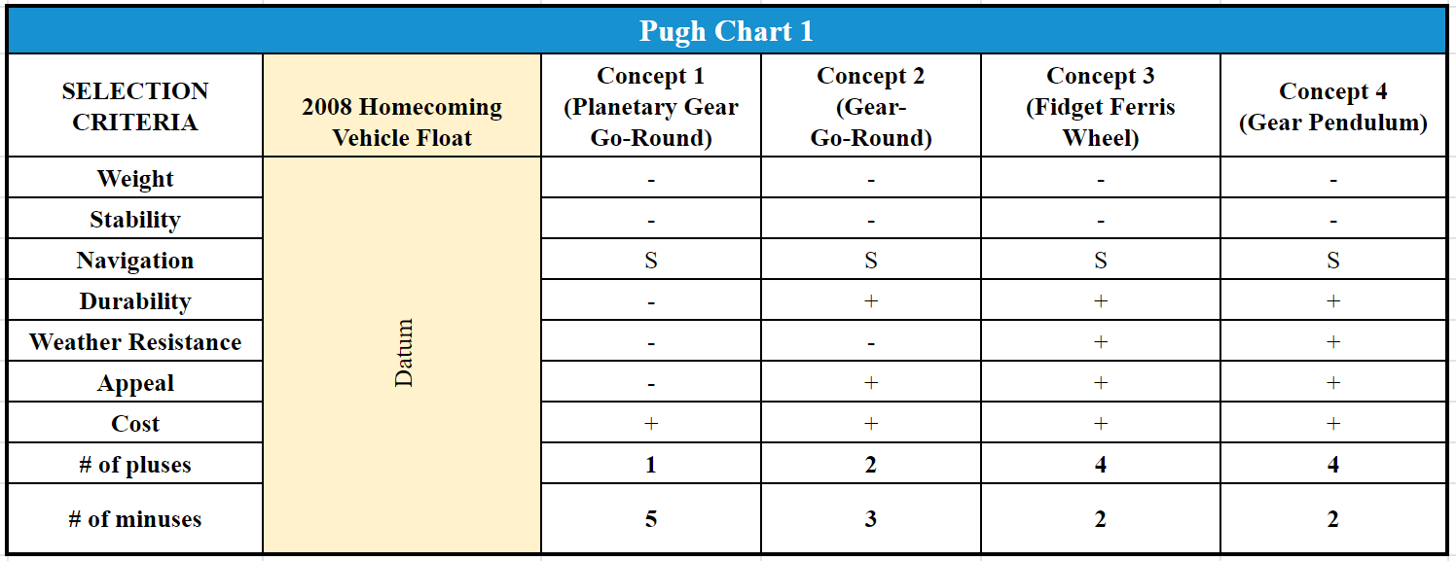
Pugh Charts
Christian Kinlaw
Notes:
Pugh Chart
Eliminated how many concepts?
Add image of the table for Pugh

Slide 33
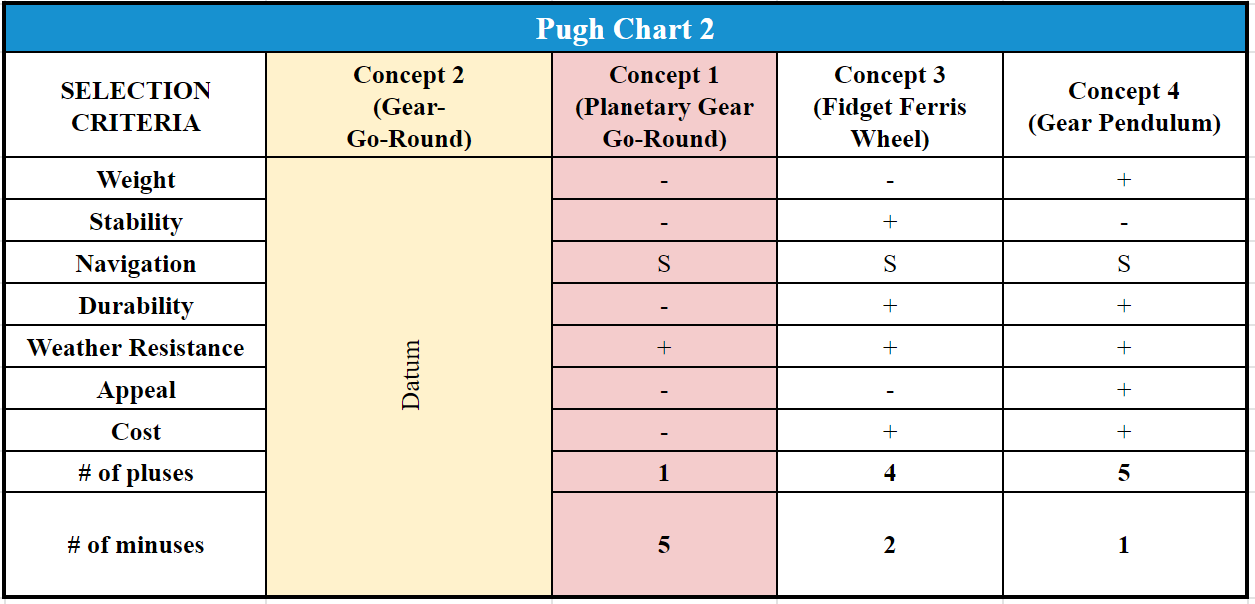
Pugh Charts
Datum:
Gear-Go-Round
Christian Kinlaw
Notes:
Pugh Chart
Eliminated how many concepts?
Add image of the table for Pugh

Slide 34
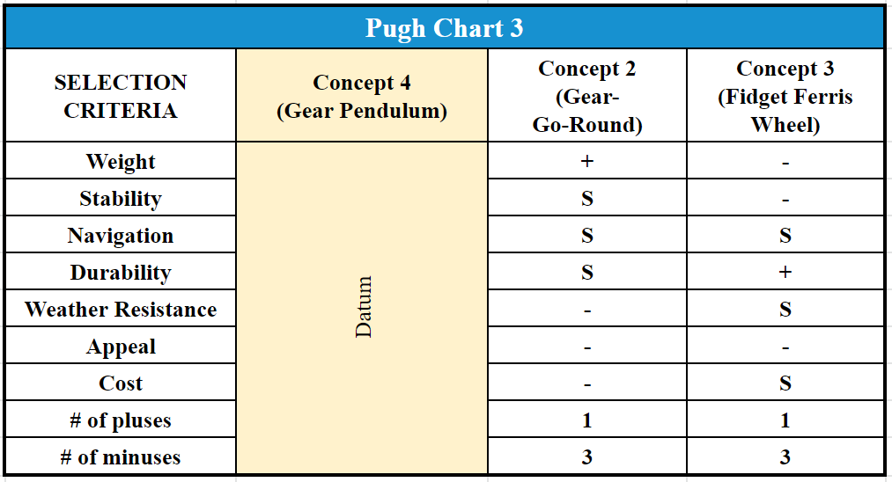
Pugh Charts
Datum:
Gear Pendulum
Christian Kinlaw
Notes:
Pugh Chart
Eliminated how many concepts?
Add image of the table for Pugh

Slide 35
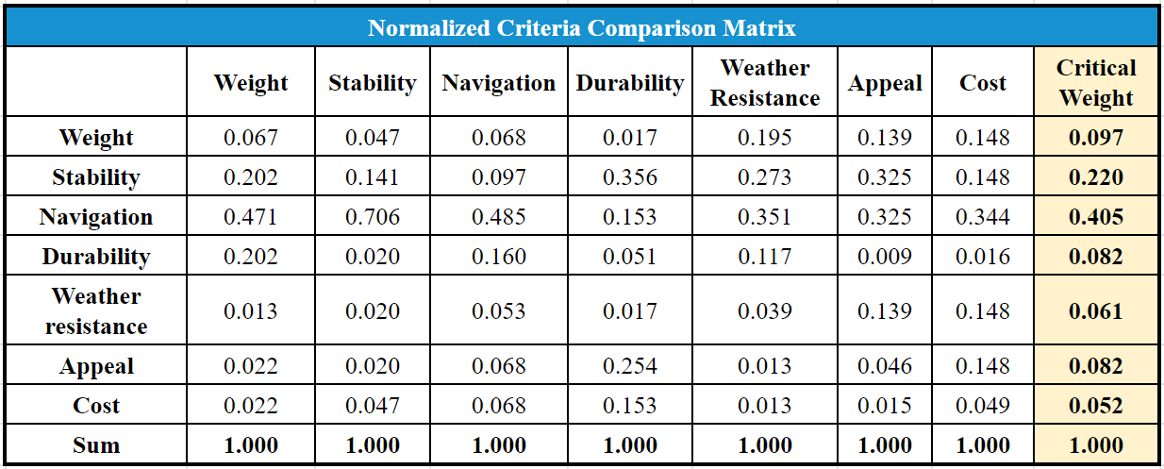
Analytical Hierarchy Process
Christian Kinlaw
Notes:
Analytical Hierarchy Process (AHP)
Eliminated how many concepts?
Add image of the table for AHP

Slide 36
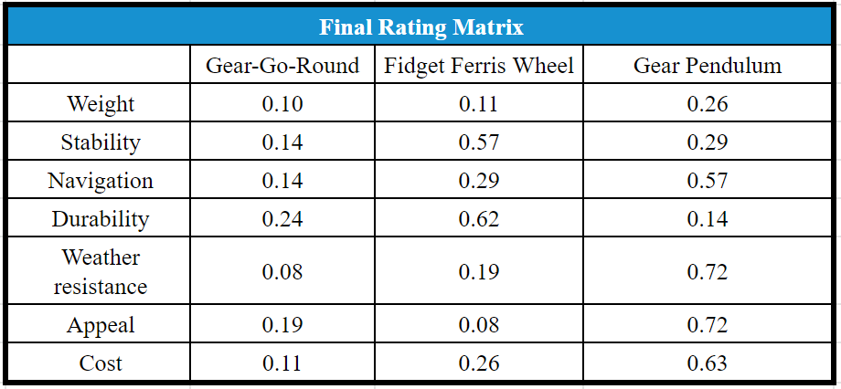
Final Selection
Christian Kinlaw
Notes:
What is the concept that won from the concept selection process?
Talk about how the concept is subject to change because of sponsor’s input needed on the final concept.
Show the final concept here or in the following slide. If we talk about it being subject to change maybe highlight what would change with it on the picture.

Slide 37
Weight Analysis Estimate

Slide 38
Bill of Materials
Christian Kinlaw

Slide 39
Standard Shapes
Summary Box
Text box 1
Outlined Text Box

Slide 40
Approved Logos

Slide 41
Color Palette

Slide 42
APA Tables
Category 1 | Category 2 | Category 3 | Category 4 | Category 5
Item 1
Item 2
Item 3
Item 4
 | Category 2 |  |  | Category 3
Category 1 | subcategory 1 | subcategory 2 |  | subcategory 1 | subcategory 2
Item 1
Item 2
Item 3
Item 4

