Slide 1
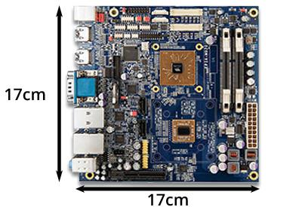
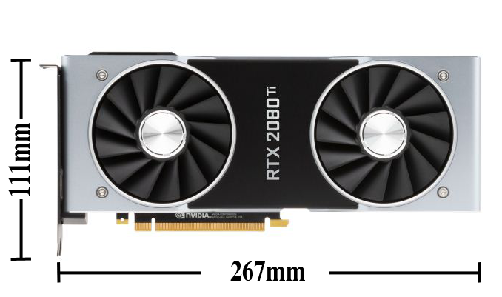
Mini-ITX Small Form Factor Computer Case
Team 527
Paul Hromadka, Patrick Huffman, William Pineda, Fabrizio Alvarado
Mockup Case
Project Background
Entrepreneurial Aspect
Reinforced glass working fluid reservoir built into side panel.
Radiator capabilities integrated into front panel.
Piping within case walls allows for a more compact cooling system while also providing additional heat transfer
Ventilation compartments in strategic positions will allow efficient airflow
Current Mini-ITX computer cases remain at relatively large sizes in order to support high-end computer components.
A small form-factor (SFX) Mini-ITX computer case capable of cooling formidable Graphics Processing Units (GPU) and Central Processing Units (CPU) may prove profitable.
The main issue is compacting the necessary equipment to provide cooling to these components into a SFX layout.
InNOLEvation Challenge
Jim Moran School of Entrepreneurship Business Model Competition
Development of Business Model Canvas
Engineering Shark Tank
FAMU-FSU College of Engineering Business Pitch Competition
Goal Statement
Design a SFX Mini-ITX computer case capable of housing and cooling higher-end Graphics Processing Units and Central Processing Units.
Thermal Schematic
Hot Water Flow
Future Work
+Q_{GPU}
+Q_{CPU}
Finalize design and CAD models
Order components
Assemble Test Rig
Develop Business Model Canvas for competition in Entrepreneurial Aspect
G
P
U
C
P
U
R
A
D
I
A
T
O
R
Project Requirement
-(Q_{GPU} + Q_{CPU})
This computer case will perform all functions that any computer case would be expected to, ie. component support and environmental protection
Acknowledgments
Pump
Reservoir
Targets
CPU Temperature | 50℃
GPU Temperature | 70℃
Case Volume | 7.5L
GPU Space Allocation | 267mm x 111mm
Cold Water Flow
Team 527 would like to thank the Dean’s Office for sponsoring this project, along with our advisers Dr. Michael Devine and Dr. Juan Ordoñez for their continued support and guidance throughout this process. Finally, thank you to our senior design instructor Shayne McConomy.
Radiator must remove the heat added by the thermal output of the GPU and CPU, Q_{GPU} and Q_{CPU}
A parallel loop design was chosen to reduce the number of radiators required.

