Slide 1
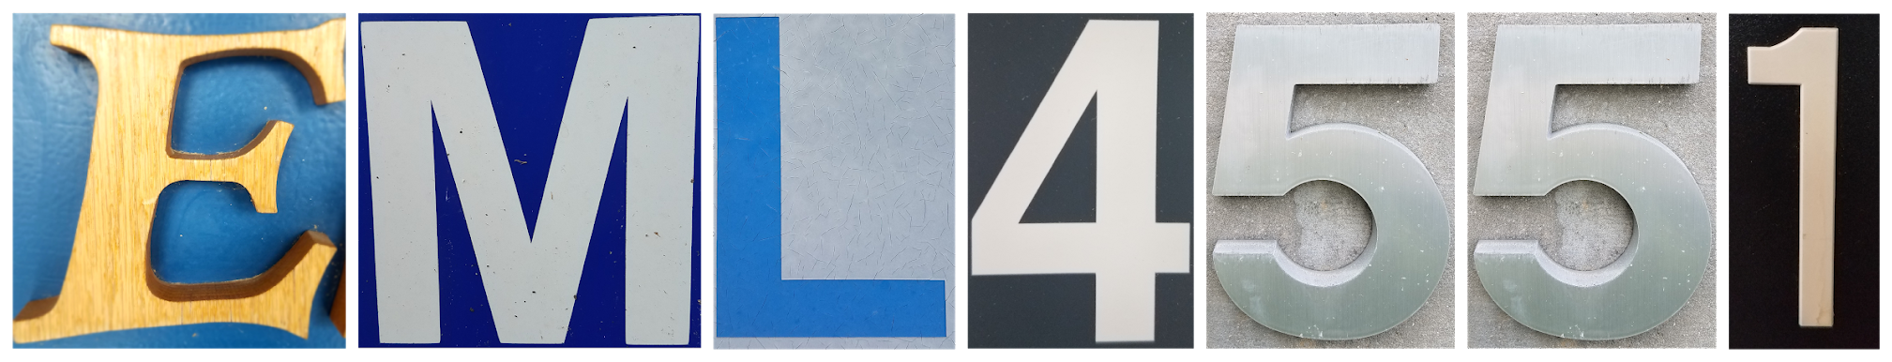
Mini - iTX Computer Case
15-Nov-18
Presenters: Paul Hromadka & Patrick Huffman

Slide 2




Team Introductions
Paul Hromadka
Team Leader
Patrick Huffman
Thermal Design Engineer
Fabrizio Alvarado
Entrepreneurial Advisor
William Pineda
Design Engineer

Slide 3


Sponsors
Dr. Michael Devine
Entrepreneur in Residence & Professor, Ph.D
Yourri Dessureault Project Proposer
Paul Hromadka

Slide 4
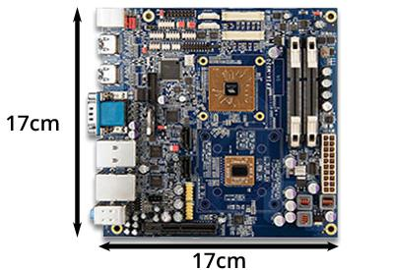
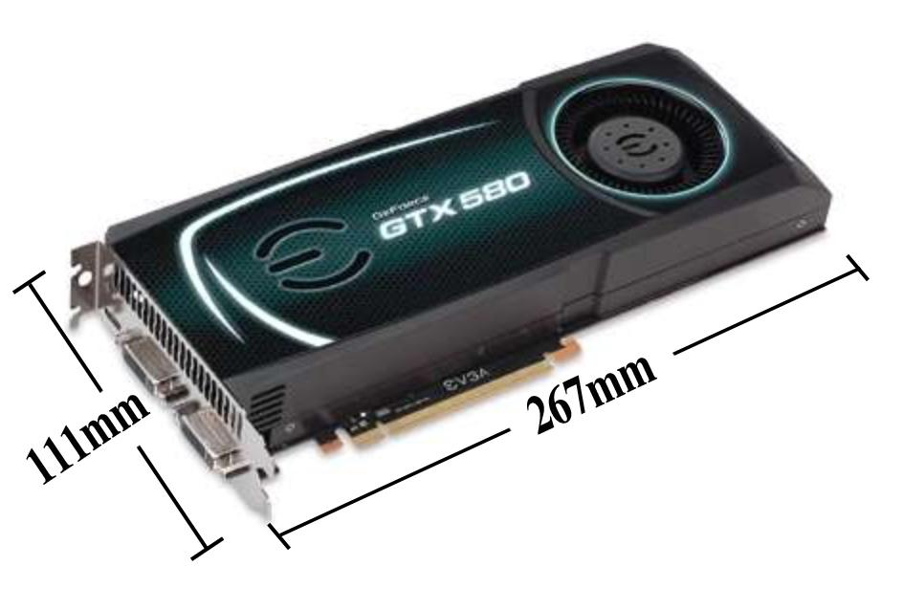
Motivation
Mini-iTX Cases currently on the market lack the ability to use a reference sized Graphics Processing Unit(GPU) in a Small Form Factor(SFX)
  Main issue is overheating
Figure 1, Mini ITX and Reference GPU Dimensions
Paul Hromadka

Slide 5
Project Background
Goal: Design a modular SFX Mini-iTX computer case to prevent high end components from thermal throttling
  Integrated into case architecture
  Is completely self contained
  Appeal to growing markets
Markets: Focus on high end computation needs
  PC Gamers
  Bitcoin Miners
  Integrated Systems for Research and Industry
Paul Hromadka

Slide 6
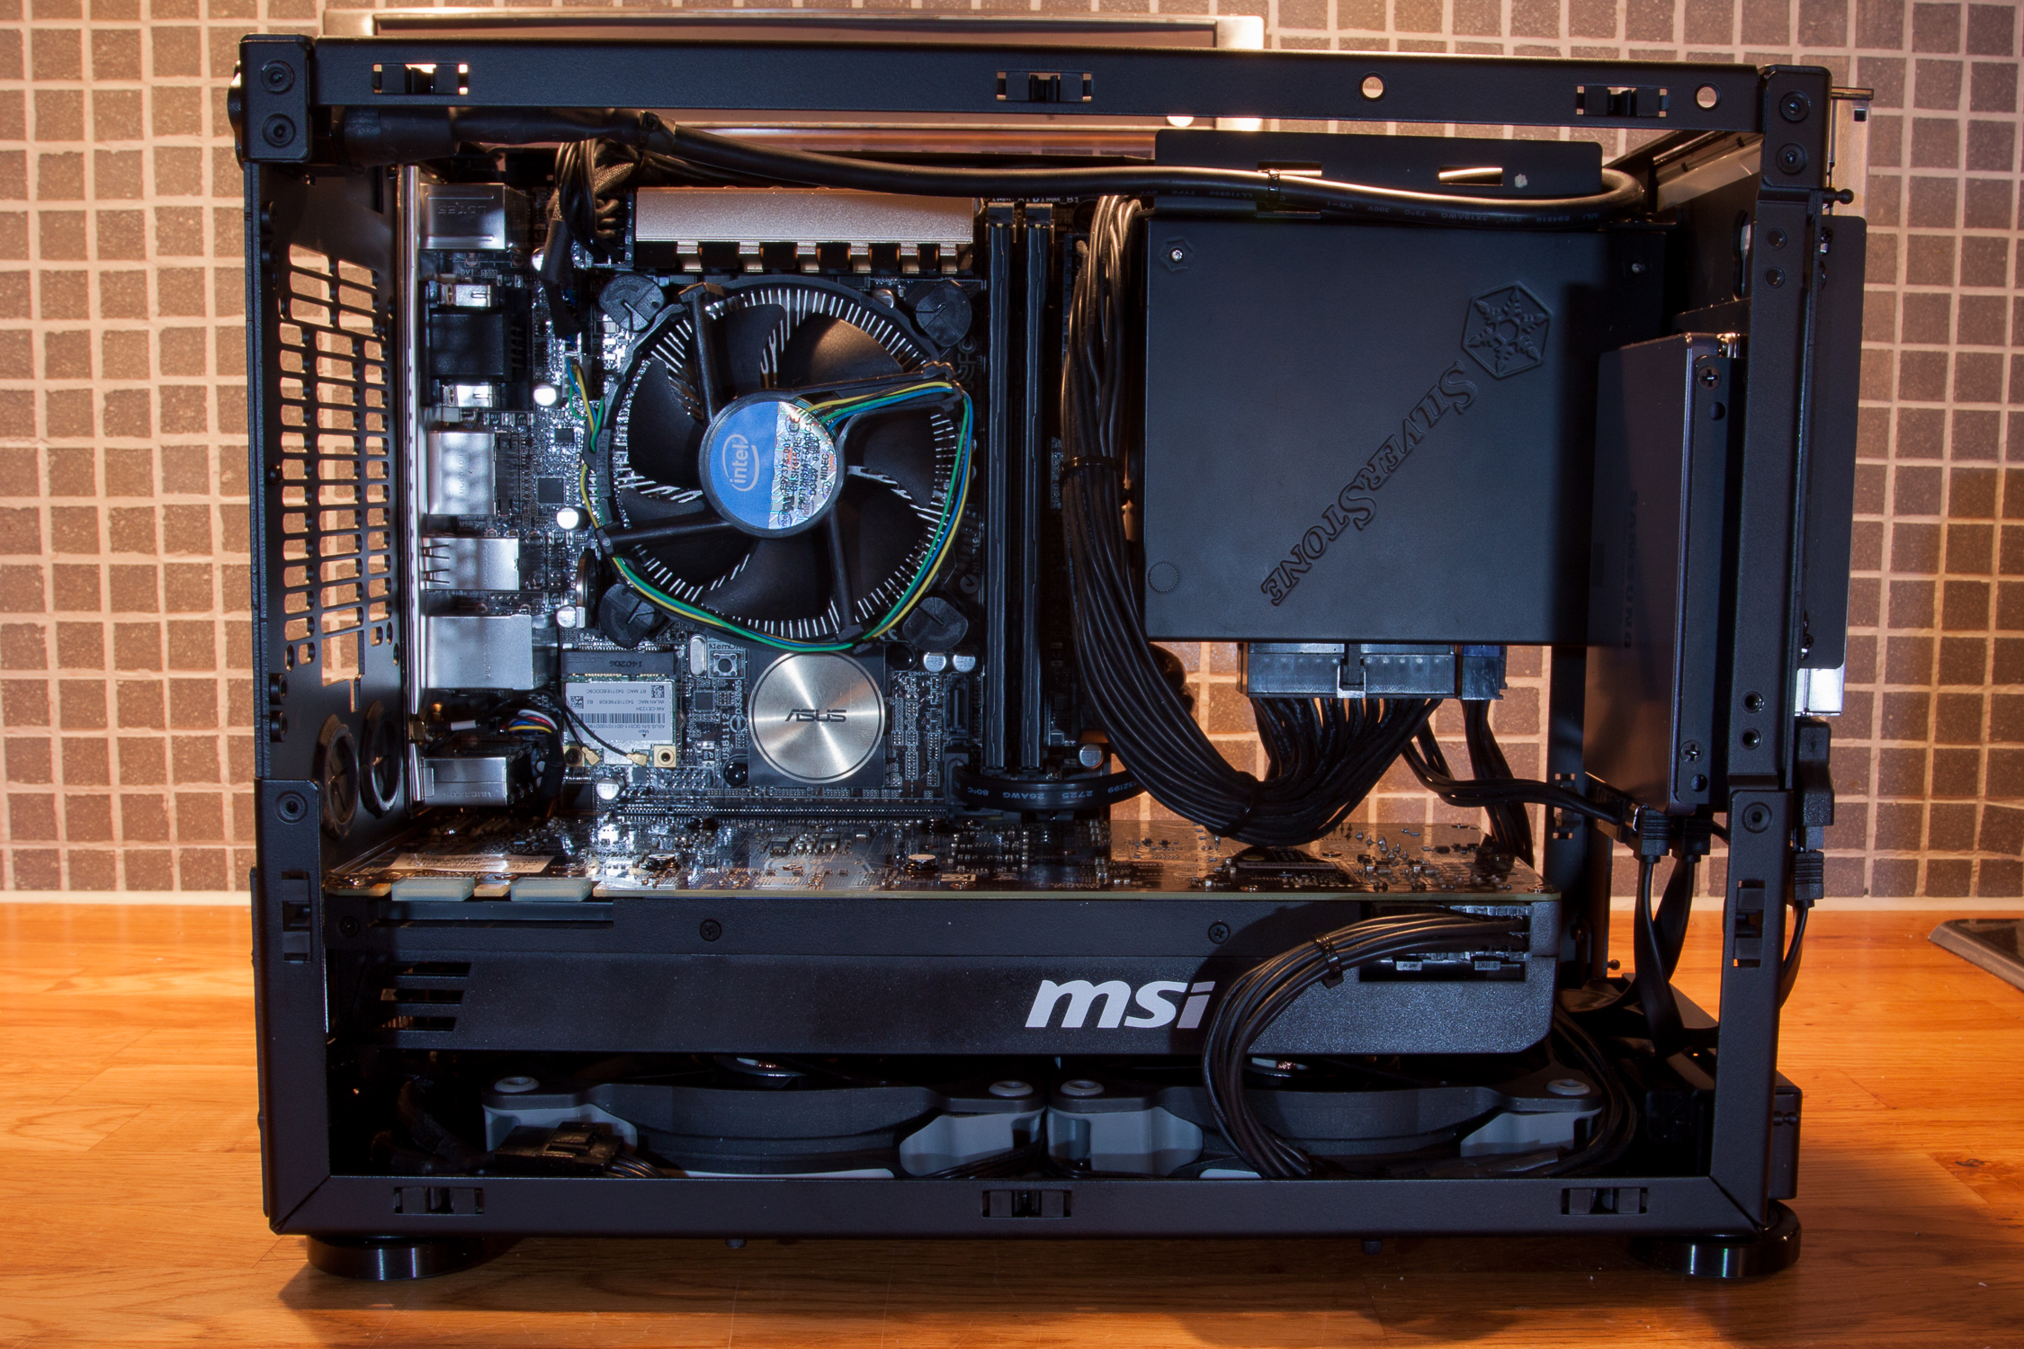
Customer Needs
Central Processing Unit (CPU)
T ≤ 50⁰C
2.5” SSD
Mini-iTX Motherboard
170mm x 170mm
Additional Needs:
Volume ≤ 7.5L
Reference Size GPU
  267mm x 111mm
Graphics Processing Unit (GPU)
T ≤ 70⁰C
Figure 2, Mini-ITX Small Form Factor
Paul Hromadka

Slide 7
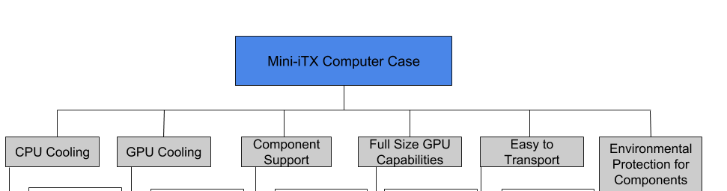
Functional Decomposition
Paul Hromadka

Slide 8
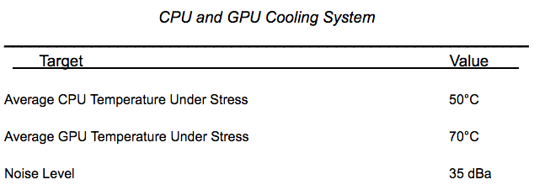
Targets
Paul Hromadka

Slide 9
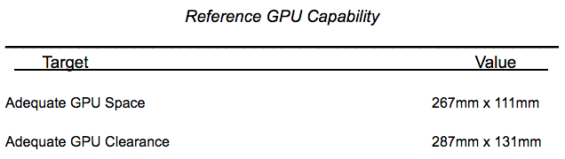
Targets
Paul Hromadka

Slide 10
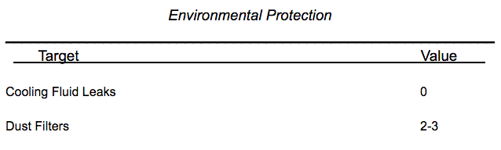
Targets
Paul Hromadka

Slide 11
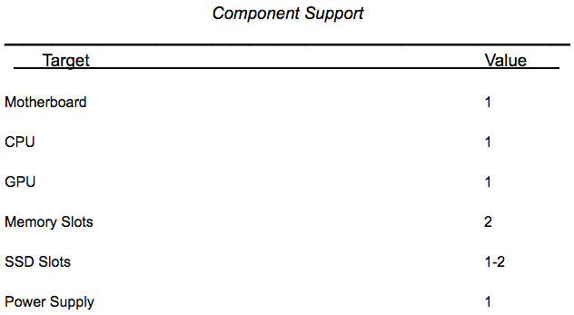
Targets
Paul Hromadka

Slide 12
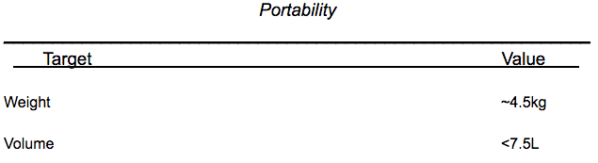
Targets
Patrick Huffman

Slide 13
Concept Generation
Conventional cooling systems were studied, such as simply using fans or using a liquid cooled system. The latter requires the use of a working fluid, pump and condenser.
Fringe systems were studied as well, like filling the computer case with a non-corrosive fluid to continuously absorb heat.
Team 527 strongly relied on rapid brainstorming. No idea brought forth in a brainstorming session was initially refused.
Patrick Huffman

Slide 14

“I’ll be honest, we’re throwing science at the wall here to see what sticks. No idea what will happen.”
- Cave Johnson, CEO, Aperture Science Laboratories
Figure 3, Portrait of Cave Johnson [1]
Patrick Huffman

Slide 15
Liquid Cooling With Piping and Radiator Inside Case Walls
Design the case to contain channeling for liquid coolant and length-adjustable tubing inside the case walls. The radiator for the cooling loop would be built into the side panel of the case, acting both as a radiator and case wall. This would open up numerous options for the design of the radiator.
Patrick Huffman

Slide 16
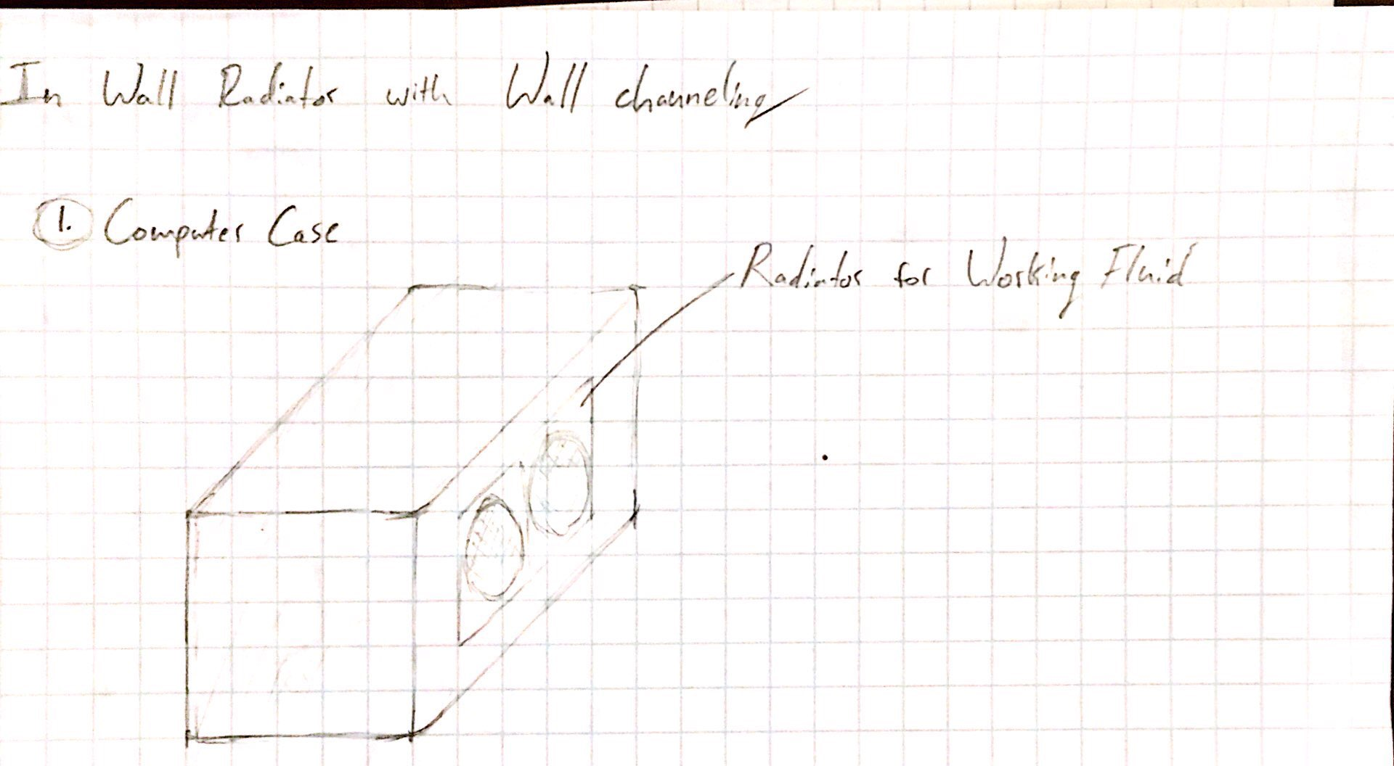
Liquid Cooling With Piping and Radiator Inside Case Walls
Figure 4, Liquid Cooling With Radiator Case Wall
Patrick Huffman

Slide 17
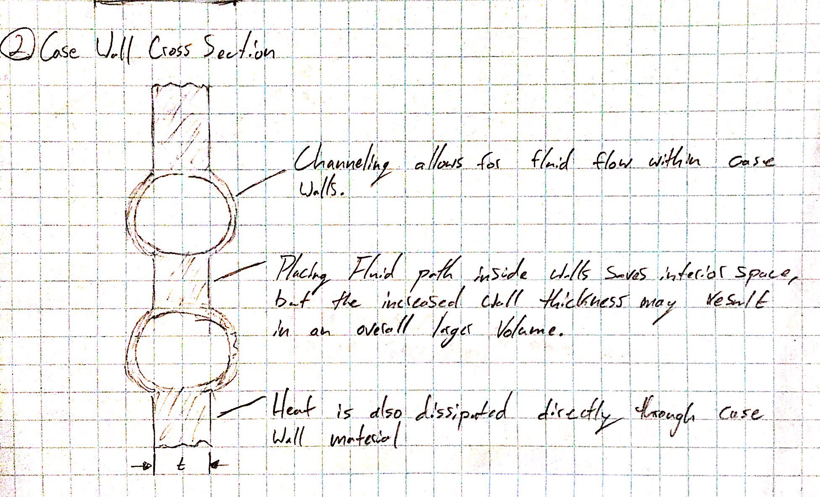
Liquid Cooling With Piping and Radiator Inside Case Walls
Figure 5, Liquid Cooling with Internal Piping Sketch
Patrick Huffman

Slide 18
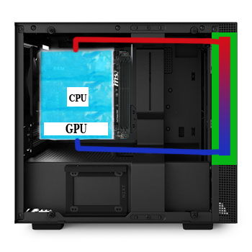
Liquid Cooling with Adaptable Gel Pouch
The purpose of the gel pouch is to increase the amount of surface area contact between the CPU/GPU and a cooling fluid. This is a unique way to approach that while minimizing space.
The gel pouch surrounds the component and is inflated with the working fluid. As the pouch inflates, it conforms to the shape of the component.
Figure 6, Gel Pouch Mock Up
Patrick Huffman

Slide 19
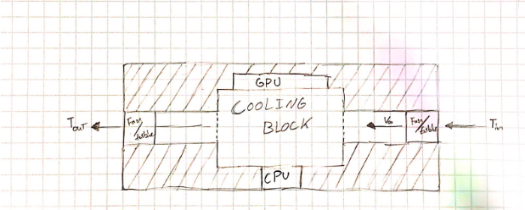
Central Cooling Block Shared by GPU and CPU
One central cooling block is fitted to both the CPU and GPU. The internal geometry of the block would be designed to sufficiently cool both components. Forced convection would aide in the heat transfer process. This would be provided through one channel that runs from one end of the case completely through the other end.
Figure 7, Central Cooling Block Sketch
Patrick Huffman

Slide 20
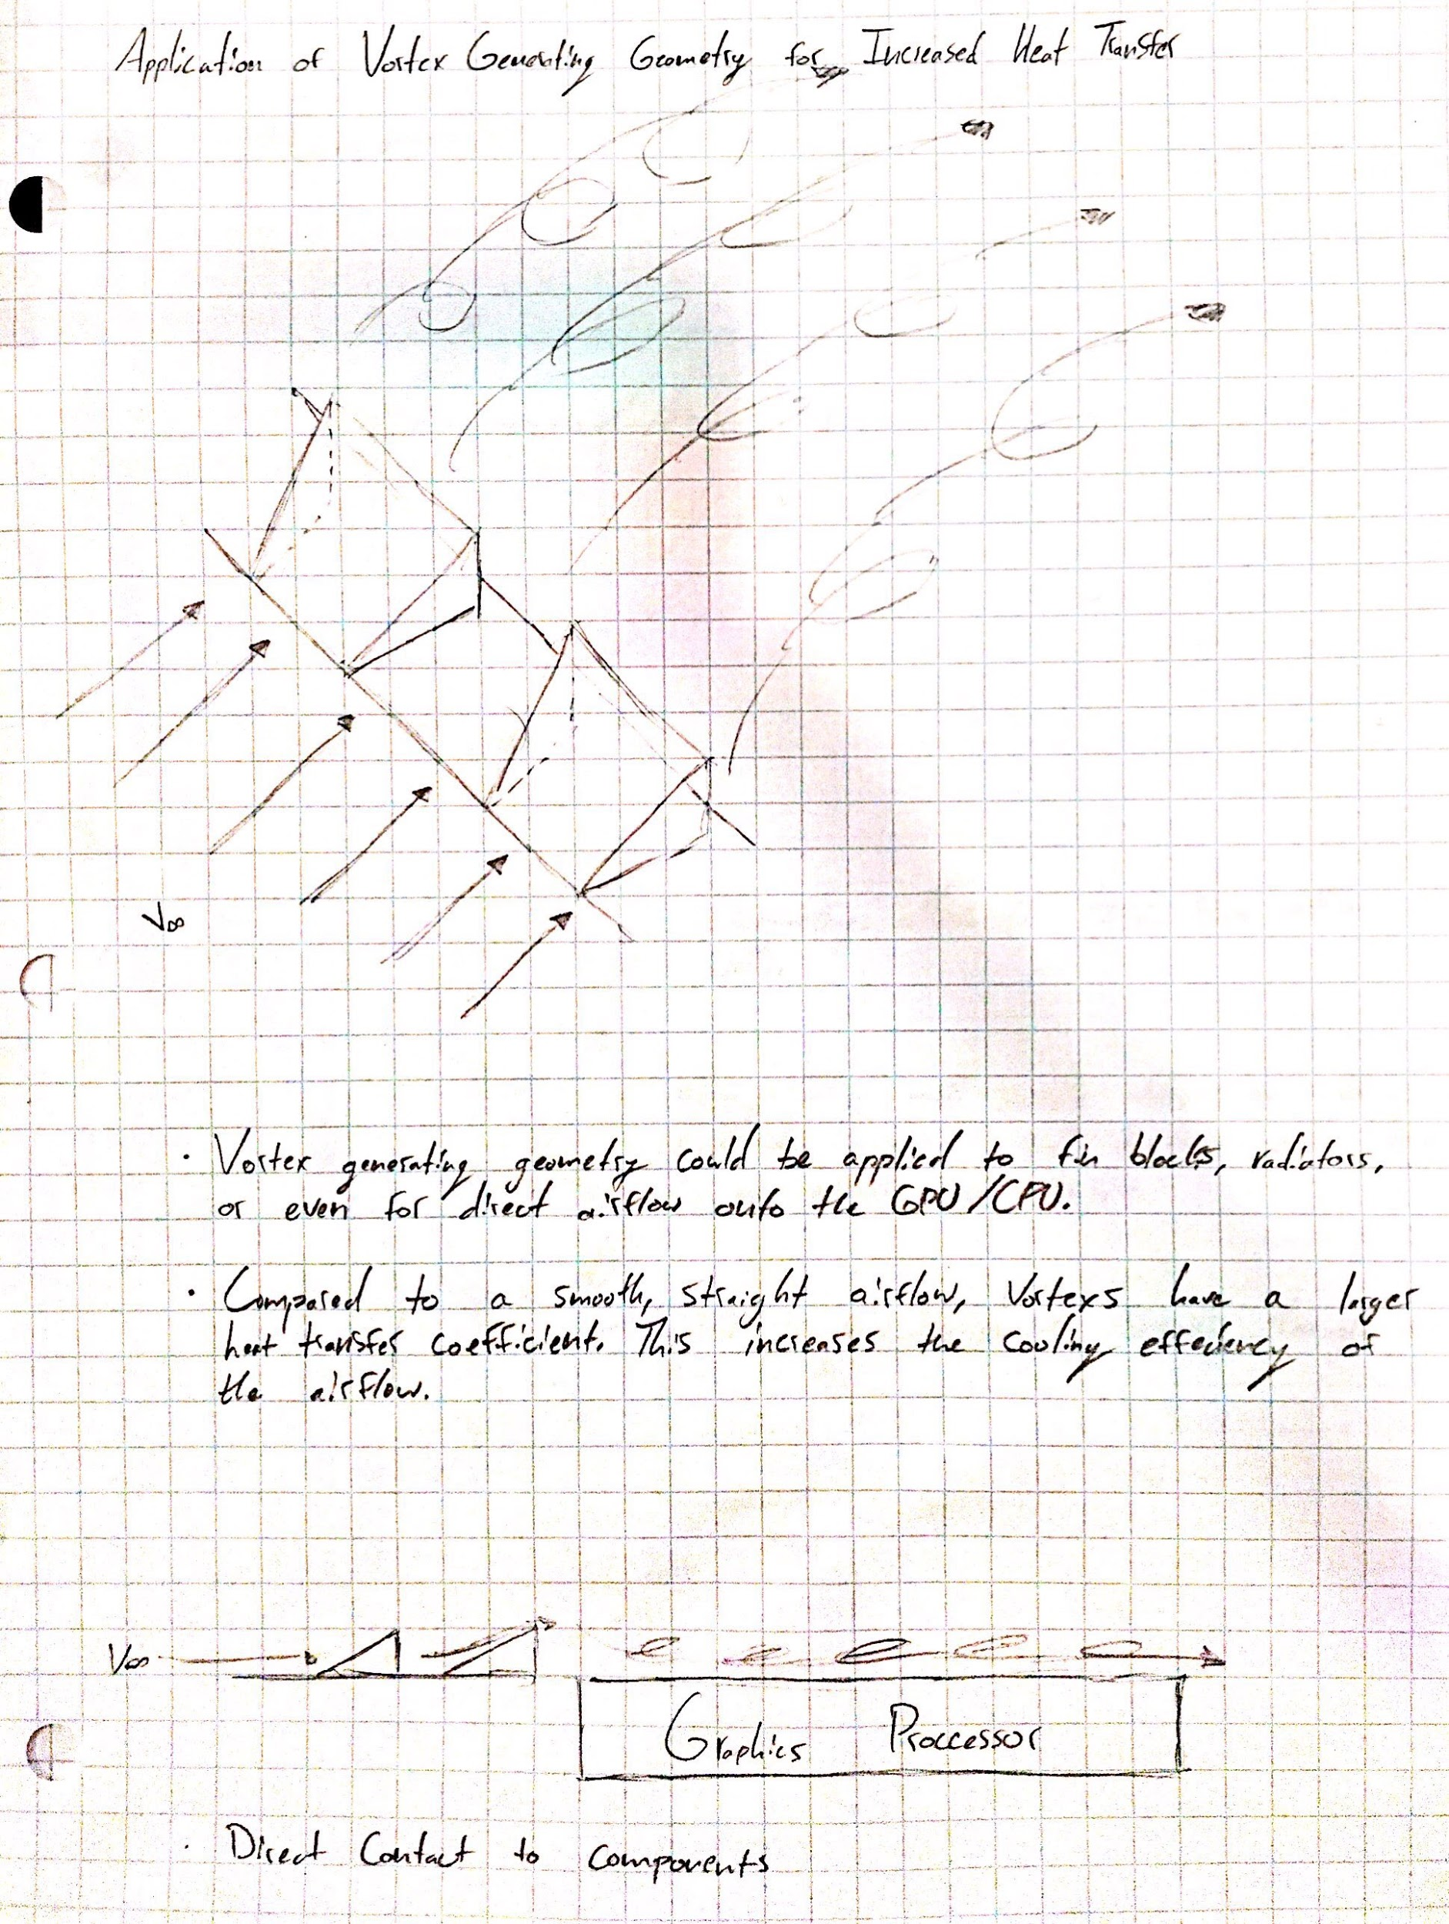
Refrigeration Cycle
Use an actual refrigeration cycle. This design becomes complex with the use of R-134a. The components needed would take up too much volume
Vortex Generating Fin Geometry
Employ the use of fin geometry that would interrupt airflow to form vortices, subsequently increasing the convection heat transfer coefficient.
Figure 8, Vortex Fin Geometry Sketch
Patrick Huffman

Slide 21
Immersive Cooling
Create a leak-proof case that can be filled with a non-corrosive, heat absorbing liquid (mineral oil) and provide enough internal circulation to keep components from overheating.
Phase Change Cooling
Evaporative Cooling
Utilize a phase change in the working fluid to cool components. Similar to the refrigeration cycle but can be used with less equipment depending on the choice of working fluid.
Have a system to spray a non-corrosive coolant onto components, which evaporates and removes heat
Patrick Huffman

Slide 22
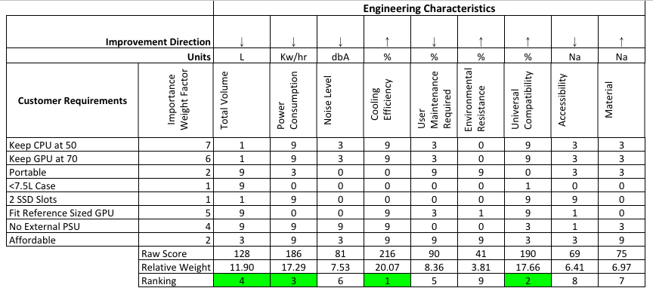
Patrick Huffman
Notes:
Ranking of Customer requirements determined by pairwise comparison.

Slide 23
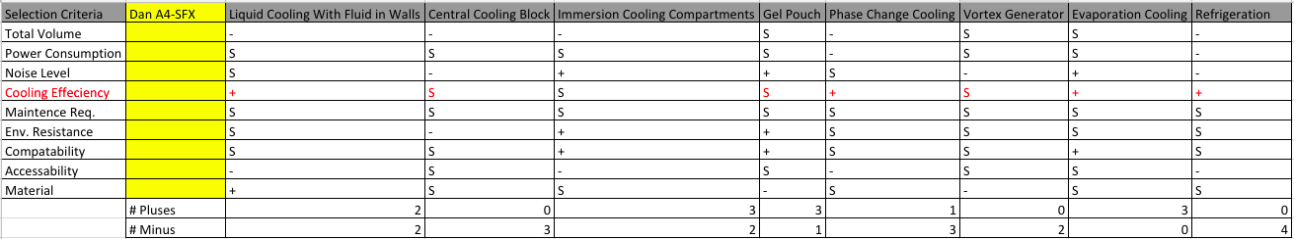
These top 8 designs were subjected to a Pugh Matrix to help weed out weaker ideas.
A competitor, the Dan A4-SFX case, was used as the initial datum for concept comparisons.
Patrick Huffman

Slide 24
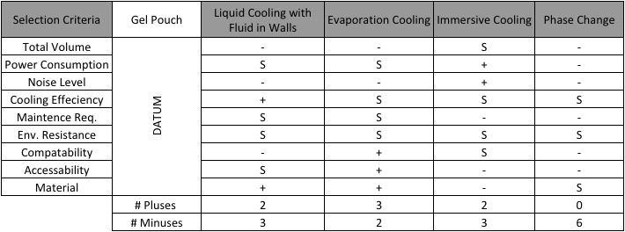
The best scoring designs were then subjected to another Pugh Matrix, with the Gel Pouch concept as the new datum
Patrick Huffman

Slide 25
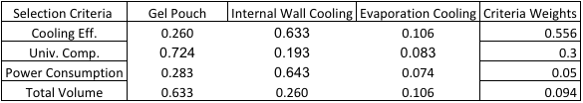

AHP and Final Selection Values
Patrick Huffman

Slide 26
Future Work
Development of Business Model Canvas for participation in the InNOLEvation Challenge
  Registration Completed: Nov. 02, 2018
Refinement of Selected Design
Test PC Assembly
Patrick Huffman

Slide 27
References
[1] Valve Corporation. Portal 2. Electronic Arts, 2011. PC.
[2] Dr. Shayne McConomy. “SD Concept Selection”. Oct 30 2018.
Microsoft Powerpoint File

Slide 28
Questions?

