Slide 1
Mini – iTX Computer Case
Senior Design Team 527
Presenters: Fabrizio Alvarado & Paul Hromadka

Slide 2

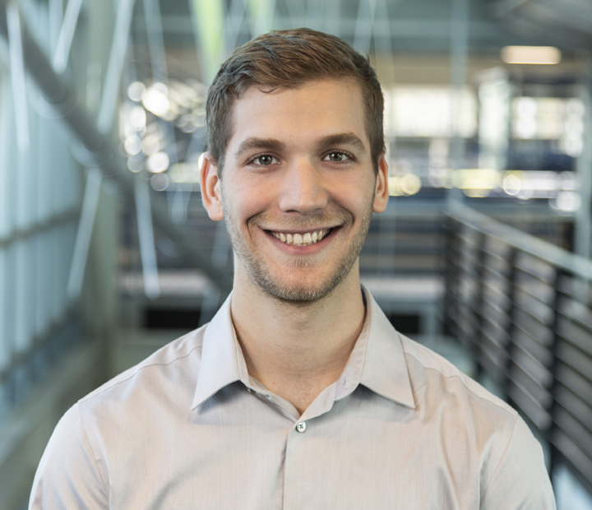

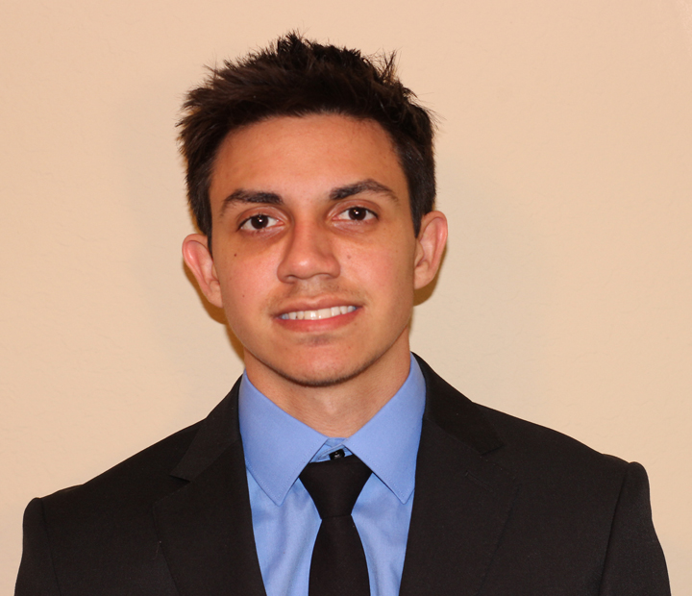
Team Introductions
Fabrizio Alvarado
Modeling Engineer
Paul Hromadka
Project Manager &
Systems Engineer
Patrick Huffman
Thermal Design
Engineer
William Pineda
Web Developer &
Design Engineer
Fabrizio Alvarado

Slide 3

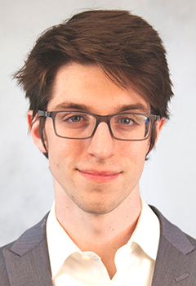

Sponsor and Advisor
Engineering Mentor
Juan Ordonez, Ph.D.
Professor of Thermal Fluids
Project Proposer
Yourri Dessereault
Graduate Student, HPMI
Academic Advisor
Michael Devine, Ph.D.
Entrepreneur in Residence
Fabrizio Alvarado

Slide 4
Terminology
Graphics Processing Unit (GPU)
Computer Processing Unit (CPU)
Small Form Factor (SFX)
  8~12 liters internal volume
Mini-ITX
  A specific set of dimensions governing a computer motherboard. Mini-ITX motherboards are 17cm x 17cm.
Reference GPU
  General size GPU, measuring 267mm x 111mm
Fabrizio Alvarado

Slide 5
Objective
To cool full size, user provided, high end components in a small form factor.

Slide 6
Project Background
Fabrizio Alvarado

Slide 7
Customer Needs
Cooling Needs:
Keeps CPU under an operating temperature of 50 °C
Keeps GPU under an operating temperature of 70 °C
General Needs:
Capable of fitting reference sized GPU
Is self contained, while maintaining a competitive internal volume for SFX market
Fabrizio Alvarado

Slide 8
Target Adjustment
Due to geometric constraints from implemented components, the targets volumetric goal needed to be adjusted.
The original goal was 7.5L
The current volume has increased by nearly 34.7% giving a final result of 10.1L
Fabrizio Alvarado

Slide 9
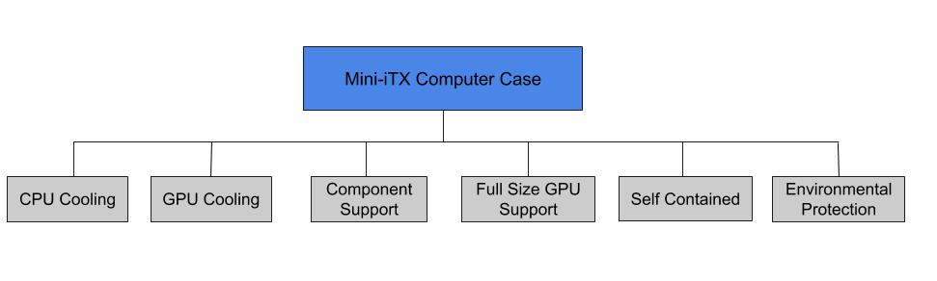
Functional Decomposition
Fabrizio Alvarado

Slide 10
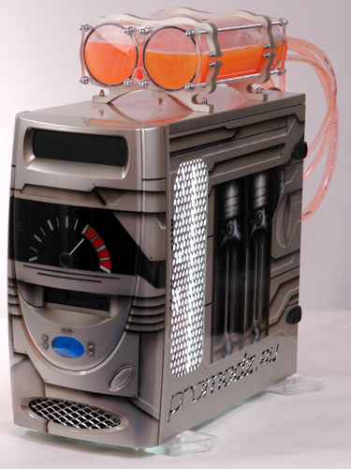
Concept Generation
Internal Wall Cooling
Adaptable Gel Pouch
Central Cooling Block
Vortex Generating Fin Geometry
Fabrizio Alvarado
Notes:
Think we should trash

Slide 11
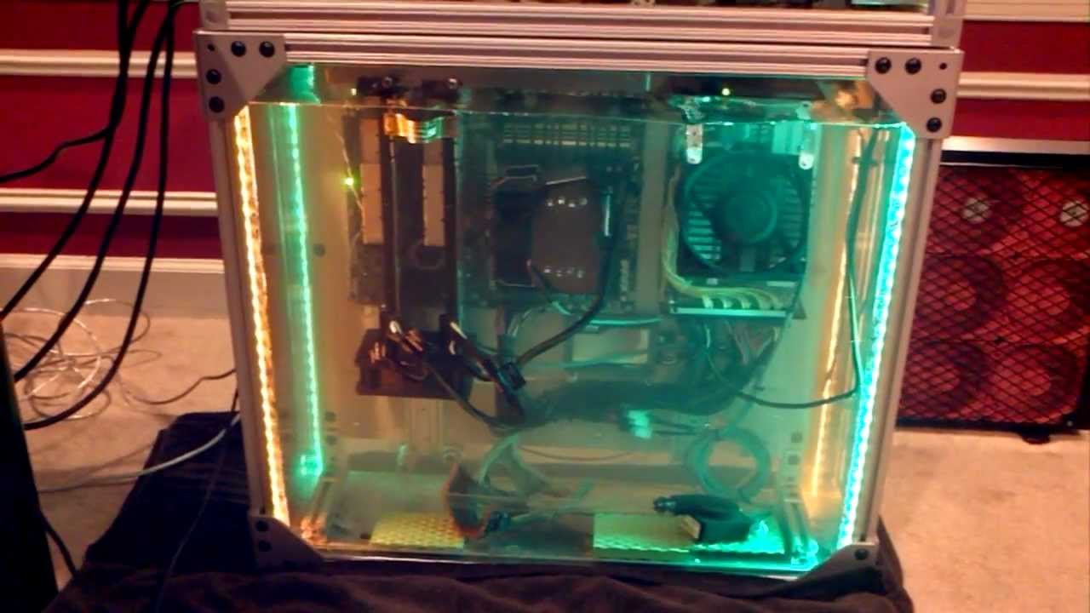
Concept Generation
Immersive Cooling
Refrigeration Cycle
Phase-Change Cooling
Evaporative Cooling
Fabrizio Alvarado
Notes:
Think we should trash

Slide 12
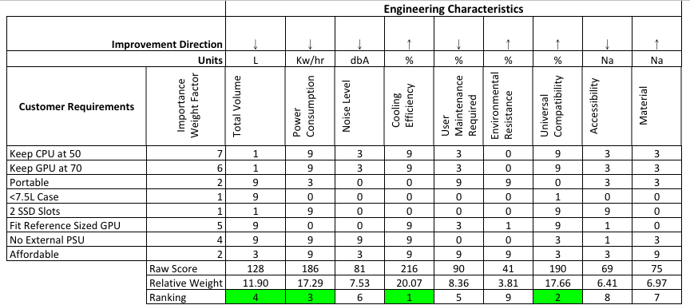
Concept Selection
Methods Used:
  HOQ
  Pugh Matrix 1
  Pugh Matrix 2
  AHP
  Final Selection
Fabrizio Alvarado

Slide 13
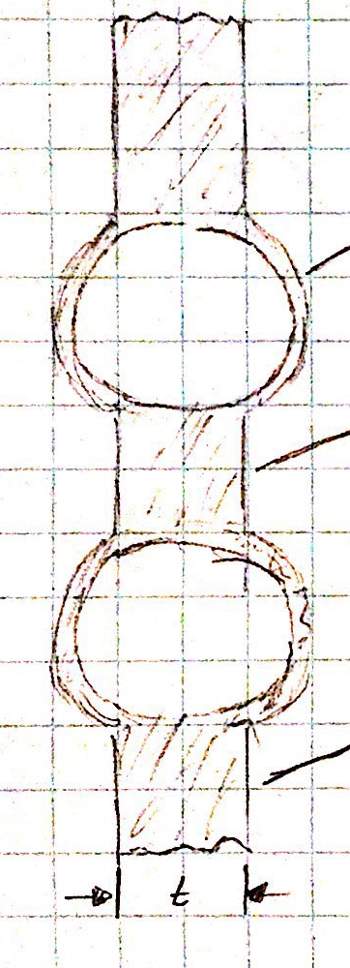
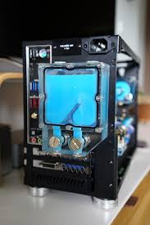
Concept Selection Revamp
Due to an increased volume of the concept cases, a new target was determined
  Including liquid cooling increased volume requirements more than expected
To minimize wasted space channels and reservoir integrated into case walls
Original Microchanneling Design
Conceptual Design
Fabrizio Alvarado

Slide 14
Embodiment
Paul Hromadka

Slide 15
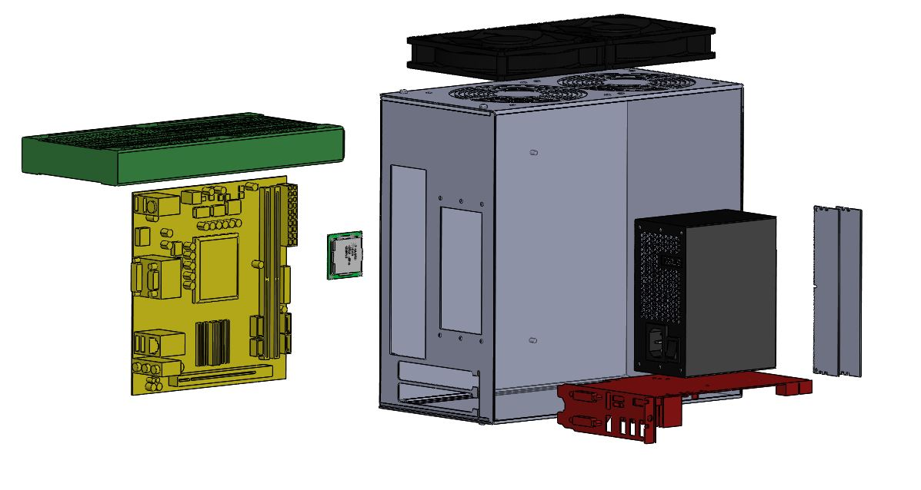
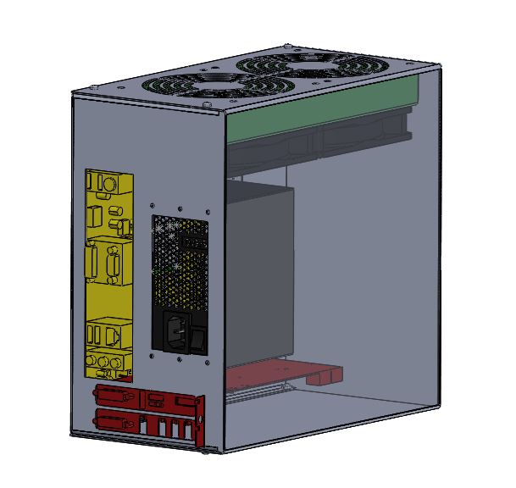
2x 120mm Fans
Radiator
CPU
2x DDR4 4g RAM
276mm
140mm
256mm
Motherboard
600W SFX PSU
GPU
Paul Hromadka

Slide 16
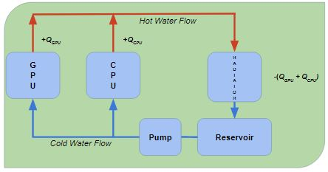
Thermal Design
Thermal Design Assumptions and Conditions
Laminar flow
Max flow rate of ~9 liters/minute (selected pump)
0.0065 meter pipe diameter
Flow inside cooling blocks is generalized as pipe flow, with contact surface area equal to the surface area of the GPU and CPU respectively.
Ambient temperature of 300K
Steady state water temperature of 290K
Paul Hromadka

Slide 17
Thermal Design
Water Temperature and Heat Added at Various Stages*
290 K, Q = 8 W from pipe flow
296 K, Q = 350 W from GPU TDP
292 K, Q = 100 W from CPU TDP
295 K, Q = 6 W from pipe flow
291 K, Q ~ -470 W from radiator cooling power
*We acknowledge these values as slightly unreasonable, and their accuracy will have no doubt changed after consulting with Dr. Ordonez prior to this Design Review having been submitted.
2
3
4
5
1
Paul Hromadka

Slide 18
Manufacturing
Paul Hromadka

Slide 19


Protocase
Design based on CAD Model
  Generated using Protocase Designer
Expected 2-3 day turn around on case manufacturing
Paul Hromadka

Slide 20
Testing
Paul Hromadka

Slide 21
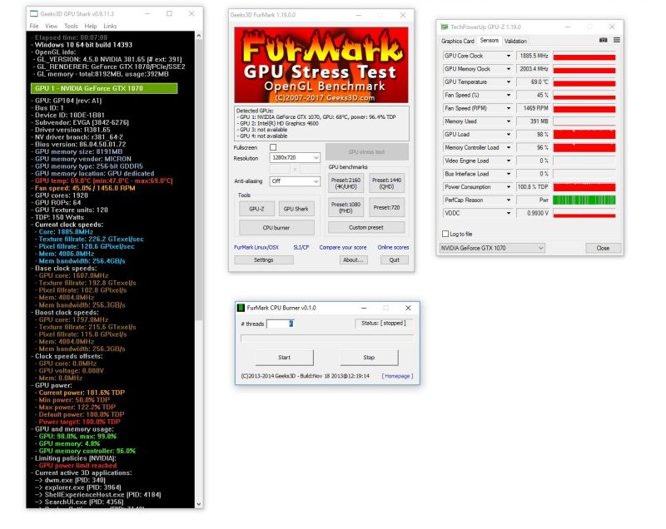
Furmark
GPU Stress Test
  OpenGL benchmark
  variable test conditions
  monitoring capability
Designed to overheat the GPU using very intensive fur rendering algorithms
Paul Hromadka

Slide 22

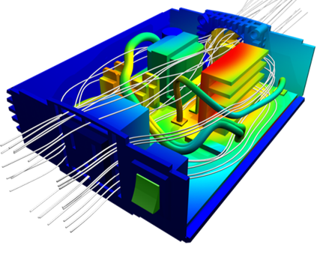
Comsol Multiphysics
Finite Element Software
  Computational Fluid Dynamics (CFD) capabilities
  Capable of solving heat transfer in fluids and solids
Use detailed CAD model as base for thermal model
Paul Hromadka

Slide 23
Project Management
Paul Hromadka

Slide 24
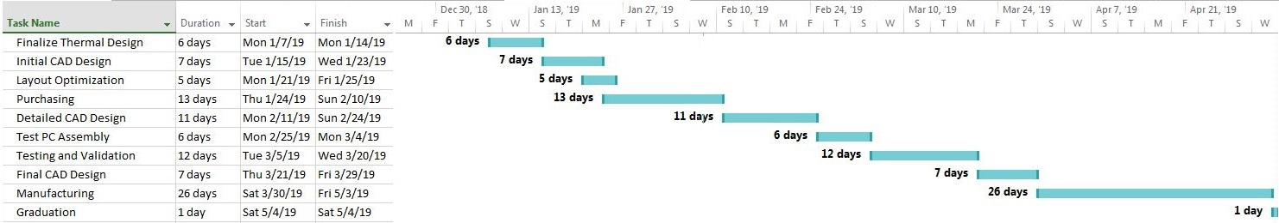
Looking Forward
Paul Hromadka

Slide 25
3 Most Important Points
Thermodynamics goals must be achieved
Protocase will be used for manufacturing (2-3 day turnaround and consultation with their engineers)
Moving into Testing and Validation then onto Prototype Construction
Paul Hromadka

Slide 26
Lessons Learned
Understand radiator sizing and capabilities before setting target volume
Expect delays
Pipe channeling or an internal reservoir within the case walls would lead to further increase in volume
It is best to have all CAD done in one program, rather than convert files between users/programs
Paul Hromadka

Slide 27
References
https://www.protocase.com/design/protocase-designer.php
http://www.npd-solutions.com/cfd.html
https://geeks3d.com/furmark/

Slide 28
Questions
Paul Hromadka

Slide 29
Backup Slides

Slide 30
Functional Decomp Backup

Slide 31
Concept Selection Backup

Slide 32
Detailed Math Backup

Slide 33
Standard Shapes
Summary Box
Text box 1
Outlined Text Box

Slide 34




Approved Logos

Slide 35
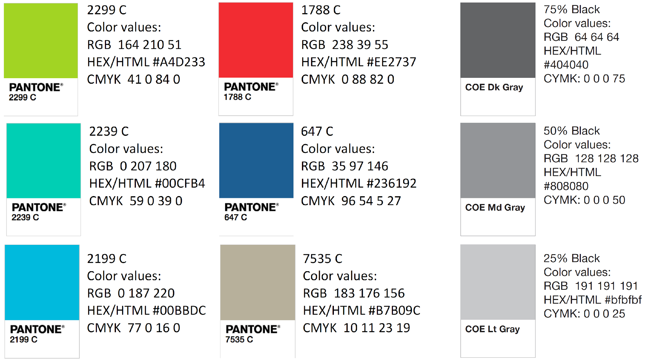
Color Palette

Slide 36
APA Tables
Category 1 | Category 2 | Category 3 | Category 4 | Category 5
Item 1
Item 2
Item 3
Item 4
 | Category 2 |  |  | Category 3
Category 1 | subcategory 1 | subcategory 2 |  | subcategory 1 | subcategory 2
Item 1
Item 2
Item 3
Item 4

