Slide 1
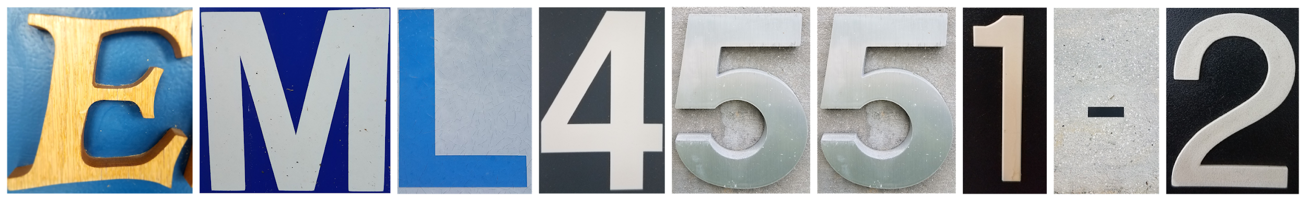
Mini-iTX Computer Case
Design Review 4
18-Jan-19

Slide 2




Team Introductions
Paul Hromadka
Team Leader
Patrick Huffman
Thermal Design Engineer
Fabrizio Alvarado
Entrepreneurial Advisor
William Pineda
Design Engineer

Slide 3


Sponsor
Dr. Michael Devine
Entrepreneur in Residence & Professor, Ph.D
Yourri Dessureault Project Proposer

Slide 4
Project Review
Terminology, Background, Market Introduction, and Key Targets for the Mini-ITX Completely Enclosed Water Cooling Case

Slide 5
Terminology
Graphics Processing Unit (GPU)
Computer Processing Unit (CPU)
Small Form Factor (SFX)
  8~12 liters of internal volume
Mini-ITX
  A specific set of dimensions governing a computer motherboard. Mini-ITX motherboards are 17cm x 17cm.
Reference GPU
  General size GPU, measuring 267mm x 111mm
Patrick Huffman

Slide 6
Project Background
Goal: Design a Small Form Factor Mini-ITX computer case that supplies sufficient cooling power to high end computer components.
  Cooling integrated into case architecture
  Self contained, utilizing no external hardware
  Maintain a competitive internal volume
Markets: Focus on high end computation needs
  PC Gamers
  Bitcoin Miners
  Integrated Systems for Research and Industry
Patrick Huffman

Slide 7

Brief Market Overview
Target Market
➢ PC gamers/Enthusiasts
▪ 62% of the gaming market are PC gamers, while 58% use console (20% both). With our product, the market would be both as this would be as compact and powerful
▪ According to an ESA Study, the market for gamers (according to 2014 study) is around of $5.08 Billion dollars.
➢Secondary Market: Research Hobbyists
▪ Advertising purposes, Home Entertainment
Patrick Huffman

Slide 8
Key Targets
Keep GPU at 70℃ at steady state operations
Keep CPU at 50℃ at steady state operations
Provide consumers with space necessary to house reference sized GPUs
Utilize no outside hardware, such as an external power supply
Keep the total case volume competitive (~7.5 liters)
Patrick Huffman

Slide 9
Case Design Details
Overview of components that consumers will be using inside the product, their dimensions, and an analysis of 3 case layout configurations

Slide 10
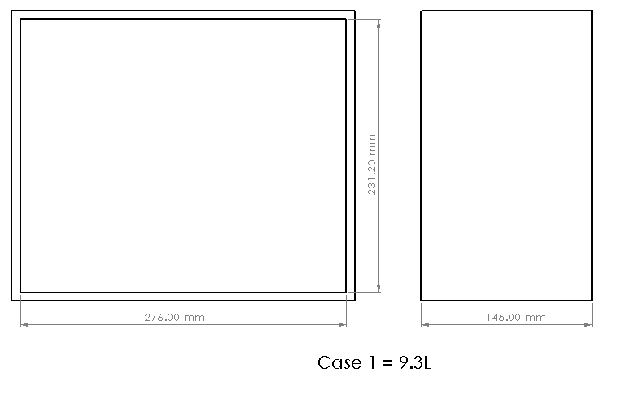
Case Layouts
William Pineda

Slide 11
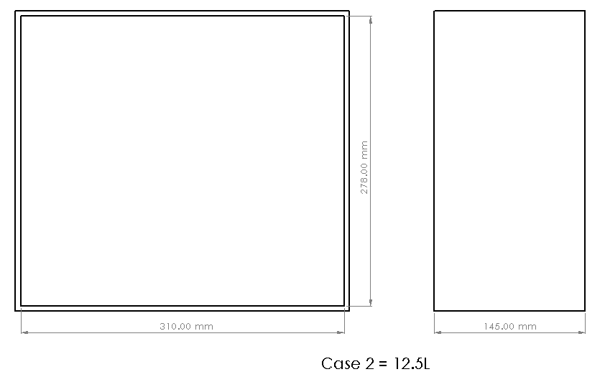
Case Layouts
William Pineda

Slide 12
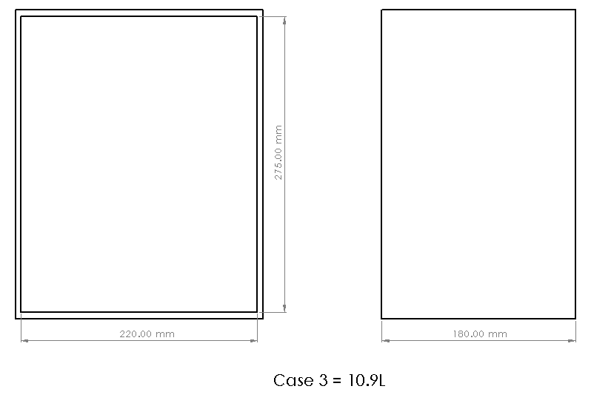
Case Layouts
William Pineda

Slide 13
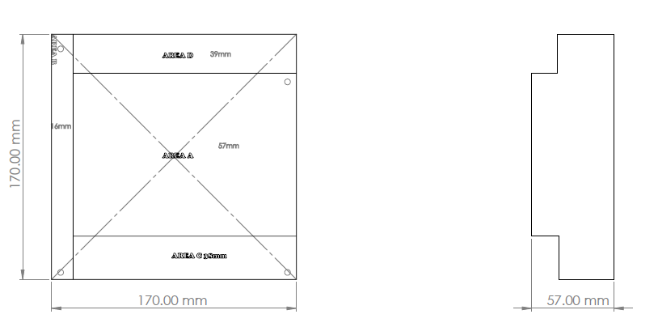
Large Components
Motherboard
William Pineda

Slide 14
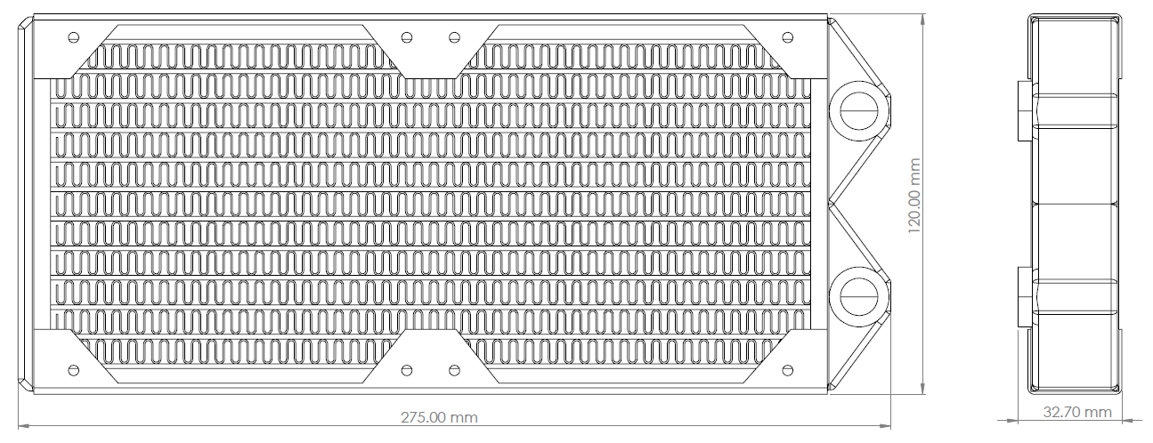
Large Components
Radiator
William Pineda

Slide 15
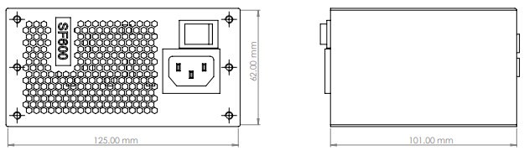
Large Components
Power Supply
William Pineda

Slide 16
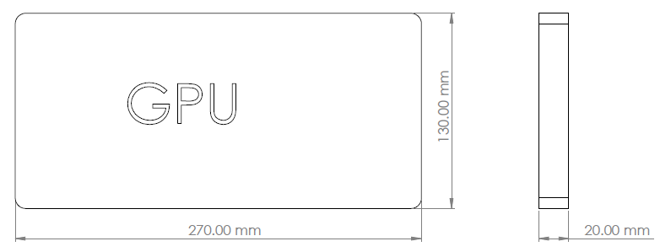
Large Components
GPU
William Pineda

Slide 17
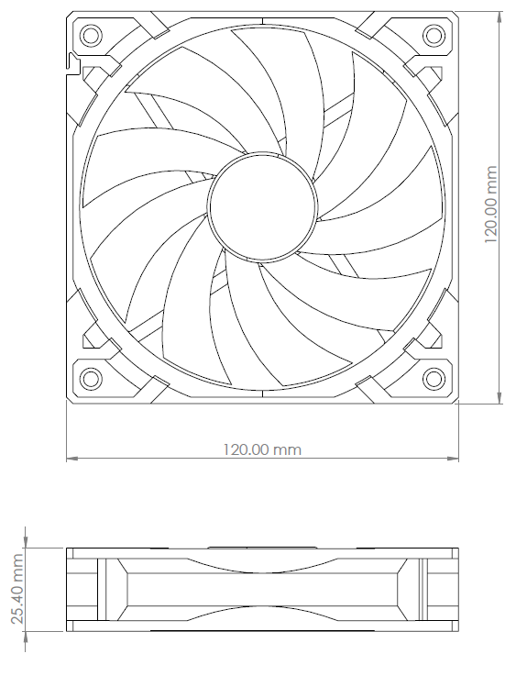
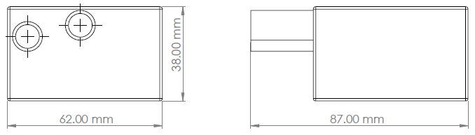
Large Components
Pump
120mm Fan
William Pineda

Slide 18
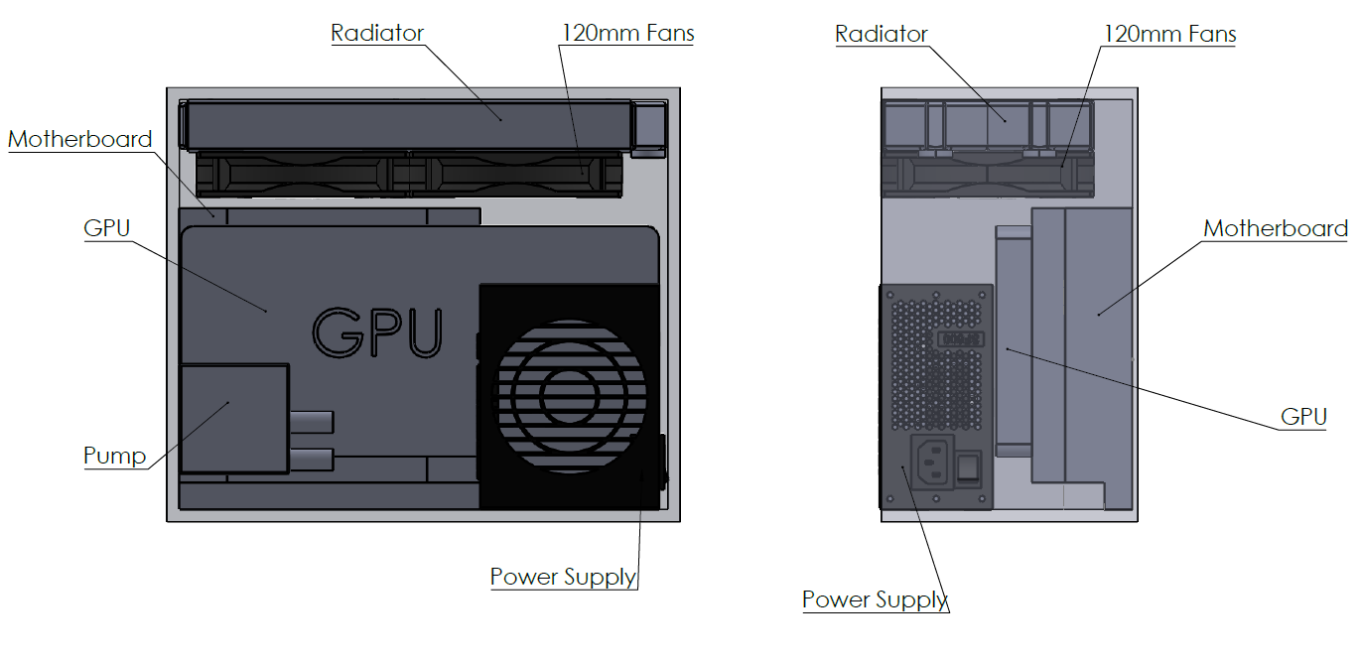
Configurations (Case 1)
Case 1 = 9.3L
William Pineda

Slide 19
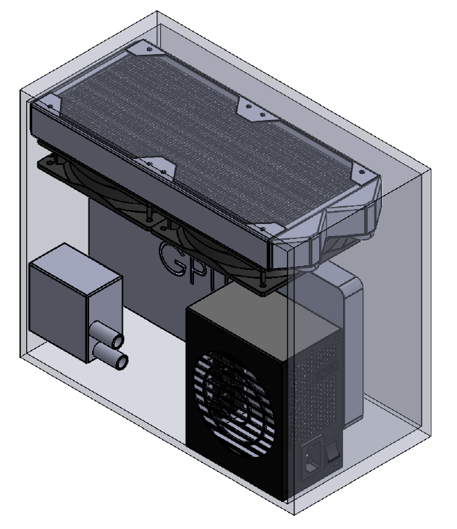
Configurations (Case 1)
Limited space between GPU and CPU
Enough space for hard drives (Mechanical and SSD)
Closest case to 7.5L goal
Easily accessible ports from motherboard and GPU
Adequate free space in case for additional airflow
231.20mm
276.0 mm
142.0 mm
Case 1 = 9.3L
William Pineda

Slide 20
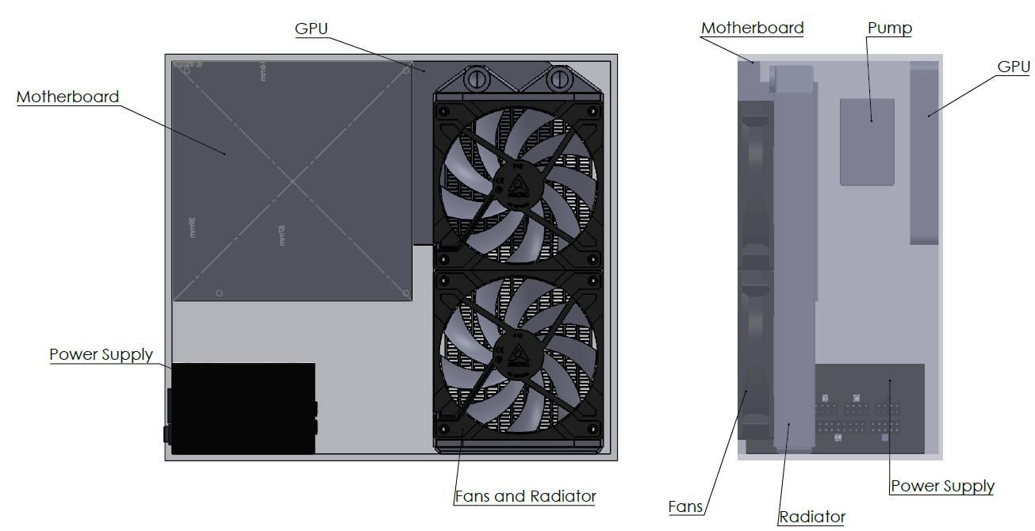
Configurations (Case 2)
Case 2 = 12.5L
William Pineda

Slide 21
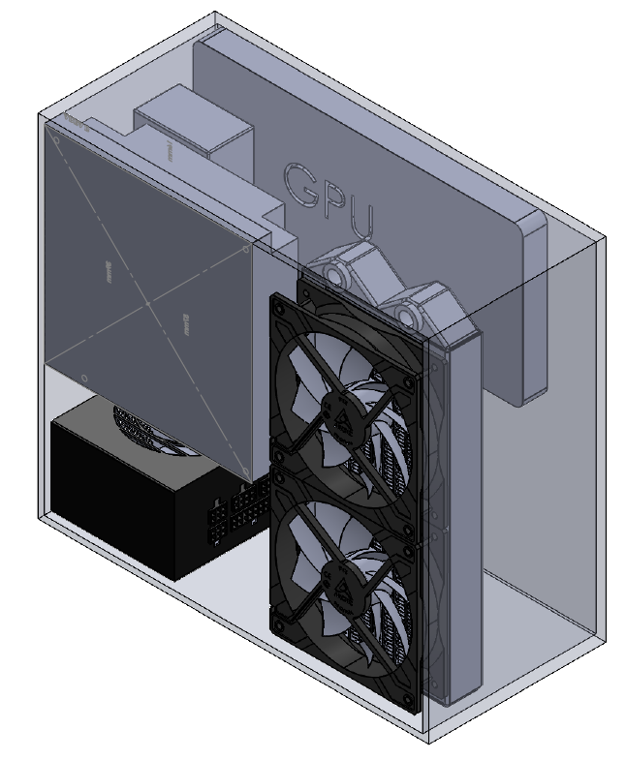
Configurations (Case 2)
Largest volume of the different configurations
Most practical in regards to the pump reaching the GPU and CPU from the reservoir
Enough space for an external reservoir
Due to geometry of internal components, there’s a large amount of wasted space, creating a larger volume
278..0 mm
310.0 mm
142.0 mm
Case 2 = 12.5L
William Pineda

Slide 22
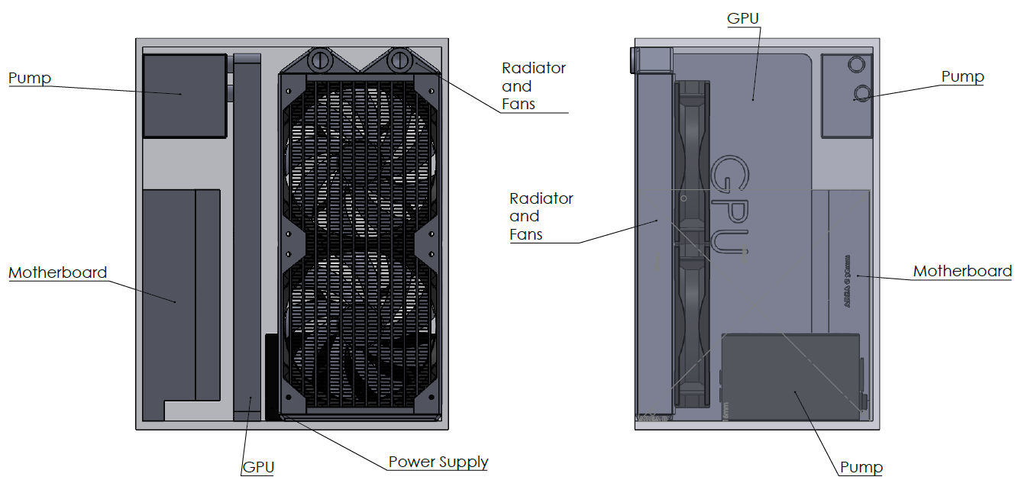
Configurations (Case 3)
Case 3 = 10.9L
William Pineda

Slide 23
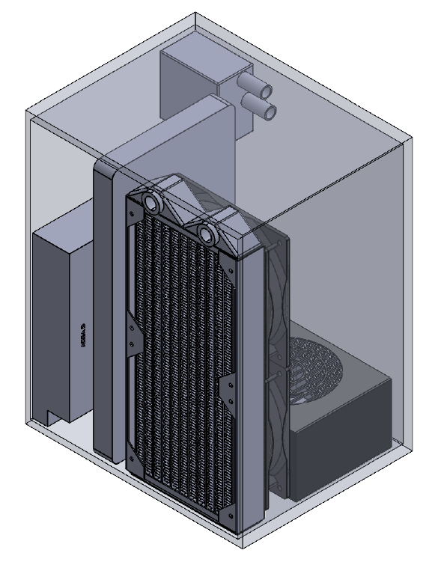
Configurations (Case 3)
Limited space between CPU and GPU can pose a problem with cooling blocks space
More compact than case 2, while still having space for hard drives, additional airflow, and other additional smaller components
Pump will be allow easy access to CPU, GPU, and radiator in this configuration
275.0mm
220.0 mm
175.0 mm
Case 3 = 10.9L
William Pineda

Slide 24
Thermal Design Details
Parallel cooling loop, thermal circuit diagram, thermal design power, and radiator selection

Slide 25
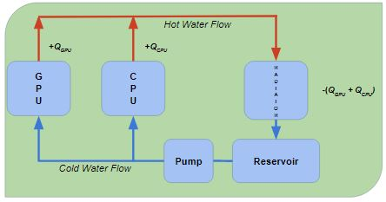
Basic Cooling Loop Schematic
A parallel flow water cooling loop will be used.
Water is pumped from the reservoir and diverted to the GPU and CPU.
The water collects heat from both components and is passed on to the radiator.
The radiator removes heat from the water and it is cycled back into the resevoir
Patrick Huffman

Slide 26



Thermal Thermal Circuit
Water
Water
R_{Conv1}
R_{Conv2}
Cooling Block
Cooling Block
Total heat dissipation needed can be calculated once certain properties are known or determined.
It is difficult to determine dissipation needed without first making assumptions about the flow.
An analysis of total Thermal Design Power is beneficial.
Radiator
R_{Cond2}
R_{Cond4}
Paste
Paste
R_{pump}
(Pump Heat)
R_{Cond1}
R_{Cond3}
GPU
CPU
Patrick Huffman

Slide 27
Thermal Design Power, and You!
What is Thermal Design Power (TDP)?
  TDP is the hardware manufacturer’s rating of how many watts of heat that component.
  High end GPUs operating at 100% capacity typically have a TDP between 250-350 Watts.
  Higher end CPUs under the same conditions have a TDP in the mid to low 100s.
These TDP ratings are for 100% operating capacity. Many PC enthusiasts will “overclock” their systems, supplying more power to their CPU and GPU in order to exceed their limits, and thus generate more heat.
Patrick Huffman

Slide 28
Why does TDP matter?
The liquid cooling loop integrated into the computer case must be able to dissipate all of the heat generated by internal components. There are 3 main components to consider for total TDP.
Graphics Processor(s) TDP
Computer Processor TDP
Pump Heat
The current goal is to offer consumers a case that can handle a TDP of 300, 120, and 25 Watts for the GPU, CPU, and pump heat, respectively.
Patrick Huffman

Slide 29
Radiators and You!
Aside from the fins per inch and total size, efficiency of radiators in PC cooling loops are determined by flow speed and the difference in temperature of the inlet flow and ambient air.
ΔT is a function of flow velocity, head loss, pipe material, and radiator choice.
Factors that affect our radiator selection:
Total volume of the radiator
Number of fans required
Heat dissipation > total TDP
Power needed
Patrick Huffman

Slide 30
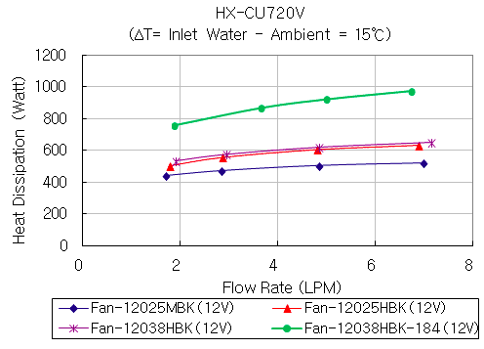
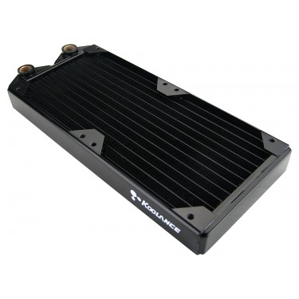
Koolance HX-CU720V, 2x120mm Radiator
Using the Koolance HX-CU720V, with 2 12038HBK fans and a ΔT of 15℃, a heat dissipation between 500-620 Watts can be achieved.
Patrick Huffman

Slide 31
Moving Forward
Finalize location of components that will limit volume but maximize efficiency of the case
Place order for internal computer components
Start creating fastening locations for components and areas for cable management
Explore possibility of passive cooling areas integrated into the design
Transfer final design to Protocase Designer for outsourced case manufacturing
Work on the marketability of the case for the Innolevation Challenge
Assemble and test
William Pineda
Notes:
Efficiency of the case will be determined by limiting head loss, power consumption, limit energy, proper space allocation

Slide 32
References
https://mygaming.co.za/news/features/89913-there-are-1-8-billion-gamers-in-the-world-and-pc-gaming-dominates-the-market.html
Intel. Thin Mini-ITX PC Based Systems Design Guide. December, 2012
Intel. Mini-ITX Addendum to the MicroATX Motherboard Interface Specification. V1.2. October, 2010.
https://koolance.com/radiator-2-fan-120mm-30-fpi-copper
https://grabcad.com/library/corsair-sf600-1
https://grabcad.com/library/cooler-80mm-1
Notes:
Not this slide will advance on default after 2 seconds. If you would like to change this then go to the transition tab and under timing change the advance slide settings.

Slide 33
Questions?

Slide 34
Backup Slides

Slide 36
Project Background
Goal: Design a modular SFX Mini-iTX computer case to prevent high end components from thermal throttling
  Integrated into case architecture
  Is completely self contained
  Appeal to growing markets
Markets: Focus on high end computation needs
  PC Gamers
  Bitcoin Miners
  Integrated Systems for Research and Industry

Slide 37
Motivation
Mini-iTX Cases currently on the market lack the ability to use a reference sized Graphics Processing Unit(GPU) in a Small Form Factor(SFX)
  Main issue is overheating

Slide 38
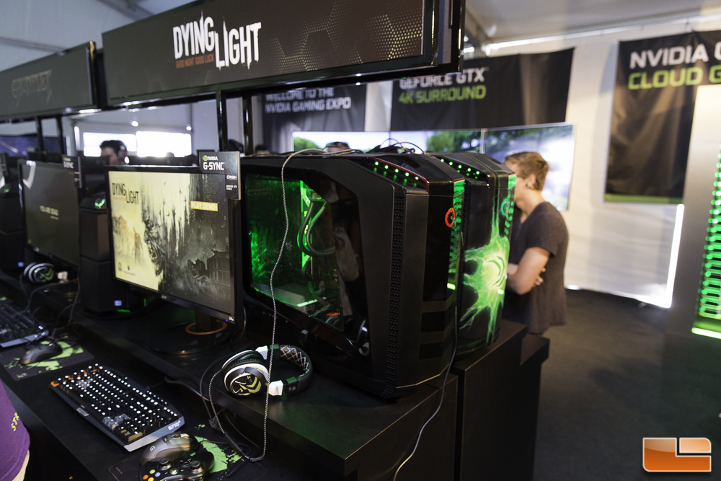
Path to Market
Personal Communication:
Video game store advertisement
Hands-on Temperature demonstrations
Gaming Expositions
Impersonal Communication:
Individual orders via website
Online support chat
E-mail
Instructional videos
31

Slide 39
Project Scope
Target Market
➢Primary Market: PC gamers/Enthusiasts
▪ There is 62% PC gamers and 58% on consoles (20% both), market would be both as this would be as compact and powerful
▪ According to an ESA Study, the market for gamers (according to 2014 study) is around of $5.08 Billion dollars.
➢Secondary Market: Research Hobbyists
▪ Advertising purposes, Home Entertainment

Slide 40
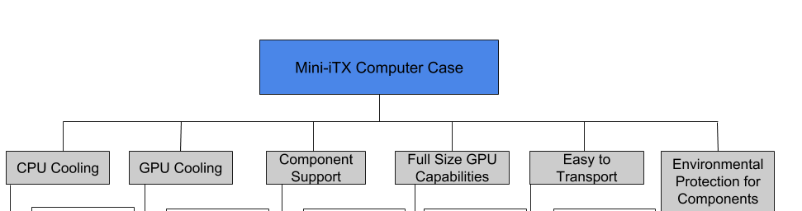
Functional Decomposition

Slide 41
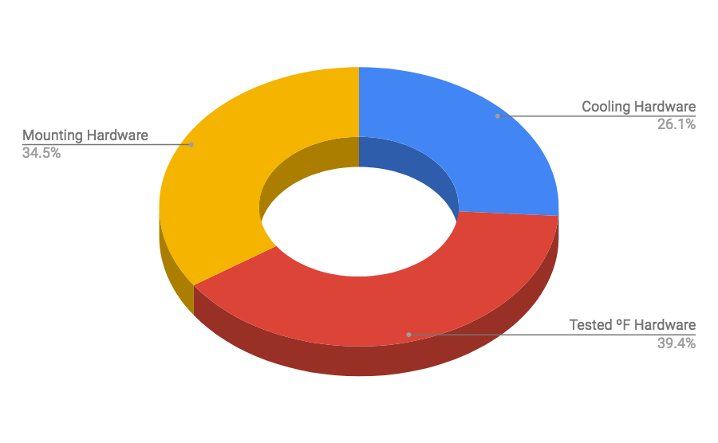
Budget Report
Item | Cost
Cooling Hardware | $ 387.99
Tested ºF Hardware | $ 587.42
Mounting Hardware | $ 513.76
Total | $ 1489.17

Slide 42
Estimated Costs and Revenues
COSTS
Current design cost (Mounting Hardware) =$520
Bulk manufacturing reduction of 60% =$210
Our retail price = $300
REVENUES
Online purchases =$
Selling 10,000 units in 2 years = Profit of$
Team contracts =$
70 Contracts in 2 years = Profit of$
33

