Slide 1
Simulated Assembly Line and
Process Workstation
Team 520
Sponsor: Tallahassee Community College
Sponsor Representatives: Bobette Stubblefield and Dylan Sutton
Academic Advisor: Dr. Dorr Campbell

Slide 2
Team Introductions
Cheyenne Laurel
Project Manager
David DiMaggio
Design Engineer
Boluwatife Olabiran
Software Engineer
JoEll Williams
Hardware Engineer
Nataajah Taylor
Test Engineer

Slide 3
Objective
Tallahassee Community College (TCC) requires an assembly line system to be used in their Advanced Manufacturing and Training Center as an educational tool
Will be used as a Mechatronics certification tool
Must allow for user to toggle failures in the hardware and software to allow for student diagnosis and repair
Cheyenne Laurel

Slide 4
Project Background

Slide 5
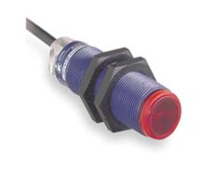
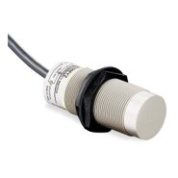
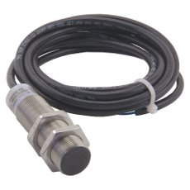
Manufacturing Technology
Photoelectric Sensor: Uses a light transmitter and receiver to test if object is in sensing area, as well as detecting size
Capacitive Proximity Sensor: Detects the capacitance of nearby objects without physical contact to determine material
Inductive Proximity Sensor: Uses a magnetic field to detect whether an object is metal or not
Figure 1: Photoelectric Sensor [1]
Figure 2: Capacitive Proximity Sensor [3]
Figure 3: Inductive Proximity Sensor [4]
Cheyenne Laurel

Slide 6
Functional Decomposition
Each dot represents the secondary function’s role in the three main functions
Allows the group to focus on the most important system components
Cheyenne Laurel

Slide 7
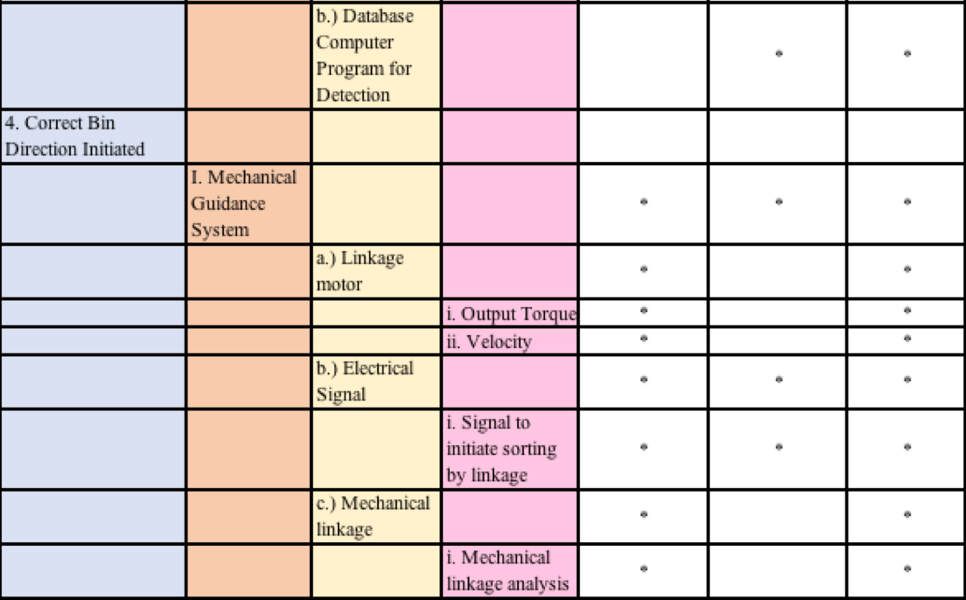
Functional Decomposition
The secondary functions regarding the mechanical guidance system, which encompasses sorting arm attached to the stepper motor, as a critical part of the system
Cheyenne Laurel

Slide 8
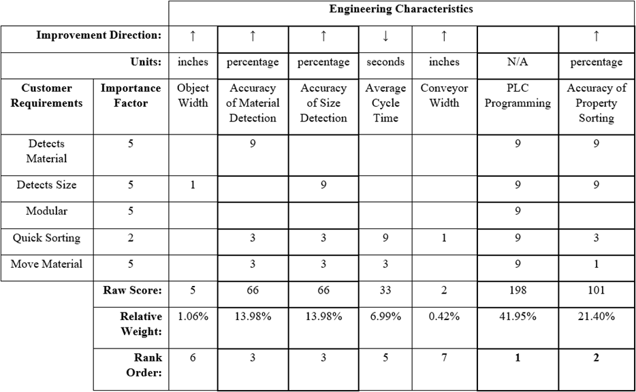
House of Quality
Most Important Engineering Characteristics:
Accuracy of Material Detection
Accuracy of Size Detection
PLC Programming
Accuracy of Property Sorting
Nataajah Taylor
8

Slide 9
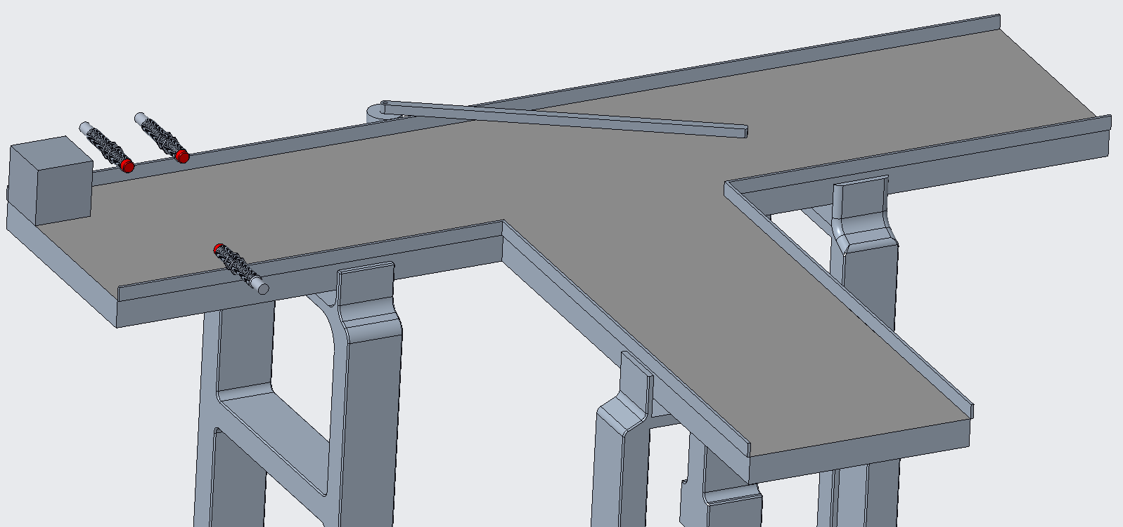
Project Design
Consists of a multiple step process:
Step 1: Object is placed on the conveyor belt
Step 2: Inductive, Capacitive, and Photoelectric sensors detect if object is present, as well as size and material
Step 3: Mechanical arm attached to stepper motor moves object to correct position for sorting based off of received sensor information.
Nataajah Taylor

Slide 10
Moving Forward

Slide 11
Ladder Logic Programming
Example of Ladder Logic Programming:
A graphical diagram based on the circuit diagrams of relay logic hardware.
Using relays to connect the inputs and outputs of the PLC, the relays enable a signal or pulse of electricity to switch on (or switch off) a separate flow of power
Uses if, and, or logic to determine the paths between each component of the system
JoEll Williams

Slide 12
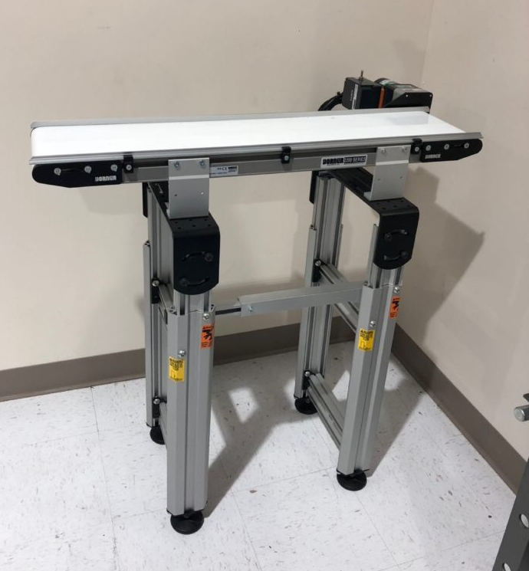
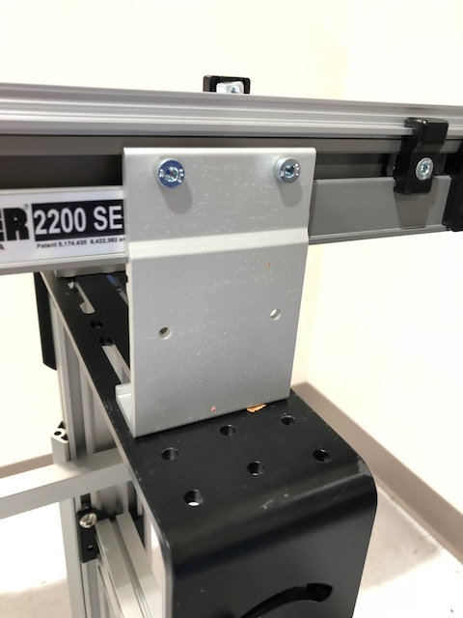
Design and 3D print sensor mounts
JoEll Williams

Slide 13
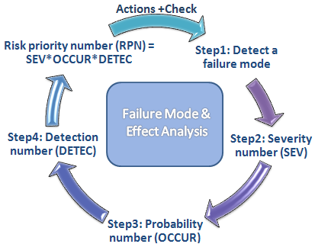
Failure Modes and Effects Analysis
Find and analyze modes of failure
Useful when programming toggleable failures for students to diagnose and solve
Figure 4: FMEA example [6]
JoEll Williams

Slide 14
References
“48mm Retroreflective Cylindrical Photoelectric Sensor; Max. Sensing Distance: 3.0m.” Grainger - For the Ones Who Get It Done., www.grainger.com/product/TELEMECANIQUE-SENSORS-48mm-Retroreflective-Cylindrical-32J327?searchBar=true&searchQuery=32J327.​
“Detection Based on ‘Light‘What Is a Photoelectric Sensor?” Main Types of Microscopes: Types & Principle｜KEYENCE Biological Fluorescence Microscopes, www.keyence.com/ss/products/sensor/sensorbasics/photoelectric/info/.​
“100 Hz Capacitive Cylindrical Proximity Sensor with Max. Detecting Distance 8.0mm.” Grainger - For the Ones Who Get It Done., www.grainger.com/product/OMRON-100-Hz-Capacitive-Cylindrical-2AKD8?searchBar=true&searchQuery=2AKD8.​
“1200 Hz Inductive Cylindrical Proximity Sensor with Max. Detecting Distance 8.0mm.” Grainger - For the Ones Who Get It Done., www.grainger.com/product/EATON-1200-Hz-Inductive-Cylindrical-40HT96?searchBar=true&searchQuery=40HT96.​
Automationnc. (2014, February 03). PLC Training - Introduction to Ladder Logic. Retrieved from https://www.youtube.com/watch?v=Ei4_HqzUFBs
Sean. “DP Failure Mode Effect Analysis - Breaking Down the FMEA – GCaptain.” GCaptain, 31 Jan. 2012, gcaptain.com/breaking-fmea/.
Notes:
Not this slide will advance on default after 2 seconds. If you would like to change this then go to the transition tab and under timing change the advance slide settings.

Slide 15
Questions?

Slide 16
Backup Slides

Slide 17
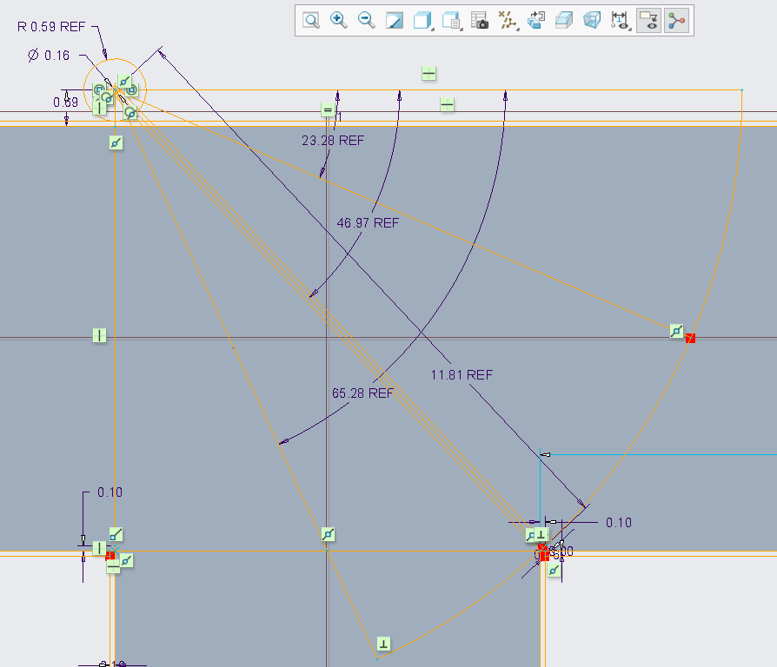
Diverter Arm Angles
Bin 1: 0º
Bin 2: 23.28º
Bin 3: 46.97º
Bin 4: 65.28º

Slide 18
Standard Shapes
Summary Box
Text box 1
Outlined Text Box

Slide 19
Approved Logos

Slide 20
Color Palette

Slide 21
APA Tables
Category 1 | Category 2 | Category 3 | Category 4 | Category 5
Item 1
Item 2
Item 3
Item 4
 | Category 2 |  |  | Category 3
Category 1 | subcategory 1 | subcategory 2 |  | subcategory 1 | subcategory 2
Item 1
Item 2
Item 3
Item 4

