Slide 1


Simulated Assembly Line and
Processing Workstation
Team 520

Slide 2





Team Introductions
Cheyenne Laurel
Project Manager
David DiMaggio
Design Engineer
Boluwatife Olabiran
Software Engineer
JoEll Williams
Hardware Engineer
Nataajah Taylor
Test Engineer
David DiMaggio

Slide 3



Sponsor and Advisor
TCC Representative
Bobette Stubblefield
TCC Representative
Dylan Sutton
ME Advisor
Dr. Dorr Campbell
David DiMaggio

Slide 4
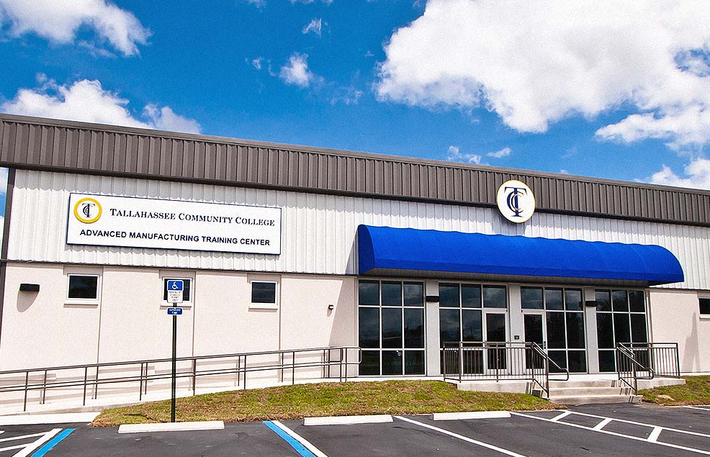
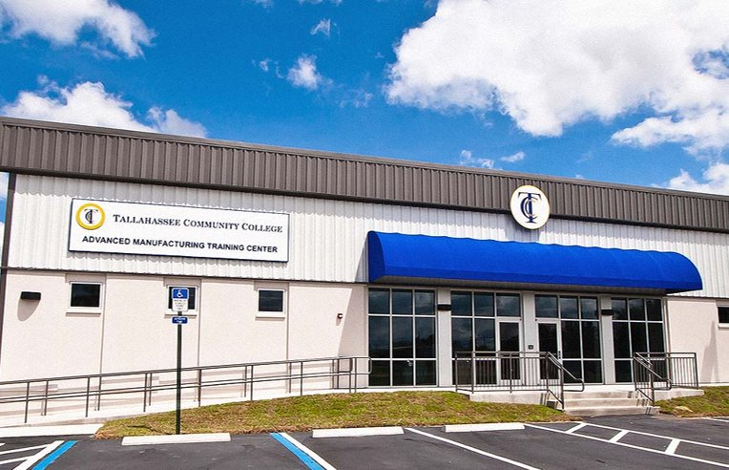
Objective
Tallahassee Community College (TCC) requires an assembly line system to be used in their Advanced Manufacturing and Training Center as an educational tool
Will be used as a Mechatronics certification tool
Must allow for user to toggle failures in the hardware and software to allow for student diagnosis and repair
Figure 1: Advanced Manufacturing and Training Center at TCC
David DiMaggio

Slide 5
Project Background

Slide 6
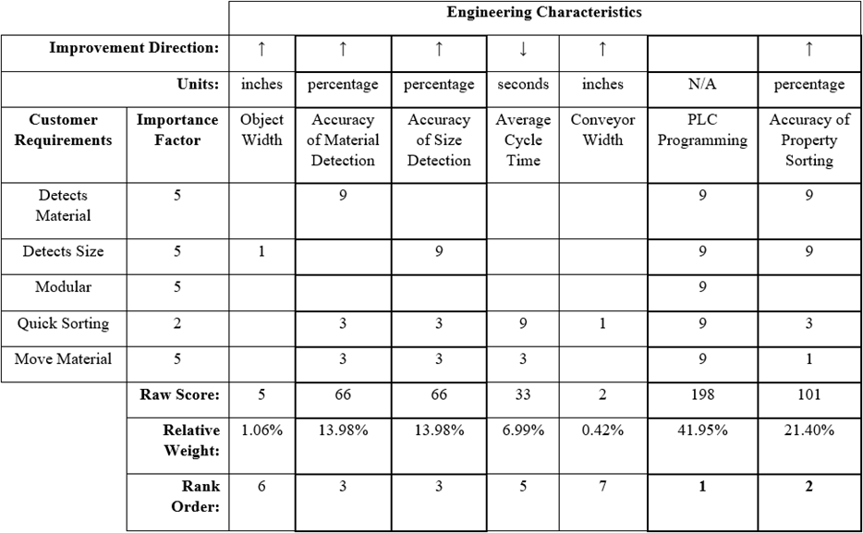
House of Quality
Determined the most important engineering characteristics to be:
PLC Programming
Accuracy of Physical Property Sorting
Accuracy of Material Detection
Accuracy of Size Detection
David DiMaggio

Slide 7
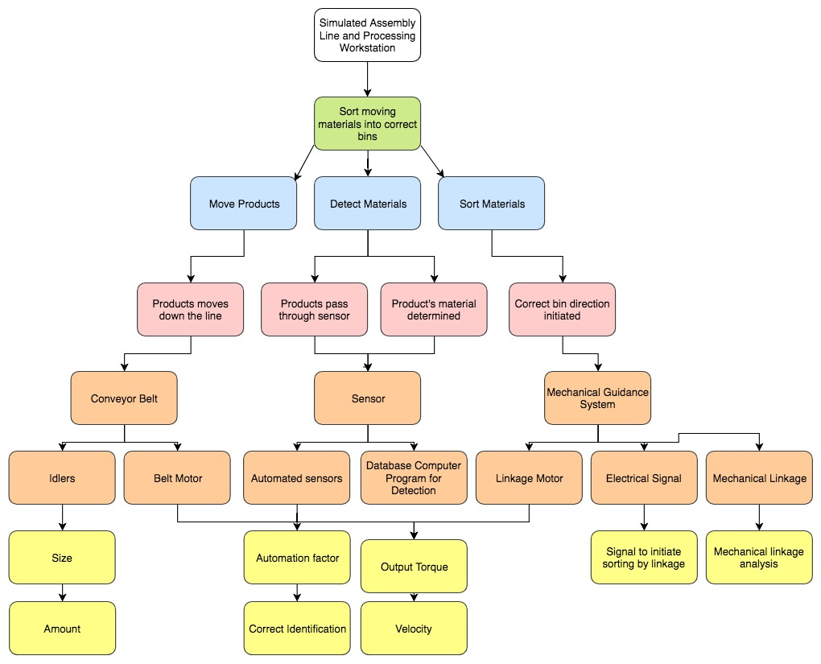
Functional Decomposition
Green- Overall Function Goal
Blue- 3 Main Functions to be achieved
Pink- Secondary Functions
Orange- Physical Components
Yellow- Measurable Inputs and Outputs
Bolu Olabiran

Slide 8
Concept Generation

Slide 9
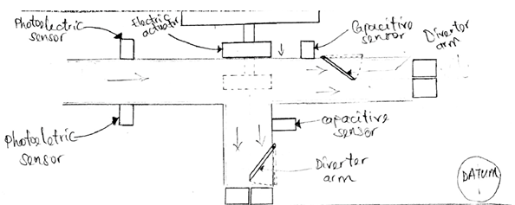
Datum Concept
Photoelectric sensor
Electric Actuator
2 Diverter Arms
2 Capacitive sensors
  Actuator pushes object to second conveyor belt based on size
Bolu Olabiran

Slide 10
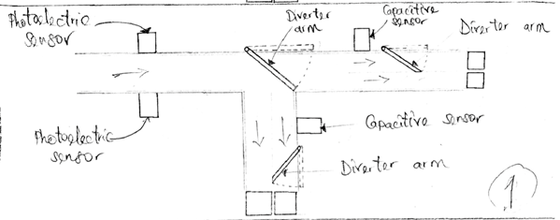
Concept 1
Photoelectric sensor
3 Diverter Arms
3 Stepper Motors
2 Capacitive sensors
  First diverter arm guides object to second conveyor belt based on size
Bolu Olabiran

Slide 11
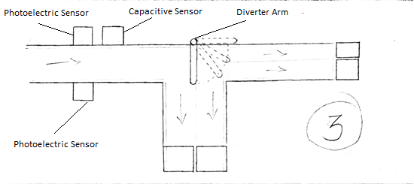
Concept 3
2 Photoelectric Sensor
1 Capacitive Sensor
1 Diverter Arm
2 Conveyor Belts
  Diverter arm programmed at angles to guide objects in corresponding bins
Bolu Olabiran

Slide 12
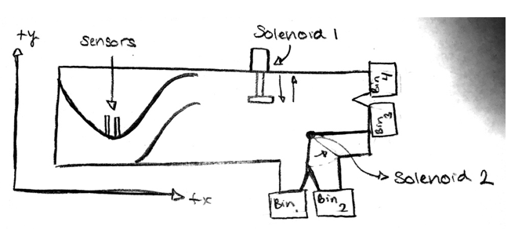
Concept 4
1 Photoelectric Sensor
2 Solenoids
2 Conveyor Belts
Diverter Arm
Track to guide objects near sensors
  Solenoids are the physical movers
Bolu Olabiran

Slide 13
Concept Selection

Slide 14
Pugh Chart
Cheyenne Laurel

Slide 15
Embodiment

Slide 16
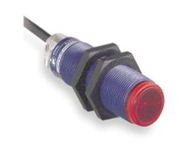
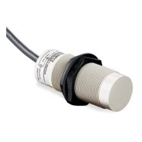
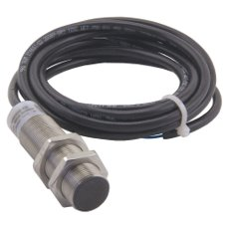
Manufacturing Technology
Photoelectric Sensor: Uses a light transmitter and receiver to test if object is in sensing area, as well as detecting size
Capacitive Proximity Sensor: Detects the capacitance of nearby objects without physical contact to determine material
Inductive Proximity Sensor: Uses a magnetic field to detect whether an object is metal or not
Figure 2: Photoelectric Sensor
Figure 3: Capacitive Proximity Sensor
Figure 4: Inductive Proximity Sensor
Cheyenne Laurel

Slide 17
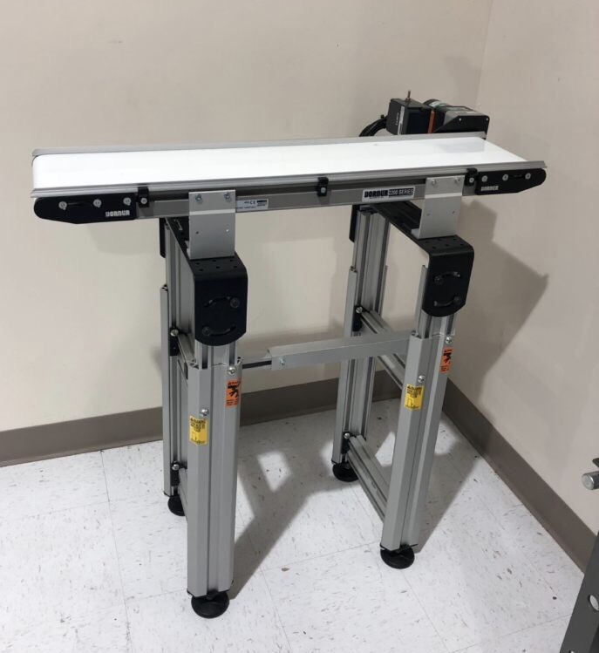
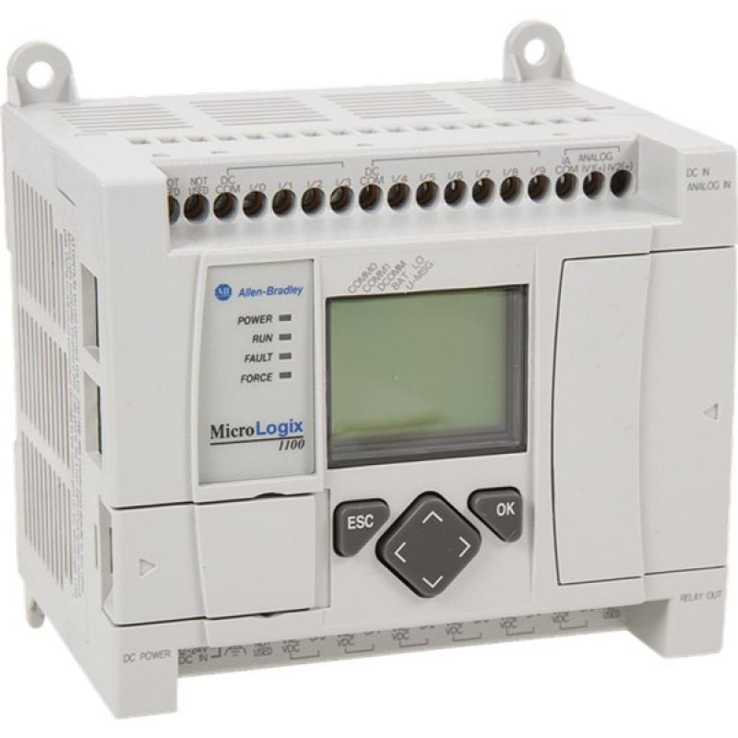
Manufacturing Technology
Dorner 2200 Conveyor Belt:
  Small Part Handling and Positioning
Allen-Bradley MicroLogix 1100:
  2 analog inputs, 10 digital inputs and 6 digital outputs
Figure 6: Allen-Bradley MicroLogix 1100 PLC
Figure 5: Dorner 2200 Conveyor Belt
Cheyenne Laurel

Slide 18
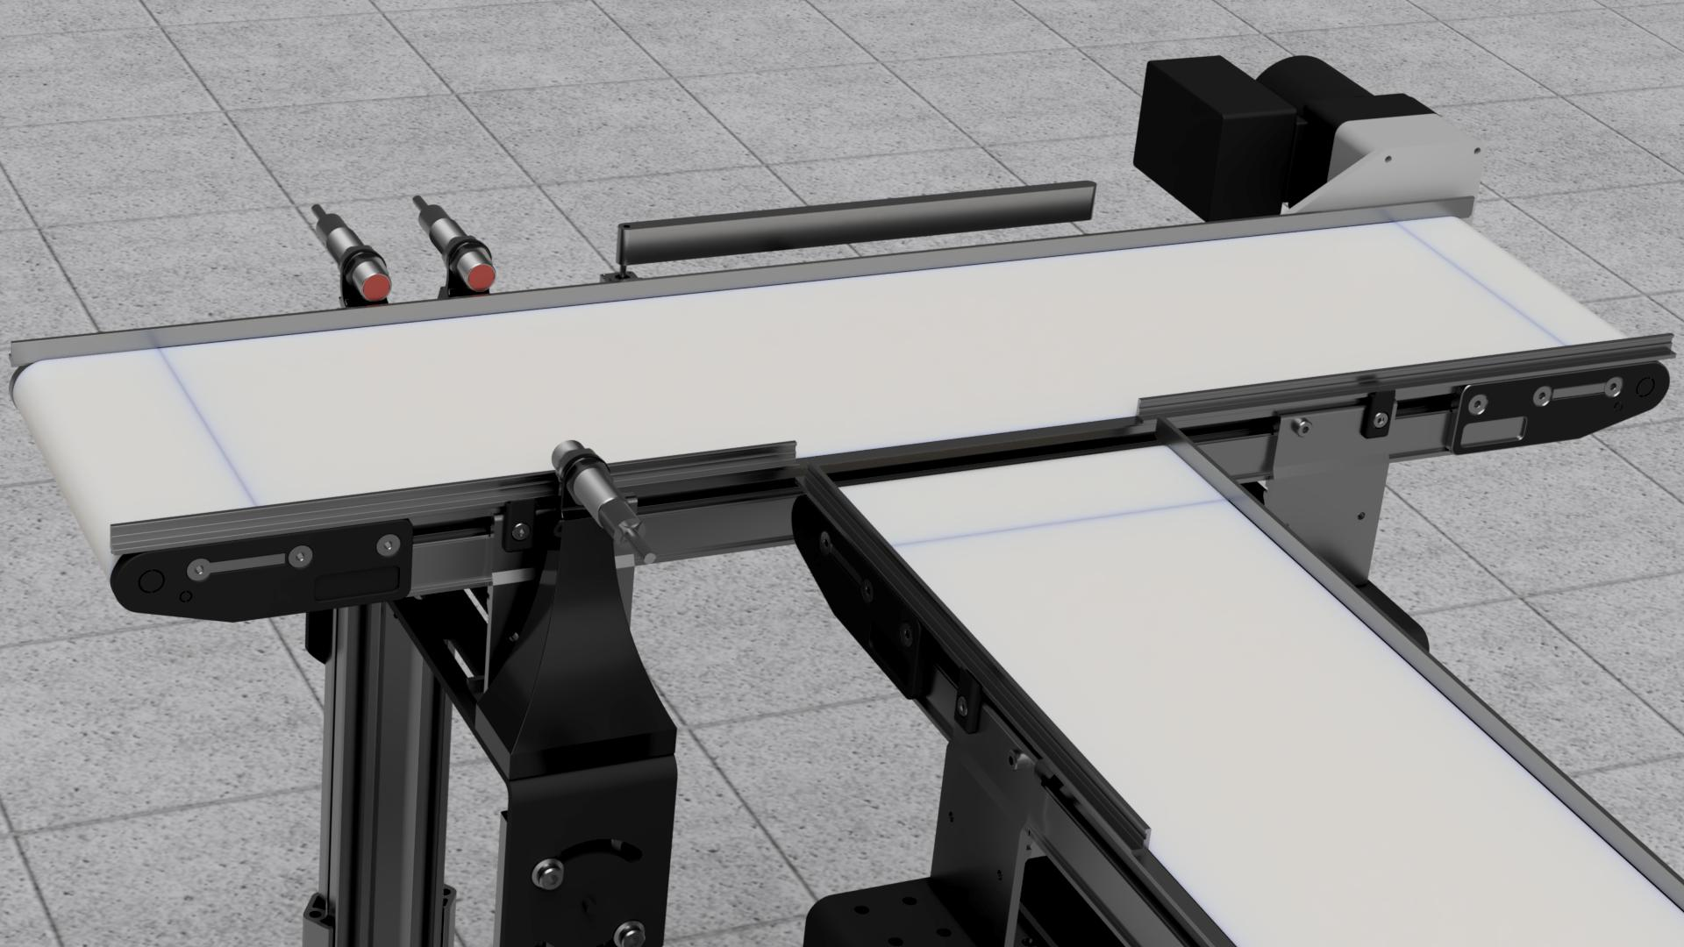
Project Design
Consists of a multiple step process:
  Step 1: An object is placed on the conveyor belt
  Step 2: Capacitive and Photoelectric sensors detect if object is present, as well as size and material
  Step 3: Diverter arm attached to a motor moves the object to correct position for sorting based off of received sensor information
Figure 7: Assembly Line CAD
Cheyenne Laurel

Slide 19
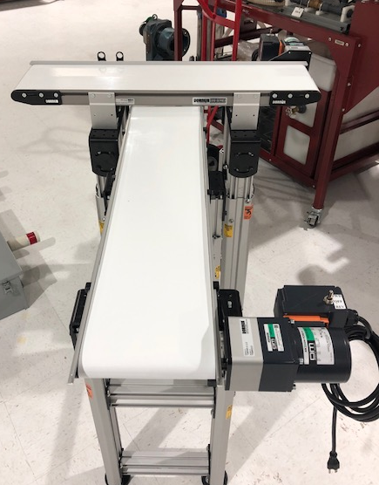
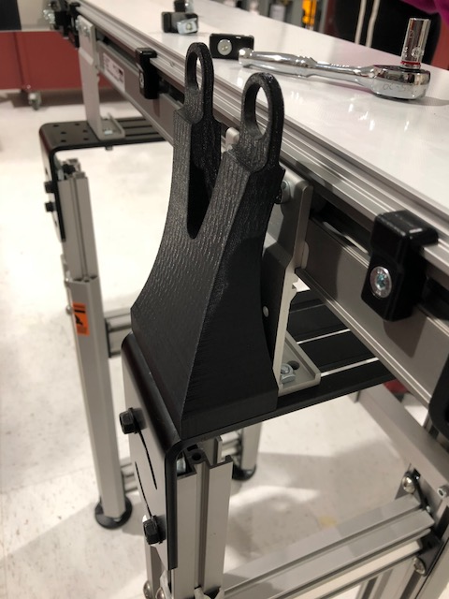
Building Status
Both conveyors are assembled and with heights adjusted to match the final concept
First sensor mount has been 3D printed and screwed into place
Figure 9: Sensor Mount
Figure 8: Current Building Status
Cheyenne Laurel

Slide 20
Manufacturing
Assembly of 2nd conveyor belt
  Need to position to make sure that all objects pass between conveyor belts without issue
3D Printing sensor mounts
Officially able to move forward with programming using MicroLogix 1100 PLC
Figure 8: Current System Set-Up
Cheyenne Laurel

Slide 21
Future Work
Re-order new Servo motor (changed from Stepper motor to Servo Motor)
Acquire diverter arm
Acquire bins and boxes for sorting
High Resolution Graphic
Risk Assessment
Poster Design
Operational Manual
Engineering Design Day – Presentation and Poster
Final report
Prototype demo
Cheyenne Laurel

Slide 22
References
CEIA , THS, Metal Detector, 2011, Serial number 20800450034, aperture 550 x 75mm, belt 2750 x 500mm .This items will be. (n.d.). Retrieved from https://www.go-dove.com/en/auction/view?id=13216983
“48mm Retroreflective Cylindrical Photoelectric Sensor; Max. Sensing Distance: 3.0m.” Grainger - For the Ones Who Get It Done., www.grainger.com/product/TELEMECANIQUE-SENSORS-48mm-Retroreflective-Cylindrical- 32J327?searchBar=true&searchQuery=32J327.
“Detection Based on ‘Light‘What Is a Photoelectric Sensor?” Main Types of Microscopes: Types & Principle｜KEYENCE Biological Fluorescence Microscopes, www.keyence.com/ss/products/sensor/sensorbasics/photoelectric/info/.
“100 Hz Capacitive Cylindrical Proximity Sensor with Max. Detecting Distance 8.0mm.” Grainger - For the Ones Who Get It Done., www.grainger.com/product/OMRON-100-Hz-Capacitive-Cylindrical-2AKD8?searchBar=true&searchQuery=2AKD8.
“1200 Hz Inductive Cylindrical Proximity Sensor with Max. Detecting Distance 8.0mm.” Grainger - For the Ones Who Get It Done., www.grainger.com/product/EATON-1200-Hz-Inductive-Cylindrical-40HT96?searchBar=true&searchQuery=40HT96.

Slide 23
Questions?

Slide 24
Backup Slides

Slide 25
Functional Decomp Backup

Slide 28
Concept Selection Backup

Slide 31
Detailed Math Backup

Slide 34
Standard Shapes
Summary Box
Text box 1
Outlined Text Box

Slide 35




Approved Logos

Slide 36
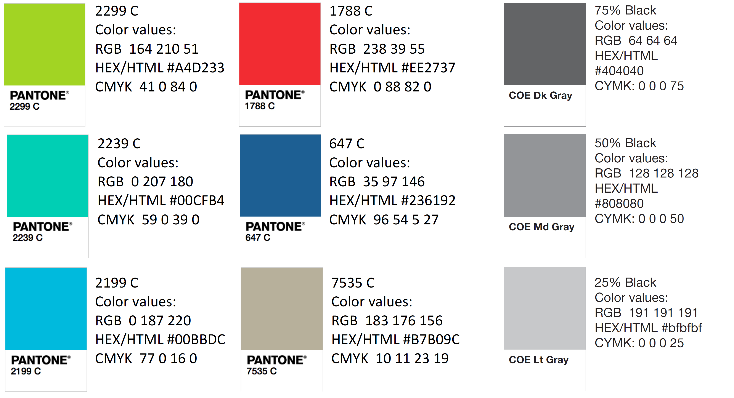
Color Palette

Slide 37
APA Tables
Category 1 | Category 2 | Category 3 | Category 4 | Category 5
Item 1
Item 2
Item 3
Item 4
 | Category 2 |  |  | Category 3
Category 1 | subcategory 1 | subcategory 2 |  | subcategory 1 | subcategory 2
Item 1
Item 2
Item 3
Item 4

