Slide 1


Simulated Assembly Line and
Processing Workstation
Team 520

Slide 2





Team Introductions
Cheyenne Laurel
Project Manager
David DiMaggio
Design Engineer
Boluwatife Olabiran
Software Engineer
JoEll Williams
Hardware Engineer
Nataajah Taylor
Test Engineer

Slide 3



Sponsor and Advisor
TCC Representative
Bobette Stubblefield
TCC Representative
Dylan Sutton
Team Advisor
Dr. Dorr Campbell
Cheyenne Laurel

Slide 4
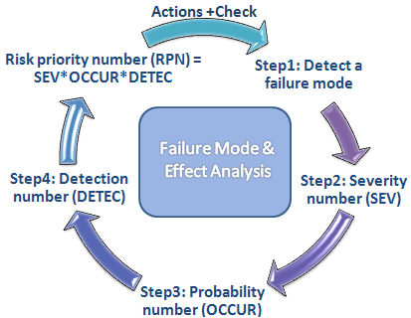
Failure Modes and Effects Analysis
Find and analyze modes of failure
Useful when programming toggleable failures for students to diagnose and solve
Figure 4: FMEA example [6]
4

Slide 5
Prototype Testing
Test the assembly and troubleshoot any issues before Engineering Design Day

Slide 6
Future Work
JoEll Williams

Slide 7
References
“48mm Retroreflective Cylindrical Photoelectric Sensor; Max. Sensing Distance: 3.0m.” Grainger - For the Ones Who Get It Done., www.grainger.com/product/TELEMECANIQUE-SENSORS-48mm-Retroreflective-Cylindrical-32J327?searchBar=true&searchQuery=32J327.​
“Detection Based on ‘Light‘What Is a Photoelectric Sensor?” Main Types of Microscopes: Types & Principle｜KEYENCE Biological Fluorescence Microscopes, www.keyence.com/ss/products/sensor/sensorbasics/photoelectric/info/.​
“100 Hz Capacitive Cylindrical Proximity Sensor with Max. Detecting Distance 8.0mm.” Grainger - For the Ones Who Get It Done., www.grainger.com/product/OMRON-100-Hz-Capacitive-Cylindrical-2AKD8?searchBar=true&searchQuery=2AKD8.​
“1200 Hz Inductive Cylindrical Proximity Sensor with Max. Detecting Distance 8.0mm.” Grainger - For the Ones Who Get It Done., www.grainger.com/product/EATON-1200-Hz-Inductive-Cylindrical-40HT96?searchBar=true&searchQuery=40HT96.​
Automationnc. (2014, February 03). PLC Training - Introduction to Ladder Logic. Retrieved from https://www.youtube.com/watch?v=Ei4_HqzUFBs
Sean. “DP Failure Mode Effect Analysis - Breaking Down the FMEA – GCaptain.” GCaptain, 31 Jan. 2012, gcaptain.com/breaking-fmea/.
Notes:
Not this slide will advance on default after 2 seconds. If you would like to change this then go to the transition tab and under timing change the advance slide settings.

