Slide 1
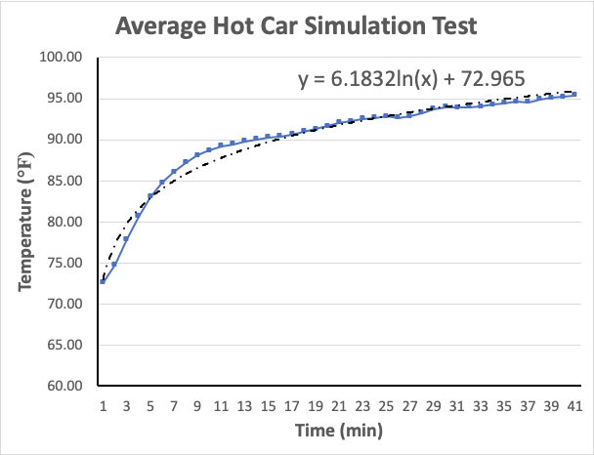
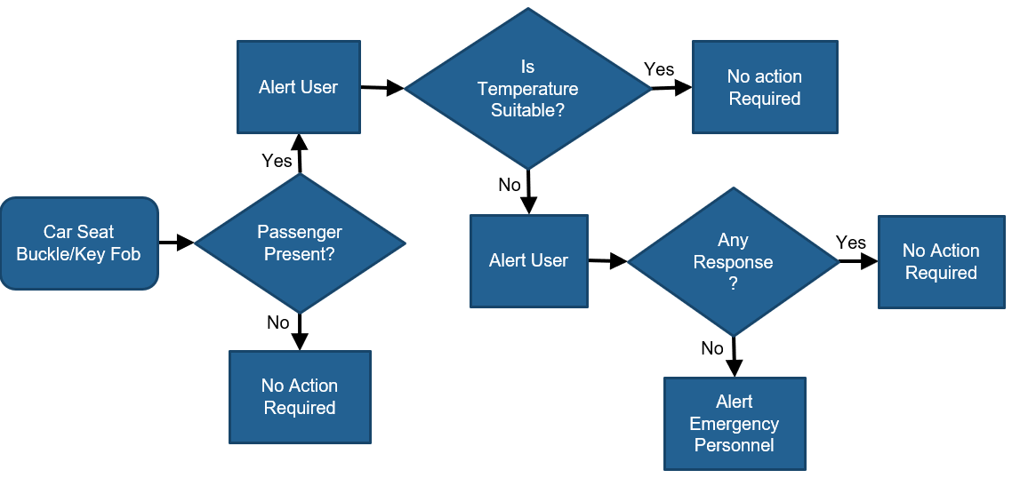
The Detector Baby
Team 511
Shadi Bilal | Karli Cash | David Miller | Matthew Zawiski
Sponsor : Lisa Allen – Wallace | Instructor : Dr. Shayne McConomy | Advisor : Dr. Simone Hruda
Background
According to the Safety Organization of Kids and Cars, an average of 37 kids die each year in hot cars (Willingham, 2018).
The rate has risen over the last 3 years, reaching a maximum of 48 deaths in 2018.
Architecture & Design
The overall device consists of two components: a modified smart seat belt buckle and a key fob.
The seat belt buckle stays in the vehicle monitoring for passenger detection and increasing internal temperature rates.
The key fob is carried by the parent to alert them of passenger detection.
Testing
The inside temperature of a turned off car was measured every thirty seconds until temperature reached an unsafe range.
A logarithmic trend line equation was created and will be used as a guideline for increasing temperature rate.
Goals
Create a device to alert parents if their child is left behind in a vehicle.
Determine the time it takes for a closed, non-operational vehicle to become uncomfortable at various outside temperatures.
Pinpoint when a child should be removed from car to prevent death.
Seat Belt Buckle
Hardware & Software Utilized
Key Fob
Results
Arduino 1.8.8 & Arduino Boards
Motherboard to store created code using Arduino software and implement it in the system when powered.
Accelerometer
An instrument used to measure and detect vehicle acceleration.
Hall Effect Sensor
Magnetic sensor stored in the seat belt buckle to measure the magnitude of a magnetic field.
Transmitter
Communication between devices to send messages when tuned to a frequency.
Temperature Sensor
Measures the inside car temperature.
Effectively detects the presence of a child in a car seat.
Accurately measures inside car temperature. Communicates the information from sensor readings to the key fob and displays on LCD.
Smart system uses accelerometer to determine that the car is in motion and the child is in no danger.
Key fob alerts and vibrates when the temperature reaches critical levels or rises drastically.
Sends emergency signal to authorities when no response is detected from the key fob.

