Slide 1
VDR 2 The Detector Baby
Team 511
Karli Cash, Matthew Zawiski, Shadi Bilal, David Miller
20-Nov-18

Slide 2
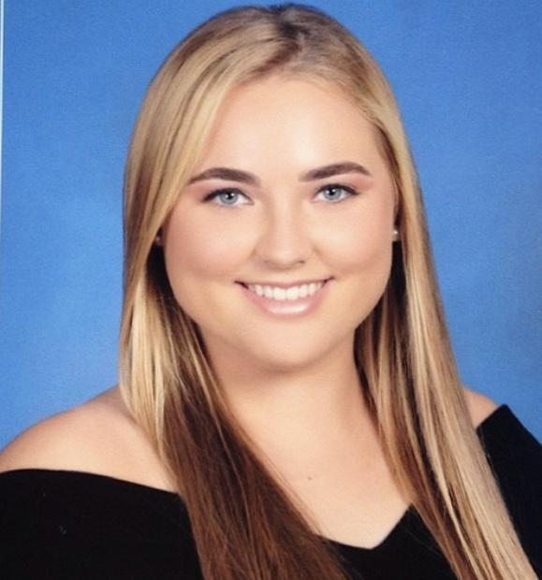
Team Introductions
Karli Cash
Project Manager
Shadi Bilal
Test Engineer
Matthew Zawiski
Software Engineer
David Miller
Design Engineer/ Financial Advisor

Slide 3
Project Summary
Our design team is tasked with creating a device that parents/caregivers can use to prevent the death of infants who are left behind in cars.
Customer needs were established. The device must detect a passenger and surrounding temperatures, alert the user upon detection, and alert emergency personnel before fatal conditions are met.
The preliminary design process begins with stating the targets of the product. From there the concept generation process begins.
Design team held a conference call with our sponsor Lisa Allen to discuss the customer needs & preliminary questions pertaining to the overall landscape of the product.
Based on the customer needs the devices main function is to alert a parent/caregiver if their child is left inside a automobile with unsafe conditions.
David Miller

Slide 4
Targets
Children tend to experience a fever when their internal body temperature reaches 100 degrees Fahrenheit, heat stroke at 104 degrees Fahrenheit, and death at approximately 107 degrees Fahrenheit (Gaggel, 2018).
Target distance was set for the device to operate at a maximum range of 50 to 100 meters.
Sizing of the secondary device was set to similar dimension of a key fob, which would allow the user to carry the device along with their keys.
Approximate dimensions : height - 0.025m, width - 0.04 m, length - 0.085 m
David Miller

Slide 5
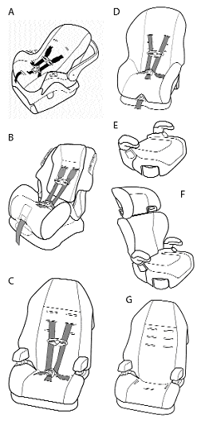
Targets Cont.
Device should be compatible with all car seats.
Detect if baby is in car seat.
Display temperature ranges and passenger vitals.
Alert users and emergency personnel.
Device should not be in power or measuring temperatures when passenger is not present.
David Miller

Slide 6
Target Testing Methods
The accuracy of temperature detection will be tested using a standard thermometer and comparing readings.
Response range will be tested by measuring the distance the two devices can operate until feedback is no longer received.
To insure devices can operate properly in high temperatures it will be placed in an environment simulating that of a hot car.
Test to ensure device can detect when a passenger is in the car seat.
David Miller
Notes:
This test would be repeated multiple times at and above the critical temperature to insure its accuracy.
(continuing on last bullet point)

Slide 7
Concept Generation
Team brainstormed many ideas to bring the project to life.
There were four main categories to consider:
Passenger detection device
Interior temperature detection
Critical temperature cut-off
Secondary response device
All ideas were put into a morphological chart.
Created 192 possible concepts.
David Miller

Slide 8
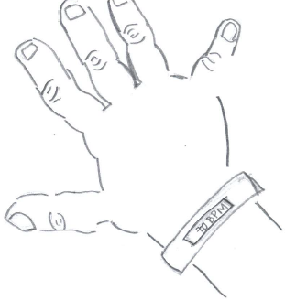
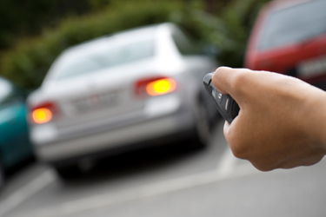
Passenger Detection Device
Heart Rate Monitor Bracelet
Smart Lock Alert
Airbag Detection Weight Technology
A bracelet that will monitor the passenger’s heart rate.
Alerts when unsafe heart rate is reached.
This will be connected to the alarm system and door locks.
Car doors will not lock until passenger is removed.
When critical, alarm system will sound until passenger is removed.
This will alert the driver, much like an airbag alert.
This occurs when a passenger is left too long in the seat after the engine is shut off.
David Miller

Slide 9
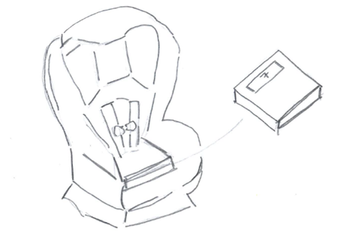
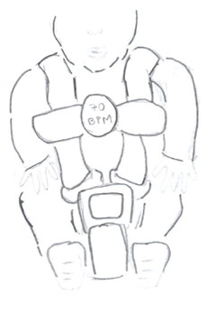
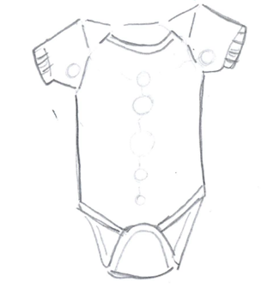
Passenger Detection Device Cont.
Scale Mechanism
Baby Monitor Car Seat Clip
Smart Baby Onesie
Similar to the airbag concept, except incorporated into the car seat.
Detects presence based off weight measured in car seat.
Clip that connects to the harness on a car seat.
Operates when connected and passenger is present.
Alerts when secondary device is too far away.
Very trendy classic that reads infant vitals and alert abnormalities to the parent.
David Miller

Slide 10
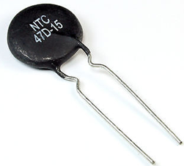
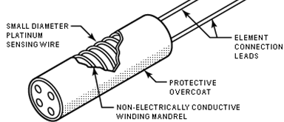
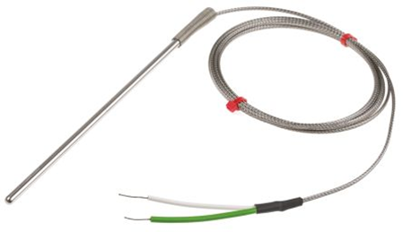
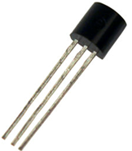
Interior Temperature Detection Device
Positive/Negative Temperature Coefficient Thermistor
Resistance Temperature Detector (RTD) Sensor
Semiconductor-Based Sensor
Thermocouples
Sensor with electrical resistance that raises or lowers with changing temperature.
Used in temperature range of -50℃ to 150℃.
Sensor that also uses an electrical resistance.
Composed of a coil of wire wrapped around a glass or silicone core.
Temperature range of -200℃ to 850℃.
Based off of the Seebeck effect.
Electricity is created, and voltage is translated to read temperature differences between materials.
Temperature range is -270℃ to 1260℃.
Electronic device that is placed on an integrated circuit to measure temperatures.
Temperature range is between -40℃ to 120℃.
Matthew Zawiski
Notes:
A positive temperature coefficient thermistor’s resistance increases with increasing temperature, while the negative temperature coefficient thermistor’s resistance decreases with increasing temperature.
According to the Seebeck effect, a temperature difference between two metals will create electricity. Thermocouples rely on this phenomenon by creating a loop with
semiconducting metals when inserted between a temperature gradient.
Two diodes are placed between a temperature gradient to measure the voltage across which is proportional to the absolute temperature.

Slide 11
Critical Temperature Cut-Off
Rate of Temperature Increase
Maximum/Minimum Absolute Temperature
This first method will be calibrated based off of a neutral temperature and then track rapidly changing temperatures towards both extremes (hot or cold).
Car’s internal temperature can rise from 70 to 115 degrees in about an hour or 0.75 degrees per minute (Jon, 2018).
This second method will work based on a specified temperature at each extreme.
Rise in temperature between the car and infant is approximately 4.5:1 degrees.
Possible fever after the car’s temperature rises above 84 degrees Fahrenheit.
Matthew Zawiski
Notes:
System calibrated to 84 degrees farenheit

Slide 12
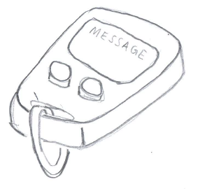
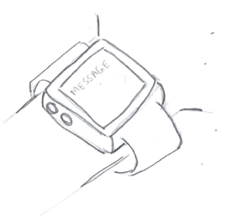
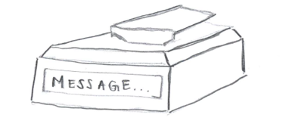
Secondary Response Device
Key Fob
Phone App
Smart Watch
Pager
Resembles a car key fob that can be carried on a key ring.
Consists of buttons and a small screen to display messages and temperature inside car.
An app that connects to the primary device for it to send messages.
The app will also provide up-to-date readings of the inside car temperature.
A watch that can be worn to receive quick alerts.
A simple solution that can be attached to the waist and display short messages.
Matthew Zawiski

Slide 13
Concept Selection
Eight designs were chosen for evaluation.
A few selection methods were carried out including:
House of Quality (HOQ)
Pugh Matrices
Analytical Hierarchy Process (AHP)
This gave the final concept to move forward with.
Matthew Zawiski

Slide 14
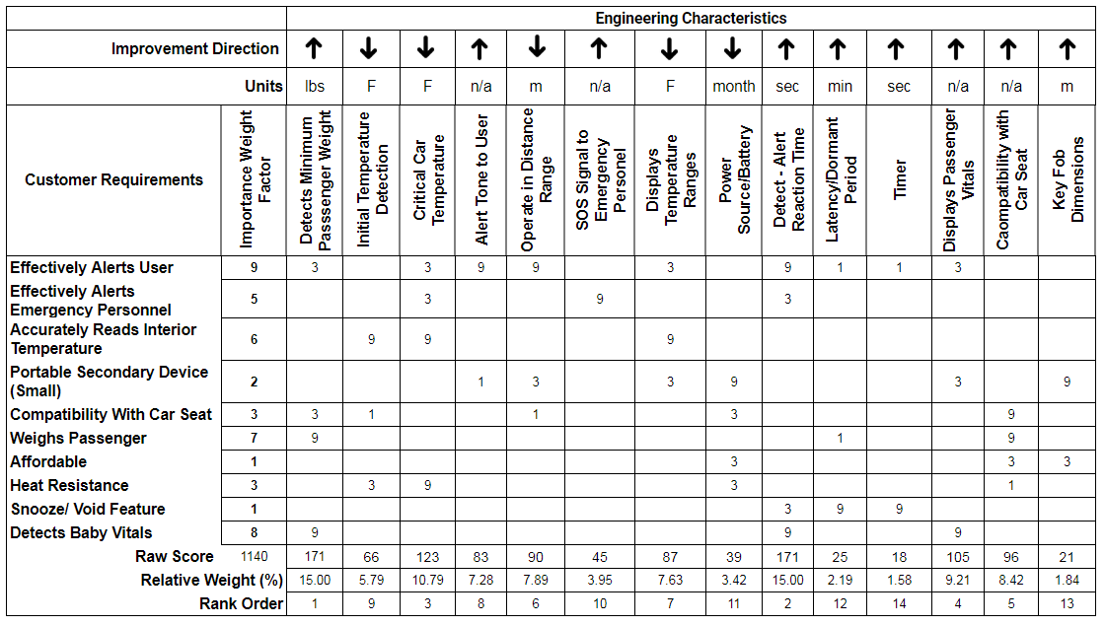
House of Quality
Customer needs compared to engineering characteristics based on a 1,3,9 scale.
Pairwise comparison evaluated to determine importance of customer requirements.
Engineering characteristics were ranked based on the calculated relative weight.
Matthew Zawiski
Notes:
A 1 being least impactful and 9 being most impactful

Slide 15
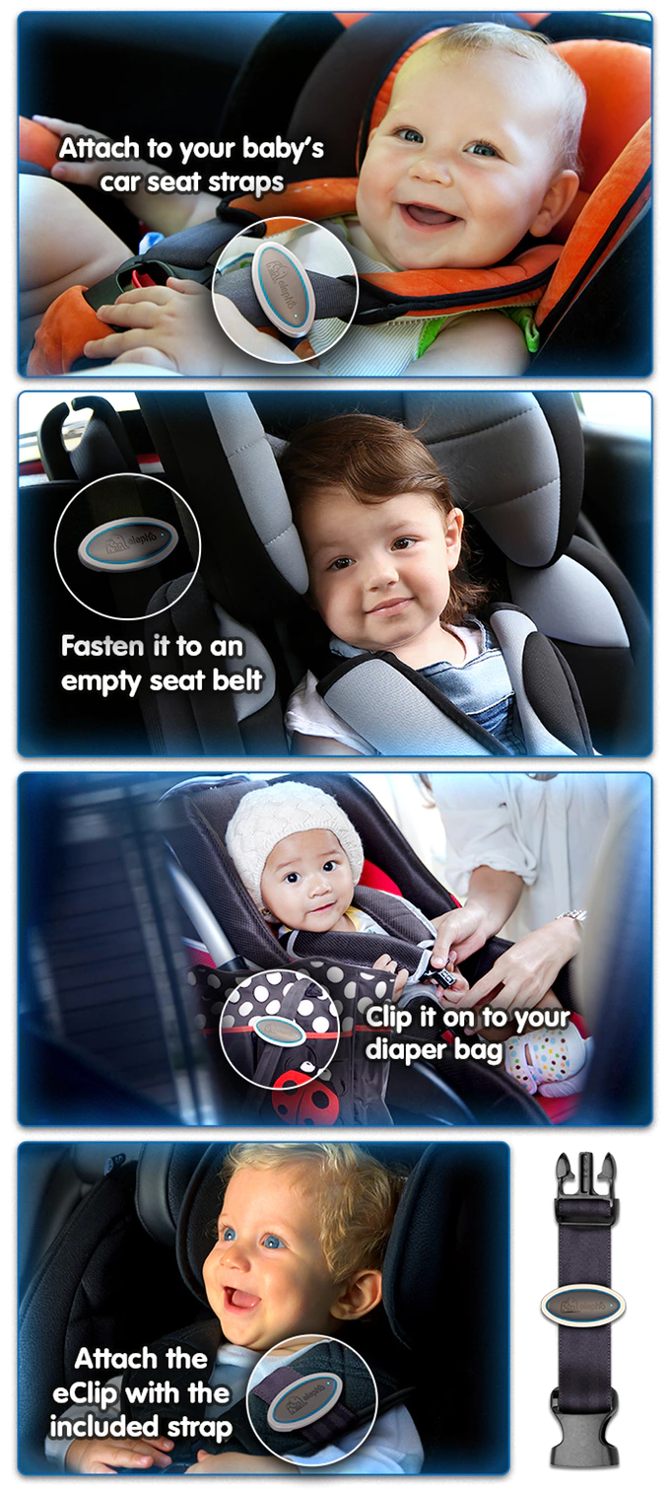
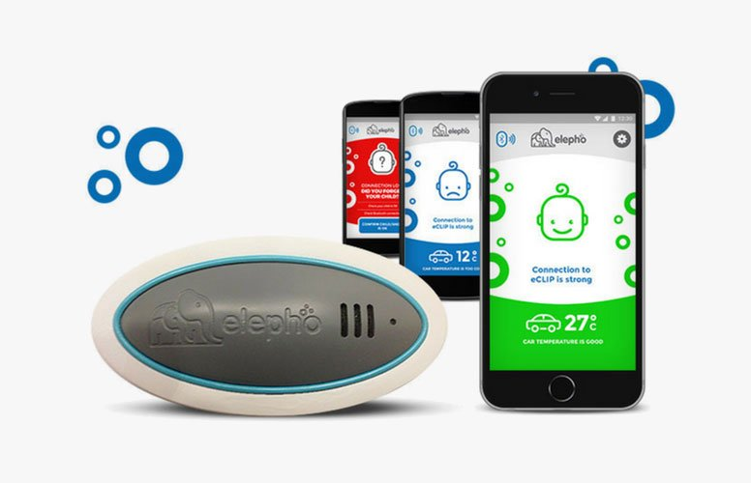
Competitor - Elpho eClip (Inc., E., 2018)
Easy setup and universal with all straps.
Low energy source with the use of Bluetooth.
Alerts user through smart phone app.
Detects when user is more than 15 feet away from the car.
Monitors temperature in the back of the car while car is on and off.
Baby proof, no choking hazards, baby incapable to turn off device.
Matthew Zawiski

Slide 16
Pugh Matrix #1
 |  | Concepts
Selection Criteria | Elpho eClip | 1 | 2 | 3 | 4 | 5 | 6 | 7 | 8
Detects Minimum Passenger Weight | Datum | Same | Same | Same | Same | Plus | Same | Same | Plus
Detect - Alert - Reaction Time |  | Minus | Same | Minus | Same | Plus | Same | Minus | Plus
Critical Car Temperature |  | Plus | Plus | Plus | Same | Same | Plus | Plus | Plus
Displays Passenger Vitals |  | Plus | Plus | Plus | Same | Same | Same | Plus | Same
Compatibility with Car Seat |  | Minus | Same | Minus | Minus | Same | Same | Minus | Same
Operate in Distance Range |  | Plus | Same | Plus | Same | Plus | Minus | Same | Same
Displays Temperature Ranges |  | Plus | Plus | Plus | Plus | Plus | Same | Plus | Plus
Alert Tone to User |  | Plus | Same | Plus | Same | Plus | Same | Same | Same
Initial Temperature Detection |  | Same | Same | Same | Same | Same | Same | Same | Same
SOS Signal to Emergency Personnel |  | Plus | Plus | Plus | Plus | Plus | Plus | Plus | Plus
# of Pluses |  | 6 | 4 | 6 | 2 | 6 | 2 | 4 | 5
# of Minuses |  | 2 | 0 | 2 | 1 | 0 | 1 | 2 | 0
Matthew Zawiski
Notes:
Mention elpho e clip on datum
Mention Top 10 engineering characteristics were used most important at the top
Talk about how concept 8 was used for datum because of the differential of 5 with pluses in the most important categories

Slide 17
Pugh Matrix #2
 |  | Concepts
Selection Criteria | 8 | 1 | 2 | 3 | 5 | 7
Detects Minimum Passenger Weight | Datum | Same | Minus | Minus | Same | Same
Detect - Alert - Reaction Time |  | Minus | Same | Minus | Same | Minus
Critical Car Temperature |  | Same | Same | Same | Minus | Same
Displays Passenger Vitals |  | Plus | Plus | Plus | Same | Plus
Compatibility with Car Seat |  | Minus | Same | Minus | Same | Minus
Operate in Distance Range |  | Plus | Same | Plus | Plus | Same
Displays Temperature Ranges |  | Same | Same | Same | Same | Same
Alert Tone to User |  | Plus | Same | Plus | Same | Same
Initial Temperature Detection |  | Same | Same | Plus | Minus | Plus
SOS Signal to Emergency Personel |  | Same | Same | Same | Same | Same
# of Pluses |  | 3 | 1 | 4 | 1 | 2
# of Minuses |  | 2 | 1 | 3 | 2 | 2
Matthew Zawiski
Notes:
Concepts 4 and 6 were eliminated.
Concept 8 was shifted to datum for re-evaluation.

Slide 18
Pugh Matrix #3
 |  | Concepts
Selection Criteria | 3 | 1 | 2 | 7
Detects Minimum Passenger Weight | Datum | Plus | Same | Plus
Detect - Alert - Reaction Time |  | Same | Plus | Same
Critical Car Temperature |  | Same | Same | Same
Displays Passenger Vitals |  | Same | Same | Same
Compatibility with Car Seat |  | Same | Plus | Same
Operate in Distance Range |  | Same | Minus | Minus
Displays Temperature Ranges |  | Same | Same | Same
Alert Tone to User |  | Same | Minus | Minus
Initial Temperature Detection |  | Minus | Minus | Same
SOS Signal to Emergency Personel |  | Same | Same | Same
# of Pluses |  | 1 | 2 | 1
# of Minuses |  | 1 | 3 | 2
Narrowed down to three final designs: 1,2,7
Analytical Hierarchy process was completed next to establish numerical weights for each engineering characteristic and design concept.
Matthew Zawiski

Slide 19
Concept Selection
Highest value was initially chosen for the final design, which was concept seven.
Heart Rate Monitor Bracelet
However, after gauging public opinion, concept two was more practical.
Therefore, concept two was chosen to move forward with.
Table 1: Alternative Values for the Final Three Concepts
Concepts | Alternative Value
1 | 0.1744
2 | 0.2860
7 | 0.5396
Matthew Zawiski

Slide 20
Final Design
The final design was determined to be concept 2, which is the combination of:
A baby monitor attached to the car seat buckles
A positive/ negative temperature coefficient thermistor
Rate of temperature increase
A Key Fob
Team plans on creating a clip system large enough to encompass microcontroller and temperature sensors.
similar to the standard baby harness clips.
Proximity sensors in the clip ends will tell if clips are secured together indicating the presence of a child.
Matthew Zawiski

Slide 21
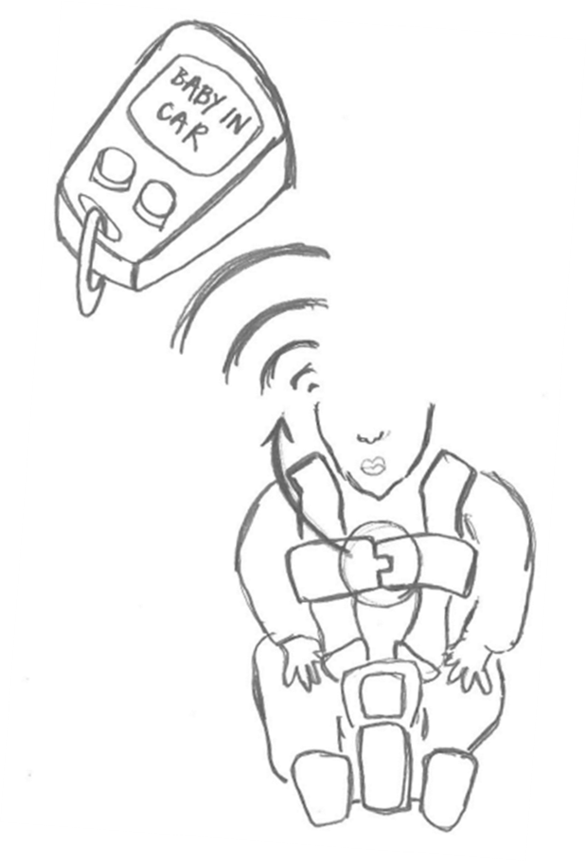
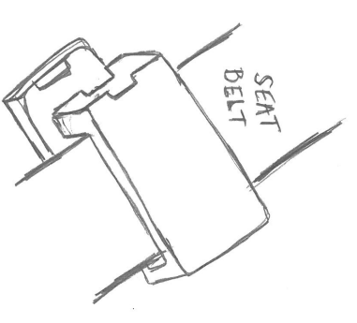
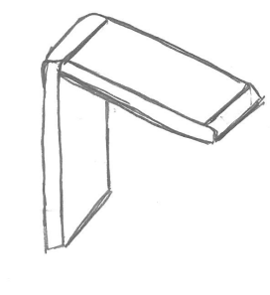
Final Design Drawlings
Matthew Zawiski

Slide 22
Bill of Materials
Category | Part | Part # | Part Description | Quanity | Units | Cost ($) / Unit | Tax ($) | Shipping Cost ($) | Total Cost ($)
Electronics
 | Arduino UNO REV3 Board | 1 | Microcontroller board | 1 | 2 | 22.00 | 2.64 | 8.50 | 55.14
 | Electronic Component Pack | 2 | Includes resistors, LEDs, buttons,potentiometer | 250 | 1 | 6.86 | 0.41 | 9.98 | 17.25
 | Wires Ribbon Cables Kit for Arduino | 3 | Includes 40 male-female, 40 male-male, 40 female-female | 120 | 1 | 6.98 | 0.42 | 9.98 | 17.38
 | Arduino speaker | 4 | Mini speaker to give off alert sound | 2 | 1 | 8.98 | 0.54 | 9.98 | 19.50
 | Mini Bread Borad | 5 | 170-Point mini bread board to create portable circuits | 2 | 1 | 2.55 | 0.15 | 8.50 | 11.20
 | LCD Display | 6 | Transmissive LCD Character Display to display messages | 1 | 4 | 8.10 | 1.94 | 8.50 | 42.84
 | ECR2032 Battery | 7 | Small battery used for power source | 10 | 1 | 4.60 | 0.28 | 9.98 | 14.86
 | Battery Holder | 8 | 2 terminal battery holder for ECR2032 batteries | 1 | 1 | 5.89 | 0.35 | 9.98 | 16.22
 | Receiver | 9 | 433 MHz reciever, located in the key fob, receives signal from the clip | 1 | 1 | 6.66 | 0.40 | 9.98 | 17.04
 | Transmitter | 10 | Located in the clip, sends a signal to key fob (Sold as kit with reciever) | 1 | 0 | 0.00 | 0.00 | 0.00 | 0.00
 | Power Switch | 11 | Switch to turn device on, off, or put in sleep mode | 10 | 1 | 4.17 | 0.25 | 9.98 | 14.40
Casing
 | 3-D Print Filament | 12 | PLA 3D Printer Filliment - Blue used to 3D print the housing of both devices | 1 | 1 | 19.99 | 1.20 | 9.98 | 31.17
 | Screws | 13 | Screws to keep casings for both devices together | 1100 | 1 | 4.99 | 0.30 | 9.98 | 15.27
 | Key Ring | 14 | Keeps the key fob connected to keychains | 50 | 1 | 3.95 | 0.24 | 9.98 | 14.17
Sensors
 | Reed Magnetic Switch | 15 | Magnetic switch used to determine when clip is connected | 1 | 1 | 0.79 | 0.05 | 7.99 | 8.83
 | Thermistors | 16 | NTC Thermistor Temperature Sensor Module for Arduino to measure temperature | 1 | 1 | 1.87 | 0.11 | 0 | 1.98
Total Cost ($) : | 297.25
Matthew Zawiski

Slide 23
Bill of Materials cont.
Category | Part | Part #
Electronics
 | Arduino UNO REV3 Board | 1
 | Electronic Component Pack | 2
 | Wires Ribbon Cables Kit for Arduino | 3
 | Arduino speaker | 4
 | Mini Bread Borad | 5
 | LCD Display | 6
 | ECR2032 Battery | 7
 | Battery Holder | 8
 | Receiver | 9
 | Transmitter | 10
 | Power Switch | 11
Casing
 | 3-D Print Filament | 12
 | Screws | 13
 | Key Ring | 14
Sensors
 | Reed Magnetic Switch | 15
 | Thermistors | 16
Purchased | Shipped | Received
No | No | No
No | No | No
No | No | No
No | No | No
No | No | No
No | No | No
No | No | No
No | No | No
No | No | No
No | No | No
No | No | No
Yes | Yes | Yes
No | No | No
No | No | No
No | No | No
No | No | No
Project Composition: 40% Ordering/Receiving Parts 60% Assembling the Device
Yes = 1, No = 0
Currently 2.35 % of the project is completed
Amount of Category Completed (%) | 5.882 | 5.882 | 5.882
Weight of Importance (%) | 15 | 5 | 20
Total Amount of Project Completed (%) | 2.353
Matthew Zawiski

Slide 24
Future Work
Risk Assessment
Poster (Summary of Project)
Ordering Parts
Purchase all parts by end of semester for them to arrive on time
Prototype & Building
Coding
Assembly
Testing
David Miller

Slide 25
References
Geggel, L. (2018, May 24). How Long Does It Take a Parked Car to Reach Deadly Hot
Temperatuers? Retrieved from Live Science: https://www.livescience.com/62651-how-hot-cars-get.html
Inc., E. (2018). eClip: Helping to pervent babies from being left in cars. Retrieved from Kickstarter:
https://www.kickstarter.com/projects/1745478023/eclip-helping-to-prevent-babies-from-being-left-in
Jon. (2018). How hot can the interior of a car get - and how quickly? Retrieved from Heat Kills:
http://heatkills.org/how-hot/
Notes:
Not this slide will advance on default after 2 seconds. If you would like to change this then go to the transition tab and under timing change the advance slide settings.

Slide 26
Questions?

Slide 27
Backup Sildes
Supporting Slides to the content above.

Slide 29
Standard Shapes
Summary Box
Text box 1
Outlined Text Box

Slide 30
Approved Logos

Slide 31
Color Palette

Slide 32
APA Tables
Category 1 | Category 2 | Category 3 | Category 4 | Category 5
Item 1
Item 2
Item 3
Item 4
 | Category 2 |  |  | Category 3
Category 1 | subcategory 1 | subcategory 2 |  | subcategory 1 | subcategory 2
Item 1
Item 2
Item 3
Item 4

