Slide 1
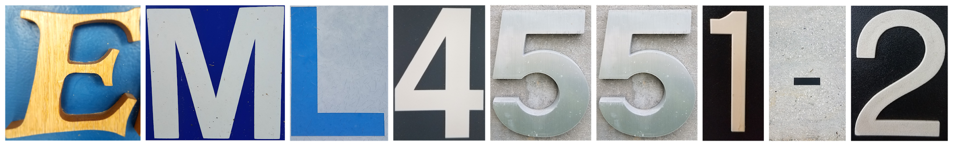
VDR 1
The Detector Baby
Team 511
Karli Cash, Matthew Zawiski, Shadi Bilal, David Miller
2-Oct-18

Slide 2
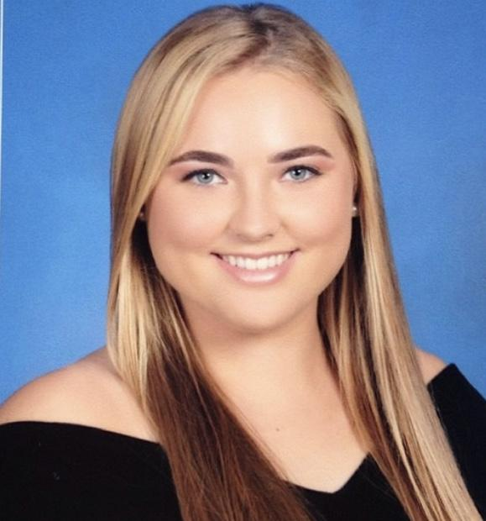
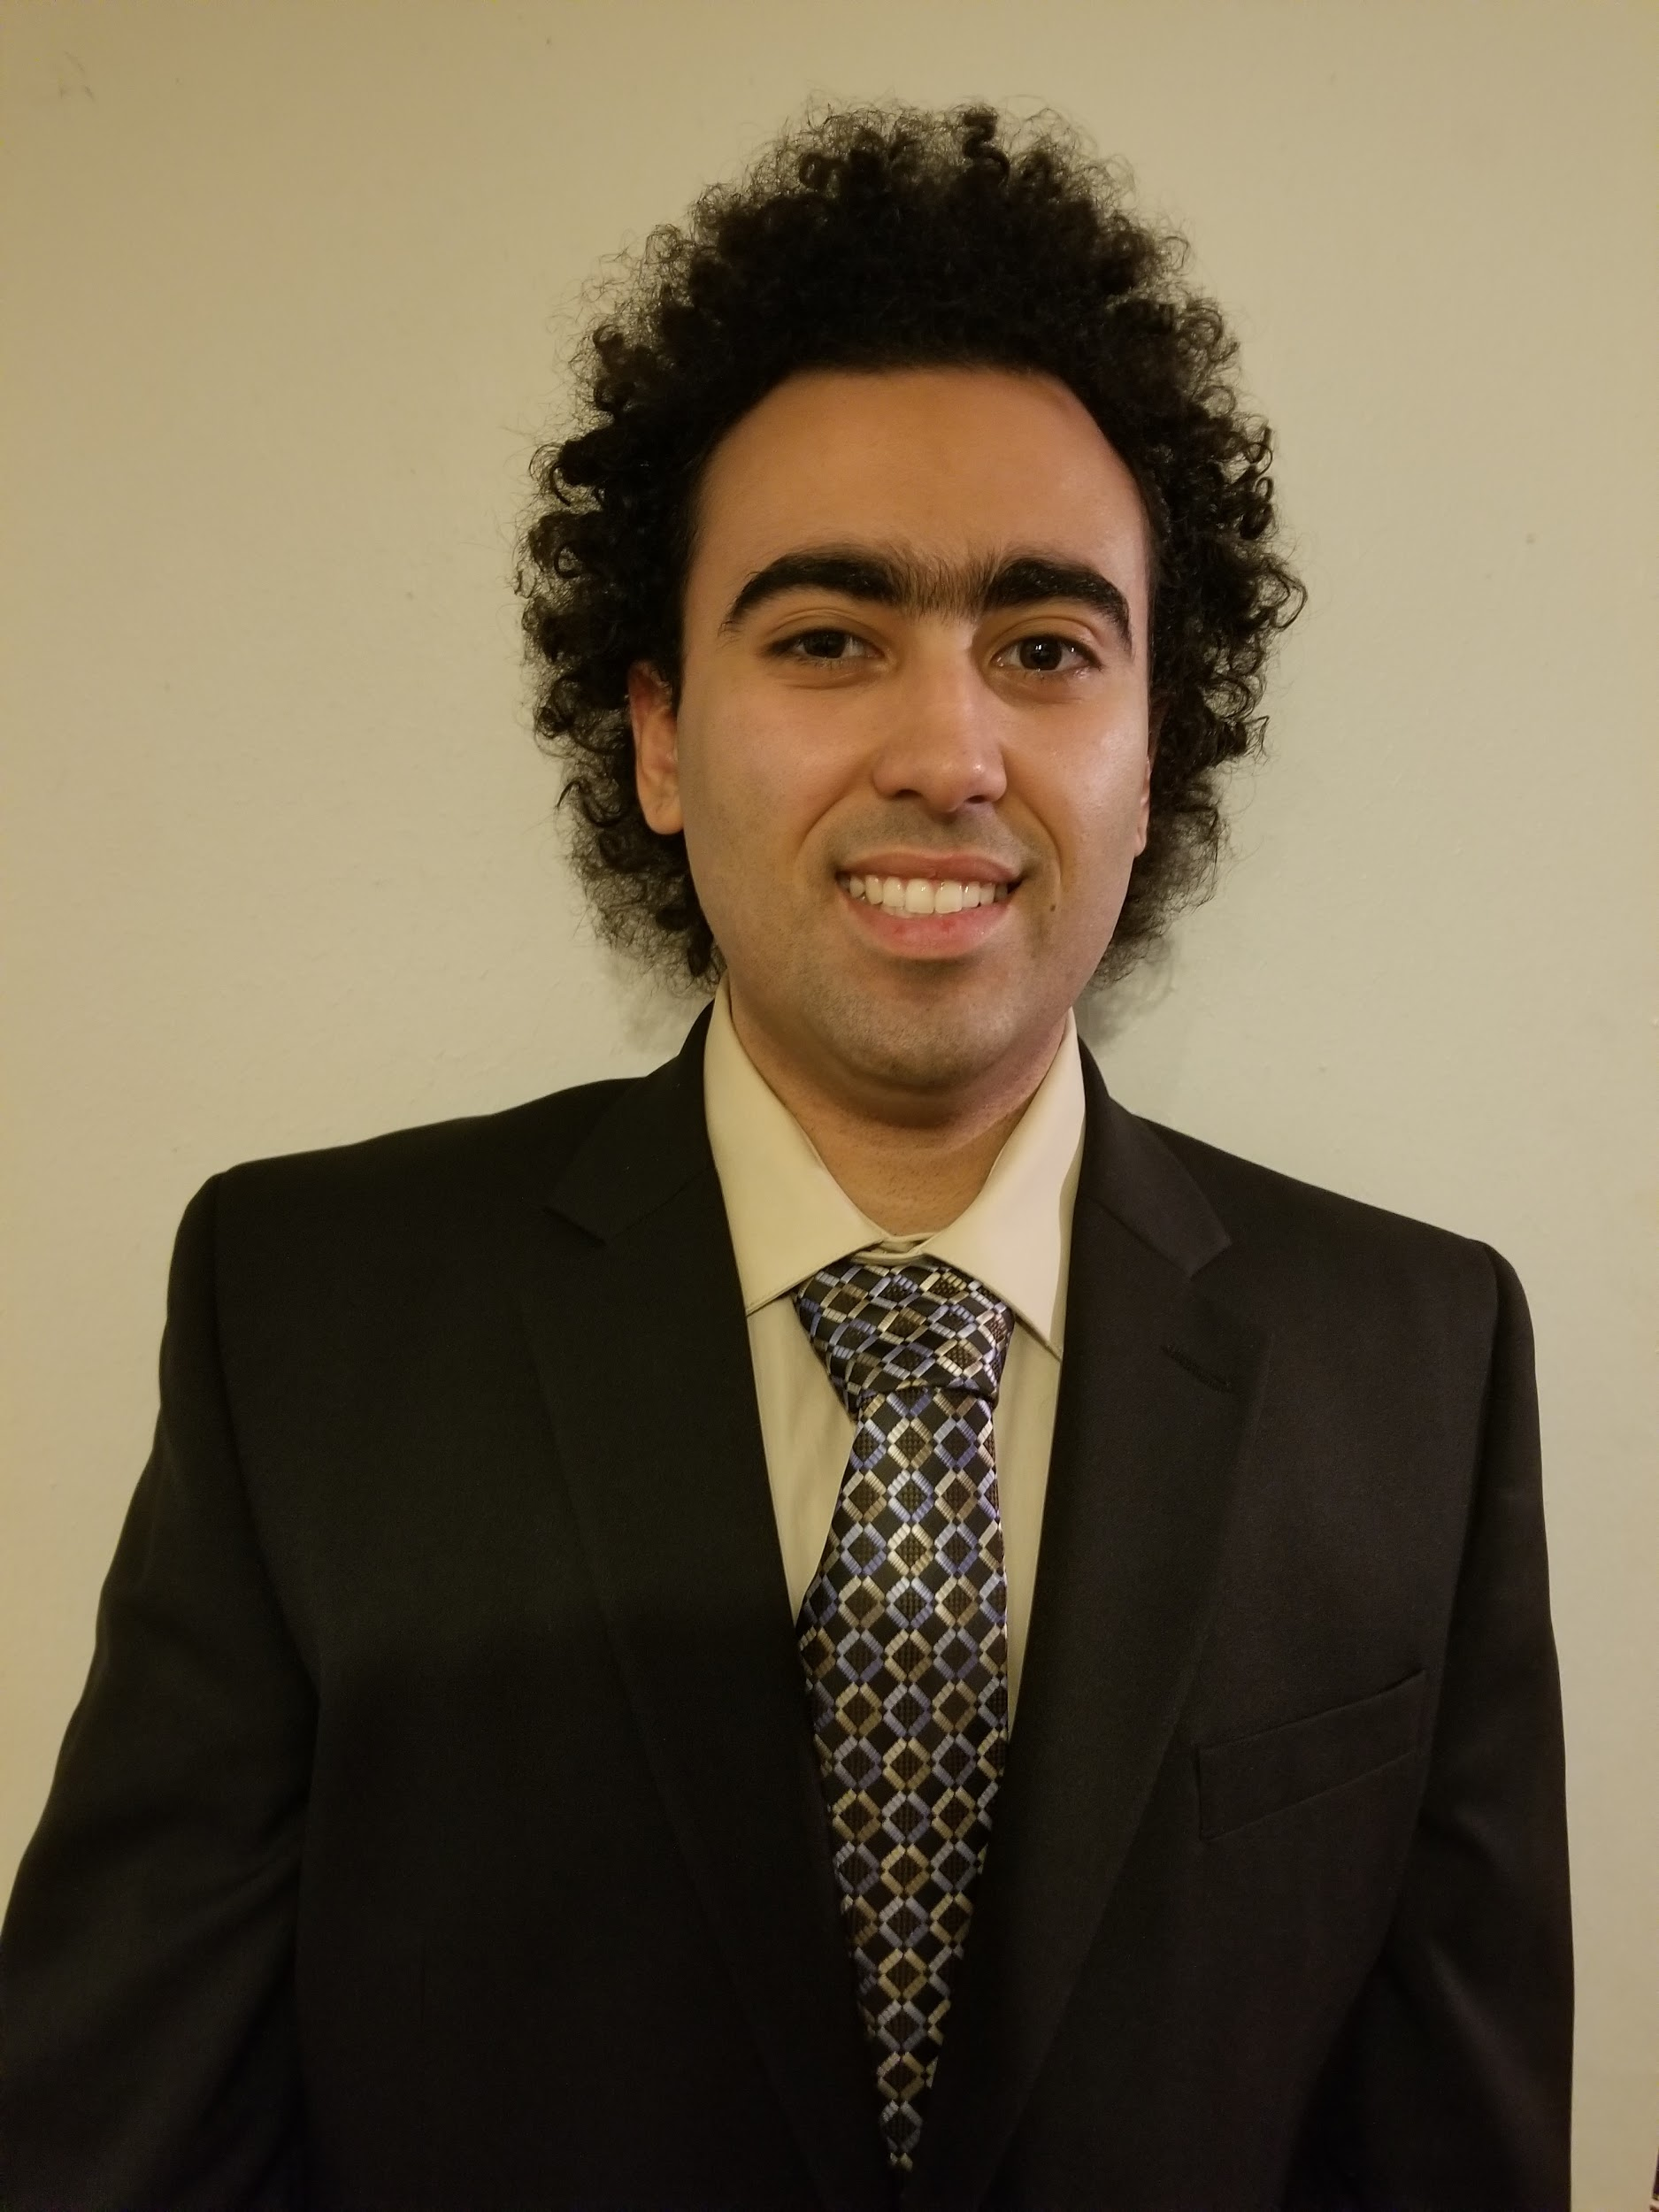
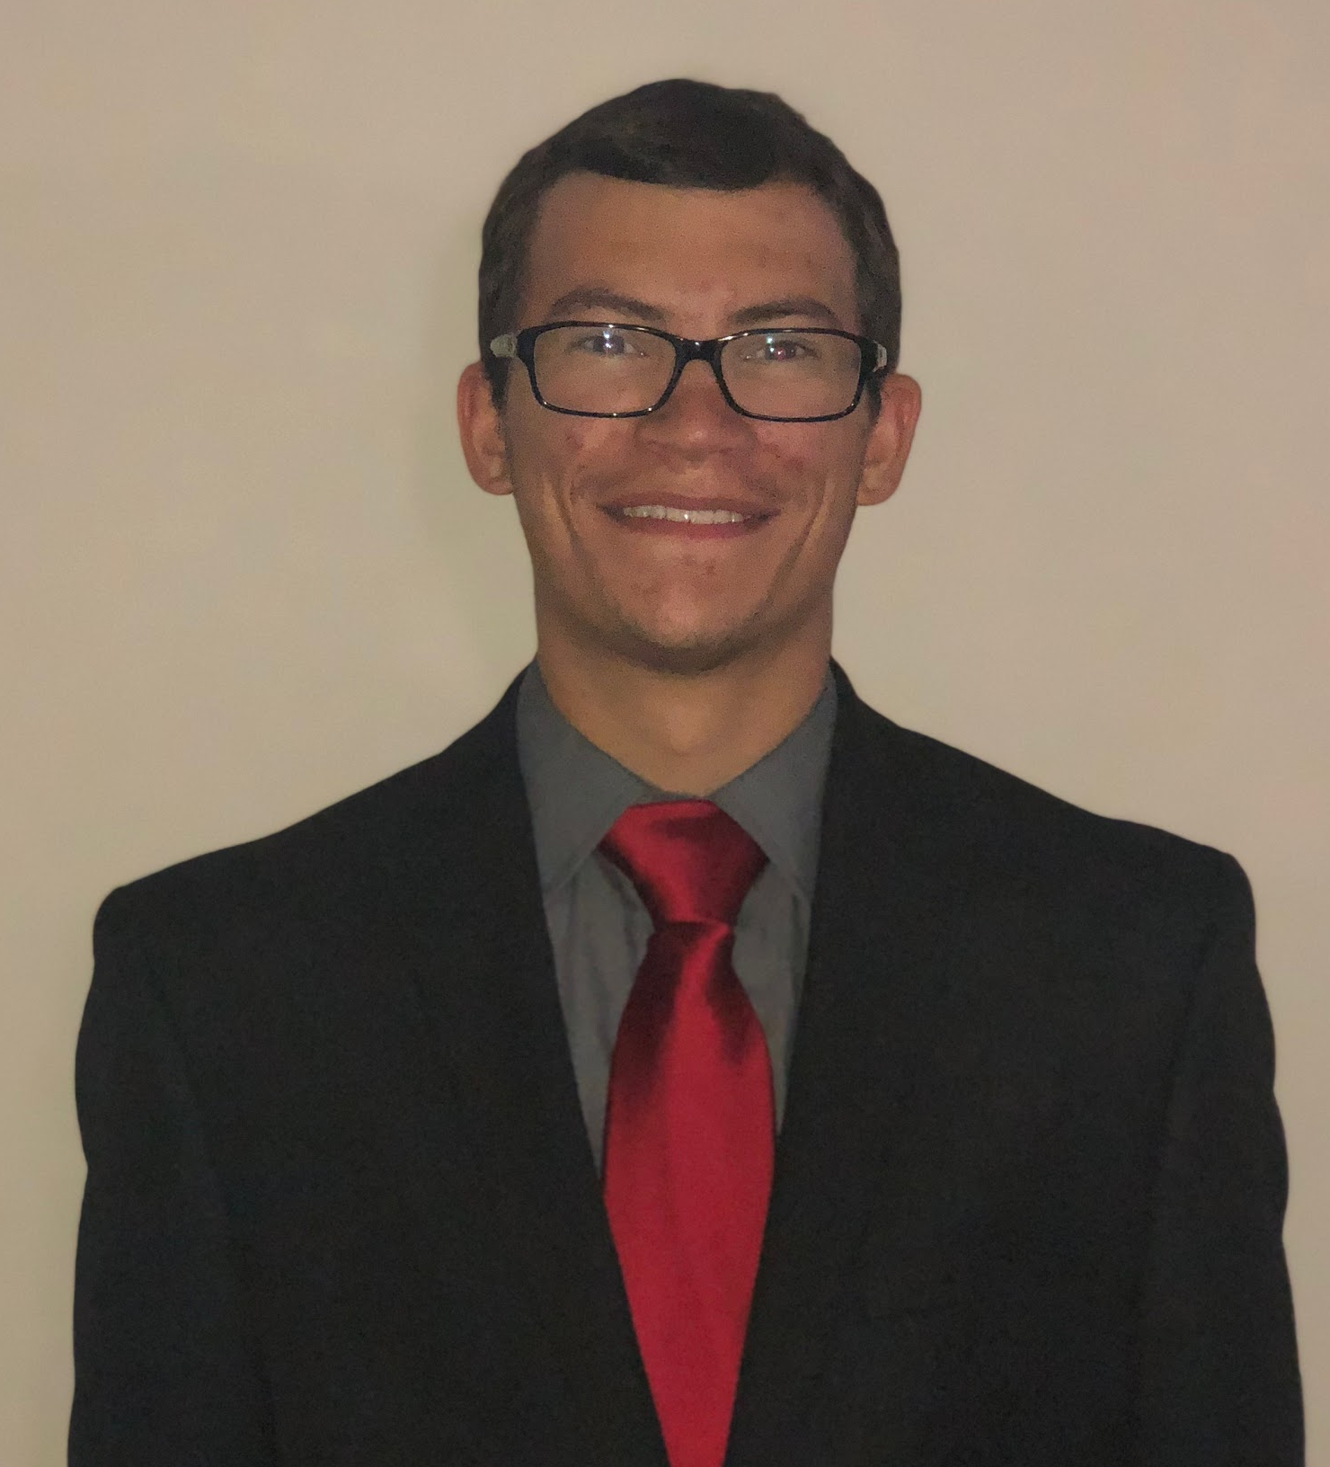
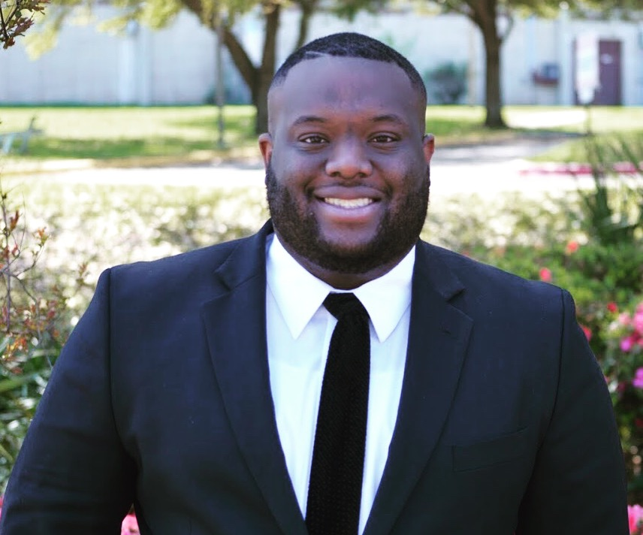
Team Introductions
Karli Cash
Team Leader
Shadi Bilal
Experiential Strategist
Matthew Zawiski
Software Engineer
David Miller
Financial Manager

Slide 3
Overview
Project Brief/Background
Project Scope
Customer Background
Customer Needs
Functional Decomposition
Future Work
Karli Cash

Slide 4
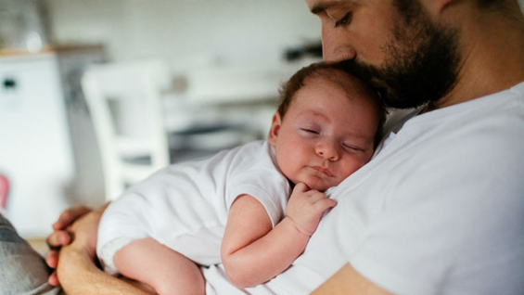
Project Brief
Project Objective: Design a device that parents/caregivers can use to prevent the death of infants who are left behind
in cars
Karli Cash

Slide 5
Background
Problem: High infant fatalities rates due to being left behind in cars.
According to the Safety Organization of Kids and Cars, an average of 37 kids die each year in hot cars (Willingham, 2018).
Children’s body temperatures rise 3-5 times faster than adults (Willingham, 2018).
Karli Cash

Slide 6
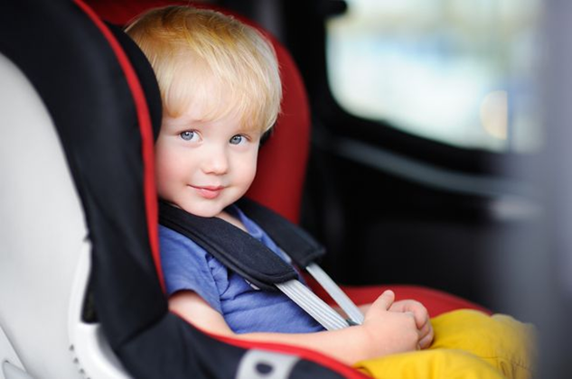
Device Features
Create a device that prevents fatalities of infants who are left behind in passenger vehicles
Alert parents when conditions inside a car become life threatening
If no action is taken device will alert Emergency Personal
Karli Cash

Slide 7
Key Goals
Reduce the number of infant fatalities caused by overheating in vehicles
Accurate detection system
Fits into virtually any car seat
Effectively alert users and authorities when child’s life is in danger
Construct a durable device that has the ability to operate in critical temperature conditions
Design an affordable product that can be dispersed to retailers
Karli Cash

Slide 8
System Breakdown
Yes
No Action Required
Yes
Alert User
Is Temperature Suitable?
Yes
No Action Required
Car Seat Sensor
Passenger Present?
No
Alert User
Any Response?
No Action Required
No
Alert Emergency Personnel
No
Karli Cash

Slide 9
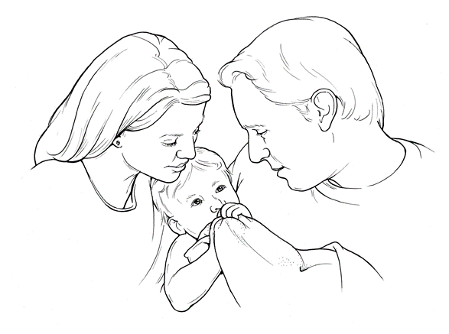
Markets
Primary
  Parents
  Legal Guardians
  Caregivers
  Pet Owners
Secondary
  Baby Product manufacturers and retailers
  Car Manufactures
Karli Cash

Slide 10

Assumptions
Parents will be in possession of secondary device
Emergency personnel will respond to secondary alert
Karli Cash

Slide 11
Stakeholders
Innovative Logistics
  Sponsor: Lisa Allen-Wallace
FAMU-FSU College of Engineering
Shayne McConomy, Ph.D
Shadi Bilal

Slide 12
Customer Need Statement
Innovative Logistics wants to market a device that will decrease fatalities resulting from children being left behind in cars.
Uses two components:
  One located in the car evaluating the environment
  Another carried by the user to alert of passenger detection and life-threatening conditions.
Alert 911 emergency personal providing GPS location and conditions in the vehicle if child is neglected.
Shadi Bilal

Slide 13
Customer Needs Questionnaire
Question/Comment | Customers Statement | Interpreted Need
What is your ultimate goal for this product? | To create a portable product that will detect infants in vehicles, which will be sold in stores. This will lead to a decrease in infant fatalities. | Portable device, offered to retailers for public use
How would you want the parent to be alerted? | The parent should be alerted through a small device carried on a keychain and possibly synced with the parent’s phone. | Develop a product similar to a key fob, integrated with a phone app
Where would you like the device to be located? | The device must be located inside or on the child's car seat | Located on, inside or underneath the child’s car seat
Shadi Bilal

Slide 14
Customer Needs Questionnaire
Question/Comment | Customers Statement | Interpreted Need
What is your ultimate goal for this product? | To create a portable product that will detect infants in vehicles, which will be sold in stores. This will lead to a decrease in infant fatalities. | Portable device, offered to retailers for public use
How would you want the parent to be alerted? | The parent should be alerted through a small device carried on a keychain and possibly synced with the parent’s phone. | Develop a product similar to a key fob, integrated with a phone app
Where would you like the device to be located? | The device must be located inside or on the child's car seat | Located on, inside or underneath the child’s car seat
Shadi Bilal

Slide 15
Customer Needs Questionnaire
Question/Comment | Customers Statement | Interpreted Need
What is the budget for the project? | The budget is from $500 to $2500. | Design around the provided budget
Do you want the device to work based on a time period? | The device should operate based on the temperature and weight of baby, but it should also allow a certain time period for the parent to leave their child while doing everyday activities such as pumping gas or running into the grocery store. | Temperature evaluation based on passenger weight, as well as a timing mechanism
Are you interested in extending the product beyond the safety of infants? | If possible, I would like the device to be developed to help the physically disabled, people with Alzheimer’s, pets, etc. | Determine if the product can aid others in similar situations
Shadi Bilal

Slide 16
Customer Needs Questionnaire
Question/Comment | Customers Statement | Interpreted Need
Are there any extra features you would like to add to the device? | Baby on board sign that can alert others passing that a child was left in the car. This signal would also be used in car accidents to inform rescue teams that a baby was once in the car in case they have been ejected. | Create an extended warning device that can alert people and rescue teams if a baby is in danger.
Would you be open to configuring the device to a different form such as a toy or bracelet? | Yes, if the device can still operate properly that would be a great idea to come up with something that can entertain the baby and check their vitals. | Open to changing the form of the device
Do you want the device to only alert the parents/user? | At first the device should alert the parents, but if no action is taken after a certain time, the police, paramedics, and fire departments should be alerted. | Contact emergency personnel when conditions become critical and no action has been taken.
Shadi Bilal

Slide 17
Functional Decomposition
Car Seat Device/Portable Device
Detection
Response
Feedback
Shadi Bilal

Slide 18
Detection
Detection
Operate in Distance Range
React to Temperature Ranges
Determine Passenger Presence
Shadi Bilal

Slide 19
Response
Response
Signal Parent
Signal Emergency Personnel
Shadi Bilal

Slide 20
Feedback
Feedback
Power On/Off
Timer Implementation
Present Passenger Vitals
Display Temperature Ranges
Shadi Bilal

Slide 21
Major vs. Minor Functions
 | Response | Detection | Feedback
Signal Parents/Emergency Personnel | x
Operate in Distance Range |  | x
React to Temperature Range |  | x
Determine Passenger Presence |  | x
Temperature Detection |  | x
Power On/Off |  |  | x
Timer Implementation |  |  | x
Present Passenger Vitals |  |  | x
Shadi Bilal

Slide 22

Future Work
Targets
  Determine operational range
  Suitable temperature ranges
  Determine method of communication between device and user
Concept Generation
  Team members will all brainstorm
Concept Selection
Shadi Bilal

Slide 23
References
Willingham AJ. (2018) More than 36 kids die in hot cars every year and July is usually the deadliest month. CNN. Retrived from https://www.cnn.com/2018/07/03/health/hot-car-deaths-child-charts-graphs-trnd/index.html.
.
Notes:
Not this slide will advance on default after 2 seconds. If you would like to change this then go to the transition tab and under timing change the advance slide settings.

Slide 24
Questions?

Slide 25
Backup Sildes
Supporting Slides to the content above.

