Slide 1
Tree Limbing and Harvesting ROV
Team 15 Presenters:
Chris Ruiz, Nestor Rigaud, Donald Phillips

Slide 2
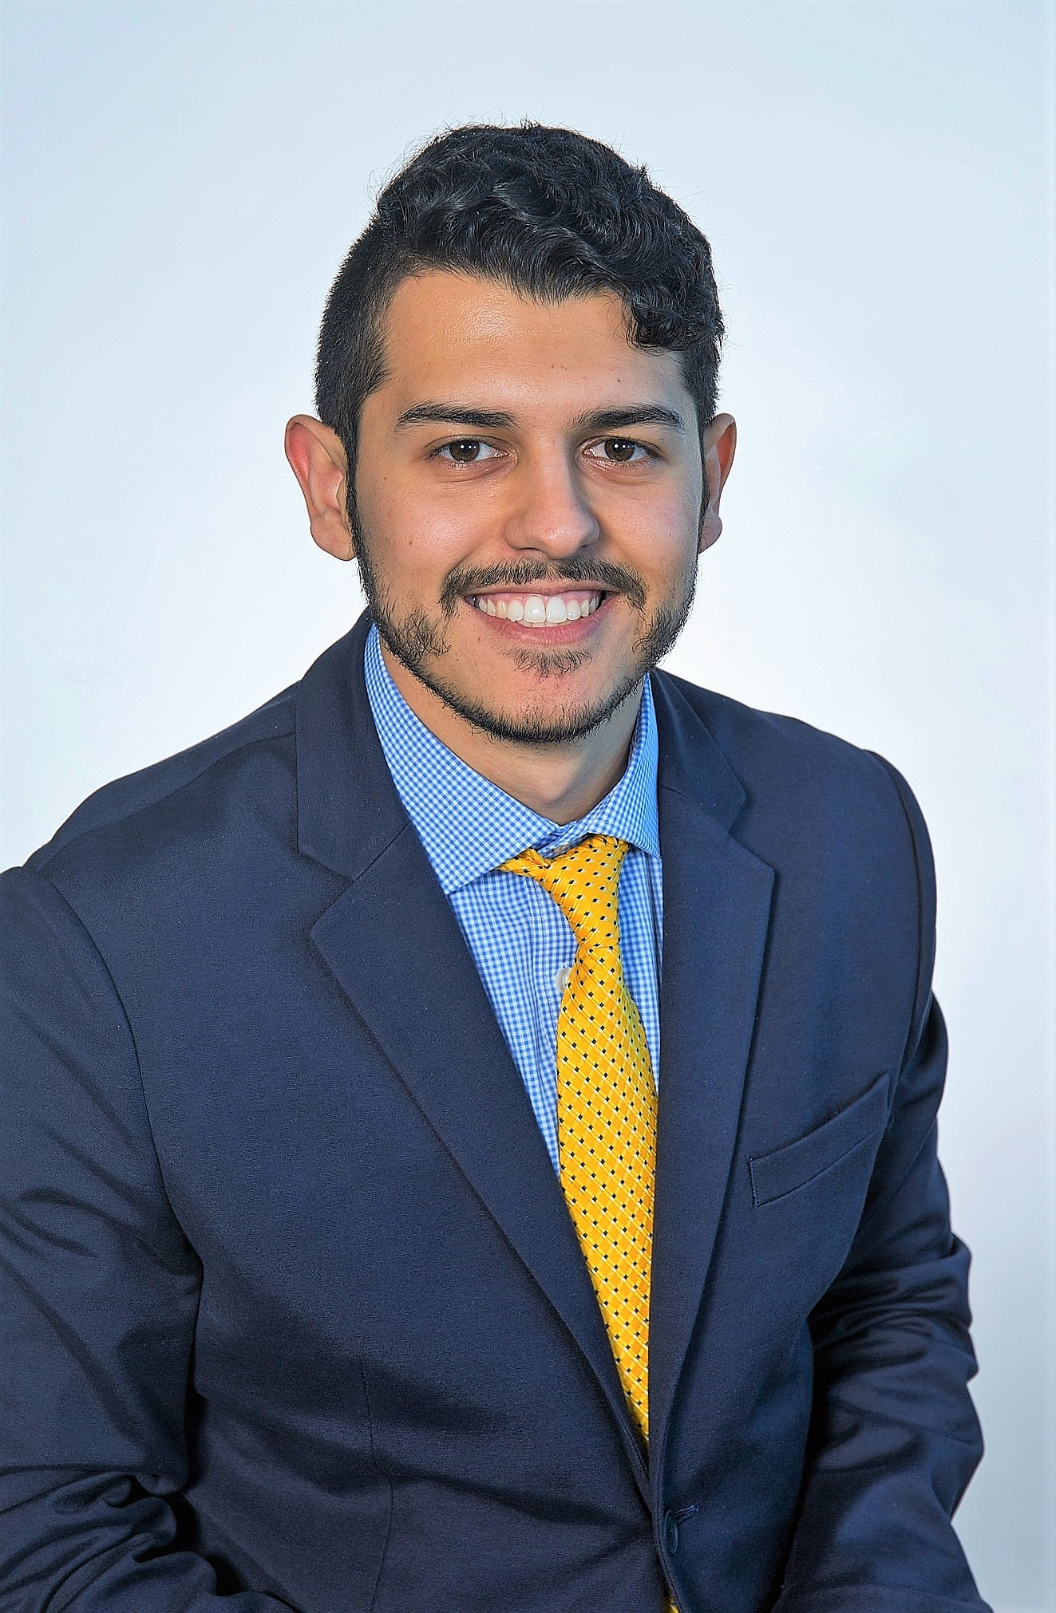
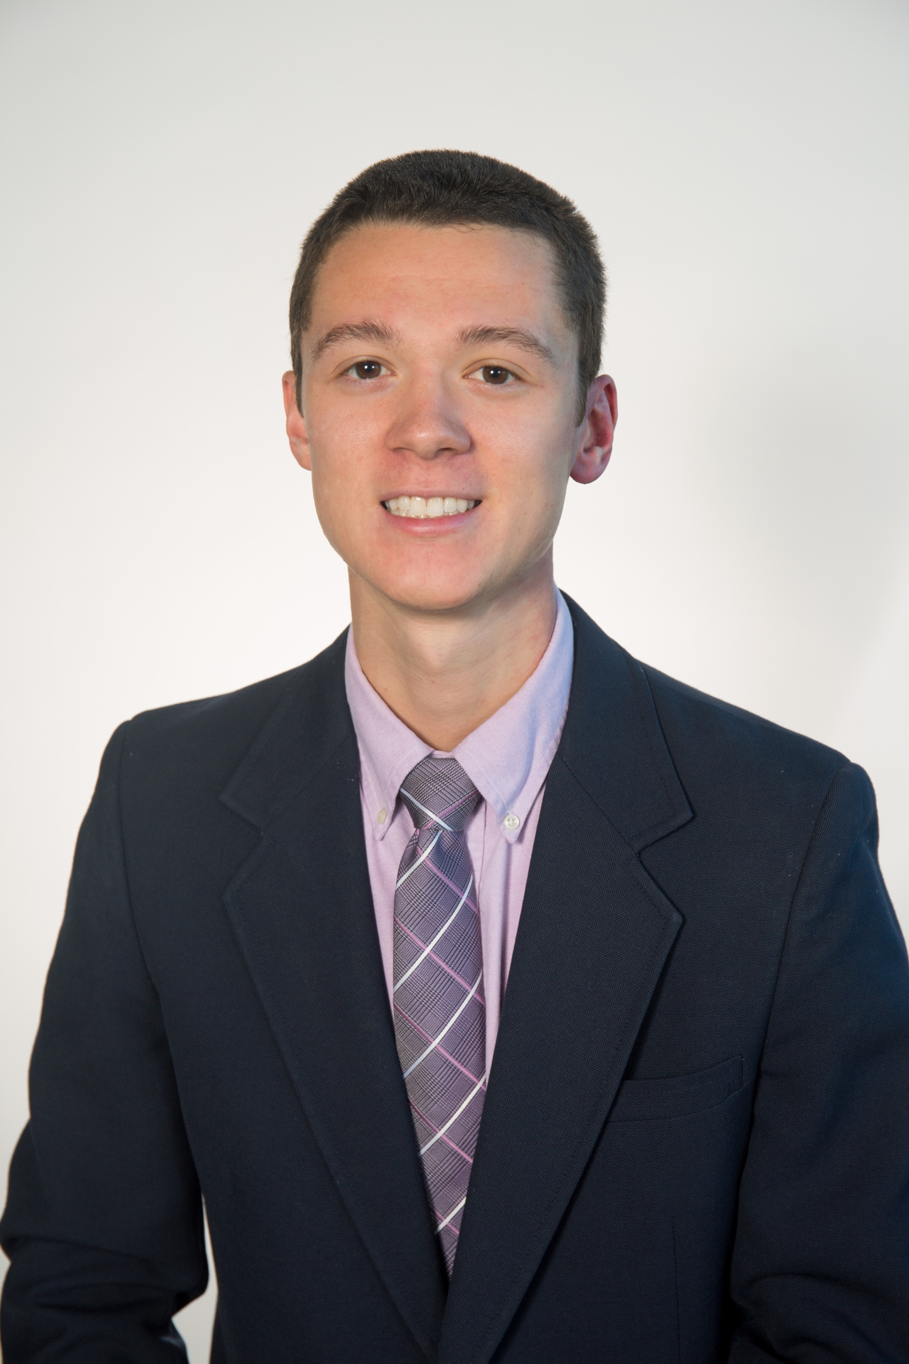
Team Introductions
Nestor Rigaud
ME DESIGN
Christopher Ruiz
TEAM LEADER
Donald Phillips
FINANCIAL ADVISOR
Alex Glazer
ME PROGRAMMING
Ryan Gaylord
LEAD
COMMUNICATIONS

Slide 3
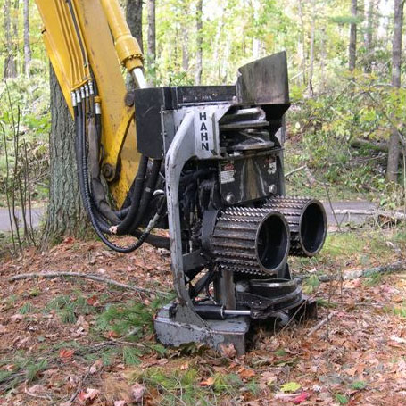
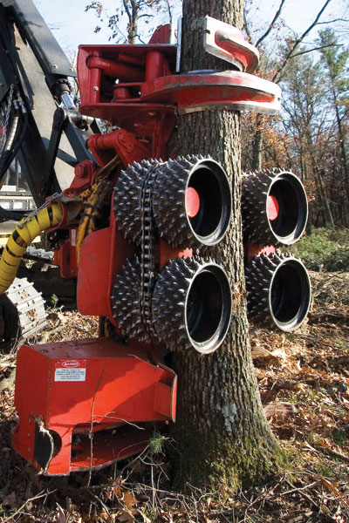
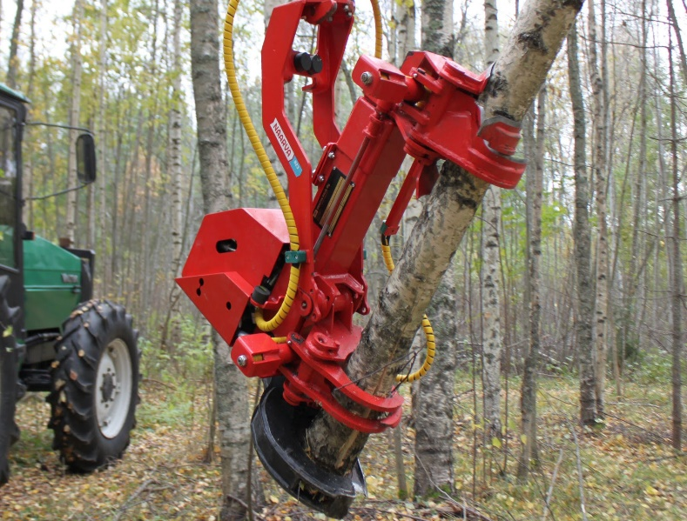
Recap
Project Scope
A Remotely Operated Vehicle or (ROV) modeled after a Total Tree Harvester head
As the ROV climbs, it will de-limb the tree
Chris Ruiz

Slide 4
Concept Selection
Based off the Naarva S23 stroke harvester
Bear hug clamping method
Hydraulic clamping system
Two clamps connected by a prismatic joint to climb the tree
A shearing blade de-limbs by the hydraulic prismatic joint
Chris Ruiz

Slide 5
Key Targets
Force to Shear Limbs | 2586 lbf
Weight | 100 lb
Opening Width of Clamps | 6-20 in
Min. Clamp Force to Climb | 100 lbf
Min. Clamp Force to Shear | 2686 lbf
Limb Diameter | 1-4 in
Chris Ruiz

Slide 6
Scaled Down Targets
Force to Shear Limbs | 1800 lbf
Weight | 70 lb
Opening Width of Clamps | 12-16 in
Min. Clamp Force to Climb | 100 lbf
Min. Clamp Force to Shear | 1900 lbf
Limb Diameter | 1-2 in
Chris Ruiz

Slide 7
ROV
Prototype Components and Information

Slide 8
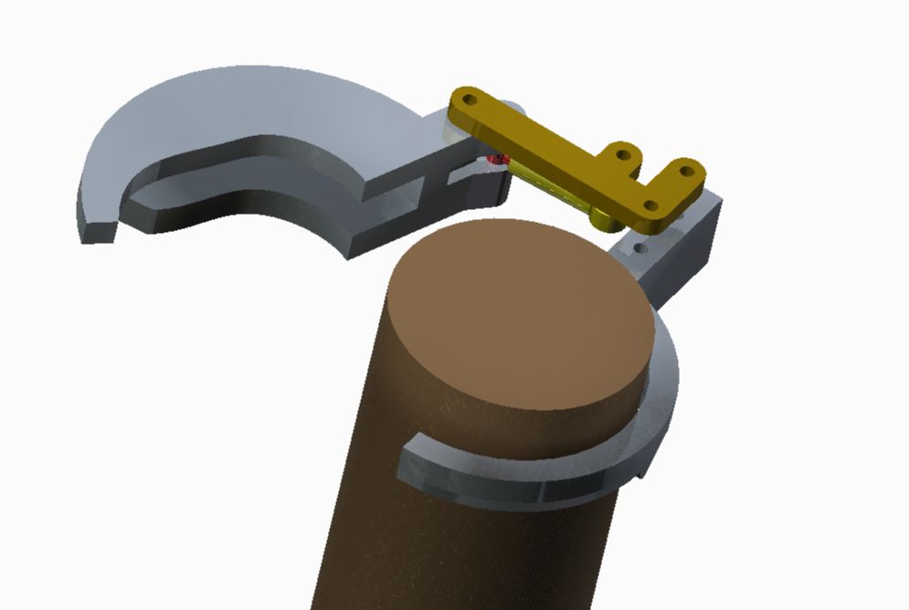
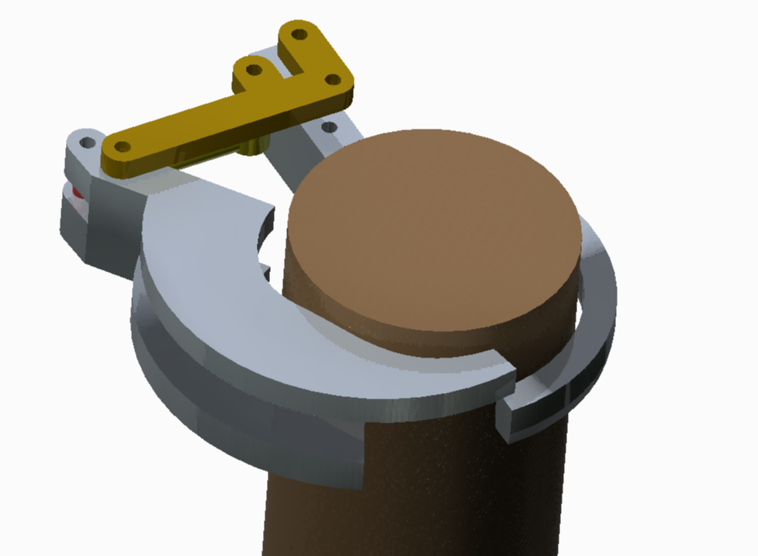
Clamping
Hydraulic cylinders for open and close clamps
One cylinder per clamp
One rigid arm per clamp
Nestor Rigaud

Slide 9
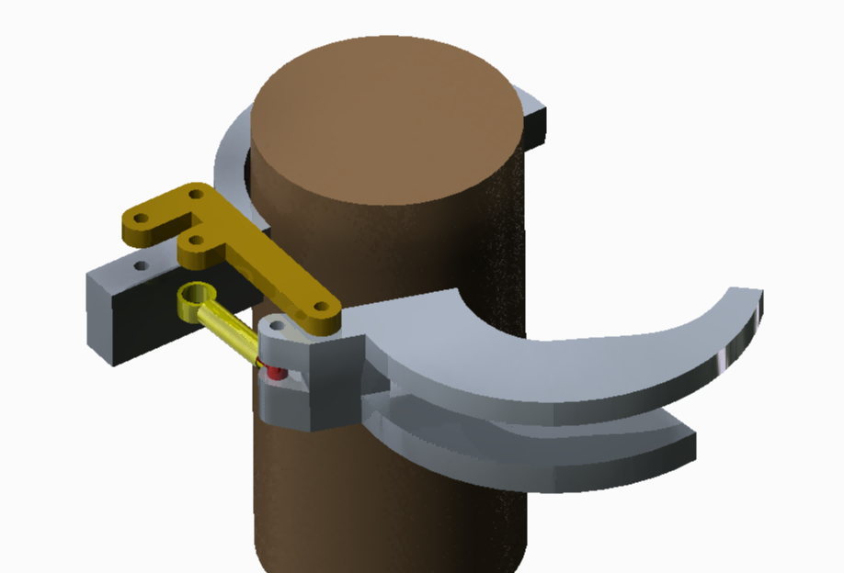
Clamping
Nestor Rigaud

Slide 10
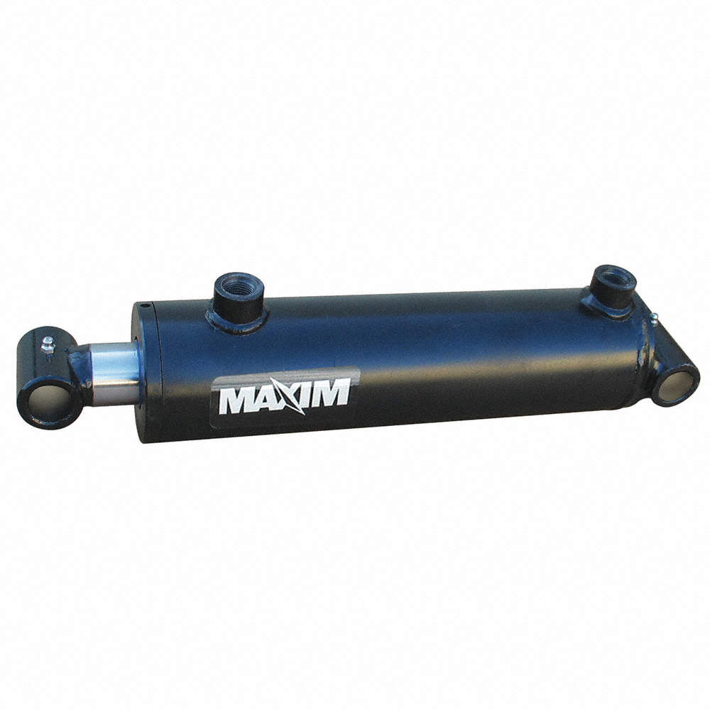
Climbing/Shearing
2 double acting welded hydraulic cylinders
Will require less psi to reach target force
Stroke: 6 in
Retract length: 14 in
Nestor Rigaud
Notes:
https://www.grainger.com/product/MAXIM-Double-Acting-Welded-Style-6FDD1?searchQuery=6fdd1&suggestConfigId=6

Slide 11
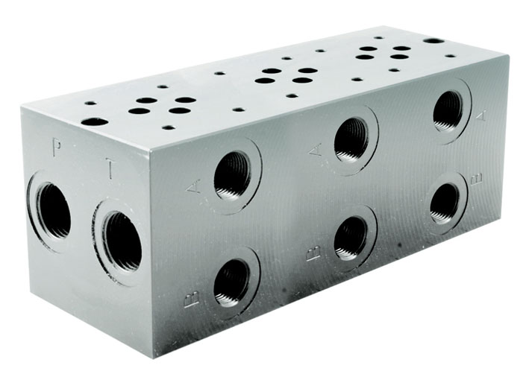
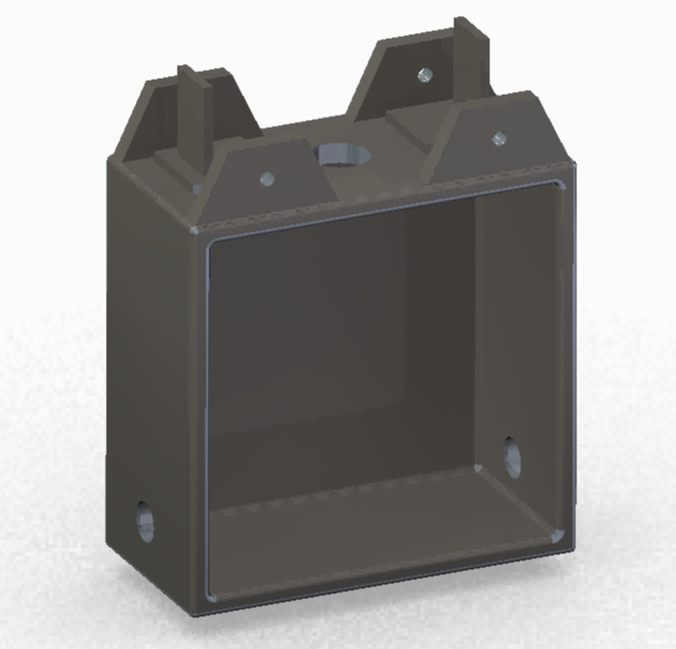
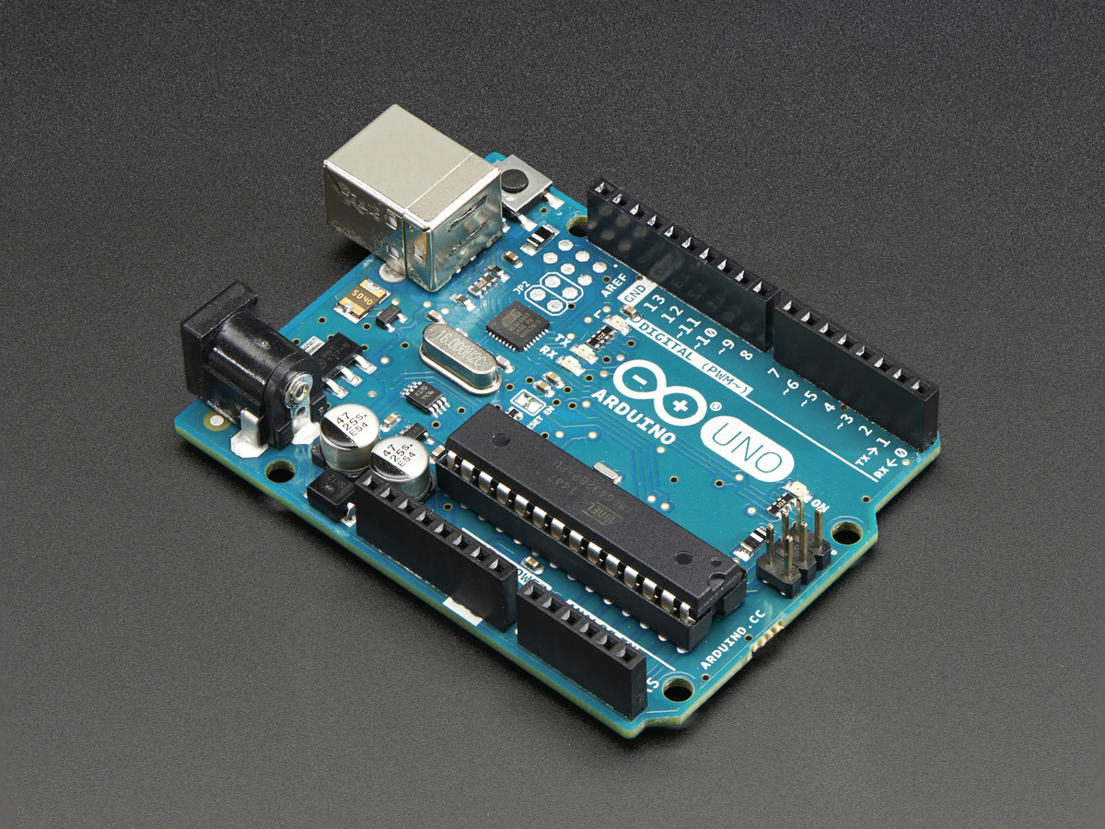
Body
A rectangular shell will be the storage location for all hydraulic and electronic systems
Manifold and valves
Circuit Board
Hose entrance and exit paths
Nestor Rigaud
Notes:
https://www.grainger.com/product/MAXIM-Double-Acting-Welded-Style-6FDD1?searchQuery=6fdd1&suggestConfigId=6

Slide 12
Hydraulic System
Open circuit system
Continuous flow to build pressure
Uses relief valve to control pressure (~2400 psi)
Manifold
3 position valves
double acting cylinders
Donald Phillips

Slide 13
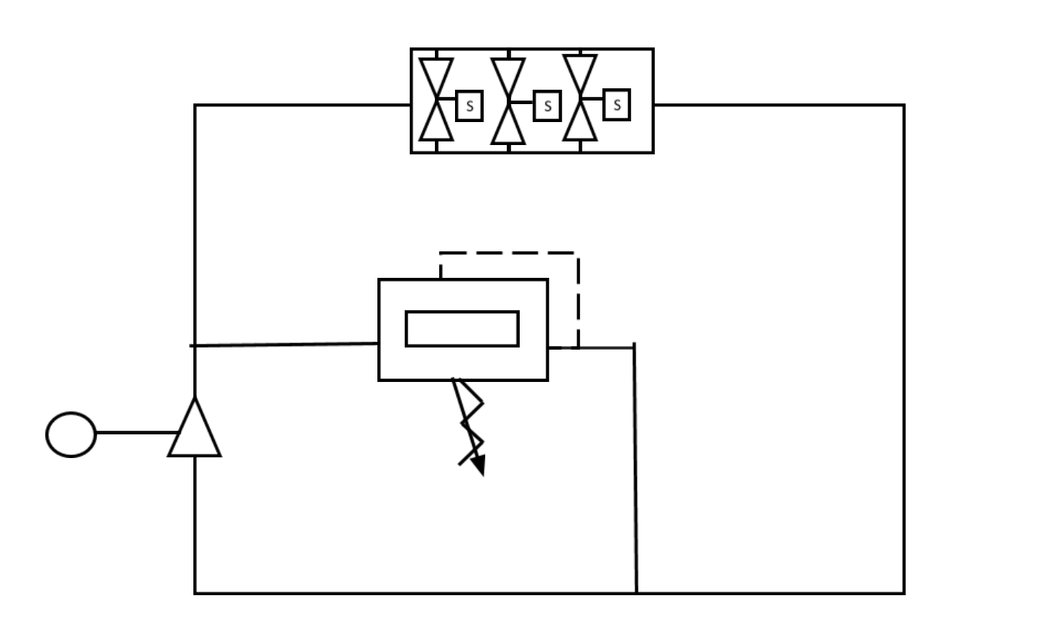
Hydraulic System
Manifold
Relief Valve
Motor
Pump
Reservoir
Donald Phillips

Slide 14
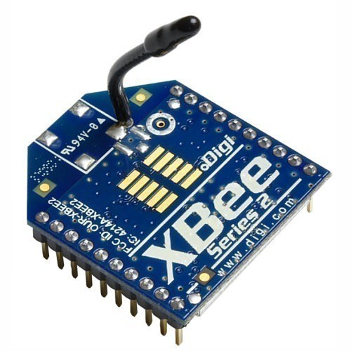
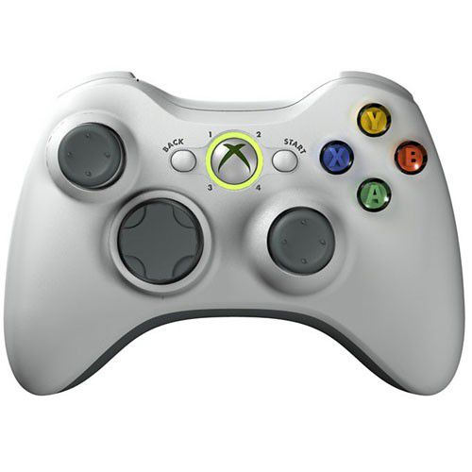
Electrical Controls System
Arduino
Coded in c
Used to control the ROV valves
Zigbee/xbee
Send the wireless signal
Gamepad
Used to input the action (move up, down, clamp, etc.)
Nestor Rigaud

Slide 15
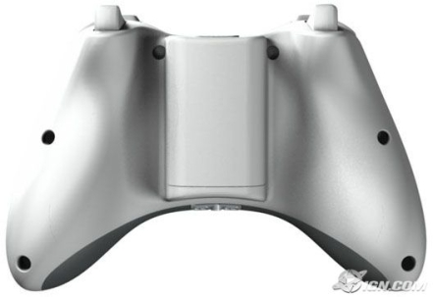
Controller action
Emergency shut down
Open clamps
Close clamps
Up/Down
Section off
Nestor Rigaud

Slide 16
Movement Pseudo Code
Open top clamp
Turn valve forward, cylinders move up
If state==‘up’
If time==cylinder expansion time
Close top clamp
Open bottom clamp
Reverse valve, Cylinders retract
If time==cylinder retraction time
Valve turn neutral
Close bottom clamp
State==idle
Nestor Rigaud

Slide 17
Potential Problems
Low flowing pump
Not have proper specs to pump at the recommended speed
Solenoid ports
Worn from previous usage
Different arrival dates from parts
One cylinder will be arriving mid march
Donald Phillips

Slide 18
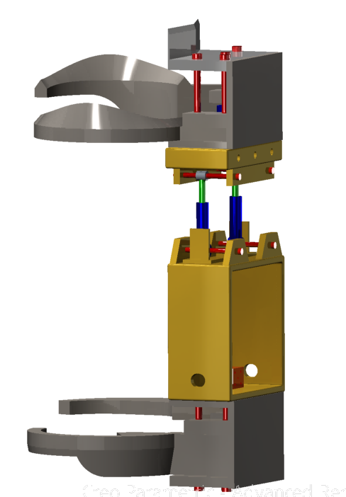
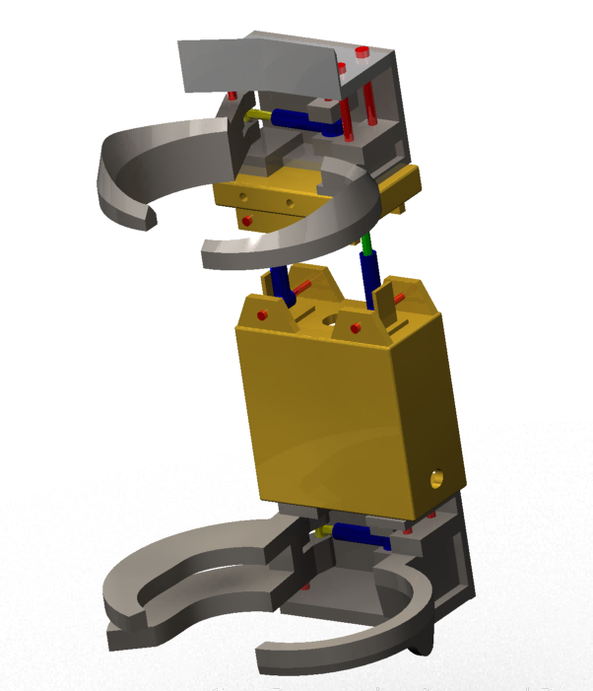
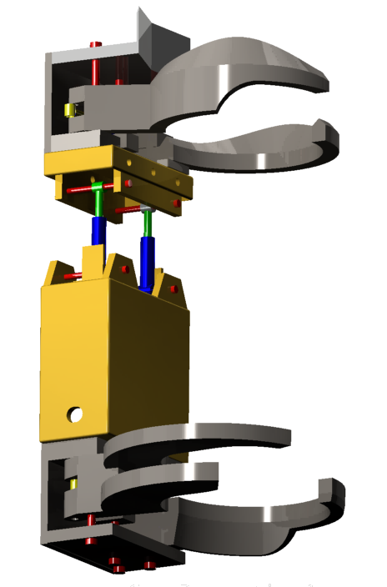
The Bear
Donald Phillips

Slide 19
Tree Harvesting ROV
The Next Step
Donald Phillips

Slide 20
The Next Step
Waiting for parts to ship
Cylinders, valves, hoses
Machining
Systems testing
Electronic
Hydraulic
Building prototype
Testing prototype
Risk assessment
Donald Phillips

Slide 21
References
[1] S. (n.d.). Naarva s23 Stroke Harvester. Retrieved November 08, 2017, from http://www.pentinpaja.fi/app/product/view/-/id/65/cat_id/10/set_language/en
[2] Loblolly Pine. (n.d.). Retrieved November 07, 2017, from http://www.wood-database.com/loblolly-pine/
[3] Pinus taeda. (n.d.). Retrieved November 07, 2017, from http://www.conifers.org/pi/Pinus_taeda.php

Slide 22
Tree Harvesting ROV
QUESTIONS?

Slide 23
Back-Up Slides
Question 1
Where will you be conducting control testing for the ROV?
Testing will be done at our sponsor’s engineering shop alongside an engineer he has delegated to assist us with the project.
[1]

Slide 24
Back-Up Slides
Question 2
Why scale down target values?
Since this class requires us to create a physical mechanism for our projects, a prototype with a smaller scale functionality will show that potential success can be achieved when considering the normal target values.

Slide 25
Back-Up Slides
Question 3
How much will all this cost? What is the Budget?
The estimated cost for buying all the parts was close to about $5,000. Fortunately our budget is virtually unlimited according to our sponsor but since his resources has allowed to us to obtain certain parts, We have only used about a third of the estimated cost.

