Slide 1
FAMU-FSU
BOOSTERS
James Beattie, Chris Bredberg, Kjell Gordon

Slide 2
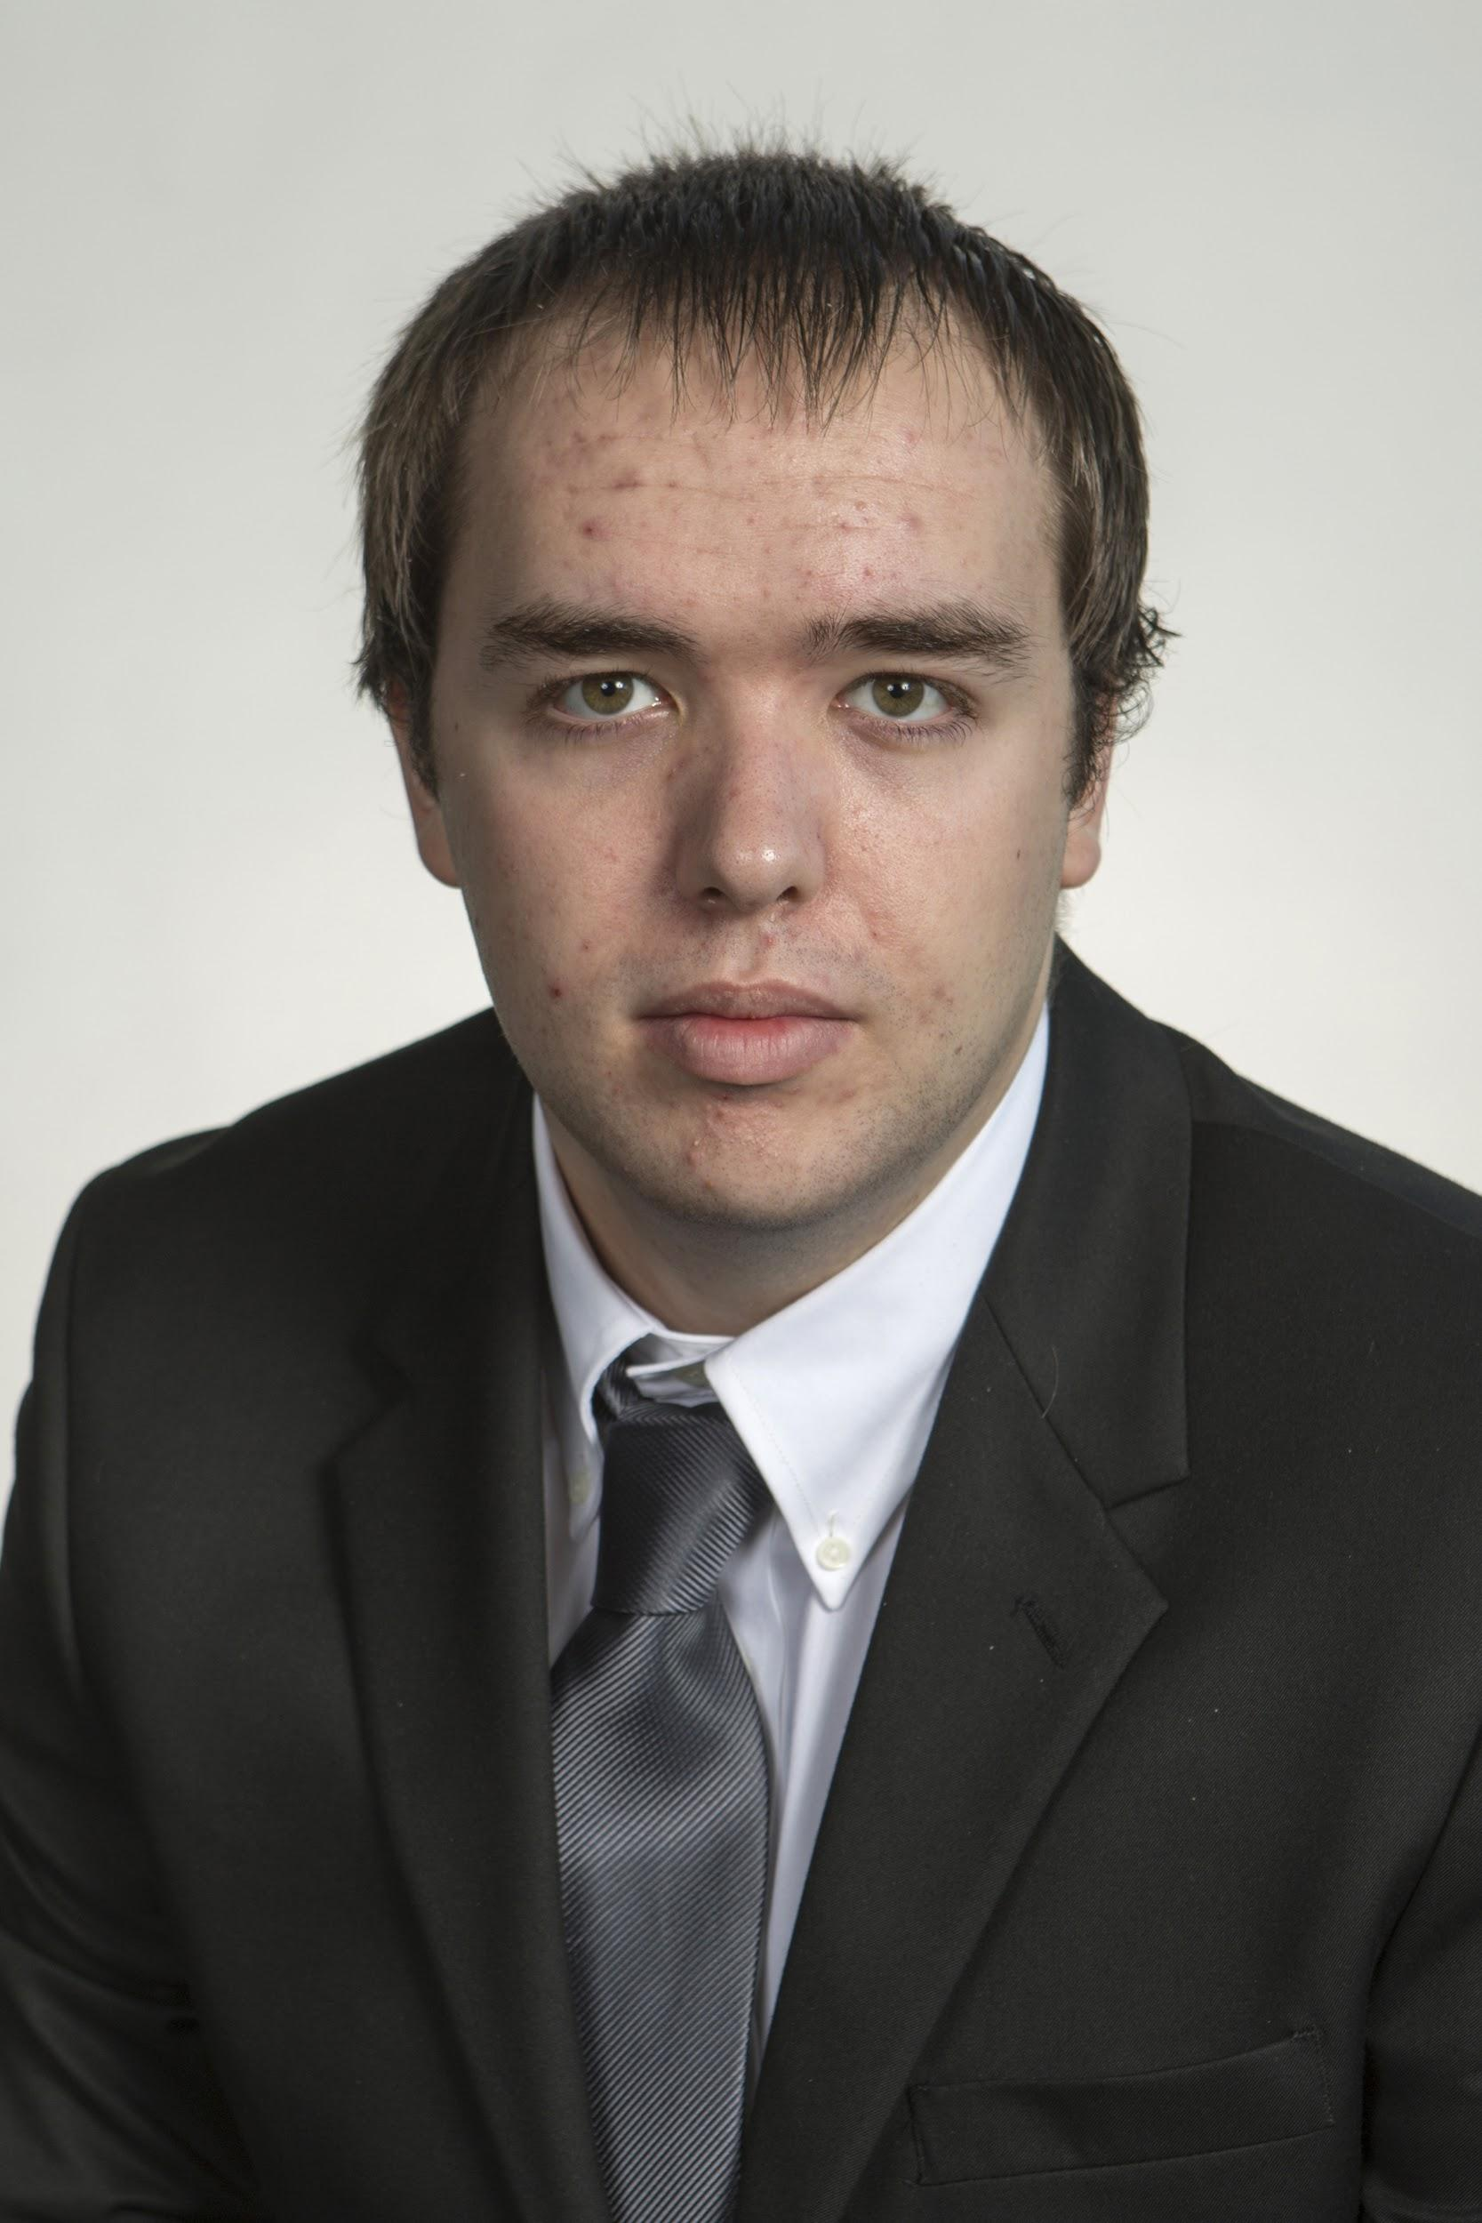
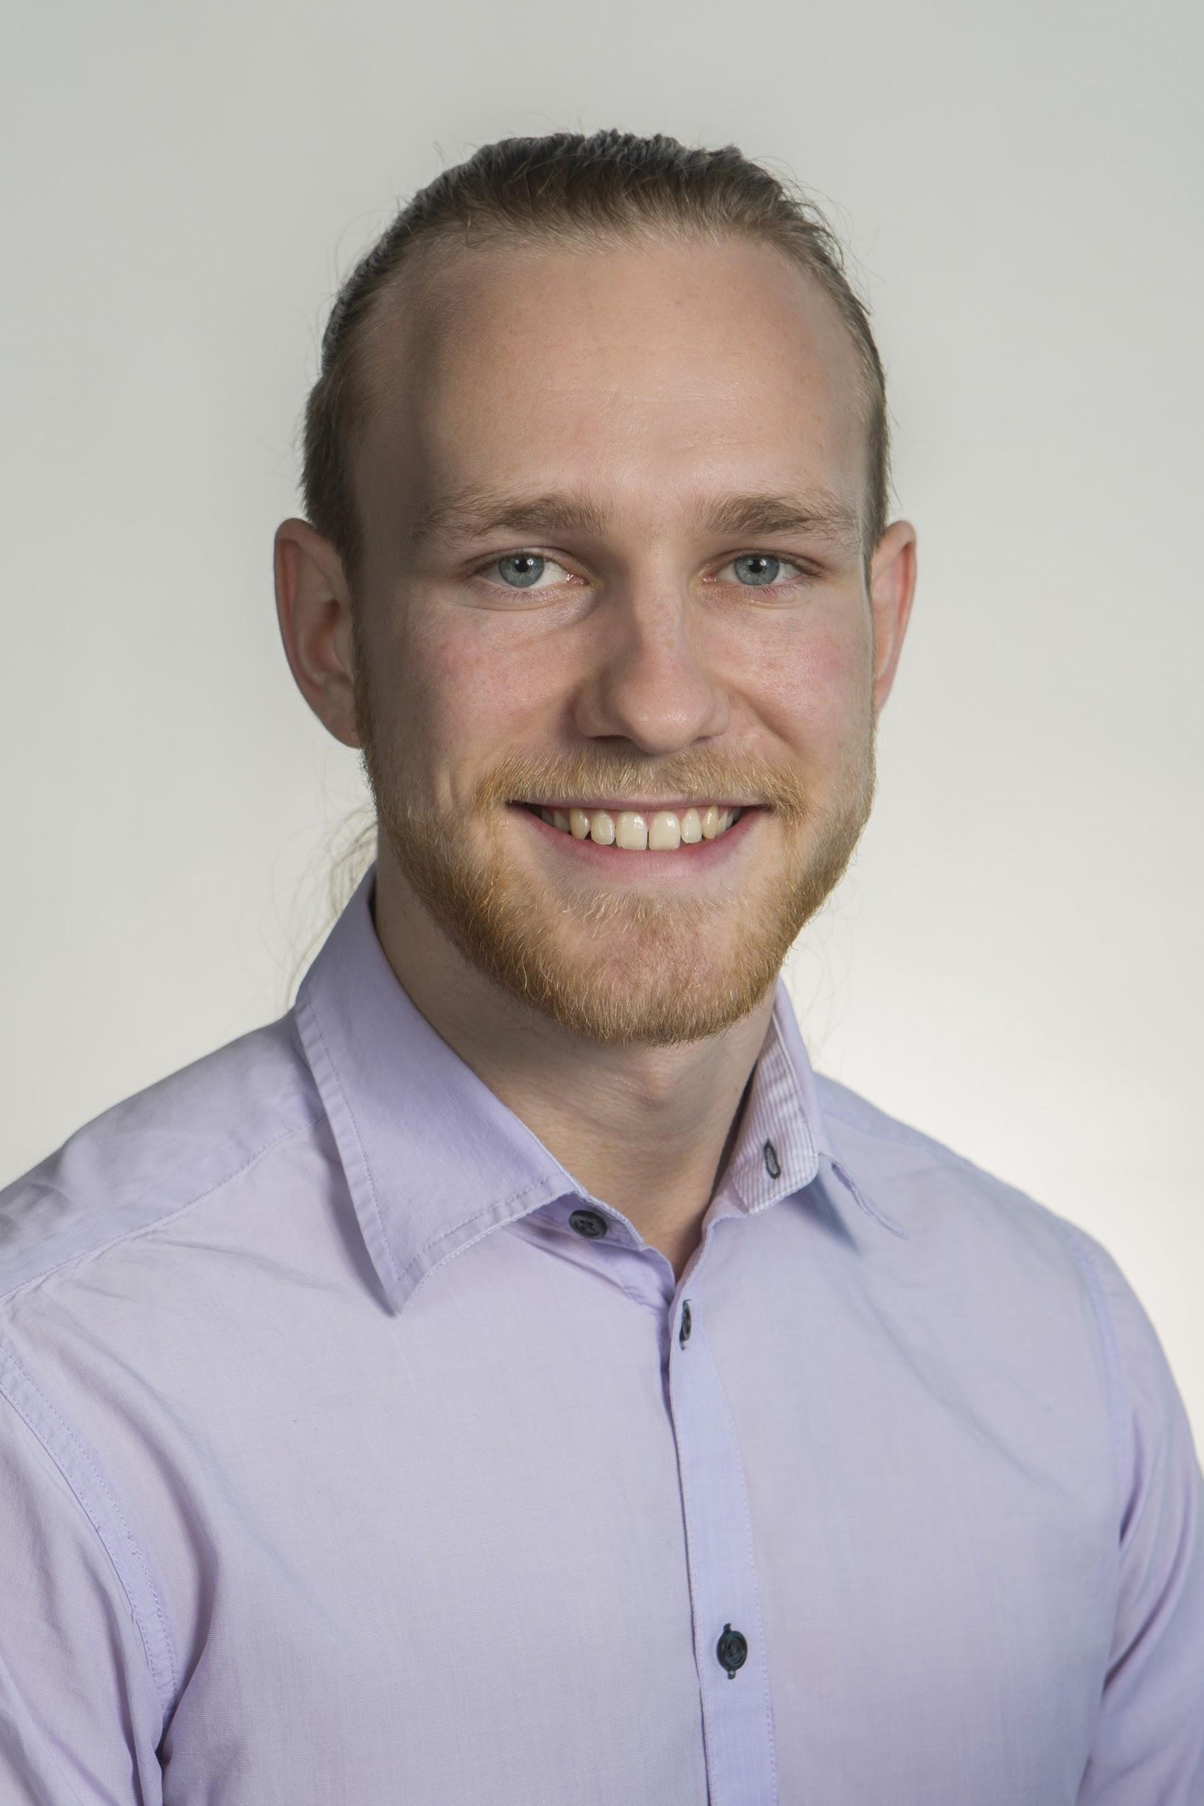
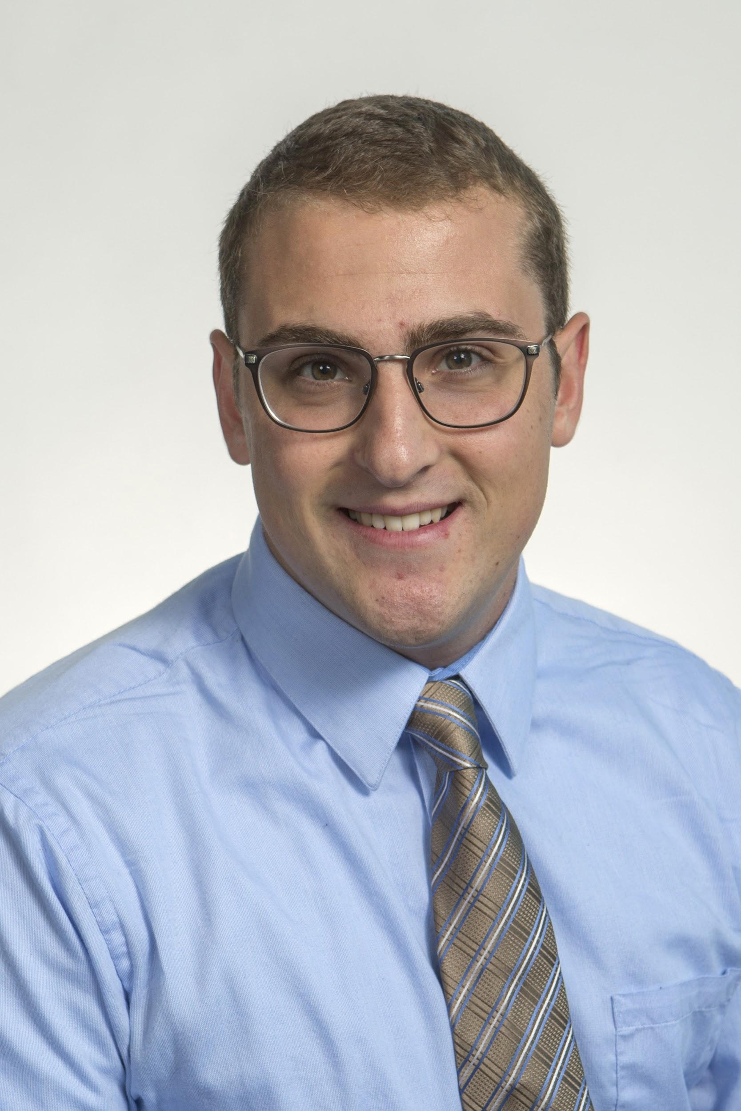
Introduction
Ryan Dwyer
Kjell Gordon
Chris Bredberg
James Beattie
Cedryc Midy
Gordon

Slide 3
Target Catalog
 | Metric | Target | Target Unit
Body | Impact Failure Force | - | N
 | Drag | - | N
 | Distance of Center of Pressure | - | m
Motor | Impulse | 160 | N*s
 | Time of Thrust | 5 | s
Electronics | Altimeter Measurement | 79.495 | kPa
 | Source Current to Deploy Recovery System | 2 | Amps
 | Data Storage Capacity | 10 | mb
 | Sampling Rate | 1 | kHz
Launch System | Launch Cable Length | 91.44 | m
Recovery System | Parachute Deployment Delay | 5 | ms
 | Descent Speed | 4.5 - 6.1 | m/s
Whole System | Apogee | 609.6 | m
 | Maximum Error in Altitude | ±15.24 | m
Bredberg
Notes:
Better format saved to pptx file in the VDR 2 folder when making the final presentation slides

Slide 4
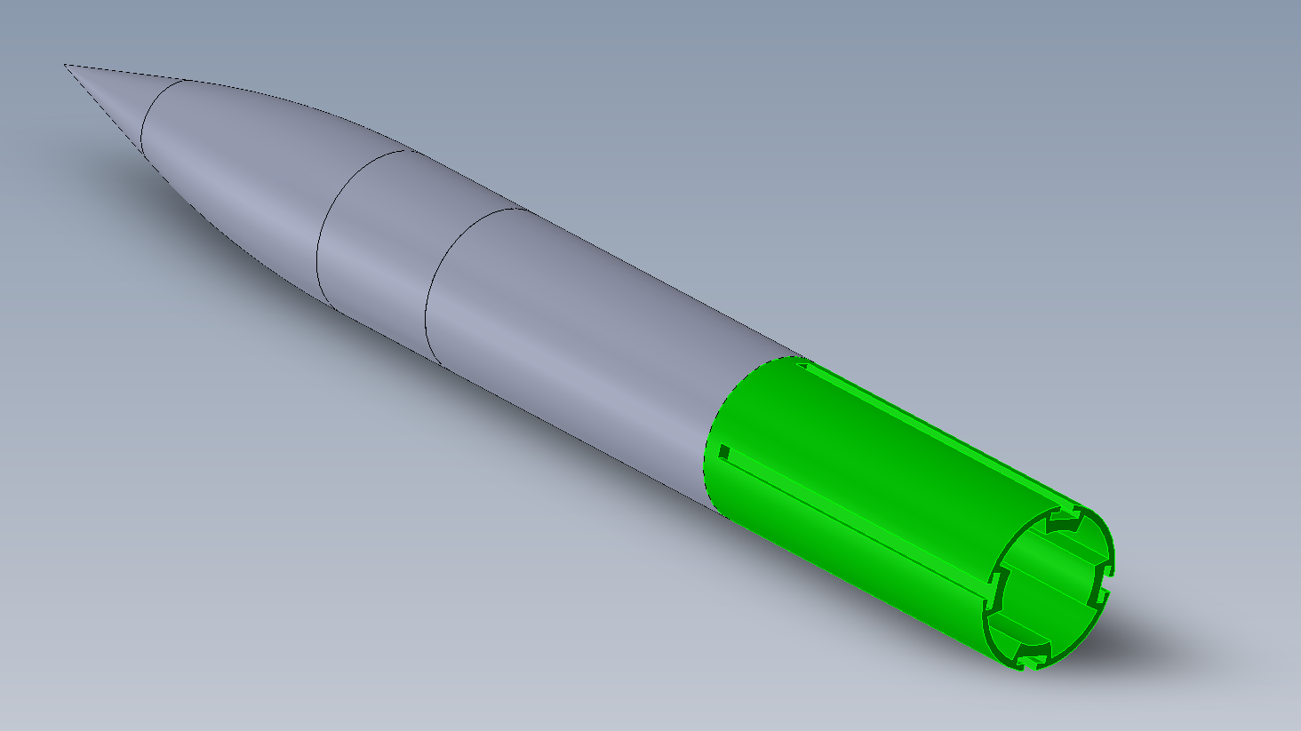
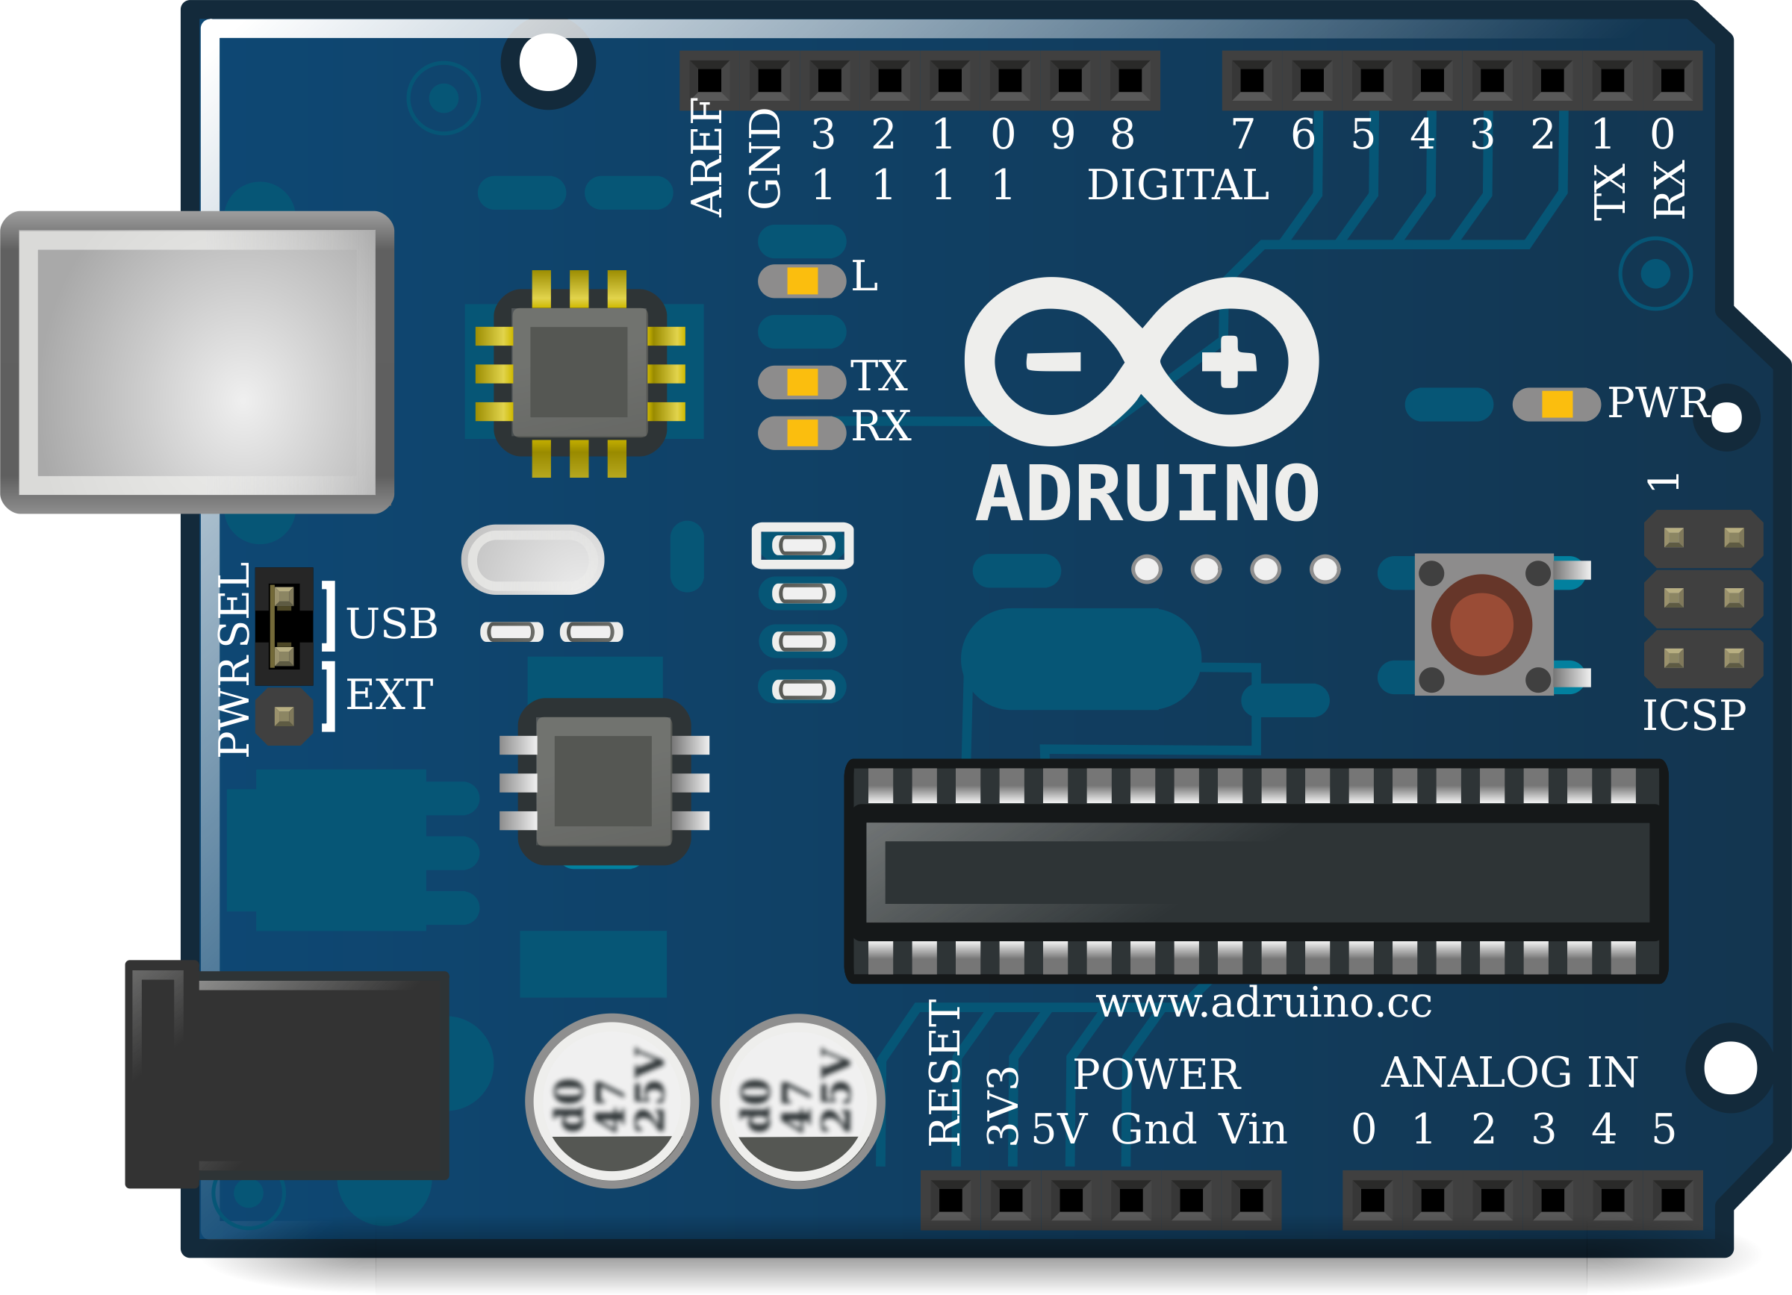
Target Summary
Body: Metrics will be specific to geometry and material of selected concepts
Catalog will be updated once selection takes place
Motor: Maximum impulse of 160 N*s
Electronics: Based on data storage capacity, Amperage needed for combustion, sensor readings, and sampling rate
Bredberg
Notes:
A lower impulse rated motor can be utilized if deemed necessary

Slide 5
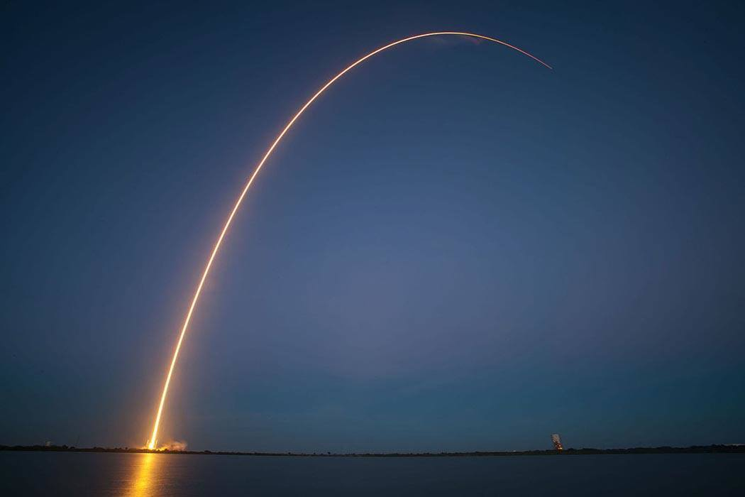
Target Summary
Launch System: Launch cable length required for optimum safety
Recovery System: Specific delay for parachute deployment and rocket descent speed
Whole System:
Apogee is our target height
Maximum error in apogee allows for variance in target height
Bredberg

Slide 6
Concept Generation
1 Body
2 Nose Cone
3 Fins
4 Electronics
5 Recovery System
6 Motor
Bredberg

Slide 7
Body
Kjell Gordon
Bredberg

Slide 8
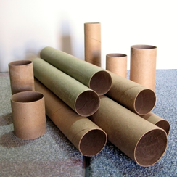
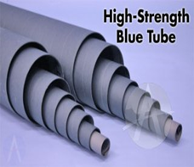
1.1 Body Material
1.1.1 Thin Cardboard
Light, cheap and easy to handle, but weak
1.1.2 Thick Cardboard
Cheap, stronger than thin cardboard
1.1.3 Blue Tube
Strongest, but expensive and heavy
1.1.4 Fiberglass
Strong, light, but expensive
Gordon

Slide 9
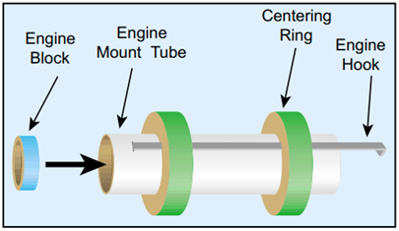
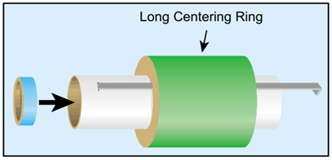
1.2 Engine Mount
1.2.1 Two Centering Rings
Light and most popular
1.2.2 One Long Centering Ring
Simple, but heavy
1.2.3 Two Disc-Type Centering Rings
Lightest, but less reliable
Gordon

Slide 10
Nose Cone
Kjell Gordon
Gordon

Slide 11
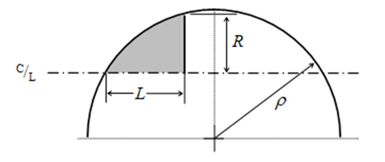
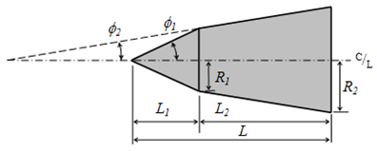
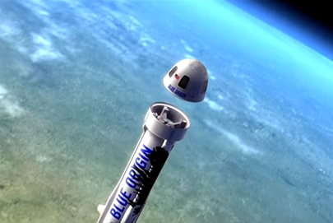
2.1 Shape
2.1.1 Conical - Simple
2.1.2 Spherically Blunted Cone - Aerodynamic
2.1.3 Bi-Cone - Simple
2.1.4 Hemispherical - Storage
2.1.5 Parabolic - Aerodynamic
2.1.6 Ogive - Storage
Gordon

Slide 12
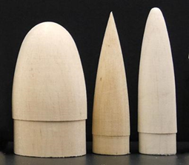
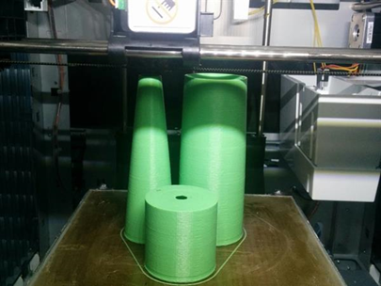
2.2 Materials
2.2.1 Balsa Wood
Very light, cheap, but not hollow
2.2.2 Plastic
Strong, many forms
2.2.3 3D Printed
Strong, made to our specification
Gordon

Slide 13
Fins
Chris Bredberg
Gordon

Slide 14
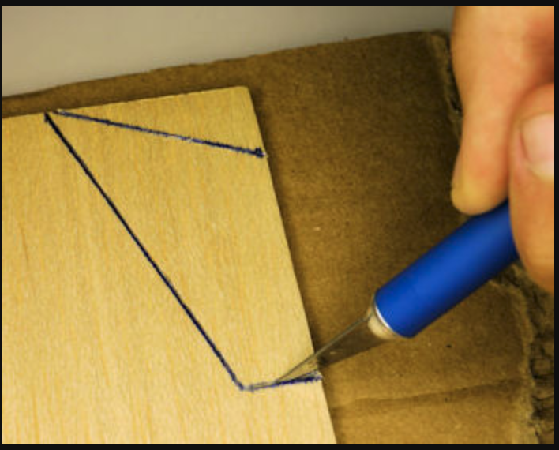
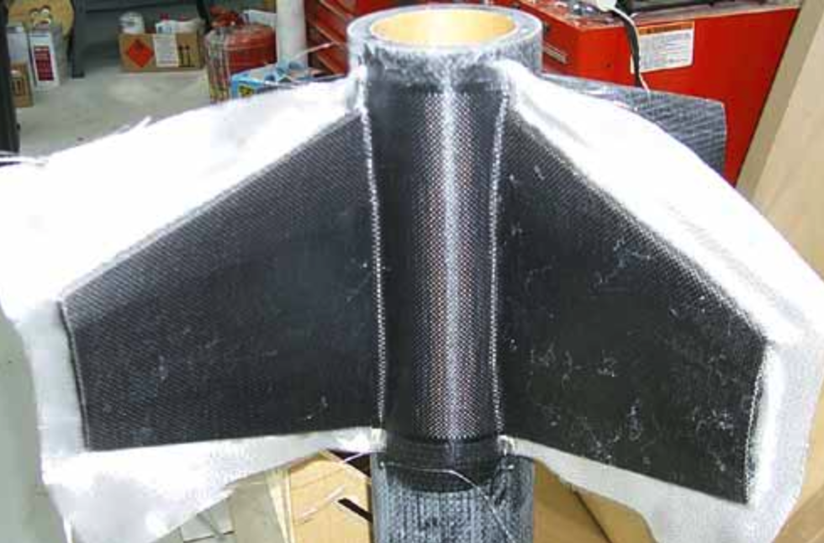
3.1 Fin Material
3.1.1 Balsa Wood
Cheap, Lightweight, Workable yet not particularly strong
3.1.2 Plastic
Cheap, Lightweight, Formable to a mold, fairly good strength
3.1.3 Fiberglass
Fairly expensive, yet very lightweight and very strong, able to be formed into a mold
Bredberg

Slide 15
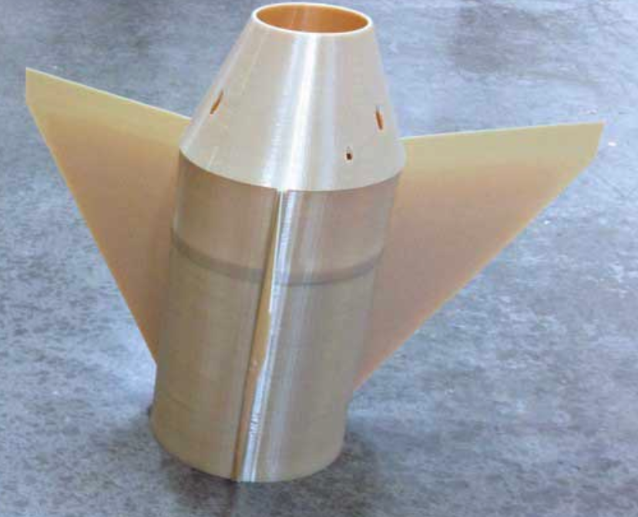
3.1 Fin Material
3.1.4 Basswood
Similar to Balsa wood yet less compressible and stronger
3.1.5 Plywood
Cheap, Lightweight, less workable and rougher than Balsa wood or Basswood
3.1.6 3D Printed Material
Most versatile material in terms of shape, stronger and stiffer than wood
Bredberg
Notes:
https://www.makeitfrom.com/compare/Acrylonitrile-Butadiene-Styrene-ABS/Balsa

Slide 16
3.2 Number of Fins
3.2.1 No Fins
Least amount of material, less drag, less stability
3.2.2-5 2-5 Fins
We could vary the amount of fins from 2 to 5
More fins means more weight, lift and drag
Less fins means less weight, drag, and lift yet at the cost of stability
Bredberg

Slide 17
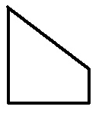
3.3 Fin Geometry
3.3.1 Elliptical
Most aerodynamically efficient
3.3.2 Trapezoidal
Similar to elliptical but with corners
3.3.3 Square
Easiest to manufacture yet least aerodynamically efficient
3.3.4 Clipped Delta
In between being easy to manufacture and aerodynamically efficient
Bredberg
Notes:
pictures

Slide 18
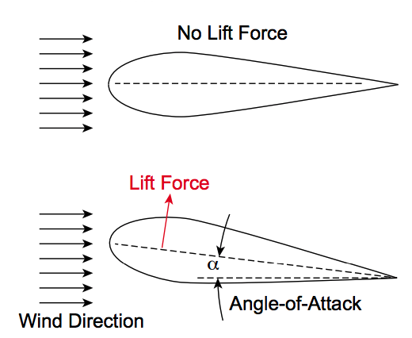
3.4 Angle of Attack
3.4.1 0°
No lift force along with the least amount of drag
3.4.2 5°
Create some lift to spin the rocket although this would create more drag
3.4.3 10°
Increase the amount of drag and lift even more
Bredberg
Notes:
Making the rocket more stable against sideways wind gusts

Slide 19
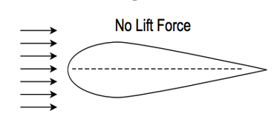
3.5 Airfoil Shape
3.5.1 Teardrop
Most efficient airfoil in terms of aerodynamics
3.5.2 Squared
Most basic airfoil, easiest to manufacture
3.5.3 Tapered
Less drag at the tip due to thinning
Bredberg
Notes:
pictures

Slide 20
Electronics
James Beattie
Bredberg

Slide 21
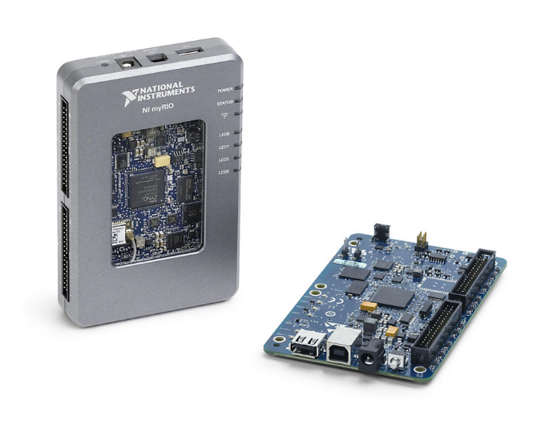
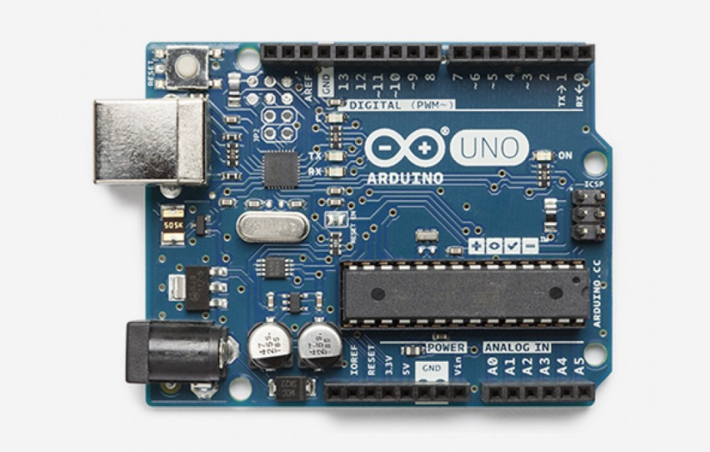
4.1 Boards
4.1.1 myRio
Heaviest board, but widely used and compatible
4.1.2 BeagleBone Blue
Not widely compatible but good processing power
4.1.3 Arduino Uno RV3
Cheap, reliable and adaptable
Beattie

Slide 22
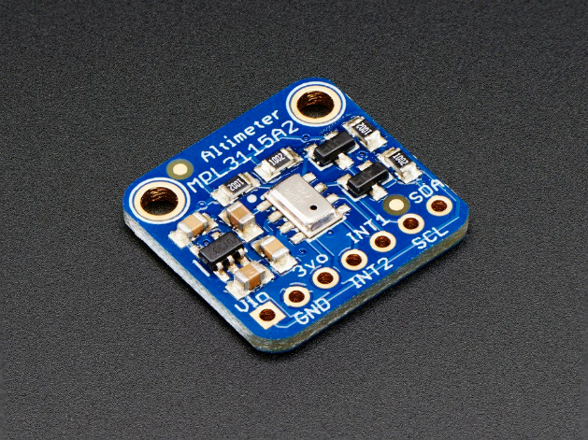
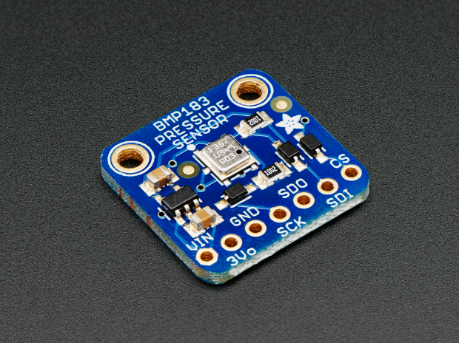
4.2 Altimeter
4.2.1 MPL3115A2 Altimeter
Greater compatibility but heavier
4.2.2 BMP183 Altimeter
Smaller, lighter and compatible with arduino
Beattie

Slide 23
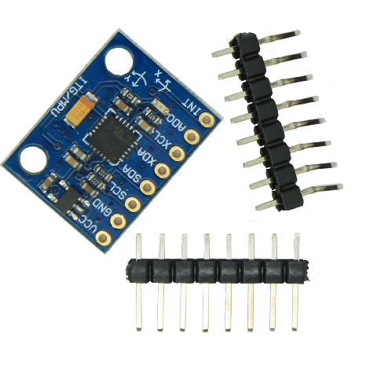
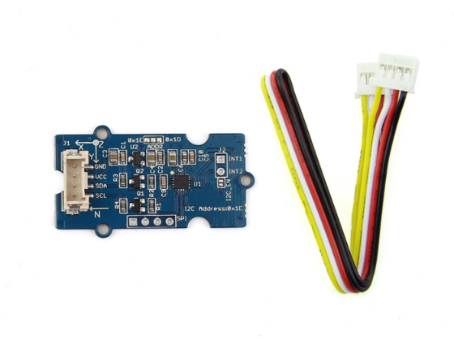
4.3 Accelerometer
4.3.1 MPU-6050 Accelerometer
Cheap and compatible with most boards
4.3.2 Grove Accelerometer
Higher cost but compatible with all boards
Beattie

Slide 24
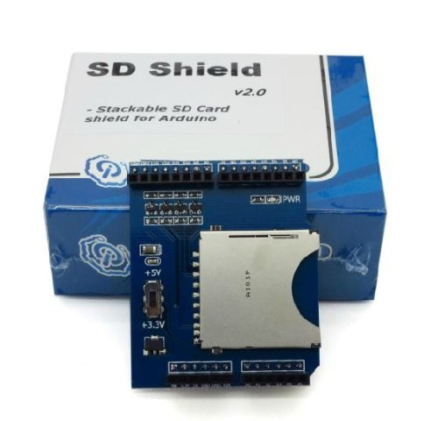
4.4 Storage Device
4.4.1 HiLetgo Stackable SD Card Shield
Extra storage for use with arduino products
Beattie

Slide 25
Recovery System
James Beattie
Beattie

Slide 26
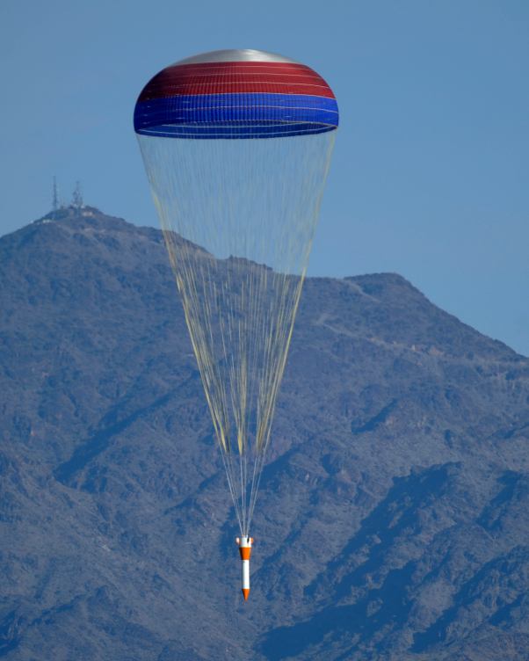
5.1 - Rocket Recovery
5.1.1 - Parachutes
Beattie

Slide 27
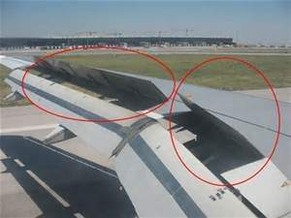
5.2 Dynamic Altitude Limiter
5.2.1 Secondary Parachutes
5.2.2 Retractable Fins
Beattie

Slide 28
Motor
James Beattie
Beattie

Slide 29
6.1 G Class
6.1.1 G-100
6.1.2 G-130
6.1.3 G-300
6.1.4 G-123
6.1.5 G-234
Beattie

Slide 30
Conclusion
General Recap
Concept Selection
Beattie

