Slide 1
Mass Flow Sensor Integration
Team 5:
Beau Rodgers
Luis Mendez
Brian Roberts
Keenan Cheeks
Sponsored by: Danfoss Turbocor
Advised by: Dr. Shih
Notes:
We are working together with our sponsor Danfoss Turbocor, and our faculty advisor Dr. shih.

Slide 2
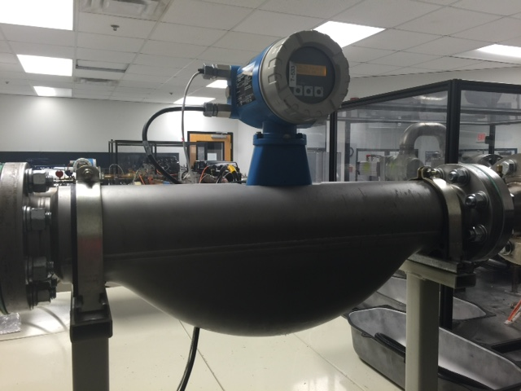
Danfoss Turbocor
Danfoss Turbocor is the world leader in oil-free centrifugal compressors.
Danfoss Turbocor is currently only able to measure compressor efficiency on site.
Mass Flow of the refrigerant is necessary to calculate efficiency.
Figure 1: Endress-Hauser flow meter
Presenter : Beau Rodgers
Notes:
To begin I want to give a little background on Turbocor and what they do. Danfoss Turbocor has designed maglev technology that uses magnetic bearings to levitate the compressor shaft eliminating the need for oil.
Currently Turbocor can only measure the efficiency of these compressors at their testing facility using a very bulky in-line mass flow sensors.

Slide 3
Customer Needs
Need Statement: Turbocor seeks to add value to their existing product in order to compete with emerging technologies by determining real time efficiency at application sites.
Goal Statement: Integrate external mass flow sensor to aid in measuring real time efficiency of Turbocor compressors.
Presenter : Beau Rodgers
Notes:
Currently, more companies are starting to develop oil free compressors making the field more competitive. To stand out on top, Turbocor wants to develop a failure modes prediction system to provide to their customers. As of now Turbocor does not have a way of acquiring real time data or monitoring real time efficiency of their compressors.
Our goal here is to concentrate on providing a means by which Turbocor can measure real-time efficiency on existing Turbocor platforms that can easily be used with their current compressor monitoring system. This is a stepping stone in developing a failure modes prediction system.

Slide 4
Project Scope
Using an externally mounted mass flow sensor, develop a package to determine real time compressor efficiency
Collected data will eventually be used to help determine future failure modes.
Presenter : Beau Rodgers
Notes:
Our first major task was to determine what our sponsor Turbocor wanted from us that would be helpful to them in the future but also comply with the requirements of this class. We jumped from designing algorithms to determine failure modes to mass storage device integration and finally to what we are working on today with developing an externally mounted mass flow sensor package to determine compressor efficiency.

Slide 5
Design Concept
Use existing ultrasonic sensors with corresponding modules to determine mass flow rate and focus on integrating sensor outputs into existing Turbocor platforms.
Presenter : Beau Rodgers
Notes:
After choosing a direction and examining the properties of the system we had two basic approaches we came up with. We could use existing ultrasonic transducers and compute our own algorithms for analyzing the output. This would also entail designing the assembly with to mount the system on the chiller. Our other idea was to find a complete sensor set that we could interface with the existing compressor hardware. This would allow us to focus on integration and the mounting mechanism itself.

Slide 6
Current Progress
Acquired materials and parts necessary for mounting system
Completed design, machining, and assembly of sensor mount
Preliminary system setup and test
Flow Meter Calibration
Completion of VI data collection system
Set up specific test times with Turbocor
Presenter : Beau Rodgers

Slide 7
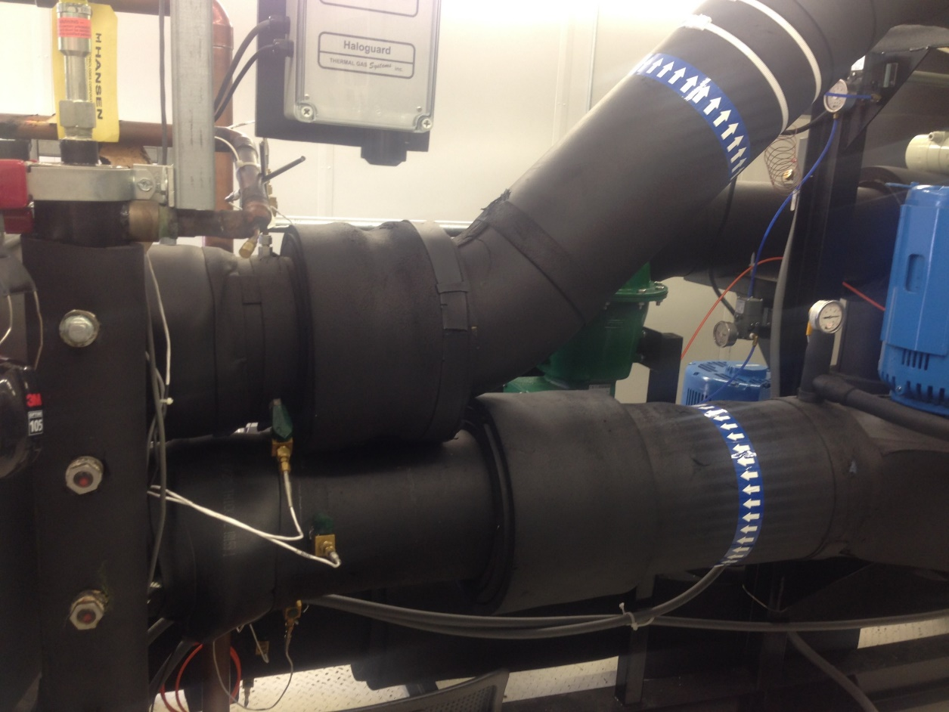
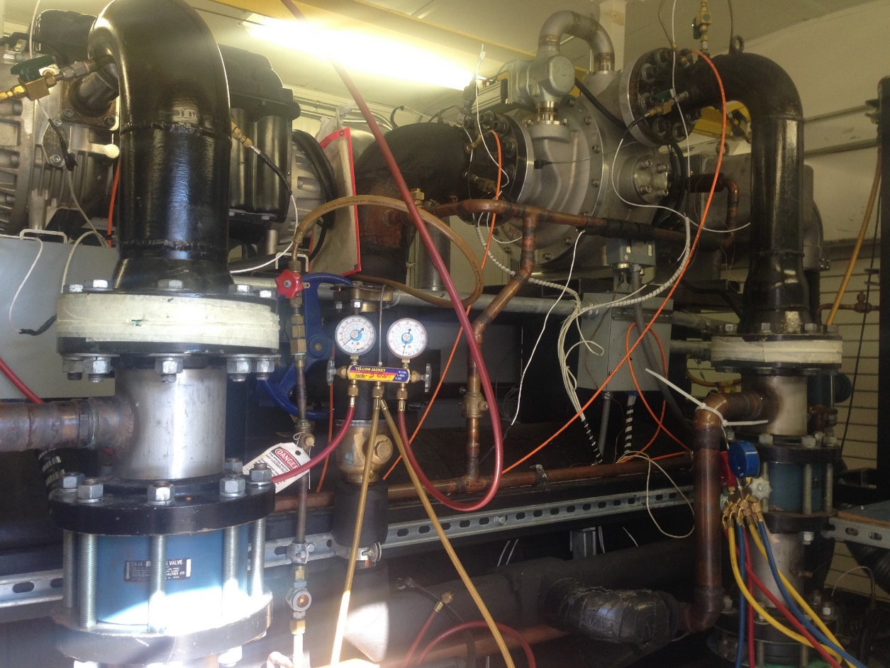
Test Facility “Chiller 3”
Full access to all operating parameters on either TT or VTT model
Compressor Input power [kW]
Necessary Temperature and Pressure
Minor System modifications allowed
Figure 2 : Danfoss Turbocor Chiller 3 Test Rig
Figure 3 : Inlet/Outlet of Evaporator
Presenter : Beau Rodgers

Slide 8
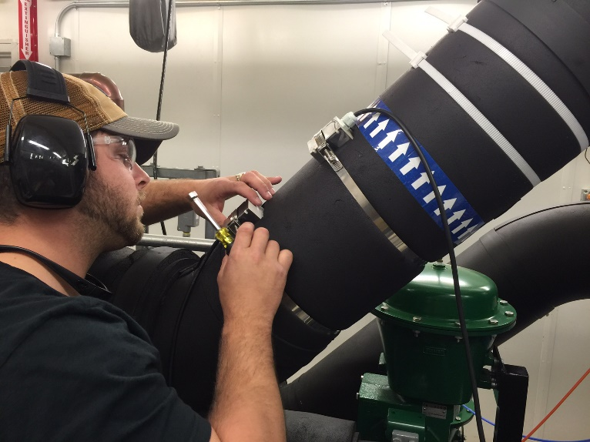
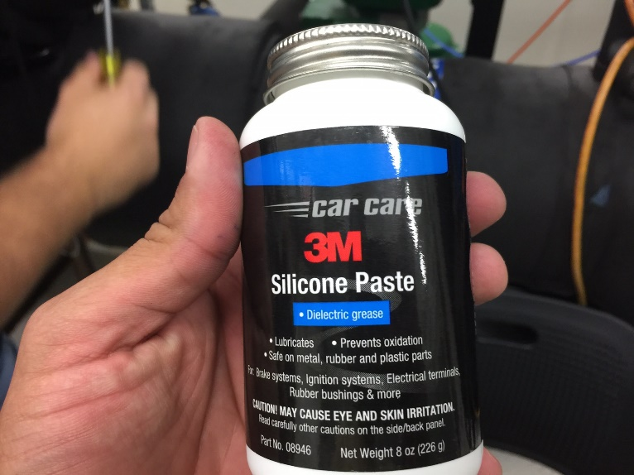
System Setup
System modifications included removal of existing insulation
Ultrasonic sensors needed to be mounted and adjusted based on pipe dimensions
For Accurate measurement, pipe surface needed to be properly prepped.
Figure 4: Sensor Mounting
Figure 5: Silicone Paste
Presenter : Beau Rodgers

Slide 9
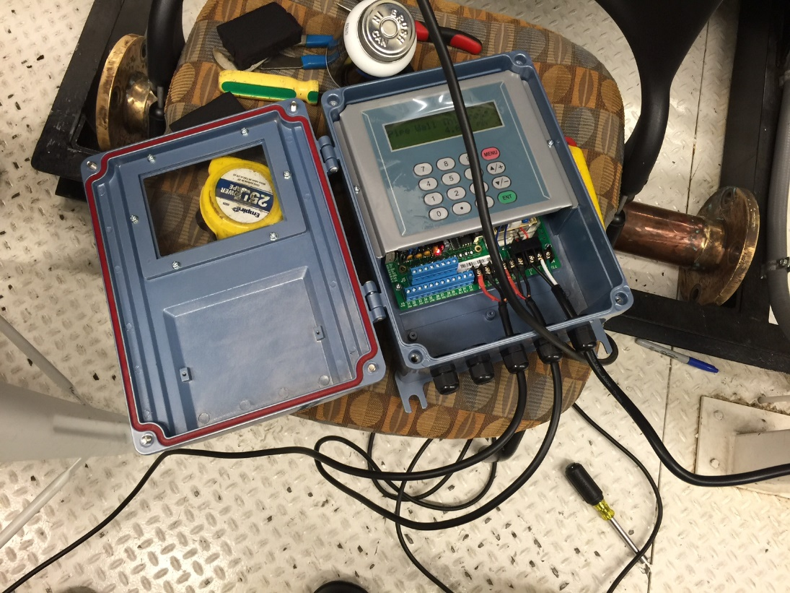
System Setup Cont.
After sensor installation, wiring to the control module was completed
Pipe dimensions are input into TDS-100 control module
Figure 6: Dalian High Peak TDS-100M
Presenter : Beau Rodgers
Notes:
Several models of sensors were researched and analyzed. The best four out of the packages found are presented here in a selection matrix. The customer requirements were weighted from 1 to 5 and each model was assigned a value from 0 to 3 corresponding to how well it meets the design criteria. From this analysis it was determined that the Dalian Hipeak TDS-100 would best suit our needs.

Slide 10
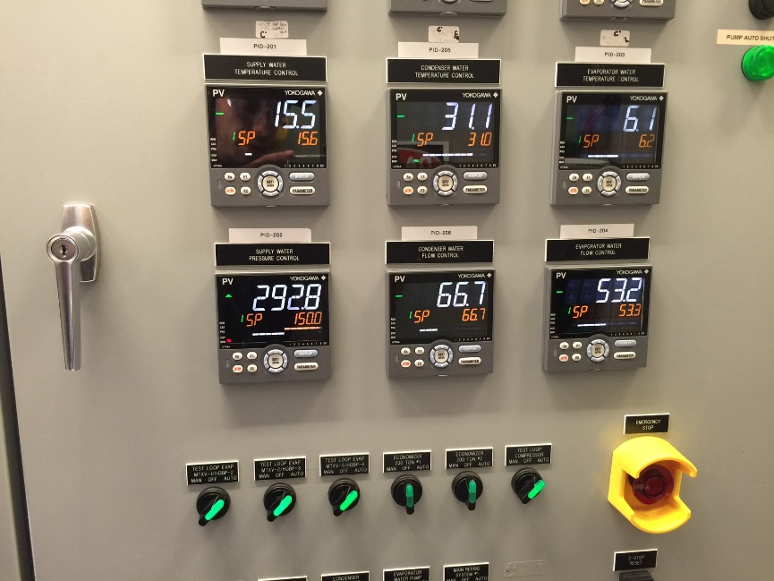
Initial Findings
After initial setup, rough calculations were used to determine sensor accuracy.
Initial comparisons resulted in inaccurate readings.
After troubleshooting and minor adjustments, readings were within 5% of what existing systems were reading.
Figure 7: Chiller 3 monitoring panel
Presenter : Beau Rodgers

Slide 11
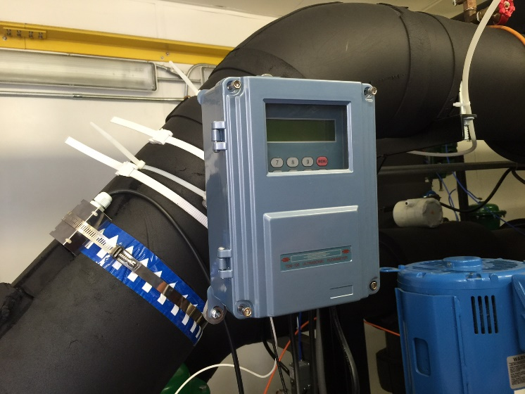
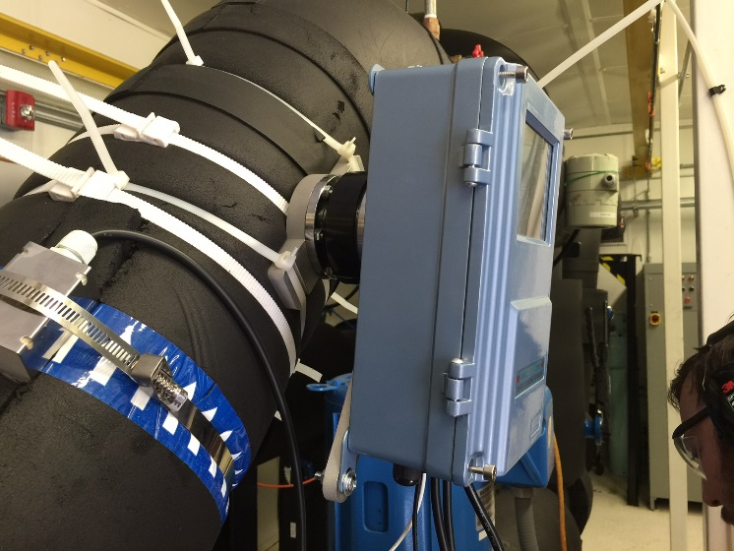
Mounting Bracket
Figure 9: Mounted Sensor Package (Front)
Figure 8: Two piece sensor mount
Figure 10: Mounted sensor Package (side)
Presenter : Luis Mendez

Slide 12
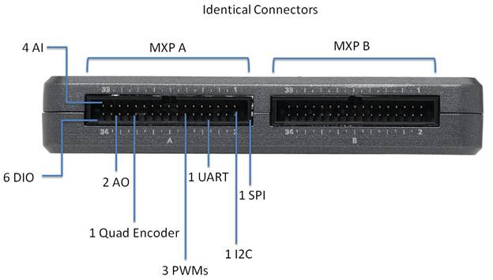
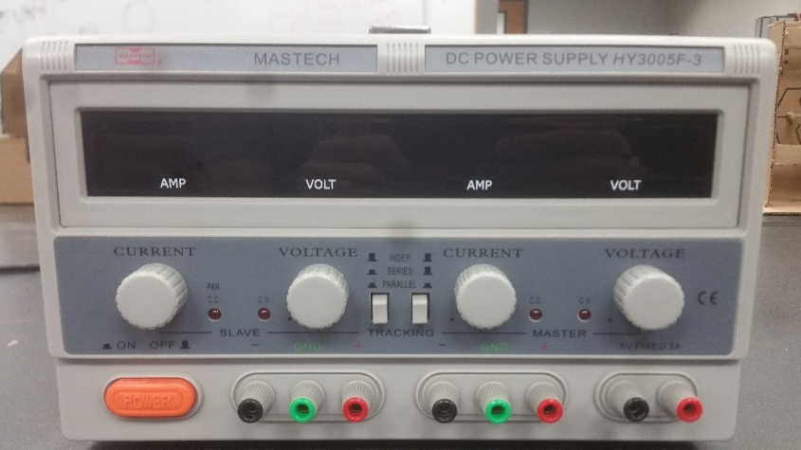
VI Testing and Operation Hardware
NI MyRIO
Versatile I/O Board
Can be programmed using C or LabVIEW
Standard AC to DC converter
Outputs a DC voltage that can be modulated
Figure 11: NI myRIO input/output
Figure 12: NI myRIO input/output
Presenter : Luis Mendez
Notes:
While researching the best way to calculate the mass flow rate without being intrusive to the current customer platforms we came across many different principles that can provide the necessary information. The only one that we found that was externally mounted was the ultrasonic mass flow sensor which was found to also be very accurate and robust.

Slide 13
LabVIEW VI
Initializes with myRIO startup
Runs until button on device is pushed
Collects data on USB drive
Uses .csv file format
Collects time and voltage
Writes to new file each time
Figure 13 - LabVIEW VI for Data Collection
Presenter : Luis Mendez
Notes:
From left
“USB flashdrive folder “– defines folder name
“Get Volume Info” – Loads drive parameters
“ ‘Clock’ box ” – controls for running the loop enclosed in the big gray square
Set to 1 kHz
“Error” boxes – Pass along error info
“ i box” – counts iterations of loop
“Analog Input” – Reads info from selected pins
Using pins A0⁻ and A0⁺
“Button box” – reads state of button on front of myRIO
“Stop sign” – ends loop if button pressed
“?!” – error checking controls (not used)
“data” “.csv” “Concatenate Strings” – used to name data files
“Build path” – Puts the correct filename and path together
Passes this value to the file writing VI
Math Function and “Build Array” – Turns iterations into time and makes array with output values
“Write to measurement file” – Self explanatory

Slide 14
Signal Processing Data collection
Sensor modeled as current source
0-24mA output
Resistor changes current flow to measurable voltage difference
297 Ω resistor 0 < output < 7.13 V
A⁻ _{(sensor)}
A0⁻
297 Ω
A0⁺
A⁺ _{(sensor)}
Figure 14 - Data Collection Circuit
Presenter : Luis Mendez

Slide 15
Signal Processing Integration
Sensor modeled as current source
0-24mA output
Circuit integrates ground lines and scales output
200 Ω resistance ~ 4.8 V output from sensor
Outputs 0-4.8V
Uses +5v from compressor
Can be scaled for operating range
A⁻ _{(sensor)}
200 Ω
Compressor Input
A⁺ _{(sensor)}
5V
Figure 15 - Integration Circuit
Presenter : Luis Mendez

Slide 16
Future Plans
Finalize on-site testing and data gathering.
Use test data to validate our thermodynamic model and develop a signal calibration table.
Work with our Turbocor advisor (system programmer) to develop pseudocode necessary to adopt our system into the Turbocor platform.
Presenter : Luis Mendez
Notes:
Moving forward we need to begin acquiring the physical parts of our system and designing the mounting bracket. After we assemble the system we can start running tests to analyze our thermodynamic model. The next step will be to integrate the system and determine overall efficiency for the compressor.

Slide 17
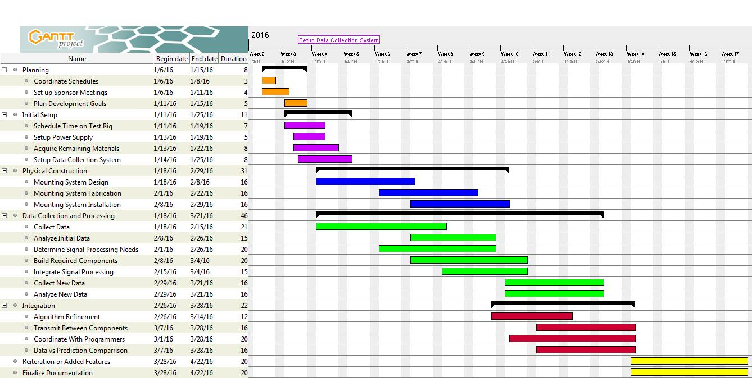
Gantt Chart
Figure 16 : Gantt Chart
Presenter : Luis Mendez
Notes:
Here is the Gantt chart we are currently using to guide our progress. Currently we are finalizing our needed parts and working on designing the bracket itself. We would like to get to prototyping early in the spring semester so that we can quickly move on to running experiments on the system.

Slide 18
Conclusion
As new technologies begin to challenge Turbocor’s market dominance, they desire added value for their products to maintain market share.
One way to achieve this goal is to add the ability to analyze data both instantly and over an extended period.
To aid in the goal of advanced data analytics we are designing a sensor module that can determine compressor efficiency to integrate into their platform.
Measuring efficiency is a necessary stepping stone towards advanced failure modes analysis.
Presenter : Luis Mendez
Notes:
As any new technology become more common place, competition becomes ever fiercer for the originator of the technology. Turbocor is looking forward and trying to maintain their place at the top of the frictionless compressor market. One approach they are taking is to add features to their existing product, specifically data analytics. This allows for failure prediction before they occur and prevent unnecessary damage to equipment. To achieve their goals several different metrics need to be monitored. Compressor efficiency is one important aspect that can reveal system health. To help them in their goal we are working to determine the mass flow rate of the refrigerant which they are not currently able to monitor.

Slide 19
Questions?

Slide 20
References
http://www.sierrainstruments.com/products/210Prod.html
Sierra InnovaSonic 210i
http://www.ecefast.com.au/media/blfa_files/TDS-100Fmanual_ece.pdf
Dalian Hipeak TDS-100F
http://www.greyline.com/ttfm10.htm
Greyline TTFM 1.0
http://www.us.endress.com/en
General Massflow Sensor information
http://www.cdiweb.com/Manufacturers/sensata/FP/Pressure_Transducer-Transmitter/?type=94&manf=512&cate=512:10&NavType=2#null
TI 112CP3-4

