Slide 1

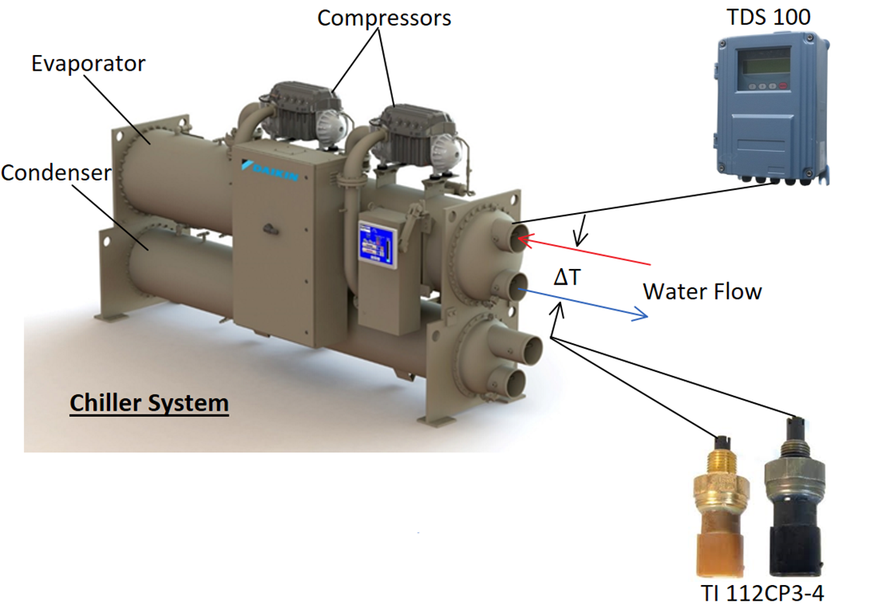
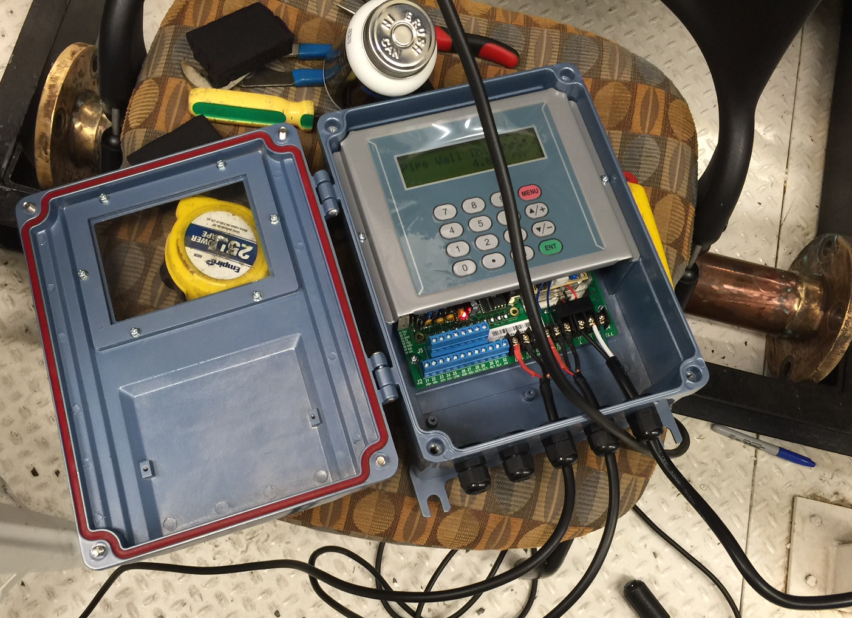
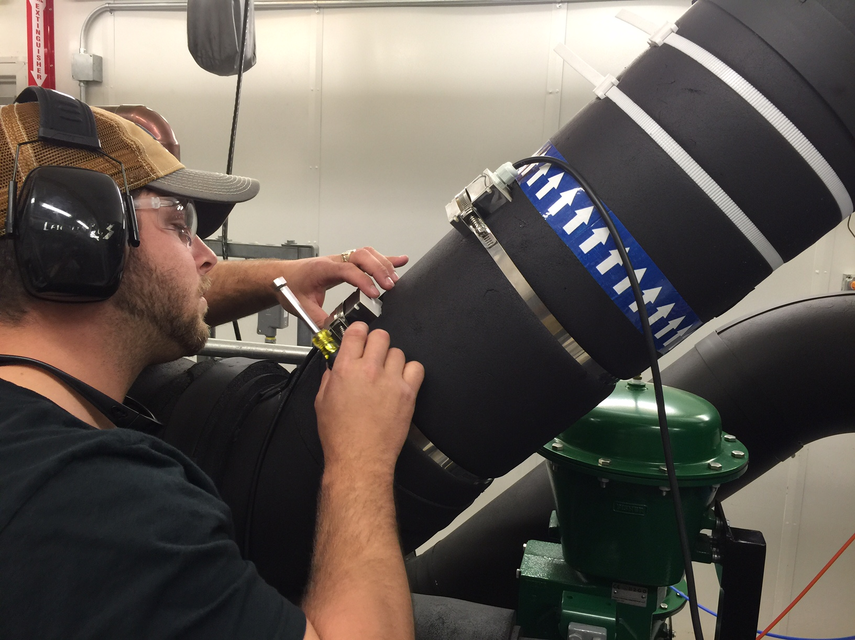
Mass Flow Sensor Integration
Team 5
Luis Mendez, Beau Rodgers, Keenan Cheeks, Brian Roberts
Aim: To develop and integrate a sensor package to determine real-time compressor efficiency….
Background
Turbocor seeks to add value to their existing product to better compete in their market.
Objectives
Develop mass flow sensor package do gather information needed for efficiency calculations
Integrate system in to existing platform
Initial step towards failure prediction system
Technical Approach
Figure 1: System Overview
Integrate a non-intrusive mass flow sensor coupled with temperature sensors in existing ports to gather the data necessary to calculate efficiency.
System will be compatible with all Turbocor compressor systems.
Future Work
Continuing testing and data analysis
Final integration into Turbocor’s existing system
Begin developing calibration curves for future failure modes analysis
Figure 2 : Ultrasonic Mass Flow sensor
Figure 3 : Sensor Installation

