Slide 1
Mass Flow Sensor Integration
Team 5:
Beau Rodgers (ber13@my.fsu.edu)
Luis Mendez (lm13r@my.fsu.edu)
Brian Roberts (bpr13b@my.fsu.edu)
Keenan Cheeks (kmc11j@my.fsu.edu)
Sponsored by: Danfoss Turbocor
Advised by: Dr. Shih

Slide 2
Developing a Project Scope
Initial scope: Determine failure modes through data analysis by implementing algorithms
First revision: Integrate a mass storage device onto the Variable Twin Turbo “VTT” compressor
Second revision: Develop a mass flow sensor to determine compressor efficiency.
Presenter: Beau Rodgers

Slide 3
Customer needs
Need Statement: Danfoss Turbocor seeks to add value to their existing product by determining real time compressor efficiency .
Goal Statement: Design an external mass flow sensor system with the ability to measure efficiency of the “VTT” model compressor.
Presenter: Beau Rodgers
Notes:
Need: Talked with rob about this technology being a niche and other competitors edging into the market. As of now turbocor does not have a way of acquiring real time data or monitoring real time efficiency of their compressor. by developing a integrated flow sensor the efficiency can be measured and provide value to the customer

Slide 4
Objectives
Mechanically integrate a mass flow sensor
Keep the sensor compact lightweight and nonintrusive
Must be durable preferably with minimum moving parts if any
Must provide added value to the customer featuring equipment health and reliability
Presenter: Beau Rodgers

Slide 5
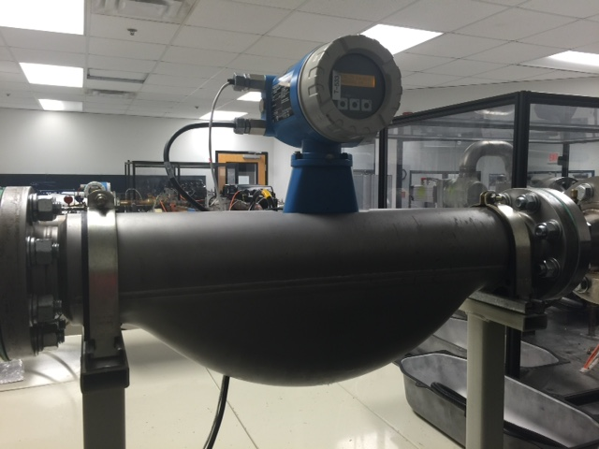
Background
Turbocor is currently only able to measure efficiency on test rigs.
Probe style in line flow sensor lends itself to extensive modification of existing systems
Clamp on external flow meter is optimal to offer as an add on to existing and future customers
Figure 1: Endress-Hauser flow meter
Presenter: Beau Rodgers
Notes:
Endress Hauser flow meter is 3 ft long 19” tall and would need
After propsing the external flow meter its specifications should be noted:
+- 1% accuracy

Slide 6
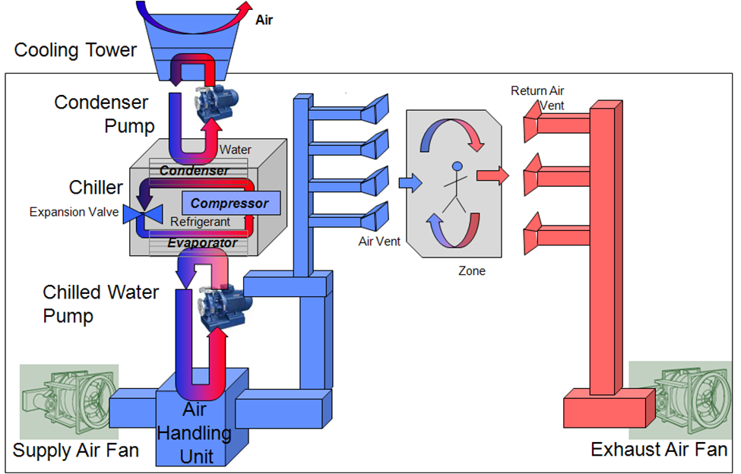
Turbocor Compressor Application
Typical Turbocor compressor application is on HVAC systems incorporating chillers.
Temperature differential will be used in conjunction with mass flow of chilled water for efficiency.
Figure 2: Typical air conditioning system
Presenter: Beau Rodgers

Slide 7
Design Concepts
Use existing ultrasonic sensors on the market for retrieving data and using our own algorithms and processing units to determine mass flow.
Use existing ultrasonic sensors with corresponding modules to determine mass flow and focus on design of clamping system and temperature differential sensors.
Possible need of an internal mass flow meter to meet desired specifications.

Slide 8
Concept Evaluation
Not using existing data collection system would be cheaper but cause unnecessary work and complications.
An internal flow sensing device was decidedly unsatisfactory due to the extensive modifications of the existing customer platforms.
Best choice would be to use existing sensors and corresponding electronics to retrieve mass flow data and focus on a mounting apparatus.

Slide 9
Potential Challenges
Maintaining budget
Flow measurement accuracy
Clamp versatility
Acquiring accurate temperature differences
Compatibility of systems
The sensor component must have standard communication output language used by Turbocor

Slide 10
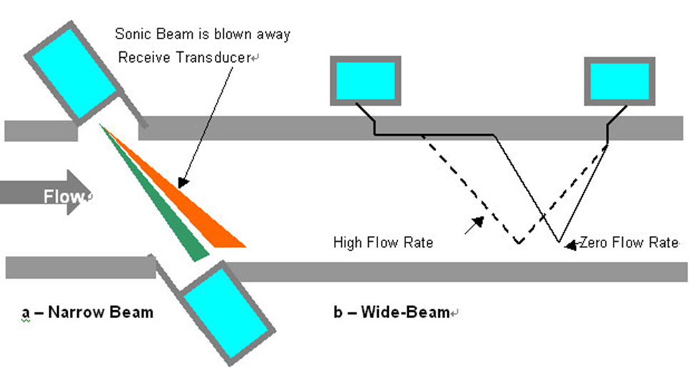
Relevant Data
External Mass flow sensors will be ultrasonic.
Narrow Beam Ultrasonic
Wide Beam Ultrasonic
Important Parameters
Pipe
Diameter
Wall thickness
Construction
Sensor
Fluid
Figure 3: Narrow vs Wide Beam Sensor

Slide 11
Ultrasonic Mass Flow Sensor
Figure 4: Wide beam sensor diagram

Slide 12
Ultrasonic Mass Flow Sensor

Slide 13
Future Plans
Select and order sensors and corresponding electronics.
Use said hardware dimensions to begin CAD design of mounting clamp.
Determine best sensors for temperature data collection.
Requires specifications for existing hardware for sensors.
Process collected Temperature data
Calculate temperature differential
Use measured mass flow rate, temperature differential, and other parameters along with known thermodynamic and physical relations to output an efficiency

Slide 14
House of Quality
Figure 5: House of Quality

Slide 15
Gantt Chart
Figure 6: Gantt Chart

Slide 16
Summary
Danfoss Turbocor seeks to add value to their existing product by determining real time compressor efficiency.
Design an external mass flow sensor system with the ability to measure efficiency of the “VTT” model compressor.

Slide 17
References
https://www.google.com/search?q=danfoss+turbocor
http://www.us.endress.com/en/Tailor-made-field-instrumentation/Flow-measurement-product-overview
http://www.eecs.berkeley.edu/~jortiz/gridos/site/modeling.html
http://www.supertech.cn/en/tech/index2.asp

