Slide 1

Design & Manufacture of Rotorcraft
IME Team#8/ME Team#31
Chabely Amo
Louisny Dufresne
Robert Johnson
Mohammed Nabulsi
Taniwa Ndebele
Victoria Rogers
Kimberlee Steinman
Mitchell Stratton
IME Team #8/ME Team #31
Slide 1 of 32
Kimberlee Steinman
Design & Manufacture of Rotorcraft

Slide 2
Team Organization
IME Team #8/ME Team #31
Slide 2 of 32
Kimberlee Steinman
Design & Manufacture of Rotorcraft

Slide 3
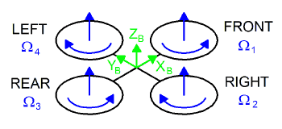
Background
A rotorcraft is a flying machine that uses lift generated by wings called rotor blades that revolve around a mast
Rotary unmanned aerial vehicles often
  fall into one of two classifications:
  High payload capacity but low
    portability
  High portability but a reduced
    payload capacity.
Figure 1. Example of a Quad-rotor [1]
IME Team #8/ME Team #31
Slide 3 of 32
Kimberlee Steinman
Design & Manufacture of Rotorcraft

Slide 4
SWOT Analysis Quadrants
Strengths | Weaknesses
Interdisciplinary Group Open Communication Stakeholders and Resources | Large Group Limited Literature Availability
Opportunities | Threats
Increase in Military Demand for Rotorcrafts | Another funded group developing a similar rotorcraft might devalue the results of the project
IME Team #8/ ME Team #31
Slide 4 of 32
Kimberlee Steinman
Design & Manufacture of Rotorcraft

Slide 5
SIPOC Analysis Chart
Suppliers | Input | Process | Output | Customers
HPMI, Online retailers, College of Engineering departments. | Group member's knowledge and training in design and manufacturing | Design a rotorcraft that meets the customer's requirements and the manufacturing processes required to create the rotorcraft | Rotorcraft matching our projects goal statement | The Department of Industrial and Manufacturing Engineering and Dr.Okoli
IME Team #8/ME Team #31
Slide 5 of 32
Kimberlee Steinman
Design & Manufacture of Rotorcraft

Slide 6
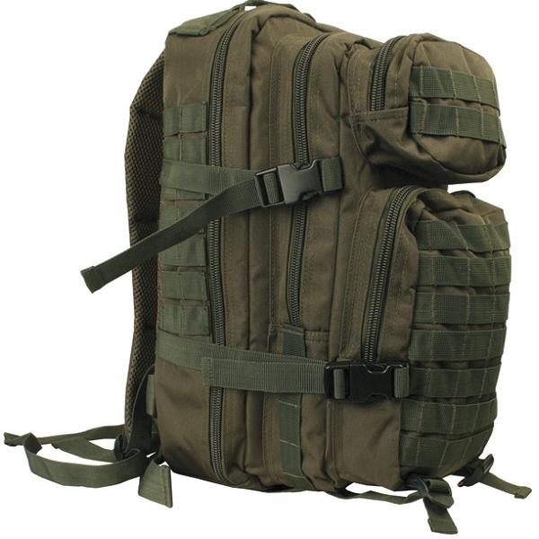
Goal Statement and Objective
Design a rotorcraft that can:
  Fit in a military backpack (23”x14.5”x15”)
  Carry a payload of at least 50 pounds
  Be made with commercial off the shelf (COTS) components
  Travel up to approximately 1 mile
  Be easily maintained and used in the field
Design the manufacturing processes to be used in creating the rotorcraft
Build a prototype of the rotorcraft
Figure 2. Military Backpack [2]
IME Team #8/ ME Team #31
Slide 6 of 32
Kimberlee Steinman
Design & Manufacture of Rotorcraft

Slide 7
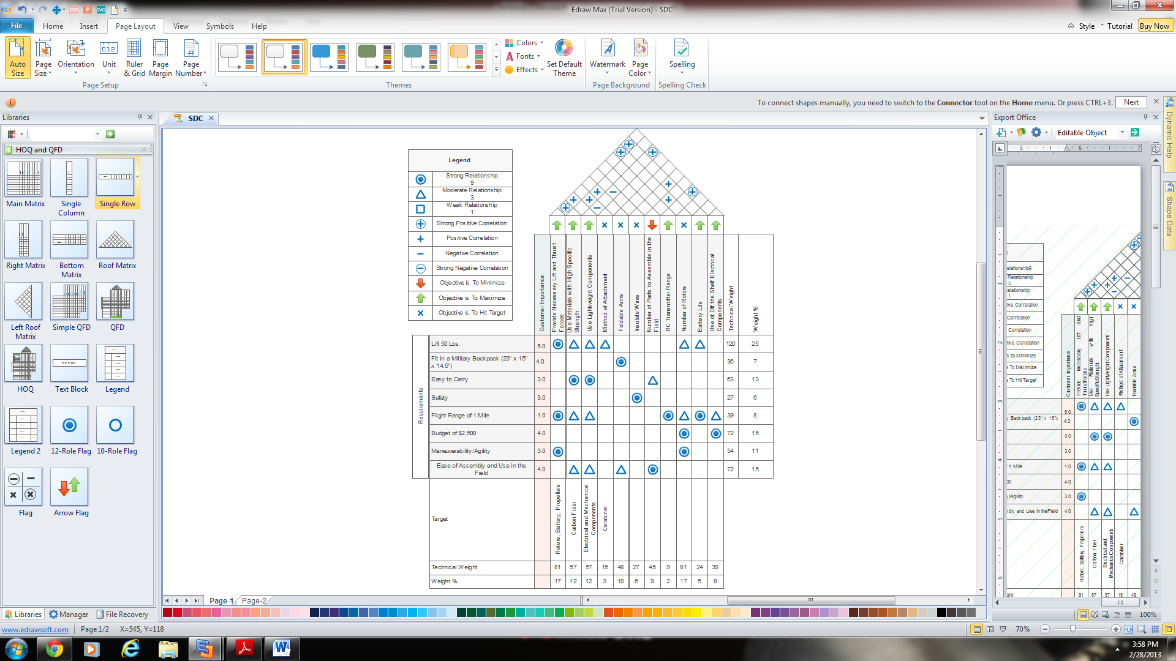
House Of Quality
IME Team #8/ ME Team #31
Slide 7 of 32
Chabely Amo
Design & Manufacture of Rotorcraft

Slide 8
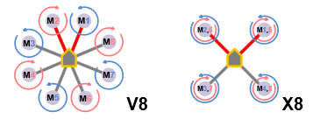
Multi-copter Configuration
Two types:
Coaxial Setup (X8)
  Two engines mounted co-axially on the ends of each boom
  Excellent Lifting Power
  Easier Portability
Radial Setup (V8)
  One engine mounted on the
    end of each boom
Figure 3. Multi-copter Configurations [3]
IME Team #8/ ME Team #31
Slide 8 of 32
Chabely Amo
Design & Manufacture of Rotorcraft

Slide 9
Designs Analyses and Comparisons
Design #1 → Proposed by Intern Student Cameron Alexander
Design #2 → Proposed by the Team
Design #3 → Proposed by the Team
IME Team #8/ME Team #31
Slide 9 of 32
Chabely Amo
Design & Manufacture of Rotorcraft

Slide 10
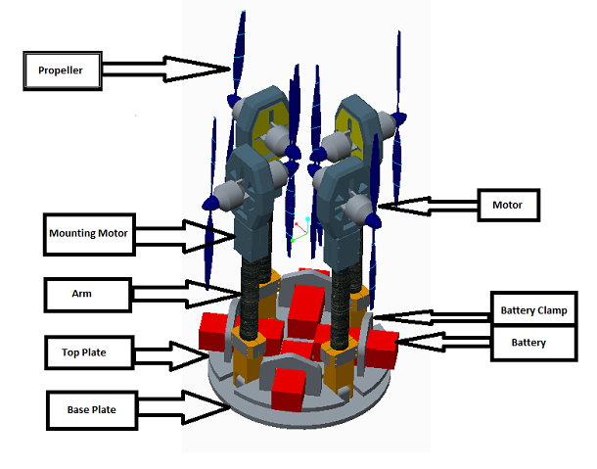
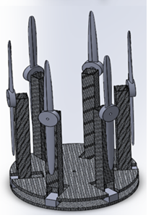
General Design
Figure 4. Cameron’s Radial Design
Figure 5. Team’s Coaxial Designs 2 and 3
IME Team #8/ ME Team #31
Slide 10 of 32
Chabely Amo
Design & Manufacture of Rotorcraft

Slide 11
Measure Phase Tool: eCalc Analysis
Provides web-based quality services to calculate evaluate and design electric motor driven systems for remote controlled models
Provides Rotorcraft outcome based on:
  Battery
  Speed Controller
  Motor
  Propeller
Guarantees error margin no greater than ±10%
IME Team #8/ME Team #31
Slide 11 of 32
Mohammed Nabulsi
Design & Manufacture of Rotorcraft

Slide 12
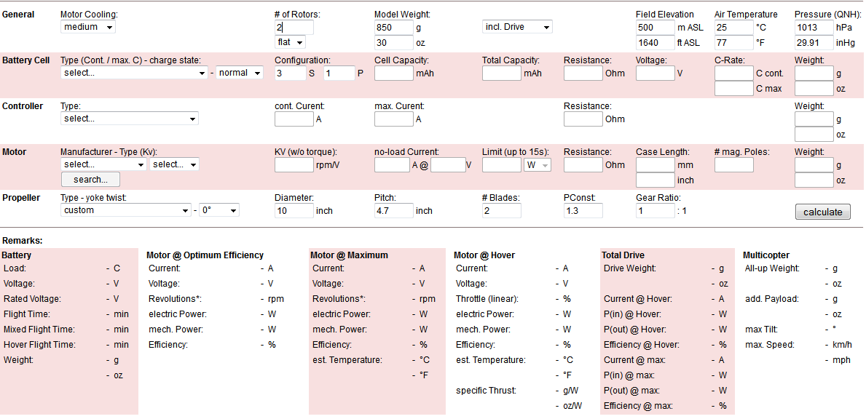
eCalc Multi-Copter Calculator
IME Team #8/ME Team #31
Slide 12 of 32
Mohammed Nabulsi
Design & Manufacture of Rotorcraft

Slide 13
Motor Comparison
Design | Motor | Kv (RPM/V) | Prop Range | Mass (Lbs.) | Max Current (A) | Max Voltage (V) | Power (W) | Cost ($)
Design #1 | E-Flite Power 52 Brushless Outrunner [6] | 590 | 12”x 8” to 14”x 7” | 0.77 | 65 | 22 | 1650 | 109
Design #2 | E-Flite Power 360 Brushless Outrunner [5] | 180 | 24”x10” to 25”x12” | 2.7 | 130 | 44.4 | 6000 | 359
Design # 3 | E-Flite Power 110 Brushless Outrunner [4] | 295 | 17”x8” to 19”x10” | 1.1 | 65 | 38.4 | 2000 | 139
IME Team #8/ ME Team #31
Slide 13 of 32
Mohammed Nabulsi
Design & Manufacture of Rotorcraft

Slide 14
Battery Comparison
Design | Battery | Capacity (mAh) | Voltage (V) | Discharge (C) | Weight (Lbs.) | Cost ($)
Design #1 | E-Flight Lipo Pack [9] | 3,200 | 22.2 | 30 | 1.49 | 100
Design #2 | Thunder Power Lipo Pack [8] | 5,000 | 33.3 | 70 | 2.56 | 419
Design #3 | Pulse Lipo Pack [7] | 5,000 | 25.9 | 65 | 2.09 | 196
IME Team #8/ ME Team #31
Slide 14 of 32
Mohammed Nabulsi
Design & Manufacture of Rotorcraft

Slide 15
Propeller Comparison
Design | Propeller | Prop Size | Weight (Lbs.) | Cost ($)
Design #1 | Plastic [12] | 16.5”x10” | 0.17 | 7
Design #2 | APC Electric [11] | 24”x12” | 0.19 | 19
Design #3 | APC Electric [10] | 18”x10” | 0.18 | 8
IME Team #8/ ME Team #31
Slide 15 of 32
Mohammed Nabulsi
Design & Manufacture of Rotorcraft

Slide 16
eCalc Results
Design | Lift Payload of 50 Lbs. | Comments
Design #1 | No | -Maximum current is over the limit for the speed controller and the motor -Motor overheat potential -Throttle at 100% (minimal maneuverability)
Design #2 | Yes | -Throttle at 77% (full maneuverability)
Design #3 | Conditionally | -Throttle at 98% (minimal maneuverability)
IME Team #8/ ME Team #31
Slide 16 of 32
Mohammed Nabulsi
Design & Manufacture of Rotorcraft

Slide 17
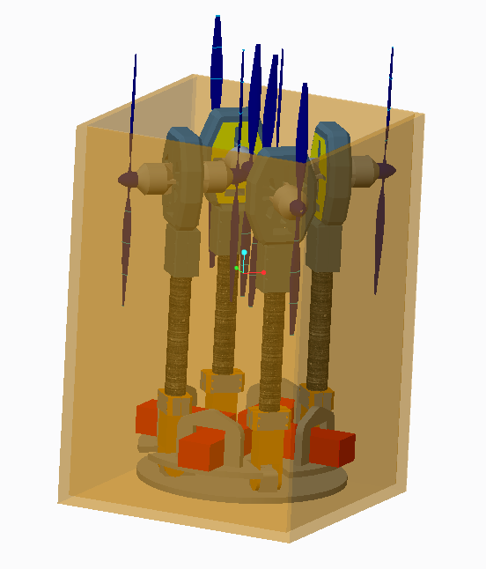
Does it Fit in the Backpack?
Design | Fit in the Military Backpack
Design #1 | YES
Design #2 | NO
Design #3 | YES
IME Team #8/ ME Team #31
Slide 17 of 32
Taniwa Ndebele
Design & Manufacture of Rotorcraft

Slide 18
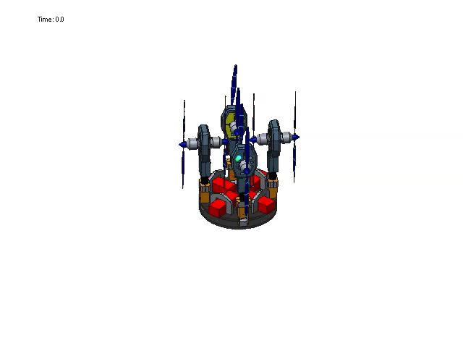
Rotorcraft Simulation
IME Team #8/ ME Team #31
Slide 18 of 32
Taniwa Ndebele
Design & Manufacture of Rotorcraft

Slide 19
Design Cost Comparison
IME Team #8/ ME Team #31
Slide 19 of 32
Taniwa Ndebele
Design & Manufacture of Rotorcraft

Slide 20
Overall Designs Comparisons
Fit in the Military
Estimated
Cost
Design
Lift
Payload of 50 lbs.
Backpack
Weight (lbs.)
($)
Design #1
NO
YES
32
3841
Design #2
YES
NO
47
7451
Design
#3
Conditionally
YES
38
2630
3645
IME Team #8/ ME Team #31
Slide 20 of 32
Taniwa Ndebele
Design & Manufacture of Rotorcraft

Slide 21
Stress Analysis
Assume arms and base plate will be carbon fiber
Attach 50 pound load to rotorcraft
Team’s analysis shows amount of deformation under load in mm
Cameron Alexander’s analysis shows yield stress
Neither design fails stress analysis
IME Team #8/ ME Team #31
Slide 21 of 32
Victoria Rogers
Design & Manufacture of Rotorcraft

Slide 22
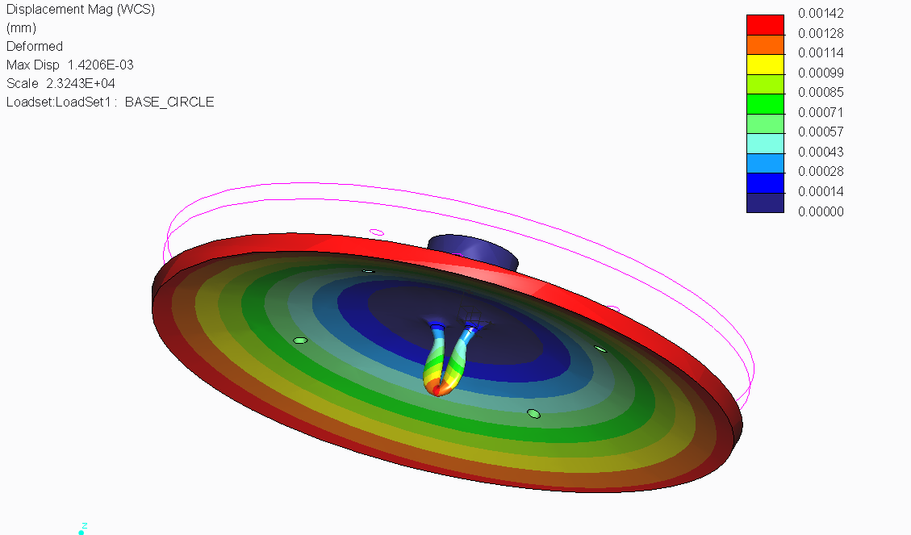
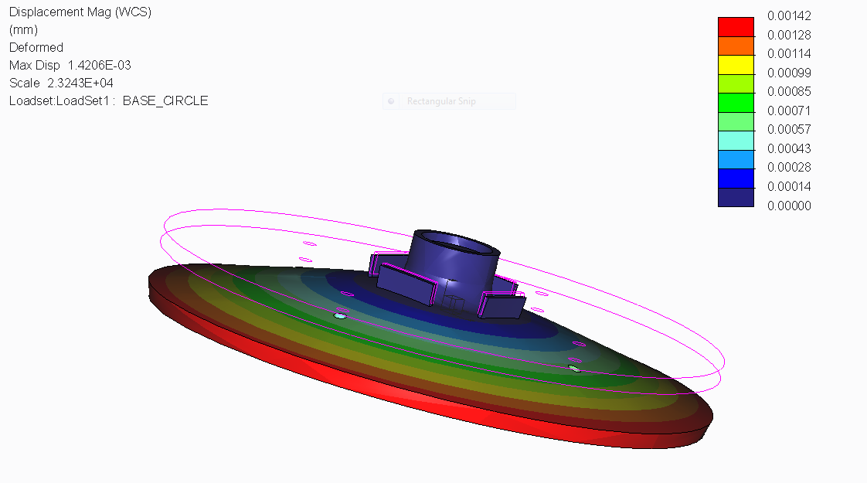
Base Plate Stress Analysis
Comparison
Team’s Design | Cameron Alexander’s Design
Bottom View with Hook
Top View without Hook
IME Team #8/ ME Team #31
Slide 22 of 32
Victoria Rogers
Design & Manufacture of Rotorcraft

Slide 23
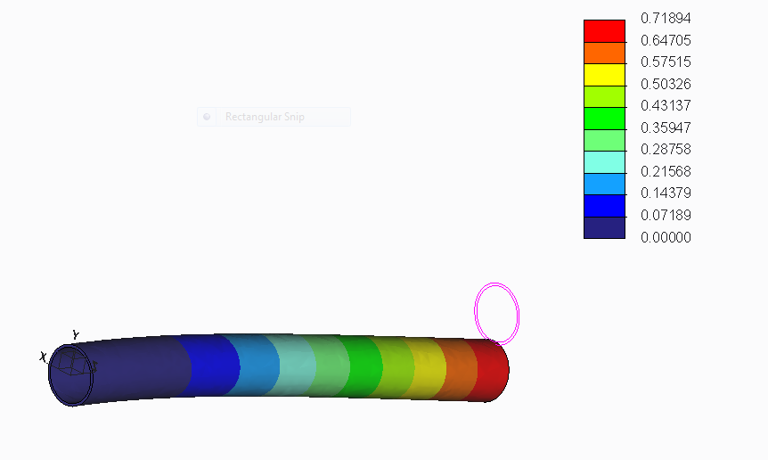
Arms Stress Analysis Comparison
Team’s Design | Cameron Alexander’s Design
IME Team #8/ ME Team #31
Slide 23 of 32
Victoria Rogers
Design & Manufacture of Rotorcraft

Slide 24

Microcontroller Unit (MCU)
  “Brain” of Rotorcraft
    Controls all main functions
    Code is stored here
    All inputs and outputs move through the MCU
  Will be placed inside the frame
    Prevents crash damage
    Kept safe from adverse weather
    Helps to maintain balance of craft
  Light relative to other parts
Figure 6. Brain of Rotorcraft
IME Team #8/ ME Team #31
Slide 24 of 32
Mitchell Stratton
Design & Manufacture of Rotorcraft

Slide 25
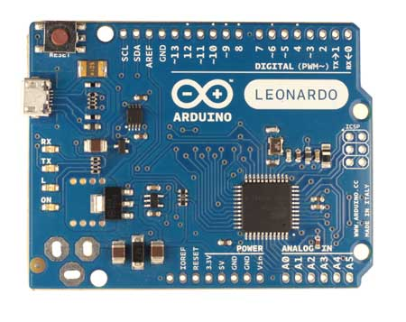
Arduino Leonardo
20 Digital I/O Ports
12 Analog inputs
C++ Programming Language
Compatible with IMU
Voltage (V) | Cost ($) | Size (in) | Weight (g)
7 – 12 | 23 | 2.7 x 2.1 | 20
Figure 7. Arduino Leonardo [13]
IME Team #8/ ME Team #31
Slide 25 of 32
Mitchell Stratton
Design & Manufacture of Rotorcraft

Slide 26
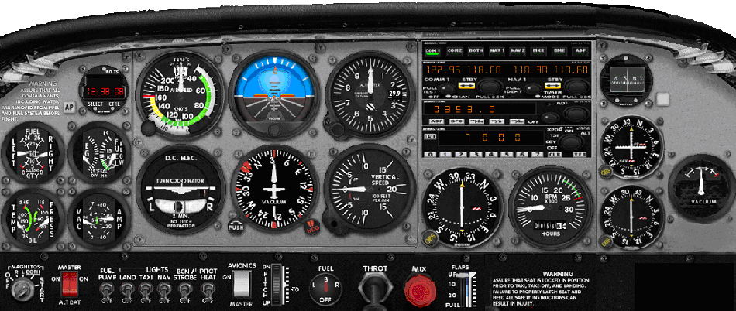
Inertial Measurement Unit (IMU)
Contains:
  Gyroscope
  Accelerometer
  Compass
Responsible for Providing orientation data to the MCU
Keeps rotorcraft straight
Figure 8. Flight Control Panel
IME Team #8/ ME Team #31
Slide 26 of 32
Mitchell Stratton
Design & Manufacture of Rotorcraft

Slide 27
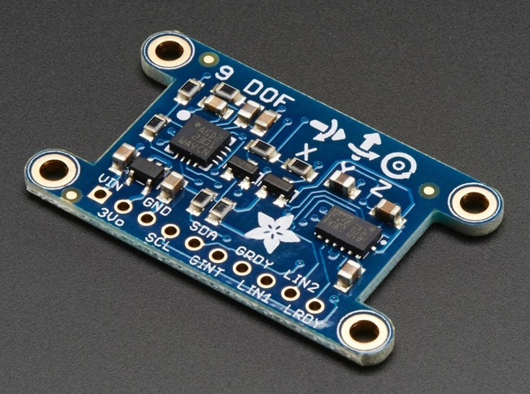
Adafruit 9-DOF IMU Breakout
Compatible with Arduino Leonardo
L3DG20H gyroscope
LSM303DLH accelerometer/compass
3V regulator
Cost ($) | Size (in) | Weight (g)
29.95 | 1.5 x 0.9 | 2.8
Figure 9. Adafruit 9-DOF IMU [13]
IME Team #8/ ME Team #31
Slide 27 of 32
Robert Johnson
Design & Manufacture of Rotorcraft

Slide 28
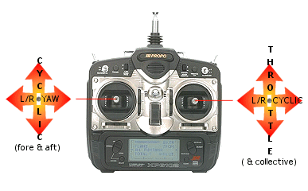
RC Controller
Input for electrical design
Must have unique frequency
  Limits interference
Figure 10. RC Controller
IME Team #8/ ME Team #31
Slide 28 of 32
Robert Johnson
Design & Manufacture of Rotorcraft

Slide 29
Design Flow
IMU
RC Controller
MCU
Rotors
IME Team #8/ ME Team #31
Slide 29 of 32
Robert Johnson
Design & Manufacture of Rotorcraft

Slide 30
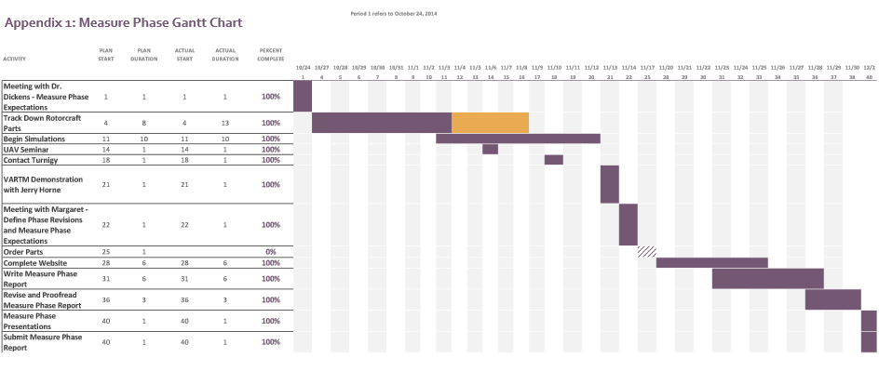
Schedule: Gantt Chart
IME Team #8/ ME Team #31
Slide 30 of 32
Louisny Dufresne
Design & Manufacture of Rotorcraft

Slide 31
Conclusion
Objective:
Design and Manufacture a Rotorcraft that can:
  Fit in a military backpack (23x14.5x15)
  Can carry a payload of at least 50 pounds
  Made with COTS components (off the shelf)
  Has a range of approximately 1 mile
  Easy to maintain and use in the field
What’s Next:
  Analyze Phase
  Build and Manufacture Design #3
  Perform Ergonomics Analysis
IME Team #8/ ME Team #31
Slide 31 of 32
Louisny Dufresne
Design & Manufacture of Rotorcraft

Slide 32
References
[1] "FlightGear Forum • View Topic - Four Rotor Helicopter." FlightGear Forum • View Topic - Four Rotor Helicopter. PhpBB Group, n.d. Web. 02 Dec. 2014.
[2] "SMALL MOLLE ASSAULT BACKPACK MILITARY RUCKSACK ARMY NEW." eBay. N.p., n.d. Web. 22 Oct. 2014. <http://www.ebay.com/itm/SMALL-MOLLE-ASSAULT-BACKPACK-MILITARY-RUCKSACK-ARMY-NEW-/170555911038>.
[3] "Multi-Rotor Frame Configurations - CopterCraft.com." CopterCraftcom RSS2. Web. 30 Nov. 2014. <http://www.coptercraft.com/multirotor-frame-configurations/#!prettyPhoto>.
[4] "Power 110 Brushless Outrunner Motor, 295Kv." (EFLM4110A): E-flite. Web. 30 Nov. 2014. <http://www.e-fliterc.com/Products/Default.aspx?ProdID=EFLM4110A>.
[5] "Power 360 Brushless Outrunner Motor, 180Kv." (EFLM4360A): E-flite. Web. 30 Nov. 2014. <http://www.e-fliterc.com/Products/Default.aspx?ProdID=EFLM4360A>.
[6] "Power 52 Brushless Outrunner Motor, 590Kv." (EFLM4052A): E-flite. Web. 30 Nov. 2014. <http://www.e-fliterc.com/Products/Default.aspx?ProdID=EFLM4052A>.
[7] "Lithium Polymer Battery." Wikipedia. Wikimedia Foundation, 29 Nov. 2014. Web. 30 Nov. 2014. <http://en.wikipedia.org/wiki/Lithium_polymer_battery>.
[8] "Pulse Battery." Pulse Battery. Web. 30 Nov. 2014. <http://pulsebattery.com/products_new.php?page=4>.
[9] "Thunder Power RC G8 Pro Force 70C 5000mAh 9-Cell/9S 33.3V LiPo Battery FREE SHIPPING SKU: TP5000-9SPF70." RCToyscom New Products. Web. 30 Nov. 2014. <http://www.rctoys.com/rc-toys-and-parts/TP5000-9SPF70/RC-PARTS-THUNDER-POWER-9-CELL-LITHIUM-BATTERIES.html>.
[10] "APC APCE-18X10, APCE 18X10, Accessories." APC APCE-18X10. Web. 30 Nov. 2014. <https://www.aero-model.com/1_3_69/Accessories_APC-18x10-E-Prop/APCE-18X10.html>.
[11] "APC APCE-24X12, APCE 18X10, Accessories." APC APCE-18X10. Web. 30 Nov. 2014. <https://www.aero-model.com/1_3_69/Accessories_APC-18x10-E-Prop/APCE-18X10.html>.
[12] "USA DEALS." 2Pcs 16.5 X 10 Black Plastic Folding Propeller Blade for RC Helicopter. Web. 30 Nov. 2014. <http://findusadeals.com/deals/B00KHUVK20.html>.
[13] "How To Build A Quadcopter." THE WORLD FROM MY POINT OF VIEW. N.p., n.d. Web. 22 Oct. 2014. <http://akashstevekhanna.wordpress.com/2014/03/01/2899/>.
IME Team #8/ ME Team #31
Slide 32 of 32
Louisny Dufresne
Design & Manufacture of Rotorcraft

Slide 33


